Slide 1


The distributed (and parallel) programming on a single device & MapReduce
SE3331-1 (2025 Fall)
Xingda Wei, Yubin Xia
IPADS, Shanghai Jiao Tong University
https://www.sjtu.edu.cn
Credits: AI-sys Sp22, CMU15-418

Slide 2
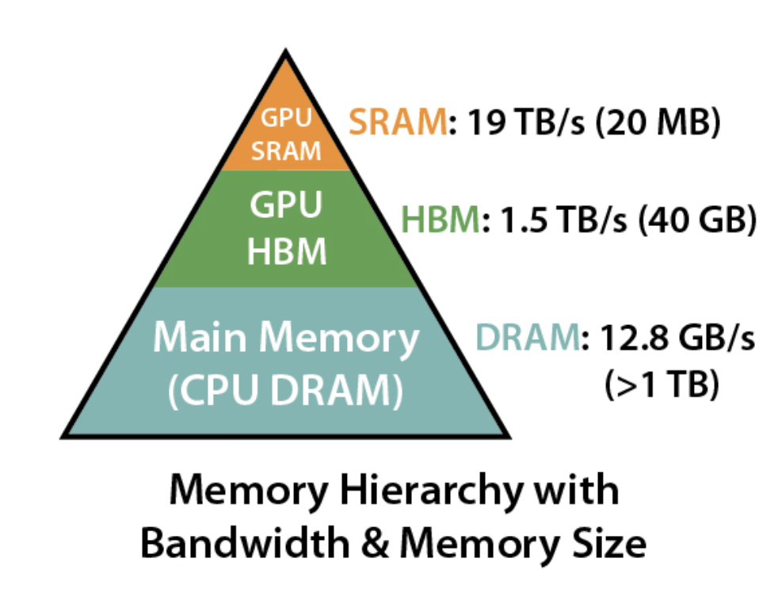
Review: Memory hierarchy in modern accelerators (e.g., GPUs)
GPU also has memory hierarchy
  SRAM: e.g., registered files, ultra fast but small
  HBM: relative fast, sufficiently large
SRAM bandwidth is not the bottleneck
Goal: minimize the HBM load
Source: https://github.com/Dao-AILab/flash-attention?tab=readme-ov-file

Slide 3
Question: what is the HBM load for basic attention?
Recap: each HBM load will load a block of data to the SRAM
  Like load cacheline in the CPU
But, how many loads depends on how the operator is implemented
  So we should break down the operator
Key operators in the basic attention
  Matrix multiplications & softmax
Q
X
X
V
Softmax( )
K^{T}

Slide 4
What is the memory loads of matrix multiplication?
A long story, actually ☺ (worth an at-least 45-minute lecture)
  We will cover three methods in this lecture: the naïve & an optimized one
K
M
M
N
X
=
K
N
Matrix A
Matrix B
Matrix C

Slide 5
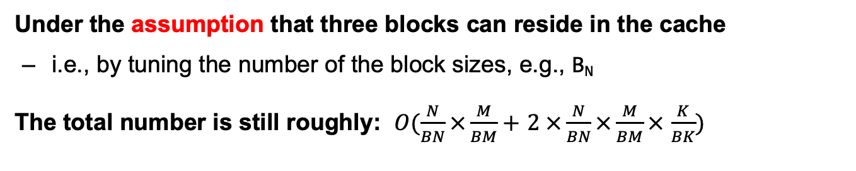
Review: Analysis of tiling (w cache)
for i in 0..N/B_{N}.step(B_{N}):
for j in 0..M/B_{M}.step(B_{M}):
for k in 0..K/B_{K}.step(B_{K}):
load(A[i:i+B_{N}][k:k+B_{K}])
load(B[k+B_{K}][j:j+B_{M}])
C[i:i+B_{N}][j:j+B_{M}] += A[i:i+B_{N}][k:k+B_{K}]
* B[k+B_{K}][j:j+B_{M}]
write(C[i:i+B_{N}][j:j+B_{M}])
Under the assumption that three blocks can reside in the cache
  i.e., by tuning the number of the block sizes, e.g., B_{N}
The total number is still roughly: $O(\frac{N}{BN}×\frac{M}{BM}+$ $2 ×\frac{N}{BN}×\frac{M}{BM}×$ $\frac{K}{BK})$

Slide 6
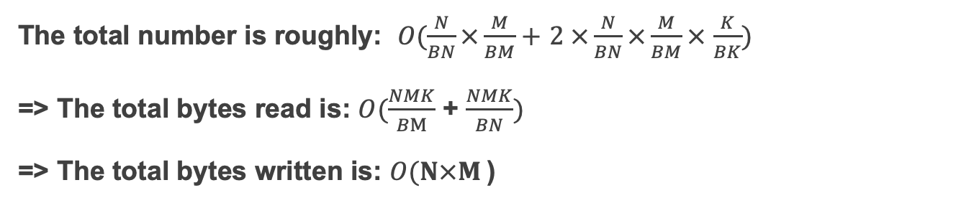
HBM accesses (w/o cache): #number vs. #bytes in tiling
for i in 0..N/B_{N}.step(B_{N}):
for j in 0..M/B_{M}.step(B_{M}):
for k in 0..K/B_{K}.step(B_{K}):
load(A[i:i+B_{N}][k:k+B_{K}])
load(B[k+B_{K}][j:j+B_{M}])
C[i:i+B_{N}][j:j+B_{M}] += A[i:i+B_{N}][k:k+B_{K}]
* B[k+B_{K}][j:j+B_{M}]
write(C[i:i+B_{N}][j:j+B_{M}])
The total number is roughly: $O(\frac{N}{BN}×\frac{M}{BM}+$ $2 ×\frac{N}{BN}×\frac{M}{BM}×$ $\frac{K}{BK})$
=> The total bytes read is: $O(\frac{NMK}{BM}$ + $\frac{NMK}{BN})$
=> The total bytes written is: $O(N×M$)

Slide 7
Back to the analysis of attention
Depend on how the operator is implemented
  So we should break down the operator
Key operators in the basic attention
  Matrix multiplications & softmax
We can calculate these using a divide and conquer approach
Why not considering the computation? Few space for acceleration
Q
X
X
V
Softmax( )
K^{T}

Slide 8
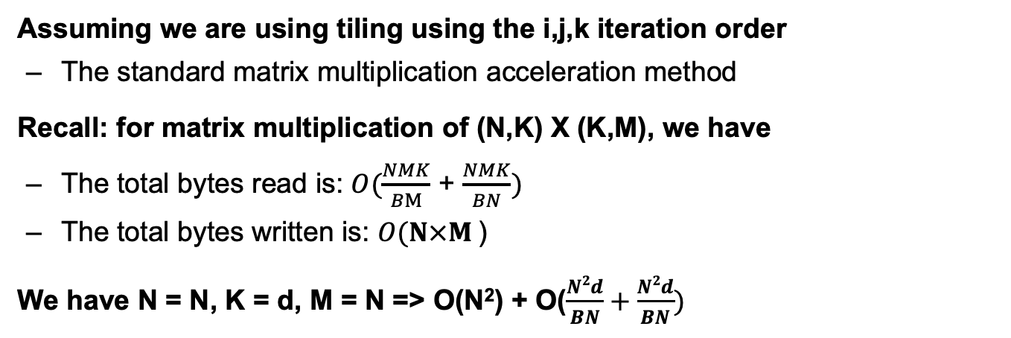
Analysis: The Q X K^{T}
Assuming we are using tiling using the i,j,k iteration order
  The standard matrix multiplication acceleration method
Recall: for matrix multiplication of (N,K) X (K,M), we have
  The total bytes read is: $O(\frac{NMK}{BM}$ + $\frac{NMK}{BN})$
  The total bytes written is: $O(N×M$)
We have N = N, K = d, M = N => O(N²) + O($\frac{N2d}{BN}+\frac{N2d}{BN})$
Considering BN can be chosen to be larger than d in the attention (why?), we can simplify the calculation as:
N
Q
X
K^{T}
d
O(N²)
d
N

Slide 9
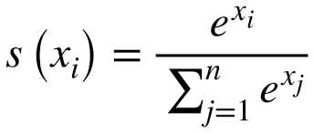
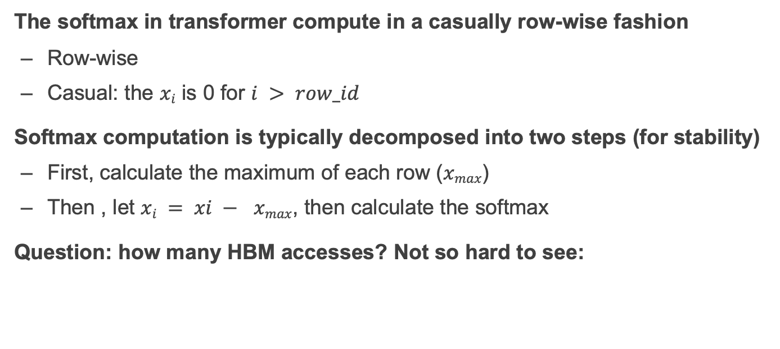
Analysis: Softmax
The softmax in transformer compute in a casually row-wise fashion
  Row-wise
  Casual: the $xi$ is 0 for $i > row_id$
Softmax computation is typically decomposed into two steps (for stability)
  First, calculate the maximum of each row ($xmax$)
  Then , let $xi = xi − xmax$, then calculate the softmax
Question: how many HBM accesses? Not so hard to see:
O(N²)
Weight =
Softmax( )
=

Slide 10
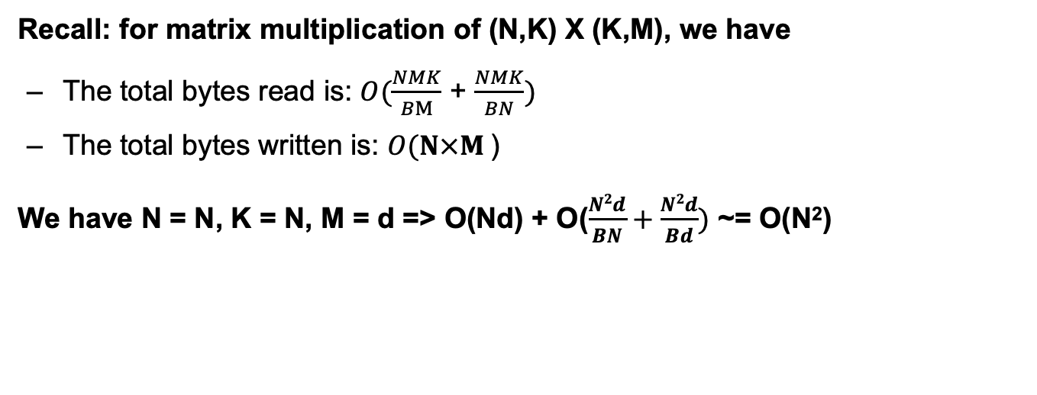
Analysis: Weight X V (still using tiling with i,j,k)
Recall: for matrix multiplication of (N,K) X (K,M), we have
  The total bytes read is: $O(\frac{NMK}{BM}$ + $\frac{NMK}{BN})$
  The total bytes written is: $O(N×M$)
We have N = N, K = N, M = d => O(Nd) + O($\frac{N2d}{BN}+\frac{N2d}{Bd})$ ~= O(N²)
N
d
N
X
V
N

Slide 11

Summary: memory accessed in attention
Key operators in the basic attention
  Matrix multiplications & softmax
Our current analysis shows that the accessed in bytes are
  And we have little optimization space if the operators are decoupled
  i.e., run each operator one-by-one
  Why? Because the softmax operator has little optimization space!
O($N2$)
Q
X
X
V
Softmax( )
K^{T}

Slide 12
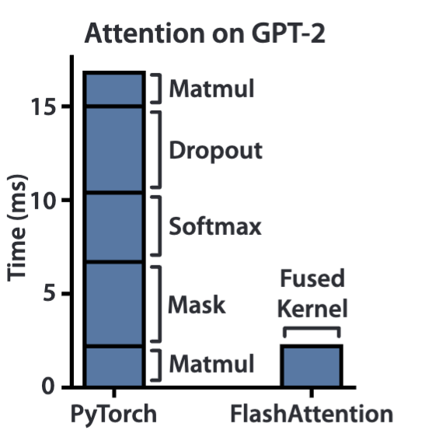
Idea: fusing the operators
Fuse: execute multiple operators together
  Can dramatically reduce the memory accessed of the overall computation!
Source: FlashAttention: Fast and Memory-Efficient Exact Attention with IO-Awareness, NIPS‘22

Slide 13
Step #1: fuse QK^{T}V (let’s forget the softmax for now)
It turns out that we can have a very efficient way of doing multiple matrixes multiplication together
  Because the same value can be reused (not needed to be loaded to the HBM and then read it)
Q
X
X
=
V
K^{T}

Slide 14
Example of reusing
O₀
=
Q₀
X
X
V₀
K₀
d
d
d
N
N
N
N
Q
X
X
=
V
O
d
K^{T}

Slide 15
Example of reusing
O₀
=
Q₀
X
X
V₀
+
Q₀
X
X
V₁
K₀
K₁
d
d
d
N
N
N
N
Q
X
X
=
V
O
d
K^{T}

Slide 16
Example of reusing
O₀
=
Q₀
X
X
V₀
+
Q₀
X
X
V₁
K₀
K₁
+
Q₀
X
X
V₂
K₂
+ …
d
d
d
N
N
N
N
Q
X
X
=
V
O
d
K^{T}

Slide 17
Why reducing the #HBM accessed?
O₀
=
Q₀
X
X
V₀
+
Q₀
X
X
V₁
K₀
K₁
+
Q₀
X
X
V₂
These intermediate results don’t need to be written back to the HBM!
K₂
+ …
d
d
d
N
N
N
N
Q
X
X
=
V
O
d
K^{T}

Slide 18
Fused QK^{T}V: the code (under tiling)
for i in 0..N/B_{Q}.step(B_{Q}): ## Iterate over the Q
O[i:i + B_{Q} , 0:d] = 0
for j in 0..N/B_{K}.step(B_{K}):
O[i,0:d] += Q[i:i+B_{Q},0:d] * K^{T}[0:d,j:j+ B_{K} ]
* V[j:j+ B_{K}, 0:d]

Slide 19
Analysis: fuse QK^{T}V: the code (under tiling)
for i in 0..N/B_{Q}.step(B_{Q}): ## Iterate over the Q
load(Q[i:i + B_{Q} , 0:d])
write(O[i:i + B_{Q} , 0:d])
O[i:i + B_{Q} , 0:d] = 0
for j in 0..N/B_{K}.step(B_{K}):
load(K^{T}[0:d,j:j+ B_{K} ])
load(V[j:j+ B_{K}, 0:d])
O[i:i+B_{Q} ,0:d] += Q[i:i+B_{Q},0:d] * K^{T}[0:d,j:j+ B_{K} ]
* V[j:j+ B_{K}, 0:d]
write(O[i:i + B_{Q} , 0:d])
Assumption: d is a small value (e.g., 768)

Slide 20
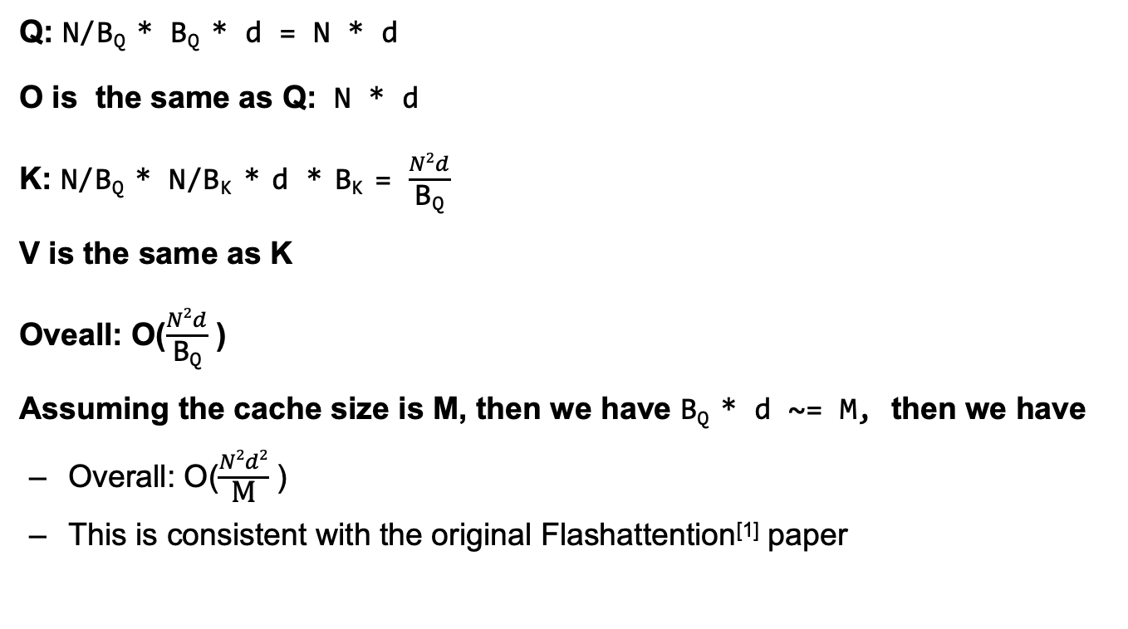
Analysis: fuse QK^{T}V: the code (under tiling)
Q: N/B_{Q} * B_{Q} * d = N * d
O is the same as Q: N * d
K: N/B_{Q} * N/B_{K} * d * B_{K} = $\frac{N2d}{\text{B}\text{Q}}$
V is the same as K
Oveall: O($\frac{N2d}{\text{B}\text{Q}}$ )
Assuming the cache size is M, then we have B_{Q} * d ~= M, then we have
  Overall: O($\frac{N2d2}{\text{M}}$ )
  This is consistent with the original Flashattention^{[1]} paper
[1] FlashAttention: Fast and Memory-Efficient Exact Attention with IO-Awareness, NIPS’22
Notes:
Thoughts: when will FlashAttention be bad? If N is small？

Slide 21
Step #2: fused QK^{T}V + Softmax
Question: can we apply the same mythology?
  Yes, though needs a little extension
O₀
=
Q₀
X
X
V₀
+
Q₀
X
X
V₁
K₀
K₁
+
Q₀
X
X
V₂
K₂
+ …

Slide 22







Step #2: fused QK^{T}V + Softmax
x$0$
x$1$
To better illustrate the algorithm, we made some extension
$$O0$$
x$0$
v$0$
x$1$
v$1$
O₀
=
Q₀
X
X
V₀
+
Q₀
X
X
V₁
K₀
K₁
+
Q₀
X
X
V₂
K₂
+ …

Slide 23





Step #2: fused QK^{T}V + Softmax
To better illustrate the algorithm, we made some extension
  Fused QK^{T}V: O0 = X0 * V0 + X1 * V1 + …
  Fused QK^{T}V + Softmax: O0 = Softmax(X0, X) * V0 + Softmax(X1, X) * V1 + …
Question: how to make the softmax operators combined together?
  Check [1] fort the online softmax if you are interested!
Softmax
$$O0$$
x$0$
v$0$
x$1$
v$1$
O₀
=
Q₀
X
X
V₀
+
Q₀
X
X
V₁
K₀
K₁
+
Q₀
X
X
V₂
K₂
+ …
[1] FlashAttention: Fast and Memory-Efficient Exact Attention with IO-Awareness, NIPS’22

Slide 24

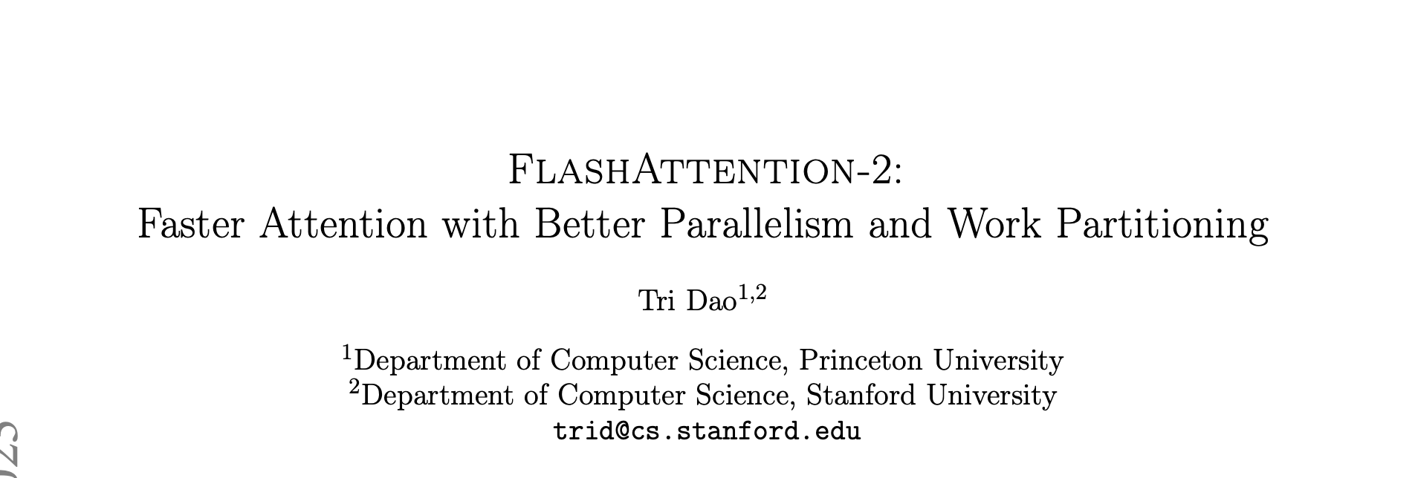
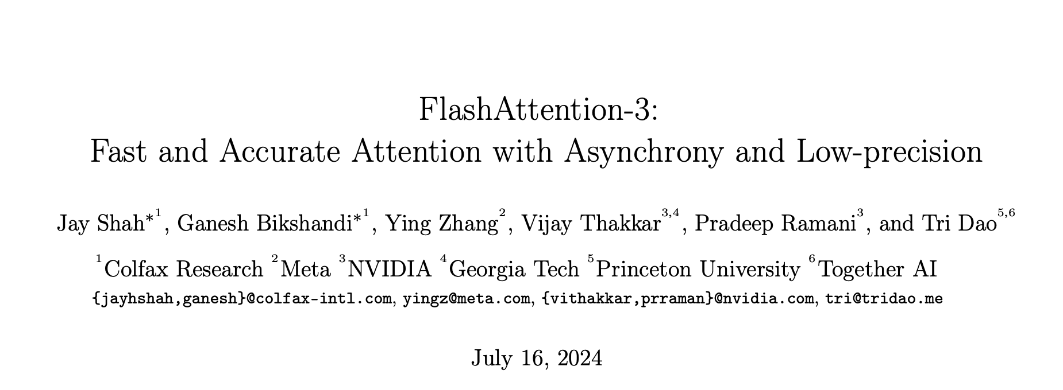

More to be optimized

Slide 25
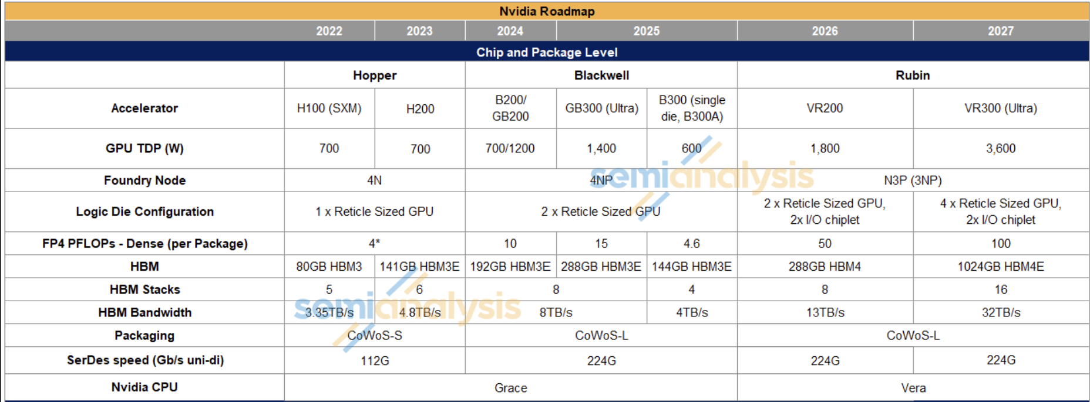
More: the future trend

Slide 26
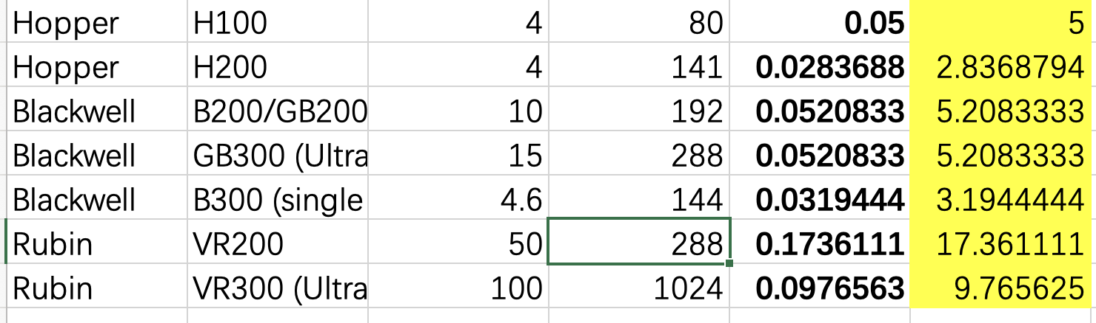
More: the future trend
FLOPS (norm.)
BW
FLOPS/BW

Slide 27
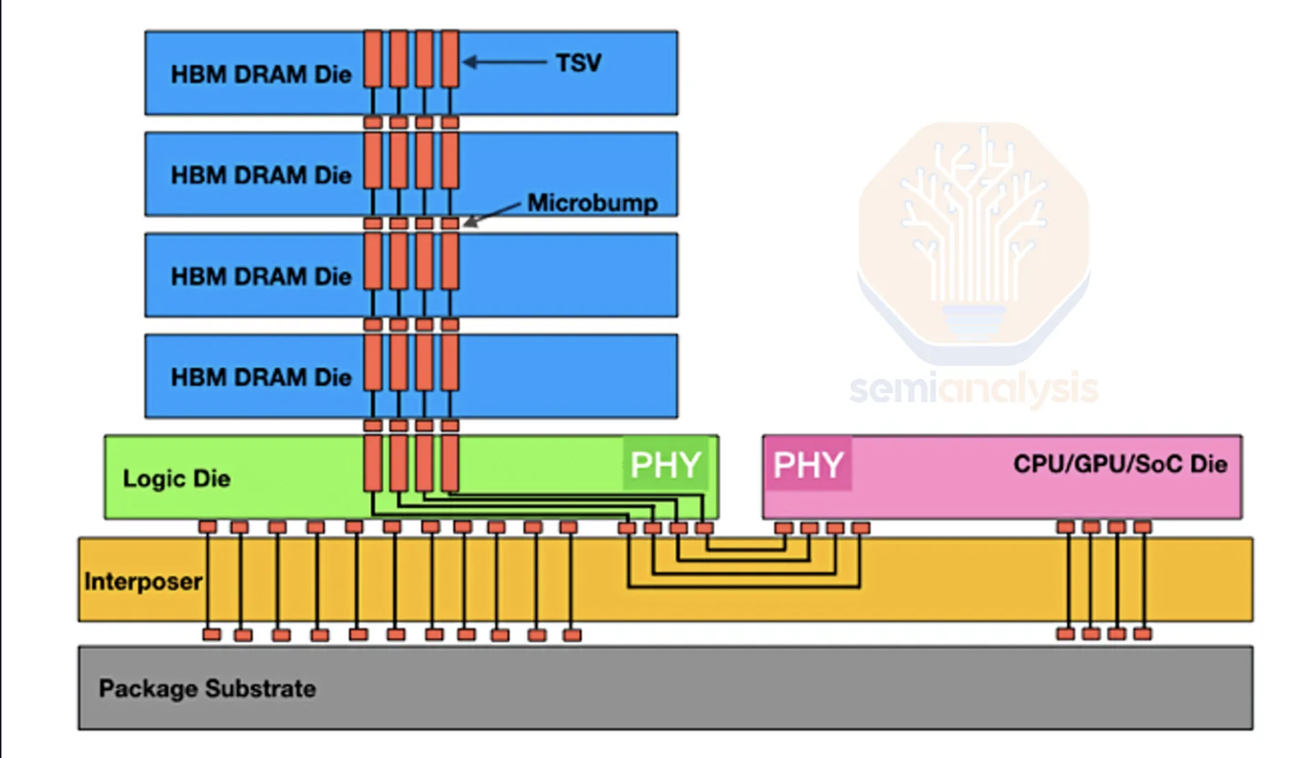
HBM is challenging to scale (on a single chip)

Slide 28
From single device to a distributed computing

Slide 29
Computing: is a single device sufficient?
A device has limited physical capacity to store “cores” (chip size)
  Our cores are generalized, e.g., can either be CPU cores, GPU cores (cores w/o cache coherence + many SIMD ALUs, etc.), domain-specific cores (Tensor cores)
How to make a single device faster?
  Increasing clock rate (has a limit)
  Put more cores on a single chip, but has physical limits, e.g., chip size

Slide 30
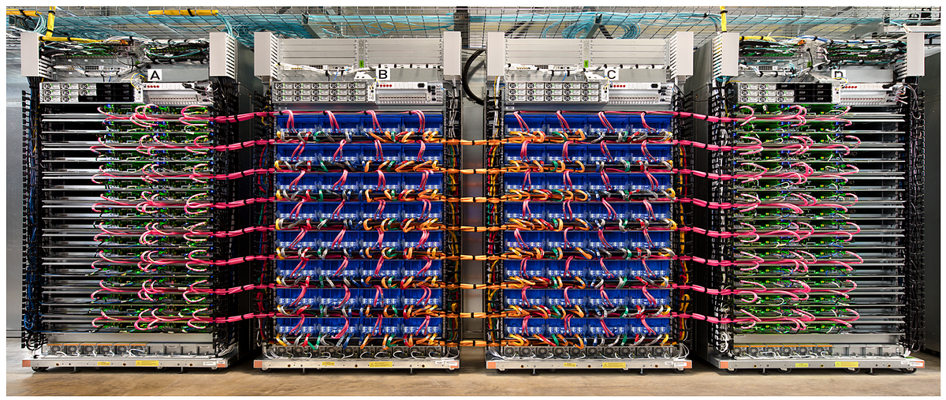
The case for distributed computing
Example: Google’s TPU v4 cluster

Slide 31
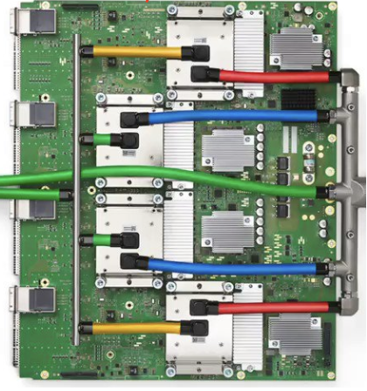

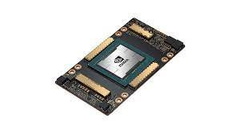

Spectrum of computation device available
Mate60 GPU
2.3 TFLOPs
Apple M2
GPU 3.6 TFLOPs
NVIDIA A100
GPU 19.5 TFLOPs
Google TPUv4
275 TFLOPS
A cluster
? TFLOPS
Performance
Notes:
Source: Wikipedia
Mate60: https://nanoreview.net/en/soc-compare/qualcomm-snapdragon-875-vs-hisilicon-kirin-9000
Intel CPU: https://setiathome.berkeley.edu/cpu_list.php

Slide 32
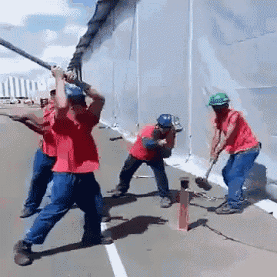
Not so easy: many tedious things to cope with
e.g., programmers need to manually do the following:
  Partition the data
  Deploy programs on multiple machines
  Schedule the works, e.g., what if the jobs have dependencies?
  Fault tolerance
  Network communication is much slower than local memory accesses

Slide 33




Use distributed computing frameworks for complex queries
Each fits a common application scenario
  One sit (typically) does not fit all!
Batch processing system
  Spark, Hadoop, etc.
Graph processing system
  GraphLab, etc.
Machine learning system
  TensorFlow, Pytorch, etc.
Note that we can also use one for another
  At the cost of programming effort and performance
Today’s focus

Slide 34
Example: batching processing
Suppose our web server records every requests in a log file
  E.g., using nginx log format, a log record looks like this:
216.58.210.78 - - [27/Feb/2015:17:55:11 +0000]
"GET /css/typography.css HTTP/1.1" 200 3377 "http://martin.kleppmann.com/"
"Mozilla/5.0 (Macintosh; Intel Mac OS X 10_9_5) AppleWebKit/537.36 (KHTML, like Gecko) Chrome/40.0.2214.115 Safari/537.36"
Abstract format: $remote_addr - $remote_user [$time_local] "$request" $status $body_bytes_sent
"$http_referer" "$http_user_agent"
  Task (simple log analysis): how to find top five popular pages?

Slide 35
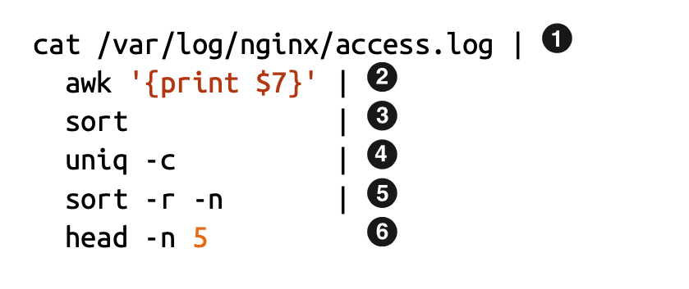
Old days: using command line to process the log
216.58.210.78 - [27/Feb/2015:17:55:11 +0000]
"GET /css/typography.css HTTP/1.1" 200 3377 "http://martin.kleppmann.com/"
"Mozilla/5.0 (Macintosh; Intel Mac OS X 10_9_5) AppleWebKit/537.36 (KHTML, like Gecko) Chrome/40.0.2214.115 Safari/537.36"
Find top five most popular pages w/ command line tools

Slide 36
Does batch processing with command line tools scale?
Command line tools are mostly single-threaded, and single-machine
  : scalability is restricted by the disk capacity
  ～ : restricted by single-thread computing power
  ～ : also restricted by the machine’s DRAM capacity
1
Scale using GFS
2
6
2
6

Slide 37
Does batch processing with command line tools scale?
Command line tools are mostly single-threaded, and single-machine
  : scalability is restricted by the disk capacity
  ～ : restricted by single-thread computing power
  ～ : also restricted by the machine’s DRAM capacity
1
How to scale?
2
6
2
6

Slide 38

Scaling log processing using RPC: step #1
for w in workers:
execute_command(w,...) // parallelly
res = []
for machines in workers:
res.append(get_res(w))
.3
.4
…

Slide 39
Scaling log processing using RPC: step #2
for w in workers:
execute_command(w,...) // parallelly
res = []
for machines in workers:
res.append(get_res(w))
.3
.4
…

Slide 40
From theory to reality
Challenge #1: what if the file is too large, & there are 10K+ servers?
Strategy (in theory)
  Step 1: decompose the file into M pieces, count top 5 concurrently
  Step 2: merge the top 5 from all the others & calculate the final top 5
Step #1
  How to decompose? How to assign threads to do chunks?
  Try #1: RPC to M machines, run the program, each given a different file

Slide 41
From theory to reality
Strategy (in theory)
  Step 1: decompose the file into M pieces, count top 5 concurrently
  Step 2: merge the top 5 from all the others & calculate the final top 5
Step #1
  How to decompose? How to assign threads to do chunks?
  Try #1: RPC to M machines, run the program, each given a different file
Challenge #2: how to effectively receive responses from multiple RPCs?

Slide 42
Scaling log processing using RPC: step #1
for w in workers:
execute_command(w,...) // parallelly
res = []
for machines in workers:
res.append(get_res(w))
Challenge #3: what if there is a machine failure?
.3
.4
…

Slide 43
Scaling log processing using RPC: step #1
for w in workers:
execute_command(w,...) // parallelly
res = []
for machines in workers:
res.append(get_res(w))
Challenge #4: load imbalance, what if a machine is slower than the others?
.3
.4
…

Slide 44
Building application with distributed computing: old days
Graduate Student
ML experts repeatedly solve the same parallel design challenges
  Implement and debug complex parallel & distributed systems
  Tune for a specific parallel platform
6 months later, a conference paper contains:
However, the resulting code will be difficult to maintain and extend
“We implemented ____ in parallel.”
Root cause: couples computation task with distributed implementation

Slide 45
Challenges programmers facing
Communicating between two machines
can be simple, e.g., with RPC
But, what about 10,000 machines?
Sending data to/from nodes
Coordinating among nodes
Recovering from node failure
Optimizing for locality
Partition data to to enable more parallelism

Slide 46
Challenges programmers facing
Sending data to/from nodes
Coordinating among nodes
Recovering from node failure
Optimizing for locality
Partition data to to enable more parallelism
When can we collect computing results from all the computing nodes?

Slide 47
Challenges programmers facing
Sending data to/from nodes
Coordinating among nodes
Recovering from node failure
Optimizing for locality
Partition data to to enable more parallelism
Failure is common,
especially at large-scale

Slide 48
Challenges programmers facing
Sending data to/from nodes
Coordinating among nodes
Recovering from node failure
Optimizing for locality
Partition data to to enable more parallelism
Transferring data over network is usually much slower than local data access

Slide 49
Challenges programmers facing
Sending data to/from nodes
Coordinating among nodes
Recovering from node failure
Optimizing for locality
Partition data to to enable more parallelism
Reduce the bottleneck of sequential part + as well as for balanced load

Slide 50
Idea: we build a framework to hide the above tasks
Goal
  Reduce programmer’s effort in solving the above challenges
Challenges
  What is the right abstraction? Thread & RPC is insufficient
  More general, harder to provide the properties presented in the previous slide
  E.g., if a thread fails, how can we know its progress?

Slide 51
MapReduce: Simplified Data Processing on Large Clusters

Slide 52
MapReduce: a distributed batch processing system
Created by Google (OSDI’04)
  Jeffrey Dean and Sanjay Ghemawat
Inspired by LISP (function language)
  Map (function, set of values)
    Applies function to each value in the set
  Reduce (function, set of values)
    Combines all the values using a function (e.g., +)
      (map #‘length’ (() (a) (a b) (a b c))) → (0 1 2 3)
      (reduce #‘+’ (1 2 3 4 5)) → 15

Slide 53
MapReduce abstraction matches our requirements well
Sending data to/from nodes
  Data is sent between Map & Reduce, can schedule Map on GFS nodes
Coordinating among nodes
  Use the MapReduce semantic to coordinate
    i.e.， only need to schedule the reducer after the mapper
Recovering from node failure
  Via re-execution because the function is stateless
Optimizing for locality
  e.g., schedule the map and reduce on the same machine
Partition data to to enable more parallelism
  Map on different parts of the data can be run in parallel, but what about reduce?

Slide 54
MapReduce Programming Interface
Map: (input shard) → intermediate (k/v pairs)
  Partition the input data into M “shards”
  Group all intermediate values associated with the same key
  Pass them to the Reduce function
Reduce: intermediate (k/v pairs) → (results)
  Partition the key space into R “pieces” using a Partition function
    E.g., hash(key) mod R (unsorted)
  Accept a key & a set of values
  Merge these values to form result of the key
Notes:
Sort may be important. E.g., sometimes the output keys are URLs, and we want all entries for a single host to end up in the same output file.

Slide 55
MapReduce Programming Model
Allows user to process huge amounts of data on thousands of nodes
Framework for data-parallel computing
  Programmers get simple yet restricted API
Users don’t have to worry about handling:
  parallelization
  data distribution
  load balancing
  fault tolerance

Slide 56

MapReduce Programming Model
Functionality
Parallelization
Data Distribution
Fault Tolerance
user
Load Balance

Slide 57
MapReduce Programming Model
Functionality
Two Primitives:
Map (input)
Parallelization
Data Distribution
MapReduce
Runtime
Reduce (key, values)
Fault Tolerance
user
Load Balance

Slide 58
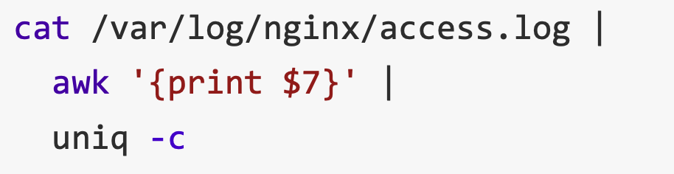
MapReduce example：Word count
Word Count: Count # occurrences of each word in a collection of documents
A simplified process of our previous log analysis example
1
2
3

Slide 59
MapReduce example：Word count
Word Count: Count the occurrences number of each word in a collection of documents
Map:
  Parse data and emit each word with a count (1)
Reduce:
  Reduce: sum together counts each key (words)
map (input) # a shard of file
  for each word w in input
  EmitIntermediate (w, “1”);
Reduce (String key, Iterator values)
  int result = 0;
  for each v in values
    result += ParseInt (v);
  emit (AsString (result));

Slide 60
MapReduce Programming Model
E.g., to find the most
popular keywords (热词)
Two Primitive:
Map (input)
for each word in input
emit (word, 1)
Word Count
Functionality
MapReduce
Runtime
Reduce (key, values)
int sum = 0;
for each value in values
sum += value;
emit (word, sum)
user

Slide 61
MapReduce Execution Flow
Map
Grab the relevant data from the source
User function gets called for each chunk of input
Map Worker
Reduce Worker
Reduce
Aggregate the results
User function gets called for each unique key

Slide 62
MapReduce Execution Flow
Map
Grab the relevant data from the source
User function gets called for each chunk of input
Partition
Identify which Reducers will handle which keys
Map partitions data to target Reducers
Map Worker
Reduce Worker
Sort
Fetch the relevant partition data from all mappers
Sort by keys (Why? Will talk about it later )
Reduce
Aggregate the results
User function gets called for each unique key

Slide 63
MapReduce: The Complete Picture
Client
Master
assign
tasks
Shard 0
Map
Worker
IF
Shard 1
Shard 2
Reduce
Worker
Output
File 1
M items
Shard 3
Map
Worker
IF
R items
...
Reduce
Worker
Output
File 2
Shard M-2
Shard M-1
Map
Worker
IF
Input
Files
Map Workers
Intermediate Files
Reduce Workers
Output
Files
Notes:
具体到实现，以文件作为input

Slide 64
MapReduce: The Complete Picture
Step1: (Client/Master) split input files into chunks (shards)
  Typically, 64MB
  Why? Fit the GFS chunk size, so one RPC is sufficient to read the chunk
Shard 0
Shard 1
Shard 2
Shard 3
...
Shard M-1
Input Files
Divided into M shards

Slide 65
MapReduce: The Complete Picture
Step2: (remote) fork processes
Start up many copies of the program on cluster
  1 master: scheduler & coordinator
  Lots of workers
Idle workers are assigned either
  Map tasks (each works on a shard)
  Reduce tasks (each works on intermediate files)
Client
remote
fork
Master
...
Map
Worker
..
Map
Worker
Reduce
Worker
..
Reduce
Worker

Slide 66
MapReduce: The Complete Picture
Step3: map task
  Reads contents of the input shard assigned to it
  Parses key/value pairs out of the input data
  Passes each pair to a user-defined Map function
    Produces intermediate key/value pairs
    These are buffered in memory
read
Map
Worker
Shard 2

Slide 67
MapReduce: The Complete Picture
Step4: create intermediate files
  Intermediate k/v pairs buffered in memory and periodically written to the local disk
    Partitioned into R regions by a Partition function
    Default function: hash(key) mod R
Intermediate File
read
Map
Worker
local
write
partition 1
Shard 2
partition 2
partition R

Slide 68
MapReduce: The Complete Picture
Step5: sorting intermediate data
  Notified by master about the location of intermediate files for its partition
  Uses RPCs to read the data from the local disks of map workers
  Sort keys from different intermediate files (like a merge sort)
  => All occurrences of the same key are grouped
  Note: both mapper and reducer needs to do the sort
local
write
remote
read
Map
Worker
Intermediate file
Reduce
Worker
Map
Worker
local
write
Intermediate file
remote
read
Reduce
Worker

Slide 69
MapReduce: The Complete Picture
Step6: reduce task
  Groups data with a unique intermediate key
  User’s Reduce function is given the key and the set of intermediate values for that key
    <key, (value1, value2, ...)>
  The output is appended to an output file
Intermediate file
Intermediate file
remote
read
Reduce
Worker
write
Output
File 1
Intermediate file

Slide 70
MapReduce: The Complete Picture
Step7: return to user
  When all map and reduce tasks have completed
  Master wakes up the user program
  The MapReduce call in the user program returns, and the program can resume execution
    Output of MapReduce is available in R output files

Slide 71
MapReduce example in action：Word count
After Map
After Sort
After Reduce
Input file
[Intermediate]
It will be seen that this mere painstaking burrower and grub-worm of a poor devil of a Sub-Sub appears to have gone through the long Vaticans and streetstalls of the earth, picking up whatever random allusions to whales he could anyways find in any book whatsoever, sacred or profane. Therefore you must not, in every case at least, take the higgledy-piggledy whale statements, however authentic, in these extracts, for veritable gospel cetology. Far from it. As touching the ancient authors generally, as well as the poets here appearing, these extracts are solely valuable or entertaining, as affording a glancing bird's eye view of what has been promiscuously …
...
it 1
will 1
be 1
seen 1
that 1
this 1
mere 1
painstaking 1
burrower 1
and 1
grub-worm 1
of 1
a 1
poor 1
devil 1
of 1
a 1
sub-sub 1
…
...
a 1
a 1
aback 1
aback 1
abaft 1
abaft 1
abandon 1
abandon 1
abandon 1
abandoned 1
abandoned 1
abandoned 1
abandoned 1
abandoned 1
abandoned 1
abandoned 1
abased 1
abased 1
…
a 4736
aback 2
abaft 2
abandon 3
abandoned 7
abased 2
abasement 1
abashed 2
abate 1
abated 3
abatement 1
abating 2
abbreviate 1
abbreviation 1
abeam 1
abed 2
abednego 1
abel 1
abhorred 3
...
Map
Reduce

Slide 72
Other examples of MapReduce
Distributed grep
  Search for words in lots of documents
  Map: emit a line if it matches a given pattern
  Reduce: just output the intermediate data
Count URL access frequency
  Find the frequency of each URL in web logs
  Map: process logs of web page access;
  output <URL, 1>
  Reduce: added values for the same URL

Slide 73
Other examples of MapReduce
Inverted index
  Find what documents contain a specific word
  Map: parse document, emit <word, doc-ID>
  Reduce: sort the doc-ID for each word, and output <word, list(doc-ID)>
Reverse web-link graph
  Find where page links come from
  Map: output <target, source> for each link to target in a page source
  Reduce: concatenate all source for each target, output <target, list(source)>
And more … (Please check the MapReduce paper)

Slide 74
Recall, common challenges of Distributed Computing
Sending data to/from nodes
Coordinating among nodes
Recovering from node failure
Optimizing for locality
Partition the data to enable more parallelism
How does MapReduce handle these challenges?
Solved
Same for
all problems
Solved

Slide 75
Fault tolerance of MapReduce
Recall: machine failures are common in datacenters
  A MapReduce job can possibly run on thousands of machines
Two choices made MapReduce easy in handling failures:
  Programming model simplifies fault recovery
    e.g., no side-effect: a map or a reduce can simply re-execute the computation to recover from failures
  Builds on a reliable service (i.e., GFS)

Slide 76
Fault tolerance of MapReduce
Worker failure
  Detection
    Master pings each worker periodically via heartbeat
    If no response is received within a certain time (timeout), the worker is marked as failed
  Recovery
    Map or reduce tasks given to this worker are reset back to the initial state and rescheduled for other worker (re-execution)
  Robust: lost 1,600 of 1,800 machines once, but finished fine
Question: can we use checkpoint?

Slide 77
Fault tolerance of MapReduce
Master failure (checkpoint)
  Master’s state is persisted to GFS
  Recover master from GFS and continue
The state includes:
  For each mapper & reduce: executing state: idle, in-progress or completed
  Locations of intermediate files
The state is checkpointed to GFS in a periodically manner
  i.e., no need to redo all the computation
Note that master is unlikely to fail, since there is only one!

Slide 78
Fault tolerance of MapReduce
Problem: bad records
  Map/Reduce functions sometimes fail for some inputs
  Best solution is to debug & fix, but not always possible
    E.g., Bugs in the third-party library
  MapReduce actually runs a large-scale fuzzing on the user code!
MapReduce simply skips them
  On segmentation fault:
    Send UDP packet to master from signal handler
    Include sequence number of record being processed
  If master sees two failures for same record:
    Next worker is told to skip the record

Slide 79
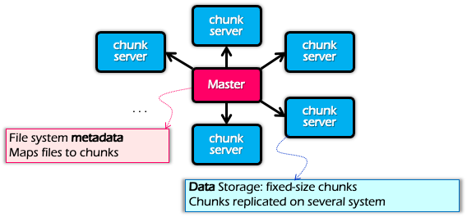
Optimization for Locality
Problem: the bandwidth of datacenter network (at that time) is scarce
  If a Map worker reads all the data from the network, it would be slow
Google: Input and Output files are stored on GFS
  Google File System (SOSP’03), see previous lectures
  Each chunk is replicated on multiple servers (3)
A review of GFS architecture

Slide 80
Optimization for Locality
Problem: the bandwidth of datacenter network (at that time) is scarce
  If Map worker reads all the data from the network, it would be slow
Google: Input and Output files are stored on GFS
  Google File System (SOSP’03), see previous lectures
  Each chunk is replicated on multiple servers (3)
MapReduce runs on GFS chunkservers
  Collocate computation and storage
Master tries to schedule map workers on one of the nodes that has a copy of the input chunk it needs

Slide 81
Refinement: redundant execution
Some workers can be slower than others, aka, stragglers
  Other jobs consuming resources on machine
  Bad disks with soft errors transfer data slowly
  Weird things: processor caches disabled ☹
Near end of phase, MapReduce spawn backup copies of tasks
  Whichever one finishes first “wins” ☺
  Dramatically shortens job completion time:“significantly reduces the time to complete large MapReduce operations ”(check the paper)

Slide 82
Summary of MapReduce
Get a lot of data from input files
Map
  Parse & extract items of interest
Partition & Sort
Reduce
  Aggregate results
Write results to output files
All the other issues, scheduling, fault-tolerance, data partitioning, are handled by the framework

Slide 83
Summary of MapReduce
The user does not need to care concurrency, fault-tolerant, data transfer, etc.
Effects: Reduce the user code burden and quality:
  Sort: only needs 50 LoC
  Indexing: reduce the code lines from 3800 LoC to 700LoC

Slide 84
Summary of MapReduce
MapReduce
Single device computing
Pros:
  Easy to scale
  Fault tolerant
  Good performance (depends!)
    Good for tasks that suits MapReduce, e.g., wordcount
Cons
  Limited programming abstraction
Scalability
Ease of
programming
Performance
Consistency
Fault tolerance

Slide 85
MapReduce is a pioneering work that helps programmers handle pitfalls in distributed computing, including:
Sending data to/from nodes
Coordinating among nodes
Recovering from node failure
Optimizing for locality
Partition data to to enable more parallelism

