Slide 1


Review
SE3331-1 (2025 Fall)
IPADS, Shanghai Jiao Tong University
https://www.sjtu.edu.cn

Slide 2
Attention!
Time: 2026-01-05 (08:00-10:00)
Locations
  东下院213
  东下院215

Slide 3
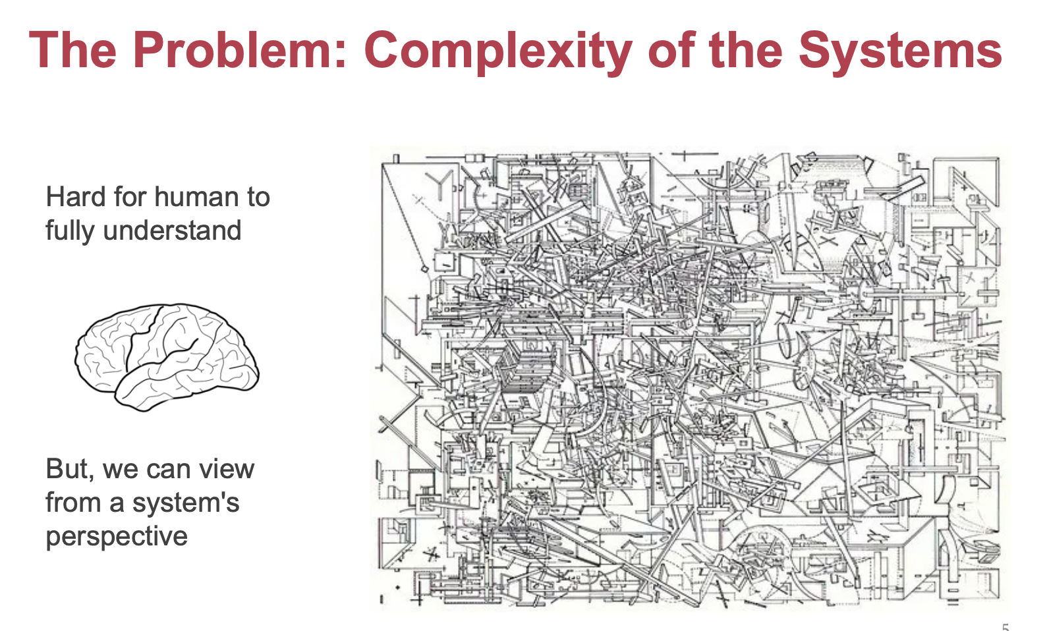
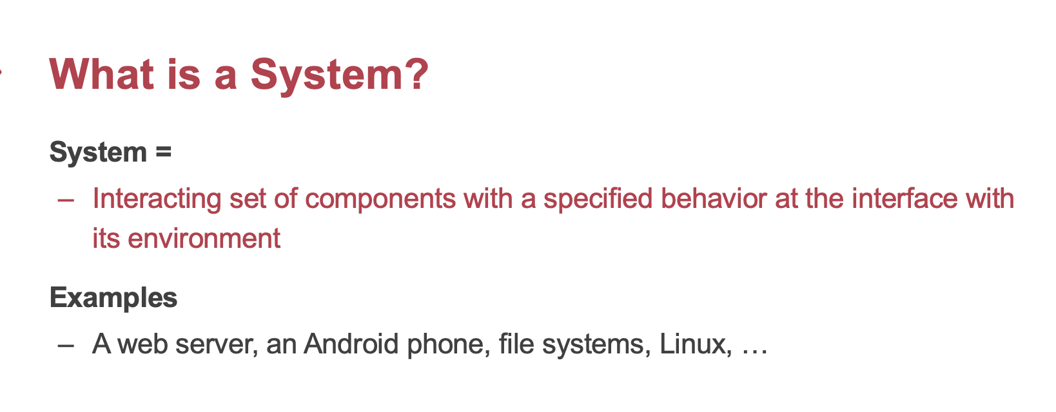
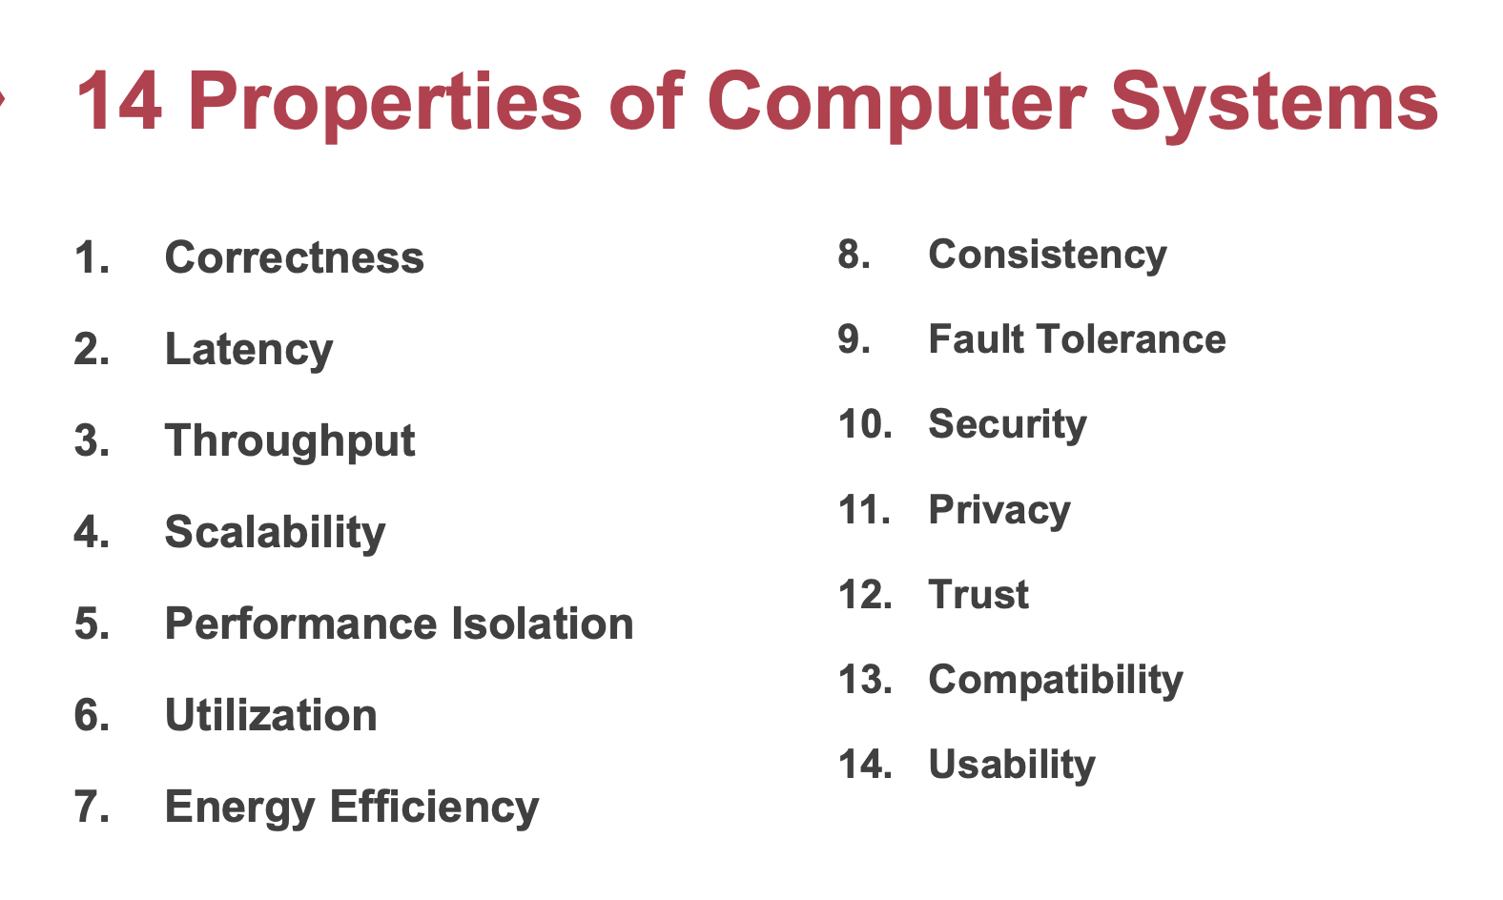
What do we learn?

Slide 4
What do we learn? Analyze the desired properties, and achieve them with general/specific techniques
1. Consistency // ~= Correctness , and availability (~= usability)
  Many lectures before … （from the midterm)
  Raft (Lab3 + CSE-15-Paxos-Raft-Review.pptx)
2. Case study: networking
  The link layer (CSE-16 network-link.pptx)
  The network layer (CSE-17 network-ip.pptx)
  The end-to-end layer (CSE-19 network-end2end.pptx)
  Naming and network naming (CSE-20 network-dns-cdn.pptx)
3. Security (CSE-21 secuity-intro.pptx)
  ROP and CFI: (CSE-22 ROP and CFI.pptx)
  Dataflow (CSE-23 secure data flow.pptx)
4. Performance: distributed and parallel computing!
  Ways to improve FLOPs attained (both hardware and software) (CSE-24-distributed and parallel computing- intro-v1.pptx, 25-gpu+attention.pdf )
  Distributed computation techniques (CSE-26-gpu+mapreduce.pptx, CSE-27-distributed training.pptx, CSE-28-distributed training+RDMA.pptx)

Slide 5
What do we learn? Analyze the desired properties, and achieve them with general/specific techniques
1. Consistency // ~= Correctness , and availability (~= usability)
  Many lectures before … （from the midterm)
  Raft (Lab3 + CSE-15-Paxos-Raft-Review.pptx)
2. Case study: networking
  The link layer (CSE-16 network-link.pptx)
  The network layer (CSE-17 network-ip.pptx)
  The end-to-end layer (CSE-19 network-end2end.pptx)
  Naming and network naming (CSE-20 network-dns-cdn.pptx)
3. Security (CSE-21 secuity-intro.pptx)
  ROP and CFI: (CSE-22 ROP and CFI.pptx)
  Dataflow (CSE-23 secure data flow.pptx)
4. Performance: distributed and parallel computing!
  Ways to improve FLOPs attained (both hardware and software) (CSE-24-distributed and parallel computing- intro-v1.pptx, 25-gpu+attention.pdf )
  Distributed computation techniques (CSE-26-gpu+mapreduce.pptx, CSE-27-distributed training.pptx, CSE-28-distributed training+RDMA.pptx)

Slide 6
Why do we design the Raft?
The goal: using replicated state machine to ensure fault tolerance
  And availability, i.e., some parts of the system fails, but we can quickly recover (some kind of usability)
The challenge: the correctness (consistency) properties may be broken
  Since the state of different replicas may be different
Here we come Raft (or Paxos, or others)
  The inconsistency state is never exposed to the application, in a highly available way (e.g., as long as > half of the replica is connected to a client)

Slide 7
Raft’s high-level approach: problem decomposition
Leader election
  Select one server as the leader (Similar to primary-backup, w/o replication)
  Detect crashes, choose new leader
Log replication (normal operation)
  Leader accepts commands from clients, append to its log
  Leader replicates its log to other servers (overwrites inconsistencies)
Safety
  Keep logs consistent (e.g., out-of-order log entries are not exposed)
Notes:
Safety can violate if a replication happens partially

Slide 8
Raft server states
Server
Server
Network
At any time, each server is either:
  Leader: handles all client interactions, log replication
    Invariant achieved: At most 1 viable leader at a time
  Follower: passive (only responds to incoming RPCs)
  Candidate: used to elect a new leader
Normal workloads
  1 server is the leader, others are the followers
Server
Servers communicates
w/ RPCs
Timeout, start election
Receive acks from majority of servers
Start
Follower
Candidate
Leader
Discover current server or
w/ high term
Discover server w/ high term

Slide 9
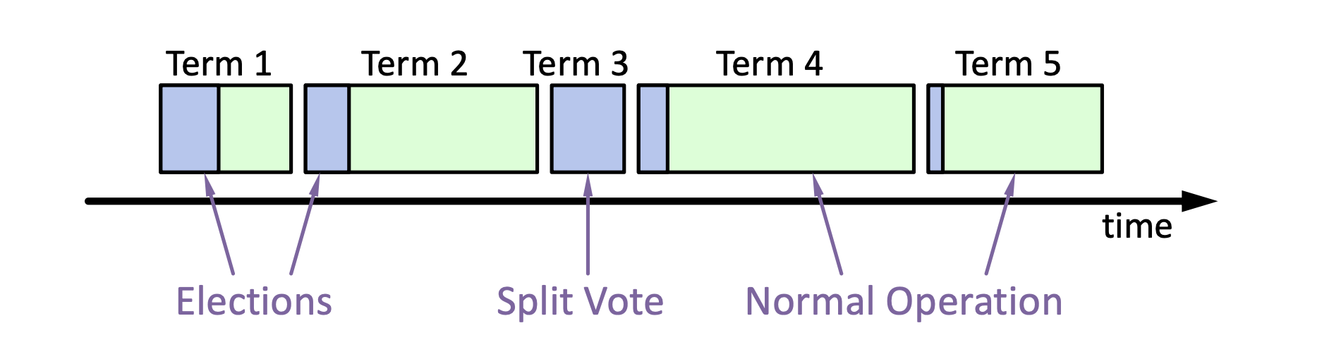
Leader election
Change its state to the candidate state
Increment current term
Vote for itself
  Send RequestVote RPCs to all other servers, retry until either
    Receive votes from majority of servers ➔ Become the leader!
    Receiver RPC from a valid leader ➔ Return to the follower
When an election should be triggered?
When can a follower accept the vote of a candidate?
Notes:
Use heartbeat to announce the leadership.

Slide 10
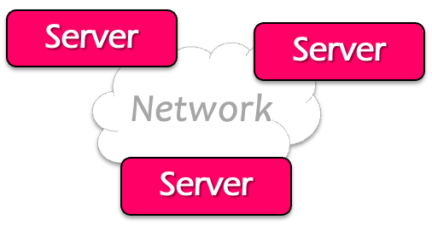

Log replication
Command
Client
Send command to the leader
Leader appends command to its log
Leader sends AppendEntries RPCs to followers
Once a new entry (of log) committed:
  Leader passes command to its state machine, returns results to client
  Notifies followers of committed entries, Follower pass committed commands to their state machines
What if the follower’s log is inconsistent w/ the leader?

Slide 11
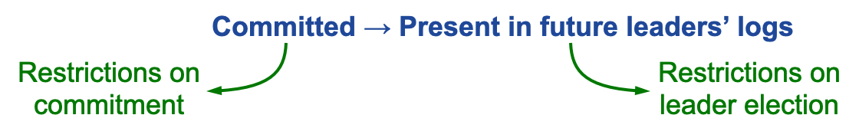
Safety requirement of the commit entry
Once a log entry has been applied to a state machine, no other state machine must apply a different value for that log entry
Raft safety property:
  If a leader has decided that a log entry is committed, that entry will be present in the logs of all future leaders (no overwritten)
This guarantees the safety requirement
  Leaders never overwrite entries in their logs
  Only entries in the leader’s log can be committed
  Entries must be committed before applying to state machine
Notes:
1. Delay the commitment of an entry until we know it is committed

Slide 12
What do we learn? Typical cases why these properties are challenging to hold, and ways to achieve them
1. Consistency // ~= Correctness , and availability (~= usability)
  Many lectures before … （from the midterm)
  Raft (Lab3 + CSE-15-Paxos-Raft-Review.pptx)
2. Case study: networking
  The link layer (CSE-16 network-link.pptx)
  The network layer (CSE-17 network-ip.pptx)
  The end-to-end layer (CSE-19 network-end2end.pptx)
  Naming and network naming (CSE-20 network-dns-cdn.pptx)
3. Security (CSE-21 secuity-intro.pptx)
  ROP and CFI: (CSE-22 ROP and CFI.pptx)
  Dataflow (CSE-23 secure data flow.pptx)
4. Performance: distributed and parallel computing!
  Ways to improve FLOPs attained (both hardware and software) (CSE-24-distributed and parallel computing- intro-v1.pptx, 25-gpu+attention.pdf )
  Distributed computation techniques (CSE-26-gpu+mapreduce.pptx, CSE-27-distributed training.pptx, CSE-28-distributed training+RDMA.pptx)

Slide 13
Review: The Link Layer
The bottom-most layer of the three layers
Purpose: moving data directly from one physical location to another
  1. Physical transmission
  2. Multiplexing the link
  3. Framing bits & bit sequences
  4. Detecting transmission errors
  5. Providing a useful interface to the up layer

Slide 14
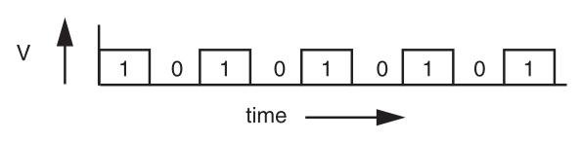
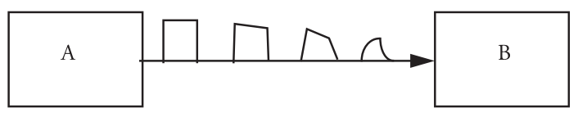
Physical transmission: Signal Transmission on Analog Line
It is hard for B to understand the signal
  B doesn't have a copy of A's clock, so when to sample the signal?

Slide 15
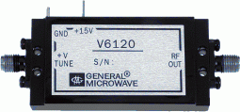
VCO: Voltage Controlled Oscillator
How to make two ends agree on the data rate without clock line?
The receiver run a VCO at about the same data rate
  VCO's output is multiplied by the voltage of incoming signal
  The product is suitably filtered and sent back to adjust the VCO
  VCO will finally be locked to both the frequency and phase of the arriving signal: phase-locked loop
  Then the VCO becomes a clock source for the receiver
Problem: if no transition in the stream (e.g., a lot of zero), the phase-locked loop cannot synchronize

Slide 16
Manchester Code
Solution: sender encodes the data to ensure transitions
Phase encoding: at least 1 level transition for a bit
  Manchester code: 0 -> 01, 1 -> 10
  Max data rate is only half, but simple enough
1
0
1
0
1
1
1
0
0
Polar NRZ
Manchester
Encoding

Slide 17
How to Share a Connection?
Isochronous communication (telephone communication)
  Needs prior arrangement between switches
  Connection: set up and tear down
  Stream: continuous bits flows out of a phone
Asynchronous communication (data communication)
  Message: burst, ill-suited to fixed size and spacing of isochronous frames
  Connectionless, asynchronous

Slide 18
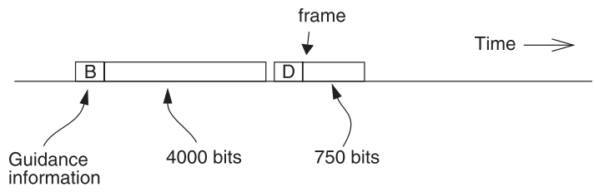
Frame and Packet: Asynchronous Link
Frame can be of any length, carried at any time that the link is free
Packet: a variable-length frame with its guidance info (header)
Connectionless transmission: no state maintained
Segment and reassemble
Packet voice: replacing many parts of isochronous network

Slide 19
Fault tolerance: Error Handling
Error detection code
  Adding redundancy: e.g., checksum at the end
What to do if detect an error
  Error correction code: with enough redundancy
    Where noise is well understood, e.g., disk
  Ask sender to resend: sender holds frame in buffer
  Let receiver discard the frame
  Blending these techniques

Slide 20
What do we learn? Analyze the desired properties, and achieve them with general/specific techniques
1. Consistency // ~= Correctness , and availability (~= usability)
  Many lectures before … （from the midterm)
  Raft (Lab3 + CSE-15-Paxos-Raft-Review.pptx)
2. Case study: networking
  The link layer (CSE-16 network-link.pptx)
  The network layer (CSE-17 network-ip.pptx)
  The end-to-end layer (CSE-19 network-end2end.pptx)
  Naming and network naming (CSE-20 network-dns-cdn.pptx)
3. Security (CSE-21 secuity-intro.pptx)
  ROP and CFI: (CSE-22 ROP and CFI.pptx)
  Dataflow (CSE-23 secure data flow.pptx)
4. Performance: distributed and parallel computing!
  Ways to improve FLOPs attained (both hardware and software) (CSE-24-distributed and parallel computing- intro-v1.pptx, 25-gpu+attention.pdf )
  Distributed computation techniques (CSE-26-gpu+mapreduce.pptx, CSE-27-distributed training.pptx, CSE-28-distributed training+RDMA.pptx)

Slide 21
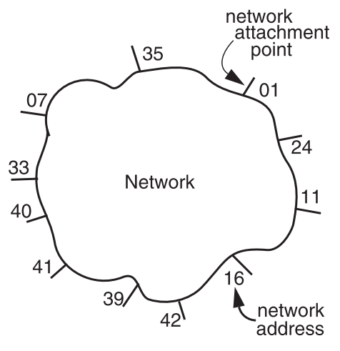
Review: The Network Layer
Addressing interface
  Network attachment points
  Network address
  Source & destination
NETWORK_SEND (segment_buffer, destnation, network_protocol, end_layer_protocol)
NETWORK_HANDLE (packet, network_protocol)

Slide 22


Managing the Forwarding Table: Routing
Routing (or path-finding)
  Constructing the tables
Impractical by hand
  Determining the best paths requires calculation
  Recalculating the table when links change
  Recalculating the table when link fails
  Adapt according to traffic congestion
Static routing vs. adaptive routing
  Adaptive routing requires exchange of info
Where are you going?

Slide 23


IP Route Table
Interface 1 … Interface N

Slide 24
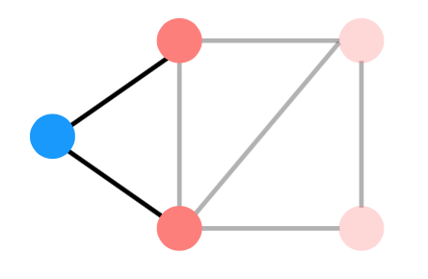
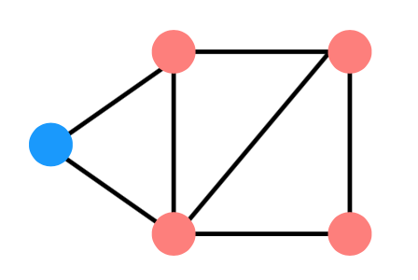
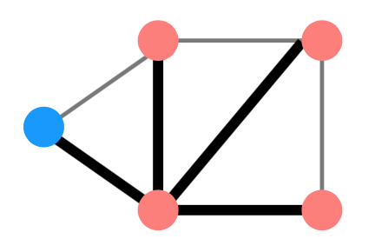
Distributed Routing: 3 Steps in General
Nodes learn about their neighbors via the HELLO protocol
Nodes learn about other reachable nodes via advertisements
Nodes determine the minimum-cost routes (of the routes they know about)

Slide 25
Two Types of Routing Protocol
Protocol 1: Link-state
  A node's advertisements contain a list of its neighbors and its link costs to those nodes
  Nodes advertise to everyone their costs to their neighbors
    via flooding
  Integrate using Dijkstra's shortest path algorithm
Protocol 2: Distance-vector
  Nodes advertise to neighbors with their cost to all known nodes
  Update routes via Bellman-Ford integration

Slide 26
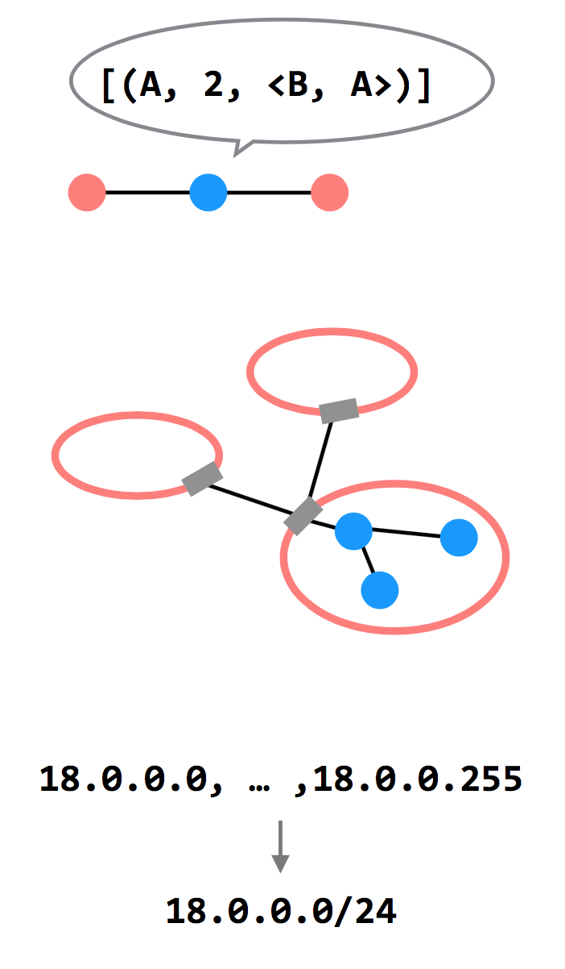
3 Ways to Scale
Hierarchy of Routing
  Route between regions, and then within a
  region
Path-vector Routing
  Advertisements include the path, to better
  detect routing loops
Topological Addressing
  Assign addresses in contiguous blocks to
  make advertisements smaller

Slide 27
What do we learn? Analyze the desired properties, and achieve them with general/specific techniques
1. Consistency // ~= Correctness , and availability (~= usability)
  Many lectures before … （from the midterm)
  Raft (Lab3 + CSE-15-Paxos-Raft-Review.pptx)
2. Case study: networking
  The link layer (CSE-16 network-link.pptx)
  The network layer (CSE-17 network-ip.pptx)
  The end-to-end layer (CSE-19 network-end2end.pptx)
  Naming and network naming (CSE-20 network-dns-cdn.pptx)
3. Security (CSE-21 secuity-intro.pptx)
  ROP and CFI: (CSE-22 ROP and CFI.pptx)
  Dataflow (CSE-23 secure data flow.pptx)
4. Performance: distributed and parallel computing!
  Ways to improve FLOPs attained (both hardware and software) (CSE-24-distributed and parallel computing- intro-v1.pptx, 25-gpu+attention.pdf )
  Distributed computation techniques (CSE-26-gpu+mapreduce.pptx, CSE-27-distributed training.pptx, CSE-28-distributed training+RDMA.pptx)

Slide 28
The End-to-end Layer
Network layer has no guarantees on:
  Delay - Order of arrival
  Certainty of arrival - Accuracy of content
  Right place to deliver
End-to-end layer
  No single design is likely to suffice
  Transport protocol for each class of application

Slide 29
Famous Transport Protocols
UDP (User Datagram Protocol)
  Be used directly for some simple applications
  Also be used as a component for other protocols
TCP (Transmission Control Protocol)
  Keep order, no missing, no duplication
  Provision for flow control
RTP (Real-time Transport Protocol)
  Built on UDP
  Be used for streaming video or voice, etc.
No "one size fits all"

Slide 30
Assurance of End-to-end Protocol
Assurance of at-least-once delivery
Assurance of at-most-once delivery
Assurance of data integrity
Assurance of stream order & closing of connections
Assurance of jitter control
Assurance of authenticity and privacy
Assurance of end-to-end performance

Slide 31
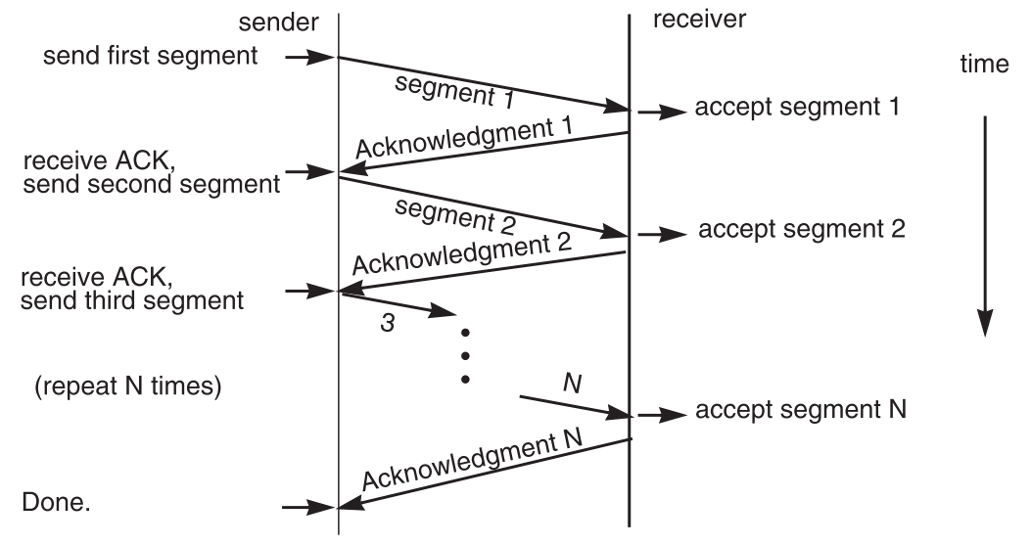
7. End-to-end Performance
Multi-segment message questions
  Trade-off between complexity and performance
  Lock-step protocol

Slide 32
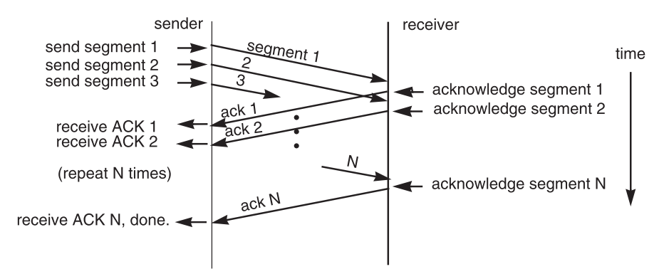
Overlapping Transmissions
Pipelining technique

Slide 33
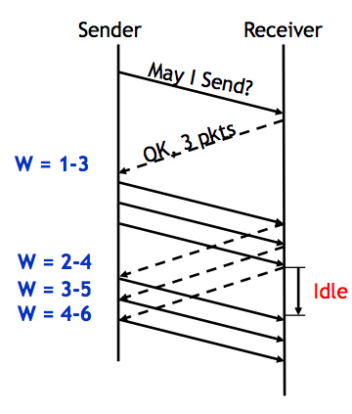
Sliding Window
Sender advances the window by 1 for each in-sequence ACK it receives
  Reduces idle periods
  Pipelining idea
But what's the correct value for the window?
  We'll revisit this question
  First, we need to understand windows

Slide 34
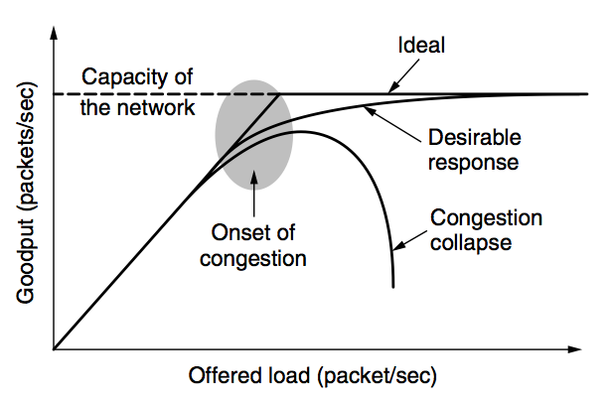
Network Congestion

Slide 35
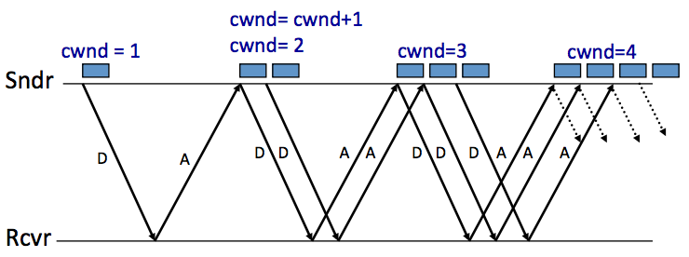
AIMD (Additive Increase, Multiplicative Decrease)
Every RTT:
  No drop: cwnd = cwnd + 1
  A drop: cwnd = cwnd / 2

Slide 36
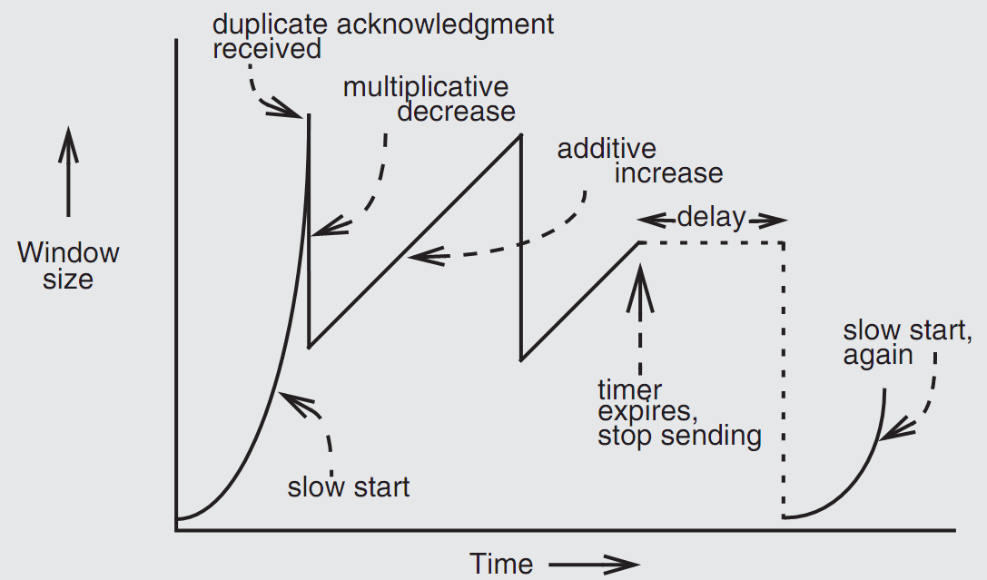
Retrofitting TCP

Slide 37
What do we learn? Analyze the desired properties, and achieve them with general/specific techniques
1. Consistency // ~= Correctness , and availability (~= usability)
  Many lectures before … （from the midterm)
  Raft (Lab3 + CSE-15-Paxos-Raft-Review.pptx)
2. Case study: networking
  The link layer (CSE-16 network-link.pptx)
  The network layer (CSE-17 network-ip.pptx)
  The end-to-end layer (CSE-19 network-end2end.pptx)
  Naming and network naming (CSE-20 network-dns-cdn.pptx)
3. Security (CSE-21 secuity-intro.pptx)
  ROP and CFI: (CSE-22 ROP and CFI.pptx)
  Dataflow (CSE-23 secure data flow.pptx)
4. Performance: distributed and parallel computing!
  Ways to improve FLOPs attained (both hardware and software) (CSE-24-distributed and parallel computing- intro-v1.pptx, 25-gpu+attention.pdf )
  Distributed computation techniques (CSE-26-gpu+mapreduce.pptx, CSE-27-distributed training.pptx, CSE-28-distributed training+RDMA.pptx)

Slide 38
DNS: Binding IP and Domain Name
Names: hostname strings
  E.g., www.sjtu.edu.cn
Values: IP addresses
  E.g., 202.120.2.119
Look-up algorithm
  Resolves a hostname to an IP address so that your machine knows where to send packets

Slide 39
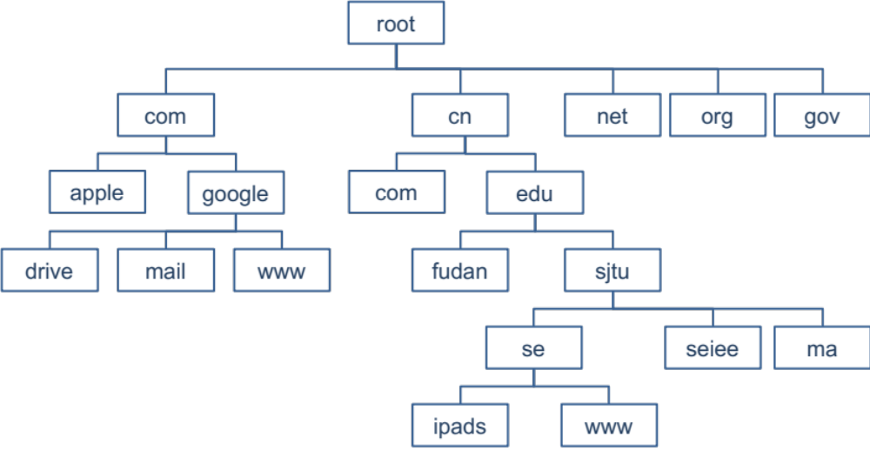
DNS Hierarchy (a partial view)

Slide 40
Fault Tolerant
Each zone can have multiple name servers
  A delegation usually contains a list of name servers
  If one name server is down, others can be used

Slide 41
Three enhancements
1. The initial DNS request can go to any name server, not just the root server
2. Recursion
3. Caching
  What about consistency? Remember: CAP!

Slide 42
What do we learn? Analyze the desired properties, and achieve them with general/specific techniques
1. Consistency // ~= Correctness , and availability (~= usability)
  Many lectures before … （from the midterm)
  Raft (Lab3 + CSE-15-Paxos-Raft-Review.pptx)
2. Case study: networking
  The link layer (CSE-16 network-link.pptx)
  The network layer (CSE-17 network-ip.pptx)
  The end-to-end layer (CSE-19 network-end2end.pptx)
  Naming and network naming (CSE-20 network-dns-cdn.pptx)
3. Security (CSE-21 secuity-intro.pptx)
  ROP and CFI: (CSE-22 ROP and CFI.pptx)
  Dataflow (CSE-23 secure data flow.pptx)
4. Performance: distributed and parallel computing!
  Ways to improve FLOPs attained (both hardware and software) (CSE-24-distributed and parallel computing- intro-v1.pptx, 25-gpu+attention.pdf )
  Distributed computation techniques (CSE-26-gpu+mapreduce.pptx, CSE-27-distributed training.pptx, CSE-28-distributed training+RDMA.pptx)

Slide 43
Attack: Code Reuse (instead of inject) Attack
ROP: Return-oriented Programming
  Find code gadgets in existed code base
    Usually 1-3 instructions, ends with 'ret'
    In libc and application, intended and unintended
  Push address of gadgets on the stack
  Leverage 'ret' at the end of gadget to
  connect each code gadgets
  No code injection
0101011010
0101011010
0101011010
return addr
0101011010
saved ebp
0101011010
0101011010
0101011010

Slide 44
CFI: Control-Flow Integrity
Main idea: pre-determine control flow graph (CFG) of an application
  Static analysis of source code
  Static binary analysis ← CFI
  Execution profiling
  Explicit specification of security policy
Execution must follow the pre-determined control flow graph

Slide 45
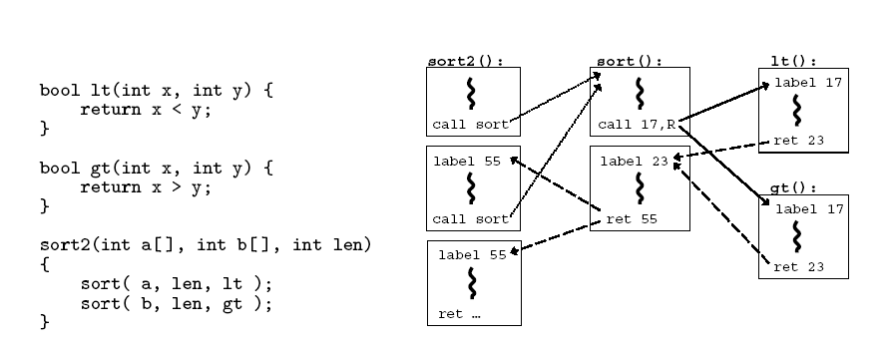
CFG Example

Slide 46
What do we learn? Analyze the desired properties, and achieve them with general/specific techniques
1. Consistency // ~= Correctness , and availability (~= usability)
  Many lectures before … （from the midterm)
  Raft (Lab3 + CSE-15-Paxos-Raft-Review.pptx)
2. Case study: networking
  The link layer (CSE-16 network-link.pptx)
  The network layer (CSE-17 network-ip.pptx)
  The end-to-end layer (CSE-19 network-end2end.pptx)
  Naming and network naming (CSE-20 network-dns-cdn.pptx)
3. Security (CSE-21 secuity-intro.pptx)
  ROP and CFI: (CSE-22 ROP and CFI.pptx)
  Dataflow (CSE-23 secure data flow.pptx)
4. Performance: distributed and parallel computing!
  Ways to improve FLOPs attained (both hardware and software) (CSE-24-distributed and parallel computing- intro-v1.pptx, 25-gpu+attention.pdf )
  Distributed computation techniques (CSE-26-gpu+mapreduce.pptx, CSE-27-distributed training.pptx, CSE-28-distributed training+RDMA.pptx)

Slide 47
Data Lifetime
The lifetime of sensitive data should be minimized
  The longer data remains in memory the greater its chances of being leaked to disk
  Swapping, hibernation, VM suspending, core dump, etc.
That's what we called "data exposure"

Slide 48
Dynamic Taint Analysis
i = get_input();
two = 2;
if(i%2 == 0){
  j = i+two;
  l = j;
} else {
  k = two*two;
  l = k;
}
jmp l;
Example sourced from CMU ECE
  Source
Will show the basic approach of dynamic taint analysis
Two concrete executions will be presented
Goal: evaluate whether control can be hijacked by [malicious] user input

Slide 49
Secure Channel

Slide 50
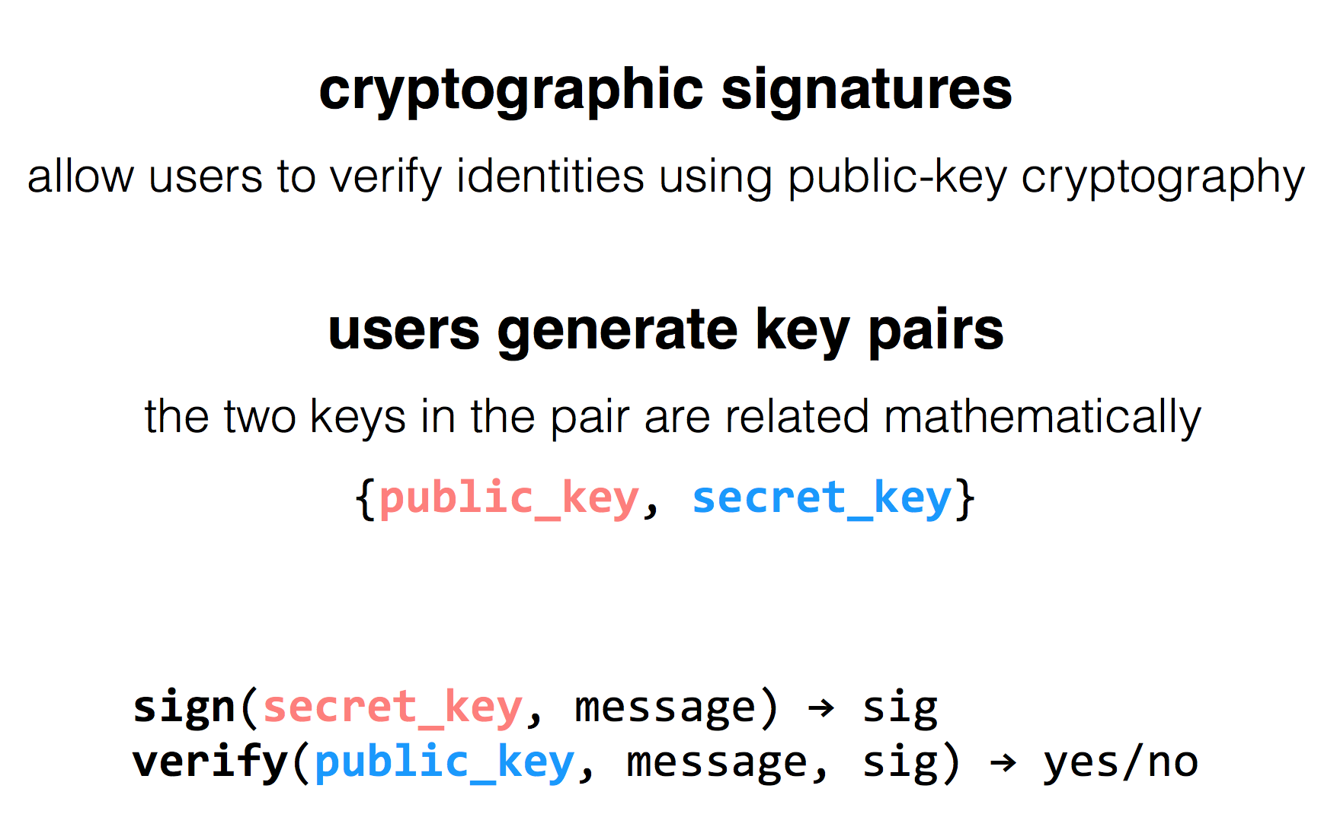
RSA Algorithm

Slide 51
has k
has k
Alice
Eve
Bob
c = encrypt(k, m)
h = MAC(k, m)
c | h
m = decrypt(k, c)
MAC(k, m) == h ?
c | h
Problem: replay attacks
(adversary could intercept a message, re-send it at a later time)
c | h

Slide 52
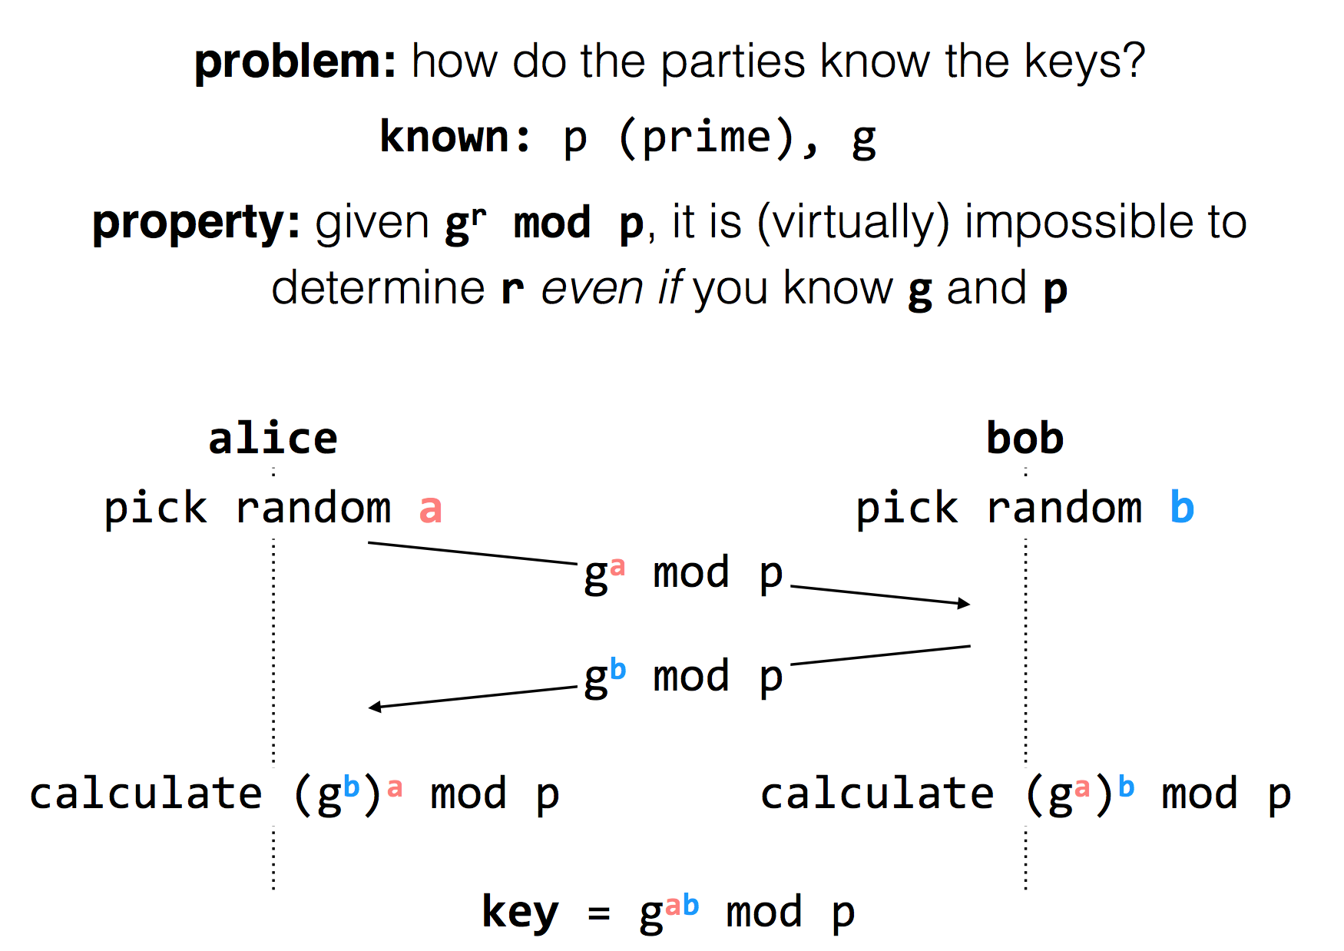
Diffie-Hellman
Key Exchange
(g^{b} mod p)ª mod p = g^{ab} mod p = (gª mod p)^{b} mod p
Notes:
g^i mod p ≠ g^j mod p （p为素数），其中i≠j且i, j介于1至(p-1)之间，则g为p的原根

Slide 53
RSA Algorithm

Slide 54
What do we learn? Analyze the desired properties, and achieve them with general/specific techniques
1. Consistency // ~= Correctness , and availability (~= usability)
  Many lectures before … （from the midterm)
  Raft (Lab3 + CSE-15-Paxos-Raft-Review.pptx)
2. Case study: networking
  The link layer (CSE-16 network-link.pptx)
  The network layer (CSE-17 network-ip.pptx)
  The end-to-end layer (CSE-19 network-end2end.pptx)
  Naming and network naming (CSE-20 network-dns-cdn.pptx)
3. Security (CSE-21 secuity-intro.pptx)
  ROP and CFI: (CSE-22 ROP and CFI.pptx)
  Dataflow (CSE-23 secure data flow.pptx)
4. Performance: distributed and parallel computing!
  Ways to improve FLOPs attained (both hardware and software) (CSE-24-distributed and parallel computing- intro-v1.pptx, 25-gpu+attention.pdf )
  Distributed computation techniques (CSE-26-gpu+mapreduce.pptx, CSE-27-distributed training.pptx, CSE-28-distributed training+RDMA.pptx)

Slide 55

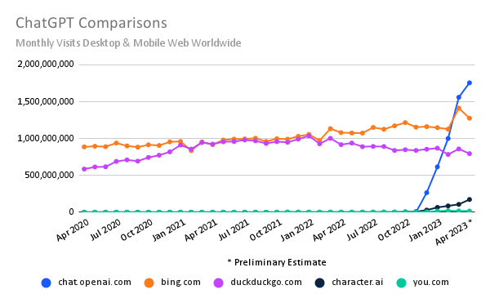
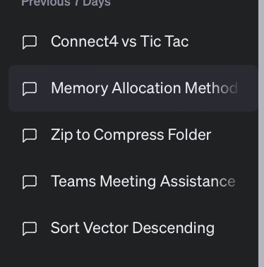
Review: Scalable web apps are everywhere: AI era
Essentially, also a web APP
  Pre-AI era: request handling = order an item
  AI era: request handling = use model to do an
  inference
The same system requirements
  High request rate
  Massive data: both for training & for serving
  history data
New requirements
  Huge computation power required
  According to GPT (☺), an inference of GPT
  ~= sorting 100,000,000 numbers
Per-user sessions
Notes:
ChatGPT access data: https://www.similarweb.com/blog/insights/ai-news/chatgpt-growth-flattens/
要确切地回答GPT-4运行一次推理所需的计算能力与传统计算（如排序）的等价关系，需要具体地了解两个任务的计算复杂性和所用的硬件。然而，我们可以对这个问题进行一个简化的概述。
GPT-4的推理:
GPT-4进行一次推理（即生成一个响应）通常只涉及前向传播，而不涉及训练。这意味着每个神经元需要与其输入进行一次乘法操作，然后加上一个偏差，并通过激活函数。
由于GPT-4有数十亿的参数，所以每次推理需要数十亿的这样的操作。这还取决于所选的序列长度和模型配置。
排序:
最常用的排序算法，如快速排序或归并排序，具有O(n log n)的平均时间复杂性，其中n是待排序的元素数量。
如果我们要排序1亿个数字，所需的操作数将是在10亿到100亿之间，这取决于常数因子和排序的数据。
如果我们进行一个非常粗略的比较：
对于GPT-4的一个简单推理与对1亿个数字的排序，所需的计算操作大致是同一个数量级的。
但请注意，这是一个非常简化和粗略的比较。实际上，不同的计算任务在不同的硬件上有着不同的效率，因此即使两者需要相同数量的操作，它们也可能在实际执行时间上有所不同。
此外，实际的操作复杂性和所需的计算能力取决于实际的任务参数和所使用的实现细节。

Slide 56
Ways to improve the computation intensity
Single device capability
System methods to fully utilize the device
System methods to do computation on multiple devices

Slide 57
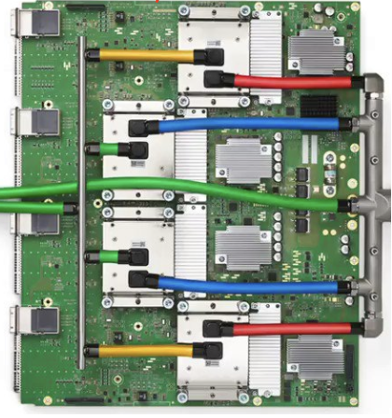

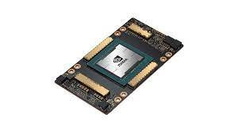


Spectrum of computation device available
Intel i5-9600K,
single core: 6.3GFLOPS
Multiple cores: 37.7GFLOPS
Mate60 GPU
2.3 TFLOPs
Apple M2
GPU 3.6 TFLOPs
NVIDIA A100
GPU 19.5 TFLOPs
Google TPUv4
275 TFLOPS
Performance
Notes:
Source: Wikipedia
Mate60: https://nanoreview.net/en/soc-compare/qualcomm-snapdragon-875-vs-hisilicon-kirin-9000
Intel CPU: https://setiathome.berkeley.edu/cpu_list.php

Slide 58
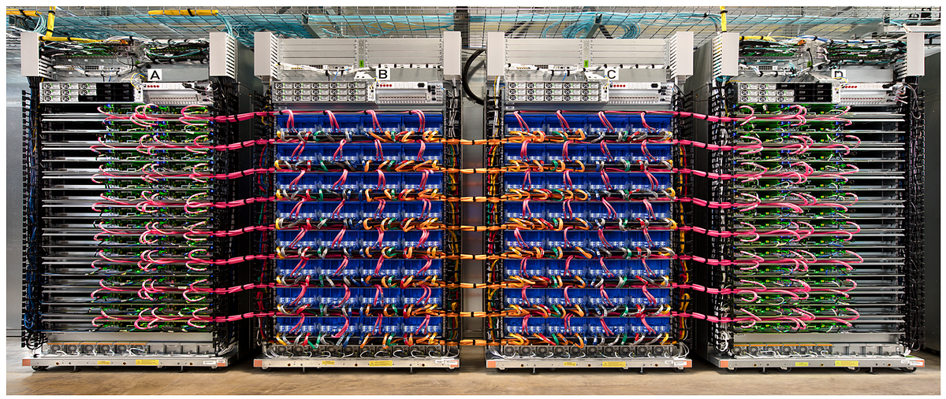
Spectrum of computation device available
Programmability
Mate60 GPU
2.3 TFLOPs
Apple M2
GPU 3.6 TFLOPs
NVIDIA A100
GPU 19.5 TFLOPs
Google TPUv4
275 TFLOPS
A cluster
? TFLOPS
Performance
Notes:
Source: Wikipedia
Mate60: https://nanoreview.net/en/soc-compare/qualcomm-snapdragon-875-vs-hisilicon-kirin-9000
Intel CPU: https://setiathome.berkeley.edu/cpu_list.php

Slide 59
The single-core machine: easy to program, hard to scale
Parallelism methods
  Pipeline
  Instruction-level parallelism (a.k.a, super scalar)
How does it scale?
  More efficient pipeline design & implementation, e.g., reduce bubble stall
  Fast clock rate, e.g., 10 MHz -> 3G Hz
  Exploiting wider instruction-level parallelism (ILP), e.g., issue 4 instructions / cycle
Optimal result: 12G Flops/sec
Notes:
Source: apple M1 has 8 decoder, so it has large instruction-level parallelism
https://news.ycombinator.com/item?id=25257932

Slide 60
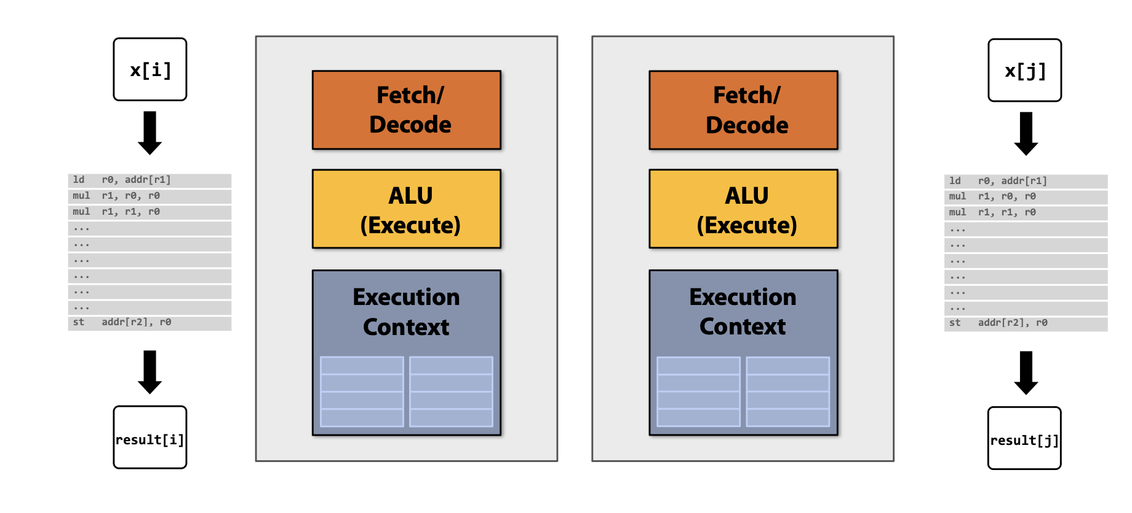
Approach #1 of multi-core: add more physical cores
Add more cores to our system
  Instead of increasing the power of fetch/decode or the entire pipeline, add multiple cores together on a simple chip

Slide 61
Problem: coherence under memory access hierarchy
Updates are first stored in the cache for better performance
  Without synchronization, different core’s cache may have different values
The consistency problem described earlier happens in a multi-core setting
  E.g., if core 1 writes to addr0, and core 2 should see it later

Slide 62
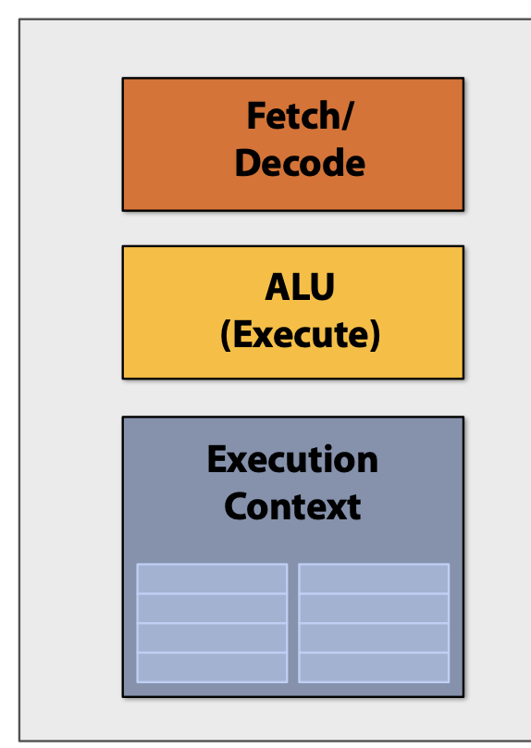
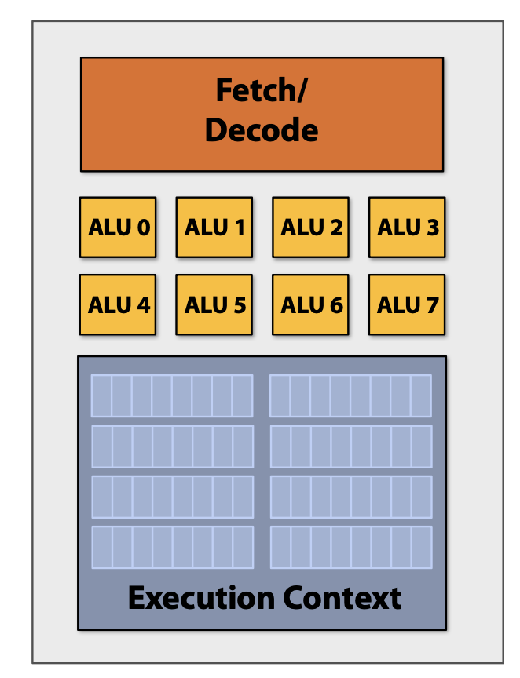
Approach #2 of multi-core: increase per-core density
More ALUs on a single core

Slide 63
Add ALUs to increase compute capability
Observation: data-parallel parallelism
  Huge computation usually means operate on a huge amount of data
  Yet, the computation (instruction) on each of the data is similar
SIMD processing
  Single instruction, multiple data
  Same instruction broadcast to multiple ALUs in parallel
Question: why not different instructions
  Cost of manage per-ALU instruction stream

Slide 64
Conditional execution under SIMD
Constrain of SIMD: every SIMD ALUs share the same program counter (PC)
  But conditional execution have 2 branches
Solution: masked instruction
  Basic idea: execute all branches sequentially
  Each ALU has a mask to indicate whether the instruction will be executed

Slide 65
Summary: parallelism on a single device
3 parallelism strategies on a single device
  Single core+: pipeline + super scalar with instruction level parallelism (ILP)
  Single core++: added SIMD support
  Multiple core: a single core (single core, single core+, single core++) can be glued together !
Question: what’s next? Single core+++++?
  Solution (Out of the scope of this lecture): domain-specific accelerators !

Slide 66
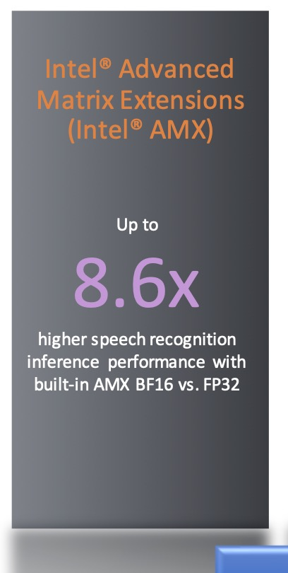
The era of domain-specific accelerators
Accelerators (even on general-purpose computing devices)
  Hardware designed to fulfill a single task
  Typically are not general-purpose, e.g., not programmable
CPU:
  SIMD + Matrix accelerators (e.g., Intel’s AMX accelerators)
GPU:
  Tensorcore: accelerators for matrix operations
TPU (Tensor processing unit):
  tensor process (optimized for large matrix operations)

Slide 67
Ways to improve the computation intensity
Single device capability
System methods to fully utilize the device
System methods to do computation on multiple devices

Slide 68
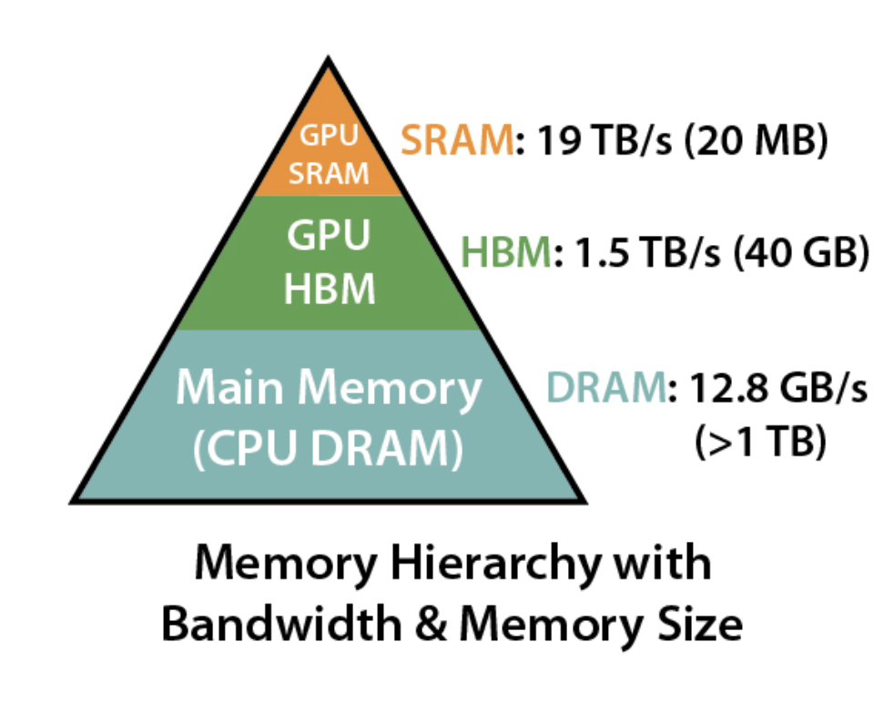
Memory hierarchy in modern GPUs
GPU also has memory hierarchy
  SRAM: e.g., registered files, ultra fast but small
  HBM: relative fast, sufficiently large
SRAM bandwidth is not the bottleneck
Goal: minimize the HBM load
  Currently requires case-by-case analyze
Source: https://github.com/Dao-AILab/flash-attention?tab=readme-ov-file

Slide 69
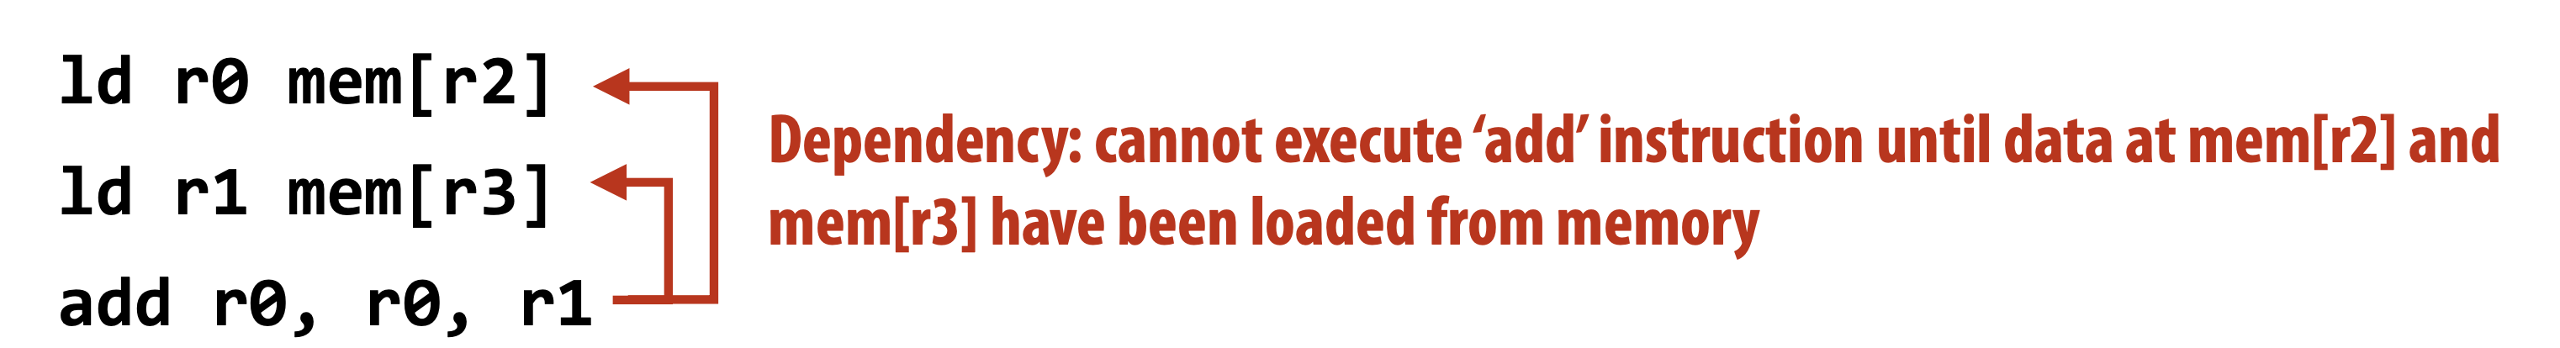
Memory stalls (Communication stalls)
A processor “stalls” when it cannot run the next instruction in an instruction stream because of a dependency on a previous instruction.
Accessing memory is a major source of stalls
Memory access times ~ 100’s of cycles
  Memory “access time” is a measure of latency
Reducing memory stalls is a large topic, out of the scope of this lecture

Slide 70
Analysis method: the roofline model
Given an application
  If we know how many FLOPs performed per-memory read, we can see whether it is computation bound or memory bound
Benefit
  Give hints on the optimization directions
128
64
Peak flops
32
16
attainable Gflop/s
Stream Bandwidth
8
4
Kernel’s Arithmetic Intensity
2
1
¹/₈
¹/₄
¹/₂
1
2
4
8
16
flop:DRAM byte ratio

Slide 71
Question: what is the HBM load for basic attention?
Recap: each HBM load will load a block of data to the SRAM
  Like load cacheline in the CPU
But, how many loads depends on how the operator is implemented
  So we should break down the operator
Key operators in the basic attention
  Matrix multiplications & softmax
Q
X
X
V
Softmax( )
K^{T}

Slide 72
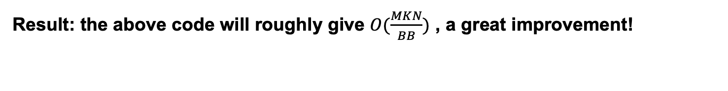
Analysis: change the loop order can improve the number of data required loaded!
for i in 0..N:
for k in 0..K:
HBM_read(A[i][k])
for j in 0..M:
if j % BB == 0:
HBM_read(B[k][j])
HBM_read(C[i][j])
C[i][j] += A[i][k] * B[k][j]
if j % BB == 0:
HBM_write(C[i][j])
Result: the above code will roughly give $O(\frac{MKN}{BB})$ , a great improvement!

Slide 73
Tiling is an effective way to improve HBM loads
Question: can we improve HBM reads w/o adding more writes?
  Yes. We can compute the end matrix in a block-version
for i in 0..N/B_{N}.step(B_{N}):
for j in 0..M/B_{M}.step(B_{M}):
for k in 0..K/B_{K}.step(B_{K}):
C[i:i+ B_{N}][j:j+B_{M}] += A[i:i+B_{N}][k:k+B_{K}]
* B[k+B_{K}][j:j+B_{M}]
B_{K}
B_{M}
B_{N}
B_{N}
B_{M}
X
=
B_{K}

Slide 74
Ways to improve the computation intensity
Single device capability
System methods to fully utilize the device
System methods to do computation on multiple devices

Slide 75
What do we learn? Analyze the desired properties, and achieve them with general/specific techniques
1. Consistency // ~= Correctness , and availability (~= usability)
  Many lectures before … （from the midterm)
  Raft (Lab3 + CSE-15-Paxos-Raft-Review.pptx)
2. Case study: networking
  The link layer (CSE-16 network-link.pptx)
  The network layer (CSE-17 network-ip.pptx)
  The end-to-end layer (CSE-19 network-end2end.pptx)
  Naming and network naming (CSE-20 network-dns-cdn.pptx)
3. Security (CSE-21 secuity-intro.pptx)
  ROP and CFI: (CSE-22 ROP and CFI.pptx)
  Dataflow (CSE-23 secure data flow.pptx)
4. Performance: distributed and parallel computing!
  Ways to improve FLOPs attained (both hardware and software) (CSE-24-distributed and parallel computing- intro-v1.pptx, 25-gpu+attention.pdf )
  Distributed computation techniques (CSE-26-gpu+mapreduce.pptx, CSE-27-distributed training.pptx, CSE-28-distributed training+RDMA.pptx)

Slide 76
Question: is a single device sufficient?
A device has limited physical capacity to store “cores” (chip size)
  Our cores are generalized, e.g., can either be CPU cores, GPU cores (cores w/o cache coherence + many SIMD ALUs, etc.), domain-specific cores
How to make a single device faster?
  Increasing clock rate (has a limit)
  Put more cores on a single chip, but has physical limits, e.g., chip size

Slide 77
Question: is a single device sufficient?
A device has limited physical capacity to store “cores” (chip size)
  Our cores are generalized, e.g., can either be CPU cores, GPU cores (cores w/o cache coherence + many SIMD ALUs, etc.), domain-specific cores
Why? Recall our previous calculation
  Basically, a A100 needs 30 seconds for an A100 GPU to finish an iteration on a single input (a.k.a, token) in the optimal case
  How many tokens are trained? 13T tokens! [1]
  To use one A100 to train GPT-4, we need about 412 years to finish the training
[1] https://the-decoder.com/gpt-4-has-a-trillion-parameters/

Slide 78
The case for distributed computing
Example: Google’s TPU v4 cluster

Slide 79




Use distributed computing frameworks for complex queries
Each fits a common application scenario
  One sit (typically) does not fit all!
Batch processing system
  Spark, Hadoop, etc.
Graph processing system
  GraphLab, etc.
Machine learning system
  TensorFlow, Pytorch, etc.
Note that we can also use one for another
  At the cost of programming effort and performance
Today’s focus

Slide 80
Building application with distributed computing: old days
Graduate Student
ML experts repeatedly solve the same parallel design challenges
  Implement and debug complex parallel & distributed systems
  Tune for a specific parallel platform
6 months later, a conference paper contains:
However, the resulting code will be difficult to maintain and extend
“We implemented ____ in parallel.”
Root cause: couples computation task with distributed implementation

Slide 81
Challenges programmers facing
Sending data to/from nodes
Coordinating among nodes
Recovering from node failure
Optimizing for locality
Partition data to to enable more parallelism

Slide 82
Idea: we build a framework to hide the above tasks
Goal
  Reduce programmer’s effort in solving the above challenges
Challenges
  What is the right abstraction? Thread & RPC is insufficient
  More general, harder to provide the properties presented in the previous slide
  E.g., if a thread fails, how can we know its progress?

Slide 83
MapReduce Programming Interface
Map: (input shard) → intermediate (k/v pairs)
  Partition the input data into M “shards”
  Group all intermediate values associated with the same key
  Pass them to the Reduce function
Reduce: intermediate (k/v pairs) → (results)
  Partition the key space into R “pieces” using a Partition function
    E.g., hash(key) mod R (unsorted)
  Accept a key & a set of values
  Merge these values to form result of the key
Notes:
Sort may be important. E.g., sometimes the output keys are URLs, and we want all entries for a single host to end up in the same output file.

Slide 84
MapReduce: The Complete Picture
Client
Master
assign
tasks
Shard 0
Map
Worker
IF
Shard 1
Shard 2
Reduce
Worker
Output
File 1
M items
Shard 3
Map
Worker
IF
R items
...
Reduce
Worker
Output
File 2
Shard M-2
Shard M-1
Map
Worker
IF
Input
Files
Map Workers
Intermediate Files
Reduce Workers
Output
Files
Notes:
具体到实现，以文件作为input

Slide 85
MapReduce: The Complete Picture
Step1: (Client/Master) split input files into chunks (shards)
  Typically, 64MB
  Why? Fit the GFS chunk size, so one RPC is sufficient to read the chunk
Shard 0
Shard 1
Shard 2
Shard 3
...
Shard M-1
Input Files
Divided into M shards

Slide 86
MapReduce: The Complete Picture
Step4: create intermediate files
  Intermediate k/v pairs buffered in memory and periodically written to the local disk
    Partitioned into R regions by a Partition function
    Default function: hash(key) mod R
Intermediate File
read
Map
Worker
local
write
partition 1
Shard 2
partition 2
partition R

Slide 87
MapReduce: The Complete Picture
Step5: sorting intermediate data
  Notified by master about the location of intermediate files for its partition
  Uses RPCs to read the data from the local disks of map workers
  Sort keys from different intermediate files (like a merge sort)
  => All occurrences of the same key are grouped
  Note: both mapper and reducer needs to do the sort
local
write
remote
read
Map
Worker
Intermediate file
Reduce
Worker
Map
Worker
local
write
Intermediate file
remote
read
Reduce
Worker

Slide 88
Fault tolerance of MapReduce
Worker failure
  Detection
    Master pings each worker periodically via heartbeat
    If no response is received within a certain time (timeout), the worker is marked as failed
  Recovery
    Map or reduce tasks given to this worker are reset back to the initial state and rescheduled for other worker (re-execution)
  Robust: lost 1,600 of 1,800 machines once, but finished fine
Question: can we use checkpoint?

Slide 89
Fault tolerance of MapReduce
Master failure (checkpoint)
  Master’s state is persisted to GFS
  Recover master from GFS and continue
The state includes:
  For each mapper & reduce: executing state: idle, in-progress or completed
  Locations of intermediate files
The state is checkpointed to GFS in a periodically manner
  i.e., no need to redo all the computation
Note that master is unlikely to fail, since there is only one!

Slide 90
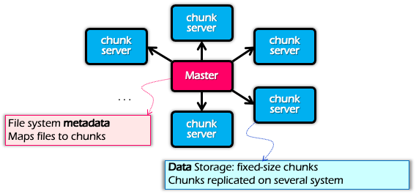
Optimization for Locality
Problem: the bandwidth of datacenter network (at that time) is scarce
  If a Map worker reads all the data from the network, it would be slow
Google: Input and Output files are stored on GFS
  Google File System (SOSP’03), see previous lectures
  Each chunk is replicated on multiple servers (3)
A review of GFS architecture

Slide 91
Refinement: redundant execution
Some workers can be slower than others, aka, stragglers
  Other jobs consuming resources on machine
  Bad disks with soft errors transfer data slowly
  Weird things: processor caches disabled ☹
Near end of phase, MapReduce spawn backup copies of tasks
  Whichever one finishes first “wins” ☺
  Dramatically shortens job completion time:“significantly reduces the time to complete large MapReduce operations ”(check the paper)

Slide 92
Restrictiveness of MapReduce Programming Model
MapReduce runtime is not optimized for multi-stage execution
  Persistent I/O (e.g., GFS)
. . .
Awk
sort
Time
Data
Data
Map
Reduce
Map
Reduce
Data
Data
Data
Map
Reduce
Map
Reduce
Startup Penalty
Disk Penalty
Startup Penalty
Disk Penalty
Data
Data
Map
Reduce
Data
Data
Data
Map
Reduce
Map
Reduce
Data

Slide 93
The computation graph abstraction
Computations are expressed as a graph (Directly acrylic graph)
  Vertices are computations (or data)
  Edges are communication channels
  Each vertex has several input and output edges
Outputs
Processing
Vertices
Channels
(file, pipe, memory)
Inputs

Slide 94
Scheduling in job manager
General scheduling rules
  Vertex can run anywhere once all its inputs are ready
    Prefer executing a vertex near its inputs (locality)
Fault tolerance
  Vertex fails → run it again, assuming that the program is idempotent
  Vertex’s inputs are gone → run upstream vertices again (recursively)
  Vertex is slow → run another copy elsewhere and use output from whichever finishes first
Notes:
Does not consider this

Slide 95
Case study: Distributed training

Slide 96
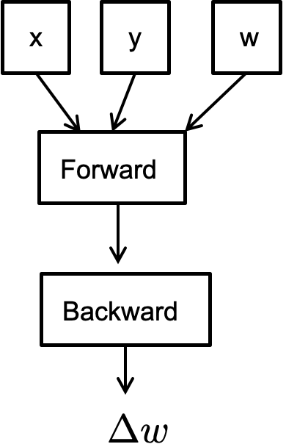
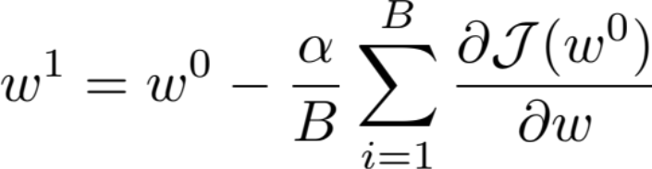
Pseudocode for Stochastic Gradient Descent
// execute on a master
for iter in num_iters:
iter
iter+1
iter
Problem: the graph cannot be parallelized across different nodes!

Slide 97
Review: Parallelization Opportunities
Data Parallelism: Distribute the processing of data to multiple PEs.
Model Parallelism: Break the model and distribute processing of every layer to multiple PEs
For either approach it is also possible to use synchronous or asynchronous updates

Slide 98

Synchronous Data Parallelism
Parallelize on the x (and y)
  Observation: the sum operator can be easily parallelized
X₀
Y₀
X₀
Y₀
w
X₁
Y₁
X₁
Y₁
x
y
w
w
Forward
Forward
Forward
Backward
Backward
Backward
0
1

Slide 99

Design goal: high GPU utilization (MFU)
Model FLOPs Utilization
Depends on several factors
  Whether the forward + backward can fully utilize the GPUs?
  Whether the data loader has a sufficient speed?
  Whether the gradients is fast enough?
0
Data loader
Forward + backward
1

Slide 100
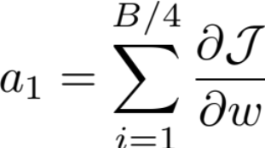
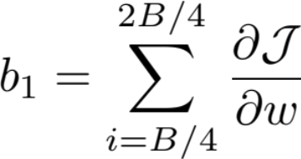
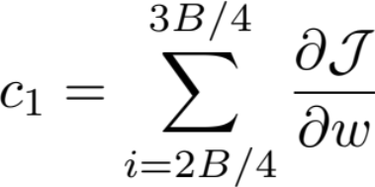
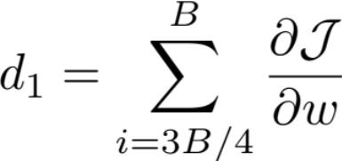
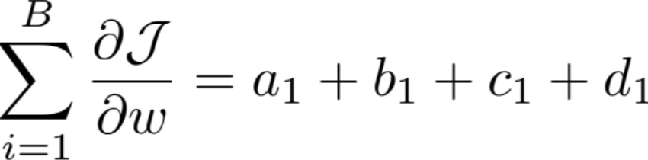
Key operator: allreduce
GPU 1
GPU 2
GPU 3
GPU 4
ALLREDUCE

Slide 101
Allreduce: put it all together
Trade-off between rounds vs. fan-in performance
  P: # processors/machines/GPUs participated in the computation
  N: the size of the data to be reduced
 | Round | Peak node bandwidth | Per-node fan-in
Parameter server (PS) | O(1) | O(N * P) | O(P)
Co-located & sharded PS | O(1) | O(N) | O(P)
Decentralized Allreduce | O(P) | O(N) | O(1)
Ring allreduce | O(2 * P) | O(N/P) | O(1)

Slide 102
Drawback of data parallelism: replicated model
Data parallelism assumes the model (parameters) are replicated on all the processes
  Such that they can do the forward & backward pass dependently
  What if the model cannot fit onto the device?
Current trends: models are becoming larger and larger
  No country (or company) can tolerate the risk of falling behind in the AI race

Slide 103
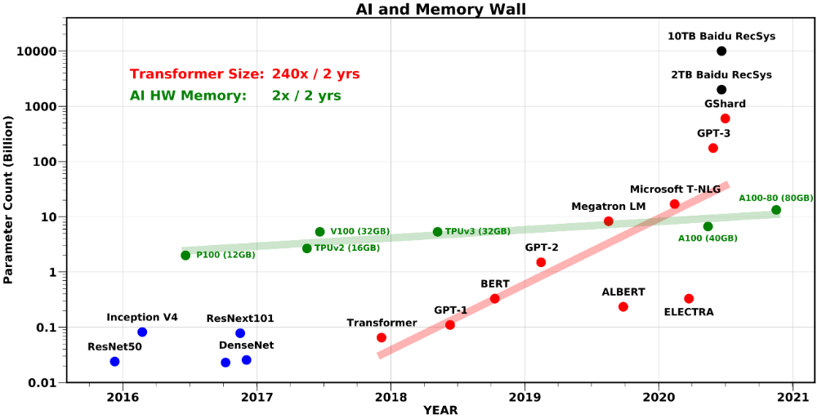
Trend: Training Large Models
Beyond single chip memory
Amir Gholami, Zhewei Yao, Sehoon Kim, Michael W. Mahoney, Kurt Keutzer, AI and Memory Wall, Riselab Medium Blogpost, 2021.

Slide 104

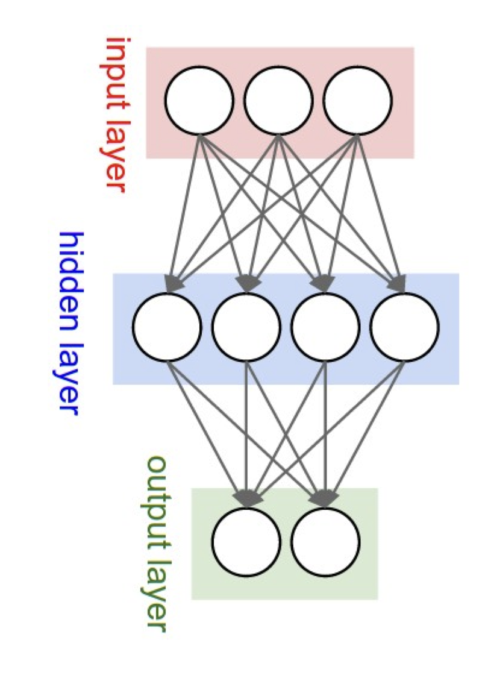
Pipeline parallelism
Partition the computation layer-by-layer, each partition is deployed on a device
  Note that different layers can be grouped together
  The strategy is out of the scope of this course
X
Y
w1
Layer #1
w2
Layer #2
The partitioned computation graph
The model

Slide 105
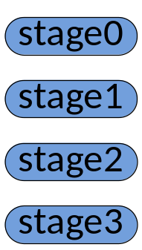

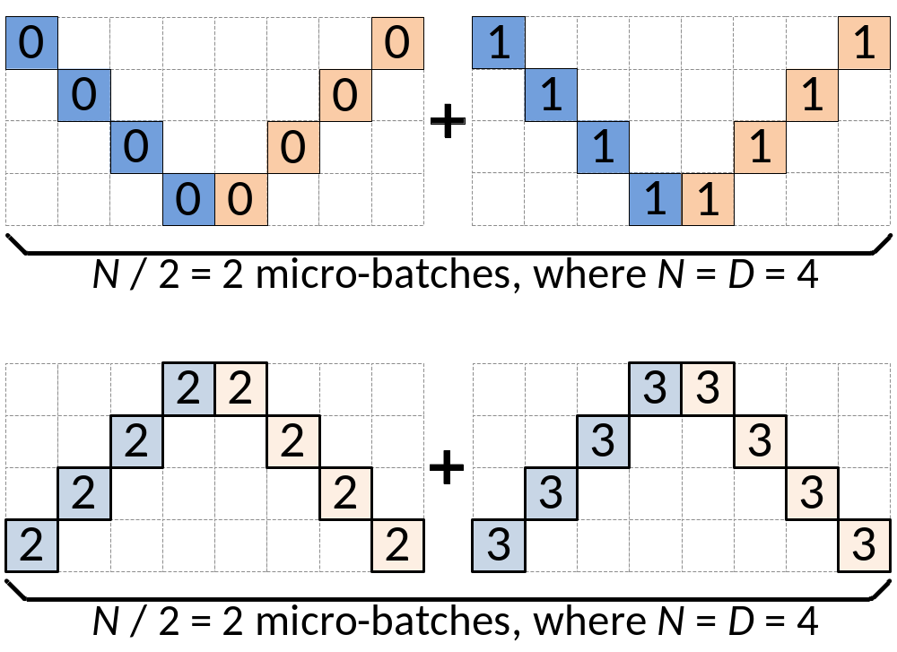






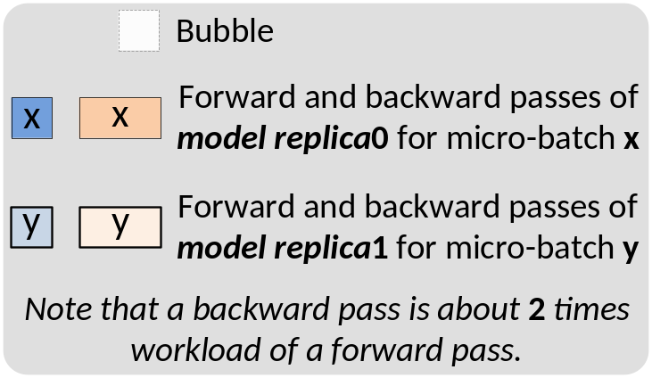
Pipeline parallelism
Bubble where processes are idle
Time
How to reduce bubble?

Slide 106

Technique: micro-batching
Reducing the bubble size by breaking the batch size into smaller pieces to reduce the idle time of the processes
  Reduces bubble size in an easy way to implement
Question: to what extent can micro-batching improves performance?
  The bubble size depends on the #partitions (p)
  The ratio bubble overhead depends on the overall pipeline numbers (m)
m
p

Slide 107

Pipeline parallelism & the number of micro-batch
Question: what is the bubble size ?
  p – 1 (p == #devices)
Question: what is the overhead?
  $tf$ : time of a forward of a micro-batch (m)
  $tb$ : time of a backward of a micro-batch (m)
  Ideal process time: $m ∗\left(tf+tb\right)$
  Wasted time of bubble: $\left(p −1\right)∗\left(tf+tb\right)$
  Bubble time fraction: $\frac{p −1}{m}$

Slide 108

Tensor parallelism
X
Y
w1
Partition the parameters of a layer
  Each partition is deployed on a separate GPU
Pros
  Support pipeline parallelism with a large layer
  Fit the hardware architecture of modern servers
Layer #1
w2
Layer #2

Slide 109

Model Parallelism (use matrix multiplication as an example): Forward Pass
d_{i}
B
B
P₀
P₀
P₁
P₀
P₀
P₁
d_{i}/P
d_{i}/P
*
d_{i}
P₁
P₁
W
X
Y^{local}
Y
Requires an all gather communication so that all processes get each others activation data
Suppose with a simple forward, each node needs to send $(P −1) × \frac{di × B}{P }$ ~= $di × B$
Notes:
\begin{align*}
\sum_{i=1}^{L} \beta (P-1) \frac{Bd_i}{P}\right)
\end{align*}
\begin{align*}
T_{{comm}}({domain}) = &\sum_{i=1}^{L}\left(\alpha {\log(P)}+ \beta \frac{P-1}{P} Bd_i\right)\\
+2&\sum_{i=2}^{L}\left(\alpha {\log(P)}+ \beta \frac{P-1}{P} d_{i-1}\right)
\end{align*}

Slide 110
The cost of model parallelism
Networking cost during model parallelism
The network communication time
0
0

Slide 111


Analysis of the network cost of model parallelism
Pipeline parallelism
One layer (deployed on 2 GPUs w/ Tensor parallelism)
One layer (deployed on 2 GPUs w/ Tensor parallelism)
  See: Attention is all you need

Slide 112

Analysis of the network cost of model parallelism
Pipeline parallelism
Z
One layer (deployed on 2 GPUs w/ Tensor parallelism)
One layer (deployed on 2 GPUs w/ Tensor parallelism)
Tensor parallelism cost:
Forward ~= $2×di × B$
Backward ~= $4× di × B$
Note that the actual cost is much higher because we need to consider other blocks like attention (model-specific details are out of the scope of this lecture), and possible multiple layers per pipeline stage

Slide 113

Analysis of the network cost of model parallelism
Pipeline parallelism
Z
One layer (deployed on 2 GPUs w/ Tensor parallelism)
One layer (deployed on 2 GPUs w/ Tensor parallelism)
Pipeline parallelism cost:
Forward ~= $di × B$
Backward ~= $di × B$

Slide 114
Review: Communication heterogeneity
Different nodes’ link capacity differs
  Internode: high bandwidth (e.g., 450GBps)
  Intranode: relative slow bandwidth (e.g., 100GBps)
Optimization opportunities
  We can do a parameter server within a server, and do rings across servers
Server
A layer with TP
GPU 0
GPU 2
GPU 0
GPU 2
NVLink
RDMA
NVLink
GPU 1
GPU 3
GPU 1
GPU 3

Slide 115
Review: Communication heterogeneity
Different nodes’ link capacity differs
  Internode: high bandwidth (e.g., 450GBps)
  Intranode: relative slow bandwidth (e.g., 100GBps)
Optimization opportunities
  We can do a parameter server within a server, and do rings across servers
Server
A layer with TP
A layer with TP
GPU 0
GPU 2
PP
GPU 0
GPU 2
NVLink
RDMA
NVLink
GPU 1
GPU 3
GPU 1
GPU 3

Slide 116

Put it altogether: parallelize distributed training

Slide 117
What do we learn?
Batch processing
Networking
Database
ChatAPP
Distributed training
…
Key-value store
Communication
channel

Slide 118


系统～= AI时代的铲子
Happy building systems!
Credits: ChatGPT
Notes:
https://wallstreetcn.com/articles/3687254

