Slide 1

Language Virtual Machines
Mingyu Wu

Slide 2
Introduction
-- Why do we need a language virtual machine?

Slide 3
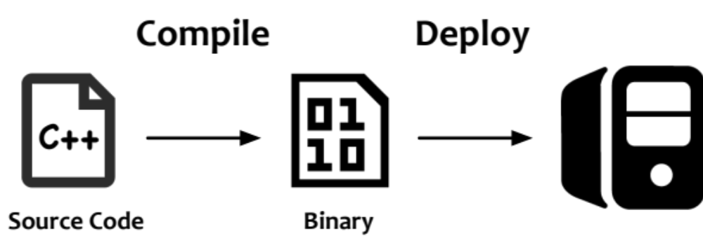
Workflow for Native Languages

Slide 4
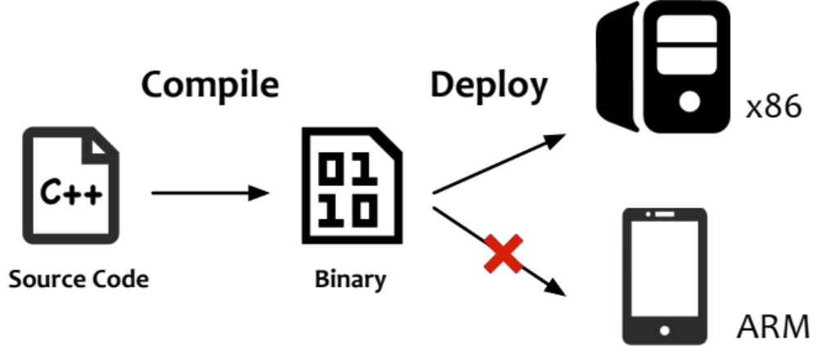
Problem: Multiple ISAs

Slide 5
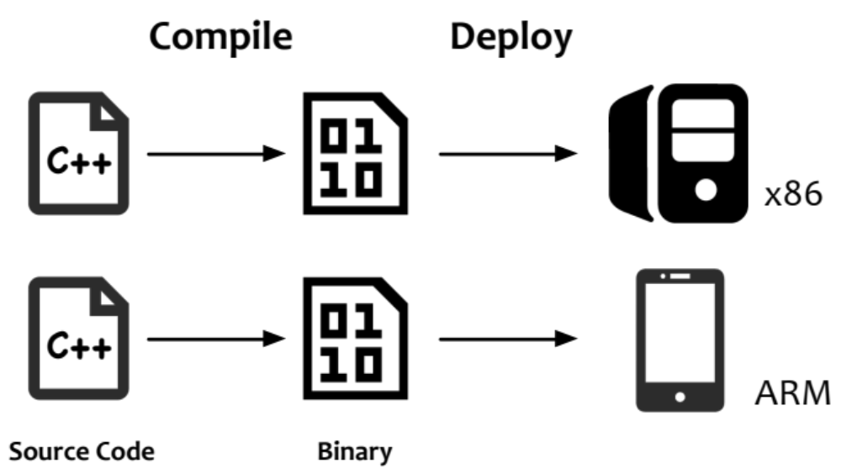
Solution: “One for Each”

Slide 6
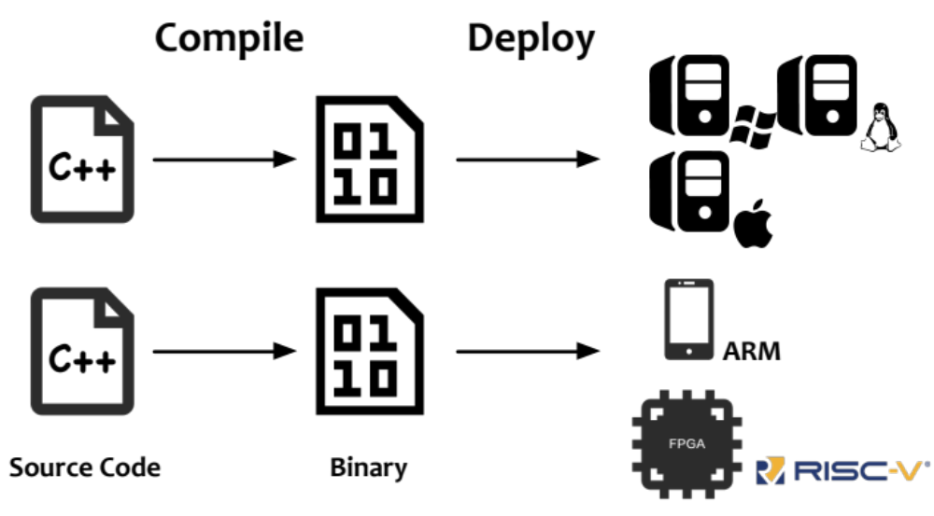
However…
The deployment environment is complicated!

Slide 7
Another Consideration: Security
Out-of-bound access
Use-after-free
char * chs = malloc(10);
Char ch = chs[10]; // oops!
free(chs);
Char ch = chs[5]; // oops!

Slide 8
“All problems in computer science can be solved by another level of indirection”
David Wheeler
University of Cambridge

Slide 9
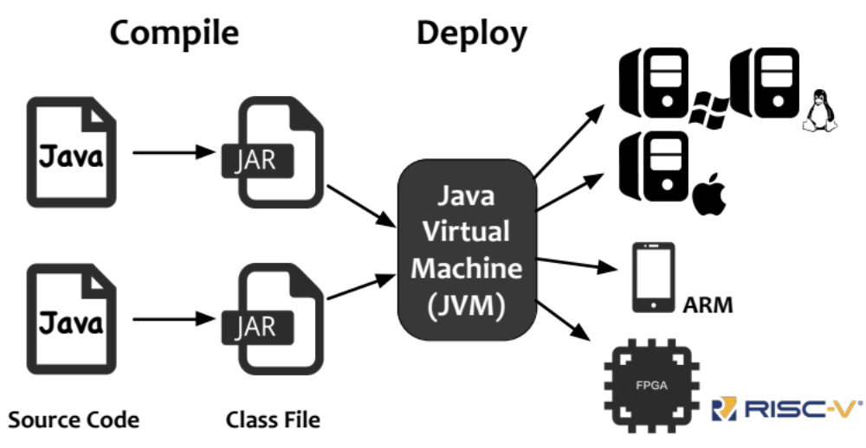
JVM: The "Indirection"

Slide 10
JVM: The "Indirection"
a.b = c;
astore_0
movq %rbx, 0xc(%rax)

Slide 11
Security Enhancement
Out-of-bound access ← runtime check
Use-after-free ← no free at all!
char * chs = malloc(10);
Char ch = chs[10]; // ArrayOutOfBoundException
free(chs);
Char ch = chs[5]; // No problem!

Slide 12
An Introduction to JVM: Outline
Code Execution
  Interpreter
  JIT compiler
Memory management
  Heap layout
  Basic GC algorithms
  Modern garbage collectors

Slide 13
Execution
-- Interpreter & compiler

Slide 14
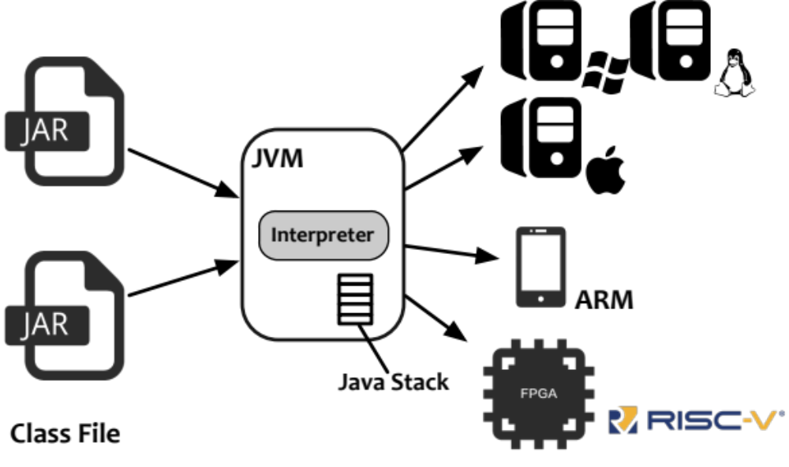
Execution Mode: Interpretation
JVM has a interpreter to execute those class files with a stack

Slide 15
Stack-based Interpretation
All instructions (bytecode) are operated on the stack
Java source code
Bytecode stream
Java stack
bipush 42
bipush 7
iadd
…
.
.
.
int z = 42 + 7;
…
top

Slide 16
Stack-based Interpretation
All instructions (bytecode) are operated on the stack
Java source code
Bytecode stream
Java stack
bipush 42
bipush 7
iadd
…
.
.
.
int z = 42 + 7;
…
42
top

Slide 17
Stack-based Interpretation
All instructions (bytecode) are operated on the stack
Java source code
Bytecode stream
Java stack
bipush 42
bipush 7
iadd
…
.
.
.
int z = 42 + 7;
…
42
7
top

Slide 18
Stack-based Interpretation
All instructions (bytecode) are operated on the stack
Java source code
Bytecode stream
Java stack
bipush 42
bipush 7
iadd
…
.
.
.
int z = 42 + 7;
…
top
42
add -> 49
7

Slide 19
Stack-based Interpretation
All instructions (bytecode) are operated on the stack
Java source code
Bytecode stream
Java stack
bipush 42
bipush 7
iadd
…
.
.
.
int z = 42 + 7;
…
49
top

Slide 20
Stack-based Interpretation
All instructions (bytecode) are operated on the stack
Other languages (like Python) have similar design
Java source code
Bytecode stream
Java stack
bipush 42
bipush 7
iadd
…
.
.
.
int z = 42 + 7;
…
49
top

Slide 21
Problem: Efficiency
Too many memory operations (>=1 per bytecode)
  Low utilization of registers
Missing optimization opportunities
mov $42, %rax
push $rax
bipush 42
bipush 7
iadd
…
mov $7, %rax
push $rax
pop %rax
pop $rbx
add $rax, $rbx
push $rbx

Slide 22
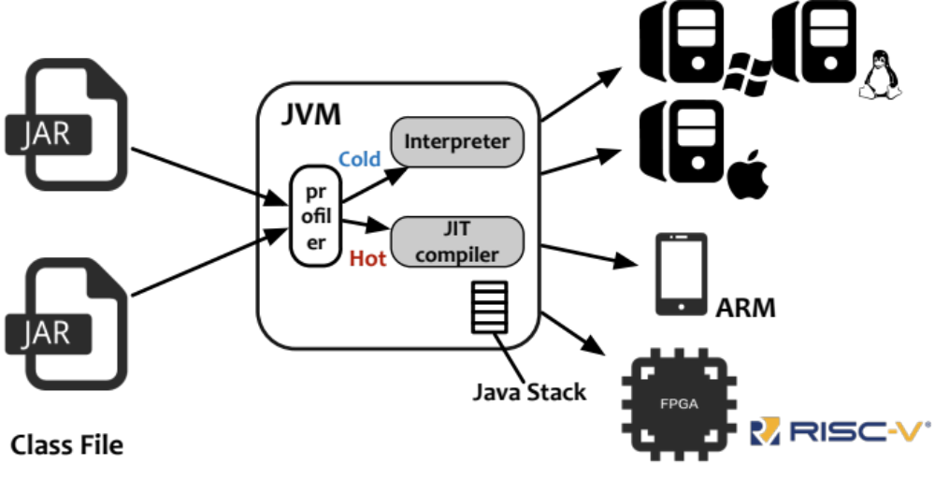
Solution: JIT (Just-In-Time) Compiler
Hot code will be compiled and executed
  "Hot" means that it has been executed for times

Slide 23
JIT: Aggressive Or Conservative?
An example: inlining
Method A
Method B
Method C
…
invokevirtual B
…
…
invokevirtual C
…
…
…

Slide 24
JIT: Aggressive Or Conservative?
An example: inlining
Choice 1: only compile A
Method A
(Compiled)
Method B
Method C
native code…
call B
native code…
…
invokevirtual C
…
…
…

Slide 25
JIT: Aggressive Or Conservative?
An example: inlining
Choice 2: inline B
Method A/B
(Compiled)
Method C
native code A…
native code B…
call C
native code B…
native code A…
…
…
More code!

Slide 26
JIT: Aggressive Or Conservative?
An example: inlining
Choice 3: inline all
Method A/B/C
(Compiled)
native code A…
native code B…
native code C…
native code B…
native code A…
More more code!

Slide 27
JIT: Aggressive Or Conservative?
What about polymorphism?
  More choices!
Method A
Method B1
Method C
…
invokevirtual B
…
…
invokevirtual C
…
…
…
Method B2
Method D
…
invokevirtual D
…
…
…

Slide 28
JIT: Aggressive Or Conservative?
Choice 1: compile A only
  Suitable for all cases where all methods are hot
Method A
(Compiled)
Method B1
Method C
native code…
call_dispatch B
native code…
…
invokevirtual C
…
…
…
Method B2
Method D
…
invokevirtual D
…
…
…

Slide 29
JIT: Aggressive Or Conservative?
Choice 2: compile only for one path
  Suitable for cases where only one path is hot
Method A/B1/C
(Compiled)
native code A…
If not B1 call slowpath
native code B1…
call C
native code C…
native code B1…
native code A…
Slow path
Method D
…
call D
…
…
…

Slide 30
JIT: Aggressive Or Conservative?
The real call graph can be very complex…

Slide 31
JIT: Aggressive Or Conservative?
The real call graph can be very complex…

Slide 32
JIT: Aggressive Or Conservative?
Summary: A tradeoff between code efficiency and runtime overhead
Worse code efficiency
Fewer compilation tasks
More slow paths
Less memory consumption
Better code efficiency
More compilation tasks
Less slow paths
More memory consumption
Conservative
Aggressive

Slide 33
Memory management
-- aka garbage collection

Slide 34
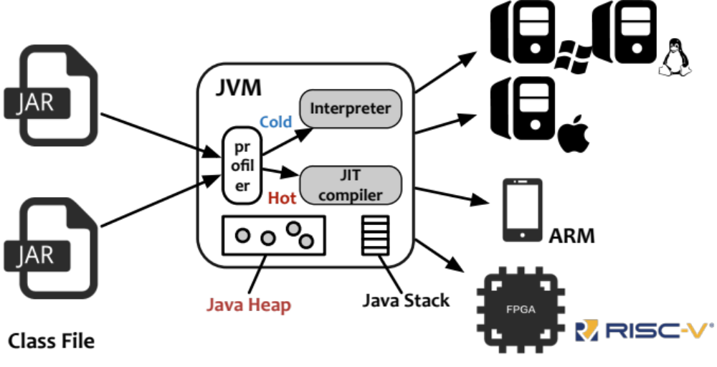
Where is data?
Java objects are organized in Java Heap

Slide 35
"Free"-free Memory Management
No free() is required in Java
  Only allocation (new) is required
JVM reclaims unused memory by garbage collection (GC)

Slide 36
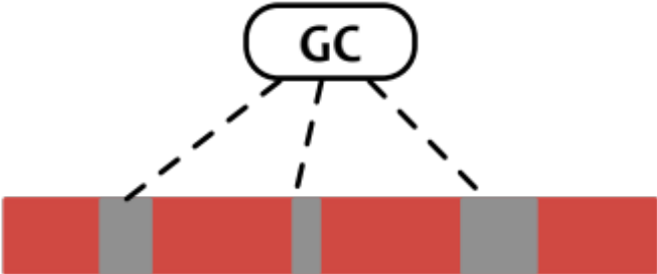
"Free"-free Memory Management
No free() is required in Java
  Only allocation (new) is required
JVM reclaims unused memory by garbage collection (GC)
  Recognize live/dead objects

Slide 37

"Free"-free Memory Management
No free() is required in Java
  Only allocation (new) is required
JVM reclaims unused memory by garbage collection (GC)
  Recognize live/dead objects
  Manage heap space

Slide 38

Heap Layout 1: Free List
Common and Straightforward
Not welcomed in Java

Slide 39

Heap Layout 1: Free List
Common and Straightforward
Not welcomed in Java
  Fragmentations

Slide 40
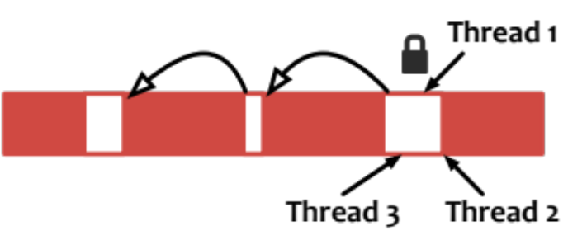
Heap Layout 1: Free List
Common and Straightforward
Not welcomed in Java
  Fragmentations
  Multi-threaded contention

Slide 41
Heap Layout 1: Free List
Common and Straightforward
Not welcomed in Java
  Fragmentations
  Multi-threaded contention
Java prefers fast allocation!

Slide 42

Heap Layout 2: Contiguous Space
Free space is always contiguous
  A bump pointer to mark how much has been used
  Allocation: Lock-free atomic instructions (CAS)

Slide 43

Heap Layout 2: Contiguous Space
Free space is always contiguous
  A bump pointer to mark how much has been used
  Fast allocation: Lock-free atomic instructions (CAS)
GC is responsible for compacting live objects
GC

Slide 44
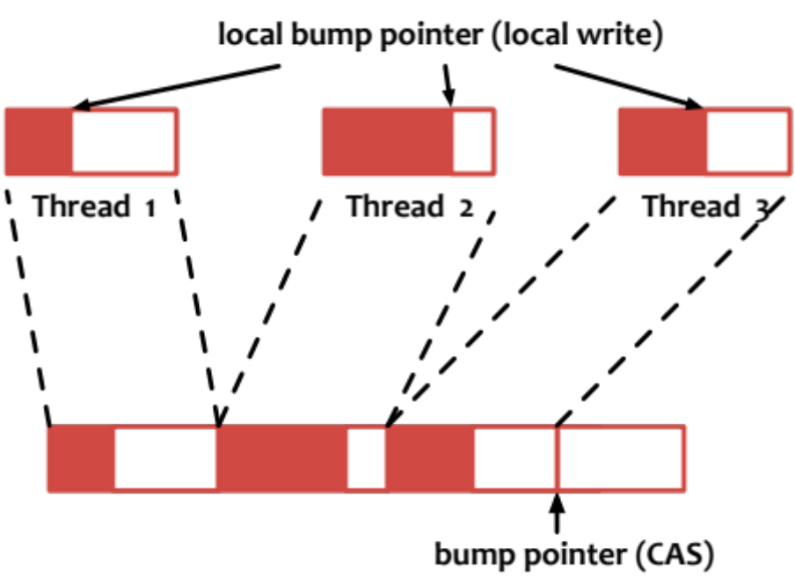
Heap Layout 2: Contiguous Space
Even faster allocation: local heap
  Allocate a large portion with CAS
  Then allocate locally

Slide 45
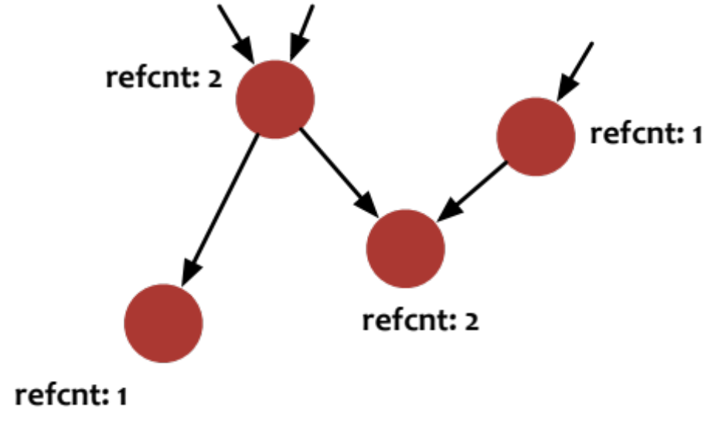
GC Algorithm 1: Reference Counting
Counting the in-references for each objects

Slide 46
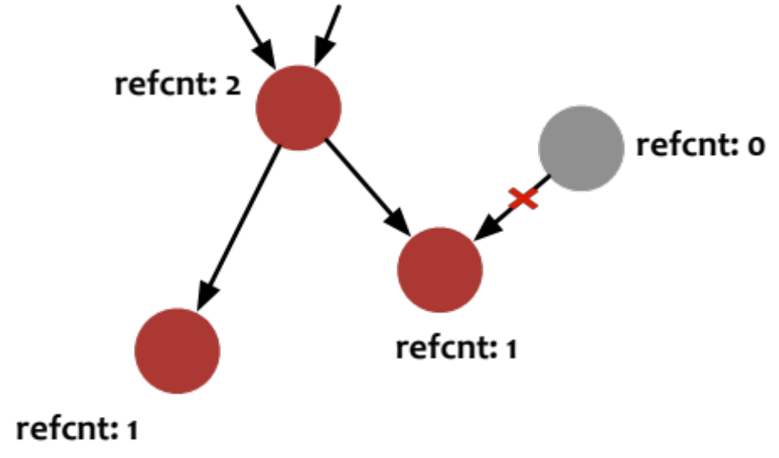
GC Algorithm 1: Reference Counting
Counting the in-references for each objects
  Immediate reclamation: reclaim when refcnt is 0
  Used by some prototype systems (NVHeap, ASPLOS11)

Slide 47
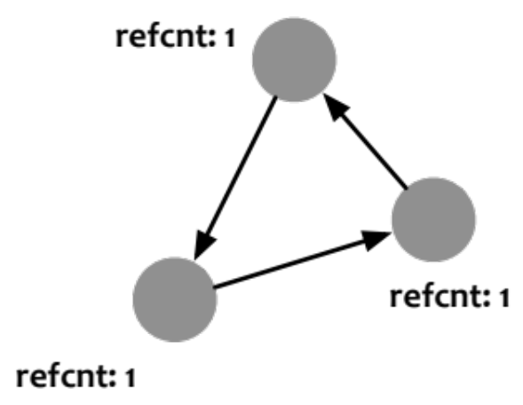
GC Algorithm 1: Reference Counting
However, still no welcomed in Java
  Performance: 30%+ worse than others (Shahriyar, OOPSLA13)
  Tightly integrated with free lists
  Failing to resolve cycles
Collector: all objects are alive!

Slide 48
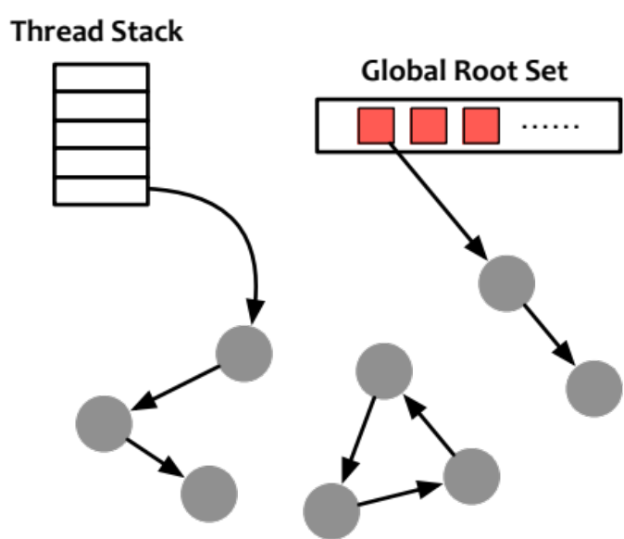
GC Algorithm 2: Tracing
Identifying live objects by traversing object graphs
  The start points are called "roots"

Slide 49
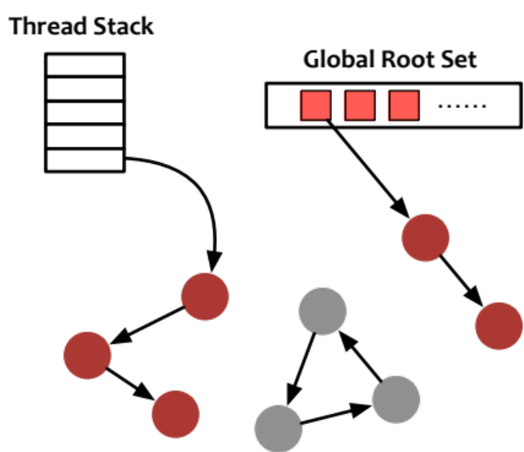
GC Algorithm 2: Tracing
Identifying live objects by traversing object graphs
  The start points are called "roots"

Slide 50
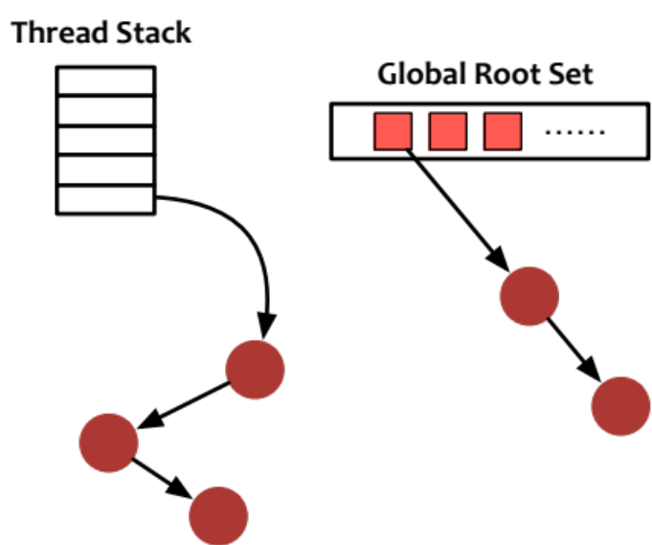
GC Algorithm 2: Tracing
Identifying live objects by traversing object graphs
  The start points are called "roots”
  Solve the cycle problem

Slide 51
Tracing GC is Popular
Can be integrated with different layout
  Free-list: Mark-Sweep (Boehm GC)
  Contiguous: Mark-Copy (PS, G1, Shenandoah…)

Slide 52
Case Study: PS
Design goal: high GC throughput
  Stop-the-world: Java threads must be paused during GC
  Task-based parallelism: dividing collections into tasks
Also consider latency
  Generational

Slide 53
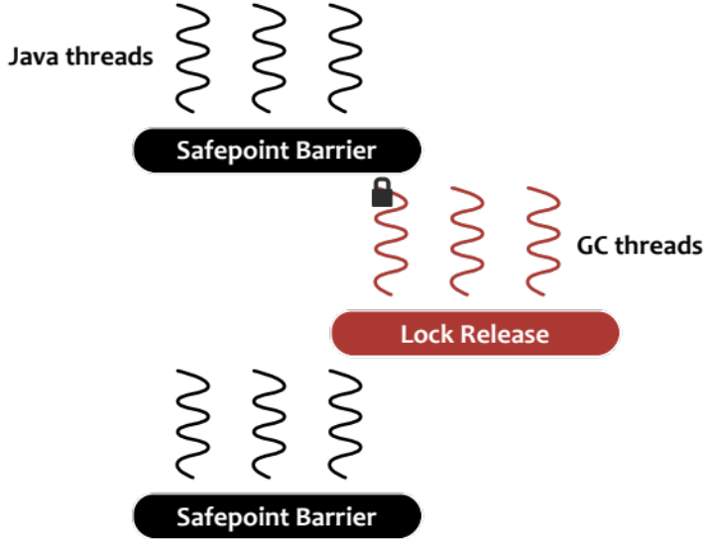
Stop-The-World
JVM leverages safepoint to pause all Java threads
  Java threads queue up for a lock held by GC threads

Slide 54
Stop-The-World
JVM leverages safepoint to pause all Java threads
  Java threads queue up for a lock held by GC threads
Aiming at high GC throughput
  CPU monopolized by GC threads
  No coordination between GC and Java threads

Slide 55
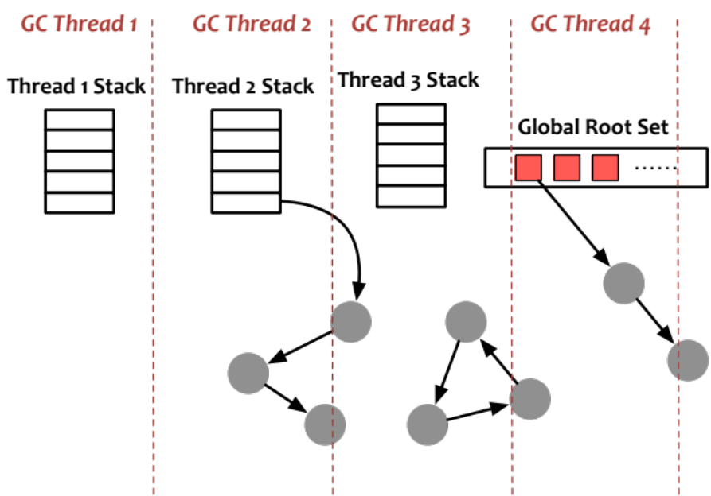
Task-based Parallelism
Dividing roots into different tasks
  Each GC threads can work independently

Slide 56
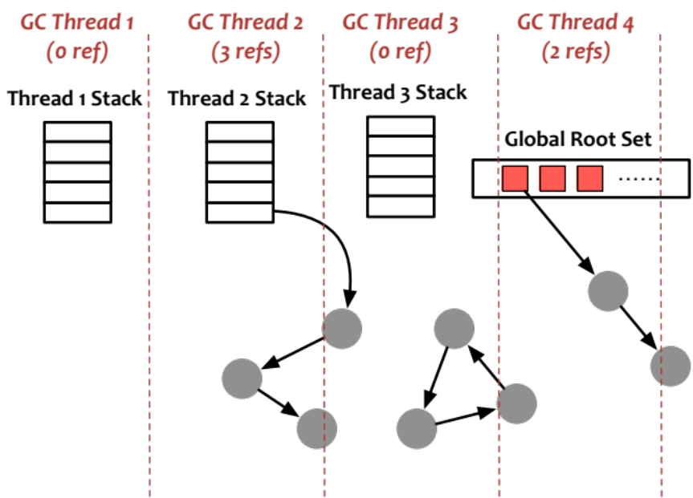
Task-based Parallelism
Dividing roots into different tasks
  Each GC threads can work independently
Problem: Load-imbalance
  Workload in graph is hard to predict

Slide 57
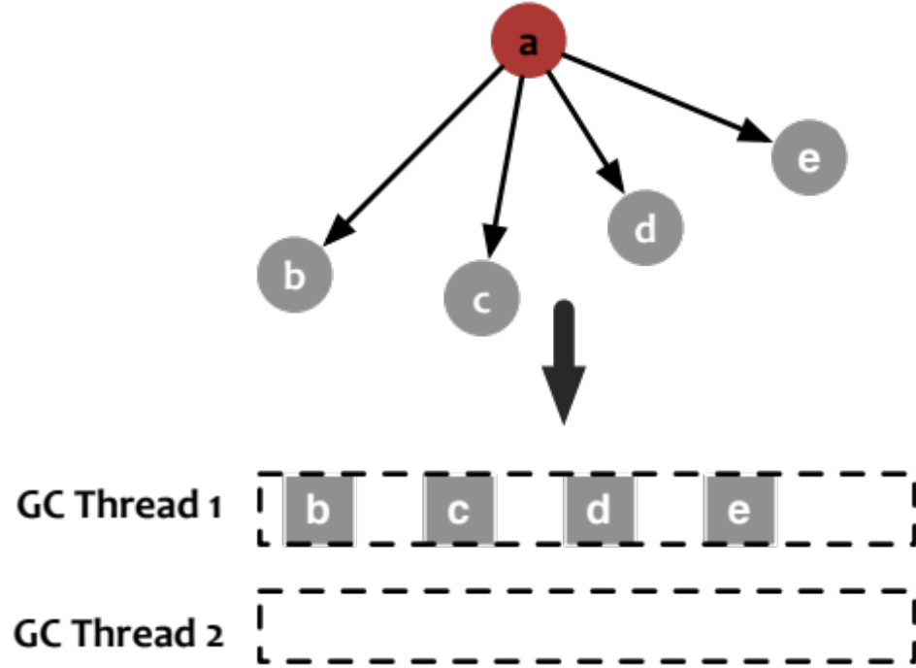
Task-based Parallelism
Solution: work-stealing (finer-grained tasks)
  Abstracting references into tasks

Slide 58
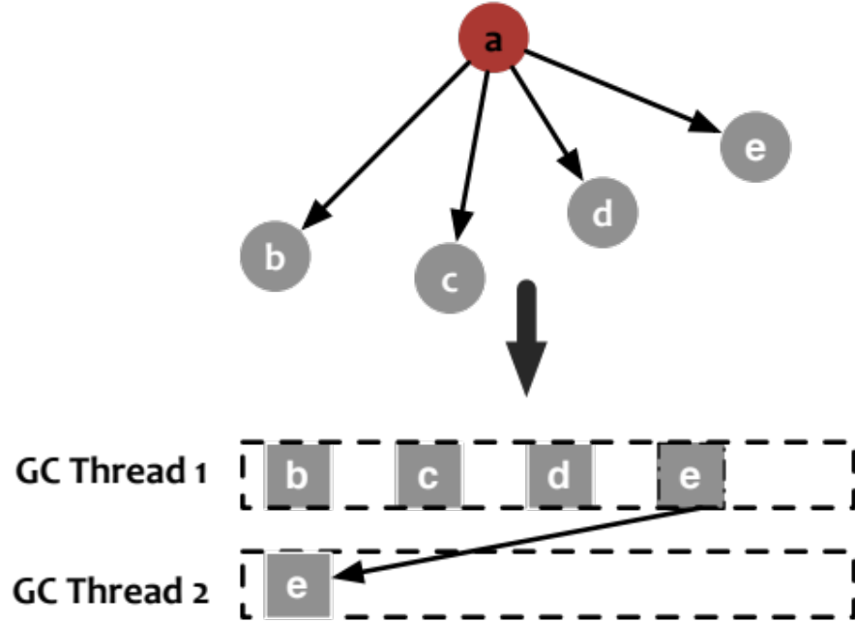
Task-based Parallelism
Solution: work-stealing (finer-grained tasks)
  Abstracting references into tasks
  Allow task stealing between threads

Slide 59
Latency Consideration
GC is usually triggered when memory is exhausted
  Pause time is proportional with live object size
  400MB live object size -> 100 ms pause
  Not scalable: what about 10GB?

Slide 60
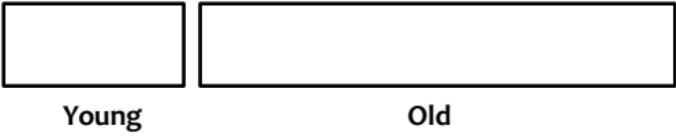
Solution: Generational GC
Dividing Java heap into multiple spaces
  In PS it has two spaces: young and old
  The size of young gen can be small and fixed

Slide 61
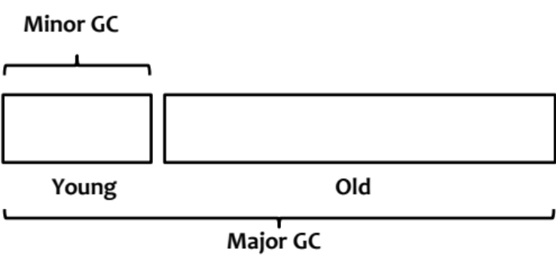
Solution: Generational GC
Dividing Java heap into multiple spaces
  In PS it has two spaces: young and old
  The size of young gen can be small and fixed
GC is also two-fold
  Minor GC: only collecting young-space (fast and frequent)
  Major GC: collecting both spaces (slow but infrequent)

Slide 62
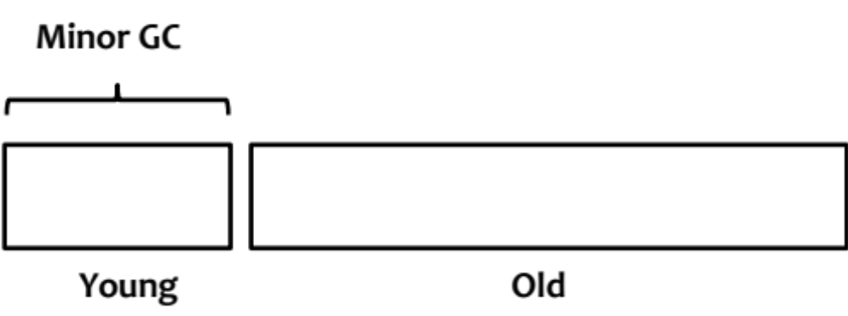
Minor GC: Collecting Young Only
Based on "generational hypothesis"
  Most objects have short life spans
  Collecting young-space is efficient for memory reclamation
  What if the hypothesis does not hold? (Yak, OSDI16)

Slide 63
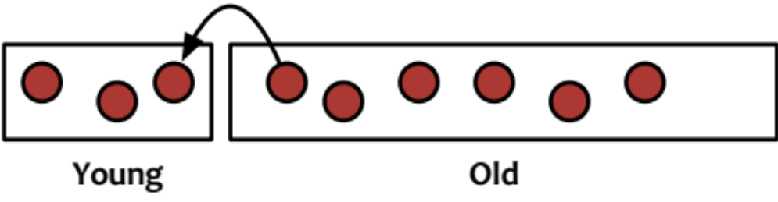
Problem: Cross-Space References
References can point from old-space to young-space
  They should be treated as roots during minor GC
How to identify cross-space references?
  Scanning the whole old space: why do we need a minor GC?
  Remembering all references: large overhead

Slide 64
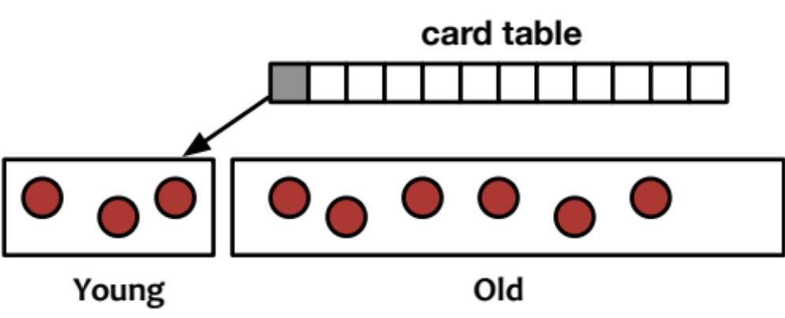
Solution: Card Table
Dividing old-space into many regions
  Using 1 bit (card) in a table for each region
When a cross-space write happens, dirty the card
  Scanning dirty cards only during minor GC

Slide 65
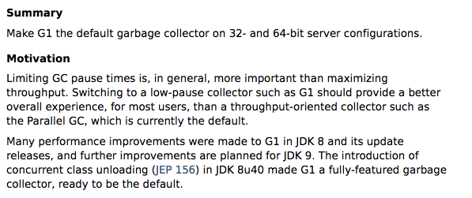
Case Study: G1

Slide 66
Design Highlight of G1
Controllable GC pauses
  Soft limits
  Region-based heap layout
  Mixed GC
(Partially) concurrent execution
  Concurrent marking

Slide 67
Controlling GC Pauses: Soft Limit
G1 allows applications to set a maximum GC pause time
  e.g. –XX:MaxGCPauseMillis=50
G1 will adjust the heap layout to meet the limit
  The layout must be adjustable and flexible
  Two spaces are not enough!

Slide 68
Controlling GC Pauses: Soft Limit
G1 allows applications to set a maximum GC pause time
  e.g. –XX:MaxGCPauseMillis=50
G1 will adjust the heap layout to meet the limit
  The layout must be adjustable and flexible
  Two spaces are not enough!

Slide 69
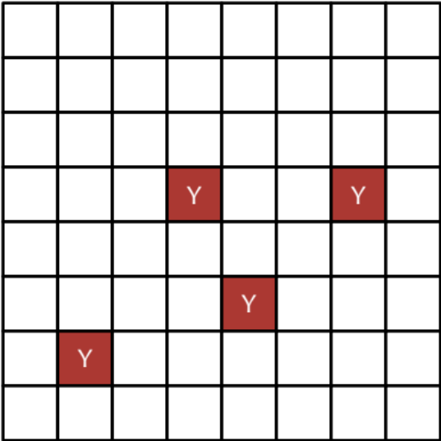
Region-based Heap Layout
Dividing the whole heap space into many regions
  Young-space now can be segregated

Slide 70
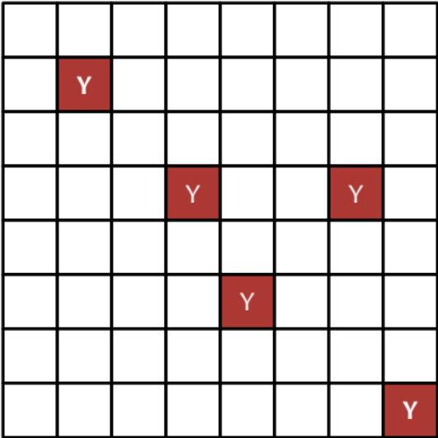
Region-based Heap Layout
Dividing the whole heap space into many regions
  Young-space now can be segregated
  Easy to enlarge/shrink

Slide 71
Region-based Heap Layout
Dividing the whole heap space into many regions
  Young-space now can be segregated
  Easy to enlarge/shrink
  Also designed for mixed GC

Slide 72
Mixed GC: Meeting the Soft Limit
Prior GC (like PSGC) only has two inflexible GC algorithms
  Minor GC pause: too short
  Major GC pause: too long
Minor GC (10 ms)
Soft Limit (50 ms)
Major GC (200 ms)

Slide 73
Mixed GC: Meeting the Soft Limit
Prior GC (like PSGC) only has two inflexible GC algorithms
  Minor GC pause: too short
  Major GC pause: too long
Solution: collect young-space and part of old-space
Mixed GC
Minor GC (10 ms)
Soft Limit (50 ms)
Major GC (200 ms)

Slide 74

Mixed GC: Collection Set (CSet)
Mixed GC should construct a CSet to reach a close-to-soft-limit GC pause
  Including all young regions

Slide 75
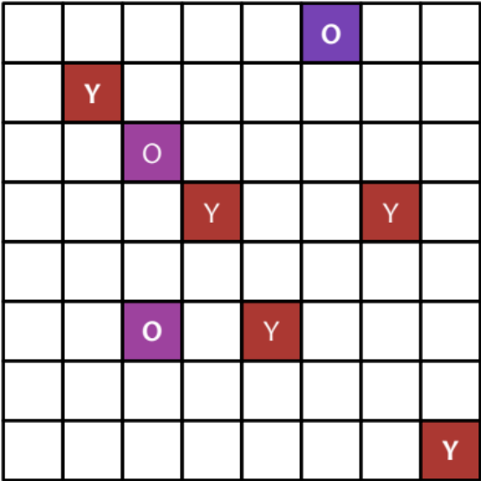
Mixed GC: Collection Set (CSet)
Mixed GC should construct a CSet to reach a close-to-soft-limit GC pause
  Including all young regions
  Adding old regions and estimating
  the GC pause
  Until the estimated pause time
  reaching the soft limit
10ms to collect
20ms
to collect
15 ms
to collect

Slide 76
Mixed GC: Collection Set (CSet)
Mixed GC should construct a CSet to reach a close-to-soft-limit GC pause
  Including all young regions
  Adding old regions and estimating
  the GC pause
  Until the estimated pause time
  reaching the soft limit
10ms to collect
20ms
to collect
15 ms
to collect
Problem: which regions to collect?

Slide 77
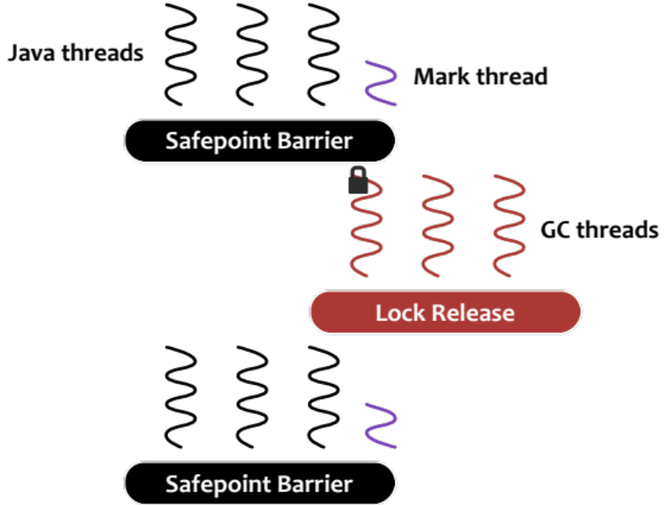
Concurrent Marking
Before STW collection, mark live objects concurrently
Handling concurrent update
  Java threads will write update into logs
  Marking threads will consume
  the logs periodically

Slide 78

Live Data Profiling
After concurrent marking, count per-region live object size
  Choose regions with the least live object for collection
live data: 0%
live data: 2%
live data: 3%

Slide 79
Live Data Profiling
After concurrent marking, count per-region live object size
  Choose regions with the least live object for collection
live data: 0%
live data: 2%
live data: 3%
Think about the name: “Garbage First”

Slide 80
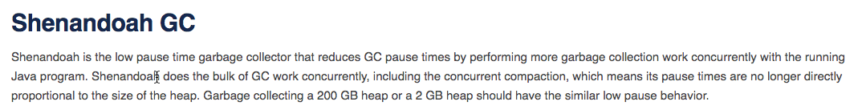
Case Study: Shenandoah
A ultra-low pause time GC regardless of heap size

Slide 81
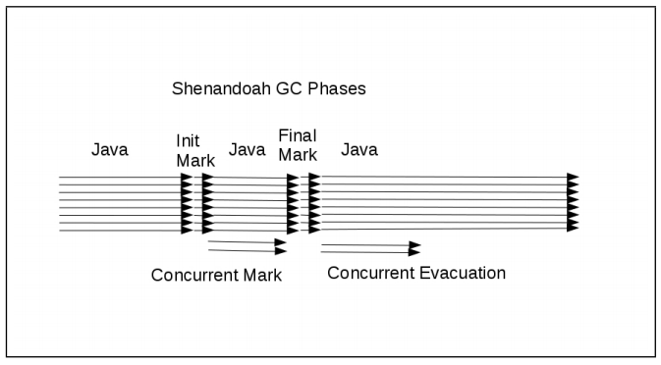
Workflow of Shenandoah
Only init/final mark require pauses

Slide 82
Design Highlight of Shenandoah
Concurrent collection
  Indirect references
Lazy reference update
  Piggy-backed with concurrent marking

Slide 83
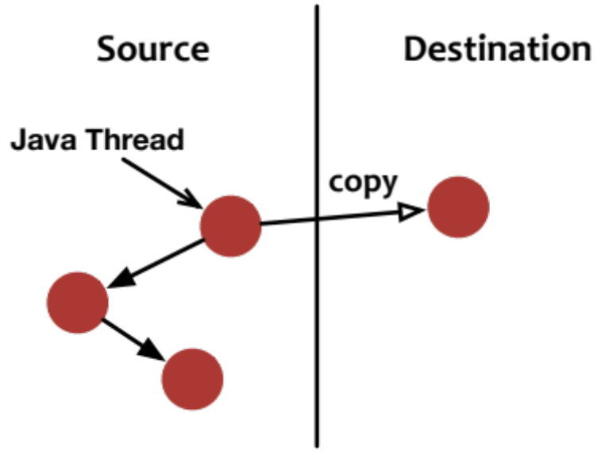
Concurrent Collection
GC threads will generate a new copy of objects
  Two copies will co-exist

Slide 84
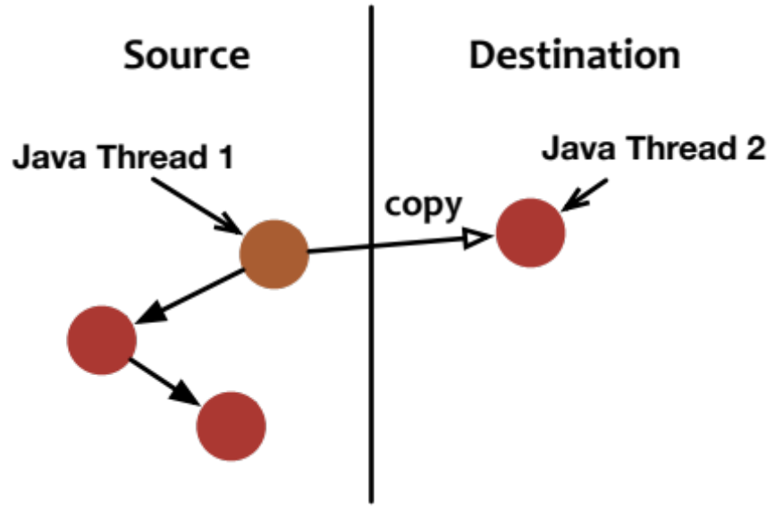
Concurrent Collection
GC threads will generate a new copy of objects
  Two copies will co-exist
Direct update would cause
problems
  Updates may not be observed

Slide 85
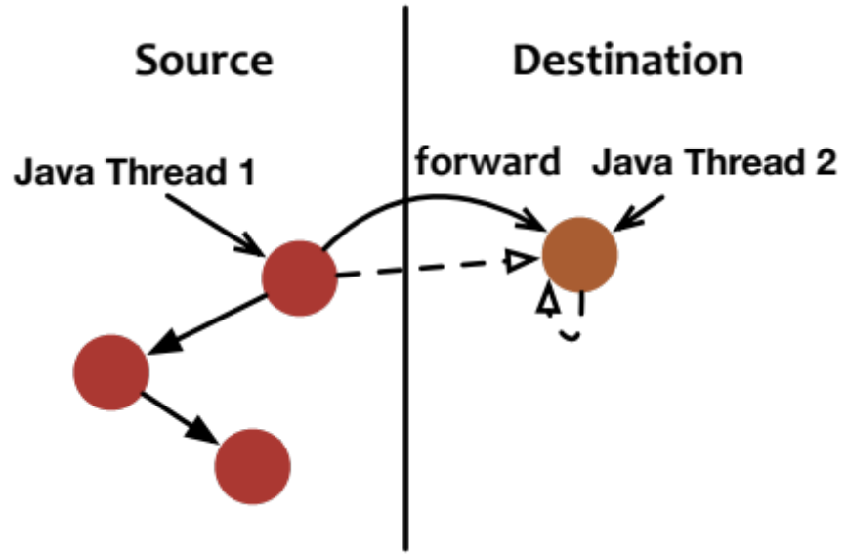
Concurrent Collection
Solution: Indirect pointer
  Always point to the newest version
  All read/writes will be forwarded to the newest one

Slide 86
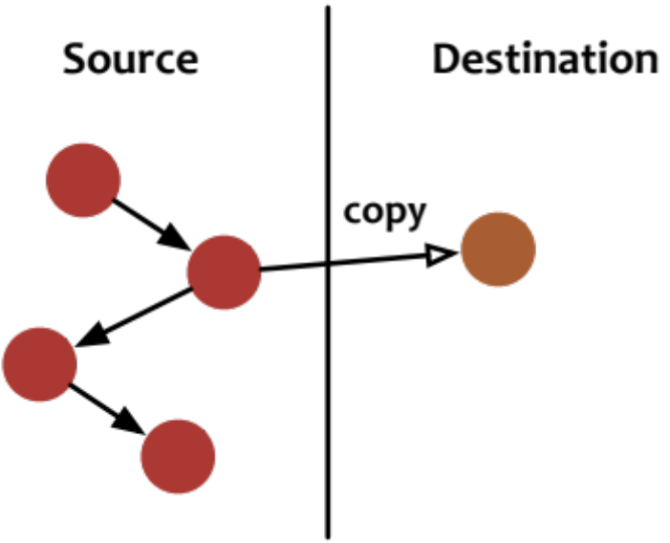
In-Reference Updates
Only part of heap space will be scanned and copied (similar to G1)

Slide 87
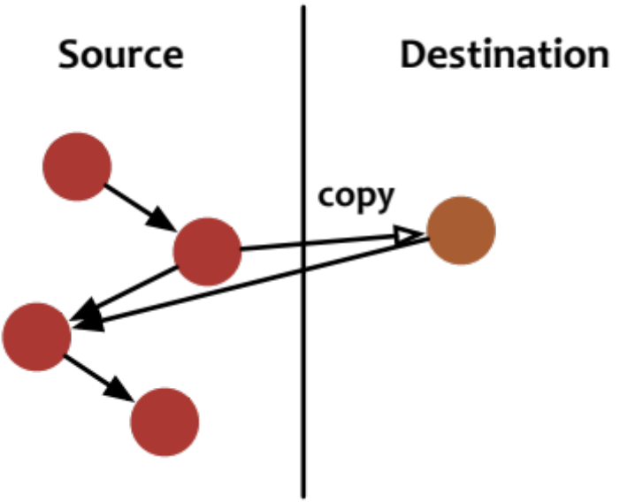
In-Reference Updates
Only part of heap space will be scanned and copied (similar to G1)
Only out-references will be updated

Slide 88
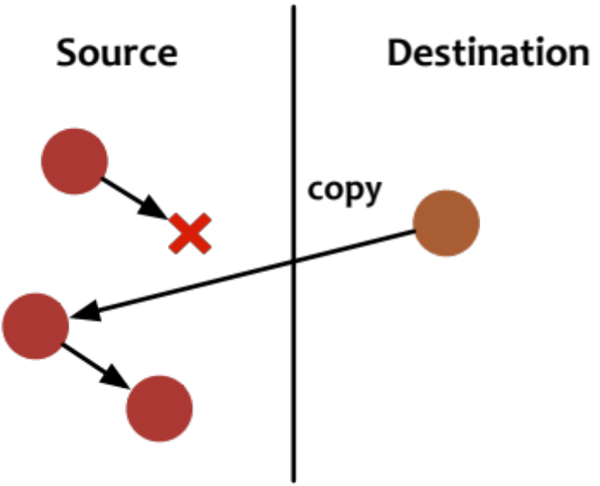
In-Reference Updates
Only part of heap space will be scanned and copied (similar to G1)
Only out-references will be updated
in-references may cause dangling pointers

Slide 89
In-Reference Updates
Design 1: Stop-The-World update
  Large pause time (violating the goal of Shenandoah)
Design 2: piggy-backed with next marking phase
  Concurrent marking will scan the whole heap (similar to G1)

Slide 90
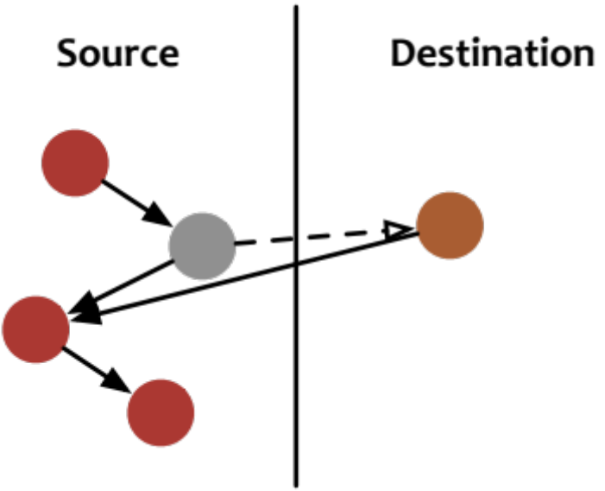
Lazy Reference Updates
Keeping a dummy object after collection
  Still using the indirect pointer

Slide 91
Lazy Reference Updates
Keeping a dummy object after collection
  Still using the indirect pointer
Correct references during marking

Slide 92
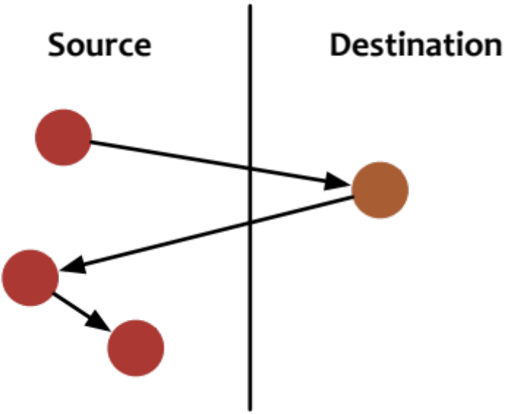
Lazy Reference Updates
Keeping a dummy object after collection
  Still using the indirect pointer
Correct references during marking
  Now the object can be reclaimed

Slide 93
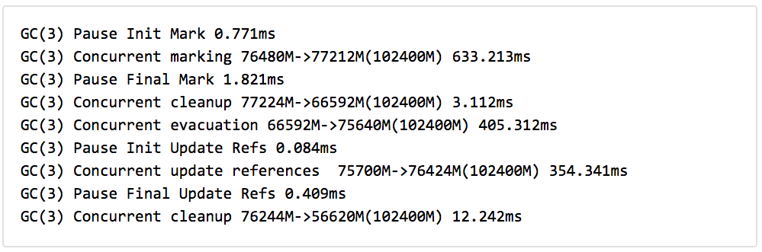
Results of Shenandoah
The pauses are really short!

Slide 94
Results of Shenandoah
But the concurrent execution time is long

Slide 95
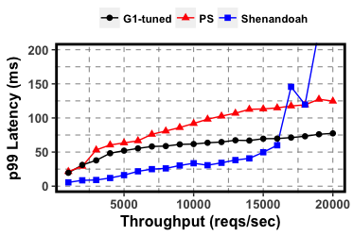
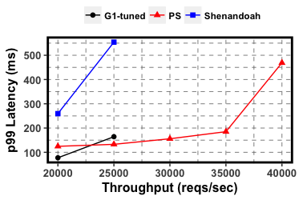
Comparison Among Modern GCs
SpecJBB2015 (online supermarket)
  80 cores, 16GB heap
Low Throughput
High Throughput

Slide 96
Summary: Throughput vs. Latency
Better GC Throughput
PSGC: Stop-The-World
  Throughput-oriented
  Large GC pauses
G1GC: adjustable & partially-concurrent
  Concurrent marking
  Controllable GC pauses
Shenandoah: mostly-concurrent
  Concurrent collection
  Ultra-low GC pauses
  Hurting application throughput
PS
G1
Shenandoah
Better User Latency

Slide 97
Other Topics on JVM
Communication
  Reducing data transfer overhead (Skyway, ASPLOS18)
Multi-JVMs
  Coordination policies on GC (Taurus, ASPLOS16)
  Elastic Java heap (ElasticMem, ATC17)
Non-volatile Memory
  Native support (Espresso, ASPLOS18)
  Automatic persistence (AutoPersist, PLDI19)

Slide 98

Conclusion
Language virtual machines: an "indirection" for portability and safety
Introduction to JVM
  Code execution: interpreter & JIT compiler
  Memory management (GC): basics & modern GC designs
Thanks!

Slide 99
“All problems in computer science can be solved by another level of indirection… except for the problem of too many levels of indirection.”
Unknown

