Slide 1

Transaction
Xingda Wei
Nov. 10, 2020
Credits:http://news.cs.nyu.edu/~jinyang/fa10/schedule.html

Slide 2
Transaction: key pillar for online trading system

Slide 3
Introduction

Slide 4
Transaction(TX) is a user specified“program”
Transfer $100 from A to B
Report sum of money
A_bal = READ(A)
If (A_bal >100) {
B_bal = READ(B)
B_bal += 100
A_bal -= 100
WRITE(A, A_bal)
WRITE(B, B_bal)
}
A_bal = READ(A)
B_bal = READ(B)
Print(A_bal+B_bal)

Slide 5
Transaction executions are concurrent
Transfer $100 from A to B
A_bal = READ(A)
If (A_bal >100) {
B_bal = READ(B)
B_bal += 100
A_bal -= 100
WRITE(A, A_bal)
WRITE(B, B_bal)
}
Report sum of money
A_bal = READ(A)
B_bal = READ(B)
Print(A_bal+B_bal)
Storage
system
  Executed from different threads,
  even different machines (distributed).

Slide 6


Why concurrency ? To achieve high performance
Moore’s law is dead, single core cannot become faster
Scaling database to many machines
- For bigger capacity & better fault tolerance
9.56 million tickets/day
$9.3 billion/day

Slide 7
Wildly execute transactions causes inconsistency
Transfer $100 from A to B
Report sum of money
A_bal = READ(A)
If (A_bal >=100) {
B_bal = READ(B)
B_bal += 100
A_bal -= 100
WRITE(A, A_bal)
WRITE(B, B_bal)
}
A_bal = READ(A)
B_bal = READ(B)
Print(A_bal+B_bal)
A = 100
B = 100
Transfer
B_bal += 100
Timeline
Report

Slide 8
Wildly execute transactions causes inconsistency
Transfer $100 from A to B
Report sum of money
A_bal = READ(A)
If (A_bal >=100) {
B_bal = READ(B)
B_bal += 100
A_bal -= 100
WRITE(A, A_bal)
WRITE(B, B_bal)
}
A_bal = READ(A)
B_bal = READ(B)
Print(A_bal+B_bal)
A = 100
B = 100
Transfer
B_bal += 100
Timeline
Report
B_bal = 200

Slide 9
Wildly execute transactions causes inconsistency
Transfer $100 from A to B
Report sum of money
A_bal = READ(A)
If (A_bal >=100) {
B_bal = READ(B)
B_bal += 100
A_bal -= 100
WRITE(A, A_bal)
WRITE(B, B_bal)
}
A_bal = READ(A)
B_bal = READ(B)
Print(A_bal+B_bal)
A = 100
B = 100
Transfer
B_bal += 100
Timeline
Report
B_bal = 200
A_bal = 100

Slide 10
Wildly execute transactions causes inconsistency
Transfer $100 from A to B
Report sum of money
A_bal = READ(A)
If (A_bal >=100) {
B_bal = READ(B)
B_bal += 100
A_bal -= 100
WRITE(A, A_bal)
WRITE(B, B_bal)
}
A_bal = READ(A)
B_bal = READ(B)
Print(A_bal+B_bal)
A = 100
B = 100
Transfer
B_bal += 100
A_bal -= 100
Timeline
Report
B_bal = 200
A_bal = 100

Slide 11
Solutions?
Leave it to application programmers
  Application programmers are responsible for locking data items
System performs automatic concurrency control
  Concurrent transactions execute as if serially

Slide 12
Solutions?
Leave it to application programmers
  Application programmers are responsible for locking data items
System performs automatic concurrency control
  Concurrent transactions execute as if seriall
  Even when the environment is concurrent

Slide 13
System guarantees transaction is ACID
A (Atomicity)
  All-or-nothing w.r.t. failures
C (Consistency)
  Transactions maintain any internal storage state invariants
I (Isolation)
  Concurrently executing transactions do not interfere
D (Durability)
  Effect of transactions survive failures

Slide 14
What is ACID in details ?
T1: Transfer $100 from A to B
T2: Report sum of money
A_bal = READ(A)
If (A_bal >100) {
B_bal = READ(B)
B_bal += 100
A_bal -= 100
WRITE(A, A_bal)
WRITE(B, B_bal)
}
A_bal = READ(A)
B_bal = READ(B)
Print(A_bal+B_bal)
Atomicity: T1 completes or nothing.
  E.g., If B += 100 => A -= 100

Slide 15
What is ACID in details ?
T1: Transfer $100 from A to B
T2: Report sum of money
A_bal = READ(A)
If (A_bal >100) {
B_bal = READ(B)
B_bal += 100
A_bal -= 100
WRITE(A, A_bal)
WRITE(B, B_bal)
}
A_bal = READ(A)
B_bal = READ(B)
Print(A_bal+B_bal)
Consistency: guarantees application semantics
  E.g.., (A_bal + B_bal) is not changed

Slide 16
What is ACID in details ?
T1: Transfer $100 from A to B
T2: Report sum of money
A_bal = READ(A)
If (A_bal >100) {
B_bal = READ(B)
B_bal += 100
A_bal -= 100
WRITE(A, A_bal)
WRITE(B, B_bal)
}
A_bal = READ(A)
B_bal = READ(B)
Print(A_bal+B_bal)
Isolation: T1 & T2 isolated from each other
  E.g., T2 does not sees T1’s intermediate result

Slide 17
What is ACID in details ?
T1: Transfer $100 from A to B
T2: Report sum of money
A_bal = READ(A)
If (A_bal >100) {
B_bal = READ(B)
B_bal += 100
A_bal -= 100
WRITE(A, A_bal)
WRITE(B, B_bal)
}
A_bal = READ(A)
B_bal = READ(B)
Print(A_bal+B_bal)
Durability: storage survives compute failures
  E.g., changes of T1 persists after client/server failures

Slide 18
System guarantees transaction is ACID
A (Atomicity)
  All-or-nothing w.r.t. failures
C (Consistency)
  Transactions maintain any internal storage state invariants
I (Isolation)
  Concurrently executing transactions do not interfere
D (Durability)
  Effect of transactions survive failures

Slide 19
Ideal isolation semantic: serializability
Definition: execution of a set of transactions is equivalent to some serial order
  Two executions are equivalent if they have the same effect on database and produce same output.

Slide 20
Why serializability?
Suppose each TX transfers system from a consistent state
to another consistent state
  CS -> TX -> CS
Then the final state of executing all TXs is consistent
  CS -> TX₁ -> TX₂ … TX_{n} -> CS

Slide 21
Examples
A_bal = READ(A)
B_bal = READ(B)
B_bal += 100
A_bal -= 100
WRITE(A, A_bal)
WRITE(B, B_bal)
A_bal = READ(A)
B_bal = READ(B)
Print(A_bal+B_bal)
Serializable? R(A),R(B),R(A),R(B),C W(A),W(B),C
Yes, equivalent serial schedule: R(A),R(B),C,R(A),R(B),W(A),W(B),C
Serializable? R(A),R(B), W(A), R(A),R(B),C, W(B),C

Slide 22
Realize serializability
Using the standard technique in concurrent programming
  Locking-based approach
Strawman solution 1:
  Grab global lock before transaction starts
  Release global lock after transaction commits
Strawman solution 2:
  Grab lock on item X before reading/writing X
  Release lock on X after reading/writing X

Slide 23
Strawman 2
A_bal = READ(A)
B_bal = READ(B)
B_bal += 100
A_bal -= 100
WRITE(A, A_bal)
WRITE(B, B_bal)
A_bal = READ(A)
B_bal = READ(B)
Print(A_bal+B_bal)
Possible with strawman 2? (short-duration locks)
R(A),R(B), W(A), R(A),R(B),C, W(B),C

Slide 24
Strawman 2
A_bal = READ(A)
B_bal = READ(B)
B_bal += 100
A_bal -= 100
WRITE(A, A_bal)
WRITE(B, B_bal)
A_bal = READ(A)
B_bal = READ(B)
Print(A_bal+B_bal)
Possible with strawman 2? (short-duration locks)
R(A),R(B), W(A), R(A),R(B),C, W(B),C
Read an uncommitted value

Slide 25
Strawman 2
A_bal = READ(A)
B_bal = READ(B)
B_bal += 100
A_bal -= 100
WRITE(A, A_bal)
WRITE(B, B_bal)
A_bal = READ(A)
B_bal = READ(B)
Print(A_bal+B_bal)
Possible with strawman 2? (short-duration locks)
R(A),R(B), W(A), R(A),R(B),C, W(B),C
Locks on writes should be held
till end of transaction
Read an uncommitted value

Slide 26
More Strawman
Strawman 3
  Grab lock on item X before read/writing X
  Release locks at the end of transaction

Slide 27
Strawman 2
lock(A)
A_bal = READ(A)
lock(B)
B_bal = READ(B)
B_bal += 100
A_bal -= 100
WRITE(A, A_bal)
WRITE(B, B_bal)
unlock(A)
unlock(B)
lock(A)
A_bal = READ(A)
lock(B)
B_bal = READ(B)
Print(A_bal+B_bal)
unlock(A)
unlock(B)
Possible? R(A),R(B), W(A), R(A),R(B),C W(B),C

Slide 28
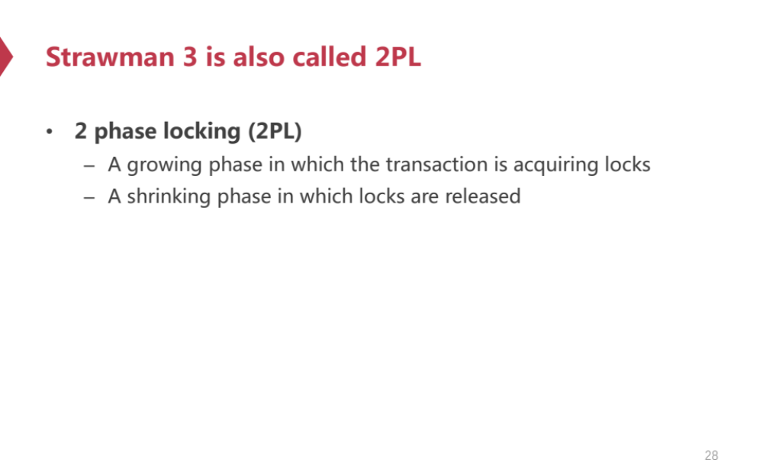
Strawman 3 is also called 2PL
2 phase locking (2PL) guarantees serializability
  A growing phase in which the transaction is acquiring locks
  A shrinking phase in which locks are released
Commit time
Access A
#locks
grabbed
A TX’s life time

Slide 29
2PL: deadlocks?
lock(A)
A_bal = READ(A)
lock(B)
B_bal = READ(B)
B_bal += 100
A_bal -= 100
WRITE(A, A_bal)
WRITE(B, B_bal)
unlock(A)
unlock(B)
lock(B)
B_bal = READ(B)
lock(A)
A_bal = READ(A)
Print(A_bal+B_bal)
unlock(A)
unlock(B)

Slide 30
2PL: deadlocks?
L(A)
lock(A)
A_bal = READ(A)
lock(B)
B_bal = READ(B)
B_bal += 100
A_bal -= 100
WRITE(A, A_bal)
WRITE(B, B_bal)
unlock(A)
unlock(B)
lock(B)
B_bal = READ(B)
lock(A)
A_bal = READ(A)
Print(A_bal+B_bal)
unlock(A)
unlock(B)
Timeline

Slide 31
2PL: deadlocks?
L(A)
lock(A)
A_bal = READ(A)
lock(B)
B_bal = READ(B)
B_bal += 100
A_bal -= 100
WRITE(A, A_bal)
WRITE(B, B_bal)
unlock(A)
unlock(B)
L(B)
lock(B)
B_bal = READ(B)
lock(A)
A_bal = READ(A)
Print(A_bal+B_bal)
unlock(A)
unlock(B)
Timeline

Slide 32
2PL: deadlocks?
L(A)
lock(A)
A_bal = READ(A)
lock(B)
B_bal = READ(B)
B_bal += 100
A_bal -= 100
WRITE(A, A_bal)
WRITE(B, B_bal)
unlock(A)
unlock(B)
L(B)
lock(B)
B_bal = READ(B)
lock(A)
A_bal = READ(A)
Print(A_bal+B_bal)
unlock(A)
unlock(B)
L(A)
Timeline

Slide 33
2PL: deadlocks?
L(A)
lock(A)
A_bal = READ(A)
lock(B)
B_bal = READ(B)
B_bal += 100
A_bal -= 100
WRITE(A, A_bal)
WRITE(B, B_bal)
unlock(A)
unlock(B)
L(B)
lock(B)
B_bal = READ(B)
lock(A)
A_bal = READ(A)
Print(A_bal+B_bal)
unlock(A)
unlock(B)
L(A)
L(B)
Timeline

Slide 34
2PL: deadlocks?
L(A)
lock(A)
A_bal = READ(A)
lock(B)
B_bal = READ(B)
B_bal += 100
A_bal -= 100
WRITE(A, A_bal)
WRITE(B, B_bal)
unlock(A)
unlock(B)
L(B)
lock(B)
B_bal = READ(B)
lock(A)
A_bal = READ(A)
Print(A_bal+B_bal)
unlock(A)
unlock(B)
L(A)
L(B)
?
Timeline

Slide 35
Disadvantages of locking-based approach
Need to detect deadlocks
  Distributed implementation needs distributed deadlock detection (bad)
Read-only transactions can block update transactions
  Big performance hit if there are long running read-only transactions

Slide 36
Optimistic concurrency control
Reads do not acquire locks
Use validation-based scheme
No deadlock
- Use speculative execution to ensure a deterministic locking order

Slide 37
Optimistic concurrency control
OCC execute transaction speculatively
  Execution phase (execute TX with (near no) concurrency control)
  Validation phase (verify the result of execution phase)
  Commit phase
Only lock the write-set in the validation phase

Slide 38
OCC: an example
Original transaction
A_bal = READ(A)
B_bal = READ(B)
B_bal += 100
A_bal -= 100
WRITE(A, A_bal)
WRITE(B, B_bal)

Slide 39
OCC: an example
Executed using OCC
Cache[A_bal] = READ(A)
Cache[B_bal] = READ(B)
Cache[B_bal] += 100
Cache[A_bal] -= 100
Original transaction
A_bal = READ(A)
B_bal = READ(B)
B_bal += 100
A_bal -= 100
WRITE(A, A_bal)
WRITE(B, B_bal)
Execution phase

Slide 40
OCC: an example
Executed using OCC
Cache[A_bal] = READ(A)
Cache[B_bal] = READ(B)
Cache[B_bal] += 100
Cache[A_bal] -= 100
Original transaction
A_bal = READ(A)
B_bal = READ(B)
B_bal += 100
A_bal -= 100
WRITE(A, A_bal)
WRITE(B, B_bal)
Execution phase
Lock(A)
Lock(B)
Abort if A_bal or B_bal has changed
Validation phase

Slide 41
OCC: an example
Executed using OCC
Cache[A_bal] = READ(A)
Cache[B_bal] = READ(B)
Cache[B_bal] += 100
Cache[A_bal] -= 100
Original transaction
A_bal = READ(A)
B_bal = READ(B)
B_bal += 100
A_bal -= 100
WRITE(A, A_bal)
WRITE(B, B_bal)
Execution phase
Lock(A)
Lock(B)
Abort if A_bal or B_bal has changed
Validation phase
A_bal = Cache[A_bal]
B_bal = Cache[B_bal]
// unlock A and B
Commit phase

Slide 42
OCC: an example
Executed using OCC
Cache[A_bal] = READ(A)
Cache[B_bal] = READ(B)
Cache[B_bal] += 100
Cache[A_bal] -= 100
Why no deadlock?
  after execution phase,
  We explore all the
  Involved data
Thus, we can assign
a deterministic lock order
Execution phase
Lock(A)
Lock(B)
Abort if A_bal or B_bal has changed
Validation phase
A_bal = Cache[A_bal]
B_bal = Cache[B_bal]
// unlock A and B
Commit phase

Slide 43
OCC: an example
Executed using OCC
Original transaction
Cache[A_bal] = READ(A)
Cache[B_bal] = READ(B)
A_bal = READ(A)
B_bal = READ(B)
Print(A_bal+B_bal)
Execution phase
Abort if A_bal or B_bal changed
Validation phase
Rrint(cache[A_bal] + cache[B_bal])
Commit phase

Slide 44
OCC: how to handle aborts?
Only retry the execution
  Excessive retries cause low performances
Cause live lock if there are many contentions !

Slide 45
Recap
We have talked about transaction’s ACID property
We have presented two classic protocols to ensure (ACI) transaction
Most protocols nowadays are those two protocol’s variations !

Slide 46
However, Serializability is Costly under Contention

Slide 47
Recap: why 2PL & OCC fails under contention ?
2PL
  Contented transactions block each other
  Read-only transactions block writers
  Dead lock (hard in a distributed setting)
OCC
  Contented transaction frequently retries

Slide 48
Observations
Read-only transaction dominates (real) workloads
  e.g., 99.8% requests to Facebook TAO are reads[1]
Read-only transaction are long-running[2]
  Blocking or retry are both unaccepted
[1] TAO [ATC’13]
[2] Challenges to adopting stronger consistency at scale. [HOTOS’15]

Slide 49
Multi-version protocols
Each data item is associated with multiple versions
Multi-version transactions:
  Reads choose the appropriate version from a consistent view (no locking and retry! )

Slide 50
Snapshot Isolation (not serializable)
A popular multi-version concurrency control scheme
A transaction:
  reads a “snapshot” of database image
  Can commit only if there are no write-write conflict

Slide 51
Implementing Snapshot Isolation
T is assigned a commit timestamp
System checks forall T’,
s.t. T’.cts > T.sts && T’.cts < T.cts
T’.wset and T.wset do not overlap
T is assigned
a start timestamp,T.sts
R(A)
W(B)
T reads the biggest version
of A, A(i), such that i <= T.sts
time
T buffers writes to B and adds
B to its writeset, T.wset += {B}

Slide 52
Snapshot Isolation: a concrete example
A_bal = READ(A)
B_bal = READ(B)
B_bal += 100
A_bal -= 100
WRITE(A, A_bal)
WRITE(B, B_bal)
A0 = 100
B0 = 100
A_bal = READ(A)
B_bal = READ(B)
Print(A_bal+B_bal)
Timeline

Slide 53
Snapshot Isolation: a concrete example
A_bal = READ(A)
B_bal = READ(B)
B_bal += 100
A_bal -= 100
WRITE(A, A_bal)
WRITE(B, B_bal)
Start_ts=1
A0 = 100
B0 = 100
A_bal = READ(A)
B_bal = READ(B)
Print(A_bal+B_bal)
Timeline

Slide 54
Snapshot Isolation: a concrete example
A_bal = READ(A)
B_bal = READ(B)
B_bal += 100
A_bal -= 100
WRITE(A, A_bal)
WRITE(B, B_bal)
Start_ts=1
A0 = 100
B0 = 100
Cache[A] = 0
Cache[B] = 200
A_bal = READ(A)
B_bal = READ(B)
Print(A_bal+B_bal)
Timeline

Slide 55
Snapshot Isolation: a concrete example
A_bal = READ(A)
B_bal = READ(B)
B_bal += 100
A_bal -= 100
WRITE(A, A_bal)
WRITE(B, B_bal)
Start_ts=1
A0 = 100
B0 = 100
Cache[A] = 0
Cache[B] = 200
Start_ts=2
Which time of A to read?
A_bal = READ(A)
B_bal = READ(B)
Print(A_bal+B_bal)
Timeline

Slide 56
Snapshot Isolation: a concrete example
A_bal = READ(A)
B_bal = READ(B)
B_bal += 100
A_bal -= 100
WRITE(A, A_bal)
WRITE(B, B_bal)
Start_ts=1
A0 = 100
B0 = 100
Cache[A] = 0
Cache[B] = 200
Start_ts=2
A0=100
A_bal = READ(A)
B_bal = READ(B)
Print(A_bal+B_bal)
Timeline

Slide 57
Snapshot Isolation: a concrete example
A_bal = READ(A)
B_bal = READ(B)
B_bal += 100
A_bal -= 100
WRITE(A, A_bal)
WRITE(B, B_bal)
Start_ts=1
A0 = 100
B0 = 100
Cache[A] = 0
Cache[B] = 200
Start_ts=2
A0=100
Commit_ts=3
A3 = 0
A_bal = READ(A)
B_bal = READ(B)
Print(A_bal+B_bal)
B3 = 0
Timeline

Slide 58
Snapshot Isolation: a concrete example
A_bal = READ(A)
B_bal = READ(B)
B_bal += 100
A_bal -= 100
WRITE(A, A_bal)
WRITE(B, B_bal)
Start_ts=1
A0 = 100
B0 = 100
Cache[A] = 0
Cache[B] = 200
Start_ts=2
A0=100
Commit_ts=3
A3 = 0
A_bal = READ(A)
B_bal = READ(B)
Print(A_bal+B_bal)
B3 = 200
Which time of B to read?
Timeline

Slide 59
Snapshot Isolation: a concrete example
A_bal = READ(A)
B_bal = READ(B)
B_bal += 100
A_bal -= 100
WRITE(A, A_bal)
WRITE(B, B_bal)
Start_ts=1
A0 = 100
B0 = 100
Cache[A] = 0
Cache[B] = 200
Start_ts=2
A0=100
Commit_ts=3
A3 = 0
A_bal = READ(A)
B_bal = READ(B)
Print(A_bal+B_bal)
B3 = 0
B0=100
Timeline

Slide 60
Snapshot isolation < serializability
The write-skew problem
Please refer to “A critique of ansi sql isolation levels [SIGMOD’95” for more detailes

Slide 61
From algorithms to systems

Slide 62
Towards modern transaction systems
2PL, OCC and SI are decades old
  Yet nowadays they are still the golden standard of concurrency control !
How can we continuously improve transaction’s performance?
  Through better system designs

Slide 63
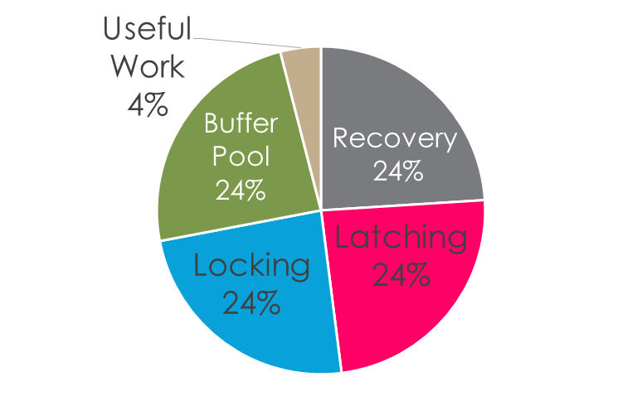
Transactions are slow in (traditional) databases
Only 4% of wall-clock time spent on useful data processing, while the rest is occupied with buffer pools, locking, latching, recovery.¹
-- Michael Stonebraker
50% of time spent on ensuring ACI

Slide 64
ACI = algorithms + implementations
Algorithms (protocols):
  2PL, OCC, etc
Implementations
  Locking methods (read-write locks), deadlock detection mechanism, etc
  How to place data (e.g., in-memory, disk, NVM)
  Different system design choices matters

Slide 65
Case study: Hstore[VLDB’08]
Put all database in memory
  Eliminate buffer pool overhead
But other parts need redesign
  How to do fault tolerance?
Totally eliminates buffer pool overhead

Slide 66
A better algorithm does yield better performance
Multi-version incurs better performance
  E.g., No abort read-only TX, etc
But incurs additional scalability bottleneck
  A global counter is used to assign timestamps
  Global timestamp allocation is slow, even on a single modern multi-core machine !

Slide 67
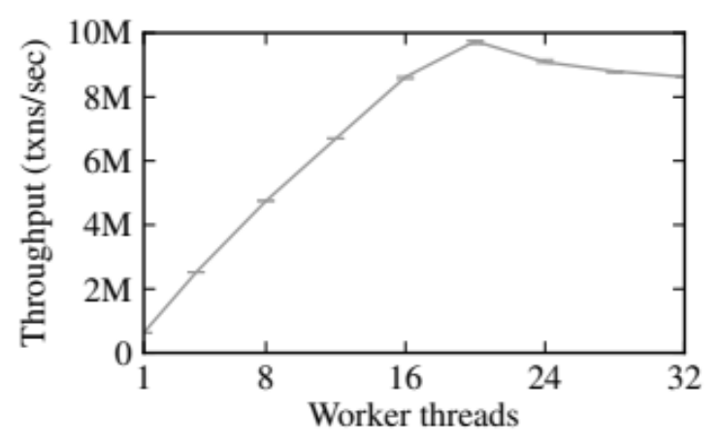
Scalability bottleneck in multi-core server
txn_commit()
{
// prepare commit
// […]
commit_tid = atomic_fetch_and_add(&global_tid);
// quickly serialize transactions a la Hekaton
}
[Hekaton] concurrency control engine in Microsoft SQL server

Slide 68
Recap: ACI
A (Atomicity)
  All-or-nothing w.r.t. failures
C (Consistency)
  Transactions maintain any internal storage state invariants
I (Isolation)
  Concurrently executing transactions do not interfere
D (Durability)
  Effect of transactions survive failures

Slide 69
Fault tolerance

Slide 70
Durability vs. Availability
Durability
  Storage states survives even if there is failures
  E.g., TX’modifications flushed to non-volatile storage
Availability (for distributed systems)
  System survives even if there is failure)

Slide 71
Logging for durability
Logging rules
  Write log record to disk before modifying persistent state
Recovery
  After system reboots, drain the logs and recover system states to a consistent state

Slide 72
Challenges of logging for in-memory databases
How to recovery logs to a consistent state ?
  If T2 reads T1’s modifications, T2’ log must be recovered after T1’s log
How to hide disk latency ?
  Typically several orders of magnitude longer than TX’s lifetime!
Please refer to Silo[SOSP’13]

Slide 73
Logging + Replication for Availability
How to maintain system’s function when there is machine failures ?
  Replication: data are replicated to multiple machines; If one machine fails, redirect the workloads to its replica
Challenge: How to maintain ACID when there is replications ?
  Use logging to sync replica’s states by a consensus protocol, e.g., Paxos

Slide 74
Case study: Spanner[OSDI’10]
A distributed (geo-replicated) databases
Use two-phase locking for concurrency control
Uses paxos to sync replication’s state
  So that each replica group function as a single machine with no failure

Slide 75
Case study: FaRM[SOSP’15]
Drawback of paxos:
  At least two network-roundtrips for a single request (e.g., lock, read/write)
FaRM uses primary backup replication with vertical paxos
  OCC for concurrency control
  Only the commit phase need to ship log to replicas

Slide 76

Summary
Protocols to ensure transaction’s ACI property
How system implementation affect transaction’s performance
Thanks!

