Slide 1
Hardware Support for Operating System
Dong Du
IPADS, Shanghai Jiao Tong University

Slide 2
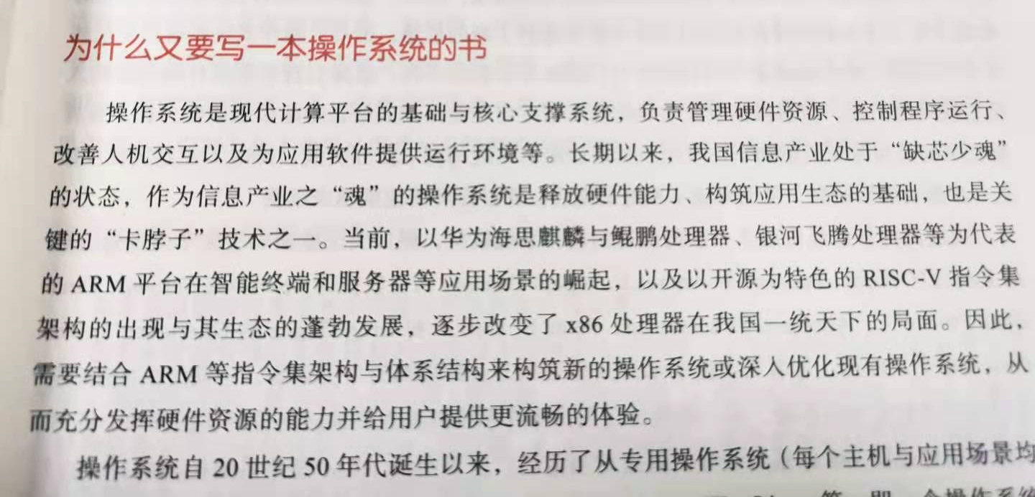


Hardware and OS
The preface of 《Modern Operating Systems》
“操作系统…负责管理硬件资源…”

Slide 3
Hardware and OS
Operating system functionality fundamentally depends upon the architectural features of the computer
Architectural support can greatly simplify or complicate OS tasks
  Early PC operating systems (DOS, MacOS) lacked virtual memory in part because the architecture did not support it
Credit: UCSD, https://cseweb.ucsd.edu/classes/fa05/cse120/lectures/120-l2.pdf

Slide 4
Review: Hardware Support
Lect-10: Arch for Security
Security
  Intel SGX, AMD SEV, ARM Trustzone, MPK, MPX, CET, TDX, PMP, …
Virtualization
  EPT/NPT, VT-d, Root/Non-Root modes, IOMMU, …
Others
  HTM, …
Lect-06: Virtualization

Slide 5
Hardware Support for OS
Protection (kernel/user mode)
Protected instructions
Memory protection
System calls
Interrupts and exceptions
Timer (clock)
I/O control and operation
Synchronization (atomic instructions)
How did we get here?

Slide 6

Let’s start at the very beginning
Credit: Cornel http://www.cs.cornell.edu/courses/cs4410/2018sp/schedule/slides/02-arch-support.pdf

Slide 7
History of Operating Systems
Phase 1: Hardware expensive, humans cheap
User at console: single-user systems
Batching systems
Multi-programming systems

Slide 8
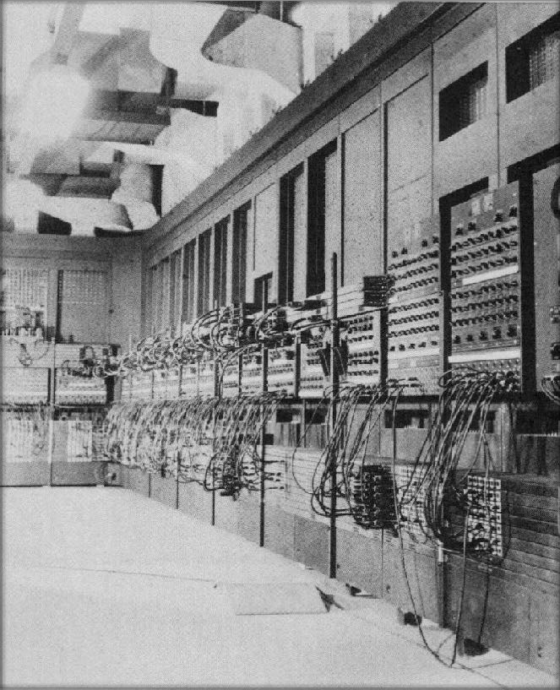
Hand Programmed Machines
(1945-1955)
Single user systems
OS = loader + libraries
Problem: low utilization of expensive components

Slide 9
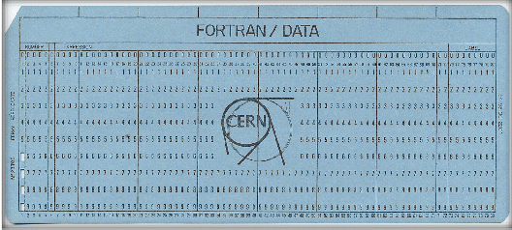
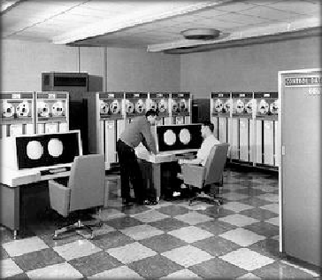












Batch processing
(1955-1965)
OS = loader + sequencer + output processor
Input
Computer
Card Reader
Tape
User Data
User Program
Tape
“System Software”
Printer
Operating System
Output

Slide 10





Multiprogramming
(1965-1980)
Keep several jobs in memory
Multiplex CPU between jobs
Program P
begin
...
Read(var)
...
end P
User Program n
User Program 2
System call Read(var) begin
StartIO(input device)
WaitIO(interrupt) EndIO(input device)
...
end Read
User Program 1
“System Software”
Operating System

Slide 11
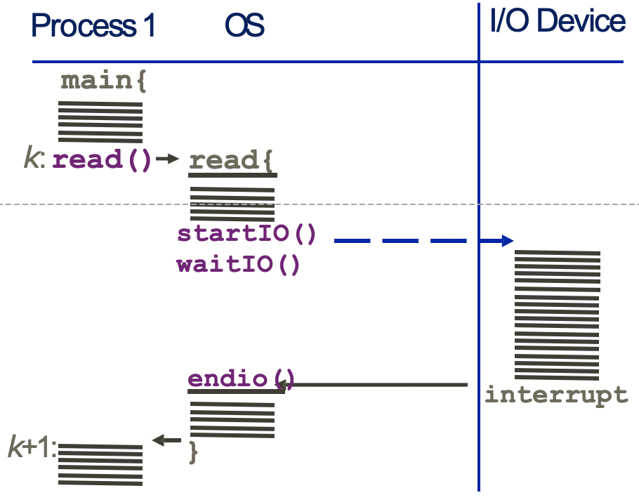
Multiprogramming
(1965-1980)
√ interrupt & I/O
Keep several jobs in memory
Multiplex CPU between jobs
User Program n
User Program 2
User Program 1
“System Software”
Operating System

Slide 12
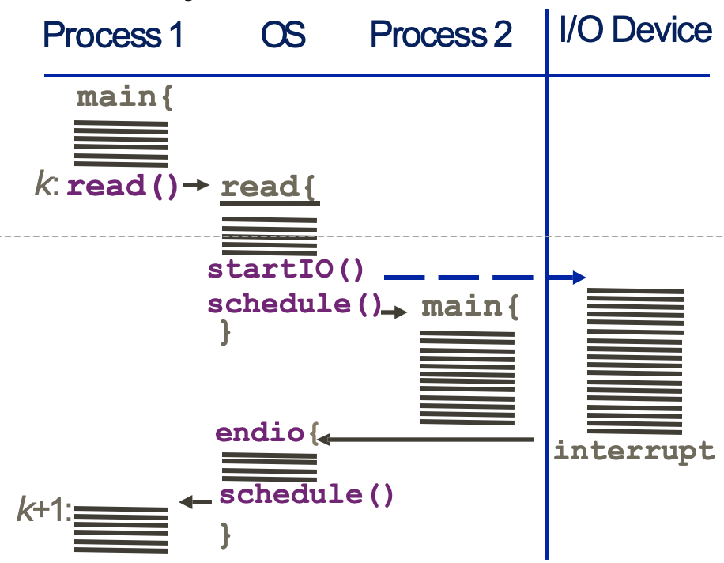
Multiprogramming
(1965-1980)
√ interrupt & I/O
√ Mem protection
Keep several jobs in memory
Multiplex CPU between jobs
√ OS protection
User Program n
User Program 2
User Program 1
Multi-tasking is achieved through cooperation, what if a process is malicious?
“System Software”
Operating System

Slide 13
History of Operating Systems
Phase 1: Hardware expensive, humans cheap
User at console: single-user systems
Batching systems
Multi-programming systems
Phase 2: Hardware cheap humans expensive
Timesharing for multiple-tasks

Slide 14
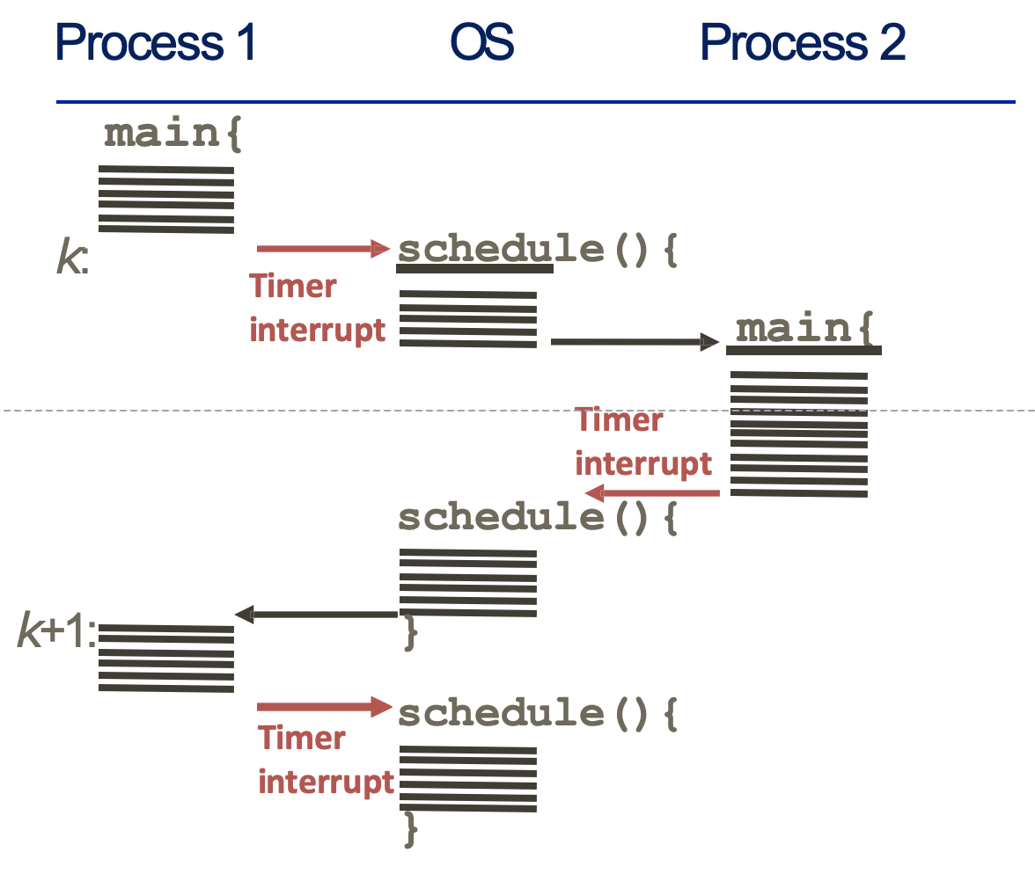
Timesharing
(1970-)
√ interrupt & I/O
√ Mem protection
Timer interrupt used to multiplex CPU between jobs
√ OS protection
√ Timer
User Program n
User Program 2
User Program 1
“System Software”
Operating System
Preemptive Multi-tasking is achieved

Slide 15
History of Operating Systems
Phase 1: Hardware expensive, humans cheap
User at console: single-user systems
Batching systems
Multi-programming systems
Phase 2: Hardware cheap humans expensive
Timesharing for multiple-tasks
Phase 3: H/W very cheap humans very expensive
Personal computing: One system per user
Distributed computing: many systems per user
Ubiquitous computing: lots of systems per users

Slide 16
Hardware Support for OS
How did we get here?
Protection (kernel/user mode)
Protected instructions
Memory protection
System calls
Interrupts and exceptions
Timer (clock)
I/O control and operation
Synchronization (atomic instructions)
Protection!
Credit: UCSD, https://cseweb.ucsd.edu/classes/fa05/cse120/lectures/120-l2.pdf

Slide 17
OS Protection: Protected Instructions
A subset of instructions of every CPU is restricted to use only by the OS
  Known as protected (privileged) instructions
Only the operating system can
  Directly access I/O devices (disks/SSDs, NICs, etc.)
» Security, fairness (why?)
  Manipulate memory management state
» Page table pointers (CR3, sptbr), page protection, TLB management, etc.
  Manipulate protected control registers
» Kernel mode, interrupt level
  Halt instruction
Notes:
HLT: Halt CPU till next interrupt.
INVLPG: Invalidate a page entry in the translation look-aside buffer (TLB).
LIDT: Load Interrupt Descriptor Table.
MOV CR registers: load or store control registers. In this case the MOV instruction (a non-privileged instruction on its own) is accessing a privileged register.
RDMSR, WRMSR: Read / write model specific registers (MSR).
(https://sites.google.com/site/masumzh/articles/x86-architecture-basics/x86-architecture-basics)

Slide 18
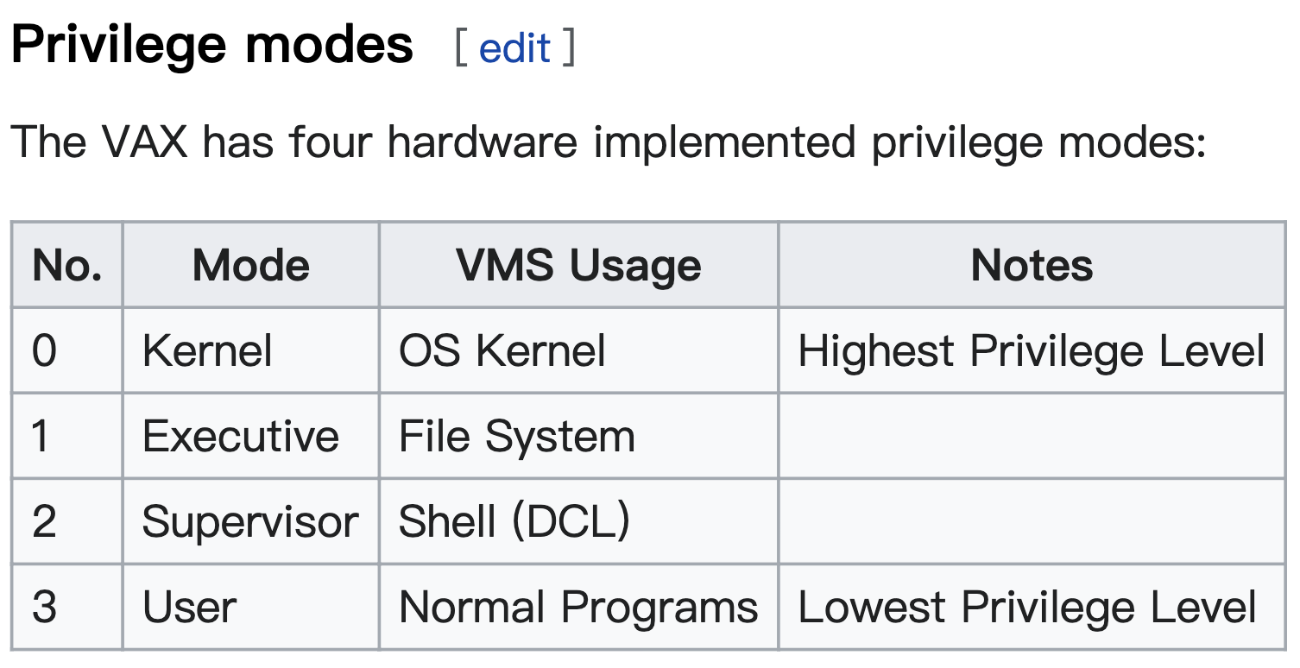
OS Protection
How do we know if we can execute a protected instruction?
  Architecture must support (at least) two modes of operation: kernel mode and user mode
» VAX, x86 support four modes; earlier archs (Multics) even more
» Why?
Protect the OS from itself (software engineering)
Ref: https://en.wikipedia.org/wiki/VAX

Slide 19
OS Protection
How do we know if we can execute a protected instruction?
  Architecture must support (at least) two modes of operation: kernel mode and user mode
» VAX, x86 support four modes; earlier archs (Multics) even more
» Why? Protect the OS from itself (software engineering)
  Mode is indicated by a status bit in a protected control register
  User programs execute in user mode
  OS executes in kernel mode (OS == “kernel”)
Protected instructions only execute in kernel mode
  CPU checks mode bit when protected instruction executes
  Setting mode bit must be a protected instruction
Notes:
X86 uses two bits in code selector (CS) register to indicate the current privilege level (CPL) of the program.

Slide 20
Memory Protection
OS must be able to protect programs from each other
OS must protect itself from user programs
May or may not protect user programs from OS
Memory management hardware provides memory protection mechanisms
  Base and limit registers
  Page table pointers, page protection, TLB
  Virtual memory
  Segmentation
Manipulating memory management hardware uses protected (privileged) operations
E.g., SGX

Slide 21
Hardware Support for OS
How did we get here?
Protection (kernel/user mode)
Protected instructions
Memory protection
System calls
Interrupts and exceptions
Timer (clock)
I/O control and operation
Synchronization (atomic instructions)
Protection
Events!
Credit: UCSD, https://cseweb.ucsd.edu/classes/fa05/cse120/lectures/120-l2.pdf

Slide 22
Events
An event is an “unnatural” change in control flow
  Events immediately stop current execution
  Changes mode, context (machine state), or both
The kernel defines a handler for each event type
  Event handlers always execute in kernel mode
  The specific types of events are defined by the machine
    Load/store fault, instruction fault, syscall, …
Once the system is booted, all entries to the kernel occur as the result of an event
The operating system is one big event handler

Slide 23
Categorizing Events
Two kinds of events, interrupts and exceptions
Exceptions are caused by executing instructions
  CPU requires software intervention to handle a fault or trap
Interrupts are caused by an external event
  Device finishes I/O, timer expires, etc.
Two reasons for events, unexpected and deliberate
Unexpected events are, well, unexpected
  What is an example?
Deliberate events are scheduled by OS or application
  Why would this be useful?

Slide 24
Categorizing Events (2)
Terms may be used slightly differently by various OSes, CPU architectures…
Software interrupt – a.k.a. async system trap (AST), async or deferred procedure call (APC or DPC)
 | Unexpected | Deliberate
Exceptions (sync) | fault | syscall trap
Interrupts (async) | interrupt | software interrupt

Slide 25
Faults
Hardware detects and reports “exceptional” conditions
  Page fault, unaligned access, divide by zero
Upon exception, hardware “faults” (verb)
  Must save state (PC, regs, mode, etc.) so that the faulting process can be restarted
Modern OSes use page faults for many functions
  Debugging, distributed shared memory, GC, copy-on-write
Are fault exceptions necessary?
Fault exceptions are a performance optimization
  Could detect faults by inserting extra instructions into code (at a significant performance penalty)

Slide 26
Handling Faults
“Fixing” the exceptional condition and returning to the faulting context
  Page faults cause the OS to place the missing page into memory
  Fault handler resets PC of faulting context to re-execute instruction that caused the page fault
Notifying the process
  Fault handler changes the saved context to transfer control to a user-mode handler on return from fault
  Handler must be registered with OS
  Unix signals or NT user-mode Async Procedure Calls (APCs)
» SIGALRM, SIGHUP, SIGTERM, SIGSEGV, etc.
Notes:
两种做法，fixing和notifying

Slide 27
Handling Faults (2)
The kernel may handle unrecoverable faults by killing the user process
  Program fault with no registered handler
  Halt process, write process state to file, destroy process
  In Unix, the default action for many signals (e.g., SIGSEGV)
What about faults in the kernel?

Slide 28
Handling Faults (2)
The kernel may handle unrecoverable faults by killing the user process
  Program fault with no registered handler
  Halt process, write process state to file, destroy process
  In Unix, the default action for many signals (e.g., SIGSEGV)
What about faults in the kernel?
  Dereference NULL, divide by zero, undefined instruction
  These faults considered fatal, operating system crashes
  Unix panic, Windows “Blue screen of death”

Slide 29
Handling Faults (2)
The kernel may handle unrecoverable faults by killing the user process
  Program fault with no registered handler
  Halt process, write process state to file, destroy process
  In Unix, the default action for many signals (e.g., SIGSEGV)
What about faults in the kernel?
  Dereference NULL, divide by zero, undefined instruction
  These faults considered fatal, operating system crashes
  Unix panic, Windows “Blue screen of death”

Slide 30
System Calls
For a user program to do something “privileged” (e.g., I/O) it must call an OS procedure
  Some old term：
    crossing the protection boundary, or
    protected procedure call
Arch provides a system call instruction that:
  Causes an exception, which vectors to a kernel handler
  Passes a parameter determining the system routine to call
  Saves caller state (PC, regs, mode) so it can be restored
» Why save mode?
  Returning from system call restores this state
Arch must permit OS to:
  Verify input parameters (e.g., valid addresses for buffers)
  Restore saved state, reset mode, resume execution

Slide 31
System Call
WeChat: read()
Trap to kernel mode, save state
User mode
Kernel mode
Restore state, return to user level, resume execution
Trap handler
Find read handler in vector table
read() kernel routine

Slide 32
System Call Questions
What would happen if kernel did not save state?
What if the kernel executes a system call?
How to reference kernel objects as arguments or results to/from system calls?
  A naming issue
  Use integer object handles or descriptors
» E.g., Unix file descriptors
  Also called capabilities (more later)
  Why not use kernel addresses to name kernel objects?

Slide 33
Interrupts
Interrupts
  Precise interrupts – CPU transfers control only on instruction boundaries
  Imprecise interrupts – CPU transfers control in the middle of instruction execution
  OS designers like precise interrupts, CPU designers like imprecise interrupts
» Why?
Interrupts signal asynchronous events
  Timer, I/O, etc.

Slide 34
Hardware Support for OS
How did we get here?
Protection (kernel/user mode)
Protected instructions
Memory protection
System calls
Interrupts and exceptions
Timer (clock)
I/O control and operation
Synchronization (atomic instructions)
Protection
Events
Timesharing with preemptive!
Managing I/O!
Credit: UCSD, https://cseweb.ucsd.edu/classes/fa05/cse120/lectures/120-l2.pdf

Slide 35
Timer
The timer is critical for an operating system
It is the fallback mechanism by which the OS reclaims control over the machine
  Timer is set to generate an interrupt after a period of time
» Setting timer is a privileged instruction
  When timer expires, generates an interrupt
Prevents infinite loops
  OS can always regain control from erroneous or malicious programs that try to hog CPU
Also used for time-based functions (e.g., sleep())

Slide 36
I/O Control
I/O issues
  Initiating an I/O
  Completing an I/O
Initiating an I/O
  Special instructions
  Memory-mapped I/O
» Device registers mapped into address space
» Writing to address sends data to I/O device

Slide 37
I/O Completion
Interrupts are the basis for asynchronous I/O
  OS initiates I/O
  Device operates independently of rest of machine
  Device sends an interrupt signal to CPU when done
  OS maintains a vector table containing a list of addresses of kernel routines to handle various events
  CPU looks up kernel address indexed by interrupt number, context switches to routine

Slide 38
I/O Example
Ethernet receives packet, writes packet into memory
Ethernet signals an interrupt
CPU stops current operation, switches to kernel mode, saves machine state (PC, mode, etc.) on kernel stack
CPU reads address from vector table indexed by interrupt number, branches to address (Ethernet device driver)
Ethernet device driver processes packet (reads device registers to find packet in memory)
Upon completion, restores saved state from stack

Slide 39
Interrupt Questions
Interrupts halt the execution of a process and transfer control (execution) to the operating system
  Can the OS be interrupted? (Consider why there might be different IRQ levels)
Interrupts are used by devices to have the OS do stuff
  What is an alternative approach to using interrupts?
  What are the drawbacks of that approach?

Slide 40
Synchronization
Interrupts cause difficult problems
  An interrupt can occur at any time
  A handler can execute that interferes with code that was interrupted
OS must be able to synchronize concurrent execution
Need to guarantee that short instruction sequences execute atomically
  Disable interrupts – turn off interrupts before sequence, execute sequence, turn interrupts back on
  Special atomic instructions – read/modify/write a memory address, test and conditionally set a bit based upon previous value

Slide 41
Part-2
Can we go further?
New Hardware Extensions Designed for OS

Slide 42
Architecture and OS
The old fashion has many limitations
  Designing OS for Hardware
The new fashion
  Hardware extensions to optimize OS design
  Hardware-Software co-design
OS
2nd
→ 1st
Architectural support
1st

Slide 43
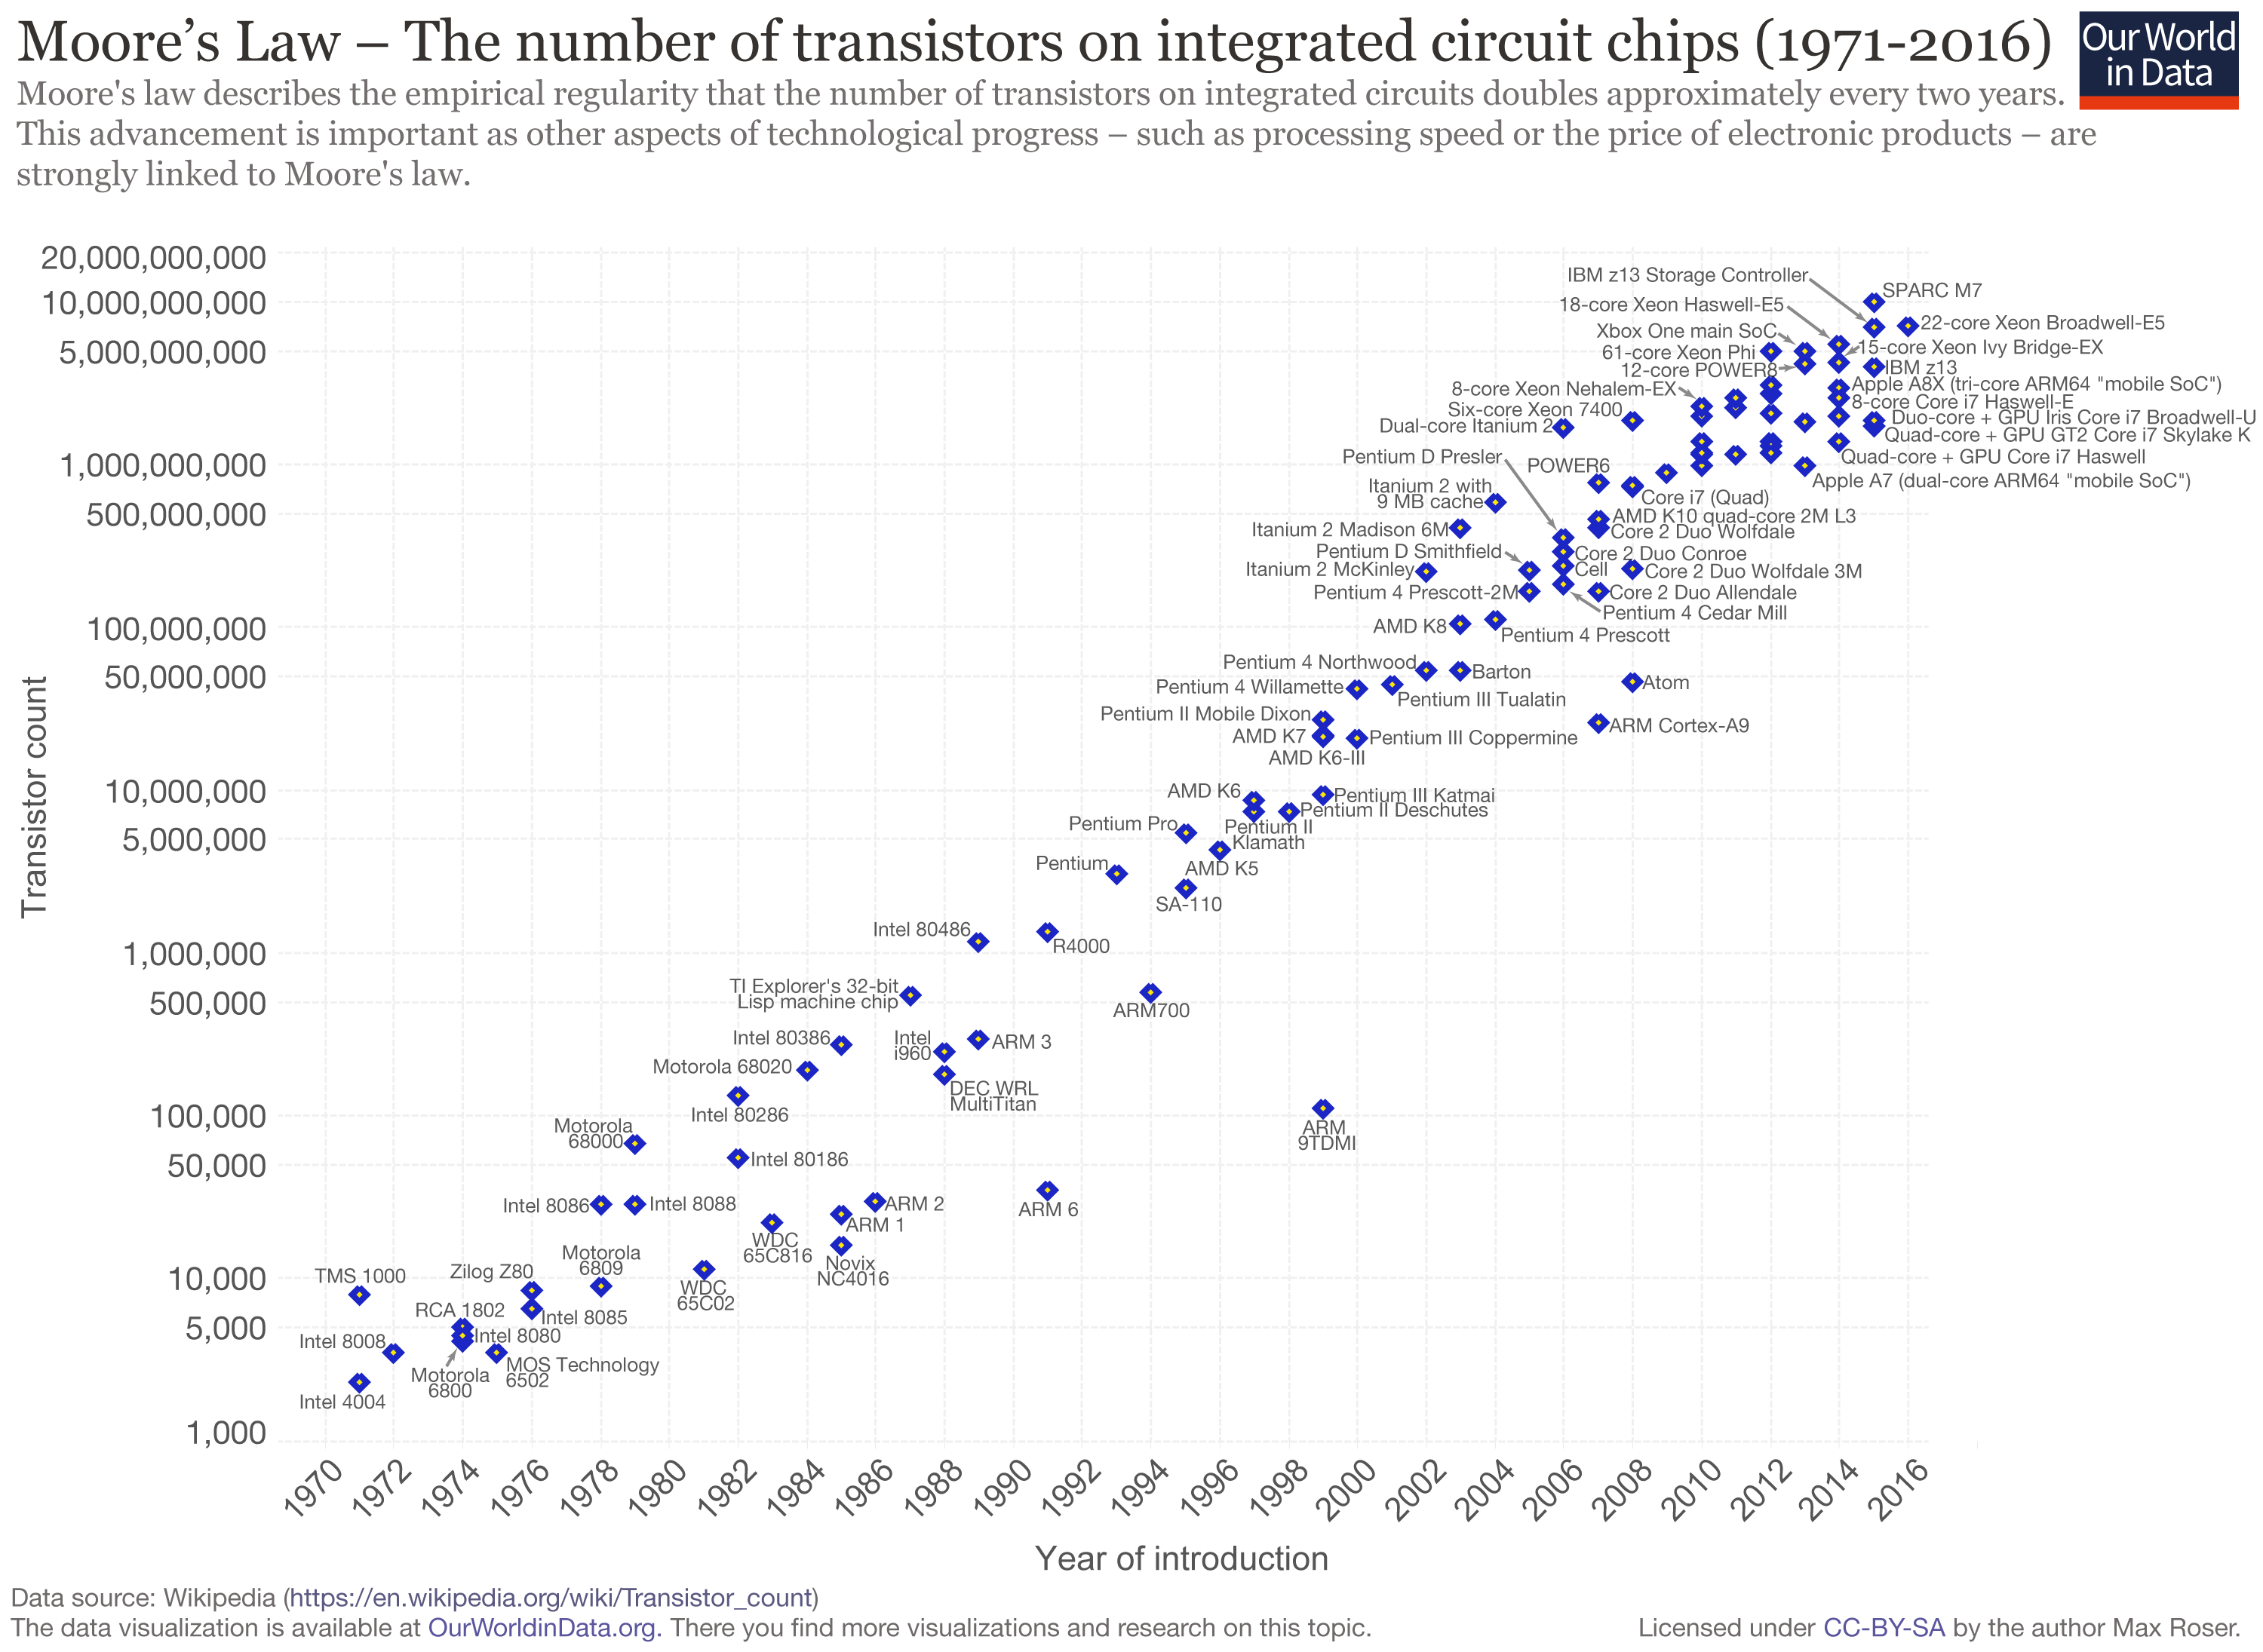
The End of Moore’s Law
Previous HW designs (1990s-2000s) are defeated by the promise of Moore’s Law

Slide 44
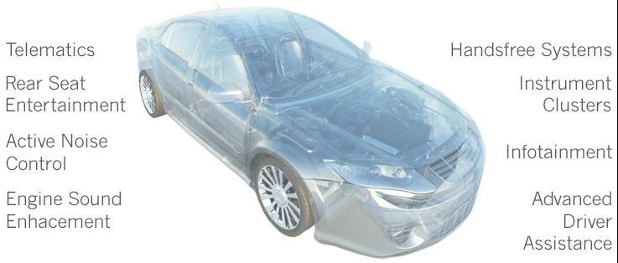
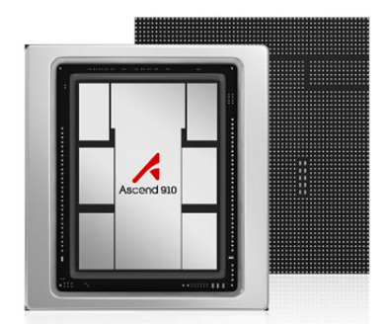
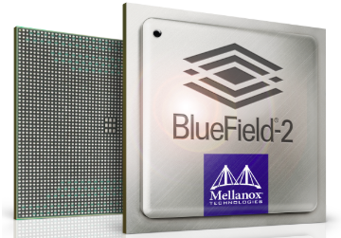
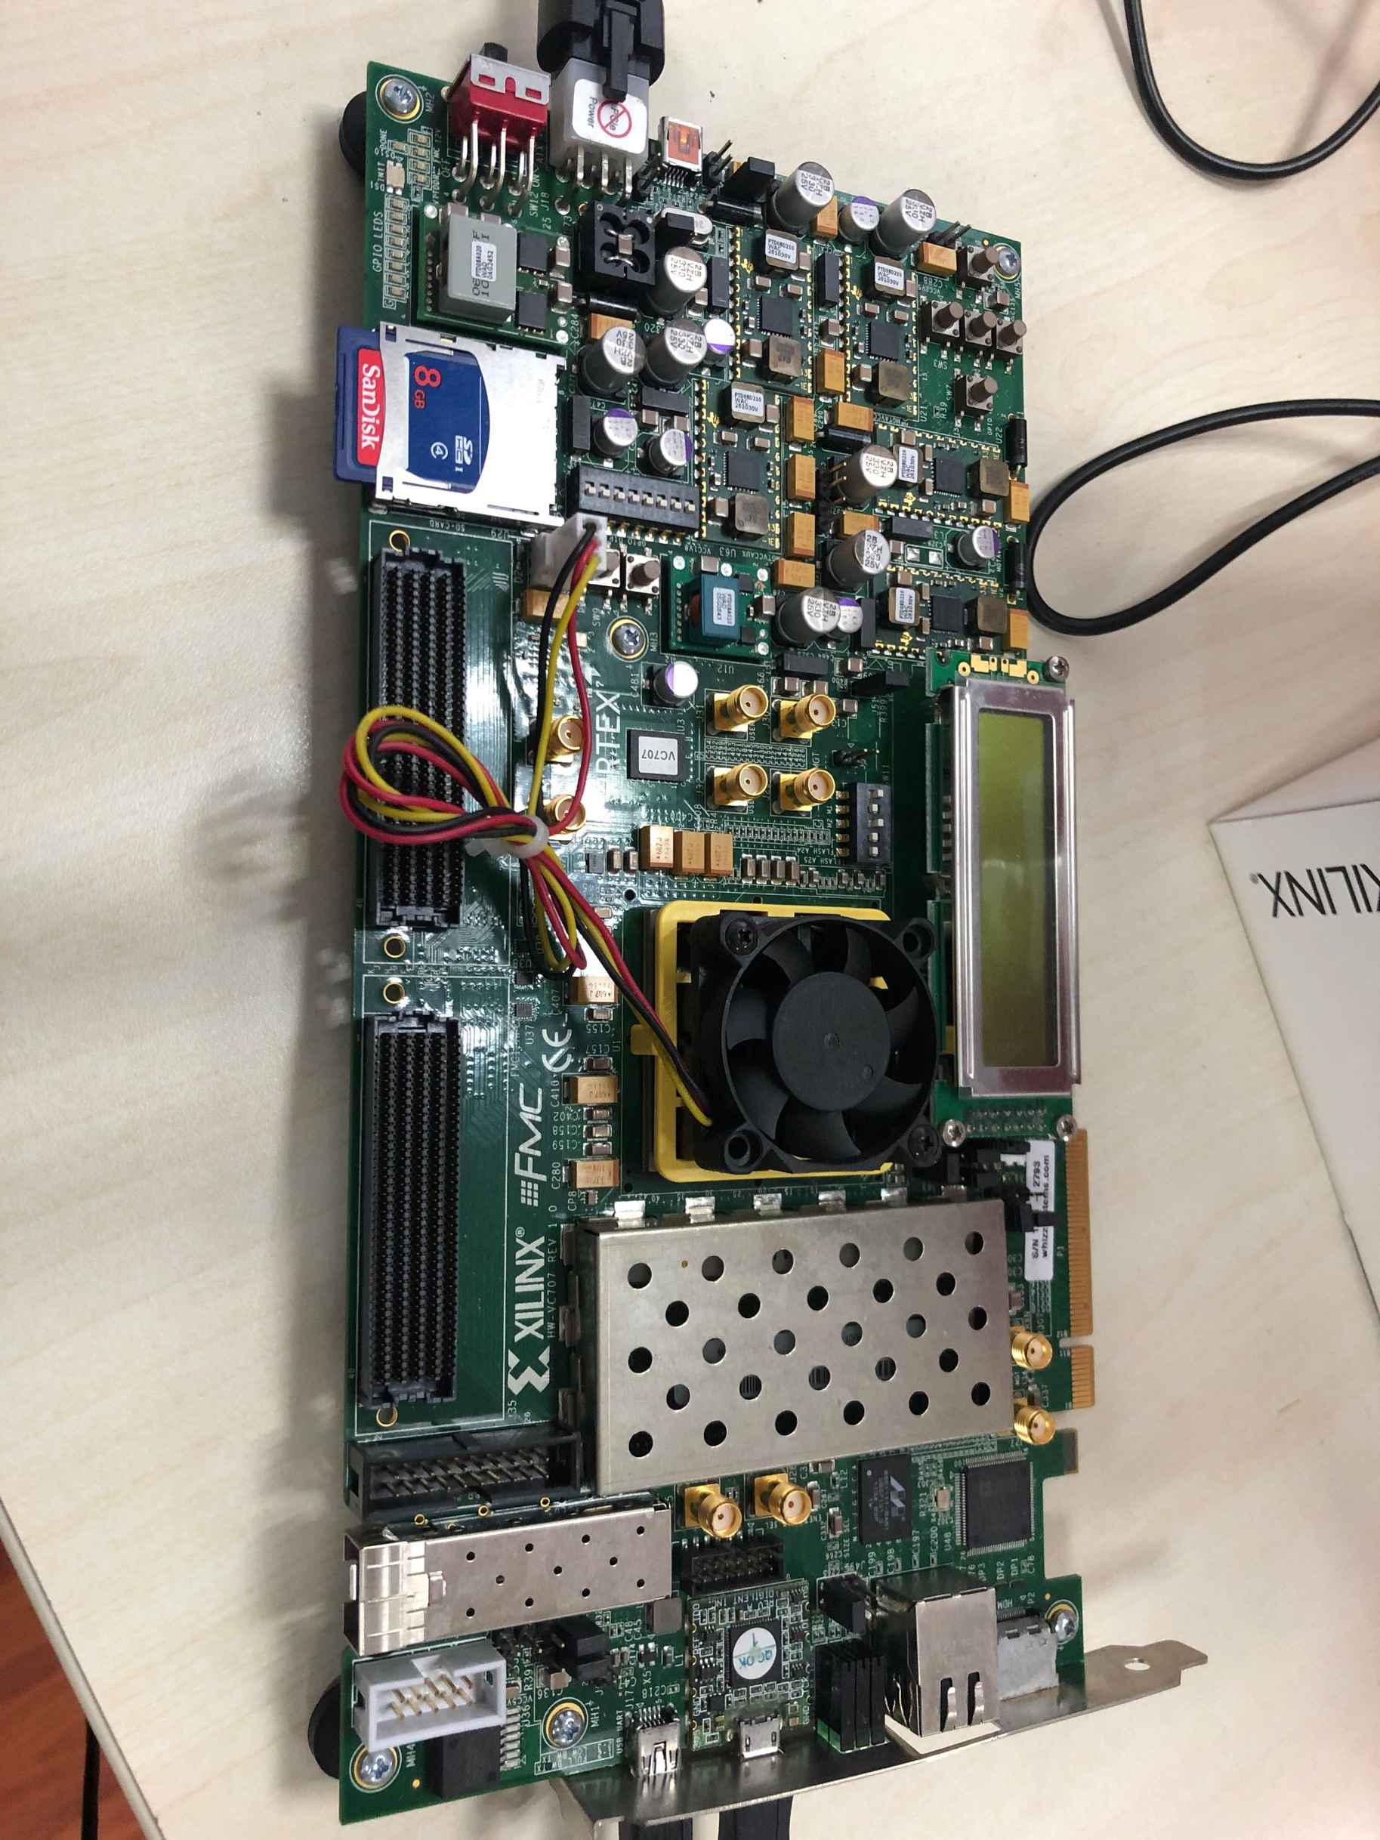

Architecture and OS
Hardware trends
  RDMA, GPU, FPGA, AI accelerators, ASIC, PIM
AI accelerators
SmartNIC
FPGA

Slide 45
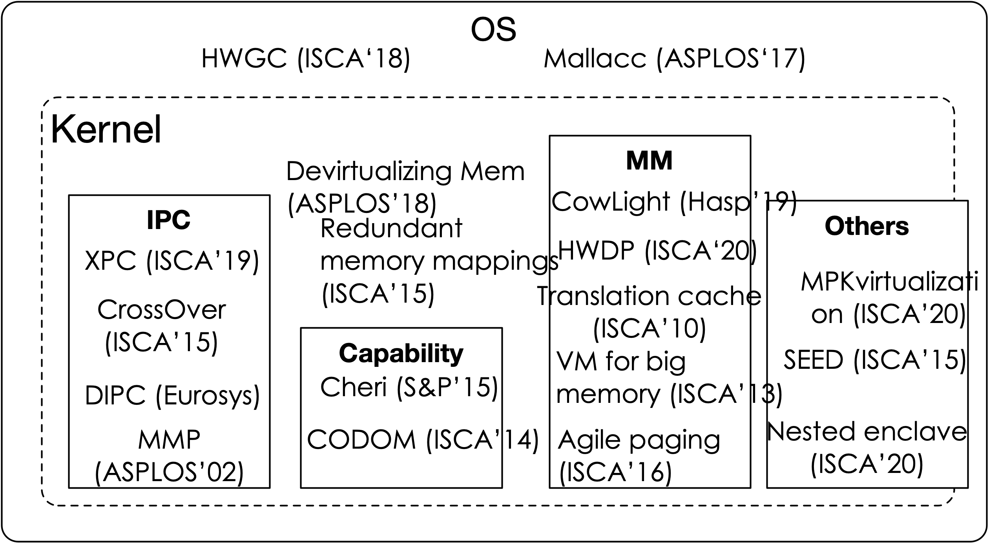
The Big Picture
Of course it is incomplete

Slide 46
Architectural support for Inter-process communication
XPC
XPC: Architectural Support for Secure and Efficient Cross Process Call. Dong Du, Zhichao Hua, Yubin Xia, Binyu Zang, Haibo Chen. (ISCA’2019)

Slide 47
Review: Microkernel
Cases: Mach, L4, MINIX, Google Zircon
Less in the core
  Inter-Process Communication (IPC)
Put the major parts in user space
  Drivers, file system, network, memory manager
Kernel (with OS services)
μKernel
User apps and
OS services
User apps
Monolithic kernel
Microkernel

Slide 48

Why Optimizing IPC?
Inter-Process Communication
Process
File System
IPC
Microkernel (e.g., L4)

Slide 49
IPC Simplified
Domain switch
  Switching from caller to callee
Data transfer
  Arguments, I/O data, …
Data transfer
Data
Process
File System
Domain switch
IPC
Microkernel (e.g., L4)

Slide 50
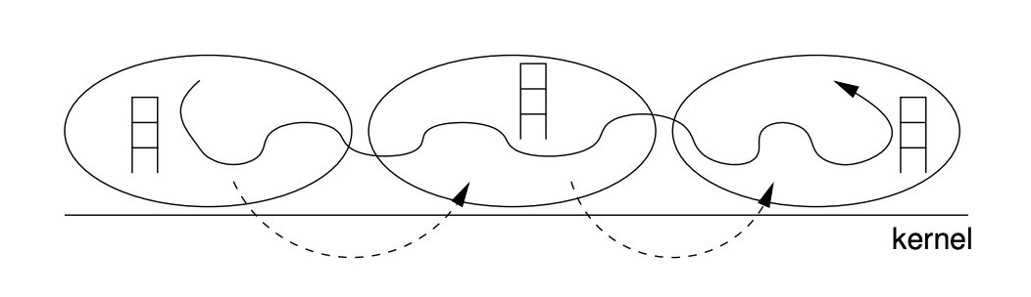
Software Optimization: LRPC and Migrating Thread
Execution contexts are spread across components, but the same schedulable entity traces invocations
Brian N Bershad, Thomas E Anderson, Edward D Lazowska, and Henry M Levy. 1990. Lightweight remote procedure call. ACM Transactions on Computer Systems (TOCS) (1990)
Bryan Ford and Jay Lepreau. 1994. Evolving Mach 3.0 to A Migrating Thread Model. In USENIX Winter.

Slide 51
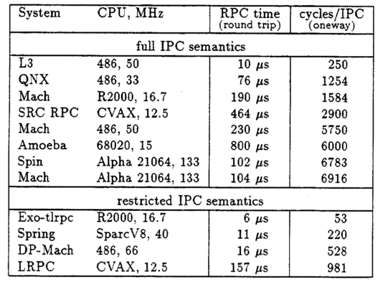
Software Optimization: L4
Fast process switch
  No scheduling
  Careful structure layout
    TLB, Cache optimized
  Kernel one-copying
    Map a calle region in kernel
1byte RPC performance
L4 can achieve 6.3us RPC.
from “On microkernel construction” (SOSP’95)

Slide 52
Breakdown of Domain Switch (e.g., seL4)
1
Switch mode (U→K)
4
Switch page table
~146 cycles
2
Save context
~107 cycles
5
Restore context
~199 cycles
3
Check capability
~211 cycles
6
Switch mode (K→U)
caller
callee
1
6
Kernel
2
3
4
5

Slide 53
End of Software Optimization
Systems |  |  | Domain Switch |  | Message passing
Type | Name | Address space | No trap | No sched | Security | Handover | Granularity | Copy time
Baseline | Mach-3.0 | Multi | ✘ | ✘ | √ | ✘ | √ | 2N
Software optimization | LRPC | Multi | ✘ | √ | √ | ✘ | √ | 2N
 | Mach (94) | Multi | ✘ | √ | √ | ✘ | √ | N
 | Tornado | Multi | ✘ | √ | √ | ✘ | √ | 0+△
 | L4 | Multi | ✘ | √ | √ | ✘ | √ | N
Domain switch:
  Trap into kernel: 2 mode switching, context save and restore (306 cycles)
  Software capability checking (211 cycles)

Slide 54
Can We Implement All IPC Logics into HW?
No, hardware should not know much about OS details
  L4: process direct switching
  seL4: fastpath & slowpath
  Google Zircon: async & throughput-target IPC
  LRPC: migration thread model
  → HW-SW co-design

Slide 55
XPC: User-level Direct Domain Switch
Process A
Process B
Process A
Process B
Two new user
instructions
Bypass the kernel to avoid mode switching
xcall
Kernel
IPC call
xret
IPC return
Kernel
Switch mode (U→K)
Save context
Check capability
Switch page table
Restore context
Switch mode (K→U)
Switch mode (U→K)
Save context
Check capability
Switch page table
Restore context
Switch mode (K→U)

Slide 56
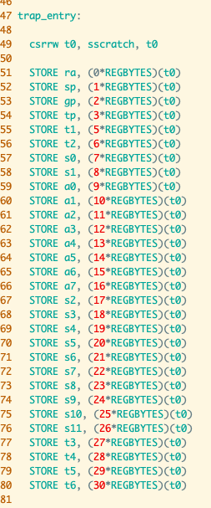
Direct Domain Switch: Context
Process A
Process B
Traditional kernel
  Save/restore all registers
  Lead to at least 62 ld/st instructions
xcall
xret
Kernel
Switch mode (U→K)
Save context
Check capability
Switch page table
Restore context
Switch mode (K→U)
Store all 31 user-registers at entry point (seL4 RISC-V)

Slide 57
Direct Domain Switch: Context
Process A
Process B
Traditional kernel
  Save/restore all registers
  Lead to at least 62 ld/st instructions
XPC: selectively save/restore
  Hardware: save necessary registers
    Program counter
    Page table base register
  Software: selectively save registers
    Decided by applications themselves
xcall
xret
Kernel
Switch mode (U→K)
Save context
Check capability
Switch page table
Restore context
Switch mode (K→U)
selectively
selectively

Slide 58
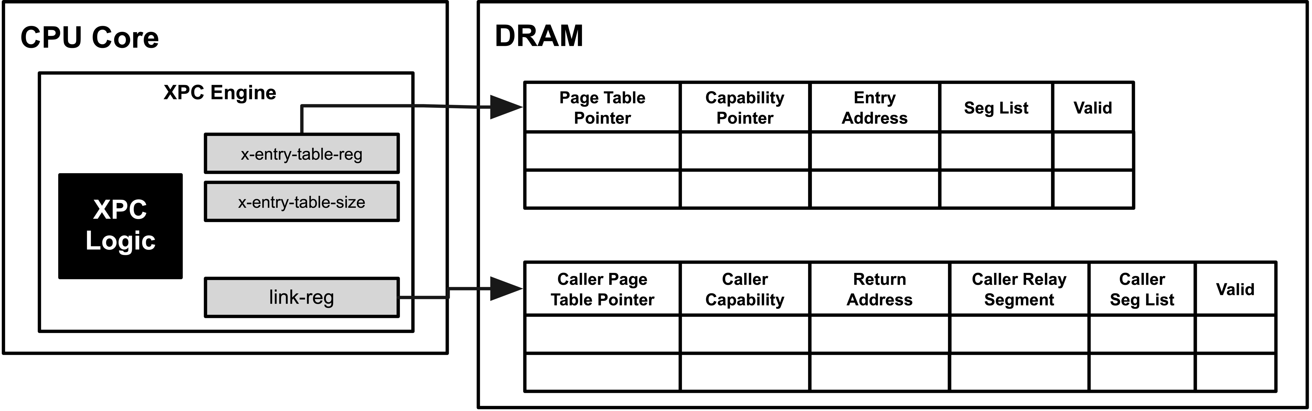
Direct Domain Switch: Context
X-entry table
  Record callee’s context
  In-memory & scale
  Global
Link stack
  Save caller’s privileged context
  Per-thread

Slide 59
Direct Domain Switch: Capability
Process A
Process B
Traditional kernel
  Check capability: whether a caller can call a callee (and other checks). ~ 211 cycles
xcall
xret
Kernel
Endpoint check
Long path in seL4!
Callee thread check
Observation: Most of the checking can be done offline
Switch mode (U→K)
Save context
Check capability
Switch page table
Restore context
Switch mode (K→U)
selectively
Reply cap check
selectively
Priority check
Affinity check

Slide 60
Direct Domain Switch: Capability
Process A
Process B
Traditional kernel
  Check capability: whether a caller can call a callee (and other checks). ~ 211 cycles
XPC: hardware-aware capability
  Introduce a capability table in hardware
    Each bit represents capability of caller→callee
  Software: set capability offline
    Set bits in capability table if check passes
  Hardware: check capability bits online
    Check the bits in the capability table
    Within 1 cycle. Fast!
xcall
xret
Kernel
Switch mode (U→K)
Save context
Check capability
Switch page table
Restore context
Switch mode (K→U)
selectively
result bit
selectively

Slide 61
Direct Domain Switch: Put All Together
15~76 cycles for user context save/restore
Process A
Process B
xcall
caller
xcall
callee
xret
6~18 cycles (+ 40 TLB flush)
Kernel
best case: 21 cycles an IPC call
0. Switch mode (U→K)
2. Save PC
3. Check result bit
4. Switch page table & flush TLB
5. Restore PC
0. Switch mode (K→U)
1. Save registers selectively by caller
Check capability and set result bits (offline)
6. Restore registers selectively by callee
Link-stack
←
Xcall-cap
Xentry-table
→
in Hardware
in Software

Slide 62
Architectural support for Copy-on-write
CoWLight
CoWLight: Hardware Assisted Copy-on-Write Fault Handling for Secure Deduplication. Kumar T, Santhosh, et al. (HASP’2019)

Slide 63
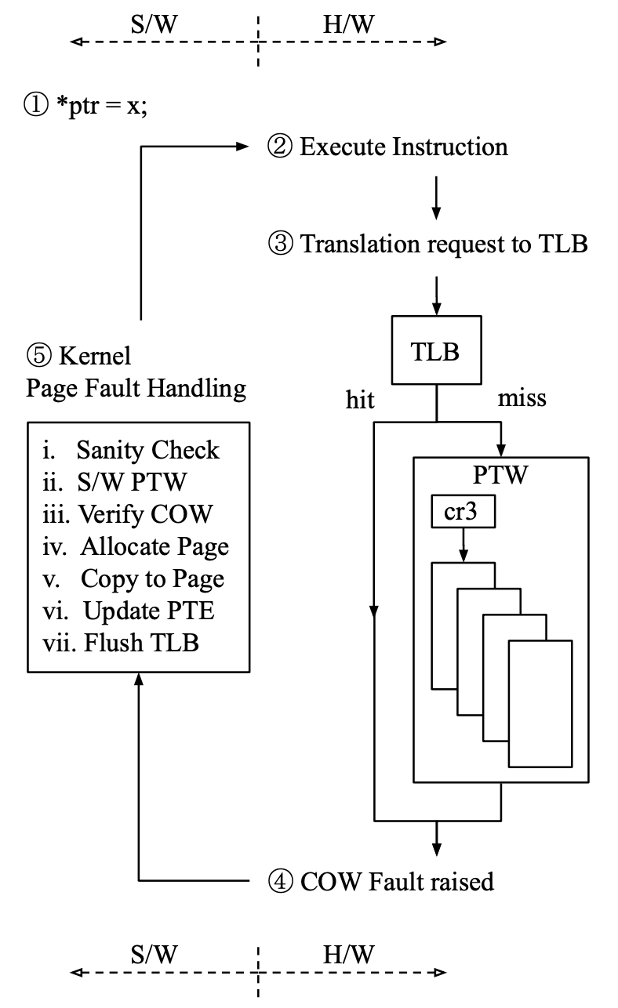
CoW Fault Handling
Hardware trigger faults
OS is responsible to handle all the things
Simple & suitable for HW
CoW triggered

Slide 64
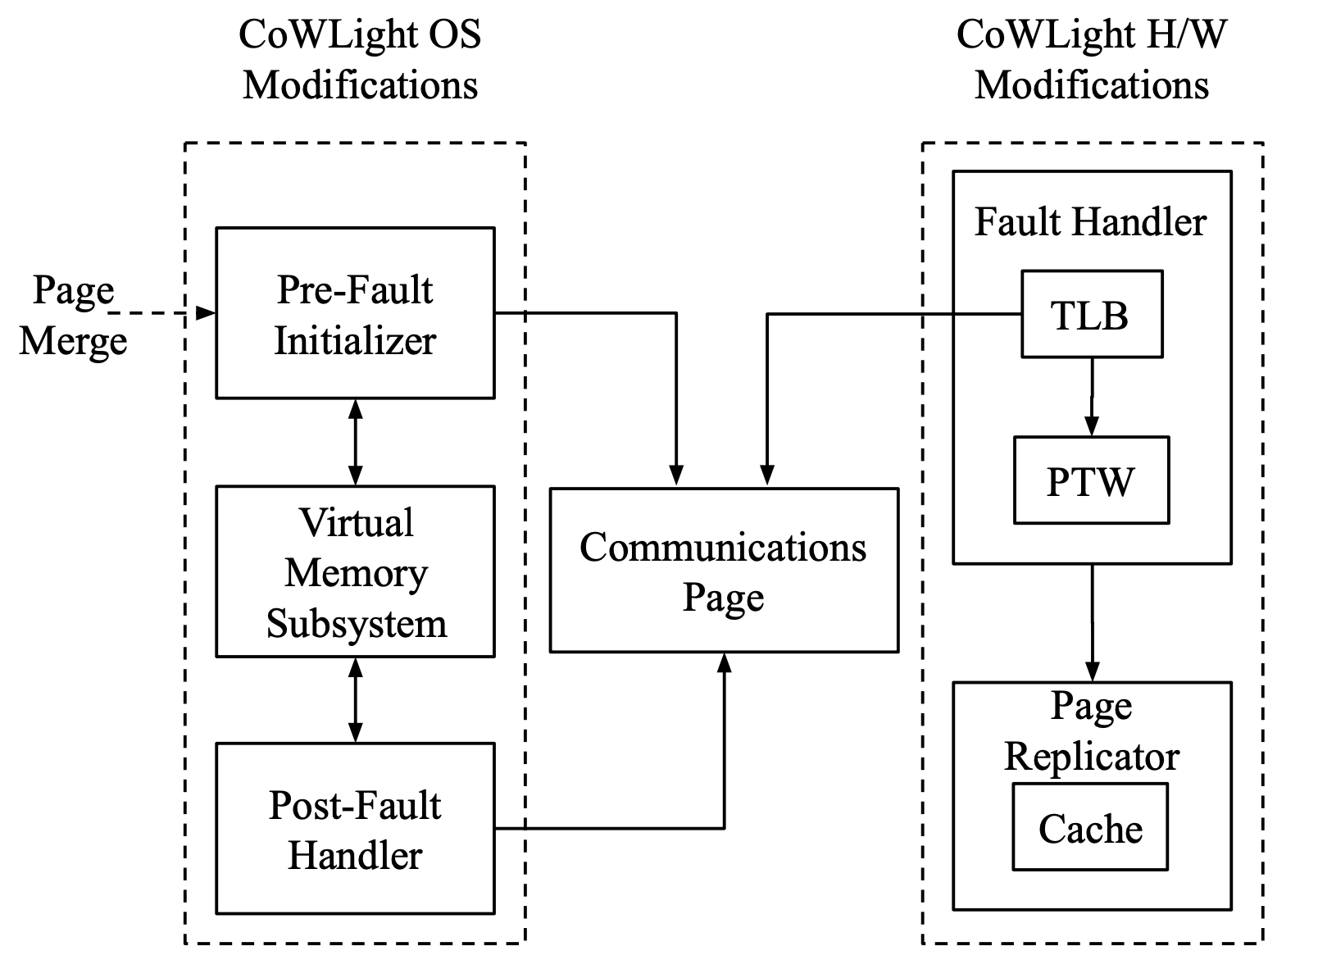
CowLight
Communication page
  Free physical pages
  Consumed physical pages (by CoWLight HW)

Slide 65
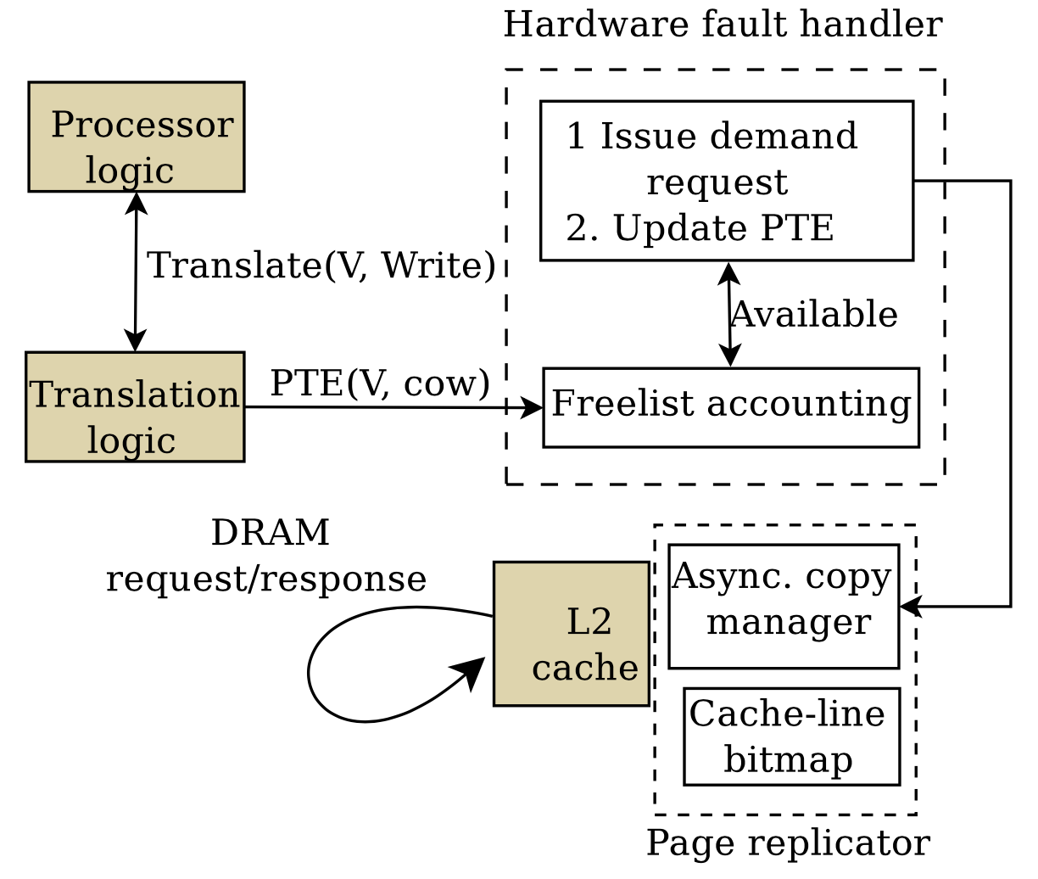
CowLight Hardware Extensions
CoW bit in PTE
Update PTE with pages in freelist
Asynchronous page copying

Slide 66
Architectural support for Memory allocation
Mallacc
Mallacc: Accelerating memory allocation. Kanev, Svilen, et al. (ASPLOS’2017)

Slide 67
^{Optimization Target}
Apps
Web server
malloc
Lib/runtime
allocator
GC
OS
Kernel (e.g., Linux)
Process
File System
Kernel

Slide 68
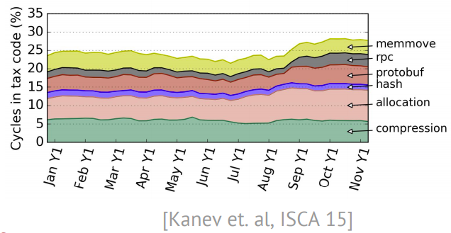
Why Optimizing Malloc?
We are used to deep accelerators motivated by 90/10 rules
Malloc
What if there is no 90% hotspot?
Largest hotspots at 1-7% datacenter tax (datacenter OS)

Slide 69
Allocator
Bookkeep available memory
  get pages from the kernel (e.g., mmap)
  give them out to application requests (e.g., malloc)
Modern allocators (tcmalloc, jemalloc, Hoard, ...)
  round requests in size classes
  keep hierarchical pools of memory
  keep closest pools thread-private
, e.g., Malloc(240)

Slide 70
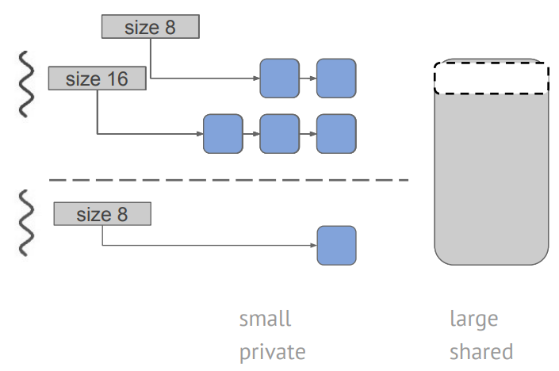
Allocator
Case

Slide 71
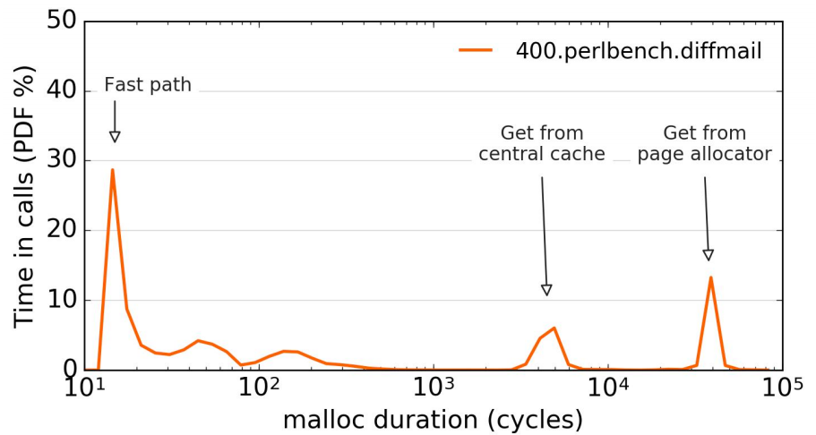
Allocator Performance
Most optimization effort spent at avoiding costly shared pools
fast paths are “fast enough”

Slide 72
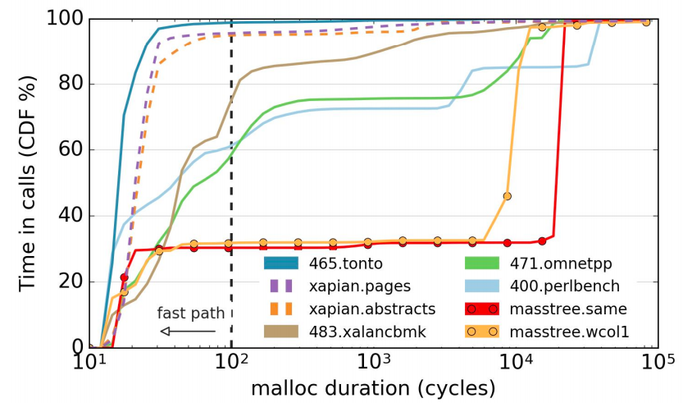
Allocator Performance
Death by a thousand cuts
fast paths are “fast enough”
Fast paths can consume the bulk of allocation time (60+%)

Slide 73
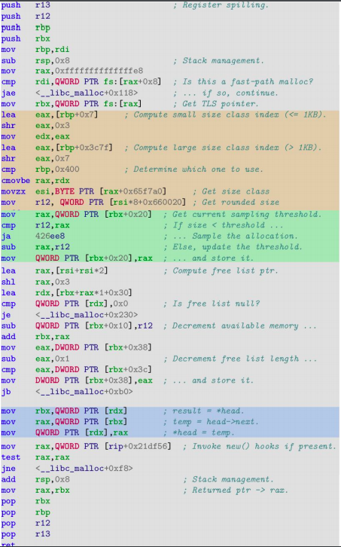
Allocator fast path breakdown
requested size → size class
(cheap hash + lookups)
sampling
(for profiling)
update metadata
(still in software)
get free address for size class
(pop free list head)

Slide 74
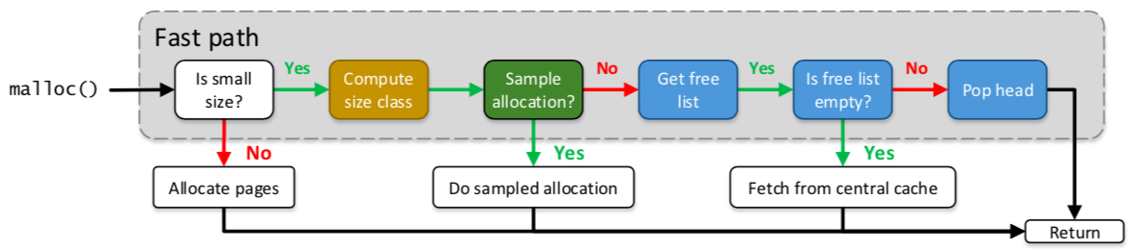
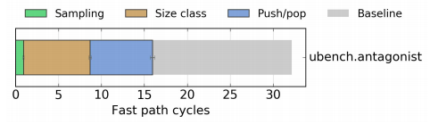
Allocator Breakdown
Optimize “size class” and “push/pop”

Slide 75
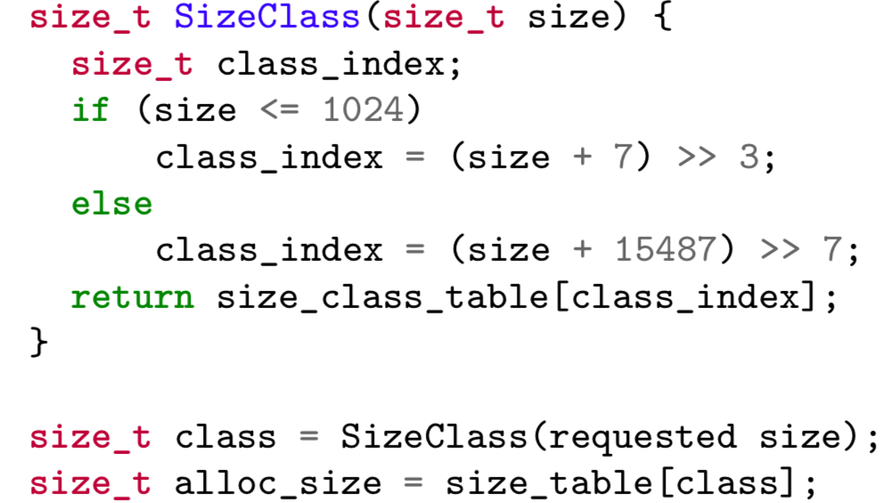
Size class loopkup
Implementation
Deterministic lookup!

Slide 76
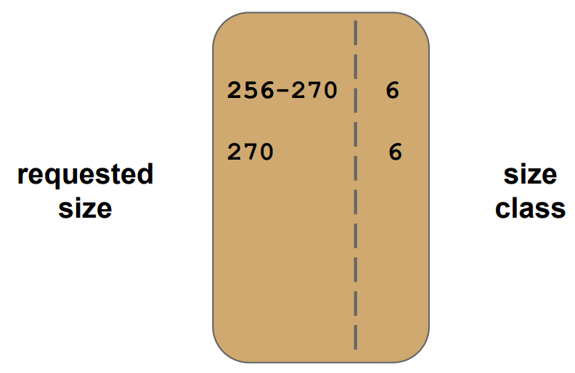
Malloc Cache: memorize hot size classes
Malloc Cache
  request size -> size class + alloc size
  Accelerate size class computation
New instructions
  mcszlookup(ReqSize)
    Reaturn: SizeClass, AllocSize
    err : ZF =0 (otherwise ZF=1)
  mcszupdate(ReqSize, AllocSize, SizeClass)

Slide 77
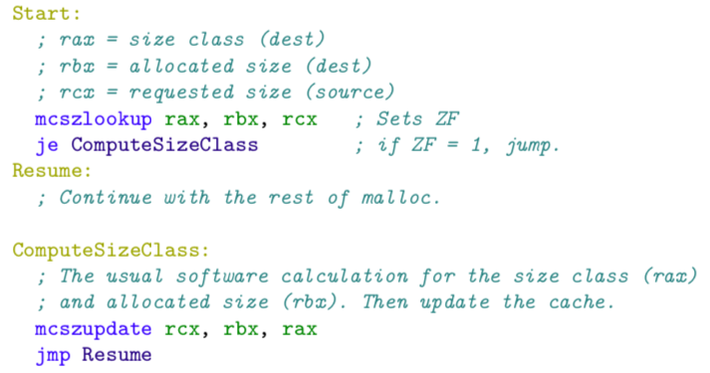
Size Class Lookup with Mallacc
1 cycle for fast path
Cache miss: goto original routine

Slide 78
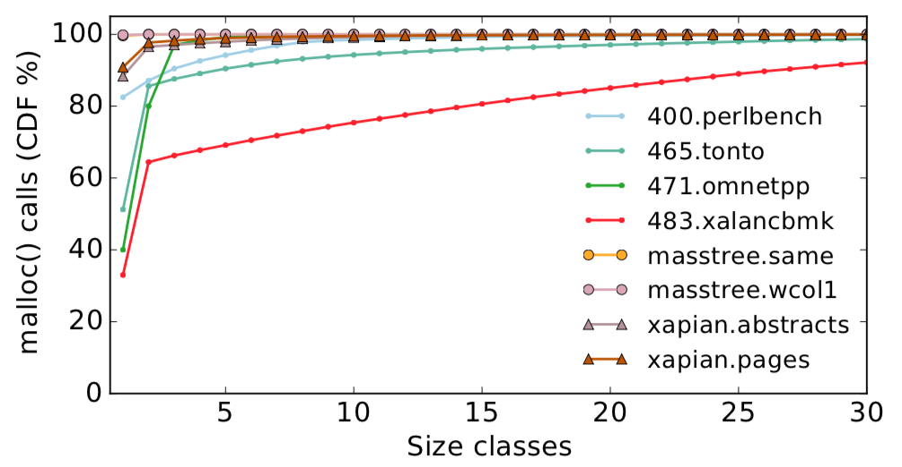
Why it works？
Many benchmarks use a very small number of size classes.
High cache hit rate!

Slide 79
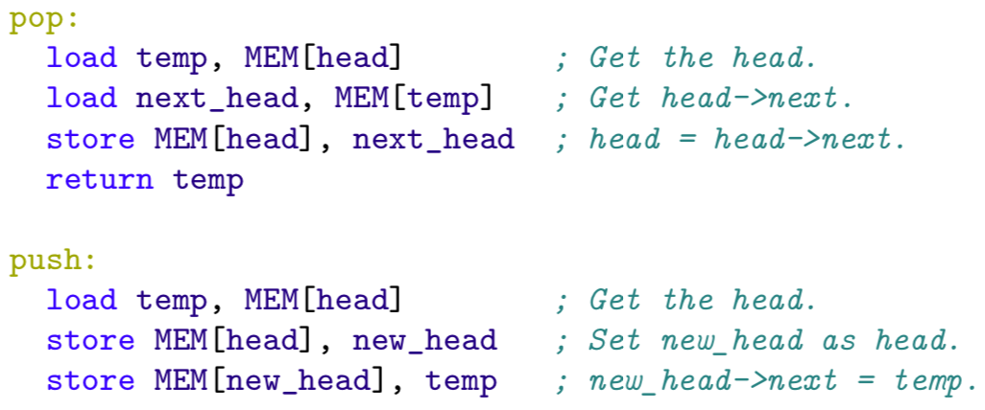
Push/pop on Free-lists
Implementation
2*Load + 1*Store
1*Load + 2*Store

Slide 80
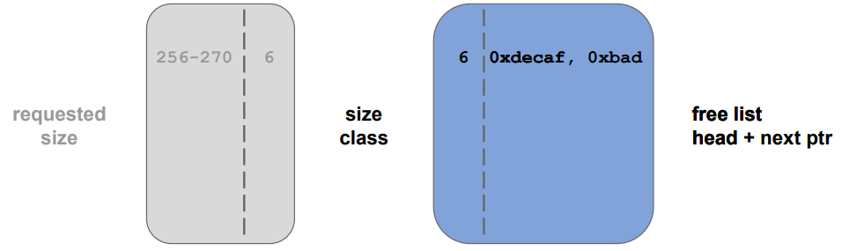
Prefetch/Store free list heads
Malloc Cache
  size class-> free list head+next
  Accelerate push/pop on free lists

Slide 81
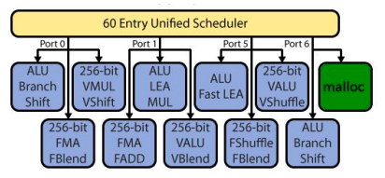
Mallacc
Typical calls take ~6-7ns (20 cycles)
To do better in hardware
  integrate with the core
  dedicated functional unit + new instructions

Slide 82
New Instructions
mchdpop(SizeClass)
  Return: Head, Next
mchdpush(SizeClass, NewHead)
  Push the NewHead in the Cache
mcnxtprefetch(SizeClass, NewNext)
  Prefetch the NewNext to the Cache

Slide 83
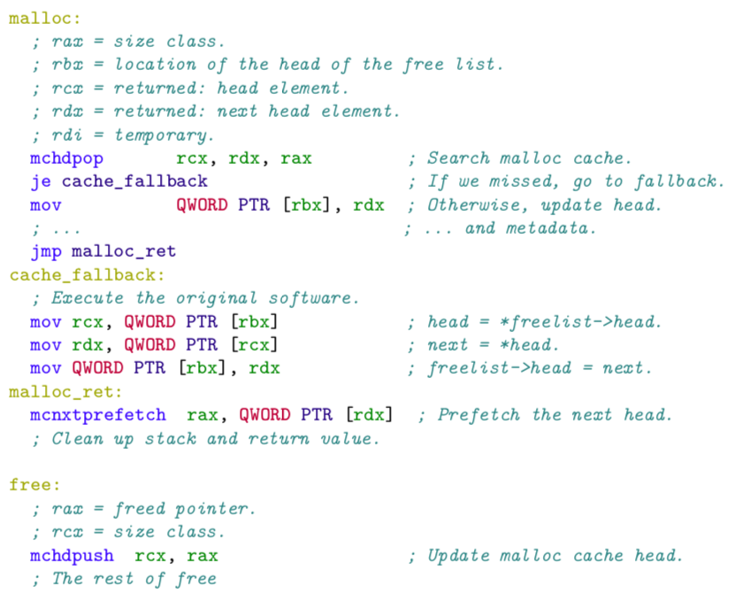
Push/Pop with Mallacc

Slide 84
Summary
Architectural supports for OS have long history
HW-SW co-design is key
  Do not put everything in HW!
HW-based optimizations are proposed when SW can not improve anymore
  Old techniques: IPC, CoW, malloc, GC

