Slide 1
Loop Optimization
Oct. 2013

Slide 2
Outline
Why loop optimization
Common techniques
Blocking vs. Unrolling
Blocking Example

Slide 3
Why
Loop: main bottleneck especially in Scientific Program(like image processing).
Repeated execution: improve a little then Speedup a lot

Slide 4
Definition
Loop optimization can be viewed as the application of a sequence of specific loop transformations to the source code or intermediate representation
Legality: result of the program should be preserved.

Slide 5
Transformation Techniques
According to Wikipedia, More than 10 items(just a list):
  fission/distribution
  fusion/combining
  interchange/permutation
  Inversion
  loop-invariant code motion
  Parallelization
  Reversal
  Scheduling
  Skewing
  software pipelining
  splitting/peeling
  Vectorization
  Unswitching
As to perflab, Loop Unrolling and Loop Blocking might be useful

Slide 6
Loop Unrolling
Mentioned a lot in class, which is also known as loop unwinding
The overhead try to eliminate:
  Pointer arithmetic
  End of loop test

Slide 7
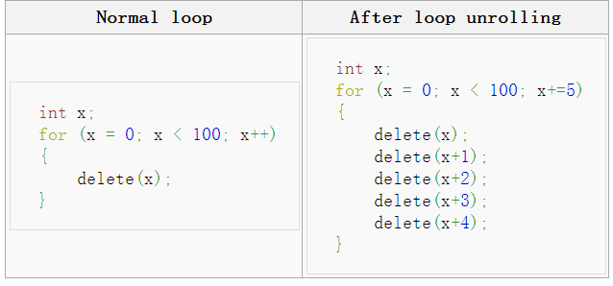
Simple example

Slide 8
Loop Blocking
Also known as loop tiling.
It partitions a loop's iteration space into smaller chunks or blocks, so as to help ensure data used in a loop stays in the cache until it is reused
Locality on loops

Slide 9
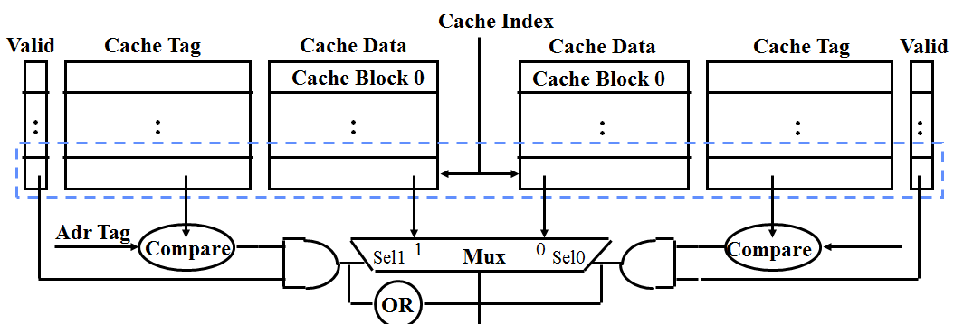
Cache Brief Review
Cache miss
One Cache line each time
Additionally: TLB miss

Slide 10
Example
Now We take Matrix multiplication as an example.
You met it in Lecture “Cache Friendly Code” Last Semester
This time, more specific.

Slide 11
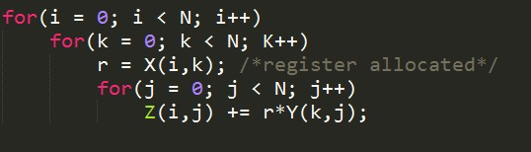
Two Matrix X * Y = Z each Matrix is N x N
Look at the innermost loop. (Besides why register allocated first ? )
k
j
j
i
k
i
X
Y
Z

Slide 12
If Cache is large enough … everything will be fine!
  Thanks to Prefetching, All Z and Y items will be reused.
What if Cache can’t hold one N x N matrix?
  Data Y would be replaced before reused
What if Cache can’t hold even a row in Z?
  Z data in the cache can’t be reused

Slide 13
What is the worst case ?
2N^3 + N^2 words of data need to be read from memory in N^3 iterations

Slide 14
Try blocking the matrix into small chunk, thus cache can hold that small chunk. Then loop locality will be back.

Slide 15
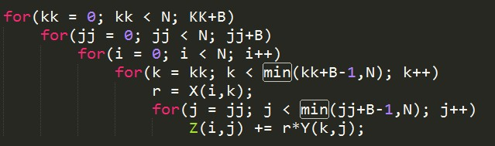
Blocking code

Slide 16
k
B
j
B
j
B
i
k
i
B
X
Y
Z

Slide 17
B <<< N (less than)
B is called blocking factor
B x B submatrix of Y and a row of length B of Z can fit in cache. Thus called B x B Blocking

Slide 18
Thus 2N^3 /B + N^2 words accessed in main memory.
Larger B, Larger performance gain?
  Choose an appropriate Blocking factor, so that cache is fully occupied by data to be reused

Slide 19
Yes, but not always.
As to fully associative cache with LRU policy, it’s right.
  Cache fully used.
In practice, caches are direct mapped or have at most a small degree of set associativity.
  Map multiple rows of a matrix to the same cache line, making it infeasible to try to fully use cache.

Slide 20
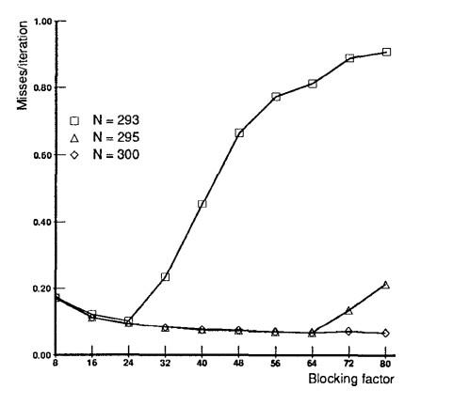
moreover, varies drastically with matrix size

Slide 21
Lab note
Hybrid method may be helpful
  Loop unrolling and blocking together.
  Function call can be inlined.
  Other methods in previous wiki list might be helpful if you want higher and higher performance. ( not suggested)

Slide 22
Some facts
Indeed, all these optimization jobs Can be done by Compiler. e.g. gcc flag LNO will do Loop Nested Optimization Job for you.
Complex Algorithm used
Manually code optimization sometimes do a better job ( you are smarter than the nerd compiler ^_^)

Slide 23
Loop Unrolling and Blocking will be involved in Midterm exam.
Thanks!!!

