Slide 1
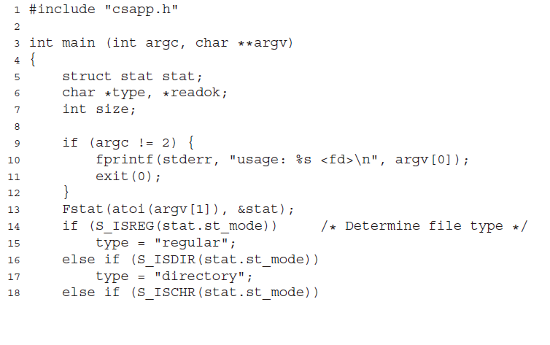
10.8

Slide 2
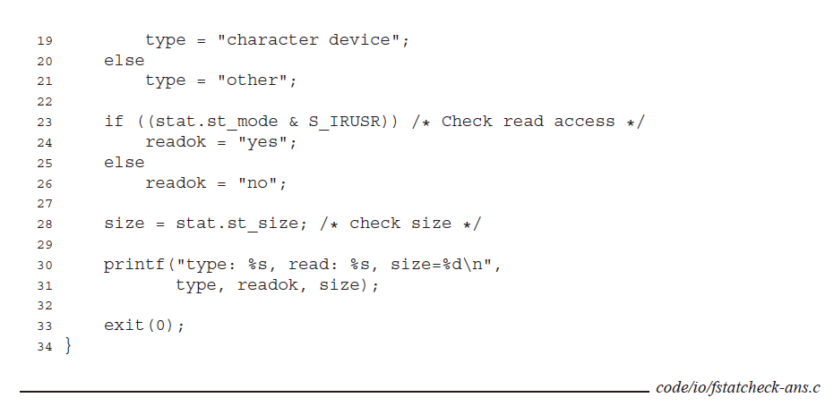
10.8

Slide 3
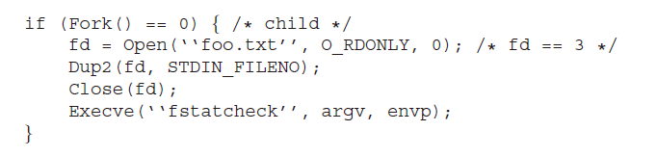
10.9

Slide 4
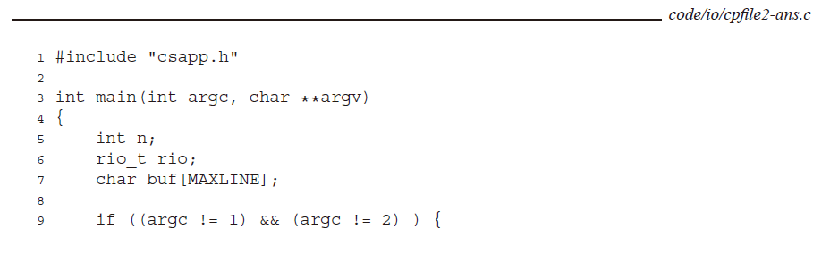
10.10

Slide 5
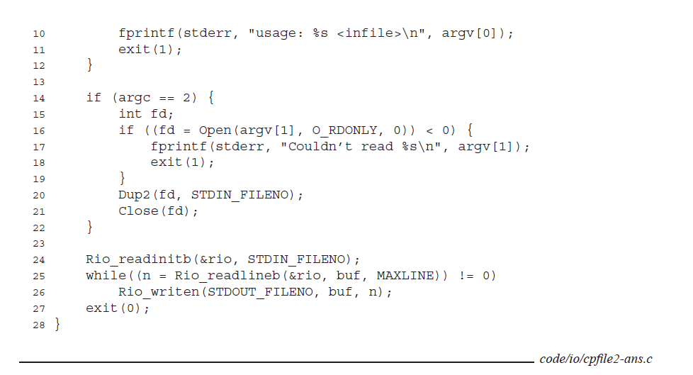
10.10

Slide 6
ARP/RARP
Institute of Parallel And Distributed Systems, Shanghai Jiao Tong University (IPADS, SJTU)
Mapping between Ethernet and IP

Slide 7
Network Topology
Take SJTU network for example
  Subnet: usually like 192.168.0.2 or 10.0.0.2
  Gateway: usually like 192.168.0.1
    Get the global IP address: 202.120.40.82
    A gateway usually has two (or more) IP address
  Proxy: get proxy’s address
    E.g., 106.185.46.164 (Japan)

Slide 8
Network Topology
Baidu
A
192.168.0.2
192.168.0.3
B
220.181.57.217
G
Google
192.168.0.4
C
Gateway
Proxy
192.168.0.1
    202.120.40.82
106.185.46.164
173.194.38.198

Slide 9
How do you code using socket to access Google?
You code as if your PC connect directly with Google
But how does the system find next hop?
C
Google
192.168.0.4
173.194.38.198

Slide 10
IP Address and ARP Address
Address of network card (MAC address)
  Globally unique and unchangeable address stored on the network card
  Ethernet header contains the MAC address of the source and the destination computer
IP address
  Each computer on a network must have a unique IP address to communicate
  Virtual and assigned by software

Slide 11
Packet are Delivered by Ethernet
  Adds an Ethernet header for delivery
  Splits the packets into frames
  Sends them down the cable to the switch
  The switch then decides which port to send the frame to (By comparing the destination address of the frame to an internal table which maps port numbers to MAC addresses)

Slide 12
Packet are Delivered by Ethernet
When an Ethernet frame is constructed from an IP packet, it has no idea what the MAC address of the destination machine is
The only information available is the destination IP address
There must be a way to the Ethernet protocol to find the MAC address of the destination machine, given a destination IP
This is where ARP, Address Resolution Protocol, come in

Slide 13
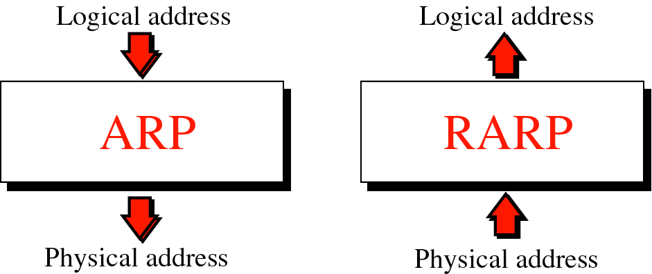
ARP & RARP

Slide 14
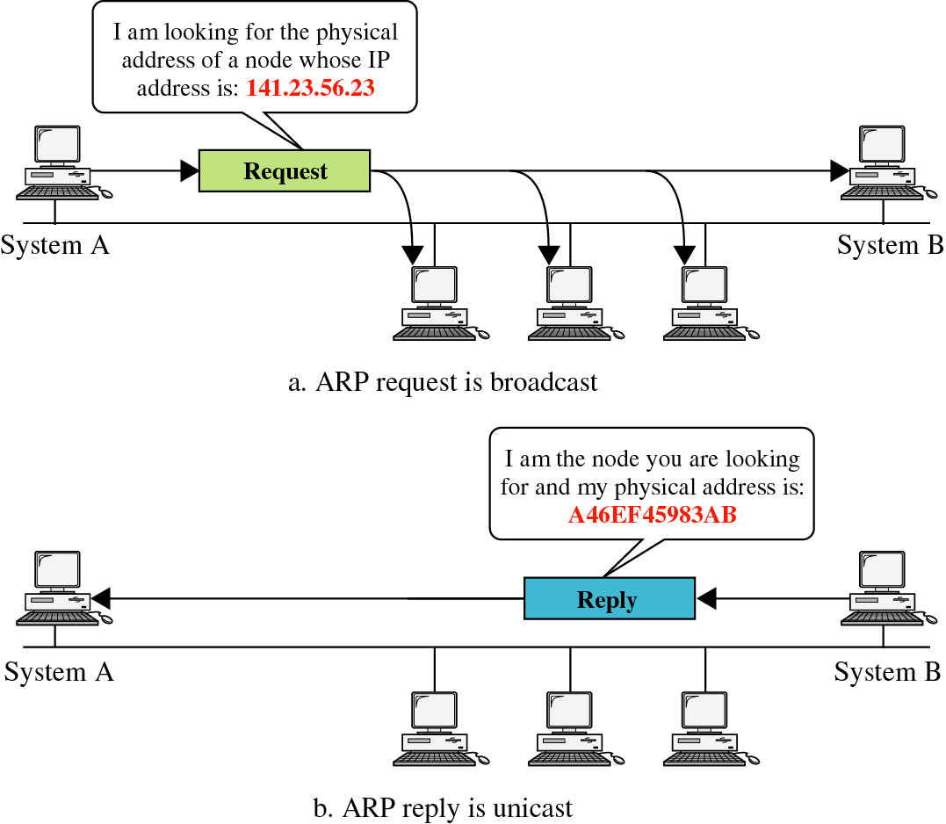
ARP & RARP

Slide 15
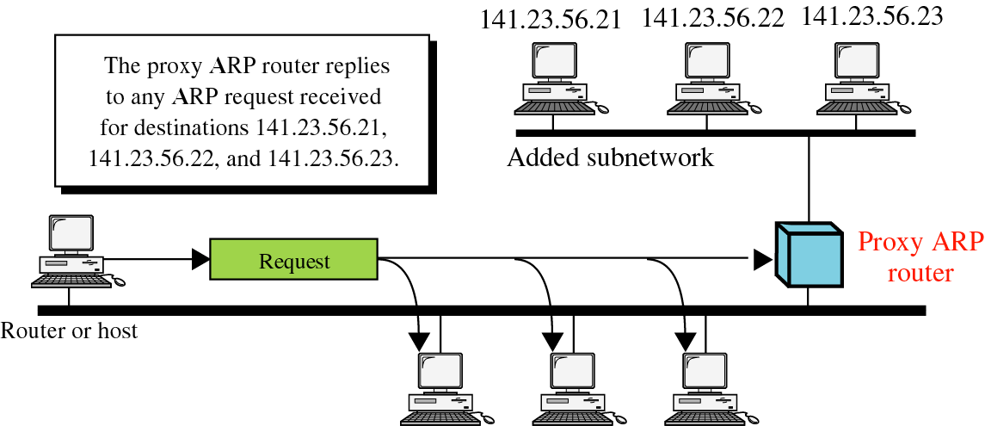
ARP & RARP

Slide 16
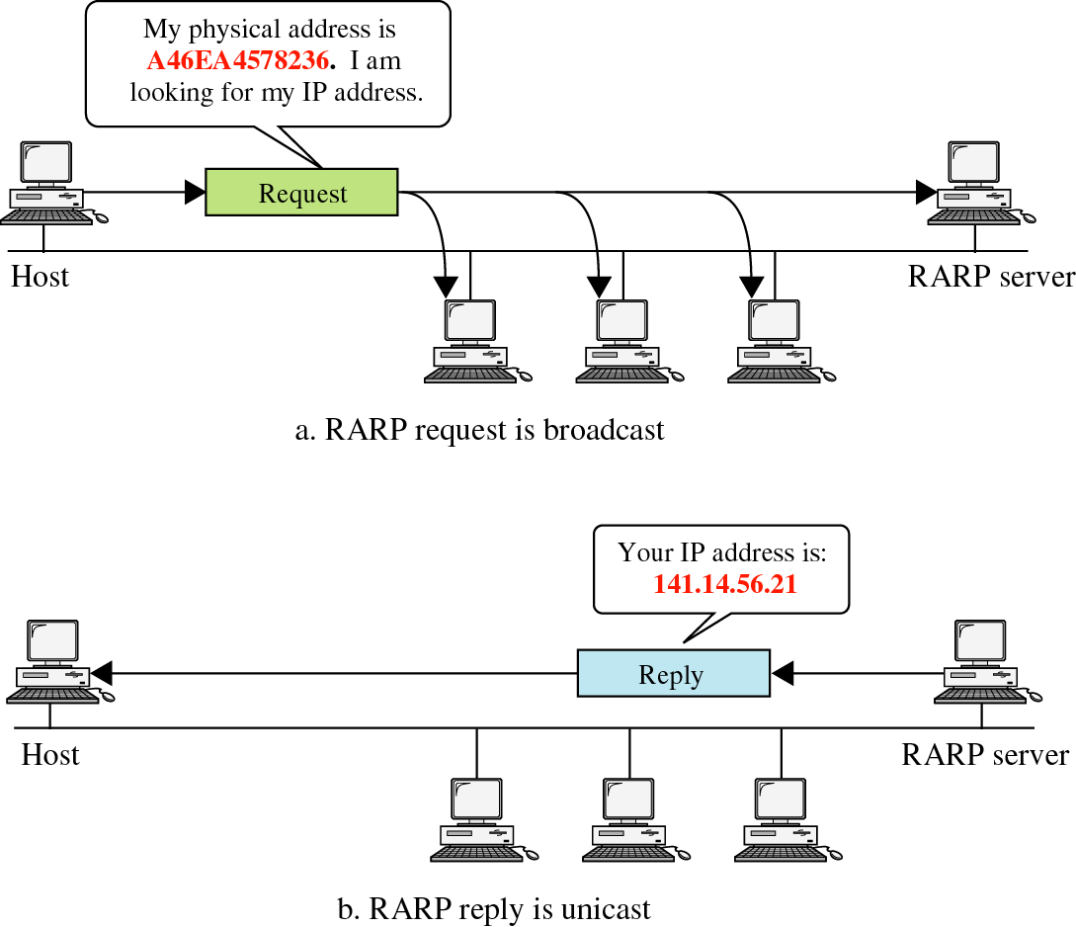

Slide 17
Putting All Together
App: I want to send a packet to Google, here is the packet with Google’s IP in its header as target IP
OS: I don’t know how to get to Google, I’ll just send it to the router (gateway). But I cannot change the source IP in the packet, so I’ll just change the MAC target address of the packet to the router’s MAC address
The router (gateway): I get a packet with my MAC as target address. Is it mine IP? No… So I’ll just forward it to next hop, by changing the target MAC address to next hop’s MAC address
Next hop: I connect directly to Google, I’ll just change the target MAC address to Google

Slide 18
ARP Spoofing
Construct spoofed ARP replies
A target computer could be convinced to send frames destined for computer A to instead go to computer B
Computer A will have no idea that this redirection took place
This process of updating a target computer’s ARP cache is referred to as “ARP poisoning”

Slide 19
Spoofed ARP reply
IP:10.0.0.2
MAC:cc:cc:cc:cc
Spoofed ARP reply
IP:10.0.0.2
MAC:cc:cc:cc:cc
switch
Spoofed ARP reply
IP:10.0.0.2
MAC:cc:cc:cc:cc
A
IP:10.0.0.1
MAC:aa:aa:aa:aa
B
IP:10.0.0.2
MAC:bb:bb:bb:bb
Hacker
IP:10.0.0.3
MAC:cc:cc:cc:cc
ARP cache
ARP cache
IP | MAC
10.0.0.2 | bb:bb:bb:bb
IP | MAC
10.0.0.1 | aa:aa:aa:aa

Slide 20
switch
A
IP:10.0.0.1
MAC:aa:aa:aa:aa
B
IP:10.0.0.2
MAC:bb:bb:bb:bb
Hacker
IP:10.0.0.3
MAC:cc:cc:cc:cc
ARP cache
ARP cache
IP | MAC
10.0.0.2 | cc:cc:cc:cc
IP | MAC
10.0.0.1 | aa:aa:aa:aa
A’s cache is poisoned

Slide 21
ARP Spoofing
Now all the packets that A intends to send to B will go to the hacker’s machine
Cache entry would expire, so it needs to be updated by sending the ARP reply again
  How often?
  depends on the particular system
  Usually every 40s should be sufficient
In addition the hacker may not want his Ethernet driver talk too much
  Accomplish with ifconfig -arp

Slide 22
Man-in-the-Middle Attack
A hacker inserts his computer between the communications path of two target computers
The hacker will forward frames between the two target computers so communications are not interrupted
E.g., Hunt, Ettercap etc
  Can be obtained easily in many web archives

Slide 23
Man-in-the-Middle Attack
The attack is performed as follows:
  Suppose X is the hacker’s computer
  T1 and T2 are the targets
  X poisons the ARP cache of T1 and T2.
  T1 associates T2’s IP with X’s MAC.
  T2 associates T1’s IP with X’s MAC.
  All of T1 and T2’s traffic will then go to X first, instead of directly to each other.

Slide 24
Spoofed ARP reply
IP:10.0.0.2
MAC:cc:cc:cc:cc
Spoofed ARP reply
IP:10.0.0.2
MAC:cc:cc:cc:cc
switch
Spoofed ARP reply
IP:10.0.0.2
MAC:cc:cc:cc:cc
T1
IP:10.0.0.1
MAC:aa:aa:aa:aa
T2
IP:10.0.0.2
MAC:bb:bb:bb:bb
Hacker
IP:10.0.0.3
MAC:cc:cc:cc:cc
ARP cache
ARP cache
IP | MAC
10.0.0.2 | bb:bb:bb:bb
IP | MAC
10.0.0.1 | aa:aa:aa:aa

Slide 25
switch
T1
IP:10.0.0.1
MAC:aa:aa:aa:aa
T2
IP:10.0.0.2
MAC:bb:bb:bb:bb
Hacker
IP:10.0.0.3
MAC:cc:cc:cc:cc
ARP cache
ARP cache
IP | MAC
10.0.0.2 | cc:cc:cc:cc
IP | MAC
10.0.0.1 | aa:aa:aa:aa
T1’s cache is poisoned

Slide 26
Forged ARP replies
IP:10.0.0.1
MAC:cc:cc:cc:cc
switch
Forged ARP replies
IP:10.0.0.1
MAC:cc:cc:cc:cc
T1
IP:10.0.0.1
MAC:aa:aa:aa:aa
T2
IP:10.0.0.2
MAC:bb:bb:bb:bb
Hacker
IP:10.0.0.3
MAC:cc:cc:cc:cc
ARP cache
ARP cache
IP | MAC
10.0.0.2 | cc:cc:cc:cc
IP | MAC
10.0.0.1 | aa:aa:aa:aa

Slide 27
switch
T1
IP:10.0.0.1
MAC:aa:aa:aa:aa
T2
IP:10.0.0.2
MAC:bb:bb:bb:bb
Hacker
IP:10.0.0.3
MAC:cc:cc:cc:cc
ARP cache
ARP cache
IP | MAC
10.0.0.2 | cc:cc:cc:cc
IP | MAC
10.0.0.1 | cc:cc:cc:cc
T2’s cache is poisoned

Slide 28
Message intended to send to T2
switch
Hacker will
relay the
message
T1
IP:10.0.0.1
MAC:aa:aa:aa:aa
T2
IP:10.0.0.2
MAC:bb:bb:bb:bb
Hacker
IP:10.0.0.3
MAC:cc:cc:cc:cc
ARP cache
ARP cache
IP | MAC
10.0.0.2 | cc:cc:cc:cc
IP | MAC
10.0.0.1 | cc:cc:cc:cc

Slide 29
Hacker will relay the message
switch
Message
intended to
send to T1
T1
IP:10.0.0.1
MAC:aa:aa:aa:aa
T2
IP:10.0.0.2
MAC:bb:bb:bb:bb
Hacker
IP:10.0.0.3
MAC:cc:cc:cc:cc
ARP cache
ARP cache
IP | MAC
10.0.0.2 | cc:cc:cc:cc
IP | MAC
10.0.0.1 | cc:cc:cc:cc

Slide 30
Defenses against ARP Spoofing
No Universal defense (!)
Use static ARP entries
  Cannot be updated
  Spoofed ARP replies are ignored
  ARP table needs a static entry for each machine on the network
  Large overhead
    Deploying these tables
    Keep the table up-to-date

Slide 31
  Someone point out
  Windows still accepts spoofed ARP replies and updates the static entry with the forged MAC
    Sabotaging the purpose of static routes
Port Security
  Also known as port binding or MAC Binding
  A feature on some high-end switches
  Prevents changes to the MAC tables of a switch
    Unless manually performed by a network administrator
  Not suitable for large networks and networks using DHCP

Slide 32
Arpwatch
A free UNIX program which listens for ARP replies on a network
Build a table of IP/MAC associations and store it in a file
When a MAC/IP pair changes (flip-flop), an email is sent to an administrator
Some programs, such as Ettercap, cause only a few flip flops is difficult to be detected on a DHCP-enabled network, where flip flops occur at regular intervals

