Slide 1
Something on TLB

Slide 2
Multiple Level TLB
Intel's Nehalem microarchitecture
  One L1 D-TLB (4-way set associative)
    64 entries for 4 KiB pages and
    32 entries for 2/4 MiB pages
  One L1 I-TLB
    128 entries for 4 KiB pages using 4-way associativity
    14 fully associative entries for 2/4 MiB pages
  One unified L2 TLB
    512-entry 4 KiB pages both 4-way associative

Slide 3
Performance Levels of TLB
These are typical performance levels of a TLB:
  size: 12 – 4,096 entries
  hit time: 0.5 – 1 clock cycle
  miss penalty: 10 – 100 clock cycles
  miss rate: 0.01 – 1%

Slide 4
TLB Flush on Context Switch
Intel 386
  Flush the entire TLB
Intel 486 and after
  Selectively invalidate TLB entry

Slide 5
Tagged TLB to Avoid TLB Flush
Alpha 21264
  Each TLB entry is tagged with an "address space number" (ASN)
  Only TLB entries with an ASN matching the current task are considered valid
Pentium Pro
  1. Page global enable (PGE) flag in the register CR4
  2. Global (G) flag of a page-directory or page-table entry
  Prevent frequently used pages from being automatically invalidated in the TLBs on a task switch or a load of register CR3

Slide 6
Handling TLB Misses
The TLB is small; it cannot hold all PTEs
  Some translations will inevitably miss in the TLB
  Must access memory to find the appropriate PTE
    Called walking the page directory/table
    Large performance penalty
Who handles TLB misses?
  Hardware-Managed TLB
  Software-Managed TLB

Slide 7
Handling TLB Misses: Hardware
Approach #1. Hardware-Managed (e.g., x86)
  The hardware does the page walk
  The hardware fetches the PTE and inserts it into the TLB
    If the TLB is full, the entry replaces another entry
  All of this is done transparently

Slide 8
Handling TLB Misses: Hardware
Hardware-Managed TLB
  Pro: No exceptions. Instruction just stalls
  Pro: Independent instructions may continue
  Pro: Small footprint (no extra instructions/data)
  Con: Page directory/table organization is etched in stone
  Con: Those transistors might be better spent on bigger TLBs? (if there are bugs in the software TLB handlers, you can actually fix them)

Slide 9
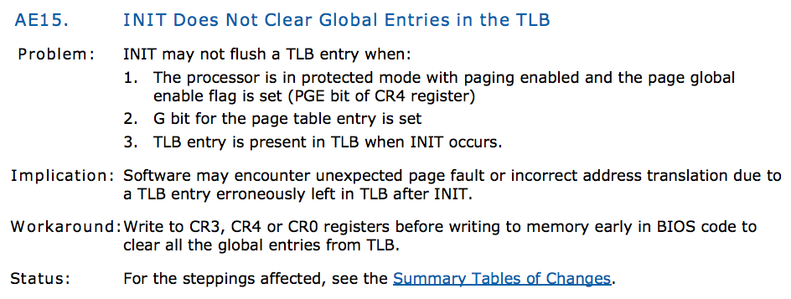

Slide 10
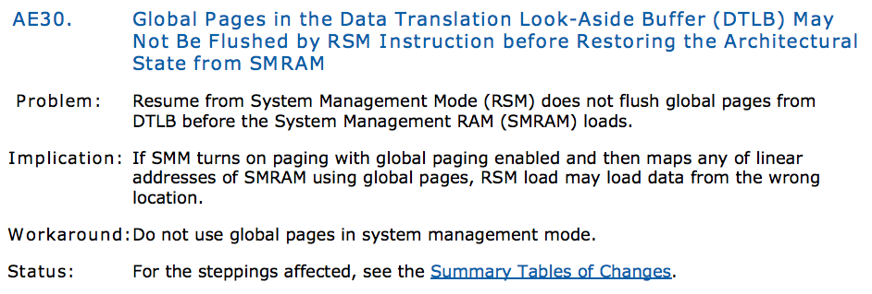

Slide 11
Handling TLB Misses: Software
Approach #2. Software-Managed (e.g., MIPS)
  The hardware raises an exception
  The operating system does the page walk
  The operating system fetches the PTE
  The operating system inserts/evicts entries in the TLB
  PowerPC architecture has examples of both software and hardware TLB, depending on the exact CPU model

Slide 12
Handling TLB Misses: Software
Software-Managed TLB
  Pro: The OS can design the page directory/table
  Pro: More advanced TLB replacement policy
  Con: Flushes pipeline
  Con: Performance overhead

Slide 13
Inter-Core Cooperative Prefetching
Problems on multi-threaded programs:
  Two types of predictable misses
Inter-Core Shared (ICS)
  Leader-Follower Prefetching
Inter-Core Predictable Stride (ICPS)
  Distance-Based Cross-Core Prefetching

Slide 14
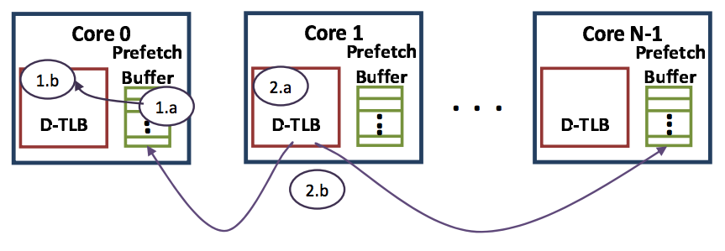
Leader-Follower Algorithm
Prefetches a TLB miss translation seen on one core (the leader) into the other cores (the followers)to eliminate inter-core shared TLB misses

Slide 15
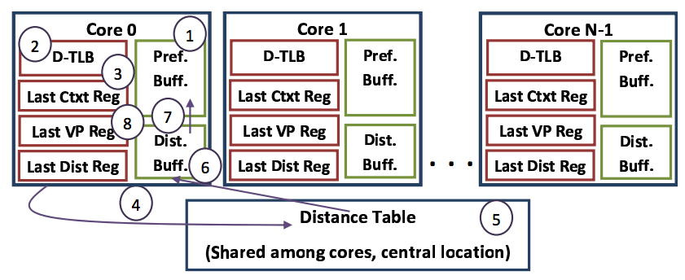
Distance-based Cross-Core prefetching uses a central, shared Distance Table to store distance pairs and initiates prefetches based on these patterns whenever a TLB miss occurs on one of the cores (for both PB hits and misses)

Slide 16
Software TLB for Isolation
Exokernel
  Separate memory management from authorization
  Each libOS can manage their own page table
  Exokernel can ensure isolation between each OSes
  Exokernel checks permission of memory access without being on the critical data path
    Check on each TLB-miss
    Create TLB entry only if a libOS has permission

