Slide 1
ROP
Introduction to Computer System, Fall 2014. (IPADS, SJTU)
Attack and Defense, and Attack

Slide 2



Slide 3
Preliminary Knowledge
Stack buffer overflow
File system API: open/read/write/dup2
Process fork
Socket
GOT / PLT
Canary on stack
ASLR (Address Space Layout Randomization)

Slide 4
Attack: Stack Buffer Overflow
A Typical Buffer Overflow Attack
  Inject malicious code in buffer
  Overwrite return address to buffer
  Once return, the malicious code runs
01010110101010111010
return addr
saved ebp
ebp
0110110101010101010101101010101010101010
void function(char *str) {
char buf[16];
strcpy(buf,str);
}
buf

Slide 5
Defense: DEP (Data Execution Prevention)
Execute Code, not Data
Data areas marked non-executable
  Stack marked non-executable
  Heap marked non-executable
Hardware enforced (NX)
You can load your shellcode in the stack or the heap…but you can’t jump to it

Slide 6
Attack: Code Reuse (instead of inject) Attack
ROP: Return-oriented Programming
  Find code gadgets in existed code base
    Usually 1-3 instructions, ends with ‘ret’
    In libc and application, intended and unintended
  Push address of gadgets on the stack
  Leverage ‘ret’ at the end of gadget to
  connect each code gadgets
  No code injection
0101011010
0101011010
0101011010
return addr
0101011010
saved ebp
0101011010
0101011010
0101011010

Slide 7
Code Execution – The ROP Way
Mem[v2] = v1
a₃
v₂
a₂
v₁
Desired Logic
Stack
mov %eax v1;
mov %ebx v2;
mov [%ebx], %eax
a₁: pop eax; ret
a₂: pop ebx; ret
a₃: mov [ebx], eax

Slide 8
Code Execution – The ROP Way
a₃
v₂
a₂
v₁
a₁
…
argv
argc
return addr
caller’s ebp
buf (64 bytes)
argv[1]
buf
Mem[v2] = v1
Desired Shellcode
%ebp
a₁: pop eax; ret
a₂: pop ebx; ret
a₃: mov [ebx], eax
Desired store executed!
%esp

Slide 9
Defense
Hide the binary file
  No way to get gadgets
Canary to protect the stack
  Try to detect stack overflow
ASLR to randomize the code
  Harder to find gadgets

Slide 10
Recap: Canary
Embed “canaries” in stack frames and verify their integrity prior to function return
E.g., StackGuard implemented as a GCC patch
  Program must be recompiled
  Minimal performance effects: 8% for Apache

Slide 11
Blind ROP

Slide 12
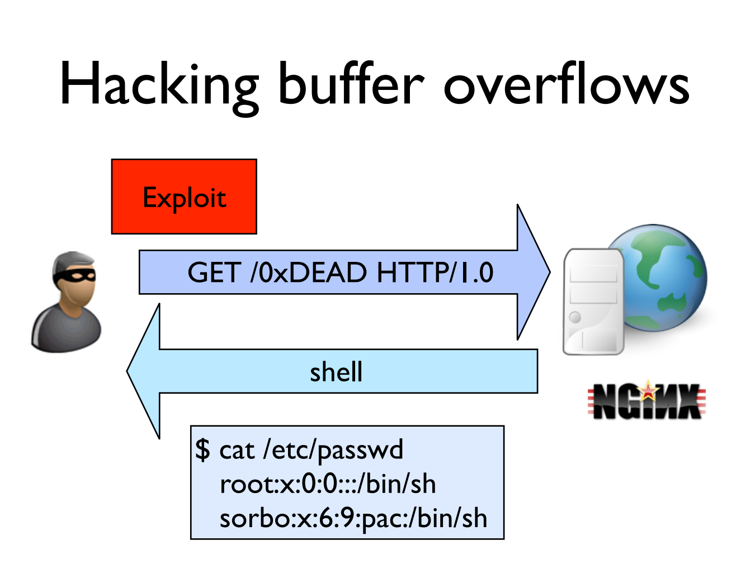

Slide 13
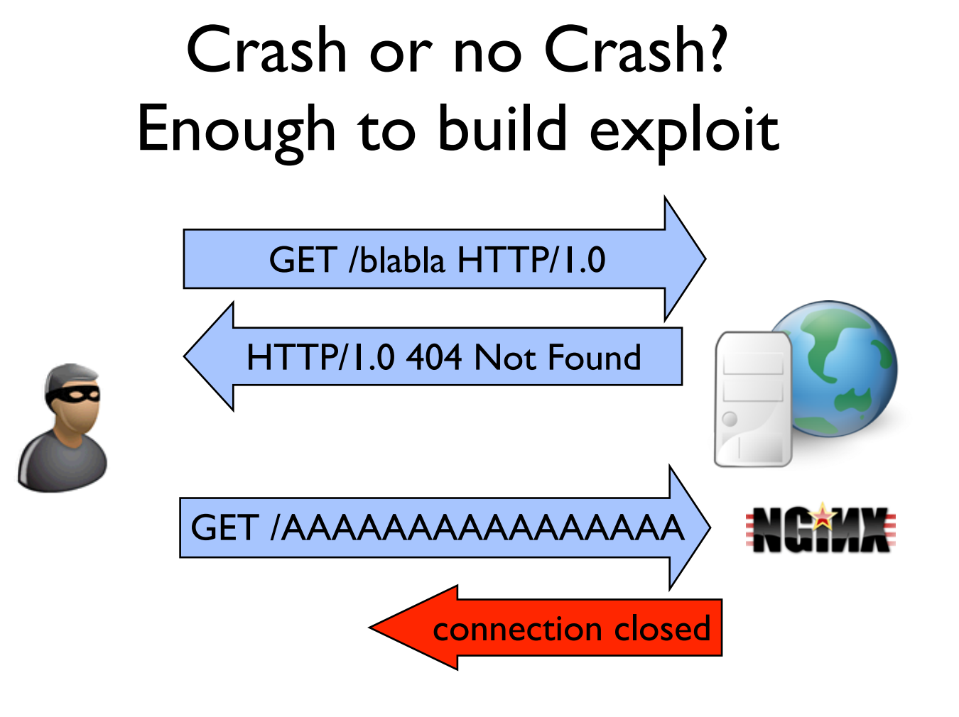

Slide 14
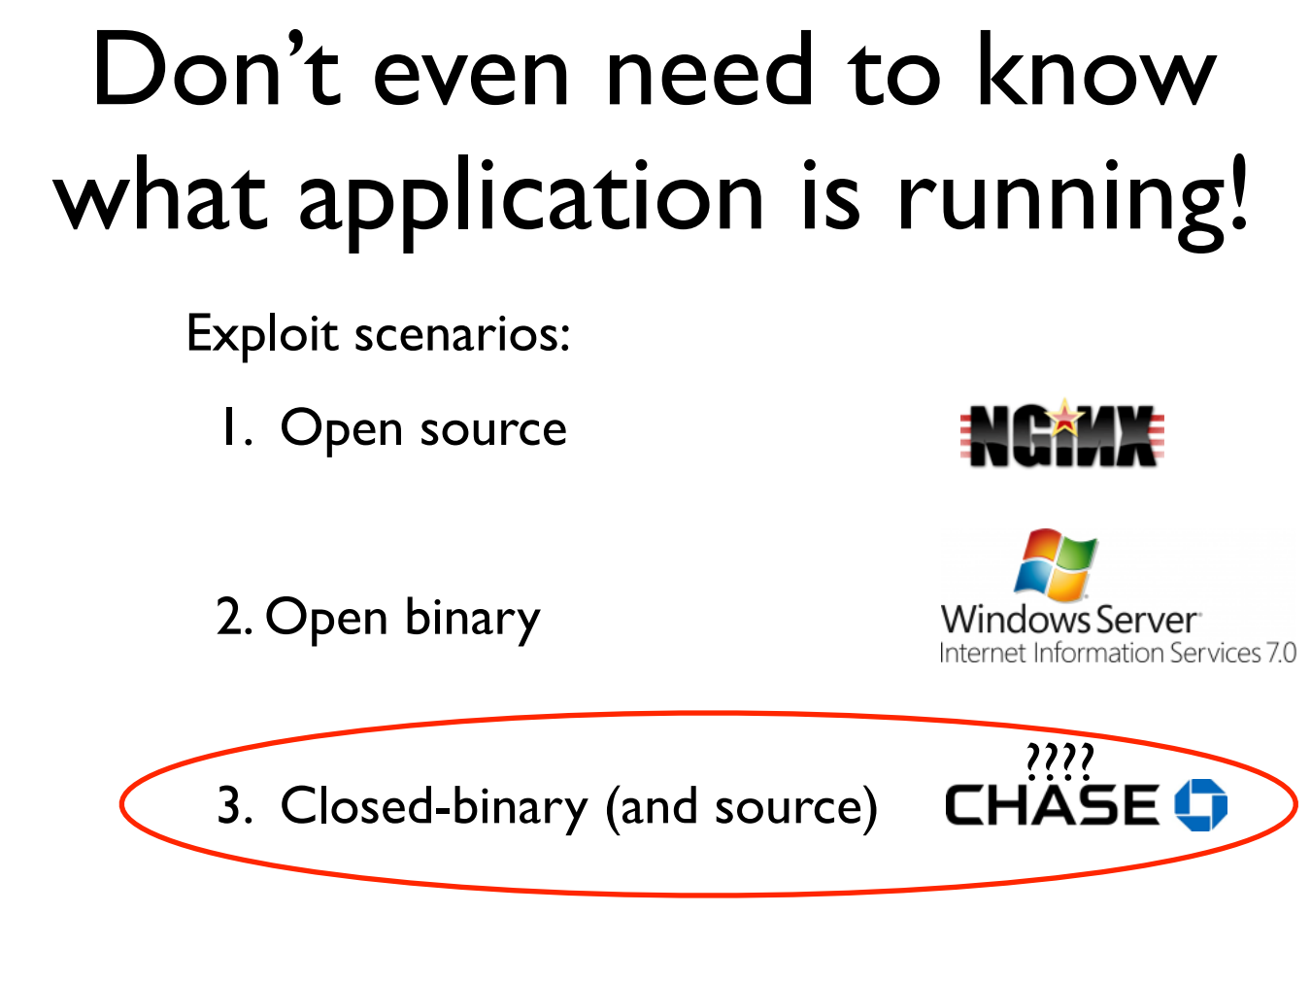

Slide 15
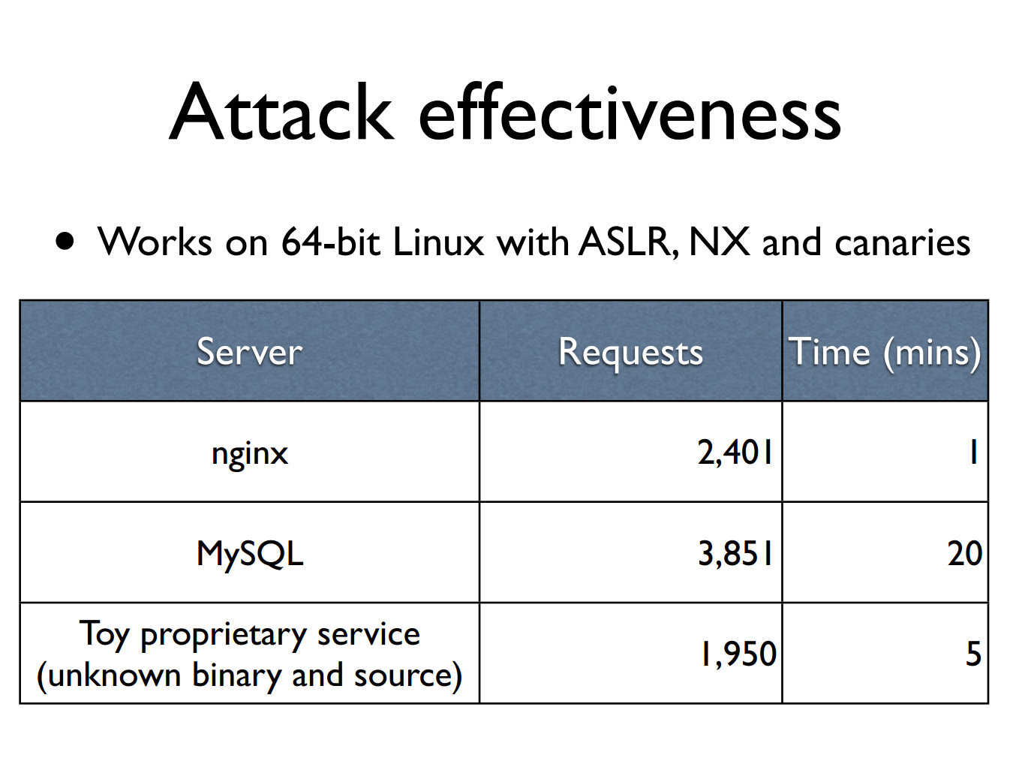

Slide 16
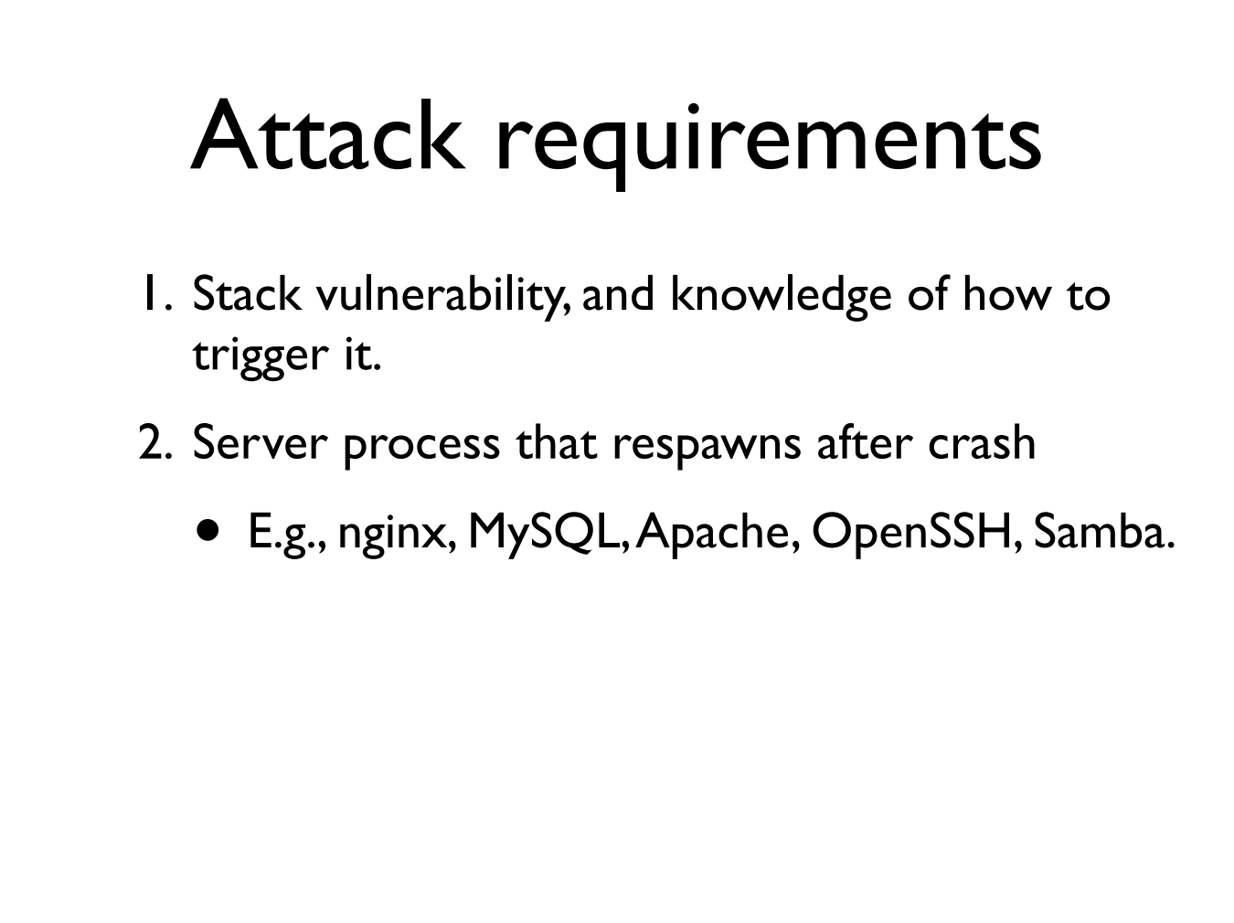

Slide 17
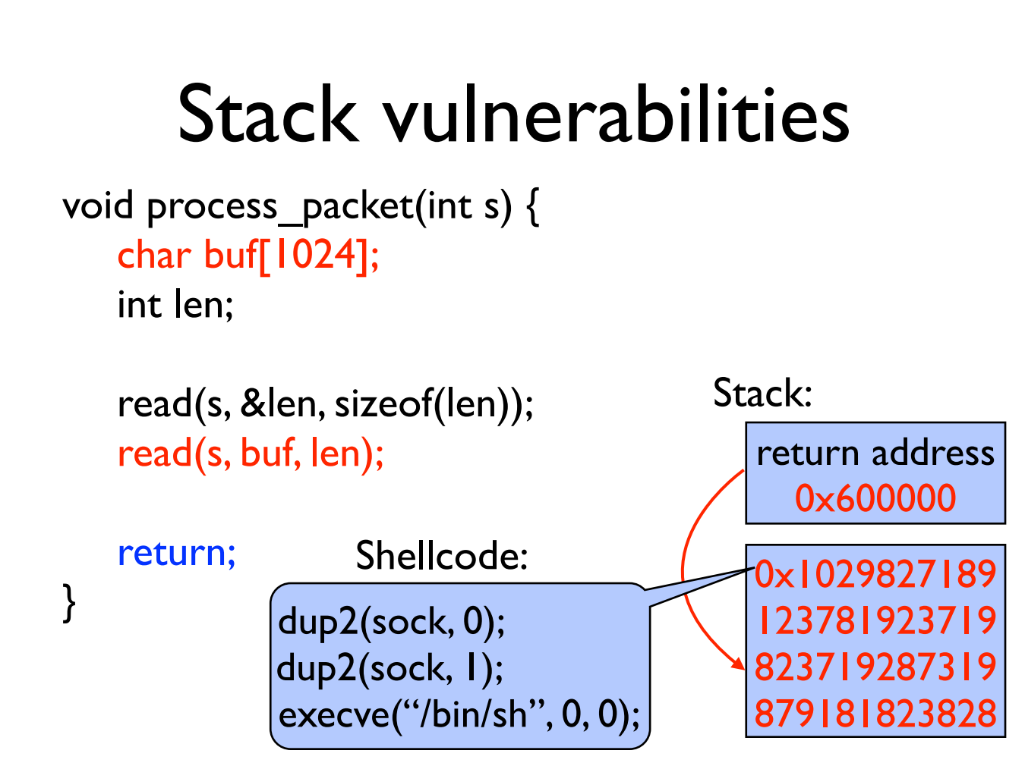

Slide 18
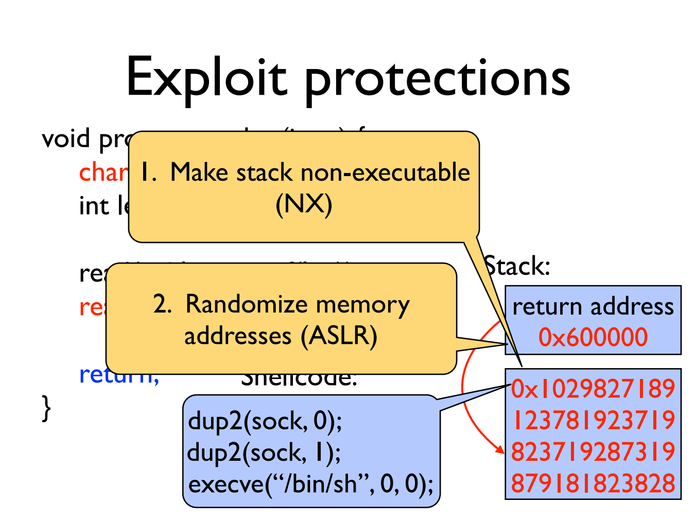

Slide 19
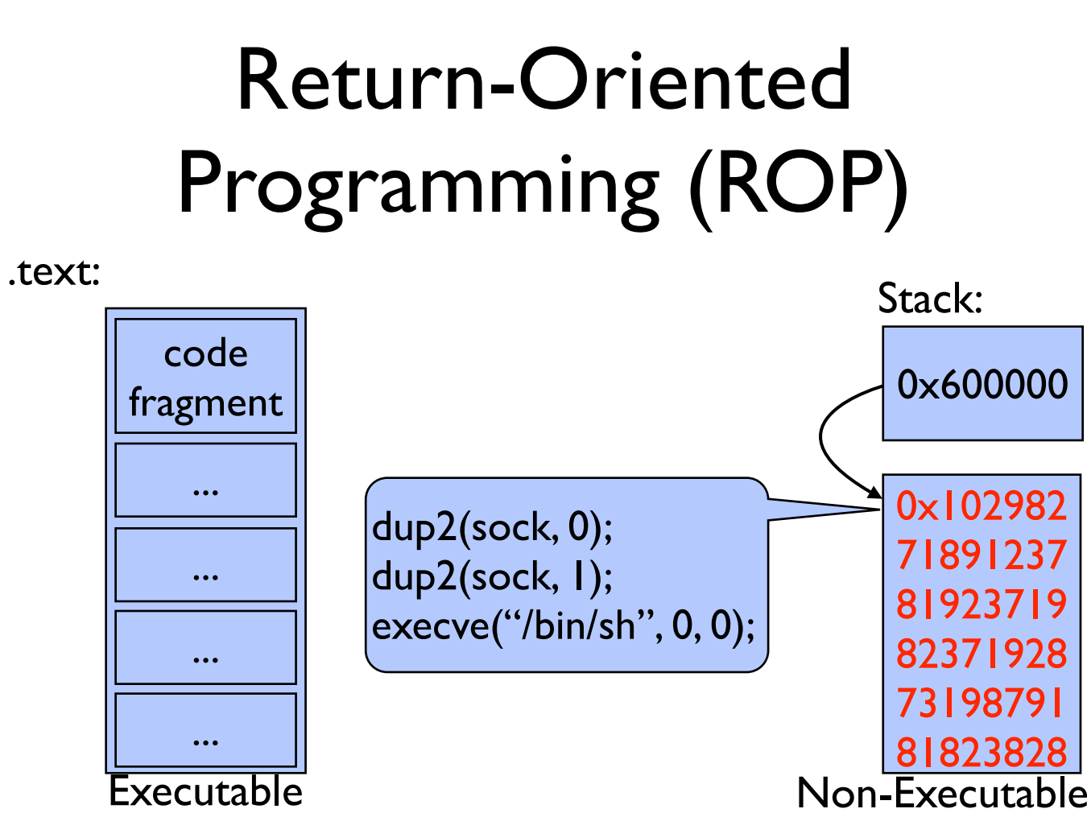

Slide 20
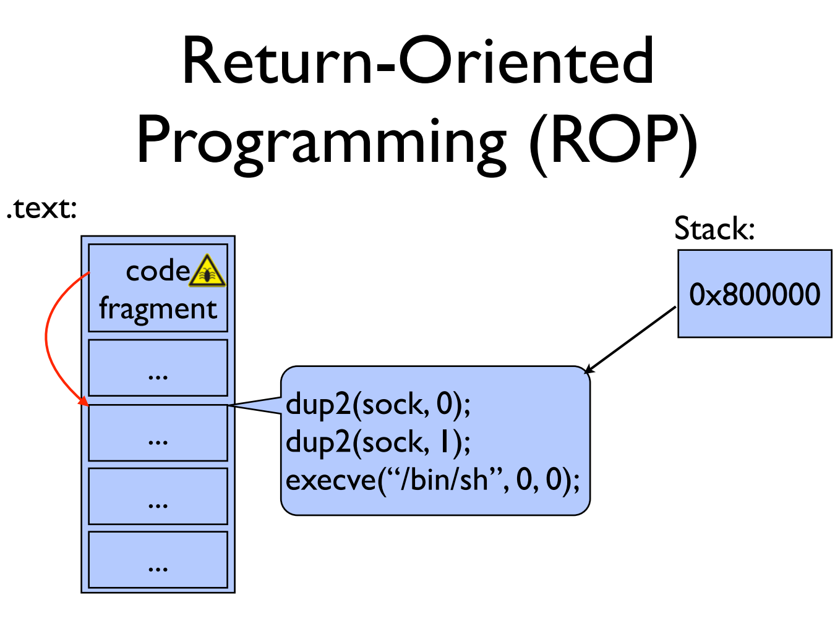

Slide 21
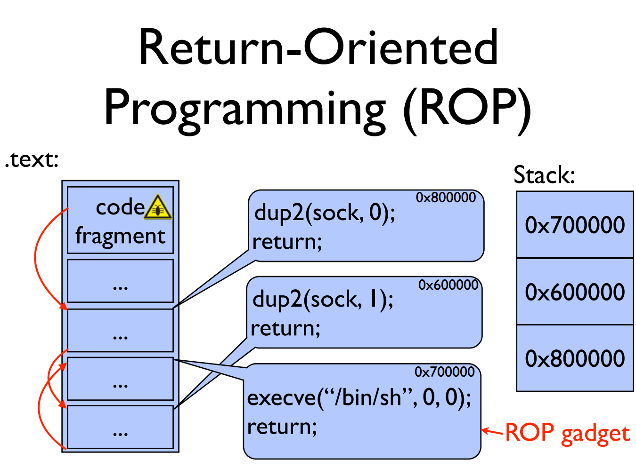

Slide 22
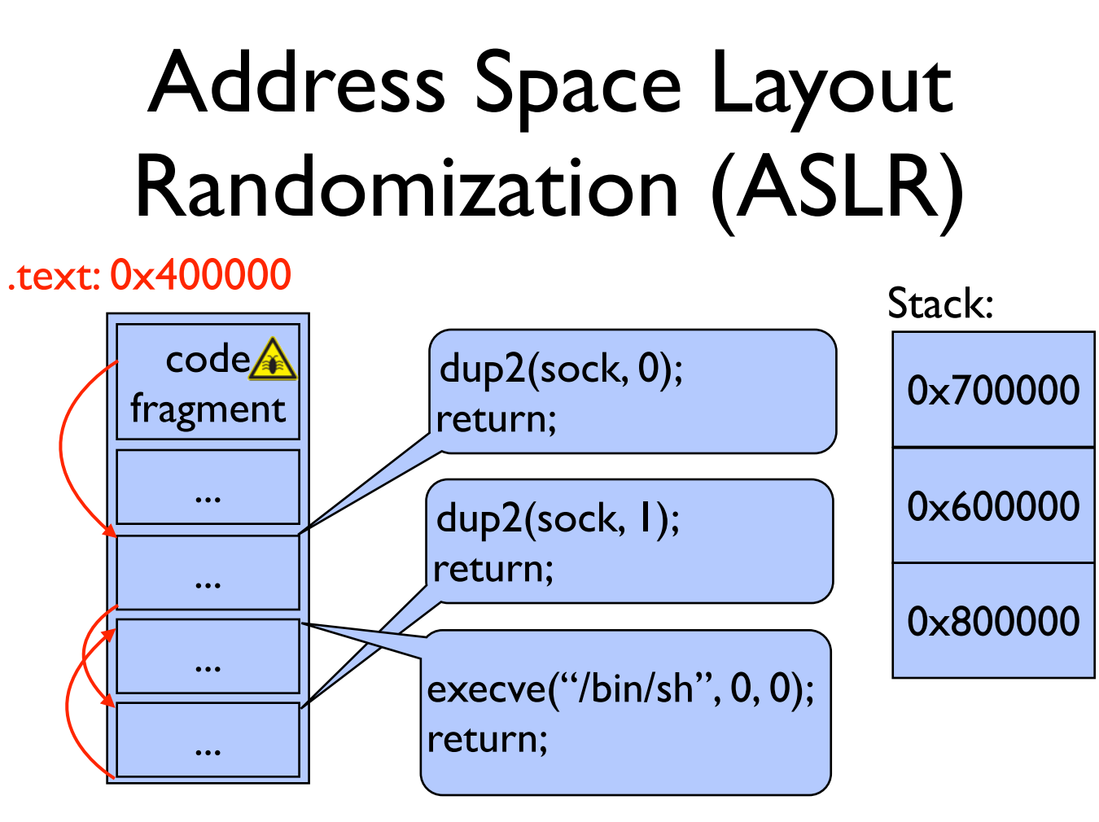

Slide 23
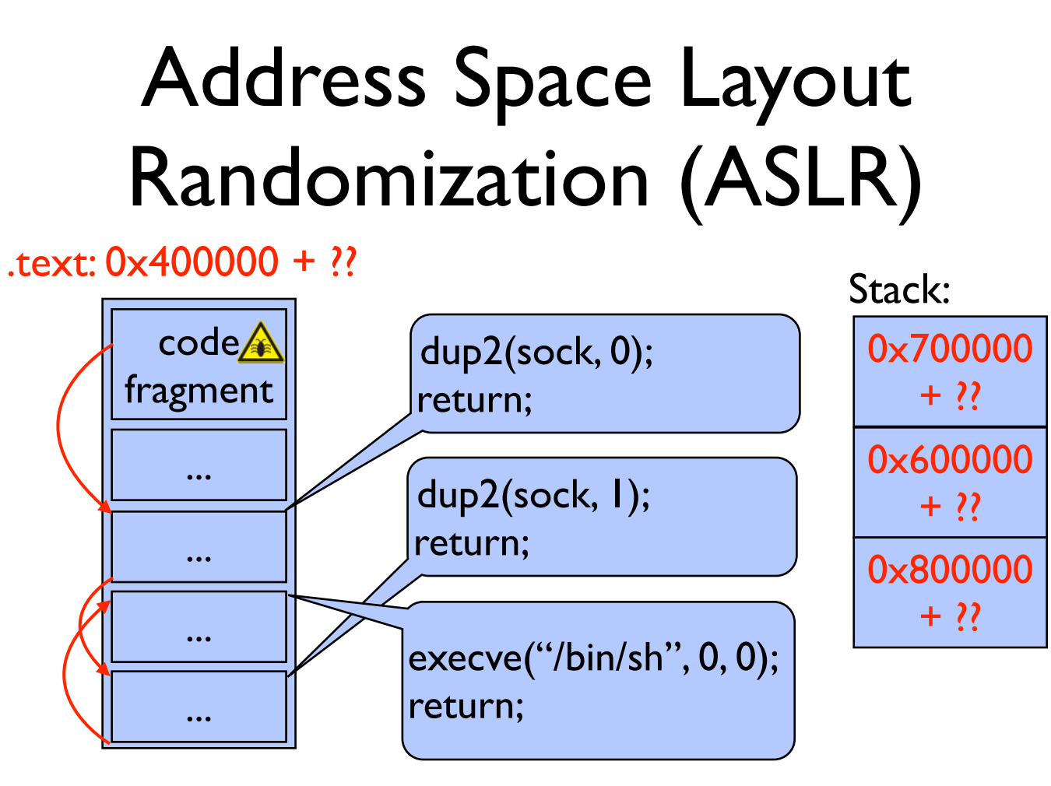

Slide 24
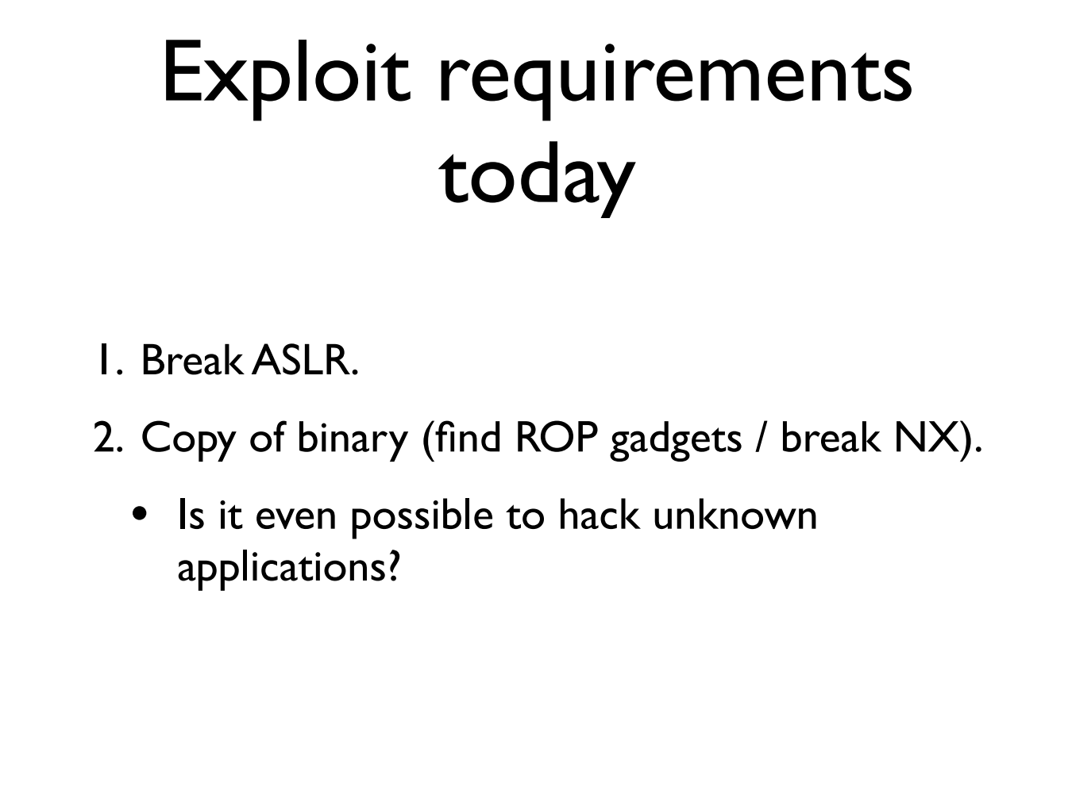

Slide 25
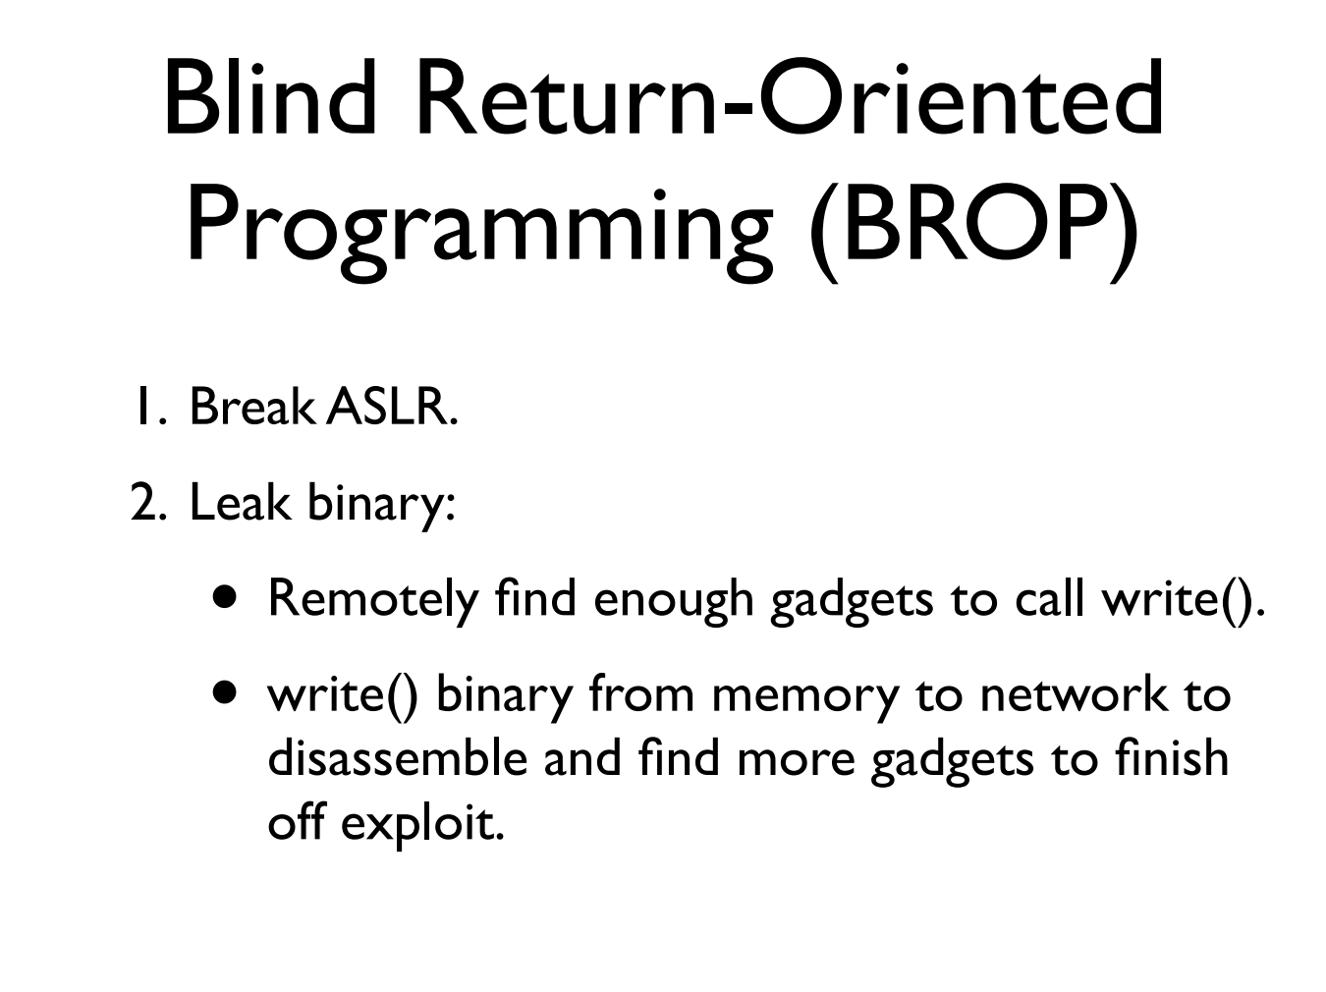

Slide 26
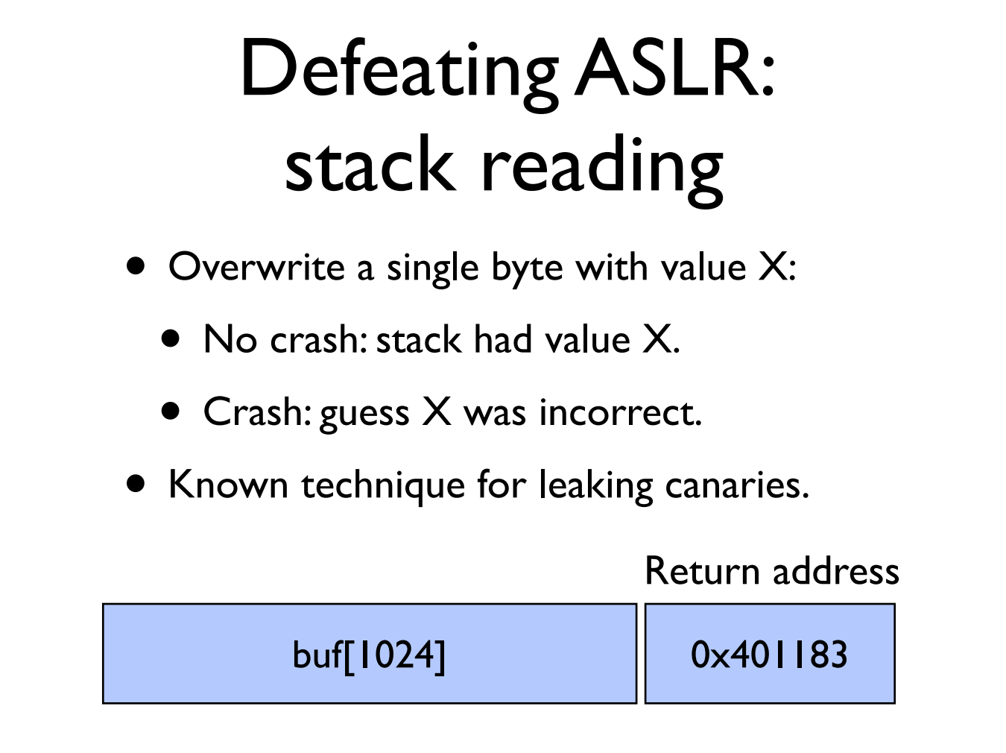

Slide 27
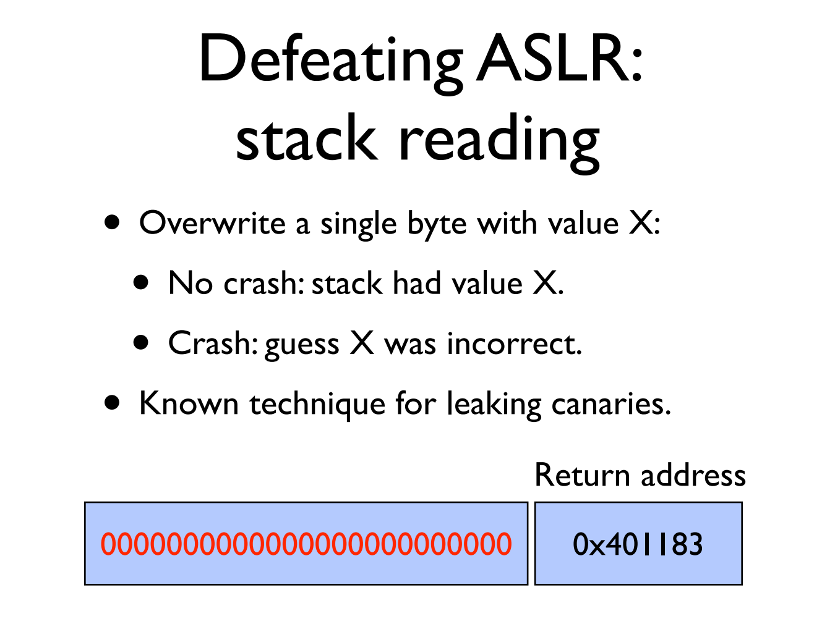

Slide 28
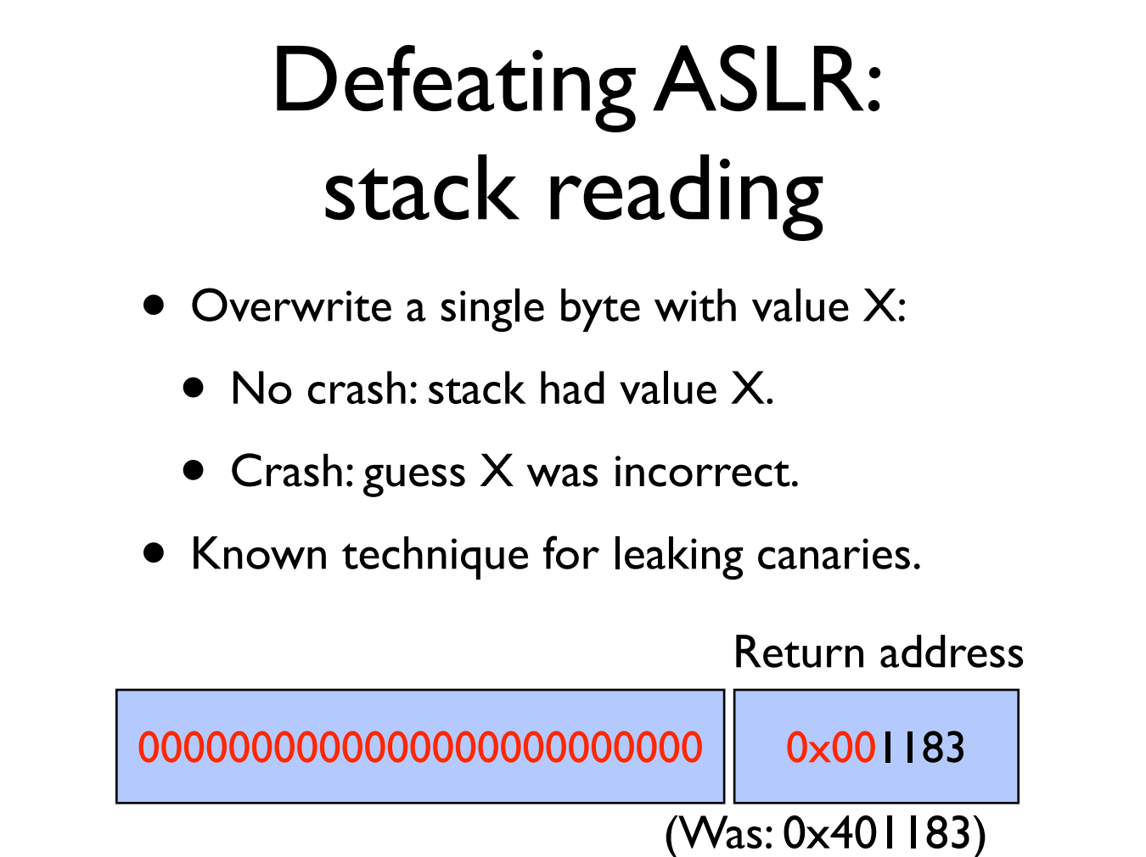

Slide 29


Slide 30


Slide 31
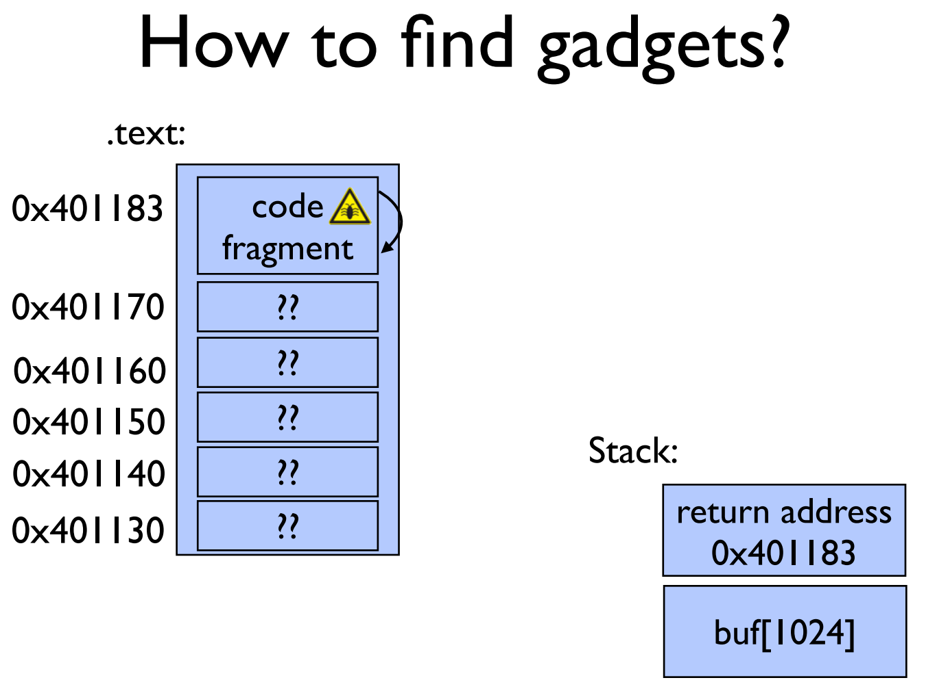

Slide 32
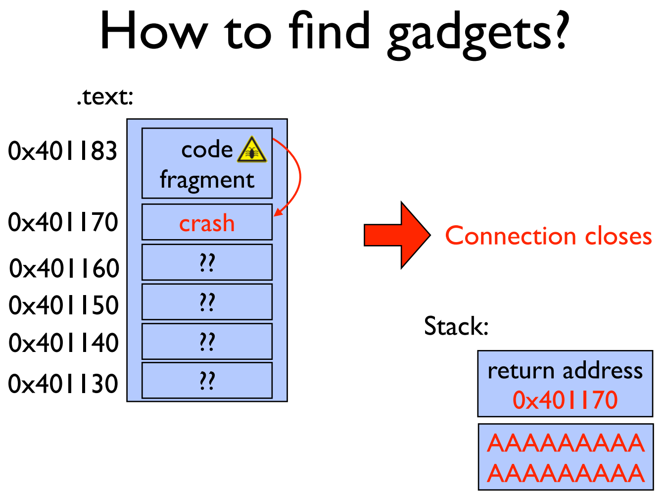

Slide 33


Slide 34
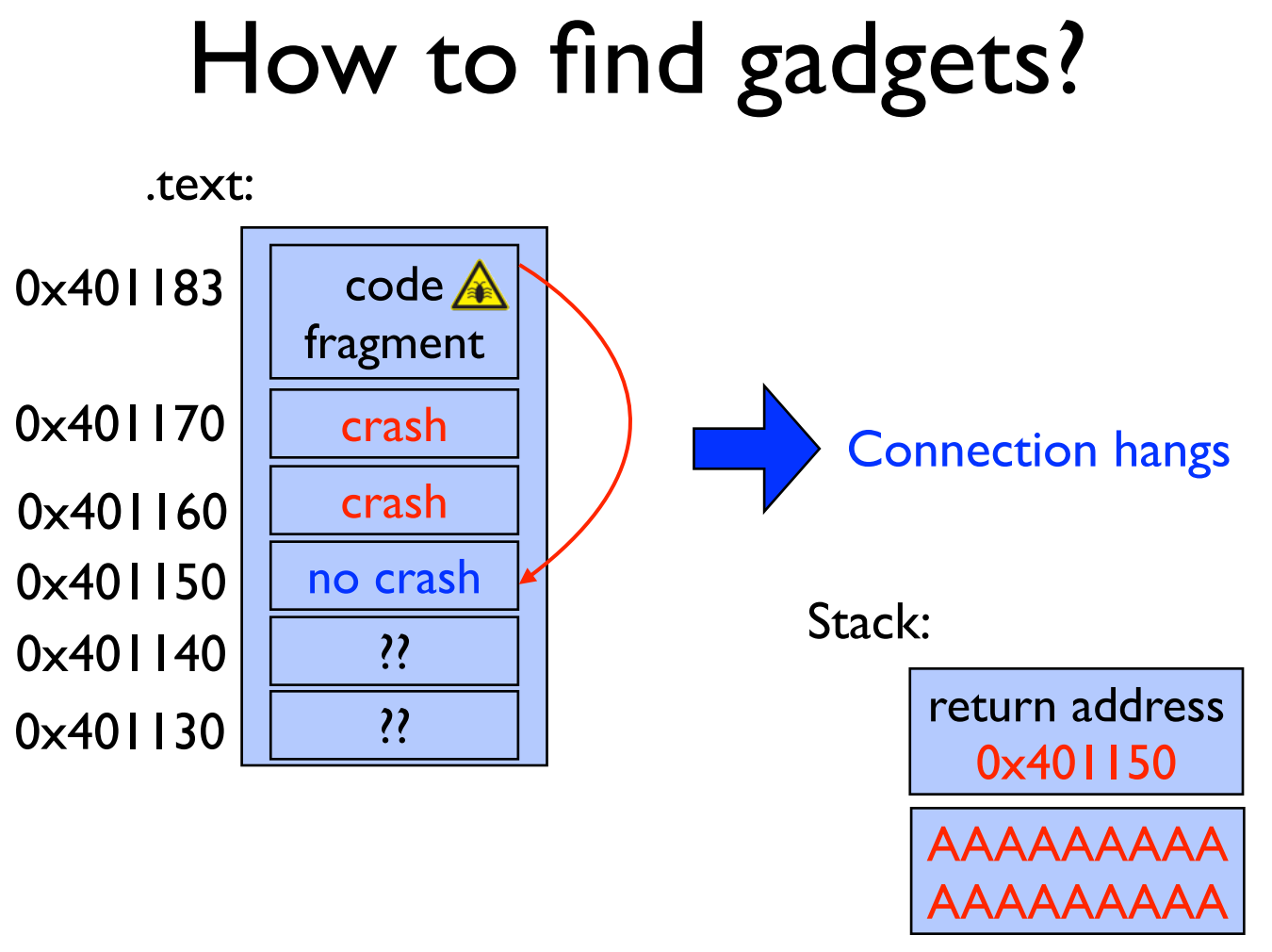

Slide 35
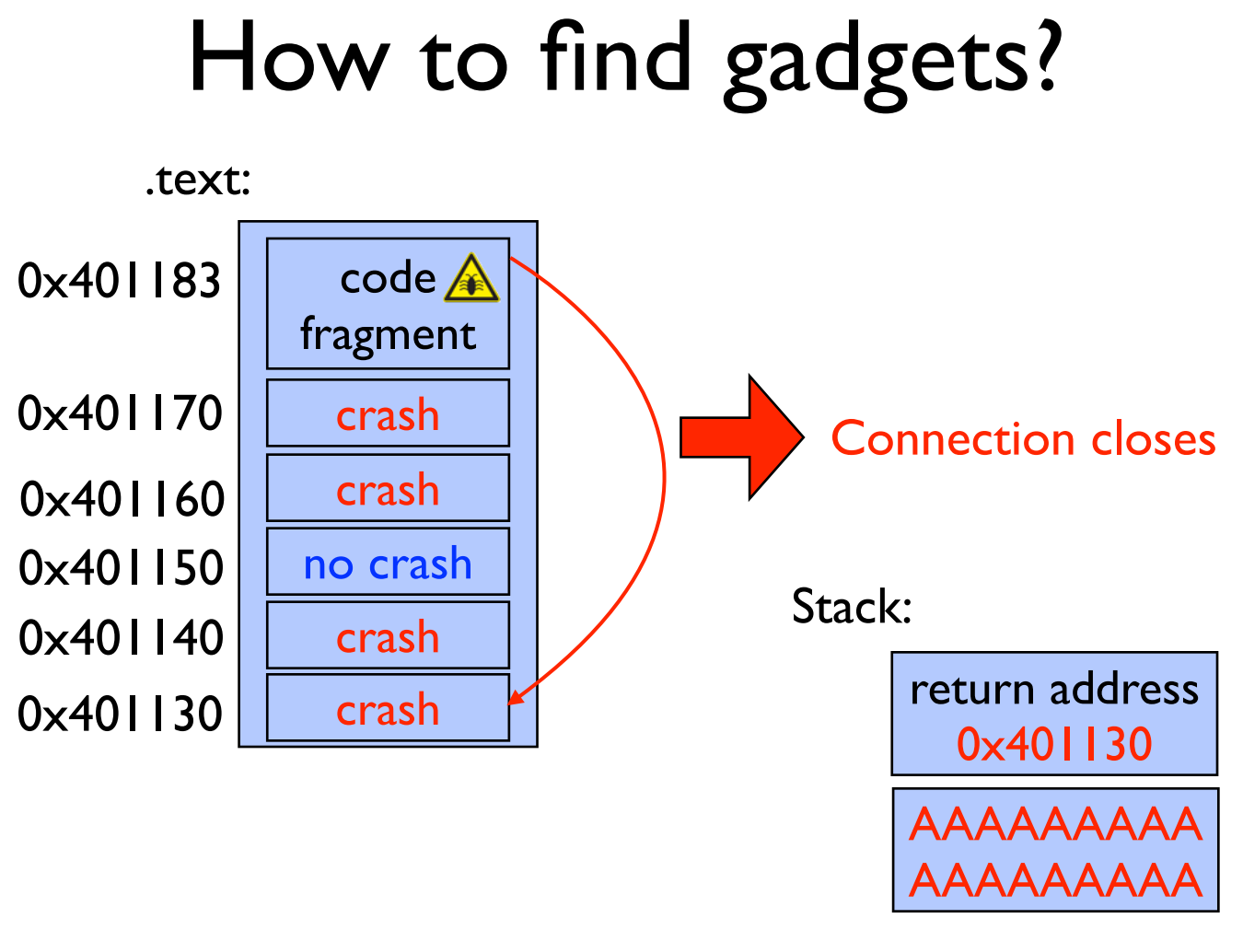

Slide 36
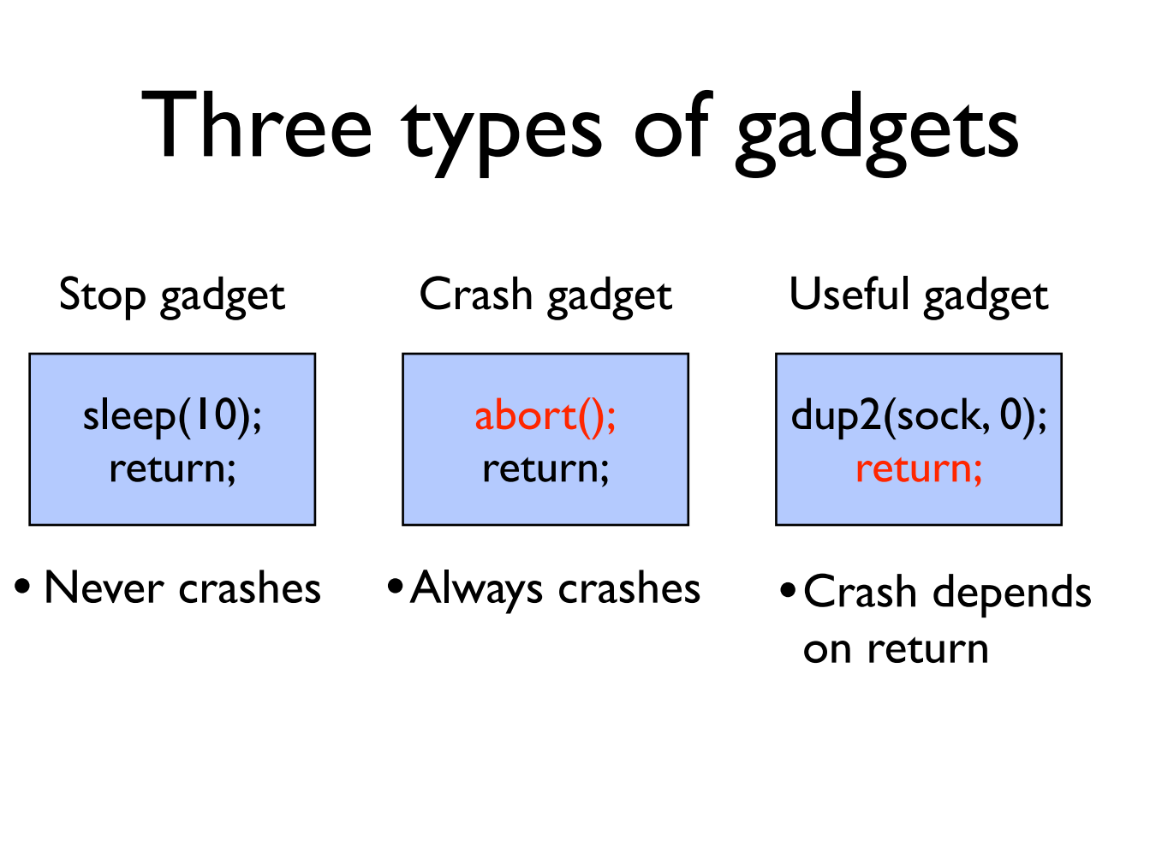

Slide 37
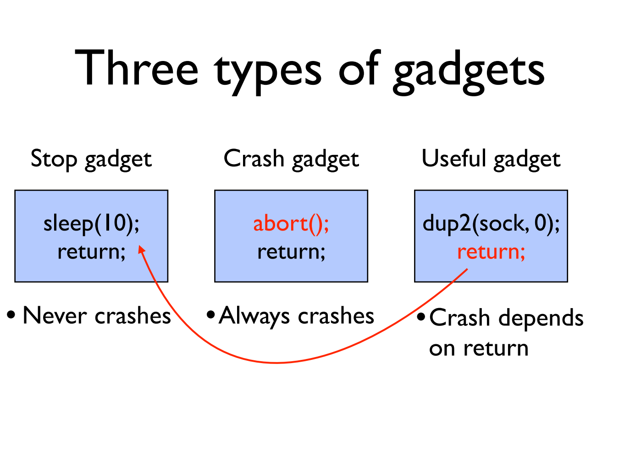

Slide 38
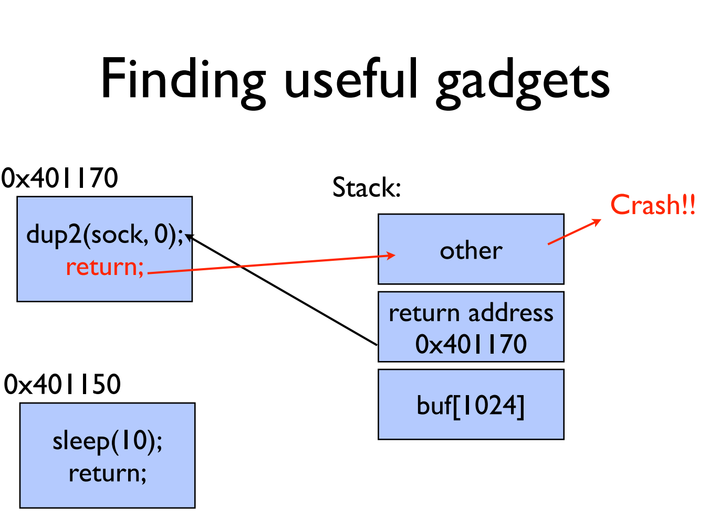

Slide 39
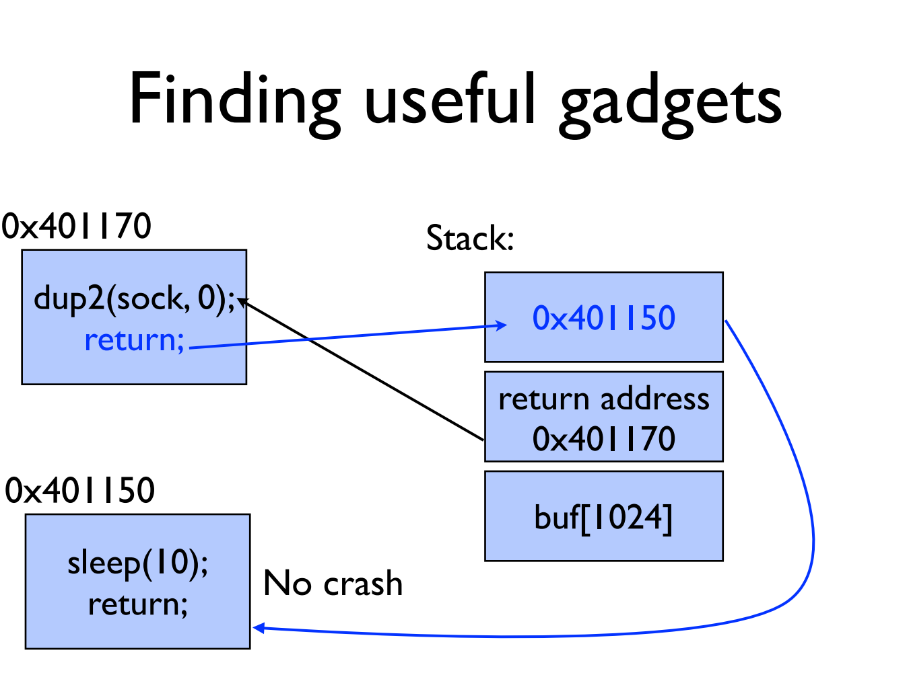

Slide 40
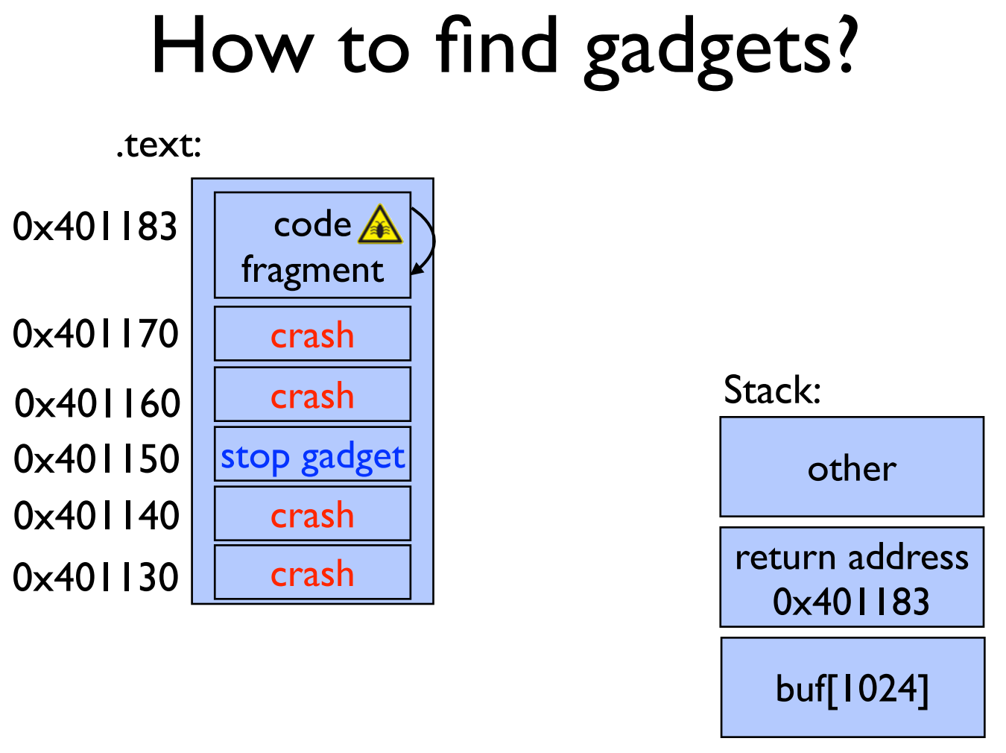

Slide 41
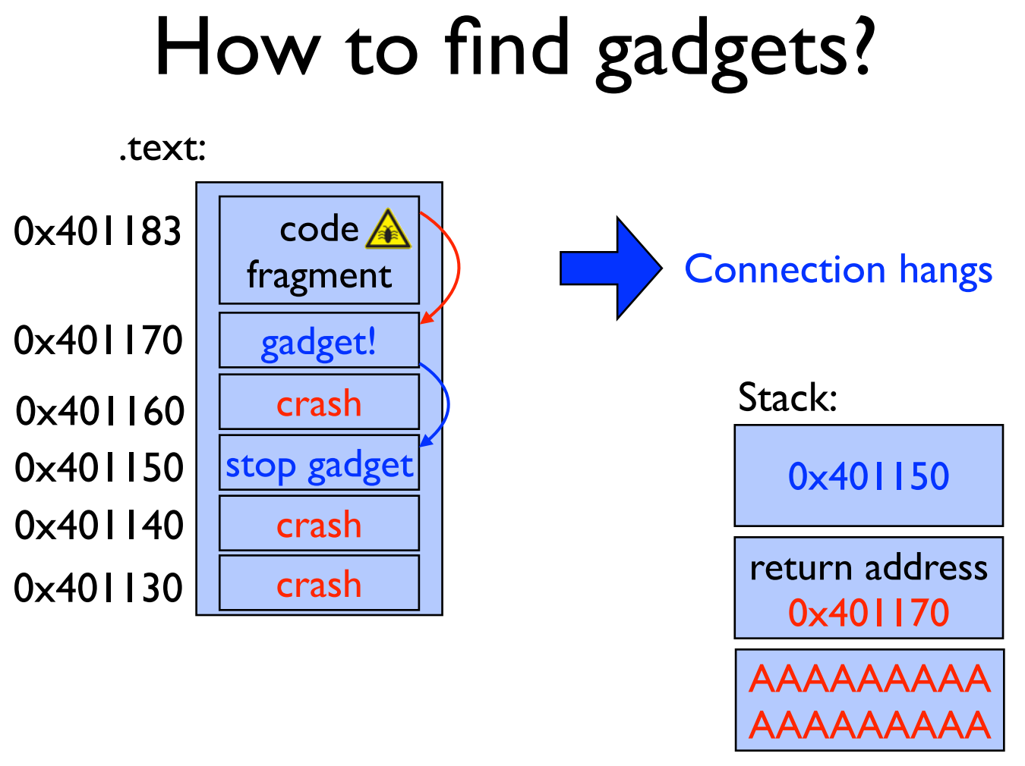

Slide 42
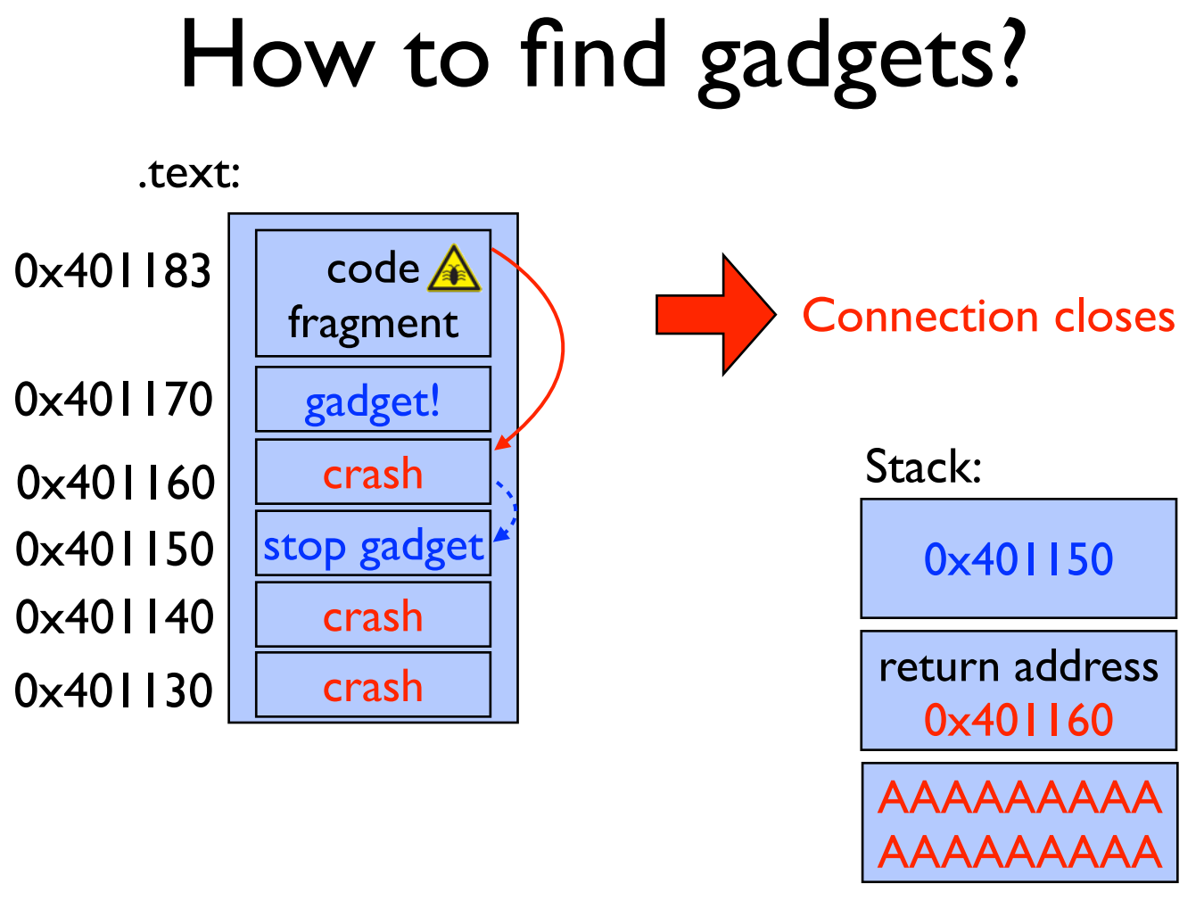

Slide 43
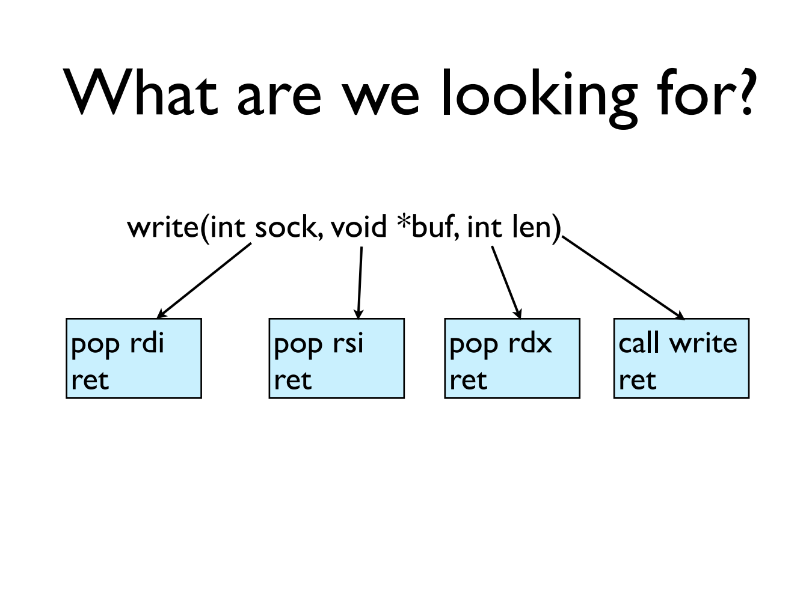

Slide 44
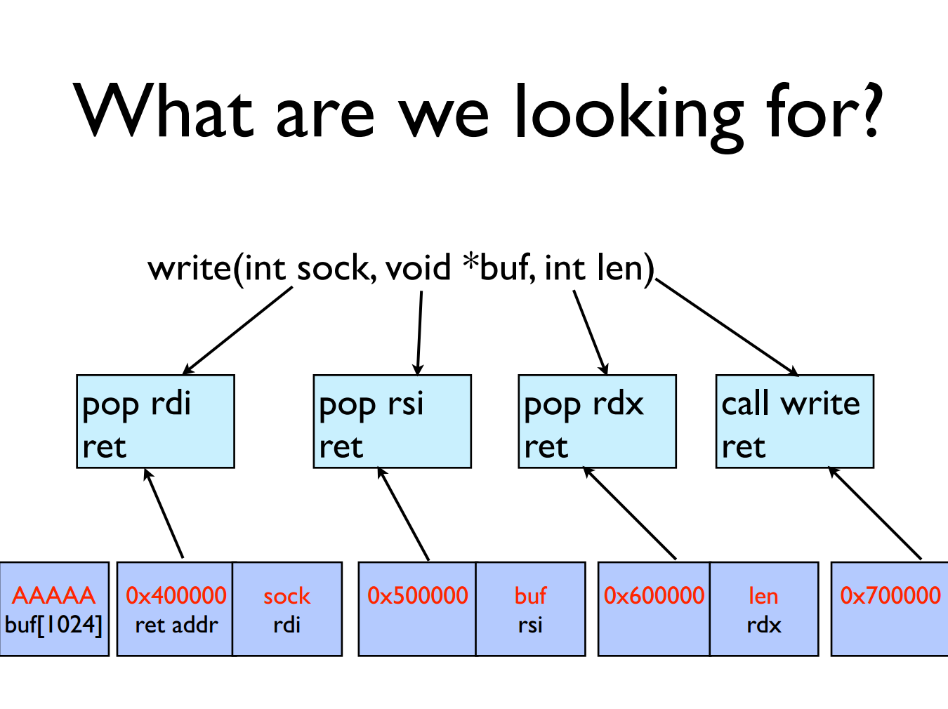

Slide 45
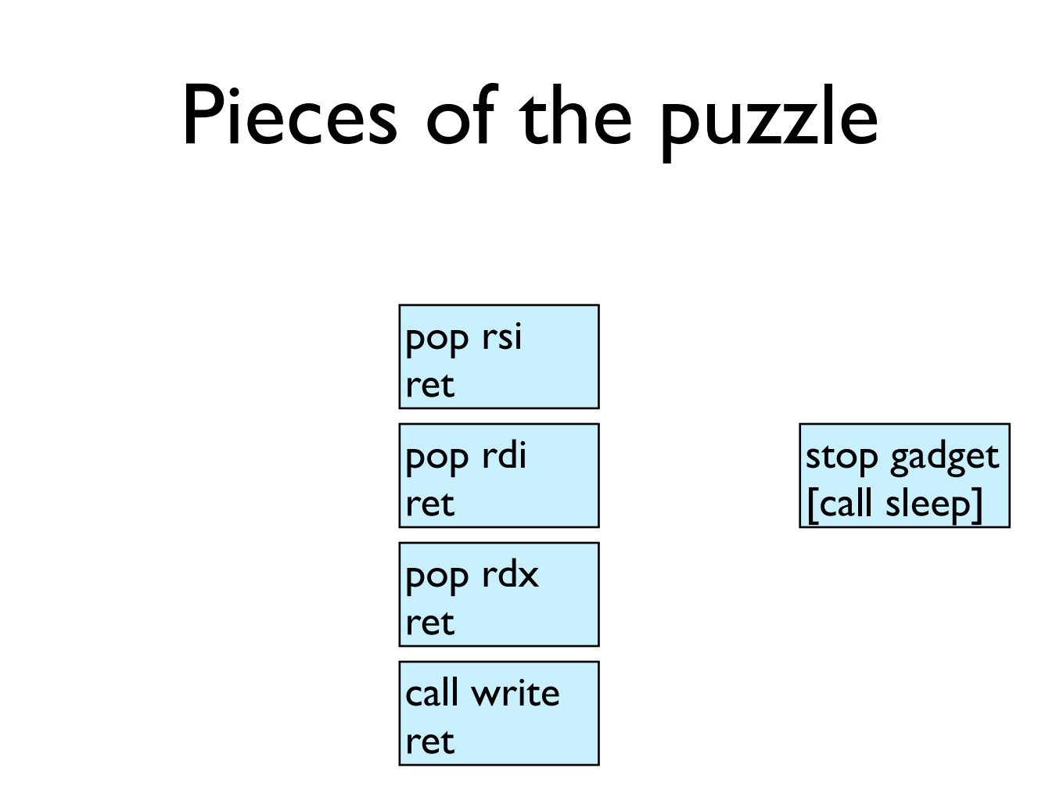

Slide 46
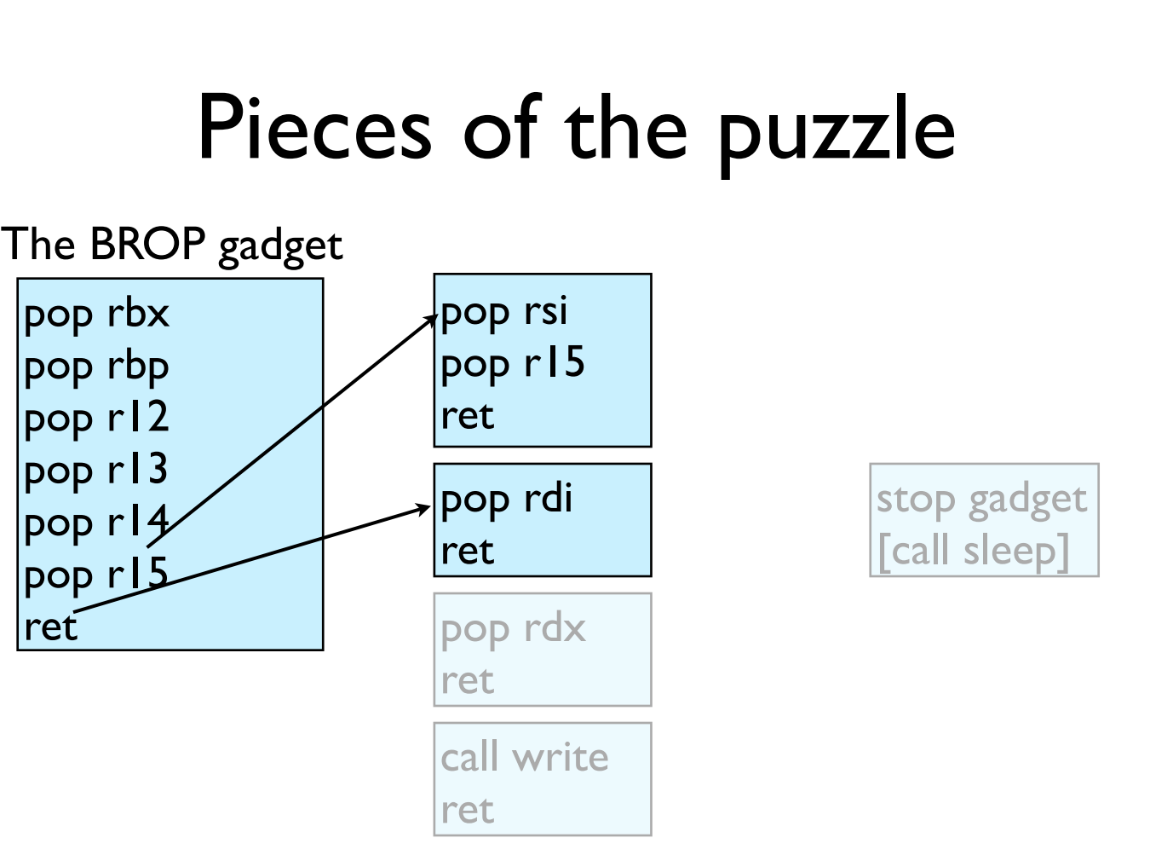

Slide 47
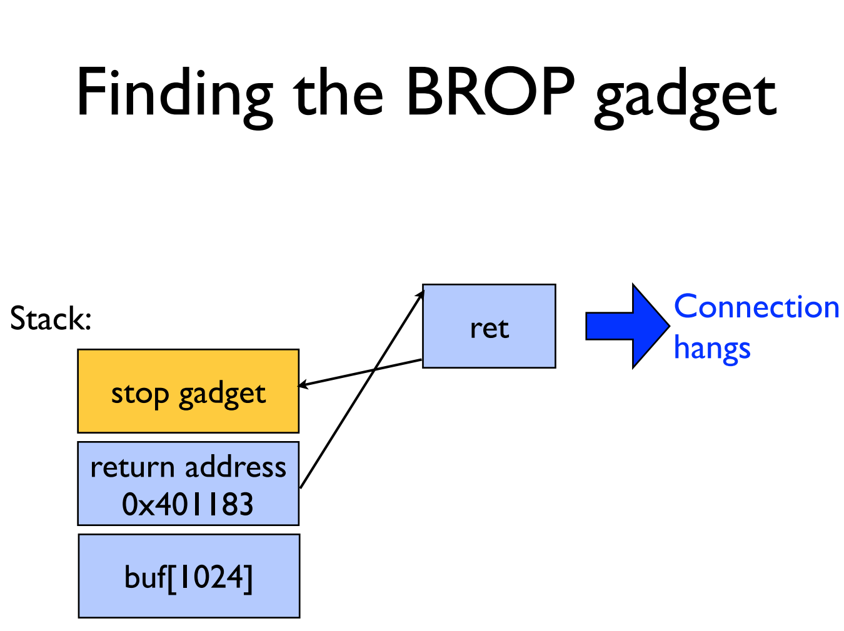

Slide 48
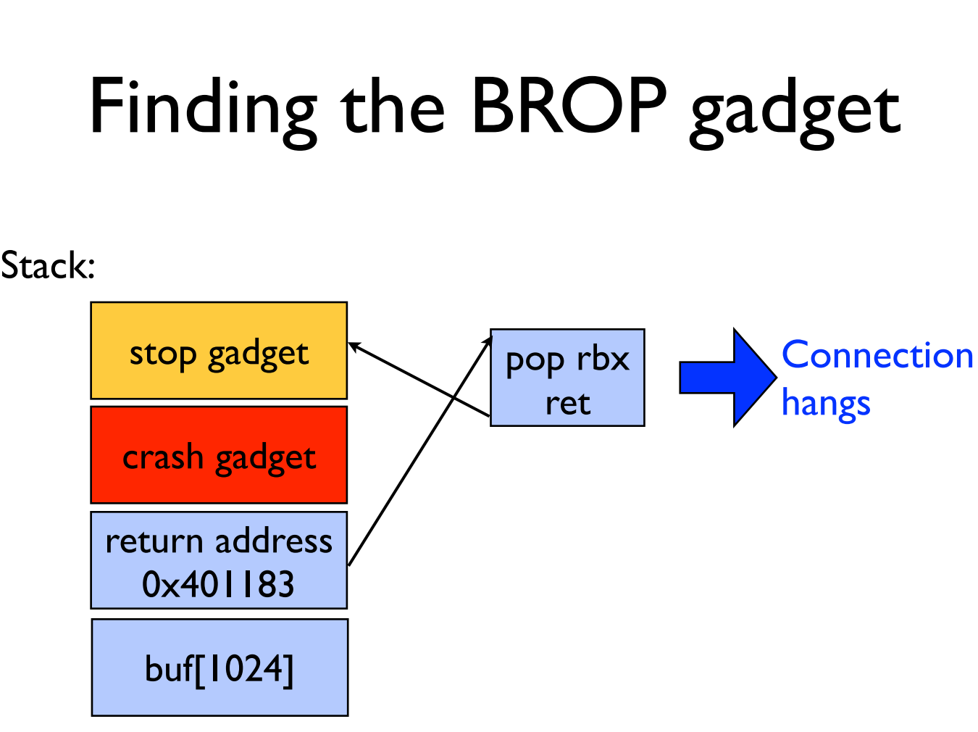

Slide 49
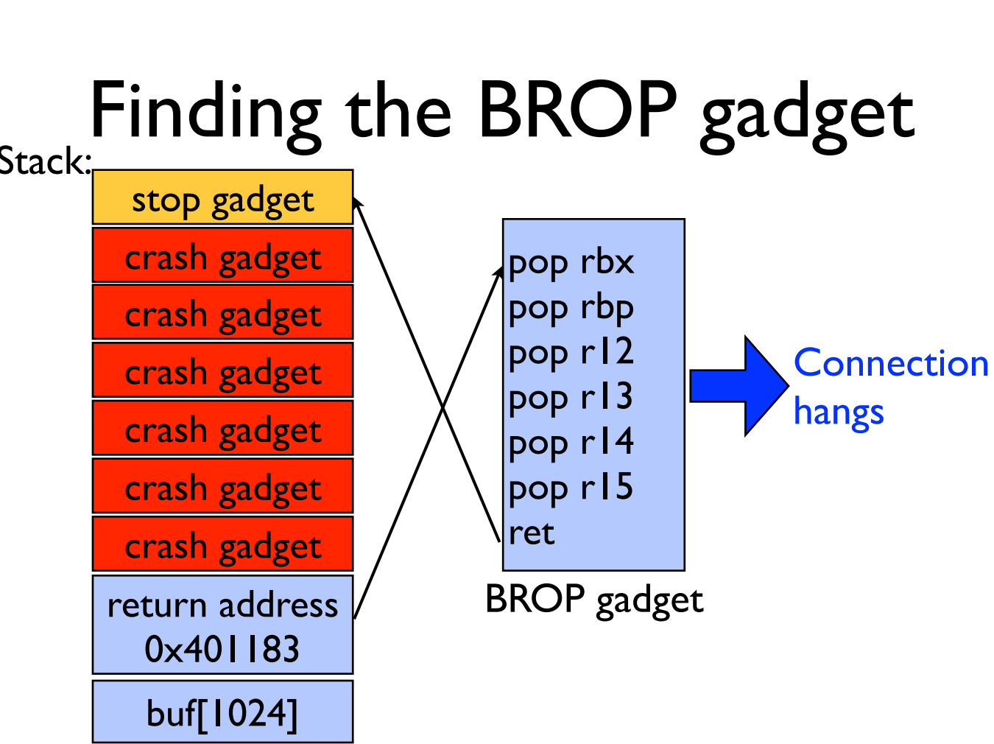

Slide 50
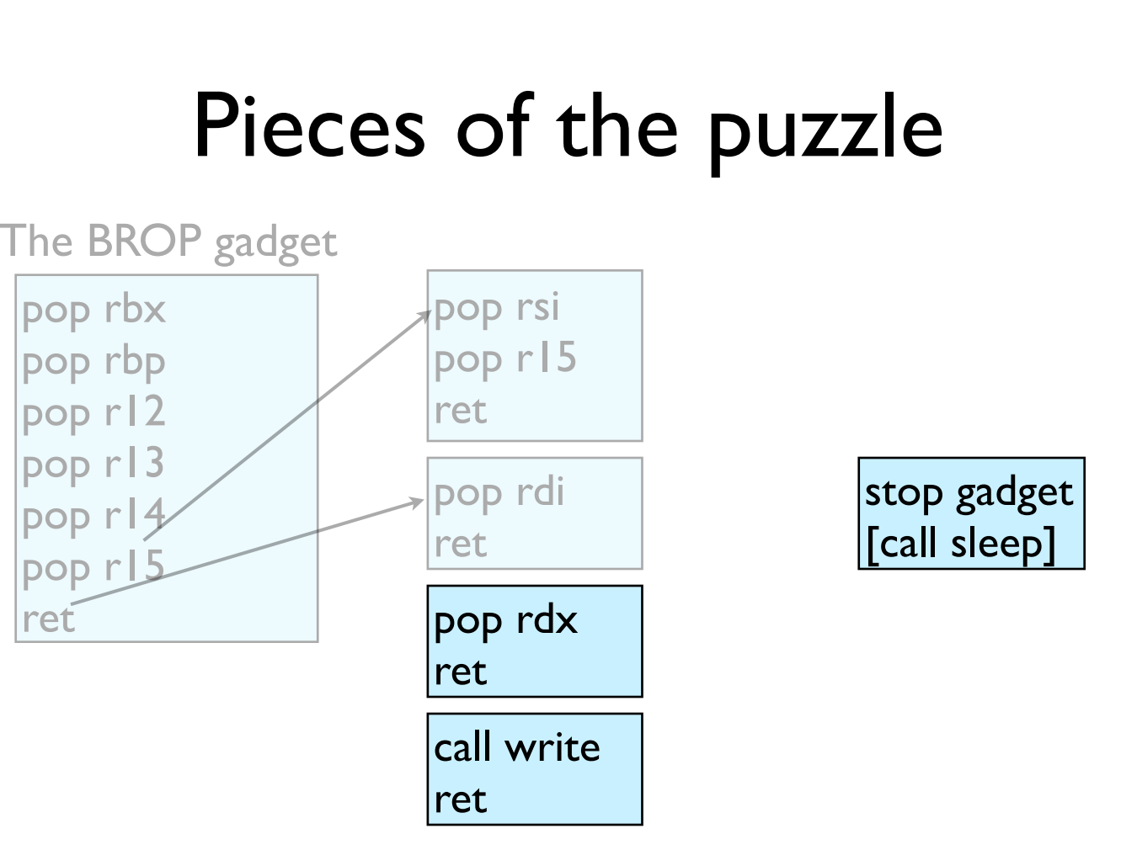

Slide 51
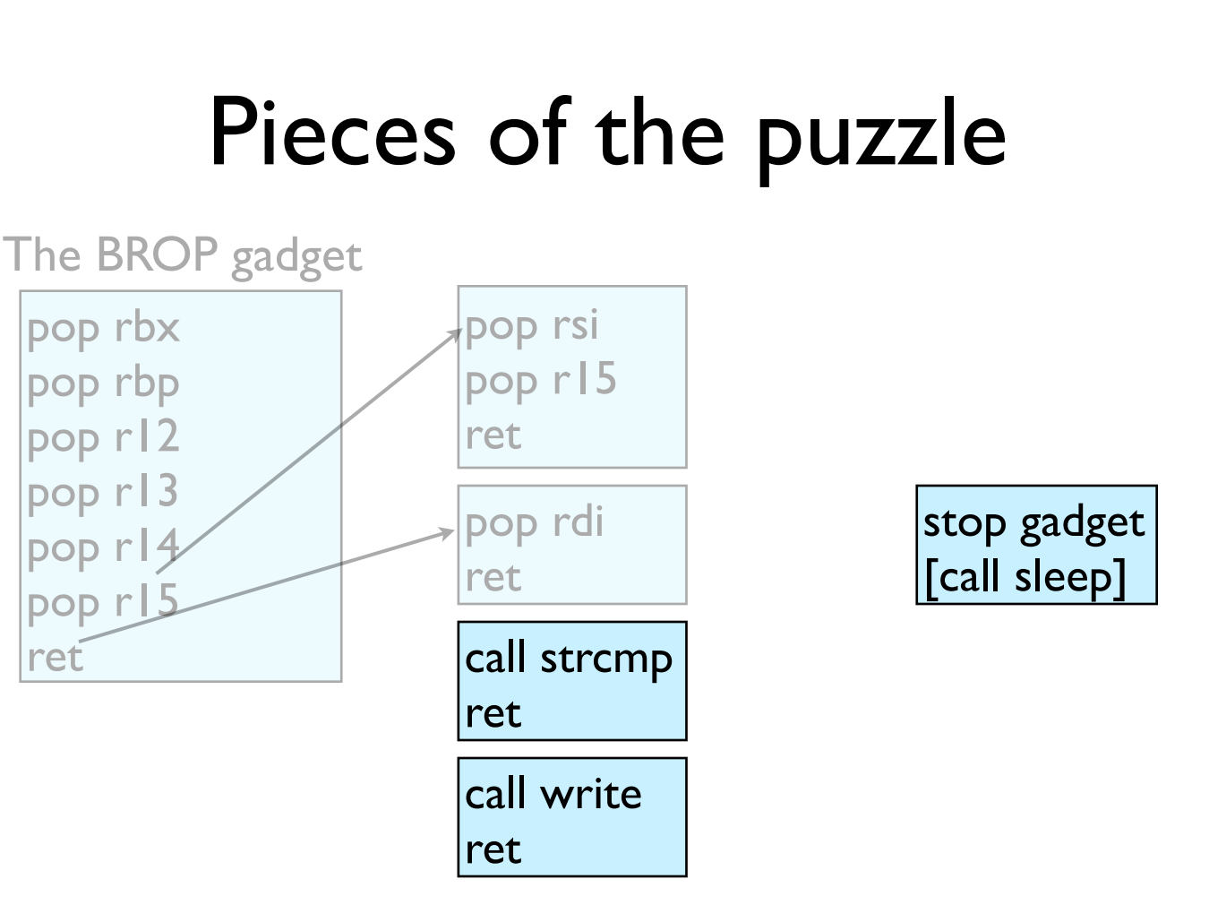

Slide 52
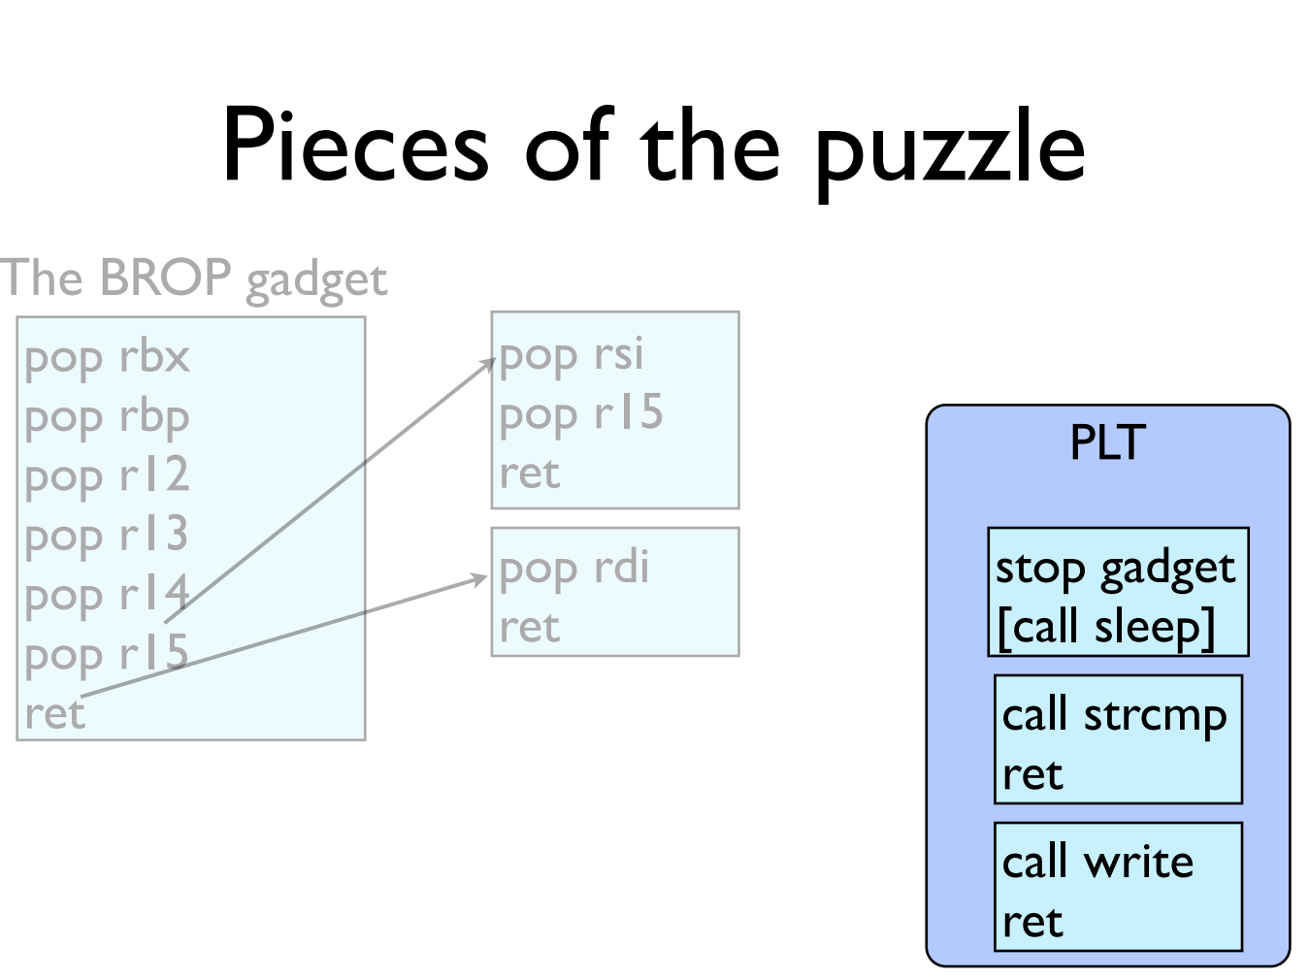

Slide 53
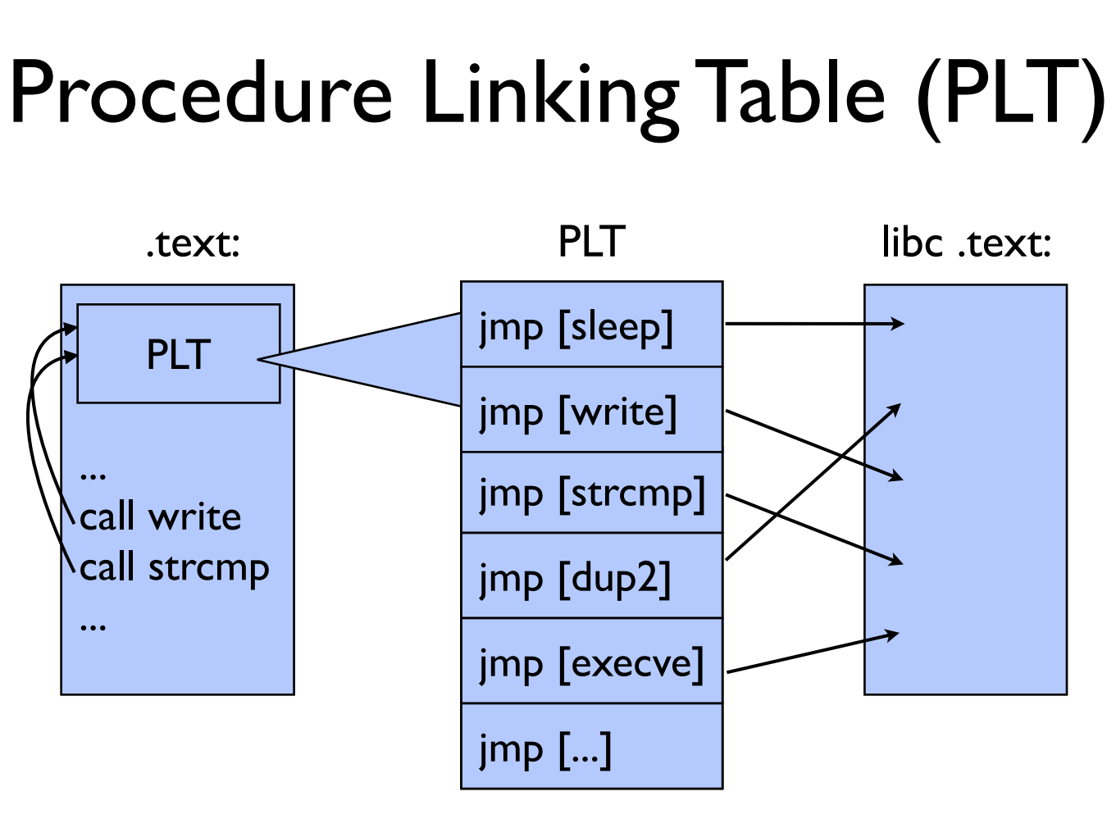

Slide 54
GOT & PLT
Jump to the address that this entry of the GOT contains:
  First time: call to dynamic linker and write the function address to GOT
  Not first time: the GOT already contains the address that points to printf.
PLT
printf() call
Dynamic linker
libc
GOT

Slide 55
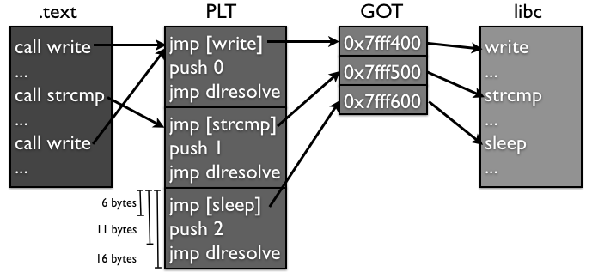
Notes:
另外，大部分的PLT项都不会因为传进来的参数的原因crash，因为它们很多都是系统调用，都会对参数进行检查，如果有错误会返回EFAULT而已，并不会造成进程crash。所以攻击者可以通过下面这个方法找到PLT：如果攻击者发现好多条连续的16个字节对齐的地址都不会造成进程crash，而且这些地址加6得到的地址也不会造成进程crash，那么很有可能这就是某个PLT对应的项了。

Slide 56
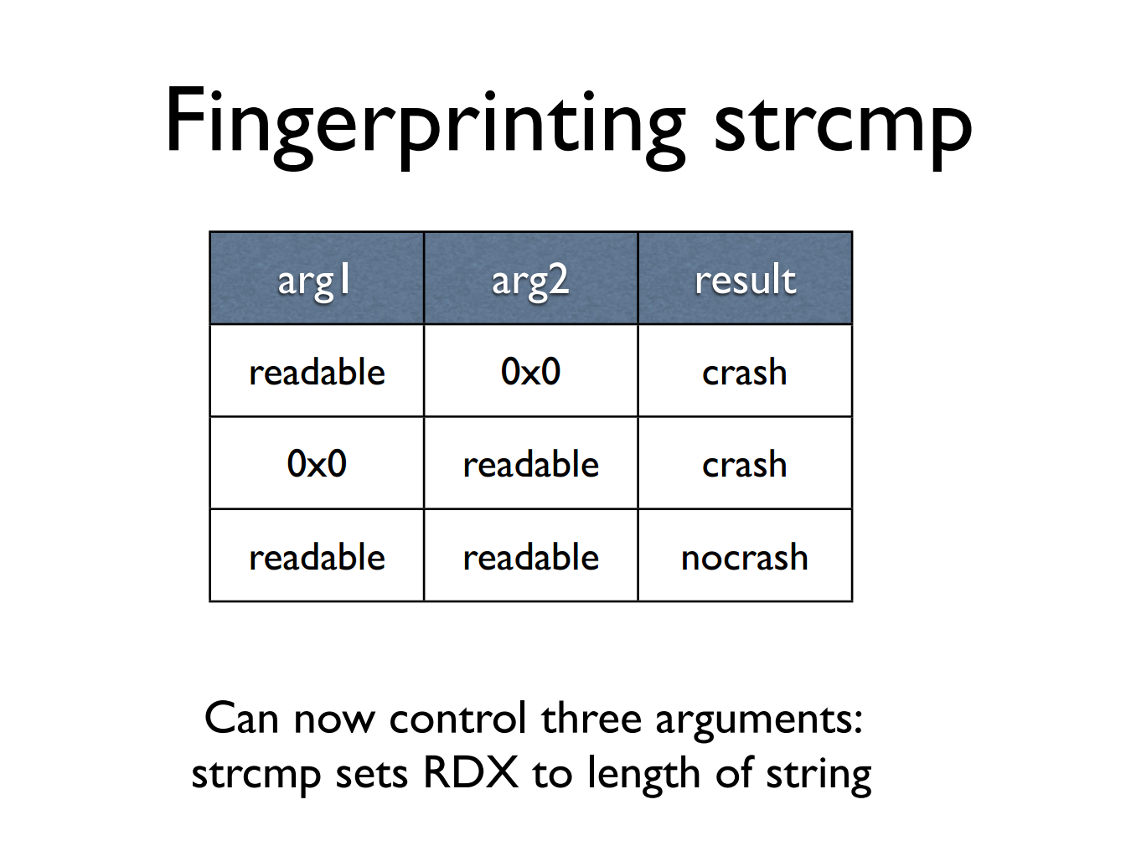

Slide 57
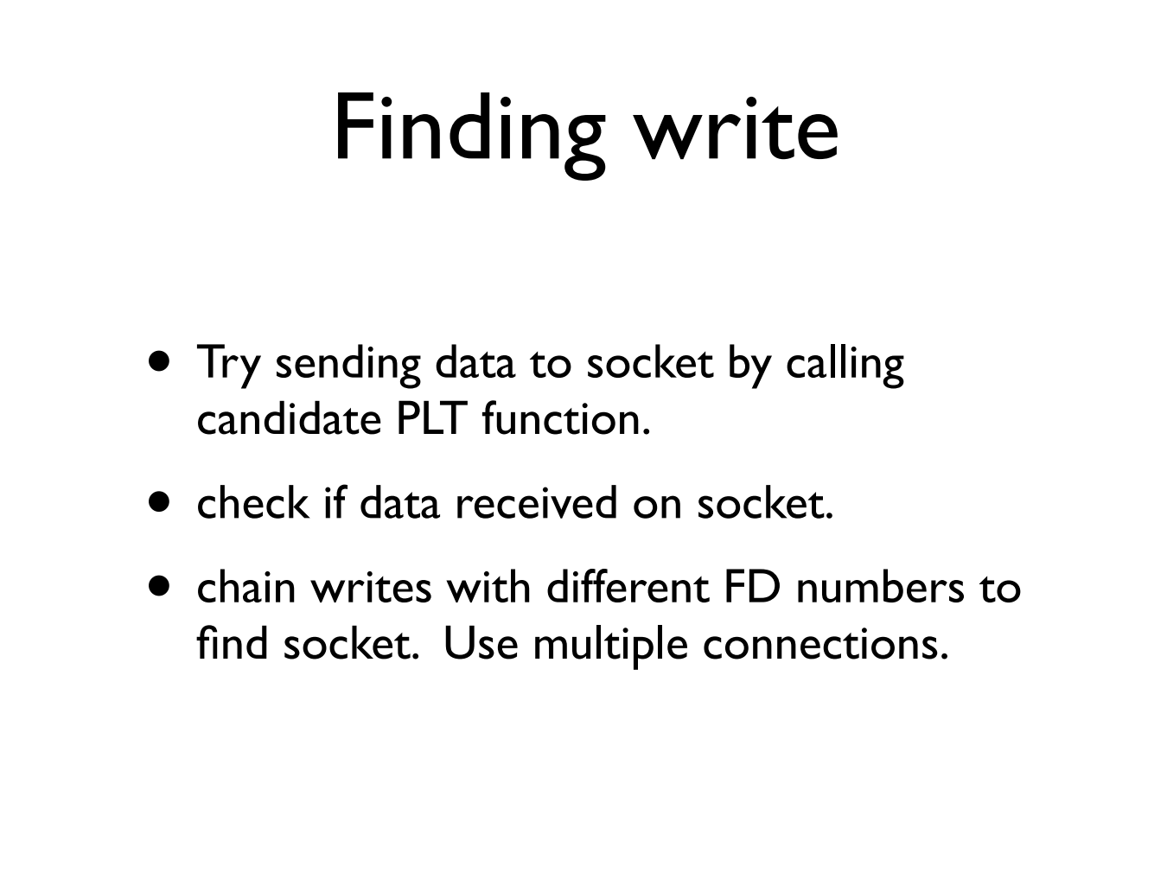
Notes:
1. 同时调用好几次write，把它们串起来，然后传入不同的文件描述符数；2. 同时打开多个连接，然后使用一个相对较大的文件描述符数字，增加匹配的可能性。

Slide 58
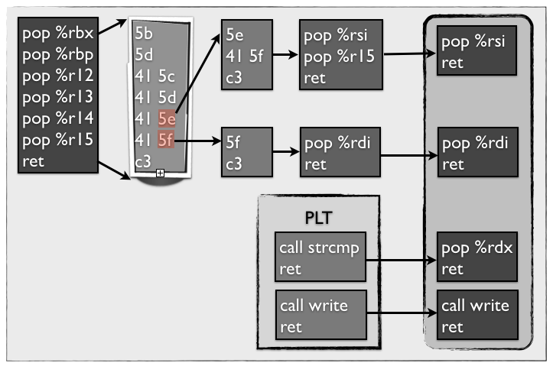

Slide 59
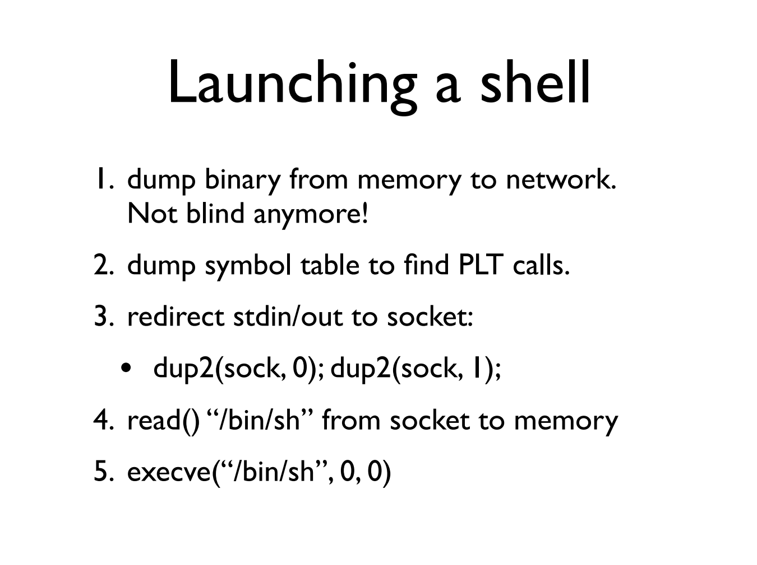

Slide 60
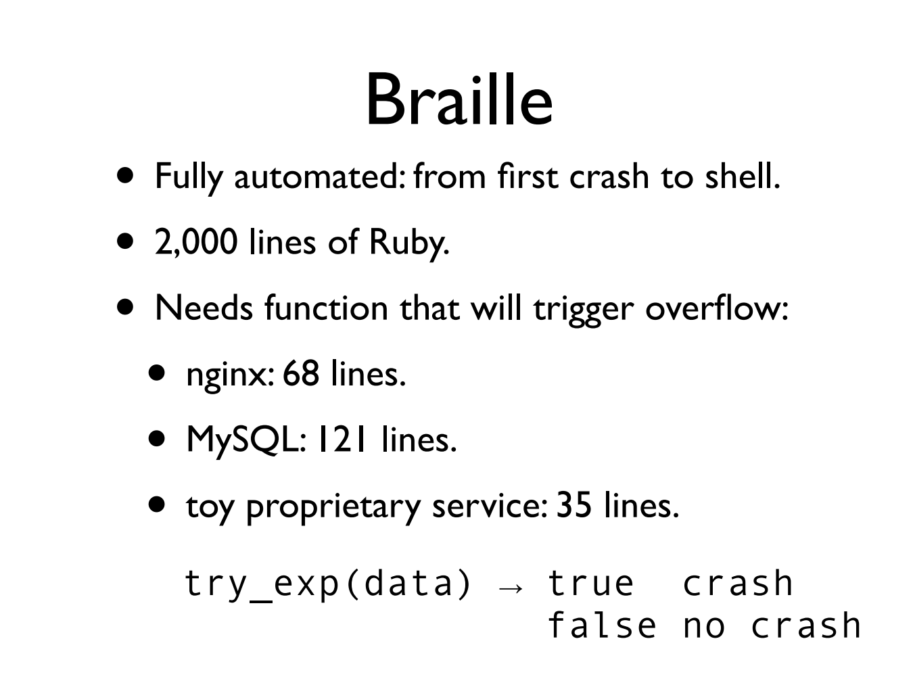

Slide 61
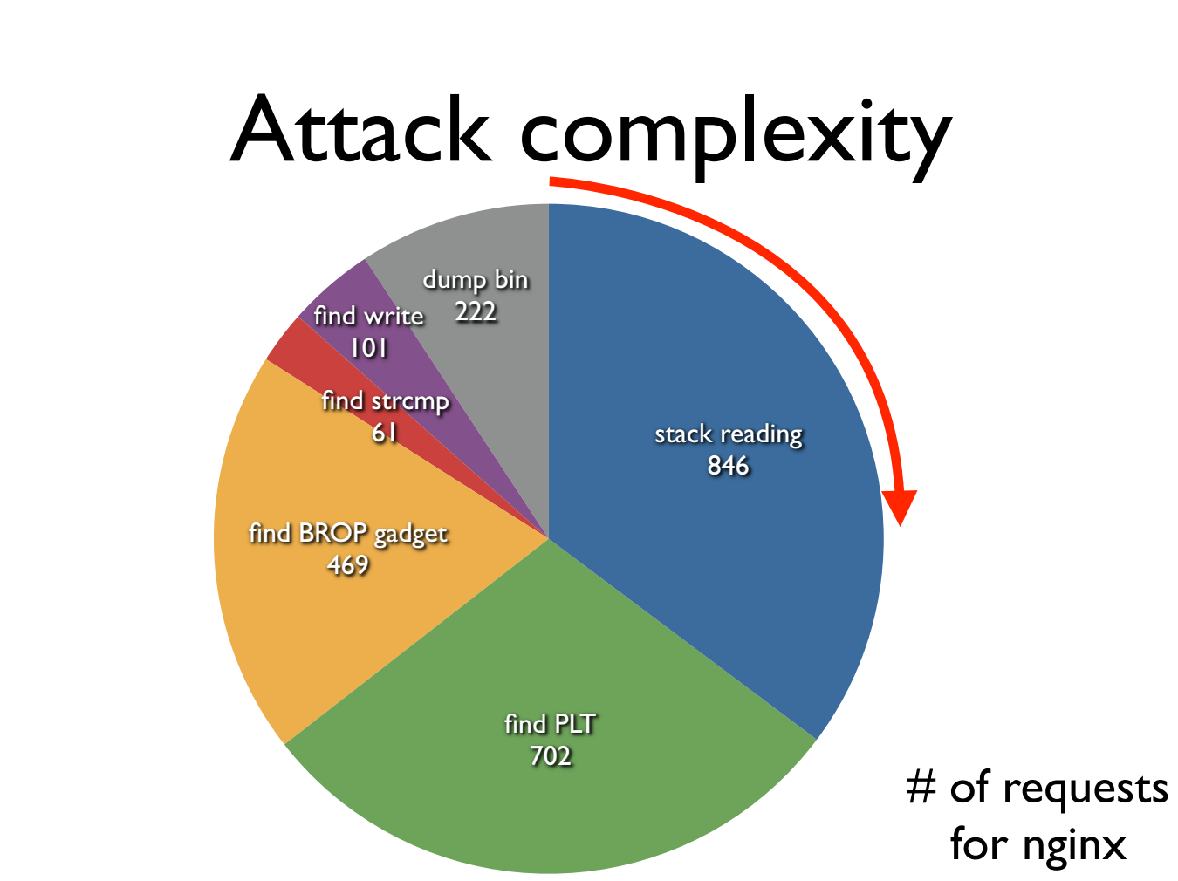

Slide 62
Try It!
http://www.scs.stanford.edu/brop/
More information
  S&P’14 paper: http://www.scs.stanford.edu/brop/bittau-brop.pdf
  Blog: http://drops.wooyun.org/tips/3071

