Slide 1
TUTORIAL LESSON
Linux & Tools
Institute of Parallel and Distributed Systems (IPADS)
Shanghai Jiao Tong University
Jinyu Gu
gujinyu@sjtu.edu.cn
2021.9

Slide 2
BIRTH of TUTORIAL LESSON
ICS introduces the Computer Systems,
then WHO introduces ICS ?
  A new environment: Linux
  Many new tools: svn, …
ICS Book does not contain them

Slide 3
OUTLINE
Pre-requisite
Linux
Tools

Slide 4
Pre-requisite
Linux
Tools

Slide 5
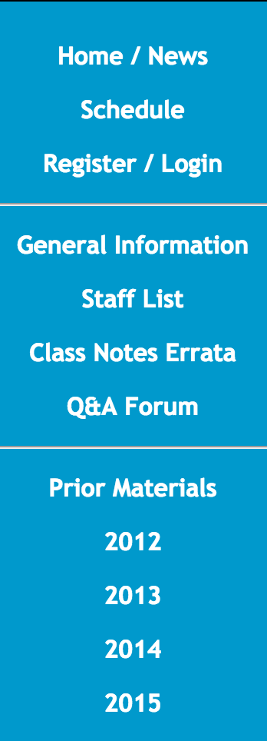
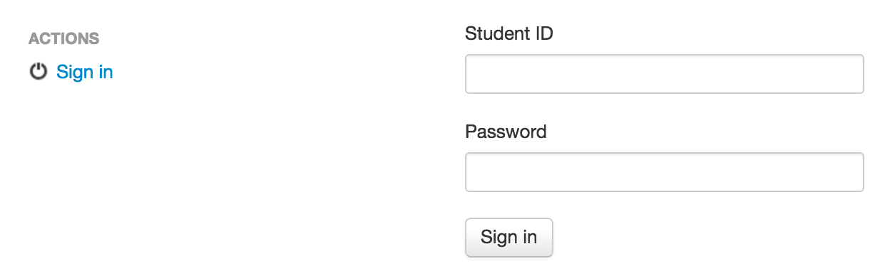
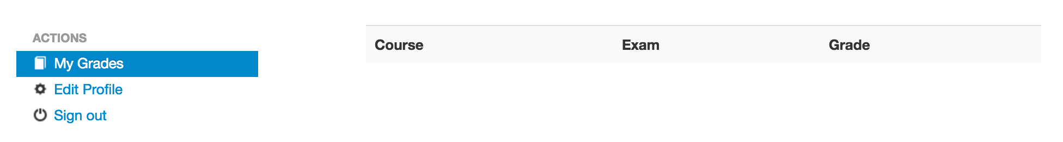
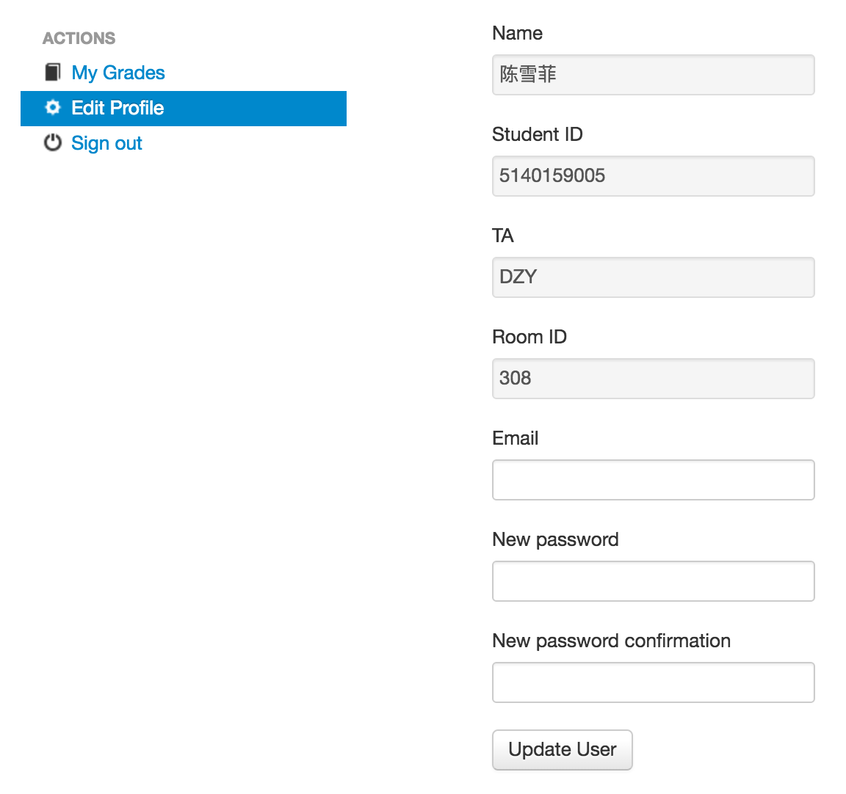
REGISTRATION

Slide 6
TASKS
Labs & Quiz
  1: Bits
  2: Bomb *
  3: Buffer Overflow *
* Online Test
Exams
  Final

Slide 7
HARD RULES
Deadline: No Extension
  Multiple submissions
Plagiarism: No Tolerance
  Forbid C&P
    from Network
    from Classmates
  Punishment
    0 point for ALL

Slide 8
Cheating will not be tolerated
…
All homework, labs and exams are to be done individually.
…
It is your responsibility to ensure that your passwords are well-guarded, directories protected, and printouts do not
fall into other hands.

Slide 9
WARNING
… 不过我的本意并没有提供代码让他抄袭的啊。他有一个binfile 的函数怎么调试都不对，我确实把这段代码发给了他，但我教会了他怎么做的了。…
…, 她请教我怎么优化，我跟她讲了优化方法然后她自己去改了，改过以后问我为什么效率没有提升， 我就叫她让我看下她的代码，发现没有实质性的优化，我嫌讲不清就叫她参考我的代码, …
… 我们都是“好学生”，在同学之间会很难拒绝。这次之后就没有这种情况发生了。…
…, 知道了，只是实在不会写唉，没学c这个指针真的看不太懂额。这次错了，下次一定不会这么做了。不过能不能请老师不要把 XX判为0分 …
… XXX没有错，有错的是将他的代码直接交上去的人，他们根本就没考虑一下这可能对XXX造成什么影响。… （From YY BBS）

Slide 10
Pre-requisite
Linux
Tools
  Introduction
  Installation
  Shell

Slide 11
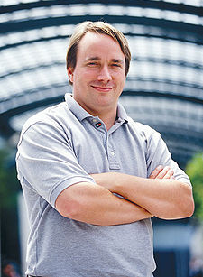

BACKGROUND
The History of Linux
  Linus Torvalds, 1991
  Unix-like Operating Systems
      “ Unix is not so much an operating system as an oral history ”
      Heirs: Linux, BSD, Solaris, MacOS X, …
      Principle: KISS
        Keep It Simple, Stupid !

Slide 12
COMPARISON
Differences between Windows and Linux
  One Kernel and Multiple Distribution
    4.19.x kernel (newest: 5.14 2021.8.30)
    RedHat / Fedora, Debian
    Suse, Gentoo, Arch, Ubuntu
    Euler, Anolis
  Powerful Command Line Interface
  Directories Organization
  …

Slide 13













Slide 14
Pre-requisite
Linux
Tools
  Introduction
  Installation
  Shell

Slide 15
INSTALL
We provided 2 solutions
  Sol-1: Install from an iso image.
      Detail in following slides
  Sol-2: Use Pre-installed VM image
      Download link on schedule page.
      Unzip and open with VMWare Workstation (Player)
      Check README.md for password and etc.
Out of the box

Slide 16
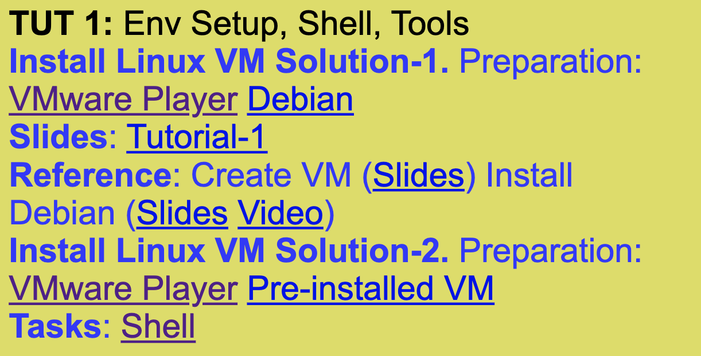
Solution-2: 使用制作好的镜像
见课程主页scheule

Slide 17
Solution-2: 使用制作好的镜像
步骤一：从主页链接下载VMware Player
步骤二：安装VMware Player
步骤三：从主页下载/解压虚拟机镜像（Pre-installed VM)
步骤四：运行VMware Player，选择打开虚拟机
- 不是新建虚拟机
- 选择步骤三中的虚拟机镜像（解压后的）

Slide 18
虚拟机镜像是怎么来的呢？
Solution-1 从iso文件安装虚拟机

Slide 19
Solution-1: 从iso文件安装虚拟机
见课程主页scheule
依然首先安装VMware Player

Slide 20
INSTALL
Step 0: How to find it ?
  SJTU Depository
  ftp://ftp.sjtu.edu.cn/
  e.g. Debian-11.0.0 (the version may be staled)
  /debian-cd/11.0.0/amd64/iso-dvd/
  Online: get the official web-site by google
  e.g. Debian (/'dɛbiːjən/, Debra + Ian)
  http://www.debian.org/distrib/

Slide 21
INSTALL
  Tips: virtual machine
  Definition
  provides a complete system
  platform which supports the
  execution of a complete
  operating system
  Java Runtime Environment
Step 1: Where to install it ?
  Cygwin
    Sorry, no technical support
  on RAW machine
    Cool !
  on VIRTUAL machine
    Safety!
Dangerous !
Recommendation !

Slide 22
INSTALL
  Tips: VMware Workstation
  Benefit
  hosted, popular, graphic
  easy, stable, checkpointed
Step 2: Create VM
  Select a Guest Operating System (if no ISO)
    e.g., Debian 9
  Set name and location
  Disk capacity
    20G (engross on demand)
  Network connection (customized)
    Bridge (separate IP) or NAT (internal IP, default)
Done !

Slide 23
INSTALL
Step 3: Configure VM
  Insert ISO image
    “VM -> Settings -> CD-ROM : Use ISO Image”
    ISO Image: “debian-9.4.0-amd64-DVD-1.iso”
  Configure Hardware (Customized)
    Memory Size
    #CPU / #Core
    Ethnet Mode
  Power On
Let’s go !

Slide 24
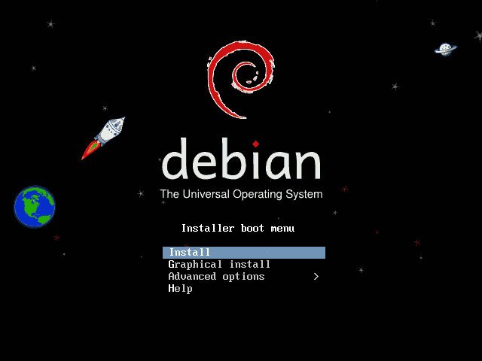

Slide 25
INSTALL
  Tips: VMware Workstation
  Switch
  Ctrl + Alt
Step 4: Install Debian
  Select a language and your location
  Select a keyboard layout
    U.S. English
  Configure the network
    Hostname and Domain name
  Set root password and Create a User
  Configure the clock
    Time Zone

Slide 26
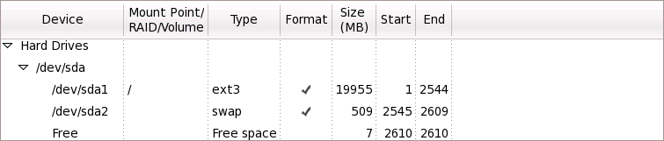
INSTALL
  Tips: hard Disk in Linux
  Naming: sd[x][y]
  sda 1 - the 1st section of 1st HD
  sdb3 - the 2nd section of 3rd HD
  * sd: SCSI disk / hd: IDE disk
Step 4: Install Debian
  Partition disks
    Manual
  Partitioning
    1. _ swap 512M (equal to memory size) - sda2
    2. / ext3 fill to maximum allowable size - sda1

Slide 27
INSTALL
  Tips: Desktop Environment
  GNOME /gə'noʊm/
  from GNU Project
  KDE /'keidiː‘iː/
  from Qt Software
  as you like
Step 4: Install Debian
  Configure package manager
    Use a Network mirror
      Hostname: ftp://ftp.sjtu.edu.cn
      Mirror directory: /debian/
  Software selection
    Graphical desktop environment
    Standard System Utilities
    …

Slide 28
INSTALL
Step 4: Install Debian
  Install GRUB boot loader
  Waiting …
  Reboot … OK ☺
Welcome to Debian 9 !

Slide 29
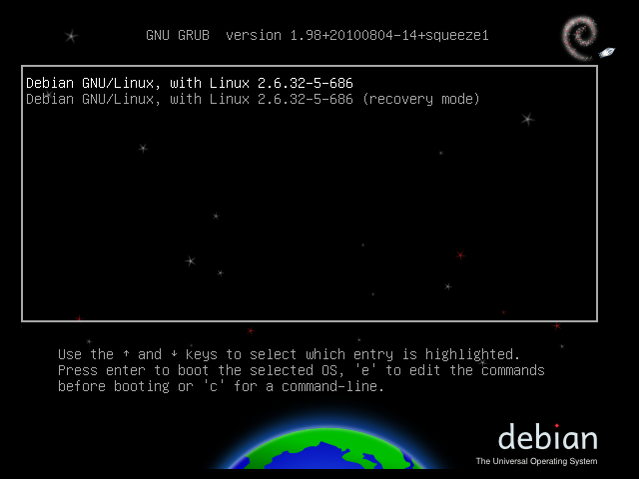

Slide 30
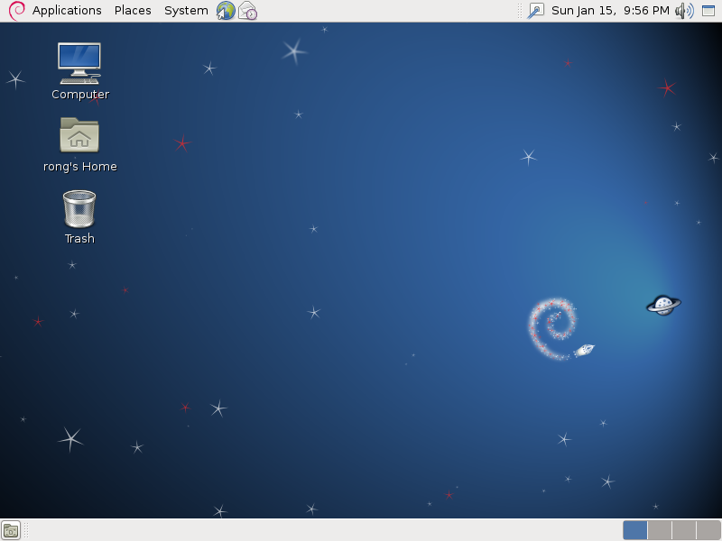

Slide 31
APPENDIX: System Virtualization
Architecture
VM
VM
Unmodified
User Software
Unmodified
User Software
VM
VM
Unmodified
User Software
Unmodified
User Software
Operating System
Operating System
Operating System
Operating System
Virtual Machine Monitor
Virtual Machine Monitor
Host Operating System
Hardware
(CPU, Memory, Disk, Ethernet)
Hardware
(CPU, Memory, Disk, Ethernet)
Non-hosted
Hosted

Slide 32





APPENDIX: System Virtualization
Virtual Machine Monitor
  VMware (EMC)
    Player, Workstation, …
    Fusion, VMware Server, ESX Server, …
  Others
    Hyper-V (Virtual PC)
    xVM (VirtualBox)
    KVM, Xen
    …

Slide 33
APPENDIX: VMware Workstation
Snapshot (unsupported in VMware Player)
  Backup the whole computer
    Don’t worry about system crash
  Trade of between storage and computers
Files in VMware Workstation
  Configuration (.vmx) BIOS (.nvram)
  Paging file (.vmem) Disk (.vmdk)
  Snapshot (.vmsn ) …

Slide 34
APPENDIX: VMware Workstation
Configuration
  Network
    >setup
    select ‘network configuration’
    >ping ftp.sjtu.edu.cn
  Install VMware Tools

Slide 35
Pre-requisite
Linux
Tools
  Introduction
  Installation
  Shell

Slide 36
SHELL
Operating System Shell
  Provide access to the services of a kernel
  Command-Line Interface (CLI)
    Unix Shell
      e.g. Bounce-Again Shell, bash
    Non-Unix Shell
      e.g. DOS
  Graphical User Interface (GUI)
    Windows, X Window (KDE, GNOME, Xfce), Mac OS

Slide 37
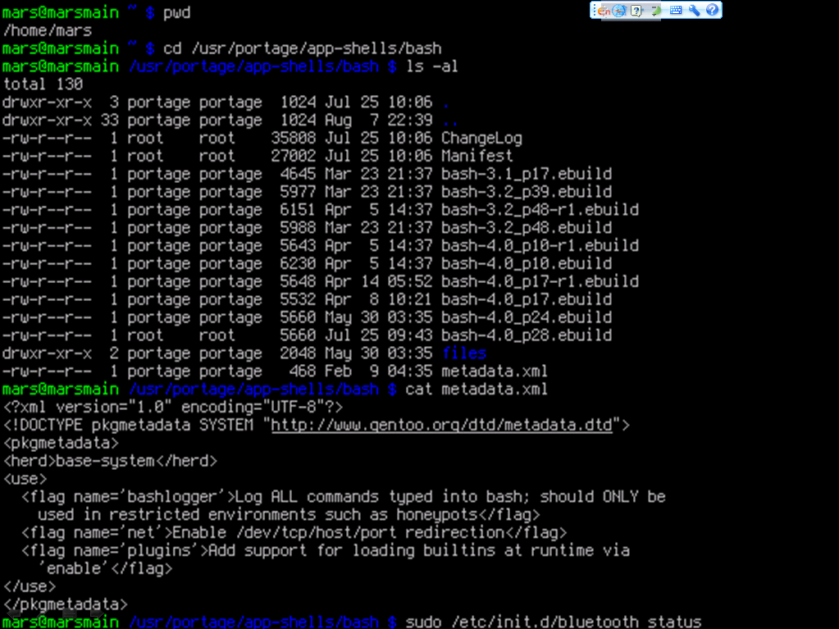

Slide 38
Commands
MOST IMPORTANT
  Search Path: /bin, /usr/bin, ...
  Command is case sensitive
  man – display the on-line manual pages
  e.g. >man man
  whatis – search the whatis database for
  complete words
  e.g. >whatis passwd

Slide 39
Commands
File and Directory
  ls - list files/dirs e.g. >ls -l
  mkdir – create a dir e.g. >mkdir test
  cd - change dir e.g. >cd test
  rm - remove files/dirs e.g. >rm -f a.txt
  cp - copy files/dirs e.g. >cp a.txt b.txt
  mv – move files/dir s e.g. >mv a.txt c.txt
  pwd – show current path e.g. >pwd
  du – estimate files/dirs space usage
  e.g. >du -c -h test
  df – report free disk space
  e.g. >df

Slide 40
Commands
File and Directory
  chmod – change mode of file/dir
  e.g. >chmod 777 test
  chown – change owner of file/dir
  e.g. >chown rong edit
  chgrp – change group of file/dir
  e.g. >chgrp guest draft -R
  $ ls -l
  drwxr--r-- 1 peter admin 4096 Mar 1 2007 drafts
  -rw-r--r-- 1 peter admin 30405 Mar 1 2007 edition-32
  -r-xr-xr-x 1 terry admin 8460 Mar 1 2007 edit
duuugggooo C owner group size date name
C:(hard link count)

Slide 41
Commands
Search
  whereis - locate special files for a command
  (binary, src and manual file)
  e.g. >whereis cp
  find – search for files/dirs in a dir hierarchy
  e.g. >find . –name “c.txt”
  locate – locate files/dirs by name in system
  based on a database
  e.g. >locate test
  grep – text search utility
  e.g. >grep “abc” . -R

Slide 42
Commands
User Account
  useradd – create a new user
  e.g. >useradd rong
  userdel – delete a user account
  e.g. >userdel rong
  passwd – set password for a user account
  based on a database
  e.g. >passwd rong
  users – print name of user currently logged
  e.g. >users

Slide 43
Commands
Text
  cat – concatenate and print files
  e.g. >cat b.txt
  head – output the first part of files
  e.g. >head –n 4 b.txt
  tail – output the last part of files
  e.g. >tail –c 50 b.txt
  wc – print the number of newlines, words,
  and bytes in files
  e.g. >wc b.txt
  cut – remove sections from each line of files
  e.g. >cut –c 4-10 b.txt

Slide 44
Commands
Misc
  echo – display a line of text
  e.g. >echo $PATH
  mount – mount a file system
  e.g. >mount /dev/sda3 /mnt
  umount – unmount a file system
  e.g. >umount /mnt
  ping – send ICMP ECHO_REQUEST to network hosts
  e.g. >ping 10.132.143.100
  date – print or set the system date and time
  e.g. >date "+%m/%d/%y“
  time – time a simple command
  e.g. >time locate mapreduce

Slide 45
Commands
Misc
  ; – join two command in one line
  e.g. >echo $PATH; whereis echo
  < > >> – redirect input and output
  e.g. >cat b.txt >> c.txt
  | – pipe the former output as the later input
  e.g. >cat b.txt | grep “abc”
  & – do command in new process
  e.g. >cat b.txt &

Slide 46
Pre-requisite
Linux
Tools
  Software Installer
  Compressing and Archiving
  Remote Login
  Text Editor

Slide 47
VERSION CONTROL
APT (Advanced Package Tools)
  A management system for software packages
  Package resource list for APT:
    /etc/apt/sources.list
  $ cat /etc/apt/source.list
  ...
  deb http://ftp.sjtu.edu.cn/debian/ squeeze main
  dbe-src http://ftp.sjtu.edu.cn/debian/ squeeze main
type URI of source dist comp
URI type: http, ftp, cdrom, file, ssh ...

Slide 48
VERSION CONTROL
APT (Advanced Package Tools)
  apt-get: command-line tool
    update e.g. >apt-get update
    install e.g. >apt-get install htop
    remove e.g. >apt-get remove htop
    upgrade e.g. >apt-get upgrade htop
  apt-cache: cache manipulator
    search e.g. >apt-cache search htop
    showpkg e.g. >apt-cache showpkg htop

Slide 49
VERSION CONTROL
APT (Advanced Package Tools)
  example: install vim
    >su root user
    >apt-get update update apt list
    >apt-cache search vim search in cache
    >apt-get install vim install vim
    >man vim manual of vim
  $ apt-cache search vim
  ...
  vim – Vi IMproved – enhanced vi editor
  vim-doc - Vi IMproved – HTML documentation
  ...

Slide 50
Pre-requisite
Linux
Tools
C Language
Lab
  Software Installer
  Compressing and Archiving
  Remote Login
  Text Editor

Slide 51
COMPRESSING
GZIP (Gnu ZIP)
  gzip file format
  Compress just single file
  Replace the original file with .gz file
  e.g. >gzip test.txt
  >gunzio test.txt.gz

Slide 52
ARCHIVING
TAR (Tape ARchive)
  tar file format
  Suffix:
    .tar e.g. >tar -cf src.tar src/
    .tgz/.tar.gz e.g. >tar -zxf src.tar.gz
    .tbz/.tar.bz2 e.g. >tar -jcf src.tbz src/

Slide 53
Pre-requisite
Linux
Tools
C Language
Lab
  Software Installer
  Compressing and Archiving
  Remote Login
  Text Editor

Slide 54
REMOTE LOGIN
SSH (Secure SHell)
  A Replacement for Telnet
    Communication through a secure channel
  Tatu Ylönen, 1995
  OpenSSH (OpenBSD Secure Shell), 1999
  e.g. >ssh -l root 10.132.143.112
  SCP, A Replacement for FTP
    e.g. >scp b.txt root@10.132.143.112:~/test/
    >scp root@10.132.143.112:~/test/b.txt ./

Slide 55
REMOTE LOGIN
Remote Login from Windows
  Command-Line Interface
    PuTTY
      act as a client for SSH and Telnet
      Developed by Microsoft
  Graphical User Interface
    VNC (Virtual Network Client)
      Platform Independent
      Client-Sever Model

Slide 56
Pre-requisite
Linux
Tools
C Language
Lab
  Software Installer
  Compressing and Archiving
  Remote Login
  Text Editor

Slide 57

TEXT EDITOR
vi (Visual Editor)
  /'viː'ai/, not /'siks/ ☺
  Extension: vim, vile, xvi, …
  Simple and Convenient
  BOOK: “learning the vi editor”
    http://www.china-pub.com/computers/common/info.asp?id=9208
  Cheat Sheet (Chinese version)
  http://jserv.sayya.org/misc/vi-vim-cheat-sheet.png
  “>vimtutor” to get a simple tutorial

Slide 58
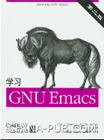
TEXT EDITOR
Emacs (Editing MACroS)
  /'imæks/
  More powerful than IDE !
    Emacs List
  BOOK: “Learning GNU Emacs”
  http://www.china-pub.com/computers/common/info.asp?id=13395

Slide 59
Tutorial-1
Tasks
  安装Linux虚拟机
  在虚拟机命令行中完成Shell作业 http://ipads.se.sjtu.edu.cn/courses/ics/tutorials/shell.html
Room
  Room-1: if your student ID is odd
  Room-2: if your student ID is even

