Slide 1
Buffer Overflow

Slide 2
Outline
Buffer Overflow
Suggested reading
  Chap 3.10.4

Slide 3
Out-of-Bounds Memory References
1 /* Implementation of library function gets() */
2 char *gets(char *s)
3 {
4 int c;
5 char *dest = s;
6
7 while ((c = getchar()) != ’\n’ && c != EOF)
8 *dest++ = c; /* No bounds checking */
9 if (c == EOF && dest ==s)
10 return NULL; /* No characters read */
11 *dest++ = ’\0’; /* Terminate String */
12 return s;
13 }

Slide 4
Out-of-Bounds Memory References
14 /* Read input line and write it back */
15 void echo()
16 {
17 char buf[8]; /* Way too small ! */
18 gets(buf);
19 puts(buf);
20 }

Slide 5
Out-of-Bounds Memory References
Return address
[7] | [6] | [5] | [4]
[3] | [2] | [1] | [0]
Stack frame
for caller
Stack frame
for echo
buf

Slide 6
Out-of-Bounds Memory References
Return address
[11] | [10] | [9] | [8]
[7] | [6] | [5] | [4]
[3] | [2] | [1] | [0]
Stack frame
for caller
Stack frame
for echo
buf

Slide 7
Out-of-Bounds Memory References
Return address
[15] | 1[4] | [13] | [12]
[11] | [10] | [9] | [8]
[7] | [6] | [5] | [4]
[3] | [2] | [1] | [0]
Stack frame
for caller
Stack frame
for echo
buf

Slide 8
Out-of-Bounds Memory References
[23] | [22] | [21] | [20]
[19] | [18] | [17] | [16]
[15] | 1[4] | [13] | [12]
[11] | [10] | [9] | [8]
[7] | [6] | [5] | [4]
[3] | [2] | [1] | [0]
Stack frame
for caller
Stack frame
for echo
buf

Slide 9
Malicious Use of Buffer Overflow
Stack
after call to gets()
void foo(){
bar();
...
}
return
address
A
foo stack frame
void bar() {
char buf[64];
gets(buf);
...
}
B
data
written
by
gets()
pad
exploit
code
bar stack frame
B
Assumption: An attacker knows the stack location
Q: How can attackers know that?
Notes:
Old Linux always used fixed stack address across different machines

Slide 10

The Famous Internet Worm of November 1988
To gain access to many of the computers across the Internet
  4 different ways
  One was a buffer overflow attack on the fingerd
Hundreds of machines were effectively paralyzed
The author of the worm was caught and prosecuted. He was sentenced to
  3 years probation
  400 hours of community service
  and a $10,500 fine
Become a professor in MIT since 2006

Slide 11
Defense-1: Stack Randomization
1 int main() {
2 long local;
3 printf("local at %p\n", &local);
4 return 0;
5 }
Running the code 10,000 times on a Linux (maybe 2.6.16) machine in 32-bit mode
The addresses ranged from
  0xff7fc59c to 0xffffd09c
  A range of around 2²³
Notes:
800w

Slide 12
Stack Randomization
Running in 64-bit mode on the newer machine
The addresses ranged from
  0x7fff0001b698 to 0x7ffffffaa4a8
  A range of nearly 2³²
Address-space layout randomization (ASLR)
  each time a program is run
  different parts of the program are loaded into different regions of memory
    code, data, heap data, library code, stack
Tips: 1. cat /proc/$pid/maps
2. static vs. dynamic
Notes:
10亿

Slide 13
Attack Against Stack Randomization
Nop sled
  a program “slides” through a long sequence of “nop”
Nop
  no operation instruction
Include a “nop sled” before the actual exploit code
  If insert 256-byte nop sled
  Need to guess 2¹⁵ starting addresses (no too much) for 32-bit machine
  Still have too many 2²⁴ for 64-bit machine
Stack Randomization
  A good mitigation but not a complete safegaurd
Q: Can attacker use a much larger region of nop?
Notes:
32bit: 3w次
64bit: 1000w次

Slide 14
Defense-2: Stack Corruption Detection
Return address
Canary
[7] | [6] | [5] | [4] | [3] | [2] | [1] | [0]
Stack frame
for caller
%rsp+24
Stack frame
for echo
buf=%rsp
Canary: Randomly generated each time the program runs

Slide 15
Stack Corruption Detection
1 echo:
2 subq $24, %rsp # Allocate 24 bytes on stack
3 movq %fs:40, %rax # Retrieve canary
4 movq %rax, 8(%rsp) # Store on stack
5 xorl %eax, %eax # Zero out register
6 movq %rsp, %rdi # Compute buf as %rsp
7 call gets # Call gets
8 movq %rsp, %rdi # Compute buf as %rsp
9 call puts # Call puts
10 movq 8(%rsp), %rax # Retrieve canary
11 xorq %fs:40, %rax # Compare to stored value
12 je .L9 # If =, goto ok
13 call __stack_chk_fail # Stack corrupted!
14 .L9 # ok:
15 addq $24, %rsp # Deallocate stack space
16 ret

Slide 16
Stack Corruption Detection
%fs:40
  Segmented addressing which appeared in 80286 and often used by thread local storage today
  It is marked as read only
    Cannot be modified by buffer overflow

Slide 17
Defense-3: Limiting Executable Code Regions
Page
  4k bytes
  As a protected unit by OS
  Should be marked as “readable”, “writable” and “executable”
    3 bits are required
Intel merged the “readable” and “writable” into one
  The exploit code in the stack can be executed
AMD introduced “NX” in X86-64
  Now there 2 bits
  Q: How about “JIT”?

Slide 18
Code Reuse Attack
Return-oriented Programming
  Find code gadgets in existed code base (e.g., libc)
  Push address of gadgets on the stack
  Leverage ‘ret’ to connect code gadgets
  No code injection
Solutions
  Shadow stack
  Return-less kernels
  Control-flow integrity
Address C
Address B
Address A
return addr
A
0101011010
B
0101011010
C
0101011010

Slide 19
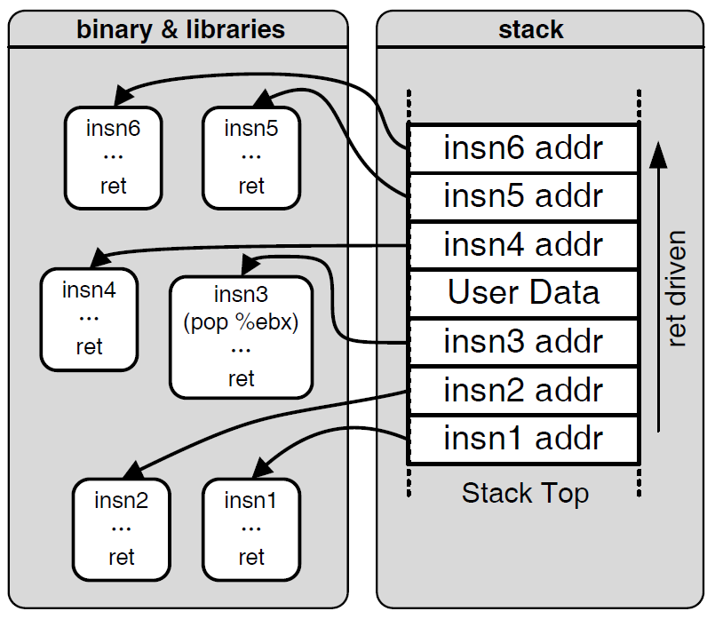

Motivation: Code Reuse Attack

Slide 20
Understanding Pointers
Notes:
双刃剑：功能强大（访问任意内存）、但容易出错、导致问题
JAVA/PYTHON 没有pointer、C++有一些限制

Slide 21
Outline
Understanding Pointers
Suggested reading
  Chap 3.10.1

Slide 22
Pointers
Every pointer has a type
  If the object has type T
    A pointer to this object has type T *
  Special void * type
    Represents a generic pointer
  malloc returns a generic pointer
Every pointer has a value
Notes:
地址和value
pointer本身也是个value
C有类型，pointer也有类型
汇编里面没有类型、也不存在pointer（地址）
Pointer类型指导汇编指令生成：长度（movb, movl, movq）

Slide 23
Pointers
Pointers are created with the & operator
  Applied to lvalue expression
    lvalue expression can appear on the left side of assignment ( e.g., p = &a; )
Pointers are dereferenced with the operator *
  The result is a value having the type associated with the pointer
Arrays and pointers are closed related
  The name of array can be viewed as a pointer constant
  ip[0] is equivalent to *ip

Slide 24
Pointer Arithmetic
Addition and subtraction
  p+i , p-i (result is a pointer)
  p-q (result is a long)
Referencing & dereferencing
  &E, *p
Subscription
  A[i], *(A+i)
Notes:
P+-I 移动多少个指针（地址变化）
板书一个例子
两个指针之间的操作：加法没意义，减法有意义

Slide 25
Example
static int daytab[2][13] = {
{0, 31, 28, 31, 30, 31, 30, 31, 31, 30, 31, 30, 31},
{0, 31, 29, 31, 30, 31, 30, 31, 31, 30, 31, 30, 31}
}
/* day_of_year: set day of year from month & day */
int day_of_year(int year, int month, int day)
{
int i, leap;
leap = (year%4 == 0 && year%100 != 0
|| year%400 ==0);
for (i = 1; i < month; i++)
day += daytab[leap][i];
return day;
}
Notes:
day_of_year: 3.5 是今年的第几天

Slide 26
Example
/* month_day: set month, day from day of year */
int month_day(int year, int yearday,
int *pmonth, int *pday)
{
int i, leap;
leap = (year%4 == 0 && year%100 != 0
|| year%400 ==0);
for (i = 1; yearday > daytab[leap][i] ; i++)
yearday -= daytab[leap][i];
*pmonth = i;
*pday = yearday;
}
Notes:
返回值：return 只有%rax；
返回更多信息：修改全局变量（不能返回局部变量）；指针的作用

Slide 27
Pointer Array
/* month_name: return name of n-th month */
char *month_name(int n)
{
static char *name[] = {
“Illegal month”,
“January”, “February”, “March”,
“April”, “May”, “June”,
“July”, “August”, “September”,
“October”, “November”, “December”
};
return (n < 1 || n > 12) ? name[0] : name[n];
}
Notes:
char *name指针数组
内存上的排布

Slide 28
Pointer Array
Illegal month\0
January\0
February\0
March\0
April\0
May\0
June\0
July\0
August\0
September\0
October\0
November\0
December\0

Slide 29
Command-line Arguments
argc: 3
argv:
$echo hello, world
$hello, world
#include <stdio.h>
/* echo command-line arguments */
int main(int argc, char *argv[])
{
int i ;
for (i = 1; i < argc ; i++)
printf(“%s%s”, argv[i],
(i < argc-1) ? “ ” : “”);
printf(“\n”) ;
return 0;
}
NULL
echo\0
Hello,\0
World\0

Slide 30
Command-line Arguments
#include <stdio.h>
/* echo command-line arguments ; 2nd version*/
int main(int argc, char *argv[])
{
while (--argc > 0)
printf(“%s%s”, ++argv, (argc > 1) ? “ ” : “”);
printf(“\n”);
return 0;
}
or
printf((argc > 1) ? “%s ” : “%s”, ++argv);

Slide 31
Pointer to Function
#include <stdlib.h>
/* numcmp: compare s1 and s2 numerically */
int numcmp(char *s1, char *s2)
{
double v1, v2;
v1 = atof(s1);
v2 = atof(s2);
if (v1 < v2) return -1;
else if ( v1 > v2 ) return 1;
else return 0;
}
/* strcmp: compare s1 and s2 as string */
int strcmp(char *s1, char *s2);
Notes:
函数类型：返回值+参数

Slide 32
Pointer to Function
#include <stdio.h>
#include <string.h>
{
...
int numeric = 0, (*cmp)(void *, void *);
char *s1, *s2;
...
if (...) numeric = 1 ;
...
cmp = (int (*)(void *, void *))
(numeric ? numcmp : strcmp);
(*cmp)(s1, s2);
...
}
Notes:
cmp是个指针，把*去掉，表示类型的指针
函数名表示函数地址，函数类型casting

Slide 33
Pointers can point to functions
void (*f)(int *)
f is a pointer to function
The function taken int * as argument
The return type of the function is void
Assignment makes f point to func
  f = func
Notice the precedence of the operators
  void *f(int *) declares f is a function
    (void *) f(int *)
Notes:
最近的符号
(*f) 指针 把*f删掉，就是指针类型
f( 函数
f[ 数组

Slide 34
Pointer Declaration
char **argv ;
int (*daytab)[13]
int (*comp)()
char (*(*x())[])()
  Function returning pointer to array[ ] of pointer to function returning char
char (*(*x[3])())[5]
  Array[3] of pointer to function returning pointer to array[5] of char
Notes:
1.指针
2.数组指针
3.函数指针
4.函数: 剩下的都是返回值，返回一个复杂的指针
5.数组

Slide 35
C operators
Operators Associativity
() [] -> . ++ -- left to right
! ~ ++ -- + - * & (type) sizeof right to left
* / % left to right
+ - left to right
<< >> left to right
< <= > >= left to right
== != left to right
& left to right
^ left to right
| left to right
&& left to right
|| left to right
?: right to left
= += -= *= /= %= &= ^= != <<= >>= right to left
, left to right
Note: Unary +, -, and * have higher precedence than binary forms
Notes:
结合率

Slide 36
Parameter Passing
Call by value
  f(xp)
Call by reference
  f(&xp)

Slide 37
Supporting Variable-Size Stack Frames

Slide 38
Supporting Variable-Size Stack Frames
(a) C code
long vframe(long n, long idx, long *q) {
long i; // local variable
long *p[n]; // local array, unknow size
p[0] = &i;
for (i = 1; i < n; i++)
p[i] = q;
return *p[idx];
}
Q: Both i and p are on the stack?
Notes:
之前见过的函数，如何访问栈上的局部变量？%rsp + offset
rsp指向栈顶（低地址）
变长+对齐

Slide 39
Supporting Variable-Size Stack Frames
(b) Portions of generated assembly code
long vframe(long n, long idx, long *q)
n in %rdi, idx in %rsi, q in %rdx
Only portions of code shown
1 vframe:
2 pushq %rbp Save old %rbp
3 movq %rsp, %rbp Set frame pointer

Slide 40
Supporting Variable-Size Stack Frames
4 subq $16, %rsp Allocate space for i (%rsp = s1)
5 leaq 22(,%rdi,8), %rax
6 andq $-16, %rax
7 subq %rax, %rsp Allocate space for array p (%rsp = s2)
8 leaq 7(%rsp), %rax
9 shrq $3, %rax
10 leaq 0(,%rax,8), %r8 Set %r8 to &p[0]
11 movq %r8, %rcx Set %rcx to &p[0] (%rcx = p)
. . .
Code for initialization loop
i in %rax and on stack, n in %rdi, p in %rcx, q in %rdx

Slide 41
Supporting Variable-Size Stack Frames
12 .L3: loop:
13 movq %rdx, (%rcx,%rax,8) Set p[i] to q
14 addq $1, %rax Increment i
15 movq %rax, -8(%rbp) Store on stack
16 .L2:
17 movq -8(%rbp), %rax Retrieve i from stack
18 cmpq %rdi, %rax Compare i:n
19 jl .L3 If <, goto loop
. . .
Code for function exit
20 leave Restore %rbp and %rsp
21 ret Return

Slide 42
Supporting Variable-Size Stack Frames
Using %rbp as a frame pointer for the top of the stack frame
At the beginning of vframe
  pushq %rbp
  movq %rsp, %rbp
At the end of vframe: leave instruction
  movq %rbp, %rsp
  popq %rbp

Slide 43
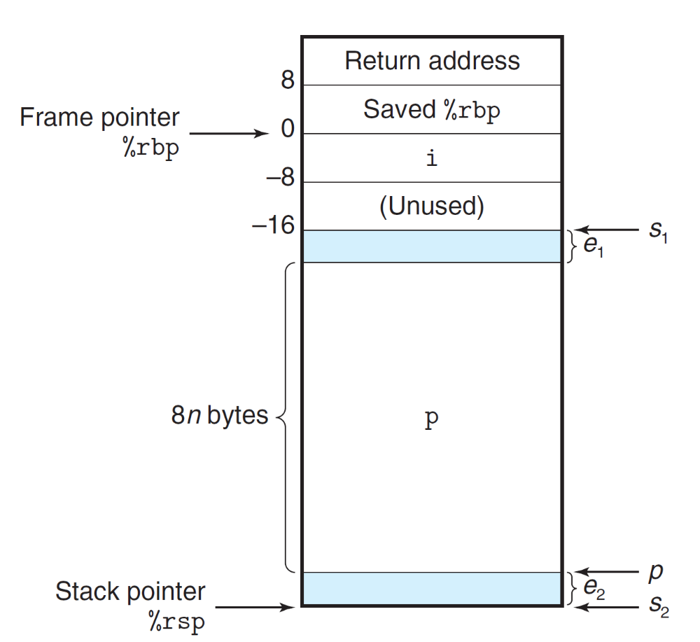
Supporting Variable-Size Stack Frames

Slide 44
Supporting Variable-Size Stack Frames
The leaq instruction of line 5
  computes the value 8n + 22
  which is then rounded down to the nearest multiple of 16 by the andq instruction of line 6
The resulting value will be
  8n + 8 when n is odd
  8n + 16 when n is even
This value is subtracted from s1 to give s2

Slide 45
Supporting Variable-Size Stack Frames
The three instructions in lines 8-10 round s2 up to the nearest multiple of 8
They make use of the combination of biasing and shifting
  (S2+7)/8
n | s1 | s2 | p | e1 | e2
5 | 2065 | 2017 | 2024 | 1 | 7
6 | 2064 | 2000 | 2000 | 16 | 0

Slide 46
Supporting Variable-Size Stack Frames
s2 is computed in a way that reserves just enough space for the array p (the nearest multiple of 16)
  %rsp: a multiple of 16
p will be aligned on a multiple of 8
  as is recommended for an array of 8-byte elements

