Slide 1


Linux & Tools
计算机系统基础 Tutorial Lesson
古金宇
gujinyu@sjtu.edu.cn
https://ipads.se.sjtu.edu.cn/courses/ics/

Slide 2
版权声明
本内容版权归上海交通大学并行与分布式系统研究所所有
使用者可以将全部或部分本内容免费用于非商业用途
使用者在使用全部或部分本内容时请注明来源
  资料来自上海交通大学并行与分布式系统研究所+材料名字
对于不遵守此声明或者其他违法使用本内容者，将依法保留追究权
本内容的发布采用 Creative Commons Attribution 4.0 License
  完整文本：https://creativecommons.org/licenses/by/4.0/legalcode

Slide 3
What is ICS Tutorial
ICS introduces the computer systems
Tutorial lessons
  Introduce the software needed by the ICS course but not written in the ICS book
  A new environment: Linux
  A set of new tools: Git, Vim, Objdump, GDB, …

Slide 4
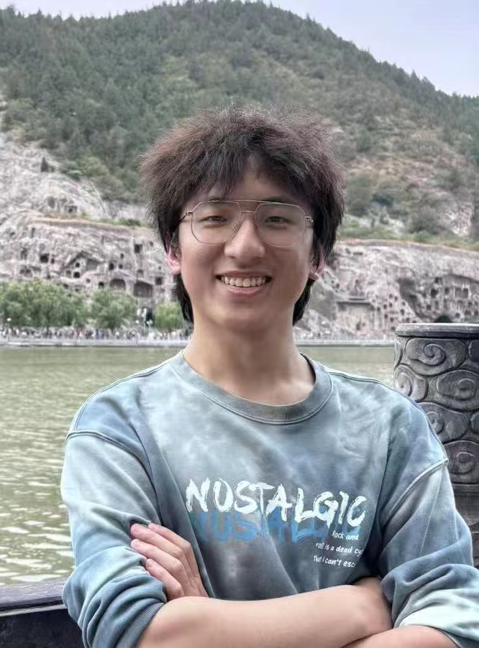

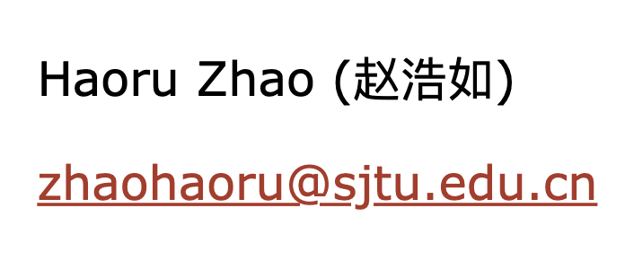
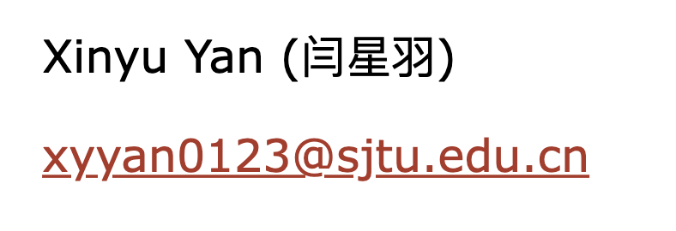
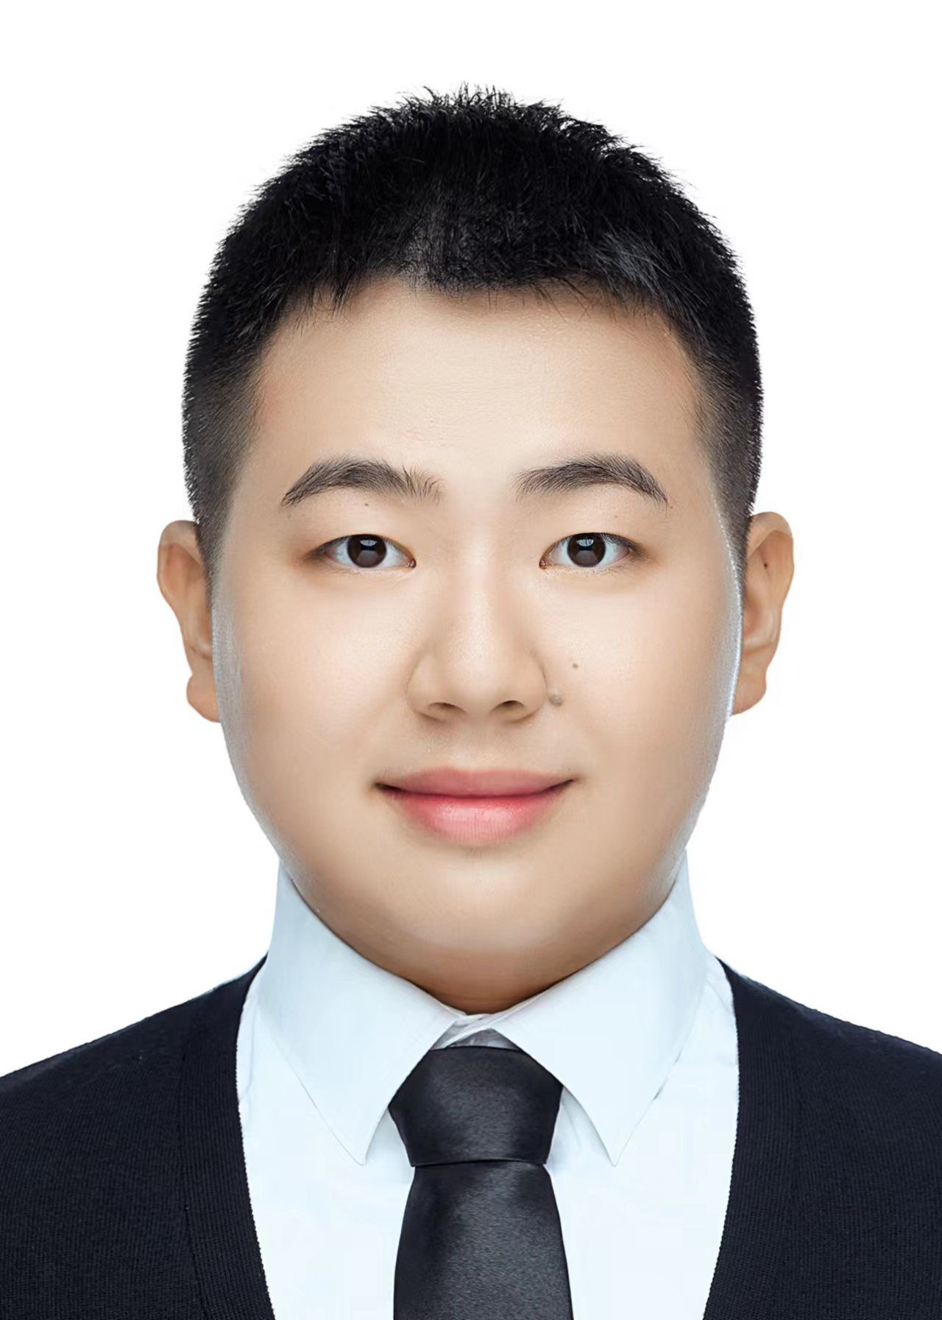
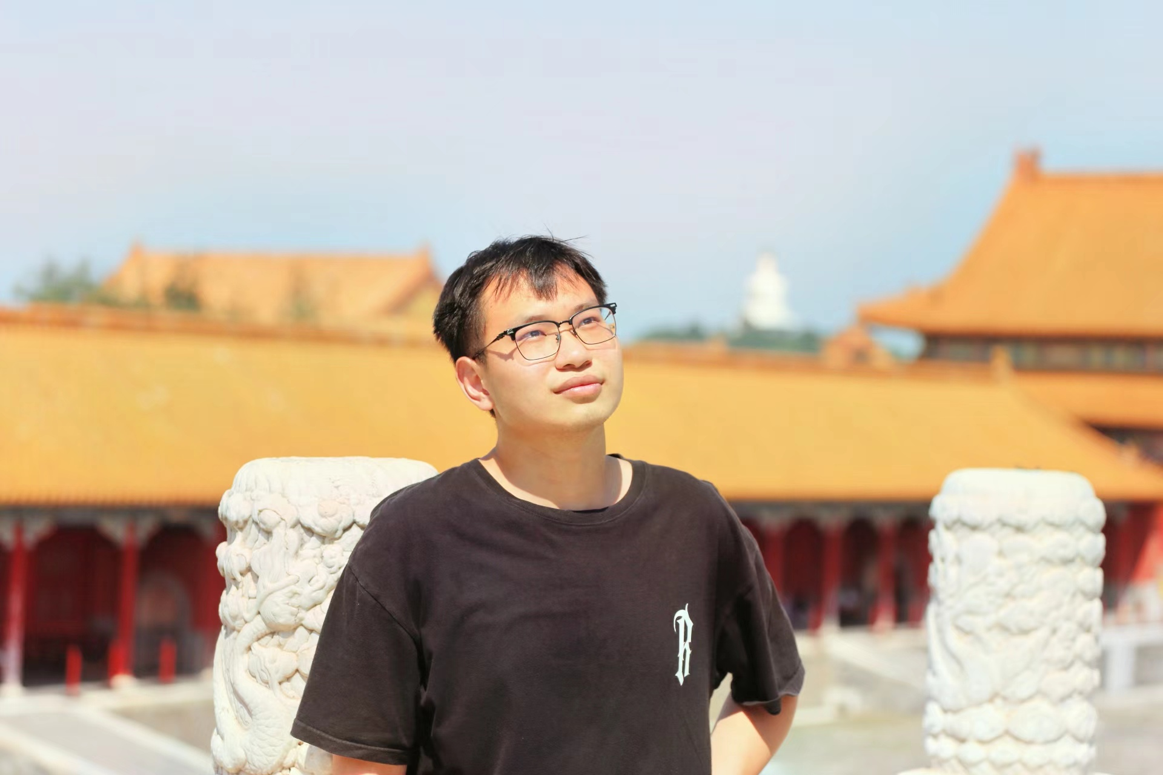

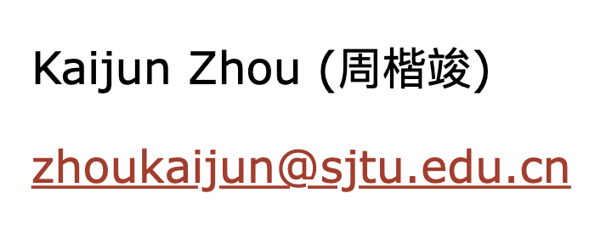
Teaching Assistants

Slide 5
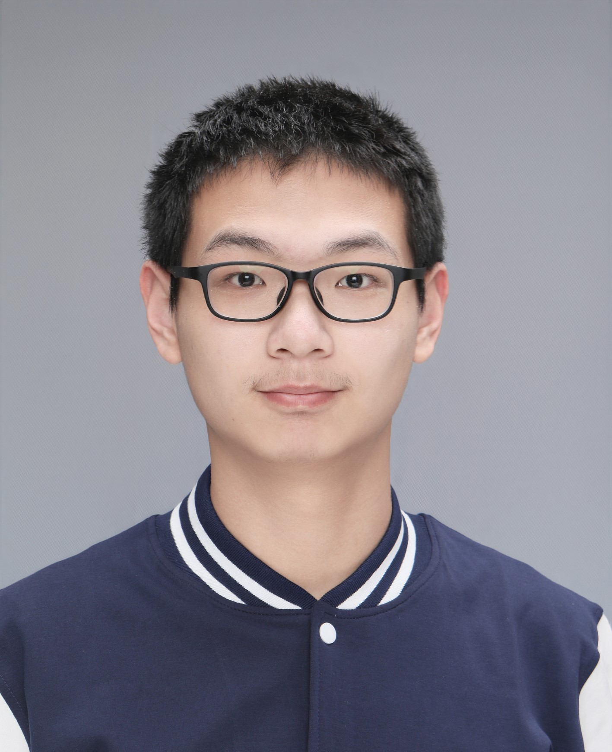

Lab Environment Contributors
廖承凡
陈启炜

Slide 6
Tasks
Homework
  Released through canvas/OC
  Every Week
Exams
  Quiz (one or two times)
  Final eaxm
Labs
  1: Bits
  2: Bomb *
  3: Buffer Overflow *
  4: Shell
* Online Test

Slide 7
Hard Rules
Deadline:
  Delay no more than 1 week: 60% points
Plagiarism: No Tolerance
  Neither from the network nor from classmates
  Punishment
    0 point for ALL *
* This also works for the following classes including ICS2, OS, CSE …

Slide 8
Prior Emails
… 不过我的本意并没有提供代码让他抄袭的啊。他有一个binfile 的函数怎么调试都不对，我确实把这段代码发给了他，但我教会了他怎么做的了。…
…, 她请教我怎么优化，我跟她讲了优化方法然后她自己去改了，改过以后问我为什么效率没有提升， 我就叫她让我看下她的代码，发现没有实质性的优化，我嫌讲不清就叫她参考我的代码, …
… 我们都是“好学生”，在同学之间会很难拒绝。这次之后就没有这种情况发生了。…
…, 知道了，只是实在不会写唉，没学c这个指针真的看不太懂额。这次错了，下次一定不会这么做了。不过能不能请老师不要把 XX判为0分 …

Slide 9
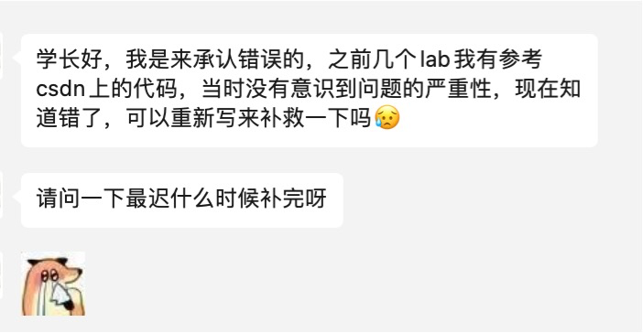
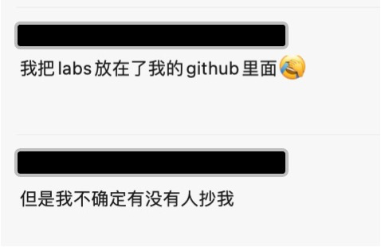
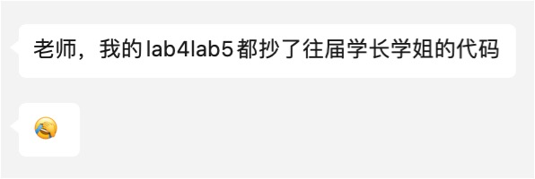
Prior Wechats

Slide 10
Linux

Slide 11




Operating Systems
Various Applications
Windows
Android
Serve Applications
Manage Hardware
Laptop
Phone
CPU, Memory, GPU…

Slide 12
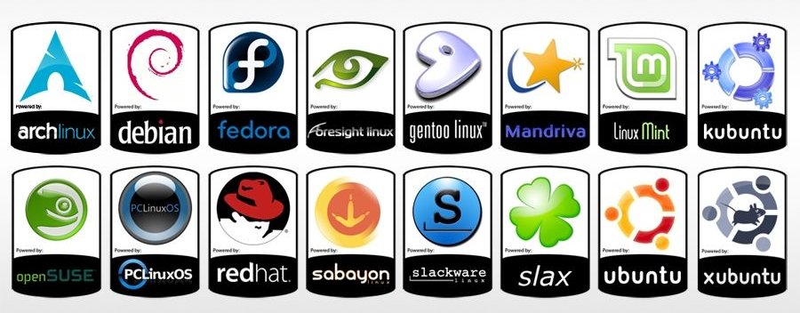
Linux

Slide 13

VM Virtualization
VM
VM
Share physical machines
  Virtual machines (VM)
Install OS and applications
  Just as using a real machine
Virtual machine monitor
  Xen, KVM, HyperV, VirtualBox
  We used vmware in ICS
Unmodified
User Software
Unmodified
User Software
Operating System
Operating System
Virtual Machine Monitor
Host Operating System
Hardware
(CPU, Memory, Disk, Ethernet)

Slide 14
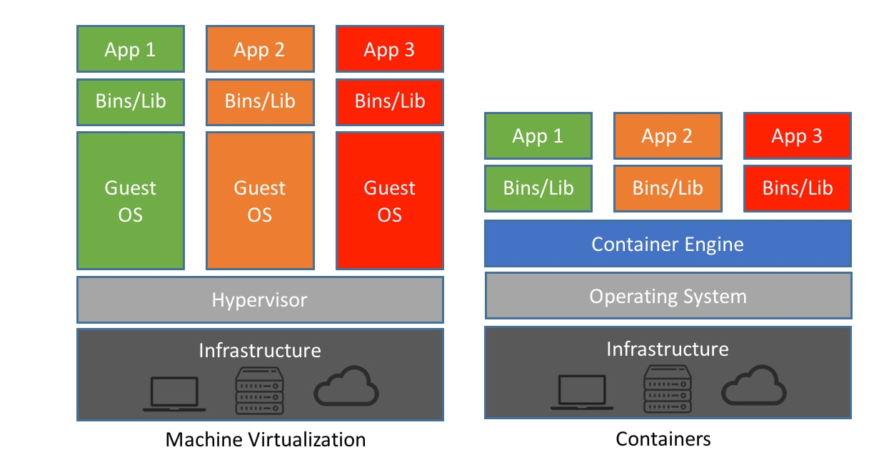
Container Virtualization

Slide 15
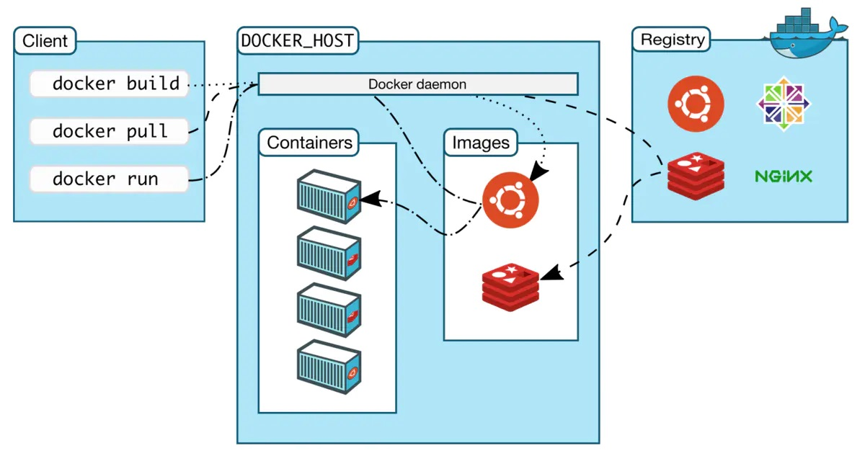
Container Virtualization
ICS: We use docker to run ubuntu container on either Mac or Windows

Slide 16
Tasks

Slide 17
Tasks
Linux guru, class dismissed!
Other guys, let us go forth and conquer the terminal! 🐧🔧
  Install docker
  Run ubuntu/Linux
  Get familiar with Shell
beginner's guide
  https://ipads.feishu.cn/docx/Ailsdq5R7oiGiBxjCNac3NGQn0E?from=from_copylink

