Slide 1


Shell
计算机系统基础 Tutorial Lesson
古金宇
gujinyu@sjtu.edu.cn
https://ipads.se.sjtu.edu.cn/courses/ics/

Slide 2
版权声明
本内容版权归上海交通大学并行与分布式系统研究所所有
使用者可以将全部或部分本内容免费用于非商业用途
使用者在使用全部或部分本内容时请注明来源
  资料来自上海交通大学并行与分布式系统研究所+材料名字
对于不遵守此声明或者其他违法使用本内容者，将依法保留追究权
本内容的发布采用 Creative Commons Attribution 4.0 License
  完整文本：https://creativecommons.org/licenses/by/4.0/legalcode

Slide 3
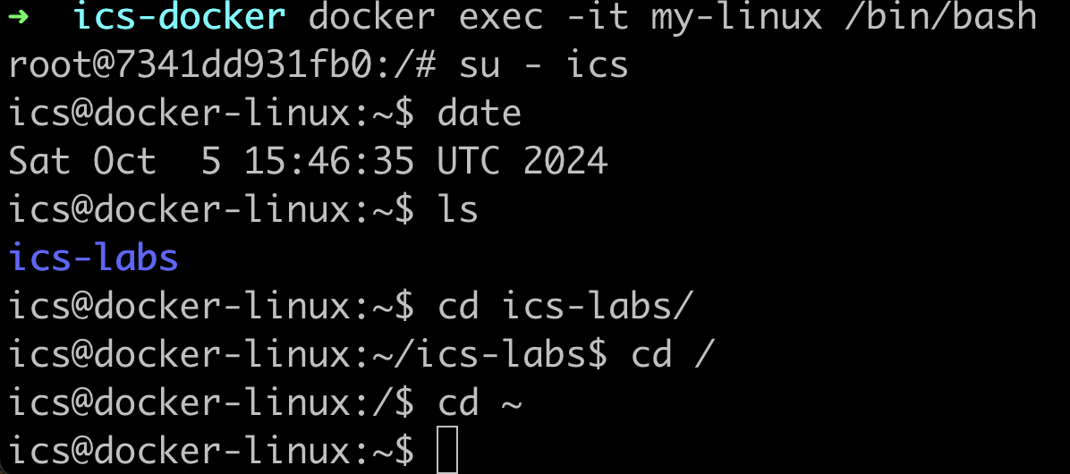
The Basics: Shell Prompt
username@hostname:pwd$
You can change the default Shell prompt by modifying .bashrc

Slide 4
The Basics: Directories
Two commands commonly used to work with the current working directory:
  pwd - print working directory
    This tells you what directory you are currently in
  cd - change directory
    This lets you change into a different directory
Important Directory Names:
  ~ – the home directory
  . – the current directory
  .. – the parent directory (the directory right above the current one)
  / – the root directory (has no parent)
Navigating in the shell now!

Slide 5
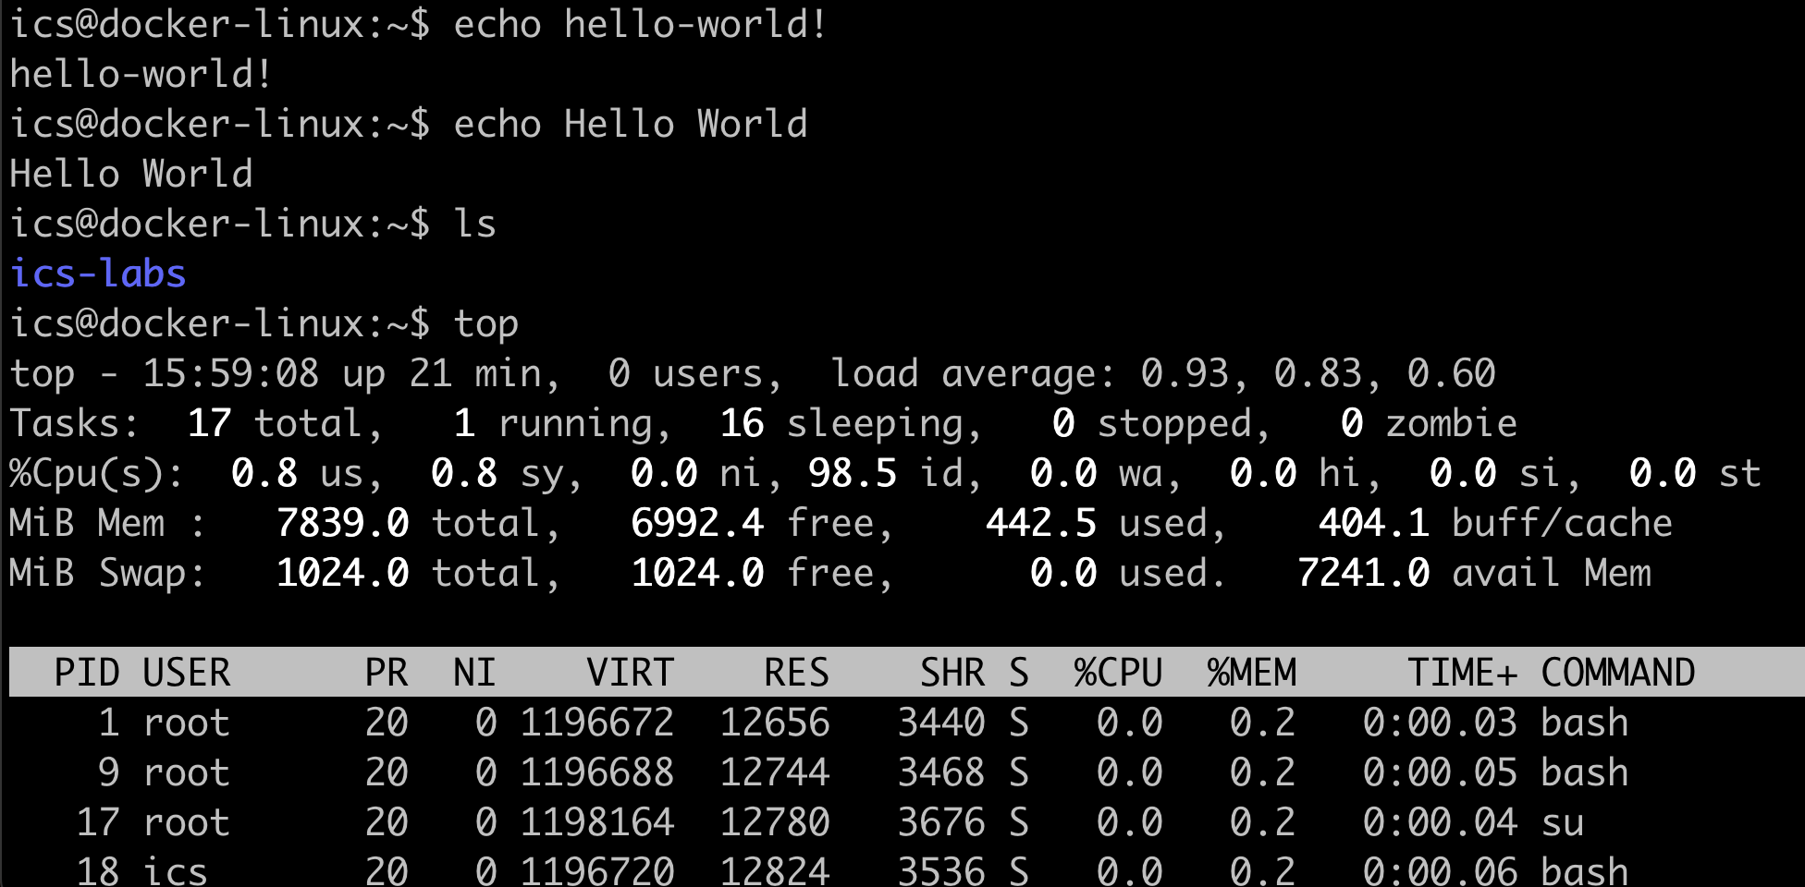
The Basics: Commands
Examples
  echo
  ls
  top

Slide 6
The Basics: Manual pages
If you are ever unsure about a command, one helpful resource is to utilize man pages
  $ man <command>
    Gives information on what a command does and what options you can give it.
    You can search through a man page by typing: /thing_i_want_to_find (press n for the next one)
  Most commands have a --help or -h option that will print out a help message

Slide 7
Tip
Since we use a minimized Linux environment, the man pages may be excluded
If the following command fails
  ics@docker-linux:~$ man man
You can type this command first
  ics@docker-linux:~$ sudo unminimize

Slide 8
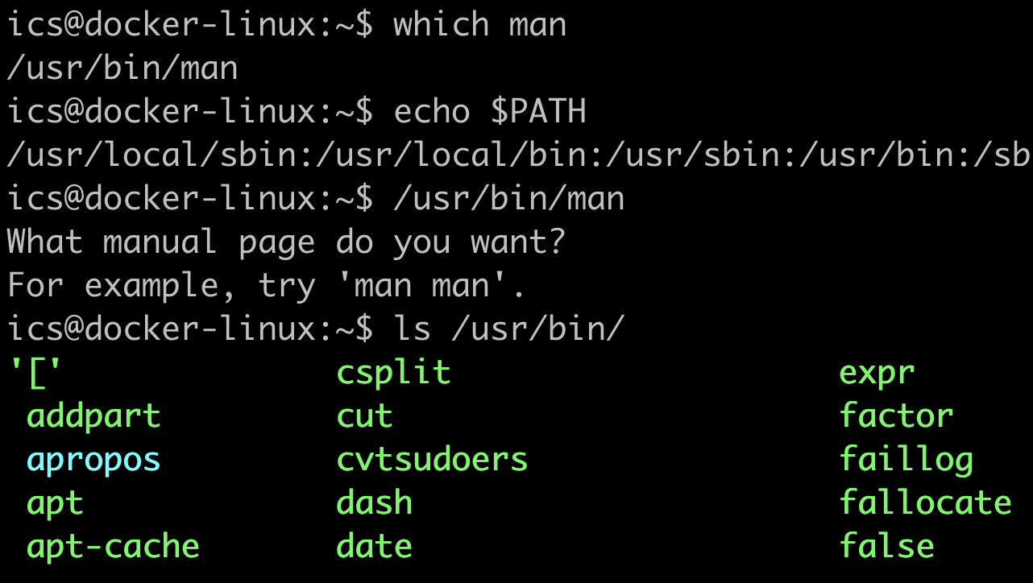
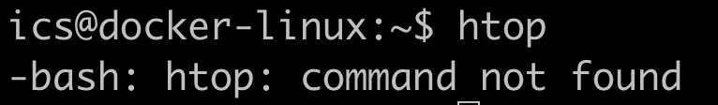
Question: Where are the Commands
Could you explain
this error info?

Slide 9
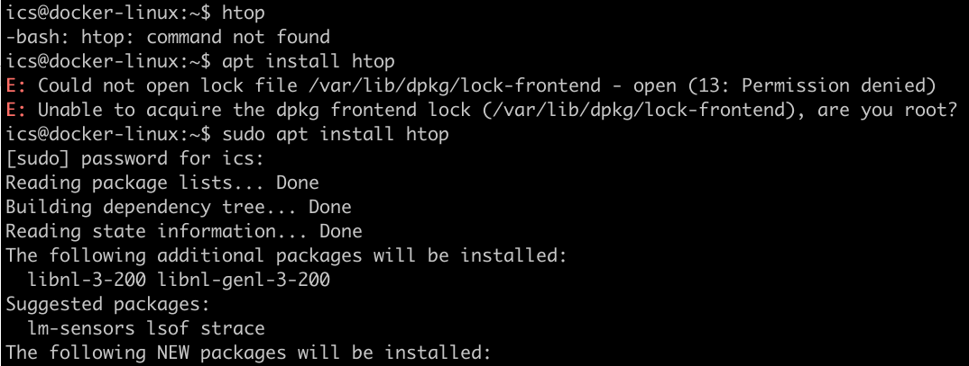
Install the Command Package
Package manager
  e.g., apt (ubuntu, Debian)
sudo apt install <command>

Slide 10
Root Permission
sudo <command>
  sudo allows a permitted user to execute a command as the superuser (root)
Be careful with sudo!
  you should not use sudo if you are not sure about what will happen next

Slide 11
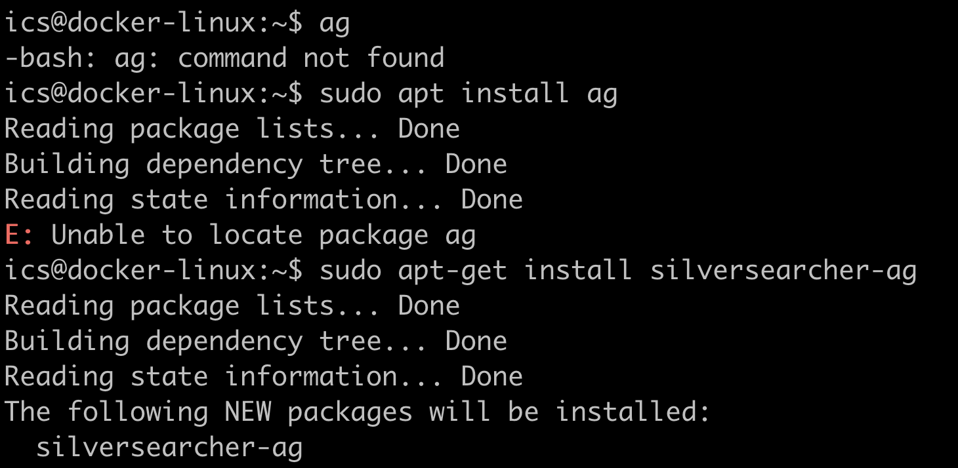
Tip: How to Know the Package Name
Ask GPT or https://command-not-found.com/

Slide 12
Handy Tool Commands

Slide 13
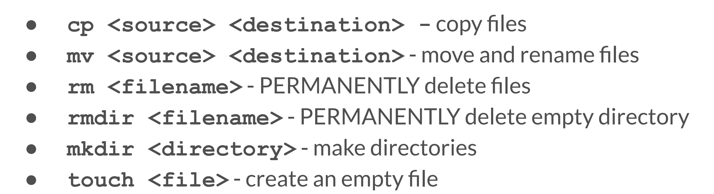
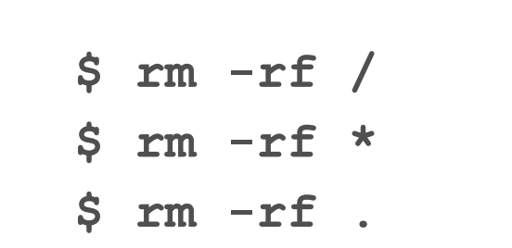
Managing Files
Warning!

Slide 14
Text Processing
cat [FILE]
  concatenates inputs and prints on the screen
sort
  sort lines of text file
  -d: dictionary order -n: numeric sort -r: reverse
head/tail
  print first (or last) lines of a file

Slide 15
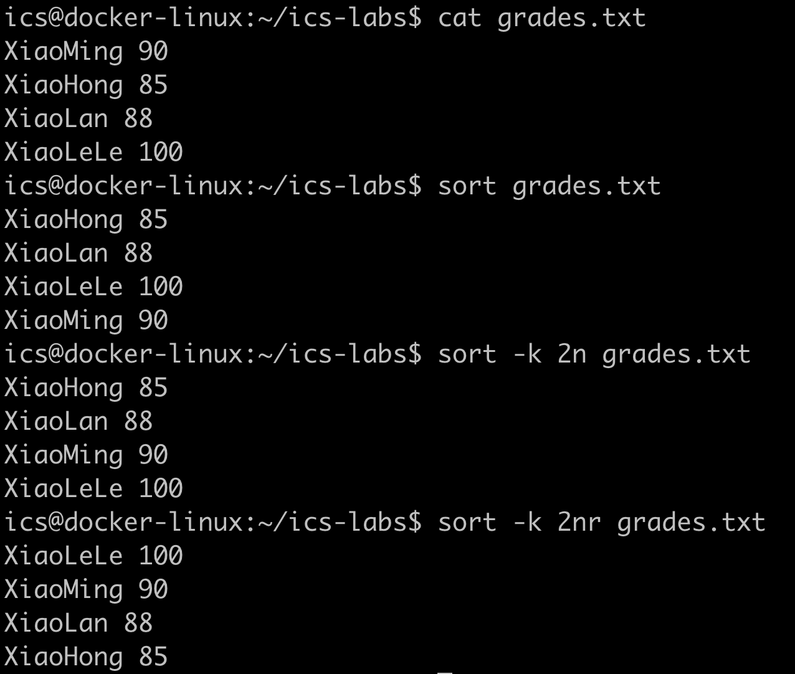
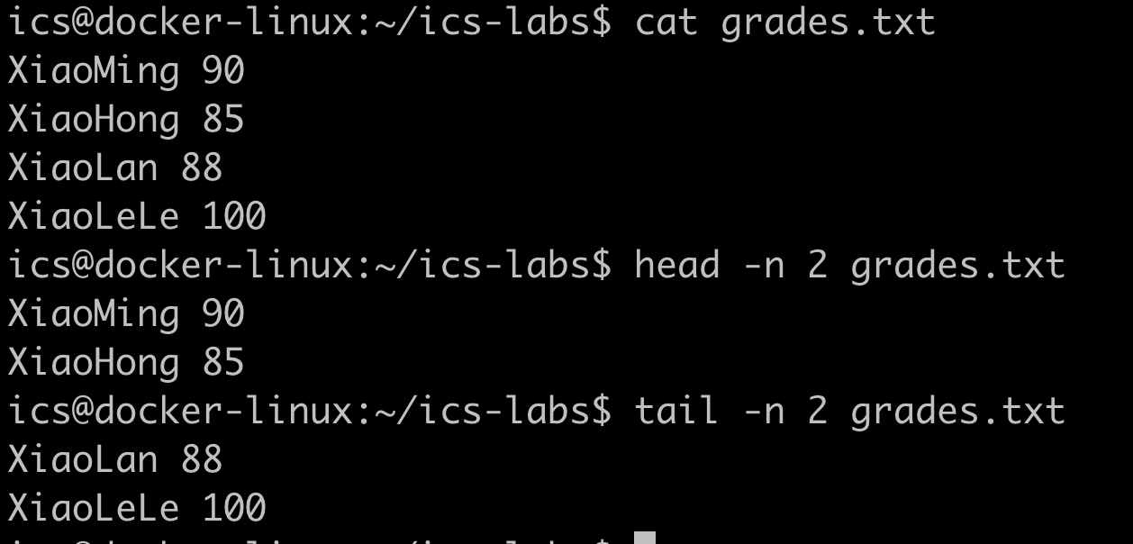
Examples

Slide 16
Input/Output Redirection
In the shell, programs have two primary “streams” associated with them: their input stream and output stream
  a program’s default input and output are both your terminal
  we can also rewire those streams
command < file.txt
  Read the stdin of “command” from “file.txt”
command > file.txt
  Send the stdout of “command” to “file.txt”, overwriting its contents
command >> file.txt command 2> file.txt command &> file.txt
Notes:
Rm

Slide 17
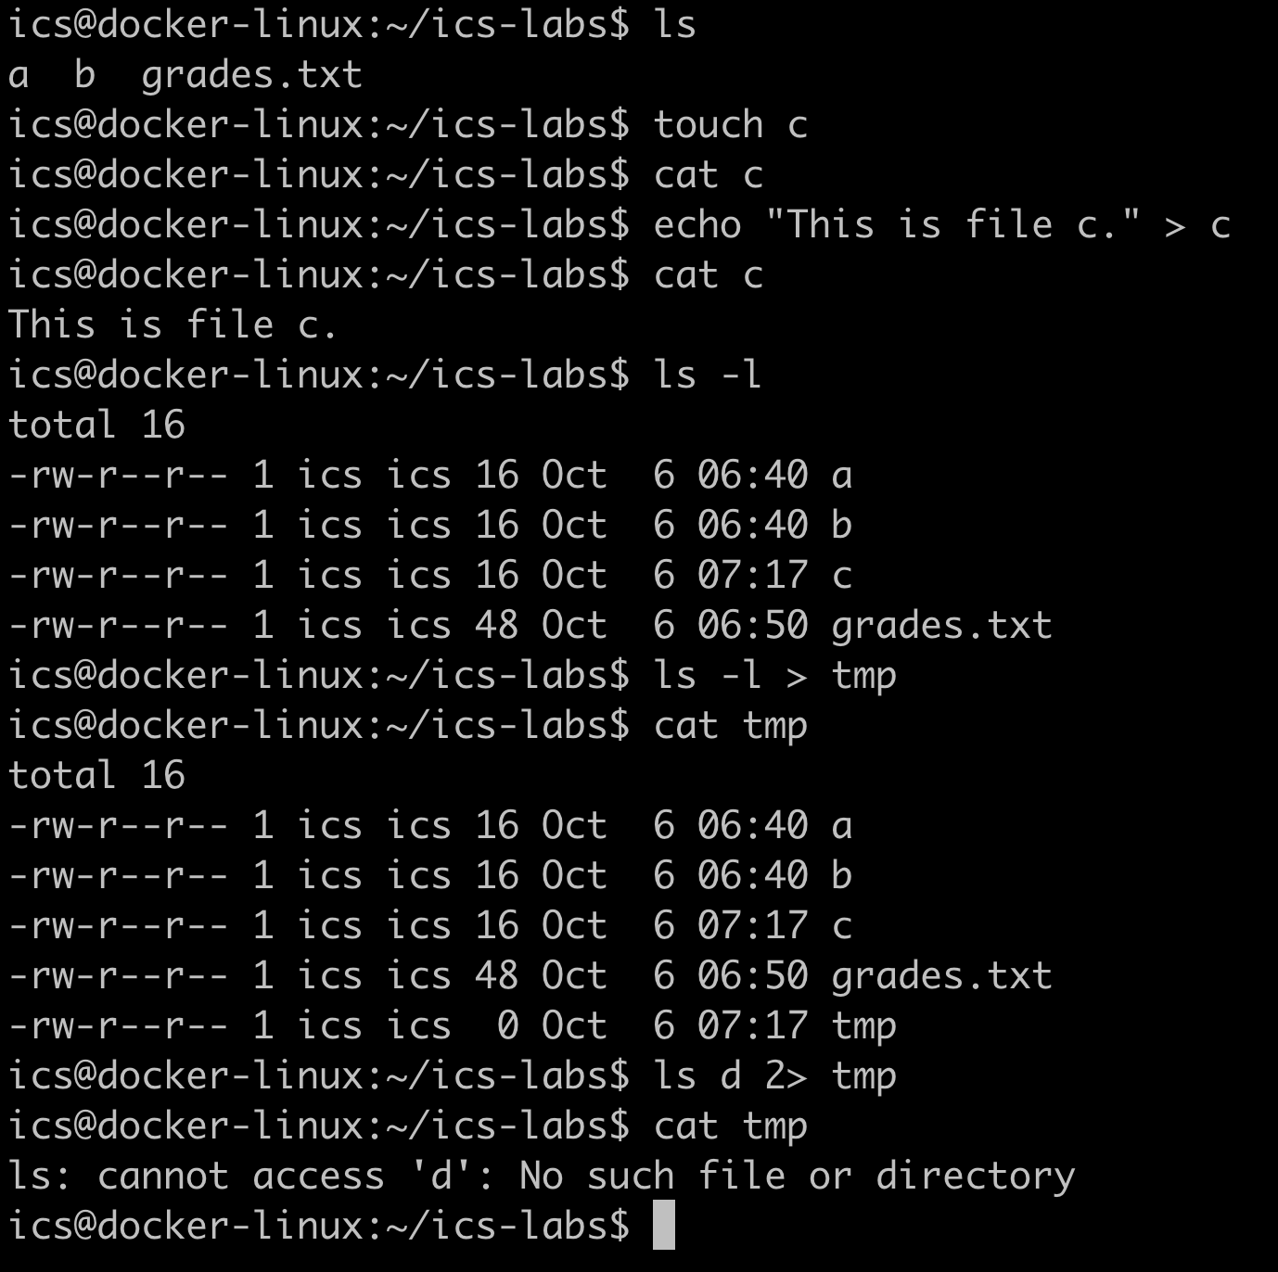
Examples
SideBar:
What `ls –l` shows
Permission
Owner
Size
Mtime

Slide 18
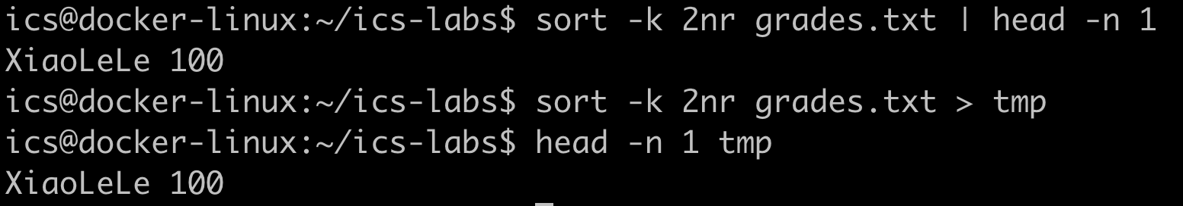
Connecting Programs
The | operator (pipe) lets you “chain” programs such that the output of one is the input of another

Slide 19
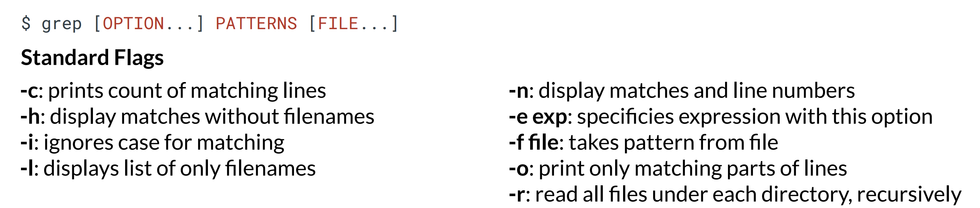
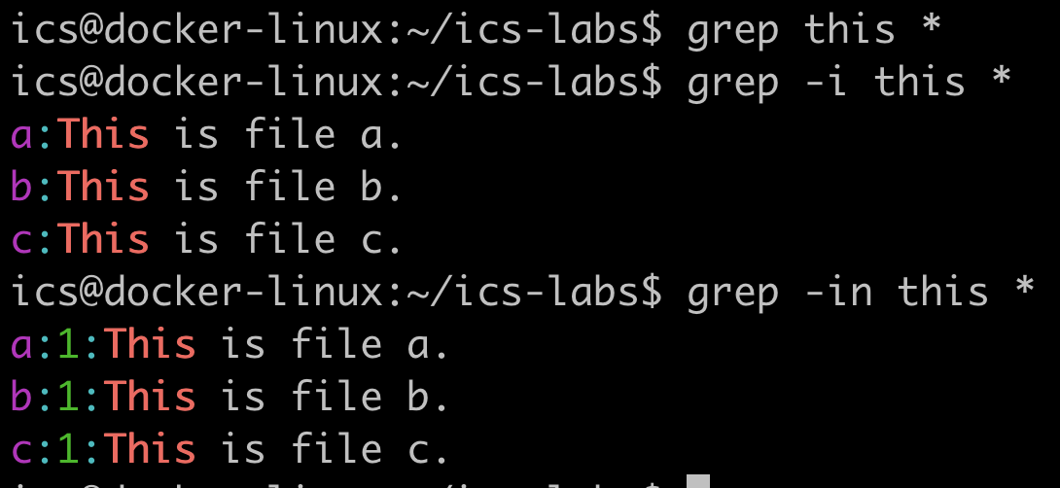
grep: Global Regular Expression Print

Slide 20
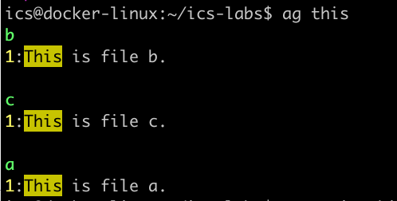
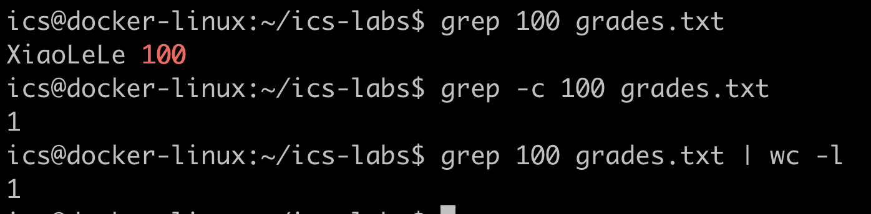
Examples
ag: a tool similar to grep
but could be faster
Both of them can help to find keyword in code or doc
Use grep with pipe |

Slide 21
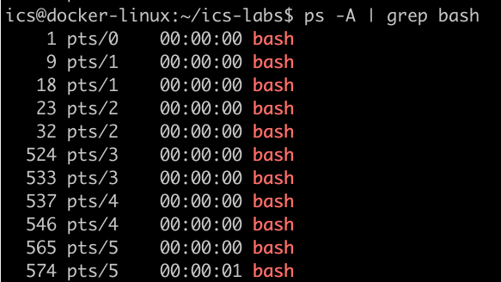
PS with grep to Locate Some Program

Slide 22
awk
Typical use case: data processing
  Average
  Max
  Min
  Get data in a certain column
  Get data that meets some condition

Slide 23
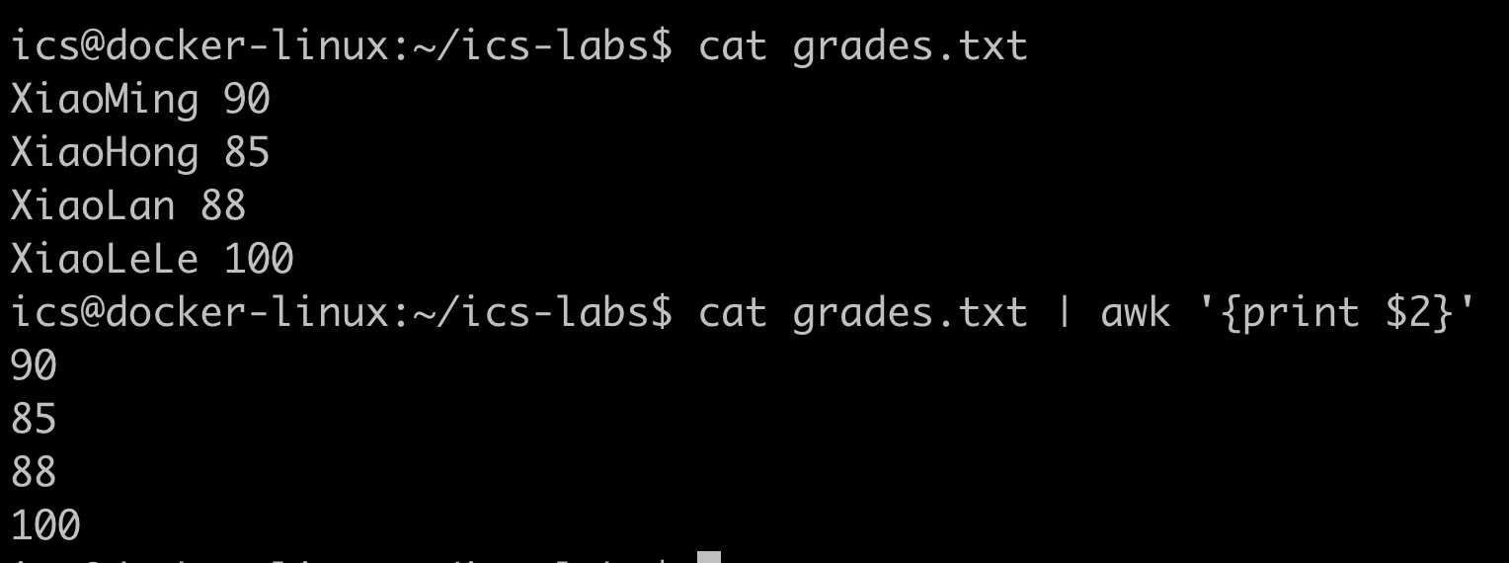
Example: Print the Second Column
$1
$2
{print $2}
execute this code each line

Slide 24
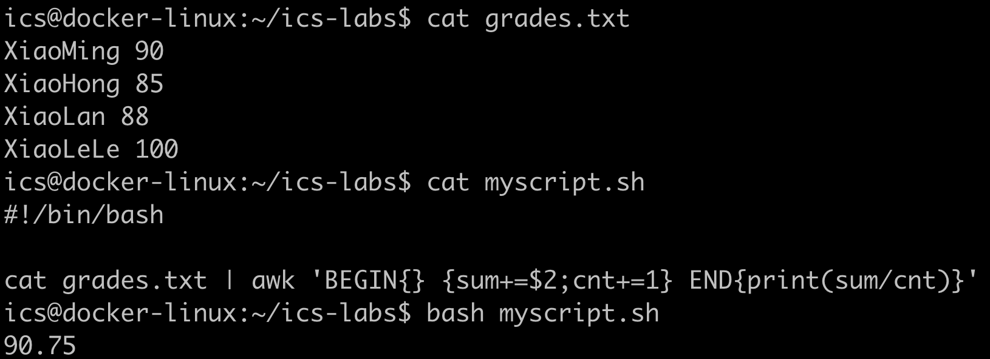
Example: Calculate the Average
A simple shell script
{sum+=$2;cnt+=1}
execute this code each line

Slide 25
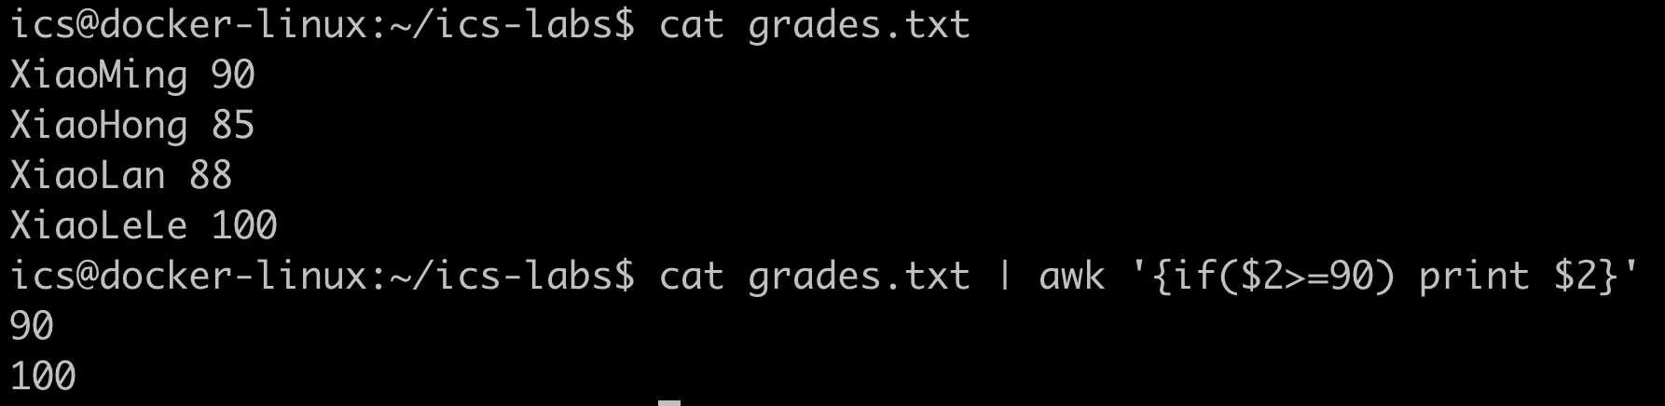
Example: Conditional Logic

Slide 26
sed
Typical use case: string text operation
  Replace: sed 's/old/new/g' file
  Replace in line 3: sed '3 s/old/new/' file
  Delete line 3: sed '3d' file
  Print line 3: sed -n '3p' file
  Add line: sed '2i\This is a new line' file
Notes:
1.将文件 file 中所有出现的 old 替换为 new
2.仅在文件 file 的第三行将 old 替换为 new
3.删除文件 file 中的第三行
4.仅打印文件 file 中的第三行
5.在文件 file 的第二行前插入 "This is a new line"

Slide 27
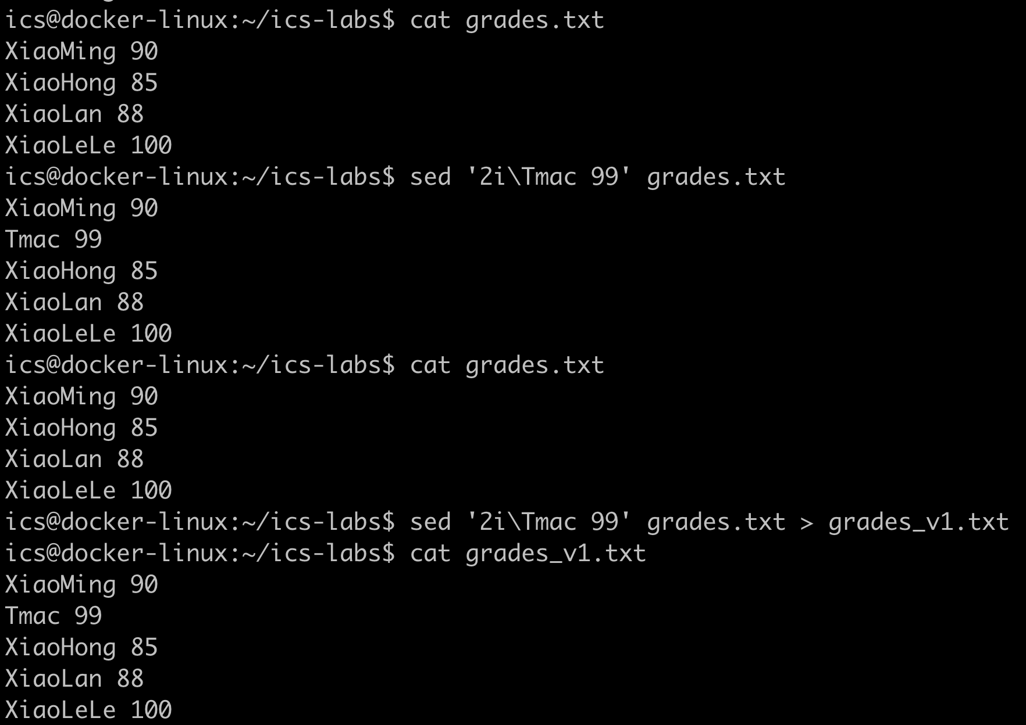
Examples

Slide 28
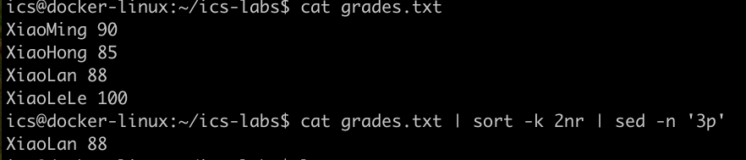
Example
Q: Could you explain the above command?

Slide 29
Tasks

Slide 30
Tasks
Create a new directory called tut-shell under ~/ics-labs
Create a new empty file called wget.sh in tut-shell
Use echo command to write the following into that file
  wget www.baidu.com
Try to execute the file, i.e., type the path to the script (`./wget.sh`) into your shell and press enter. Understand why it doesn’t work by consulting the output of ls (hint: look at the permission bits of the file).

Slide 31
Tasks
5. Run the command by explicitly starting the bash interpreter, and giving it the file wget.sh as the first argument, i.e., `bash wget.sh`. This may also fail due to another error (wget: command not found). How to fix it? (Hint: apt)
6. After you install the wget program, `bash wget.sh` will work now. Why does this work, while `./wget.sh` didn’t?

Slide 32
Tasks
7. Look up the chmod program (e.g., `man chmod`)
8. Use chmod to make it possible to run the command `./wget.sh`rather than having to type `bash wget.sh`
9. Does `wget.sh` instead of `./wget.sh` work? How to make it work? (Hint: $PATH)
10. Use connected commands to write the last modified time of wget.sh into a file called last-modified.txt in your home directory

Slide 33
Tasks
More challenging shell assignment
  http://202.120.40.8:10680/courses/ics/tutorial/shell/ (part 3-III)

