Slide 1


Git+Vim+VS Code
计算机系统基础 Tutorial Lesson
古金宇
gujinyu@sjtu.edu.cn
https://ipads.se.sjtu.edu.cn/courses/ics/

Slide 2
版权声明
本内容版权归上海交通大学并行与分布式系统研究所所有
使用者可以将全部或部分本内容免费用于非商业用途
使用者在使用全部或部分本内容时请注明来源
  资料来自上海交通大学并行与分布式系统研究所+材料名字
对于不遵守此声明或者其他违法使用本内容者，将依法保留追究权
本内容的发布采用 Creative Commons Attribution 4.0 License
  完整文本：https://creativecommons.org/licenses/by/4.0/legalcode

Slide 3


Git: Version Control System
Git is software for tracking changes in any set of files.
  Created by Linus Torvalds in April 2005 to manage Linux kernel code
  A command line version control tool
  Cross Platform, Free & Open Source
  Offering distributed version control
  Managing large project effectively
Sidebar: A “git” is a cranky old man. Linus meant himself ☺

Slide 4
Git: Version Control System
Git orginzes commits as DAG
Commit is a collection of files and folders within some top-level directory
Commit 0
Commit 1

Slide 5
Why Version Control?
Working by yourself
  Look at old versions of a project
  Keep a log of why certain changes were made
  Work on parallel branches of development
Working with others
  See what other people have changed, learn and review
  Resolve conflicts in concurrent developmen
Better than copy pasting code or zipping and sending!

Slide 6
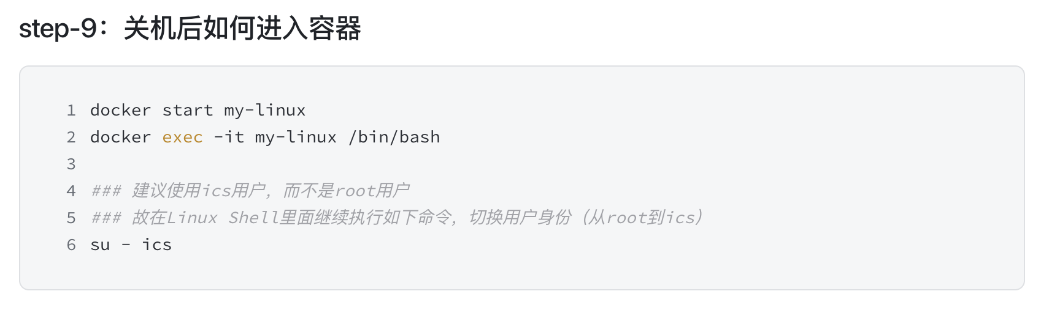
Recall: How to access your container?

Slide 7
Install and Config Git
Installation
  $ sudo apt install git nano
Configuring Git (replace with your own id & email)
  $ git config --global user.name “<your_username>”
  $ git config --global user.email “<your_email>”
  These two git commands response nothing.
  To see the current set of configs: $ git config --list
  Check usage of git command: $ git help <command>

Slide 8
Tip
If you encounter problems when installing git, you can try the following command:
  $ sudo apt update

Slide 9
Registration
Registration
  http://202.120.40.8:10643/
Clone the ICS repo in ics-labs directory
  $ cd ics-labs
  $ git clone http://202.120.40.8:10680/your-ID.git
  e.g. git clone http://202.120.40.8:10680/523031910000.git
  Enter your student ID and password used in registration
  $ git config --global credential.helper store
  Temporarily save the username and password and keep them valid for a period

Slide 10
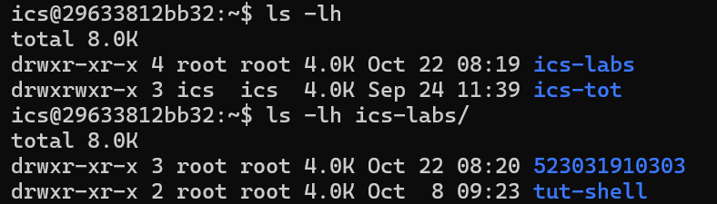
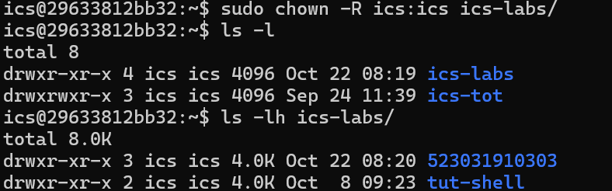
Tip
If you encounter problems like permission denied when cloning, you can try the following command: $ cd ~; sudo chown –R ics:ics ics-labs
The directory belongs to root
The directory belongs to ics

Slide 11
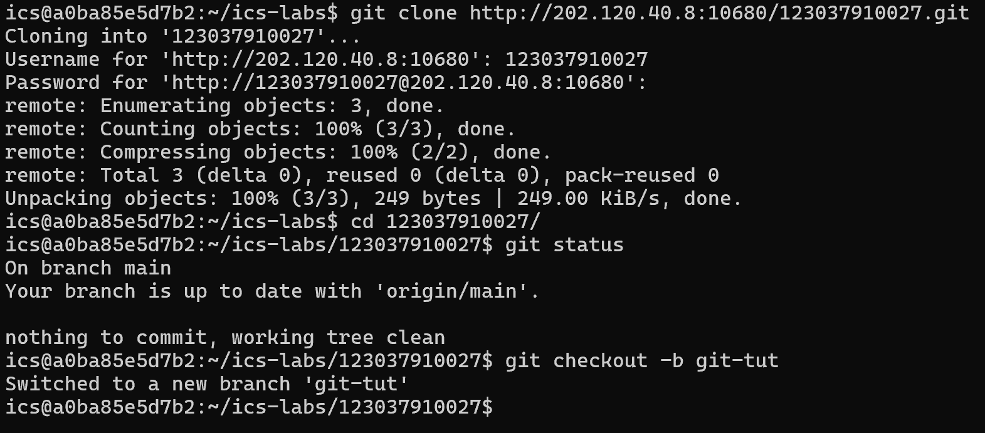
Case 1: Basic Local Operations
$ git status check current branch info
$ git checkout –b <branch_name> checkout to new branch

Slide 12
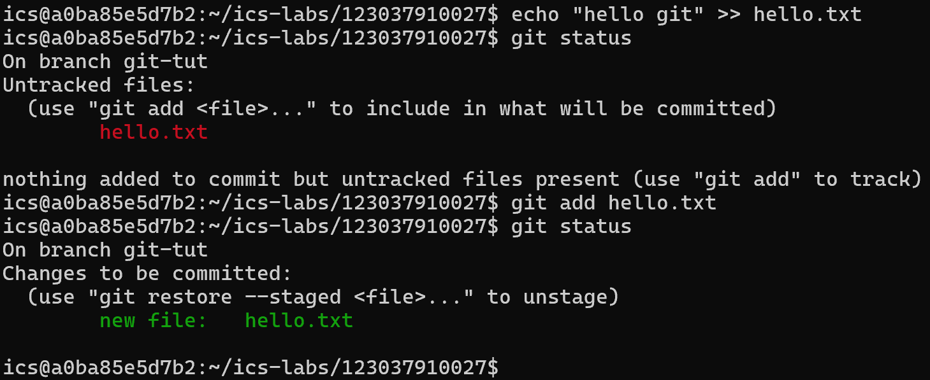
Case 1: Basic Local Operations
$ git add <file>
  Add changes to staging area
  Determine changes to be committed

Slide 13
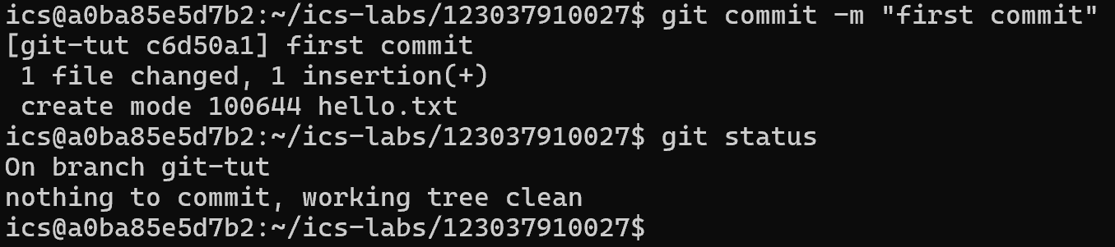
Case 1: Basic Local Operations
First Commit!
  $ git commit commits all changes added to staging area.
  -m means commit message
  write descriptive, meaningful messages for future you!

Slide 14
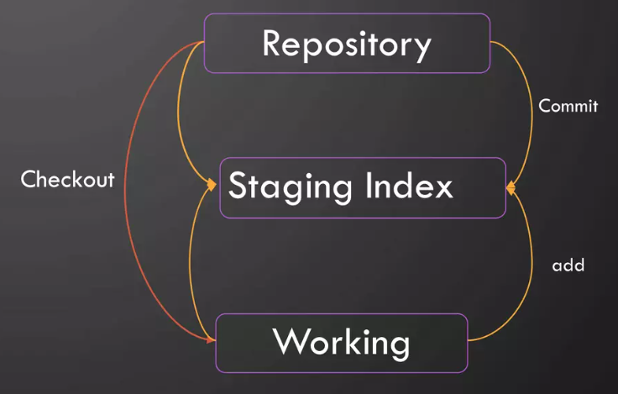
Case 1: Basic Local Operations
In git, files can be:
  In your local repo (committed)
  Checked out and modified, but not yet committed
  in-between, in a "staging" area
    Ready to be committed
    Commit saves all staged state

Slide 15
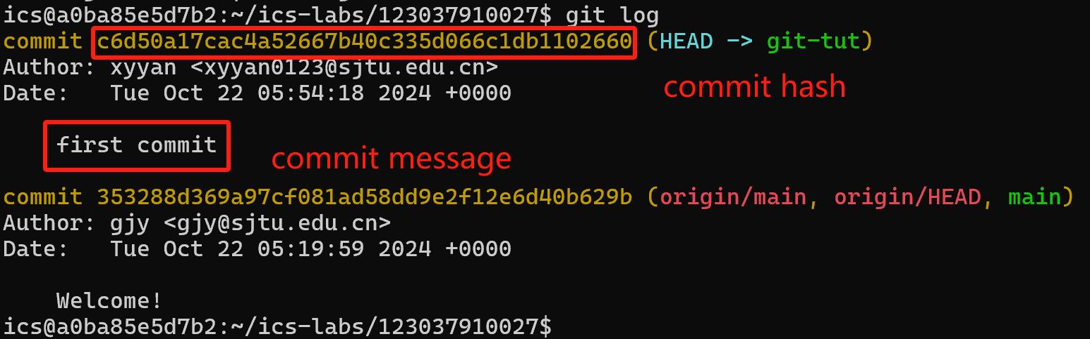
Case 1: Basic Local Operations
Check History
  $ git log shows list of commits in current branch
  Each commit has unique commit id.
  In DAG, it shows all ancestors of current commit.

Slide 16
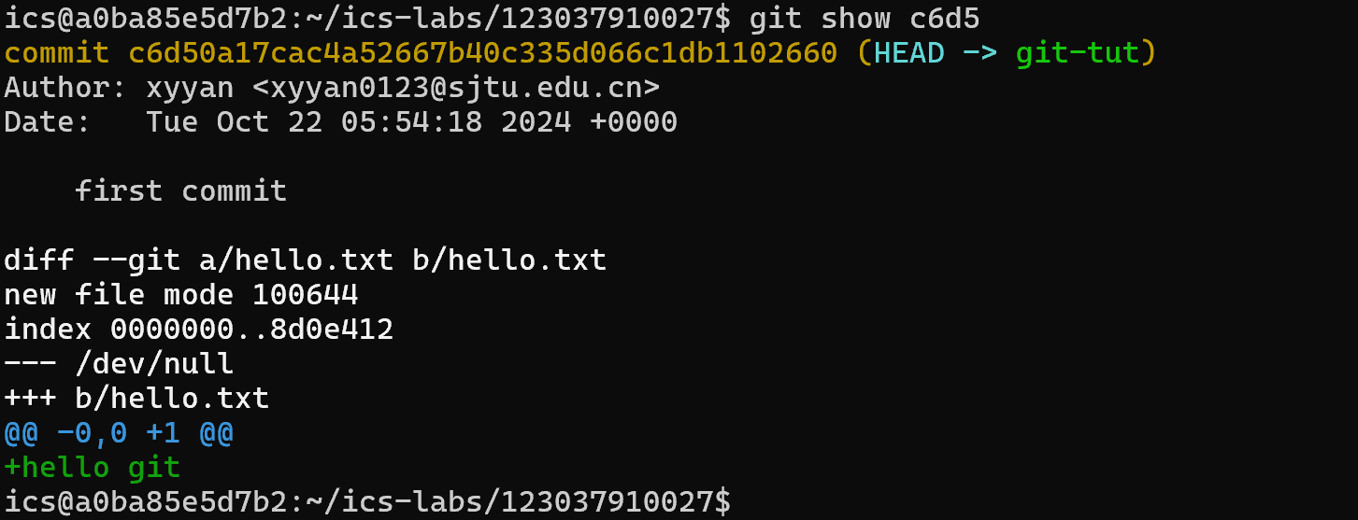
Case 1: Basic Local Operations
Detail on commit
  $ git show <commit id> shows commit info with changes.
  just using first few characters of commit id is ok.

Slide 17
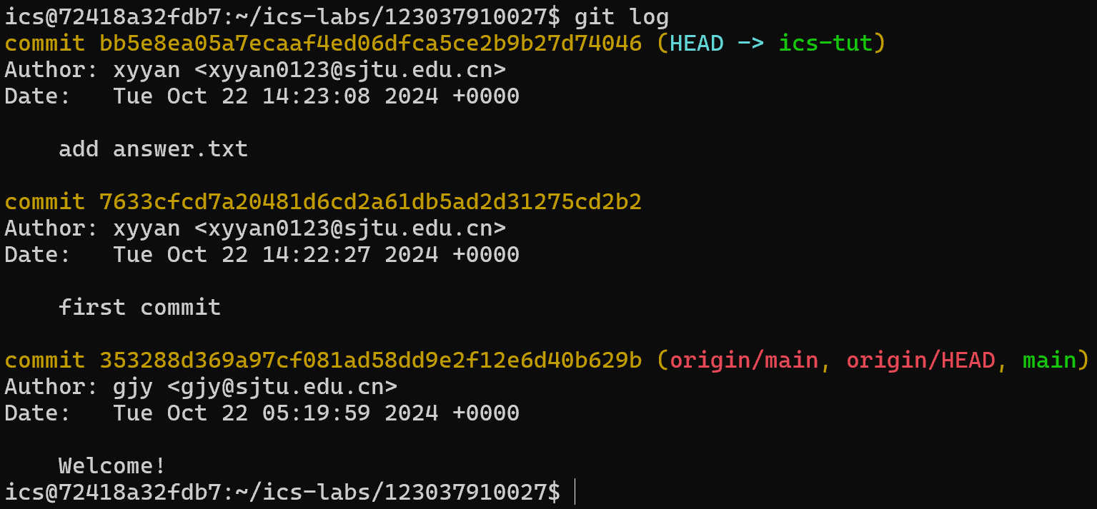
Case 1: Basic Local Operations
Add one more file and commit

Slide 18
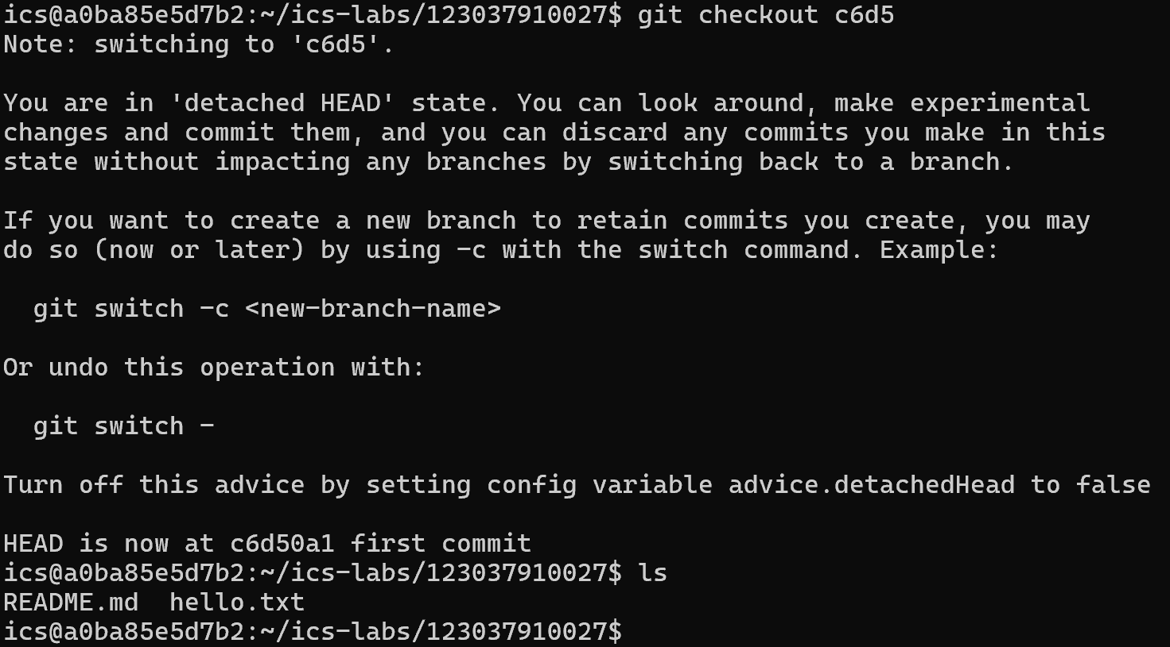
Case 1: Basic Local Operations
Switch to old version(maybe a workable version)
  $ git checkout <commit id>

Slide 19
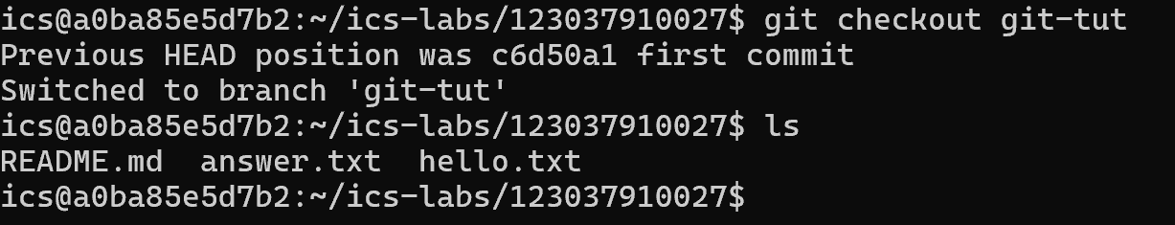
Case 1: Basic Local Operations
Switch back to newest commit of branch git-tut
  $ git checkout git-tut

Slide 20
Case 1: Basic Local Operations
Summary
  Tracking history
  A better way to manage project
    Single functionality for each commit
    Easily roll back to a workable version
    Commit message hints
    …

Slide 21
Case 2: Working with Remote Repo
Set up remote repository
  $ git remote add <name> <url>
    <name> : name of remote repository
    <url>: url of remote repository (Gitlab/Github/Gitee…)
  $ git branch --set-upstream-to=<remote>
    Bind local branch to remote branch
Or just clone from remote(we use in ICS lab)
  $ git clone <url>
  download code from remote

Slide 22
Case 2: Working with Remote Repo
Main Working Loop
  git add
  git commit -m “<message>”
  “git push” update changes to remote server
If working with others on remote server(Lab release):
  “git pull” : pull code from remote and update local branch
  “git fetch” : fetch without update

Slide 23
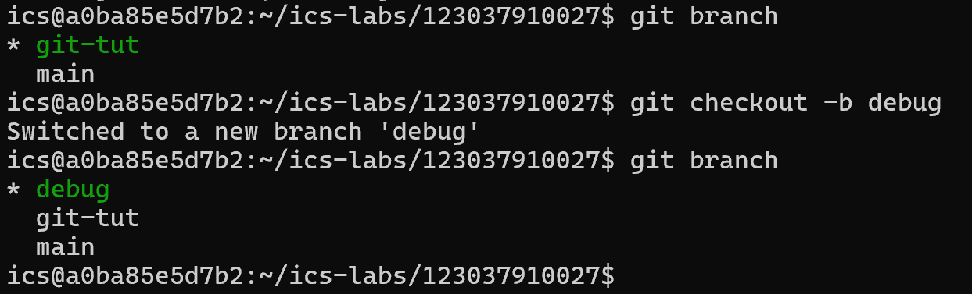
Case 3: Debugging
You find a bug in your project
You need to add many logs to debug
Create and switch to a new branch: git checkout -b <name>
Check the current branch: git branch

Slide 24
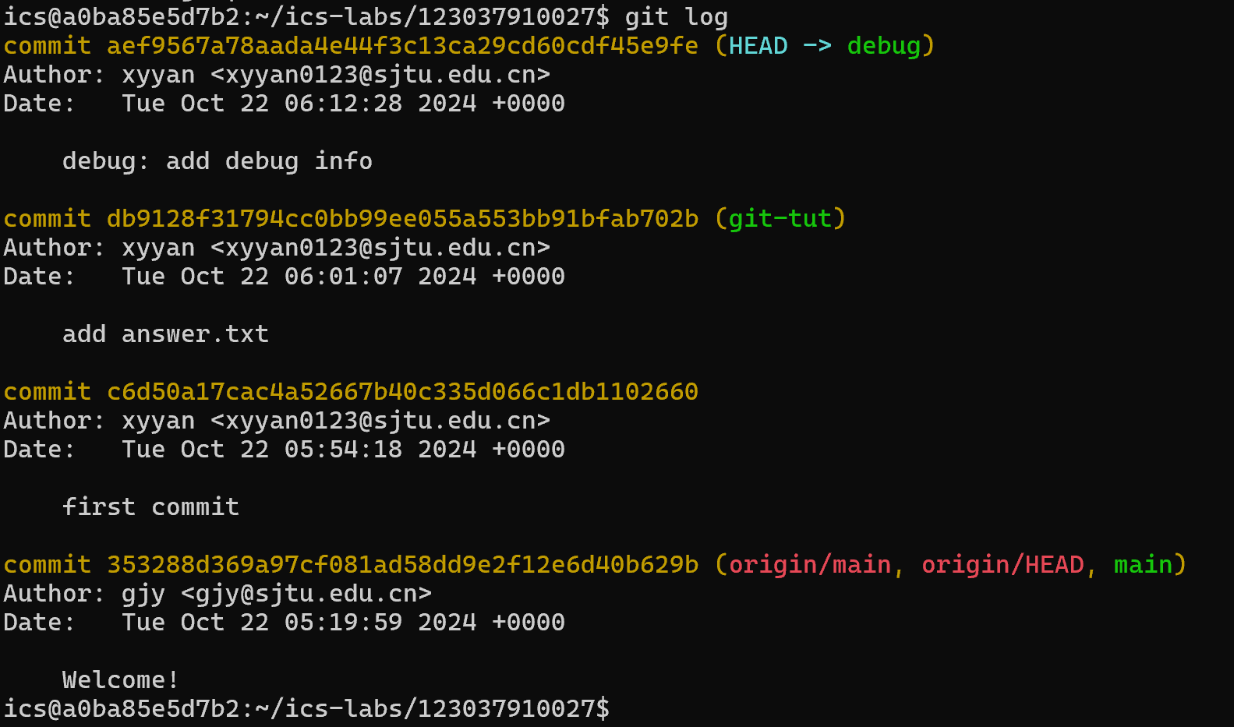
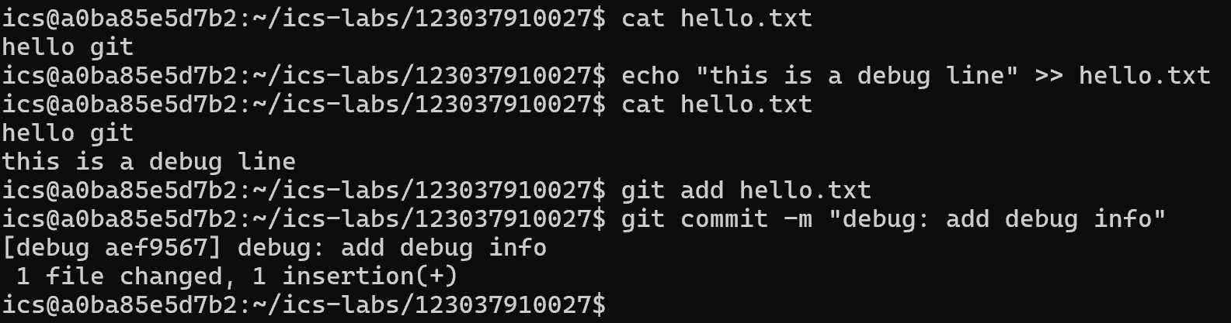
Case 3: Debugging
Make changes and commit on branch debug

Slide 25
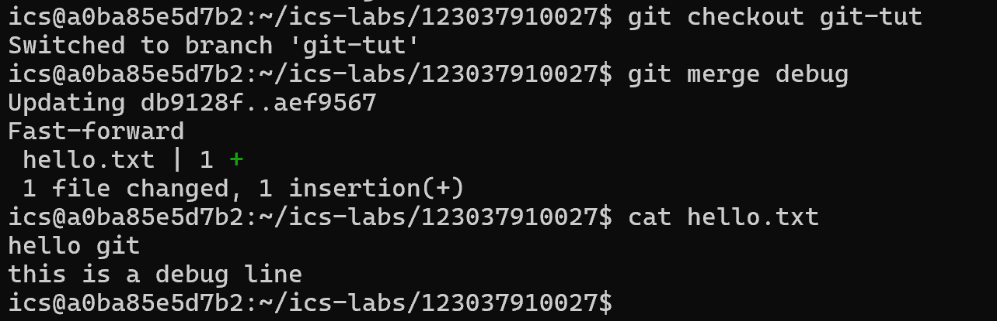
Case 3: Debugging
Merge debug branch into master: git merge <revison>
  checkout to branch master first

Slide 26
Case 3: Debugging
git-tut log
debug log
DAG before merge
Commit
Add answer.txt
Commit
Add debug info
Commit
Add hello.txt
Commit
Add answer.txt
Commit
Add hello.txt
Commit
Add answer.txt
Branch git-tut
Commit
Add hello.txt
Branch debug
Commit
Add debug info

Slide 27
Case 3: Debugging
DAG after merge
Commit
Add hello.txt
Commit
Add answer.txt
Commit
Add debug info
Branch git-tut
Branch debug

Slide 28
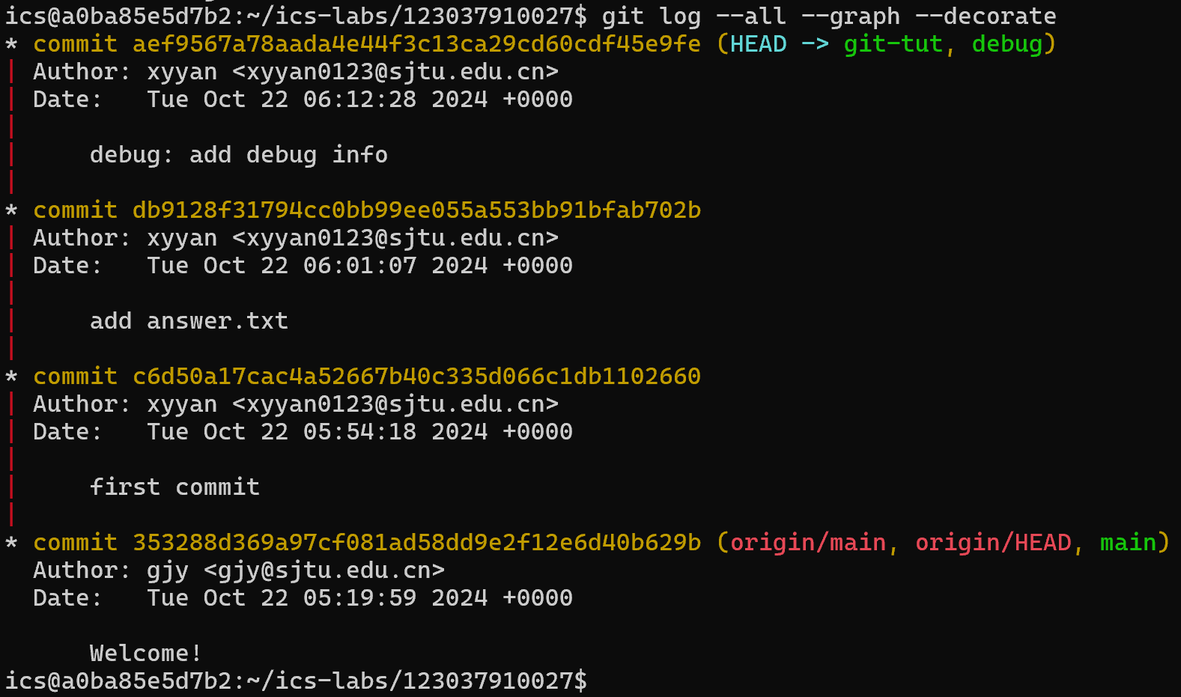
Case 3: Debugging
Visualize history as a DAG:
$ git log --all --graph --decorate

Slide 29
Case 3: Debugging
Assume master has a extra commit after debug checkout and before merge
Commit
Add hello.txt
Commit
Add answer.txt
*Assumed Commit
message
Branch git-tut
Branch debug
Commit
Add debug info

Slide 30
Case 3: Debugging
After merge:
Commit
Add hello.txt
Commit
Add answer.txt
*Assumed Commit
message
Commit
Merge debug into master
Branch main
Branch debug
Commit
Add debug info

Slide 31
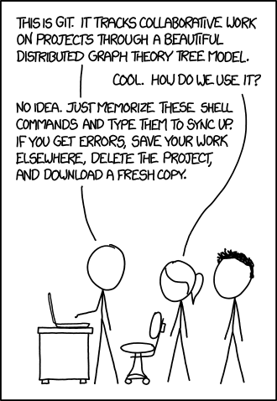
Case 4: Correct Mistakes
It’s normal to make mistakes

Slide 32
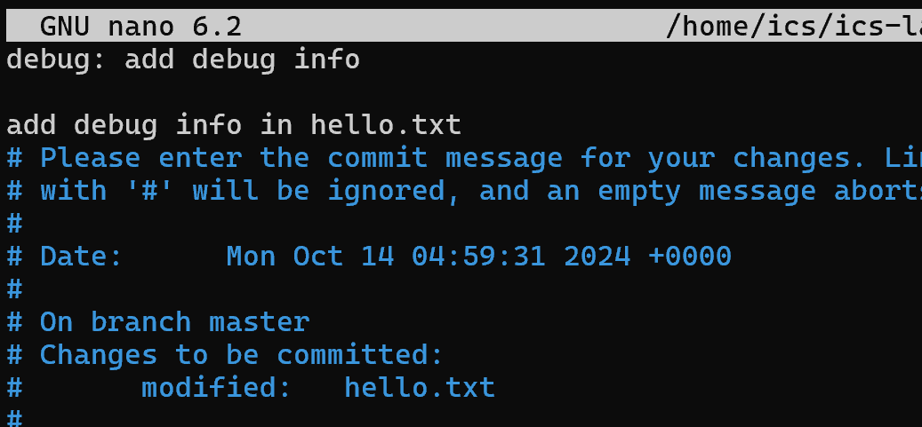
Case 4: Correct Mistakes[1]
You made a commit, with wrong or incomplete message
$ git commit --amend
Press ctrl+X ,then Y and finally enter to quit editor

Slide 33
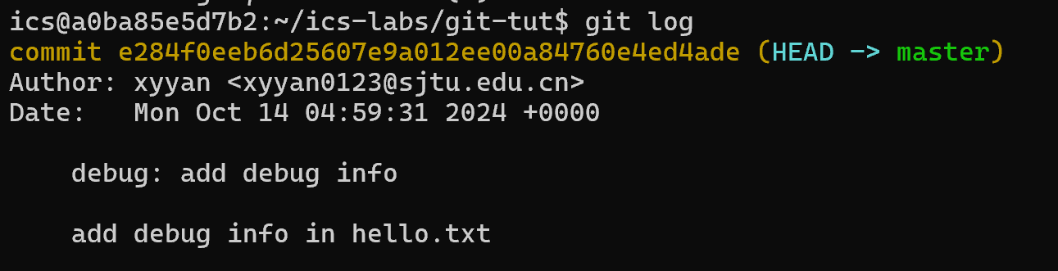
Case 4: Correct Mistakes[1]
You made a commit, with wrong or incomplete message
$ git commit --amend
Press ctrl+X ,then Y and finally enter to quit editor

Slide 34
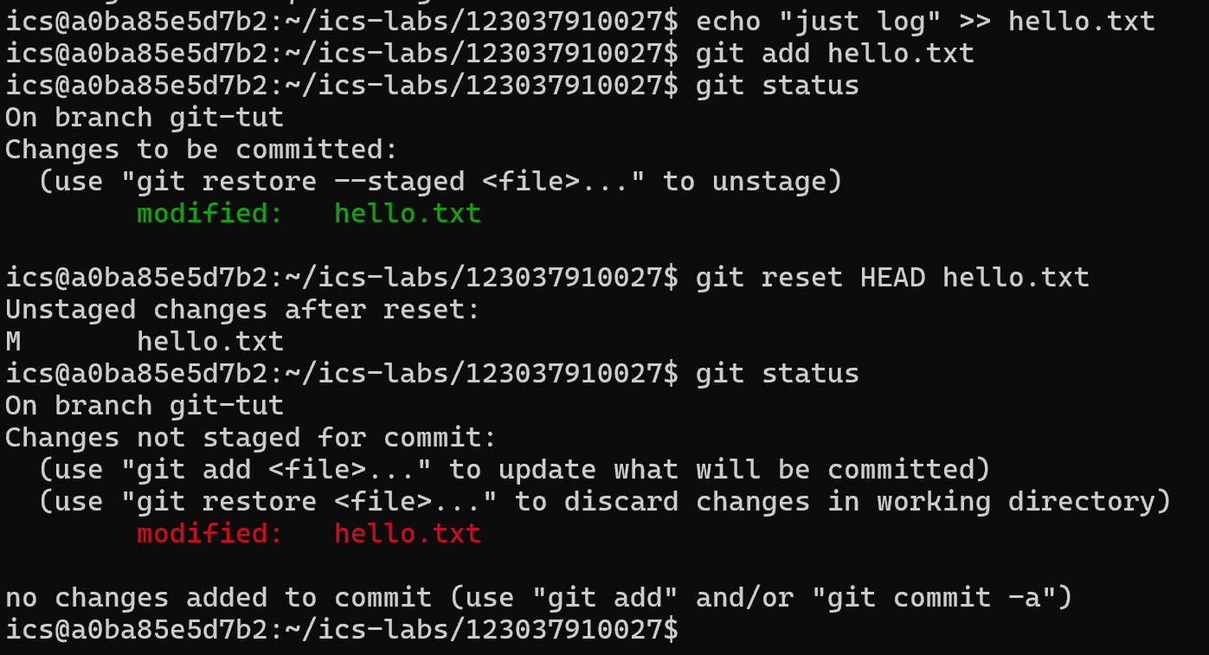
Case 4: Correct Mistakes[2]
You mistakenly add a file to stage area
$ git reset HEAD <file>

Slide 35
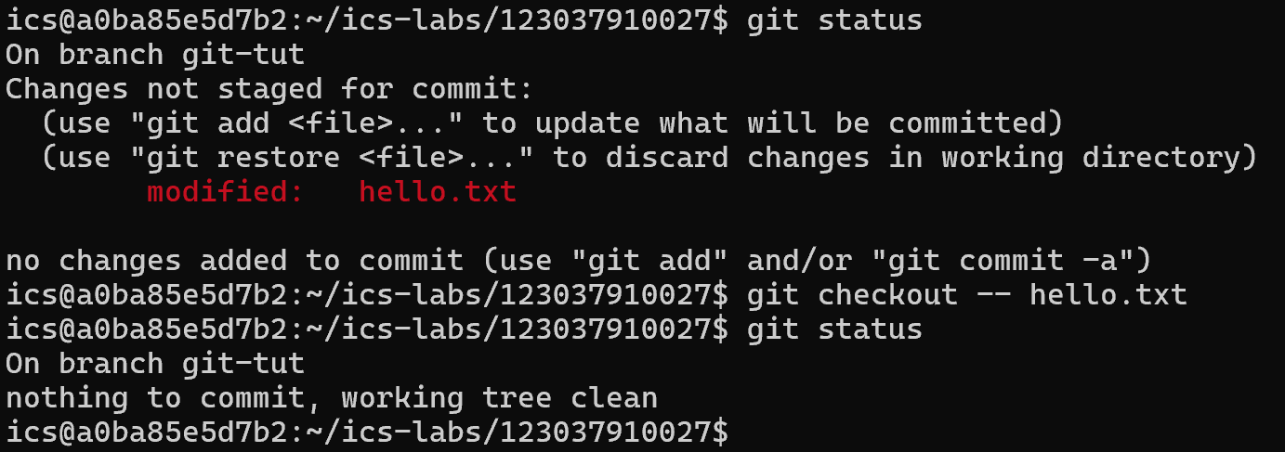
Case 4: Correct Mistakes[3]
You want to discard changes on some files
$ git checkout -- hello.txt

Slide 36
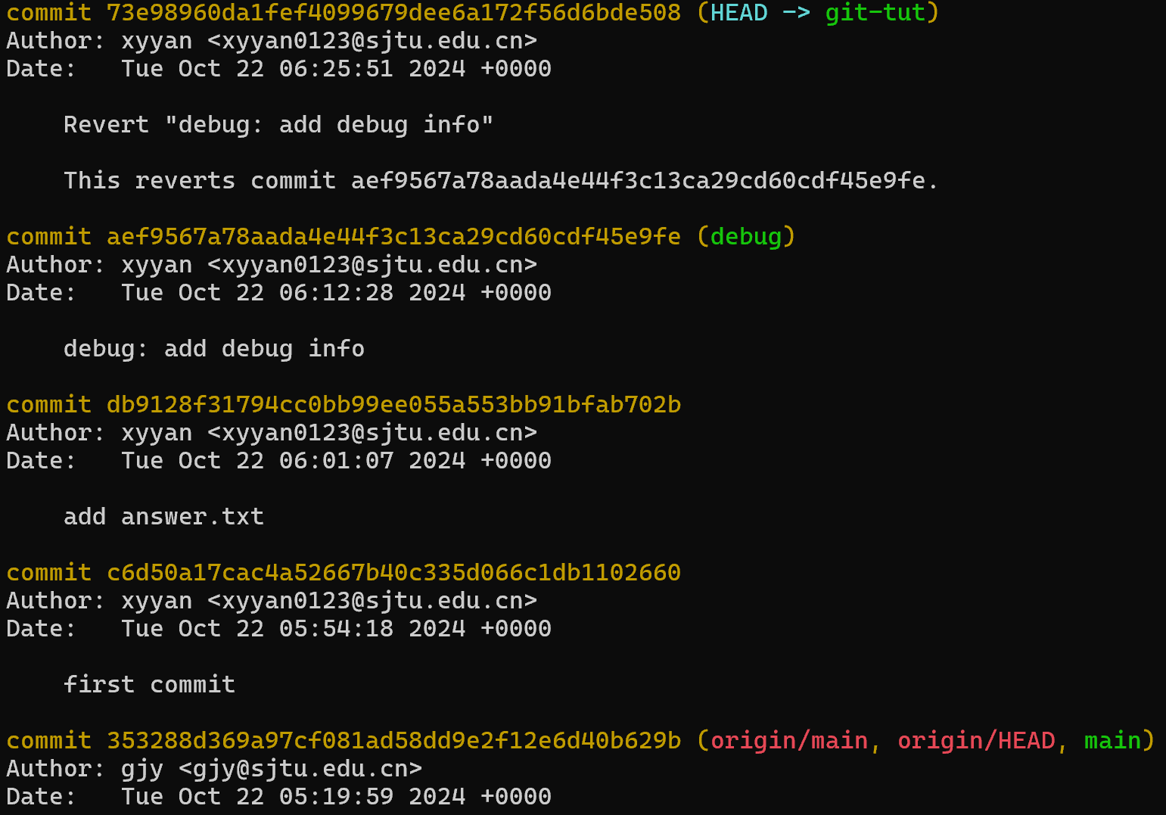
Case 4: Correct Mistakes[4]
You made a wrong commit, want to undo it.
$ git revert <commit id> add a new commit to undo
$ git reset --hard <commit id> get back to old commits
Prefer git revert as git reset discard changes after given commit

Slide 37
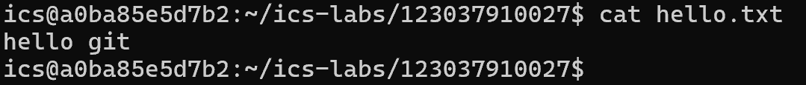
Case 4: Correct Mistakes[4]
You made a wrong commit, want to undo it.
$ git revert <commit id>
Debug info added was removed.

Slide 38
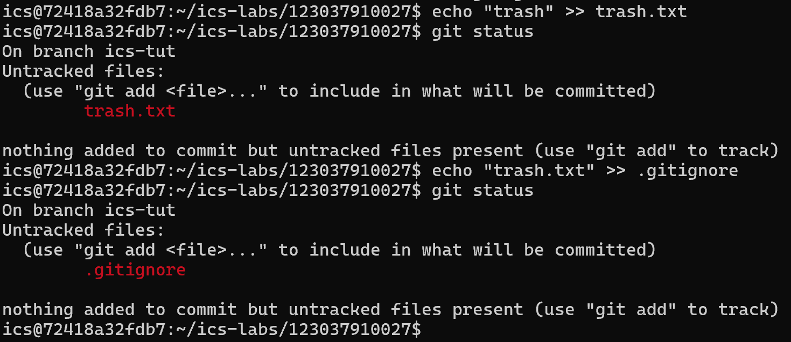
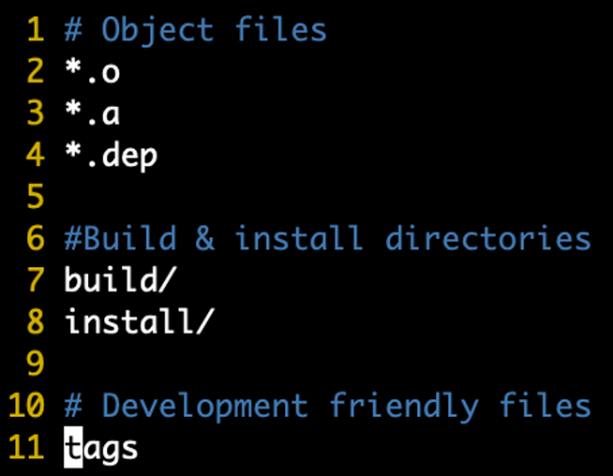
Useful Tools
Some files should never be uploaded
  Binary files produced in build process, Log files, …
.gitignore : ignore matched files

Slide 39
Useful Tools
Some files should never be uploaded
  Binary files produced in build process, Log files, …
.gitignore : ignore matched files

Slide 40
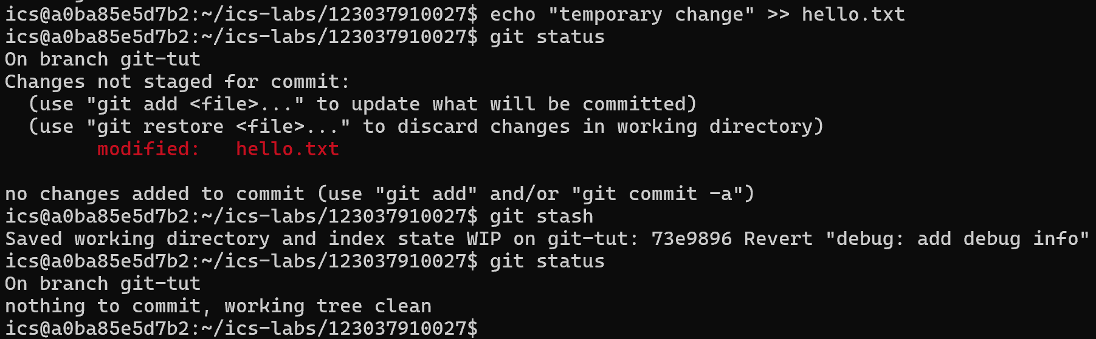
Useful Tools
Need to switch branches but don't want to commit changes?
$ git stash temporarily remove modifications

Slide 41
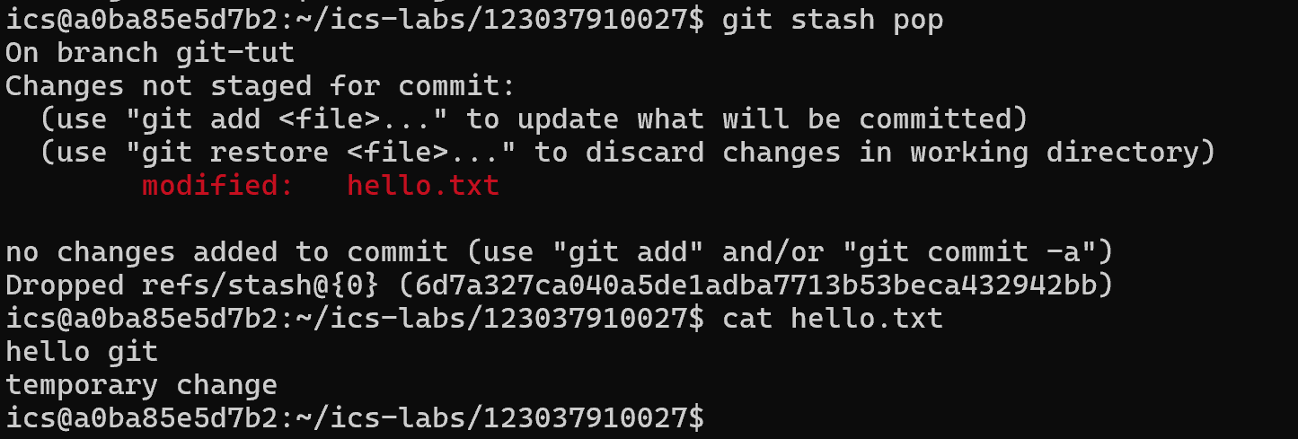
Useful Tools
Need to switch branches but don't want to commit changes?
$ git stash pop pop back modificaions

Slide 42

Useful Tools
Working in a team, who write the bug code?
$ git blame <file> show who last edited which line

Slide 43
Editor

Slide 44
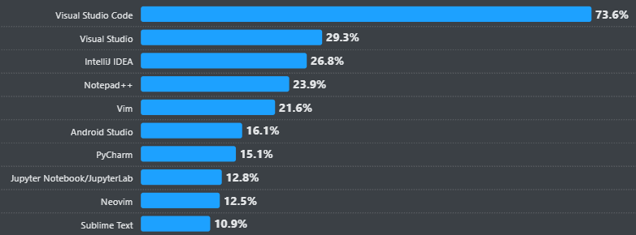
Editor Options
Hottest Editor
Vim most popular command-line editor
VS Code most popular GUI editor
Stack Overflow survey about most popular editors

Slide 45
VIM

Slide 46
Vim
Installation
$ sudo apt install vim
$ vim <file> hello.txt for example
First question: How to close vim?
:q quit
:wq save and quit
:!q force quit (used when you make a mess)

Slide 47
Vim: Basic movement
Vim is highly customizable by configuring ~/.vimrc
$ cp /etc/vim/vimrc ./vimrc-copy
$ vim ./vimrc-copy
Look around
  Basic movements: “hjkl” (left, bottom, up, right)
  Words: w (next word), b (beginning of word), e (end of word)
  Lines: 0 (beginning of line), ^ (first non-blank character), $ (end of line)
  Scroll: Ctrl-u (up), Ctrl-d (bottom)
  Search: f<character> (single character) /<string> (highlight string)
  Undo: u
  Delete: x (single character), dd (single line)

Slide 48
Vim: How to edit
Three big modes
  normal mode (Press “esc” key)
  --insert-- mode: Press “i” key in normal mode
    --insert-- mark on bottom-left corner
    changes write into text buffer
  --visual-- mode: Press “v” key in normal mode
    --visual-- mark on bottom-left corner
    use movements to higtlight selction
    Copy-and-Paste:
      key “y” for copy(yank) selected text
      key “p” for paste
Try $ vimtutor for more tips and tricks for VIM!

Slide 49
Vs code

Slide 50
VS Code + Plugins
Installation
  Install on your host machine
  Download Visual Studio Code - Mac, Linux, Windows
Extensions
  Git extension helps you use git functionality in GUI
  Docker extension helps you manage
  Dev Container extension helps you open and modify code in container env

Slide 51
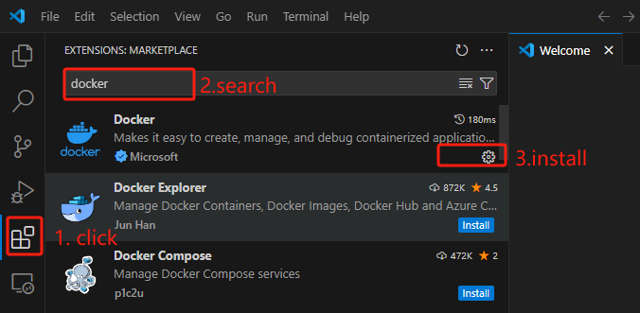
VSCode
Installation

Slide 52
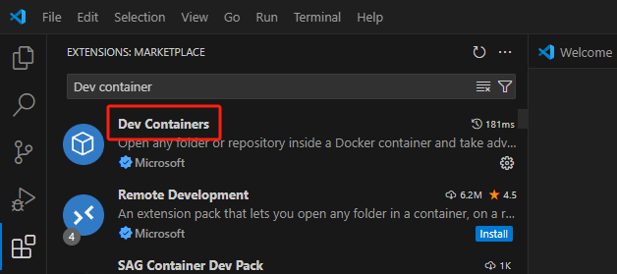
VSCode
Installation

Slide 53
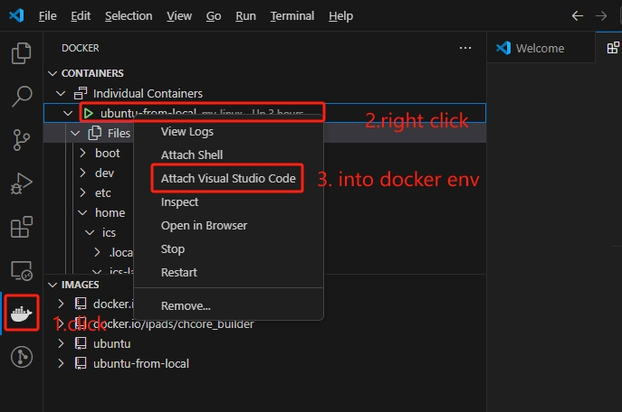
VSCode
Keep container my-linux open and running
A new window will be open

Slide 54
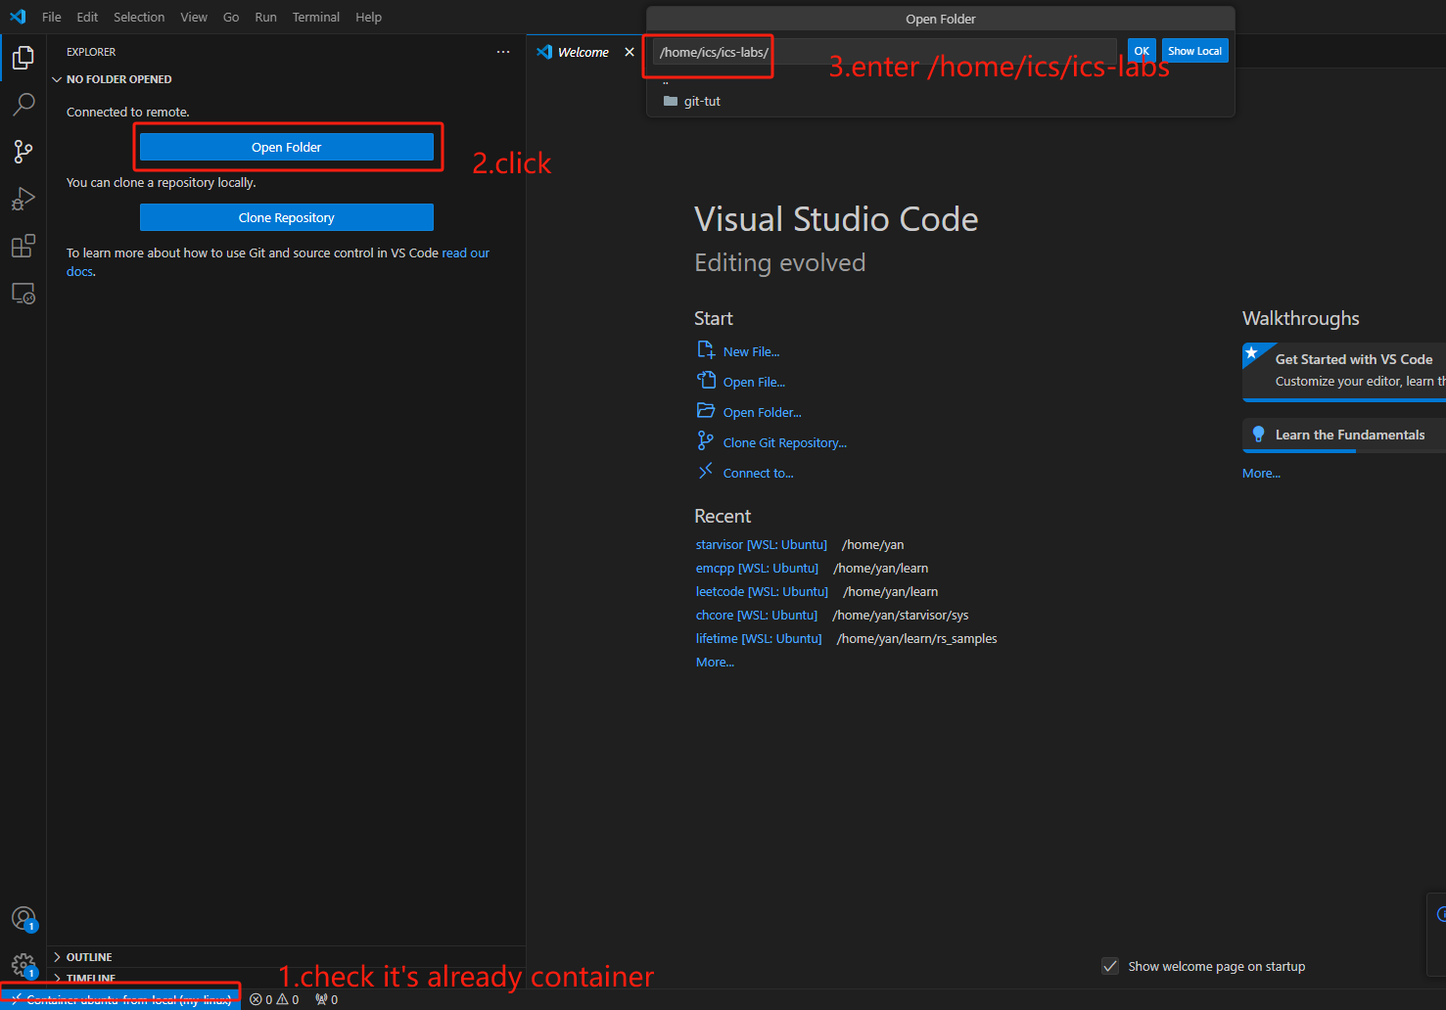
Docker Plugins

Slide 55
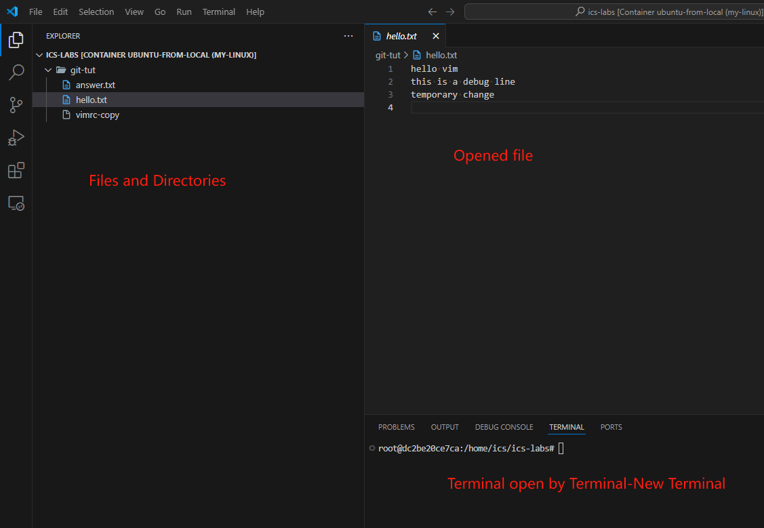
VS Code
Now we can change files by VS Code!

Slide 56
Tasks

Slide 57
Tasks-Git
Clone a git repository from Gitee/GitHub
Explore the version history by visualizing it as a graph.
Who was the last person to modify README.md? (Hint: use git log with an argument).
What was the commit message associated with the last modification to the first line of README.md? (Hint: use git blame and git show).

Slide 58
Tasks-Git
5. Modify one of its existing files. What happens when you do git stash? What do you see when running git log --all --oneline? Run git stash pop to undo what you did with git stash. In what scenario might this be useful?
6. You can define global ignore patterns in ~/.gitignore_global after running git config --global core.excludesfile ~/.gitignore_global. Do this, and set up your global gitignore file to ignore OS-specific or editor-specific temporary files, like .DS_Store.

Slide 59
Tasks-Git
7. If you mistakenly commit sensitive data to remote server, git rm only removes data from the latest commit? Please research how to properly delete sensitive data from Git history.

Slide 60
Tasks-Vim
Open vimrc-copy file we created in vim.
Find which line contains “smartcase”
Copy the line and paste to the end of file
Uncomment that line
Save & quit

Slide 61
Tasks
A visualizable Git tutorial
  https://learngitbranching.js.org/
More Vim Exercise
  $ vimtutor
Another tutorial( if you wanna use ssh)
  ICS Guidance
GNU make in windows
  https://gnuwin32.sourceforge.net/packages/make.htm

