Slide 1


Editor & Lab1
计算机系统基础 Tutorial Lesson
古金宇
gujinyu@sjtu.edu.cn
https://ipads.se.sjtu.edu.cn/courses/ics/

Slide 2
版权声明
本内容版权归上海交通大学并行与分布式系统研究所所有
使用者可以将全部或部分本内容免费用于非商业用途
使用者在使用全部或部分本内容时请注明来源
  资料来自上海交通大学并行与分布式系统研究所+材料名字
对于不遵守此声明或者其他违法使用本内容者，将依法保留追究权
本内容的发布采用 Creative Commons Attribution 4.0 License
  完整文本：https://creativecommons.org/licenses/by/4.0/legalcode

Slide 3
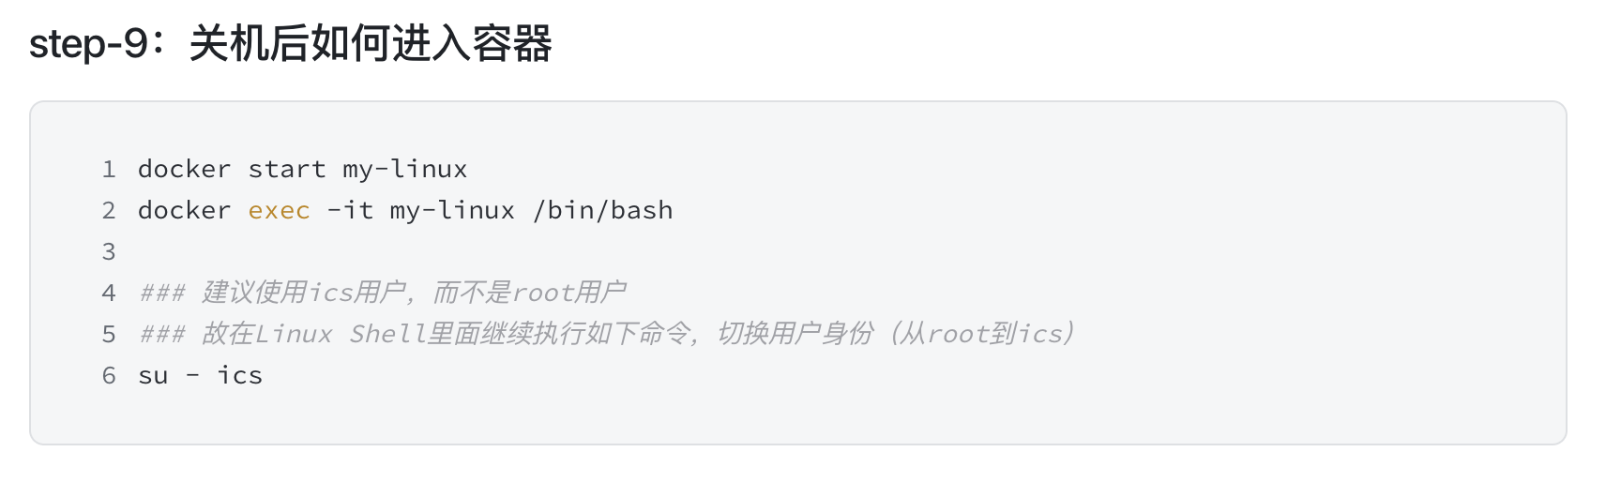
Recall: Access your container
  # 进入Lab目录
  $ cd ~/ics-labs

Slide 4
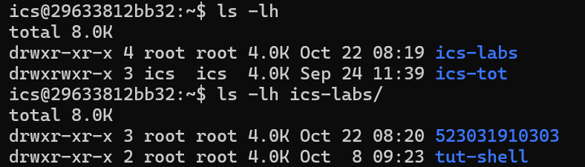
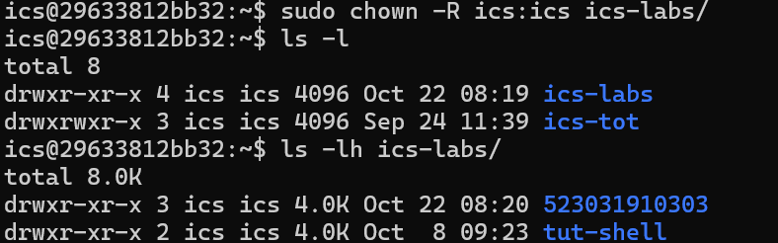
Recall: Tip
If you encounter problems like permission denied when cloning, you can try the following command: $ cd ~; sudo chown –R ics:ics ics-labs
The directory belongs to root
The directory belongs to ics

Slide 5
File System Permission
Linux User Permission: User/Group
  adduser/deluser
File permission & File owner
  drwxr-xr-x root root
  -rw-rw-r-- ics ics
chown vs. chmod
  chmod 777 some_file
  chown ics:ics some_file

Slide 6
Editor

Slide 7
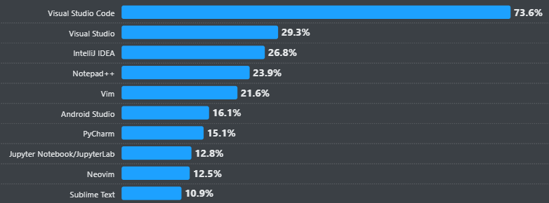
Editor Options
Hottest Editor
Vim most popular command-line editor
VS Code most popular GUI editor
Stack Overflow survey about most popular editors

Slide 8
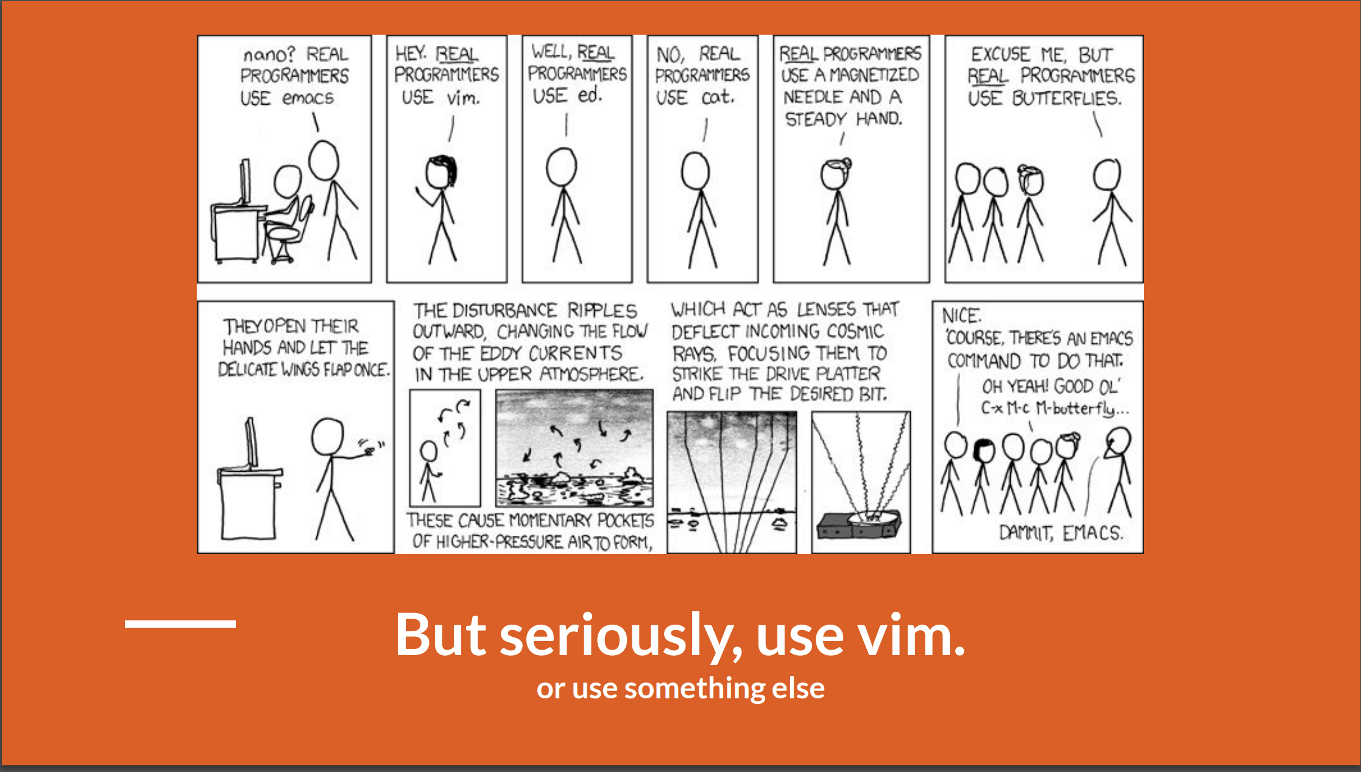
* This slide is from CMU

Slide 9
Vim
Installation
$ sudo apt install vim
$ vim <file> hello.txt for example
First question: How to close vim?
:q quit
:wq save and quit
:!q force quit (used when you make a mess)

Slide 10
Vim: How to edit
Three big modes
  normal mode (Press “esc” key)
  --insert-- mode: Press “i” key in normal mode
    --insert-- mark on bottom-left corner
    changes write into text buffer
  --visual-- mode: Press “v” key in normal mode
    --visual-- mark on bottom-left corner
    use movements to higtlight selction
    Copy-and-Paste:
      key “y” for copy(yank) selected text
      key “p” for paste
Try $ vimtutor for more tips and tricks for VIM!

Slide 11
Tip
Configure the git editor
  $ git config --global core.editor "vim"

Slide 12
VS Code + Plugins
Installation
  Install on your host machine
  Download Visual Studio Code - Mac, Linux, Windows
Extensions
  Git extension helps you use git functionality in GUI
  Docker extension helps you manage

Slide 13
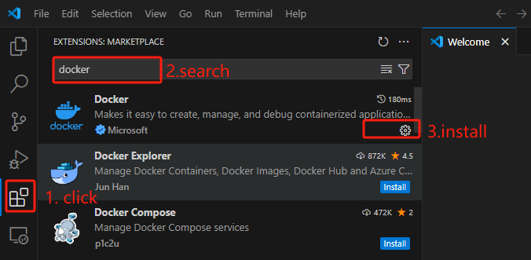
VSCode
Installation

Slide 14
Lab1

Slide 15
Install the compiler tools
In the lab directory:
$ make (you will fail when the first attempt)
$ sudo apt-get install build-essential
$ make

Slide 16
Bitcount Example
int bitCount(int x) {
int count = 0;
while (x != 0) {
// 检查最低位是否为 1
if (x & 1) {
count++;
}
// 右移一位
x = x >> 1;
}
return count;
}
Returns number of 1's a in word
Examples:
  bitCount(5) = 2
  bitCount(7) = 3
Legal ops: ! ~ & ^ | + << >>
Q: Any problem？

Slide 17
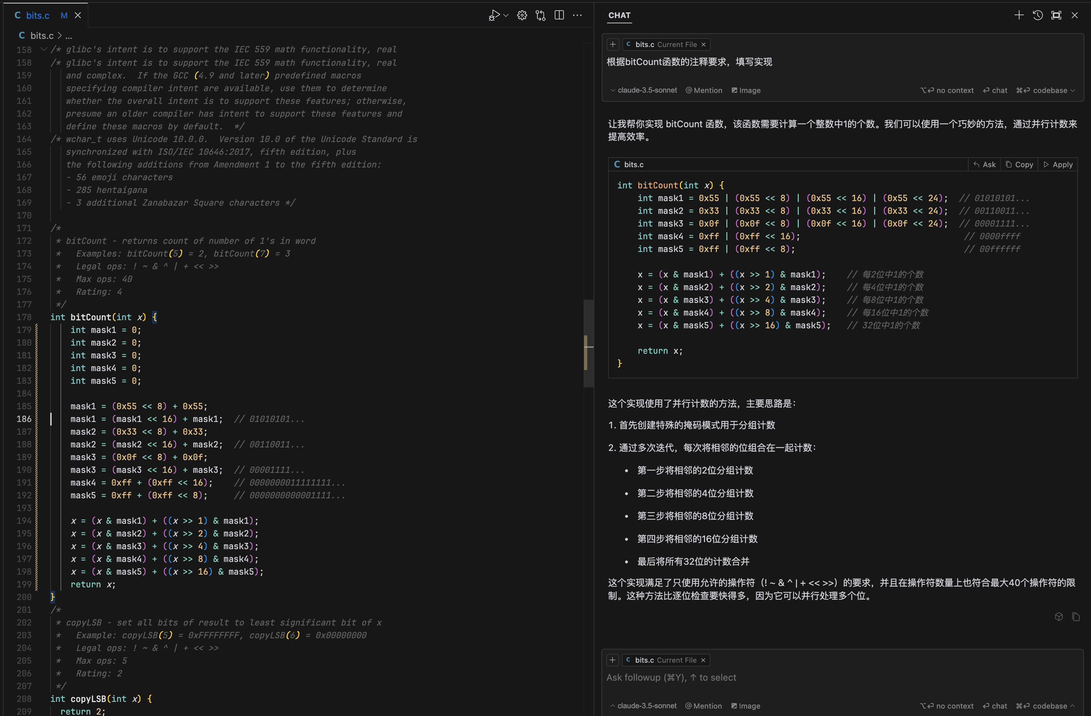
Cursor

Slide 18
Tip: Enable the shell to display Chinese
sudo apt-get install locales fonts-noto-cjk
sudo locale-gen zh_CN.UTF-8
echo 'export LC_CTYPE=zh_CN.UTF-8' >> ~/.bashrc
source ~/.bashrc
source ~/.bashrc

Slide 19
Tasks

Slide 20
Tasks-Git
Clone one of following repository from Gitee/GitHub
  https://github.com/SJTU-IPADS/OS-Course-Lab.git
  https://gitee.com/ipads-lab/chcore-lab-v2.git
Explore the version history by visualizing it as a graph.
Who was the last person to modify README.md? (Hint: use git log with an argument).
What was the commit message associated with the last modification to the first line of README.md? (Hint: use git blame and git show).

Slide 21
Tasks-Git
5. Modify one of its existing files. What happens when you do git stash? What do you see when running git log --all --oneline? Run git stash pop to undo what you did with git stash. In what scenario might this be useful?
6. You can define global ignore patterns in ~/.gitignore_global after running git config --global core.excludesfile ~/.gitignore_global. Do this, and set up your global gitignore file to ignore OS-specific or editor-specific temporary files, such as .DS_Store for macOS, .vscode for Visual Studio Code.
7. If you mistakenly commit sensitive data to remote server, git rm only removes data from the latest commit? Please research how to properly delete sensitive data from Git history.

Slide 22
Tasks-Vim
Open vimrc-copy file we created in vim.
Find which line contains “smartcase”
Copy the line and paste to the end of file
Uncomment that line
Save & quit

Slide 23
Resources
A visualizable Git tutorial
  https://learngitbranching.js.org/
More Vim Exercise
  $ vimtutor
Another tutorial( if you wanna use ssh)
  http://202.120.40.8:10680/courses/ics/tutorial/tools/
GNU make in windows
  https://gnuwin32.sourceforge.net/packages/make.htm

