Slide 1


Assembly
计算机系统基础 Tutorial Lesson
古金宇
gujinyu@sjtu.edu.cn
https://ipads.se.sjtu.edu.cn/courses/ics/

Slide 2
版权声明
本内容版权归上海交通大学并行与分布式系统研究所所有
使用者可以将全部或部分本内容免费用于非商业用途
使用者在使用全部或部分本内容时请注明来源
  资料来自上海交通大学并行与分布式系统研究所+材料名字
对于不遵守此声明或者其他违法使用本内容者，将依法保留追究权
本内容的发布采用 Creative Commons Attribution 4.0 License
  完整文本：https://creativecommons.org/licenses/by/4.0/legalcode

Slide 3
GNU Tools
OBJDUMP (OBJect-file DUMP)
  Display information from object files
    Disassemble object file
    Show file headers
    Show symbol table
    ...
  Commands
    objdump –d | -D <object-file>
-D also dump the data section

Slide 4
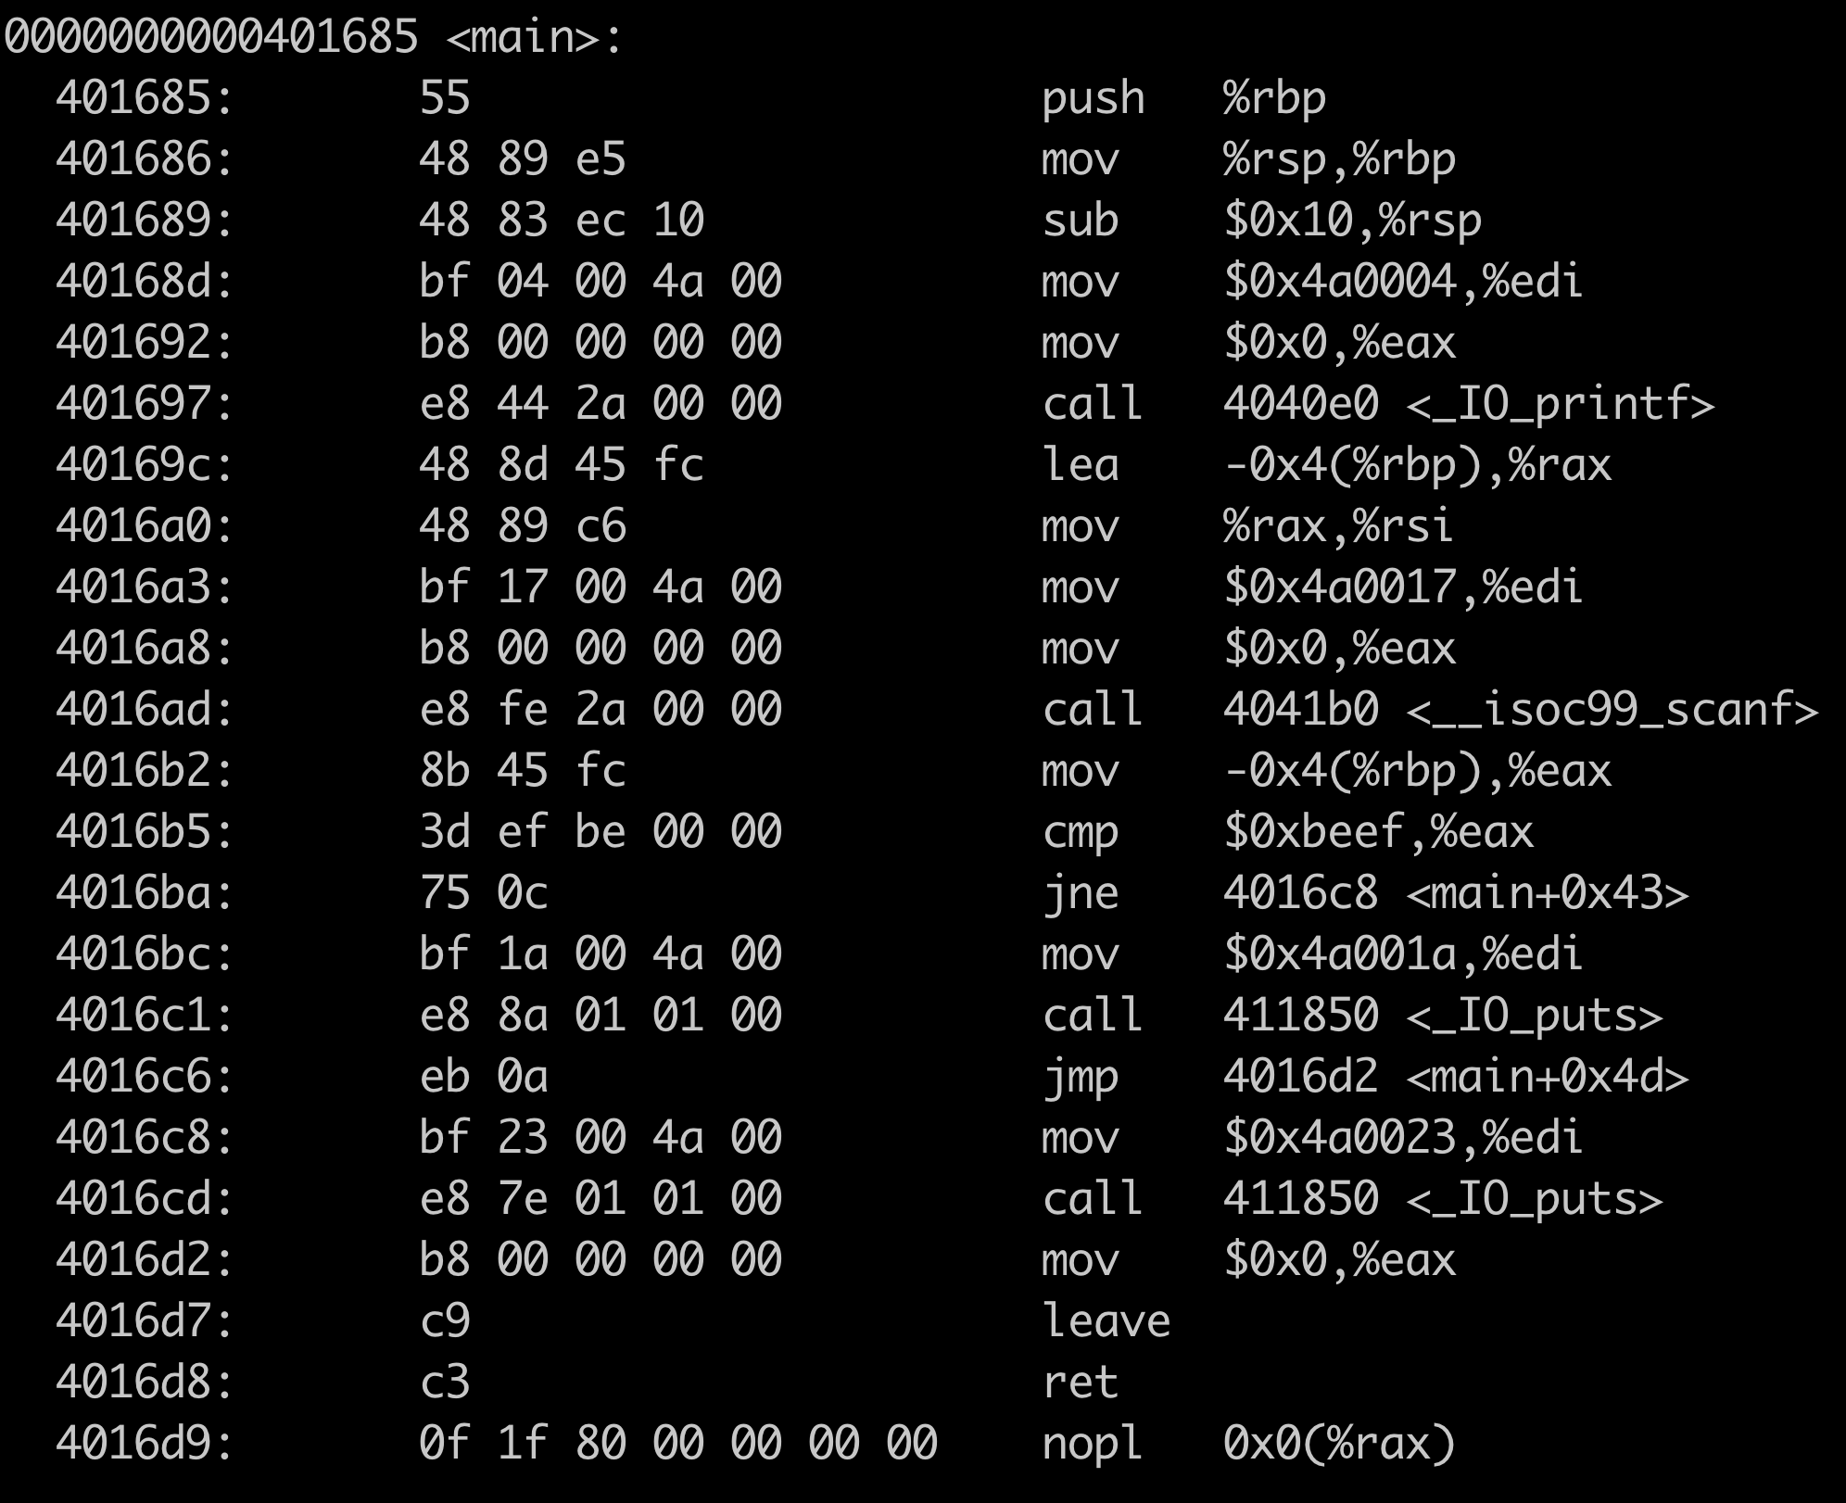

Slide 5
Bomb

Slide 6
Defuse Bomb
What is Bomb?
  Only a binary file
What should you do?
  Find the key and defuse the bomb!
What can you use?
  Anything from ICS course
  Any tools
Right key
Survive
Wrong key
Bomb !
gdb
calculator
strings
objdump
paper
pencil

Slide 7
Demo
Please be careful!
  A binary bomb
  Need a password to defuse it
Demo
$./bomb
input password:
bomb!...
$./bomb
input password:
survive!
224
123

Slide 8

HACKER
Notes:
Intel12-pc tutorial-coding/tut-lesson-3

Slide 9
Step by Step
From machine code to assembly code
  objdump –D bomb > asm
  objdump –d bomb > asm

Slide 11
Step by Step
Find key functions and parameters
  scanf: where does the password store ?
  printf/puts: which the instruction will print “bomb” ?

Slide 14
Step by Step
Find key functions and parameters
  scanf: where does the password store ?
  printf: which the instruction will print “bomb” ?
Find key strings
  bomb, survive and password

Slide 16
Input/Output
int printf(const char *format, …)
  First argument is one string
  Calling convention: first argument is in %rdi

Slide 17
0x4a0004
0x4a001a
0x4a0023

Slide 18
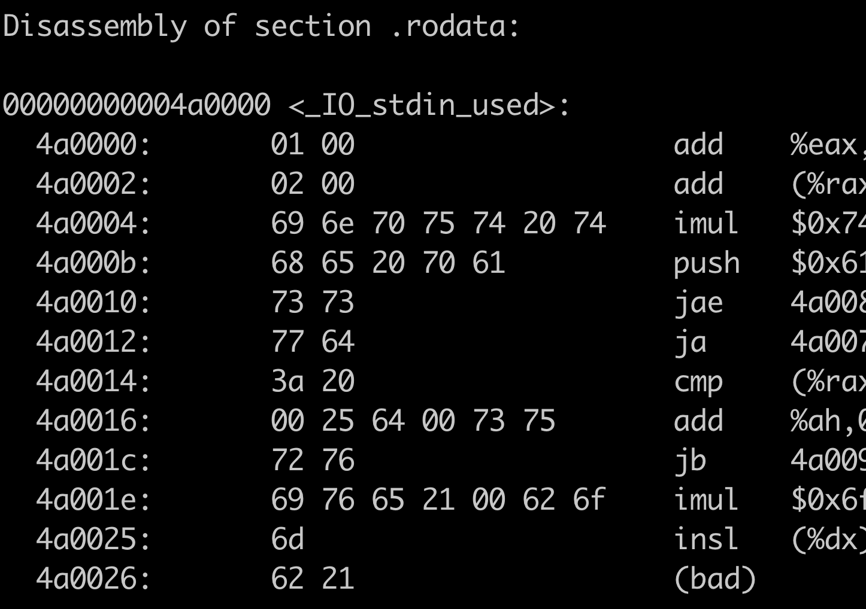

Slide 19
0x4a0004
i n p u t t
h e p a
s s
w d
:

Slide 20
i n p u t t
h e p a
s s
w d
:
0x4a001a
s u
r v
i v e ! b o
m
0x4a0023
b !

Slide 21
input the passwd:
survive!
bomb!

Slide 22
Step by Step
Find key functions and parameters
  scanf: where does the password store ?
  printf: which the instruction will print “bomb” ?
Find key strings
  bomb, survive and password
Find key operators
  jmp/jxx, change control flow
  cmp/test, how to judgment condition

Slide 23
input the passwd:
survive!
bomb!

Slide 24
input the passwd:
survive!
bomb!

Slide 25
input the passwd:
-0x4(%rbp) == %eax == 0xbeef
survive!
bomb!

Slide 26
Input/Output
int printf(const char *format, …)
  First argument is one string
  Calling convention: first argument is in %rdi
int scanf(const char *format, …)
  First argument is one string
  E.g., scanf(“%d\n”, &passwd)
    The input password will be stored in memory

Slide 27
input the passwd:
passwd == 0xbeef
survive!
bomb!

Slide 28
% d

Slide 29
input the passwd:
%d
passwd == 0xbeef
Should input 48879
survive!
bomb!

Slide 30
Using GDB

Slide 31
Can we do it more efficiently and safely?
Defuse bomb using GDB
  set breakpoint on the critical path
  watch registers and/or memories
  terminate program on demand
  single step execution

Slide 32
GNU Tools
GDB (Gnu DeBugger)
  Start your program
  Stop on special conditions
  Exams what has happened
  Change thing in your program
Install gdb
  sudo apt install gdb

Slide 33
GNU Tools
GDB (Gnu DeBugger) usage
    gdb <file>
    break FUNC | *ADDR
    run
    print</?> $REG | ADDR
    continue | stepi | nexti
    quit
Reference
http://ipads.se.sjtu.edu.cn/courses/ics/tutorials/gdb-ref.txt

Slide 34
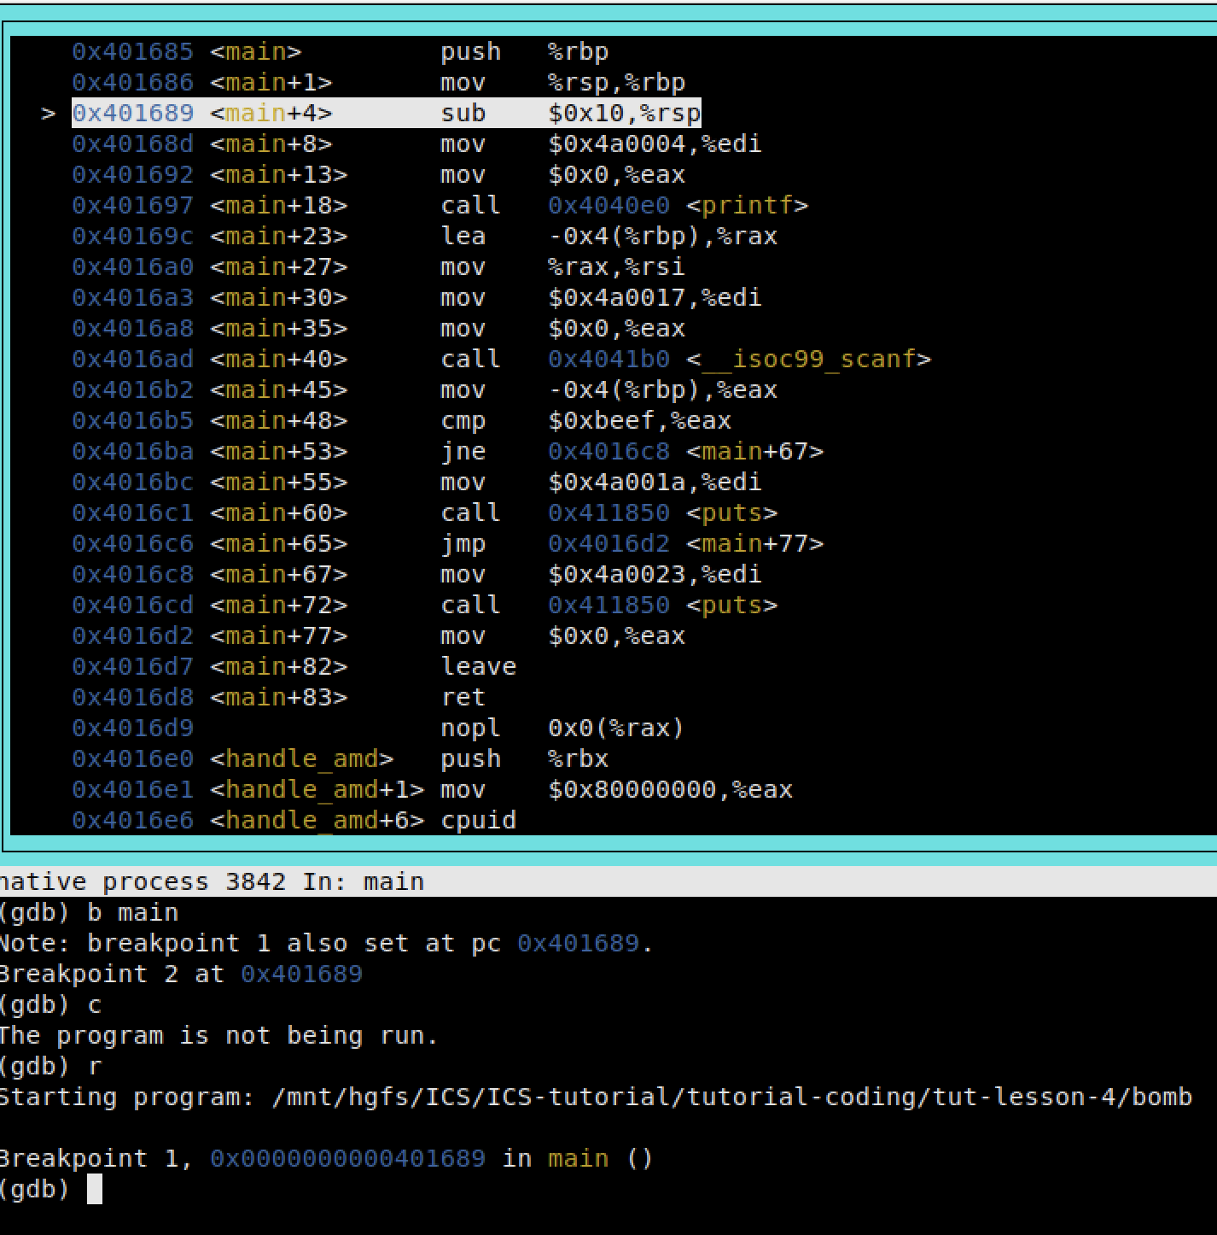
A live demo
b main
r
layout asm
x/s 0x4a0004
ni
ni
x/s $rdi
p/x $rdi
b *0x4016cd
quit

Slide 35
Dynamic Link vs. Static Link
gcc
  -static
file
  ELF info: dynamic/static
objdump
  PC addresses are different
Tip: The demo bomb is static linked while the exercise bomb is dynamic linked.

Slide 36
Tasks

Slide 37
Tasks
Assembly assignment (git)
  Defuse your first bomb in the class!
  Enjoy your bomb lab later!

