Slide 1
Introduction &
8 Important Problems in
Modern Operating Systems
Haibo Chen
Institute of Parallel and Distributed Systems (IPADS)
Shanghai Jiao Tong University
http://ipads.se.sjtu.edu.cn/haibo_chen

Slide 2
Outline
Why Choose This Course?
8 important problems of OS
Course information

Slide 3



What is an Operating System?
操作系统是管理硬件资源、控制程序运行、改善人机界面和为应用软件提供支持的一种系统软件。[计算机百科全书(第2版)]
应用
应用
向上提供公共服务
应用
应用
应用
人机接口（shell/GUI窗口系统）
系统调用
资源管理（存储、设备、计算）
向下管理资源
计算资源
存储资源
Notes:
操作系统是一种中间体！ 对下管理各种资源，对上提供公共服务！
操作系统的总体结构包括三部分：资源管理（本质上是虚拟机)、系统调用、人机接口；

Slide 4
Why Study OS?
Operating system is a maturing field
  Hard to get people to switch operating systems
  Then why?
Many things are OS issues
  High-performance
  Resource consumption
  Battery life, radio spectrum
  Security needs a solid foundation
  New “smart” devices need new OSes
Q: What applications are highly OS-related, which are not?

Slide 5
Why Study OS?
OS is the core of the broad “systems area”
Lots of systems companies
  Microsoft, Google, IBM, EMC, CISCO, VMware
  What’s Google’s core?
    Google Cluster, GFS, MapReduce, BigTable
  Good OS knowledge is a necessity to get you good offers/promotions
    at such companies and top universities

Slide 6
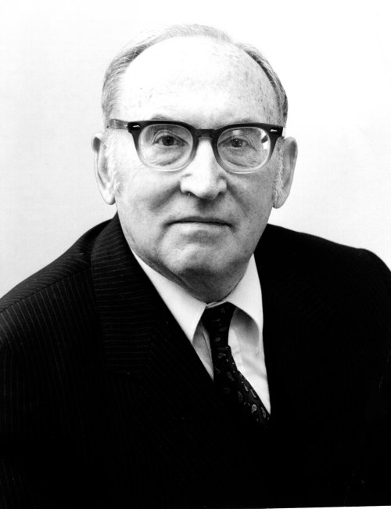
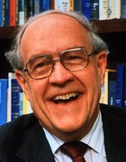
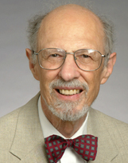
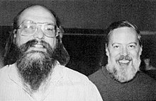
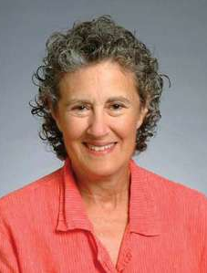
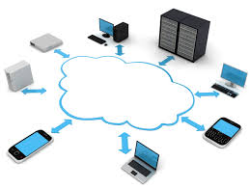
Turing Awards and OS Evolution
Maurice Wilkes
1967年图灵奖
Frederick Brooks
1999年图灵奖
Fernando J. Corbató
1990年图灵奖
EDSAC,1949
Multi-programming
第一台存储程序式电子计算机
IBM System/360,1964
CTSS,1961 & Multics,1969
分时操作系统
Unix,1971
多任务多用户操作系统
Venus,1972
小型低成本交互式分时操作系统
2019
分布式操作系统
Ken Thompson & Dennis Ritchie
1983年图灵奖
Barbara Liskov
2008年图灵奖

Slide 7

缺心(芯)少魂(操作系统)
http://industry.people.com.cn/n1/2018/0425/c413883-29949735.html
Notes:
习大大：核心技术、核心竞争力是买不来的。

Slide 8
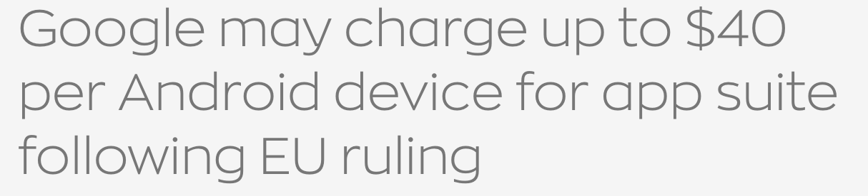

业界：操作系统从“免费”走向收费，
从开放走向“封闭”
例子1：Google正式对欧盟区域的Android进行收费，初步高达40美元每设备
例子2：IBM 340亿美元收购RedHat，构筑其云计算竞争力
例子3：谷歌投入600+人力数十亿美元研发自研OS Fuchsia

Slide 9
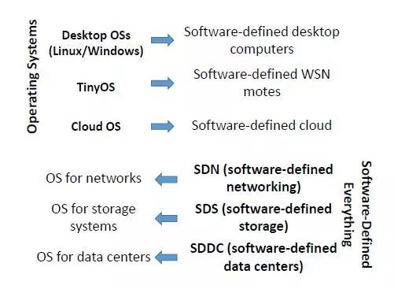
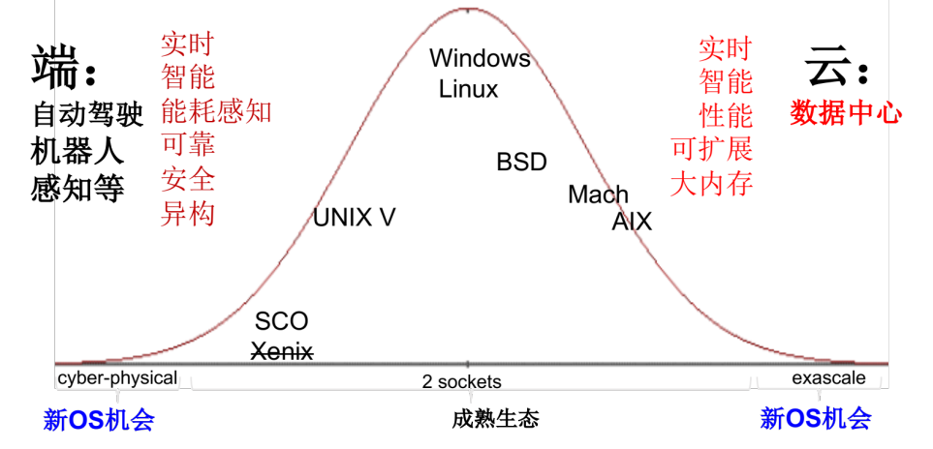
硬件+应用驱动：孕育泛在操作系统机会
操作系统发展：应用驱动+硬件驱动
观点:
硬件与应用蓬勃发展，在端和数据中心侧可能孕育新的操作系统
传统操作系统如Linux进入架构稳定期，难以根本上适应新硬件与应用需求
Toward Ubiquitous Operating Systems: A Software-Defined Perspective. Hong Mei, Yao Guo. IEEE Computer. 2018
Notes:
当前有一个较为普遍的共识：推动操作系统研究的最大动力就来自于 应用驱动和硬件驱动
为什么这么说呢，还是因为操作系统在整个计算机系统中所处的位置决定的
操作系统的两大任务无非就是：管理硬件资源（资源虚拟化） + 提供编程接口（功能可编程）
梅宏院士在IEEE Computer发表的论文中对操作系统的未来进行了展望，提出了普适操作系统（Ubiquitous Operating System）的概念，用来指代正在涌现的无处不在的新型操作系统。因为软件定义X的需要，操作系统将无处不在。
我们非常认同这一观点，但同时我们也认为，发展是存在不均衡性（不同时期，在不同领域的机会是不完全相同的）从早期的大型机操作系统研究到后来的桌面系统。而当前我们的观点：端和云
另一方面，传统操作系统架构进入稳定期（
今天主要介绍在数据中心方面的一些工作。

Slide 10
Real Machine VS. Abstraction Machine
Carnegie Mellon
Many courses emphasize abstraction
  Abstract data types
  Asymptotic analysis
These abstractions have limits
  Especially in the presence of bugs
  Need to understand details of underlying implementations

Slide 11
Useful outcomes from taking this course
  Become more efficient programmers
    Able to find and eliminate bugs efficiently
    Able to understand and tune for program performance
  Understand design and implementation of real complex systems
  Try to build one on your own (like a Turing-award level OS)

Slide 12
Is “simple” really simple?
A simple program?
How does it get executed?
#include <stdio.h>
int main() {
printf(“hello world\n”);
return 0;
}
How does it got translated to machine code?
How does the program get executed in detail?
Link, load, execute, finish?
Notes:
简约不简单

Slide 13
Course Perspective
Carnegie Mellon
Our course is programmer-centric
  Purpose is to show that by knowing more about the underlying system, one can be more effective as a programmer
  Enable you to
    Write programs that are more reliable and efficient
    Incorporate features that require hooks into OS
      E.g., concurrency, signal handlers
    Build an operating system!
  Cover material in this course that you won’t see elsewhere
  Not just a course for dedicated hackers

Slide 14
Outline
Why we study OS?
8 problems of OS
Course information

Slide 15
8 Important Problems in Operating systems

Slide 16
8 Important Problems
(Not a Rank)
Scale Up
Security & Trustworthy
Energy Efficiency
Mobility
Write Correct (Parallel) Code
Scale Out
Non-Volatile Storage
Virtualization

Slide 17
#1: Scale up
(or Performance Scalability)

Slide 18




Multicore Evolution
  Multicore is commercially prevalent recently
    Eight cores and Twelve cores on a chip are common
    Hundreds of cores on a single chip will appear in near feature
Challenge#1: make software performance follow Moore’s Law
1X
4X
8X
64X
Notes:
The multicore platform is prevalent recently. For example, Quad-cores and eight cores on a chip becomes very common. It was predicted that tens and hundreds of cores on a single chip will appear in the near future.
Hence, data-parallel applications could be the potential ideal consumer to harness the power of multicore platform.

Slide 19
Why Operating System Matters?
Terms of operating system here
  Broadly defined, including hypervisor, operating systems, runtime environments
Operating systems manage and hide resources from applications
  Hide tedious and complex low-level details
  Provide execution environments to apps
Operating systems determines app perf. in many cases
  Many apps spend a large fraction of time in system software

Slide 20
Operating System Meets Multicore
(Operating) systems 20 years ago
  Enjoys the free lunch provided by hardware (Moore’s Law)
  Recall the Andy-Bill’s Law
Multicore: ending the free lunch!
  Software must evolve with hardware changes
OS: a vital role to bridge the gap between apps and hardware
  Need to evolve itself with multicore
  Need to evolve for apps with multicore

Slide 21
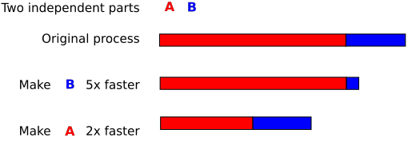

What is scalability?
Application does N times as much work on N cores as it could on 1 core
Scalability may be limited by Amdahl's Law:
  Locks, shared data structures, ... Shared hardware (DRAM, NIC, ...)

Slide 22
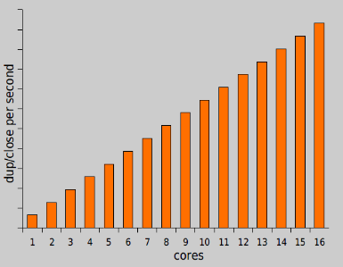
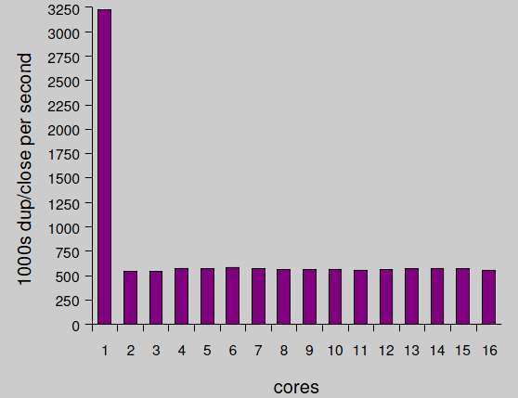
Motivating example: file descriptors
Ideal FD performance graph
Actual FD performance

Slide 23
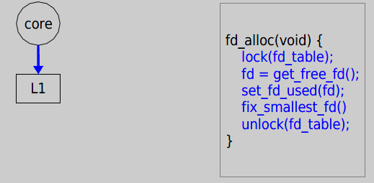
Why throughput drops?
Load fd_table data from L1 in 3 cycles.

Slide 24
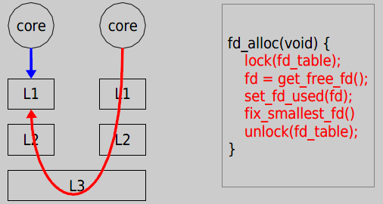
Why throughput drops?
Now it takes 121 cycles!

Slide 25
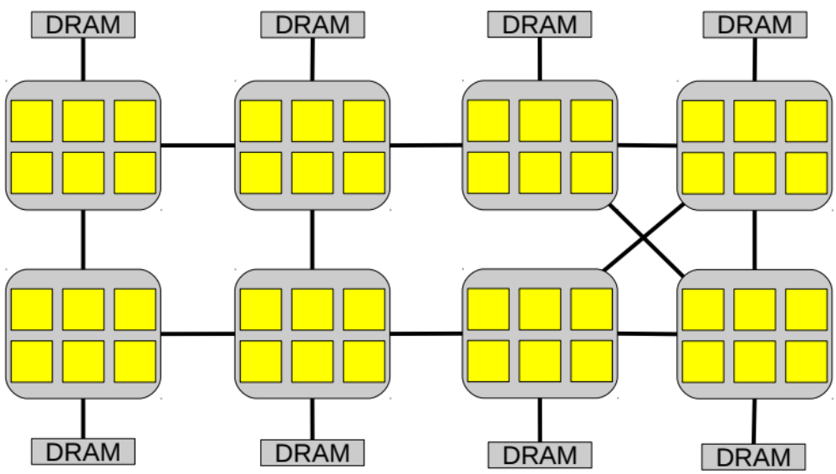
Off-the-shelf 48-core server
6 core x 8 chip AMD

Slide 26
Scale Up OS
Better abstraction to user applications
Eliminating non-scalable synchronization
Minimize sharing of common data structures
Bridge the memory wall
You will fill this..

Slide 27
Issue#2: Security & Trustworthy

Slide 28


Security
From Wikipedia:
  Security is the degree of resistance to, or protection from, harm
Why Operating System matters?
  Operating system (including hypervisors) lies in the lowest levels in a computer
  How could you protect your application & data without properly protect your OS
Notes:
Buffer overflow: if you control myOS, you can nearly do anything?

Slide 29
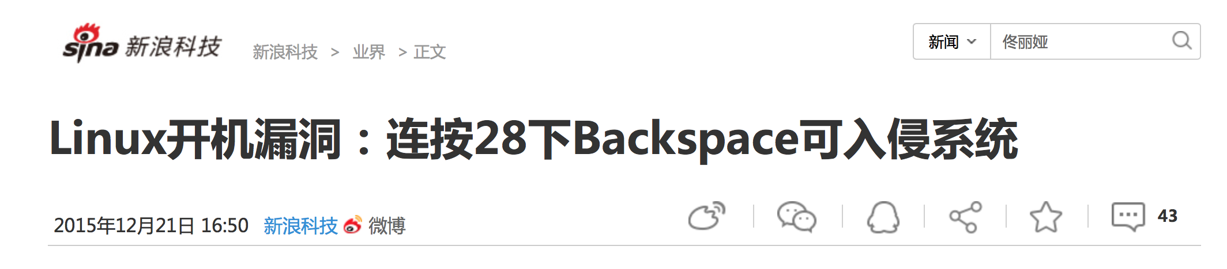
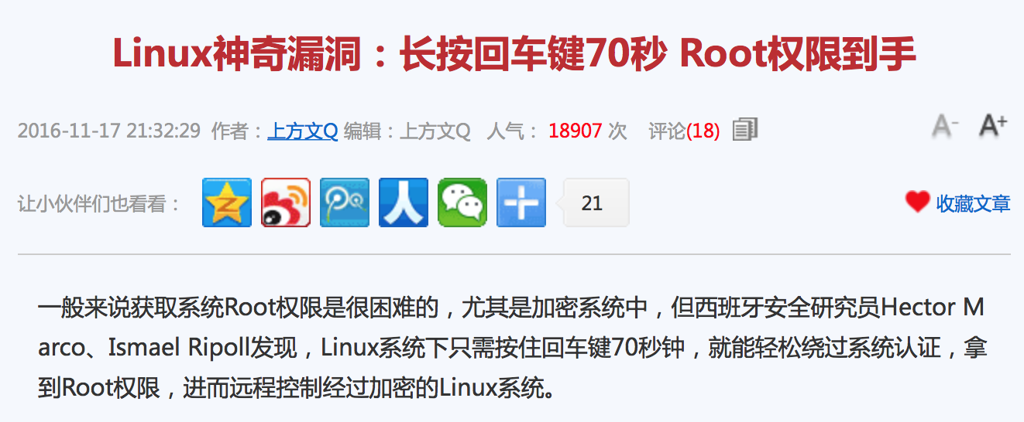
CVE-2015-8370
CVE-2016-4484
Notes:
瓦伦西亚科技大学网络安全小组研究人员Hector Marco与 Ismael Ripoll在Grub 2中，发现存在一项整数下溢(integer underflow)漏洞，编号CVE-2015-8370。通过该漏洞成功入侵的黑客可进入GRUB的Rescue Shell，进而提升权限、复制磁盘信息、安装RootKit、或是摧毁包括GRUB在内的任何资料，即使磁盘加密也可能遭到覆写，导致系统无法工作。
研究人员发现该漏洞的攻击方法相当简单：只需在GRUB要求输入用户名时，连续按28次倒退键，就可进入Rescue Shell。IT管理员只需按照此方法操作，若看到系统重启，或是进入救援模式，即可判断自己系统有此漏洞。
这个问题来自Linux标准磁盘加密程序Cryptsetup的一个漏洞(CVE-2016-4484)，它处理密码输入错误的时候，会允许用户多次重试输入，直到错误超过93次，程序就会给用户一个带Root权限的shell(busybox)。也就是说，如果你重复93次输错密码，或者持续按回车键大概70秒，就能够获得root initramfs (initial RAM filesystem) shell。

Slide 30
Meltdown caused by the addiction of performance
    Break user/kernel isolation
Allow attacker to read arbitrary kernel data
    Hardware bug in architecture
Hard to be fixed by micro-code patch
    Exist in almost all Intel CPUs produced in past 20 years

Slide 31


Meltdown
key = 0x01
Mapped with kernel privilege in page table
Kernel
User
Access key
Permission Error!

Slide 32

Meltdown
key = 0x01
Mapped with kernel privilege in page table
Kernel
User
Meltdown
Can access key!

Slide 33

Meltdown
CPU
Instruction
Effect
Cache
Memory
key = 0x01
Kernel
User
Meltdown

Slide 34
Meltdown
CPU
Instruction
Effect
Permission Error!
1
Load key, %rax
%rax = 1
Reorder
Execution
Load buf[%rax], %rbx
Access buf[1]
2
Cache
Memory
key = 0x01
Kernel
Key = 1
… | buf[0] | buf[1] | buf[2] | … | buf[n] | …
User
Meltdown
buf
(Attack buffer)

Slide 35
Meltdown
CPU
Instruction
Effect
Permission Error!
1
Load key, %rax
%rax = 1
Reorder
Execution
Load buf[%rax], %rbx
Access buf[1]
2
Rollback status
w/o cache status!
Exception
3
Cache
Memory
key = 0x01
Kernel
2
Key = 1
buf[1]
2
… | buf[0] | buf[1] | buf[2] | … | buf[n] | …
User
Access
buf[1]
Fill buf[1]
to cache
Meltdown
buf
(Attack buffer)

Slide 36
Meltdown
CPU
Instruction
Effect
Permission Error!
1
Load key, %rax
%rax = 1
Attacker finds that buf[1] is in the cache, so that key equals to 1!
Reorder
Execution
Load buf[%rax], %rbx
Access buf[1]
2
Rollback status
w/o cache status!
Exception
3
Cache
Memory
key = 0x01
Kernel
2
Key = 1
buf[1]
2
… | buf[0] | buf[1] | buf[2] | … | buf[n] | …
User
Access
buf[1]
Fill buf[1]
to cache
Meltdown
buf
(Attack buffer)

Slide 37
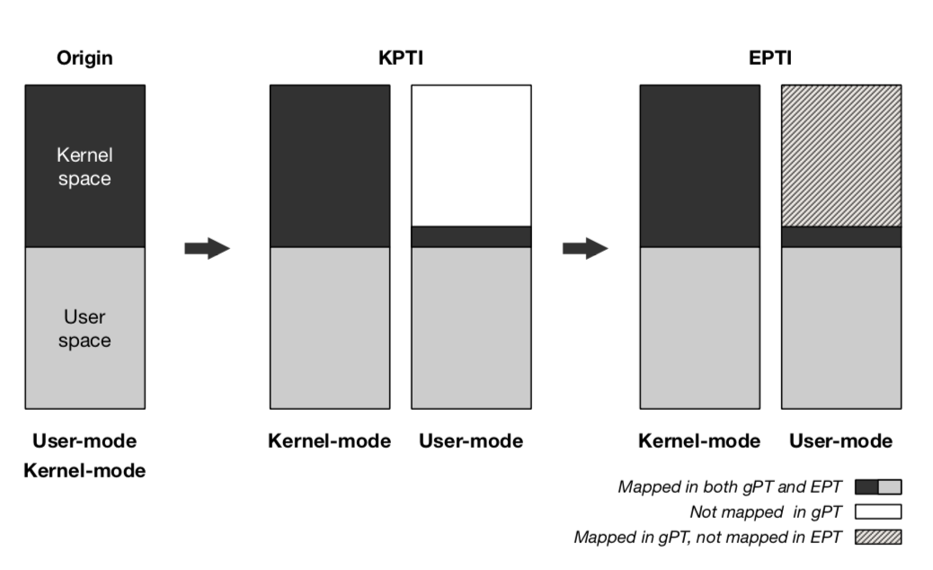
Defense against Meltdown
Linux standard approach：KPTI
  Need to patch guest VM
  Large overhead: >=10%
Approach from IPADS：EPTI
  Using EPT and VMFUNC for guest VM protection
  No hypervisor involvement for Kernel/User crossings
  No patches required to existing VMs
  Performance overhead reduced 45% over KPTI
EPTI：Seamless and Efficient Defense against Meltdown (Usenix ATC 2018)

Slide 38
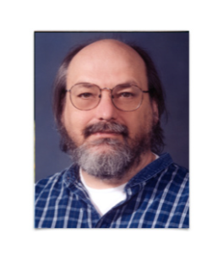
Trustworthy
“To what extent should one trust a statement that a program is free of Trojan horses? Perhaps it is more important to trust the people who wrote the software.”
  – Reflection on trusting trust [Thompson84]
Approach: formal verification
  Recent research: seL4
  Industry adoption: HongMeng @ Huawei

Slide 39
Issue#3: Power Efficiency

Slide 40

Power Efficiency
Greener World, Better Life!
Again, why it has to do with OS?
  OS control every computer and many devices!
  Thus determines the power used by each computer

Slide 41
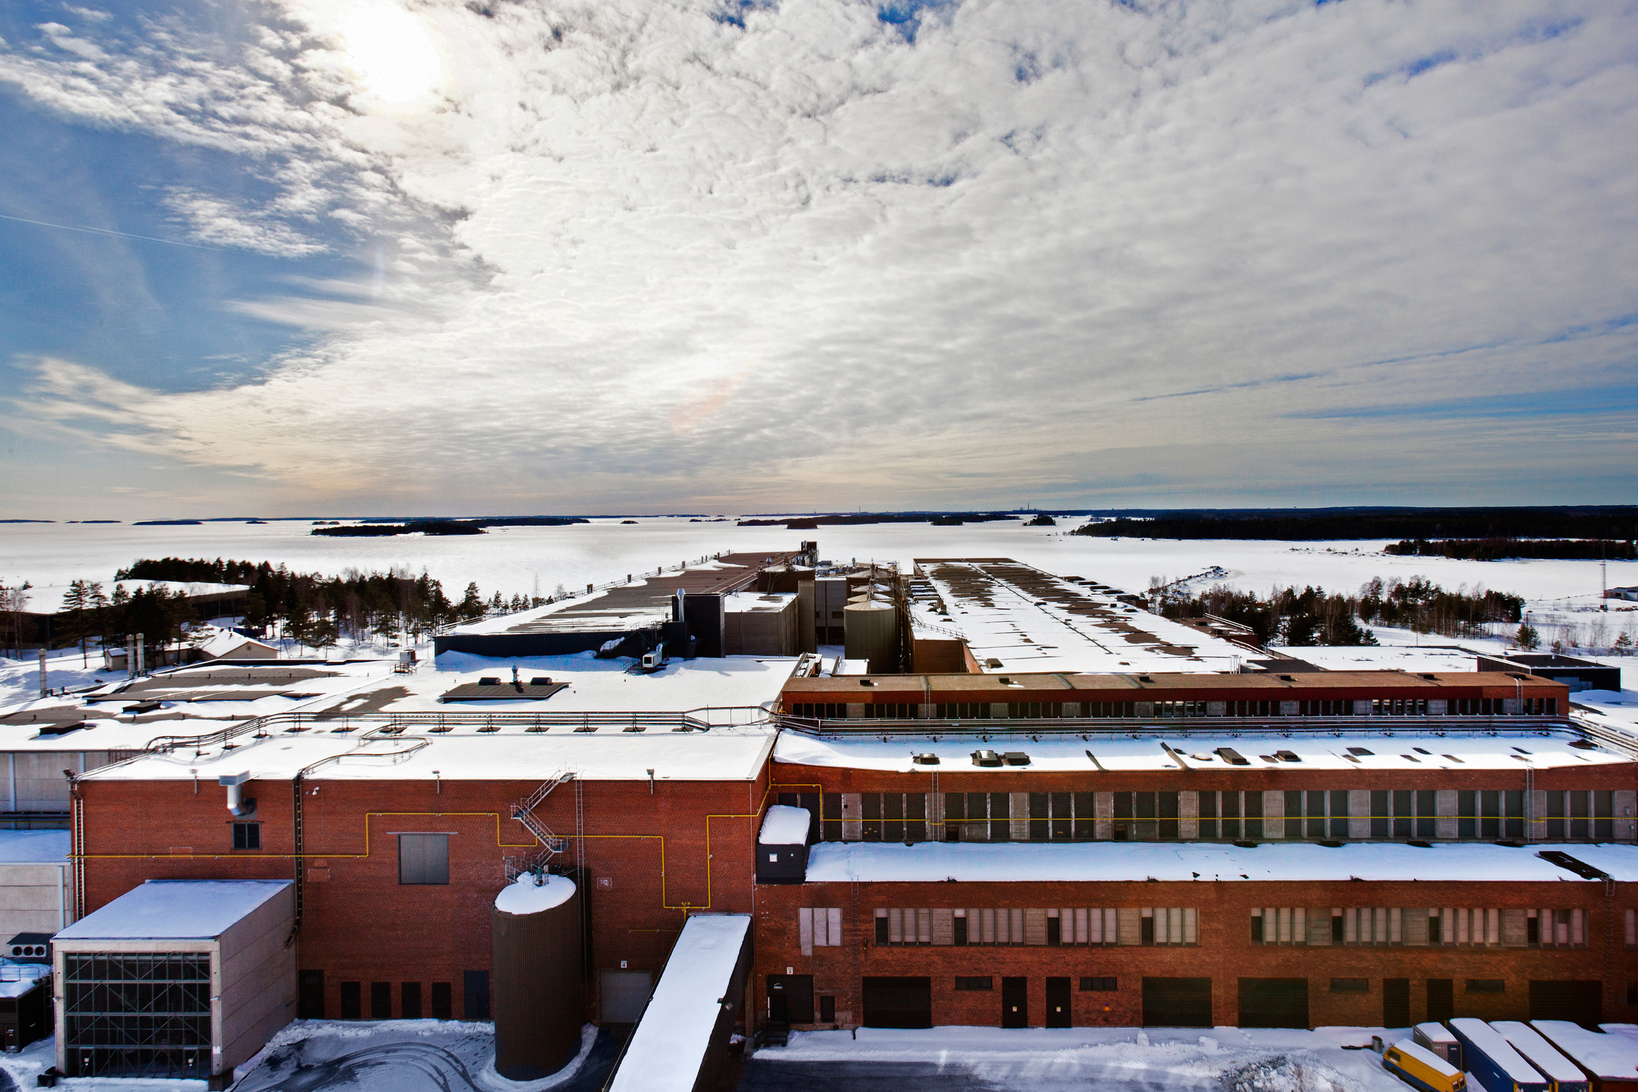
Google Datacenter: Finland

Slide 42
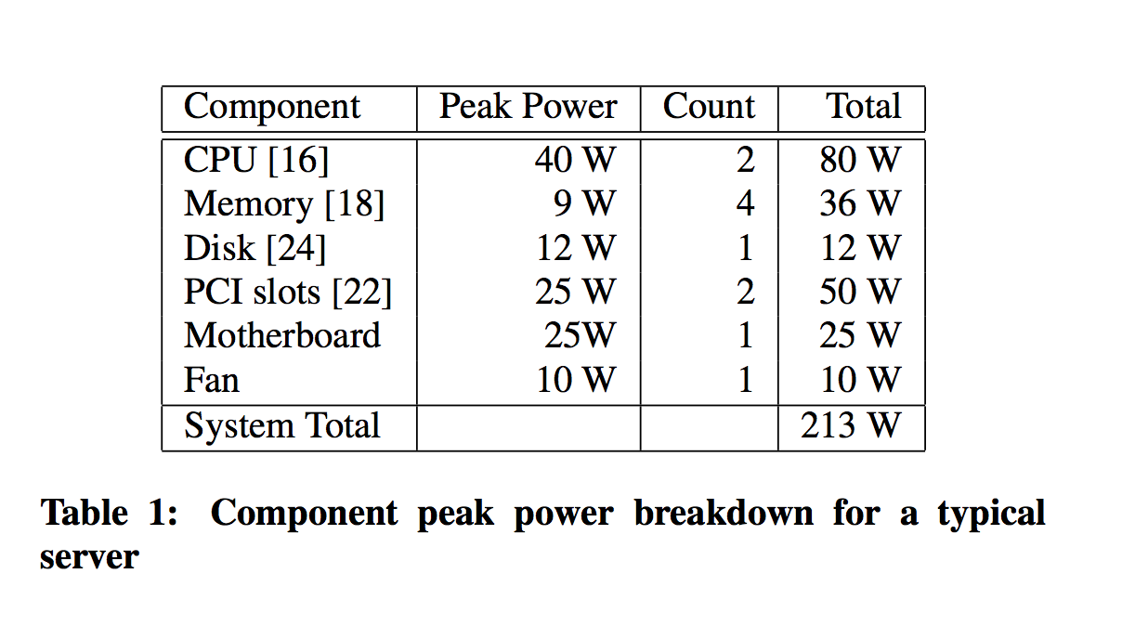
Power Breakdown in Server

Slide 43
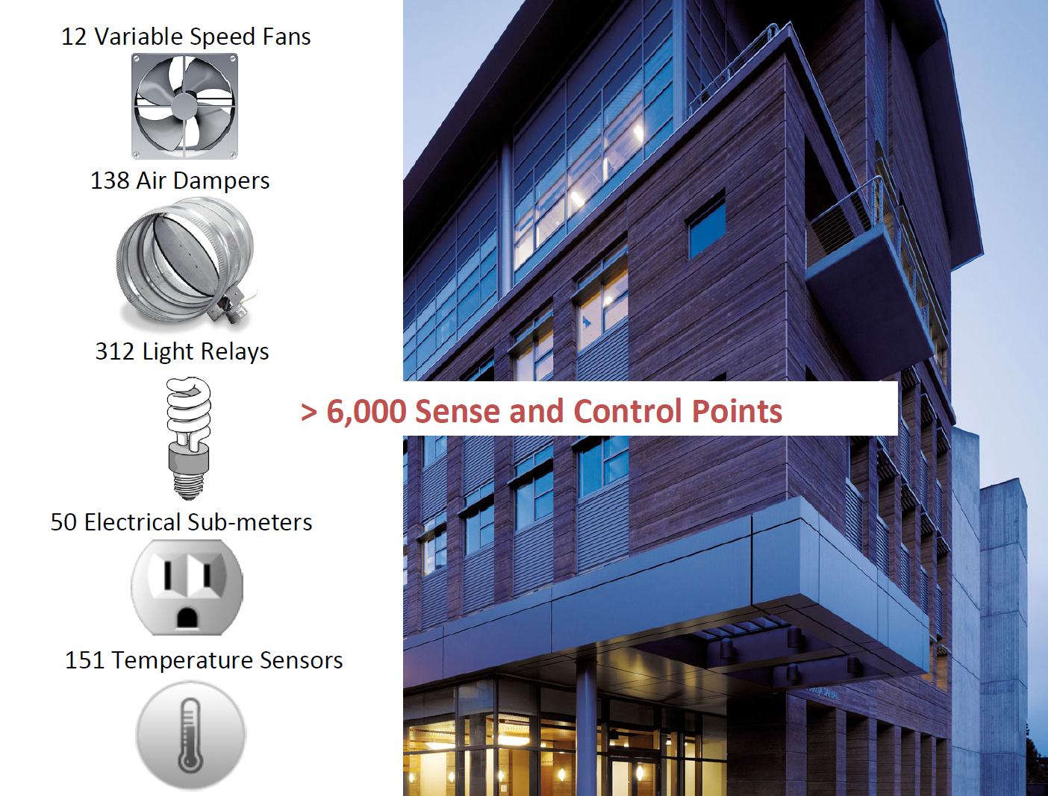

Slide 44
Why Operating System Matters?
Dynamic voltage and frequency scaling
  Adjust the frequency of CPU according to workload
Power off devices to save power
  Like disk, LCD, or even memory
Problem: energy consumption doesn’t scale with workloads
  Static power, leakage power
New!: Near Threshold Voltage

Slide 45
Issue#4: Mobility

Slide 46
Smartphone OS
Symbian
Windows Mobile
RIM Blackberry OS
Apple iOS
Google Android
Palm WebOS
Windows Phone 7

Slide 47
Android Software Stack
Linux kernel
Libraries
Android run time
  core libraries
  Dalvik virtual machine
application layer
application protocol

Slide 48
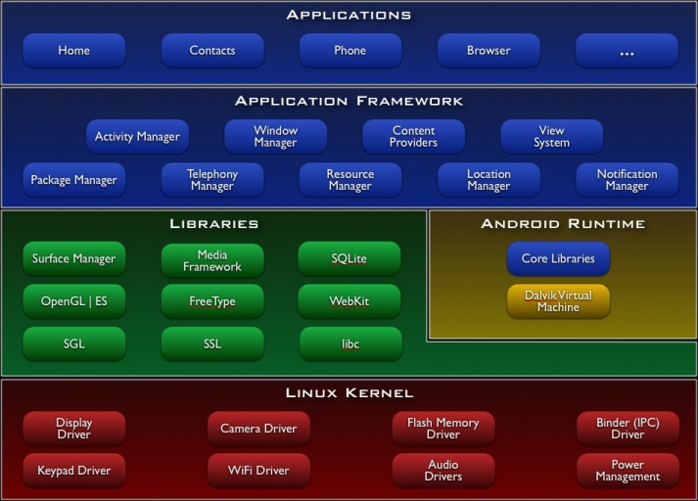
Android Architecture

Slide 49
What’s Unique for Mobile OS?
Energy Efficiency
Richer User Experience
  But more limited resources
Security
  More user data put into mobile OSes

Slide 50
Issue#5: Write Correct Parallel Code

Slide 51
Writing concurrent program is really HARD!
Concurrent programs are prone to concurrency bugs
Concurrency bugs have notorious characteristics
  Non-deterministic
  Hard to test and diagnose
But in multi-core era, we need to write concurrent program to harness the power of multi-core

Slide 52
Quote from Dijkstra
I am convinced more than ever that this type of work is very difficult, and that every effort to do it with other than the best people is doomed to either failure or moderate success at enormous cost.
Edsger Dijkstra
The Structure of the “THE” –Multiprogramming System
1968

Slide 53
Easiest One
Thread 1
Thread 2
if (thd->proc_info) {
…
fputs(thd->proc_info, …)
…
}
thd->proc_info = NULL;
MySQL ha_innodb.hpp

Slide 54
Approaches to addressing the problem
Concurrency bug detection
  Race detection
  Atomicity violation detection
  Deadlock bug detection
Concurrent program testing
  Exhaustive testing
  Different coverage criteria proposed
Concurrent programming language/model design
  Transactional memory

Slide 55
What OS can do?
Reduce sources of non-determinism
Tolerate application bugs
Faithfully capture concurrency bugs for reproducing
Provide better programming interfaces to ease programming
  Operating transactions

Slide 56
Issue#6: Scale Out
(use distributed systems)

Slide 57
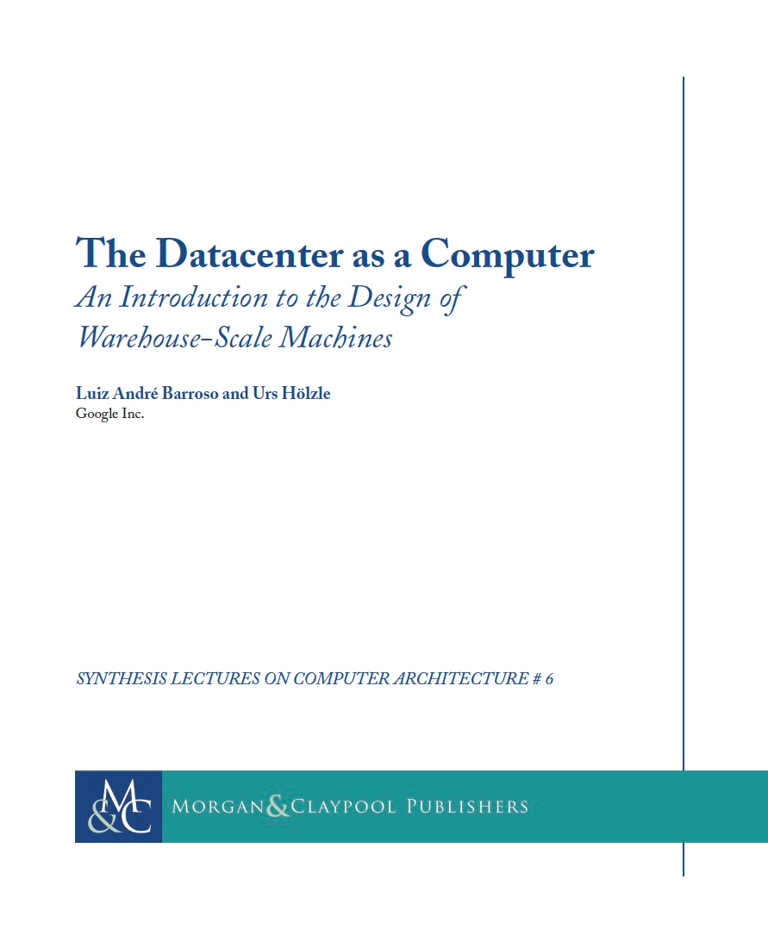

Slide 58
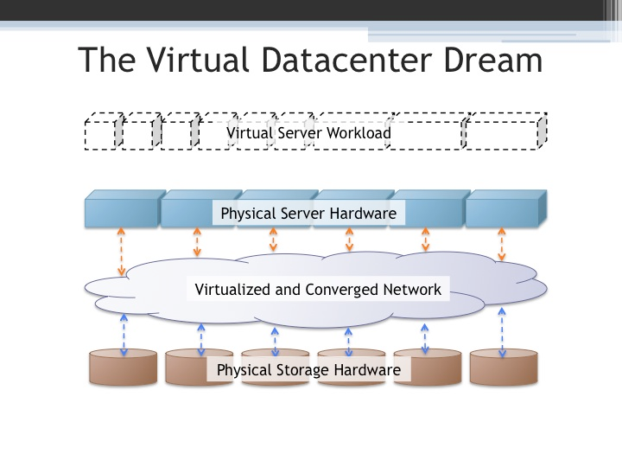

Slide 59
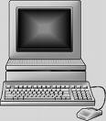
What are distributed systems?
Multiple
hosts
A network cloud
Hosts cooperate to provide a unified service
Examples?
Notes:
Multiple computers
Network interconnection (LAN or WAN).
Cooperative to provide some service
Example: Akamai CDN, network file systems, distributed database, DNS
Counterexample: a single shared UNIX machine

Slide 60
Why distributed systems? for ease-of-use
Handle geographic separation
Provide users (or applications) with location transparency:
  Web: access information with a few “clicks”
  Network file system: access files on remote servers as
  if they are on a local disk, share files among multiple computers

Slide 61
Why distributed systems? for availability
Build a reliable system out of unreliable parts
  Hardware can fail: power outage, disk failures, memory corruption, network switch failures…
  Software can fail: bugs, mis-configuration, upgrade …
  To achieve 99.999% availability, replicate data/computation on many hosts with automatic failover

Slide 62
Why distributed systems? for scalable capacity
Aggregate resources of many computers
  CPU: Dryad, MapReduce, Grid computing
  Bandwidth: Akamai CDN, BitTorrent
  Disk: Frangipani, Google file system

Slide 63
Why distributed systems? for modular functionality
Only need to build a service to accomplish a single task well.
  Authentication server
  Backup server

Slide 64
Challenges
System design
  What is the right interface or abstraction?
  How to partition functions for scalability?
Consistency
  How to share data consistently among multiple readers/writers?
Fault Tolerance
  How to keep system available despite node or network failures?

Slide 65
Challenges (continued)
Different deployment scenarios
  Clusters
  Wide area distribution
  Sensor networks
Security
  How to authenticate clients or servers?
  How to defend against or audit misbehaving servers?
Implementation
  How to maximize concurrency?
  What’s the bottleneck?
  How to reduce load on the bottleneck resource?
Notes:
Prompt students to answer questions for a mini-quiz
Memory load 30ns
Disk seek >5ms (Solid state disk 0.1-0.3ms)
Disk throughput 40M
LAN throughput
LAN latency
WAN throughput
WAN latency

Slide 66
A word of warning
A distributed system is a system in which I can’t do my work because some computer that I’ve never even heard of has failed.”
-- Leslie Lamport

Slide 67
Issue#7: Non-Volatile Storage

Slide 68
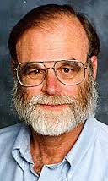
Tape is Dead
Disk is Tape
Flash is Disk
RAM Locality is King
Jim Gray
Microsoft
December 2006
In memory of Jim Gray
Notes:
lost at sea January 28, 2007

Slide 69
Tape Is Dead
Disk is Tape
1TB disks are available
10+ TB disks are predicted in 5 years
Unit disk cost: ~$400 → ~$80
But: ~ 5..15 hours to read (sequential)
~15..150 days to read (random)
Need to treat most of disk as
Cold-storage archive

Slide 70
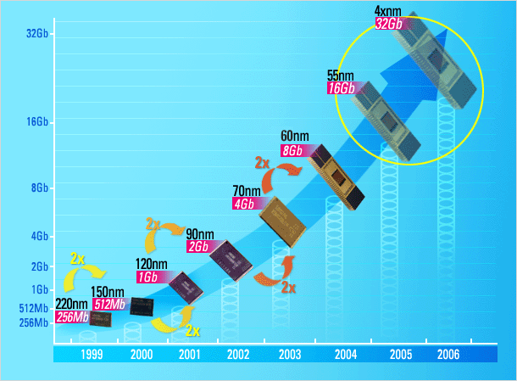

FLASH Storage?
1995 16 Mb NAND flash chips
2005 16 Gb NAND flash
Doubled each year since 1995
Market driven by Phones, Cameras, iPod,…
Low entry-cost,
~$30/chip → ~$3/chip
2012 1 Tb NAND flash
== 128 GB chip
== 1TB or 2TB “disk”
for ~$400
or 128GB disk for $40
or 32GB disk for $5
Samsung prediction

Slide 71
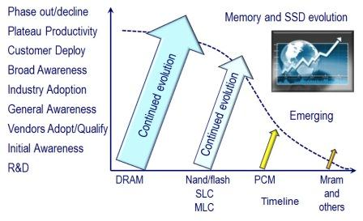
Storage Hiereary

Slide 72
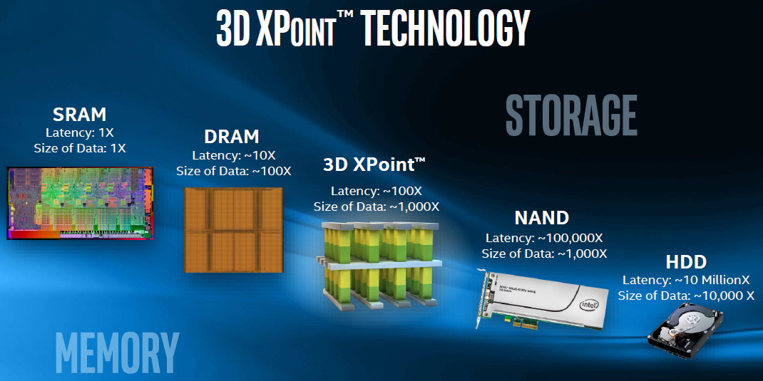
New Storage Keeps Coming

Slide 73
What can OS do?
Needs to adapt to the new storage model
Non-volatility changes the way operating system manage resources
  Like crash recovery
  Recall fsck
Better I/O performance

Slide 74
Issue#8: Virtualization

Slide 75
“Any problem in computer science can be solved with another level of indirection.”
  David Wheeler in Butler Lampson’s 1992 ACM Turing Award speech.

Slide 76
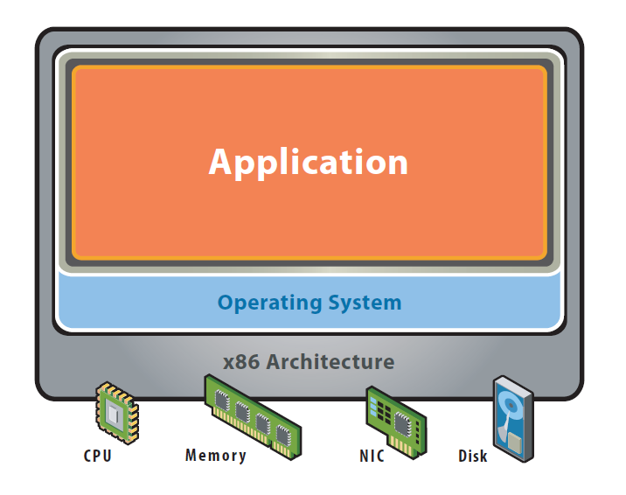
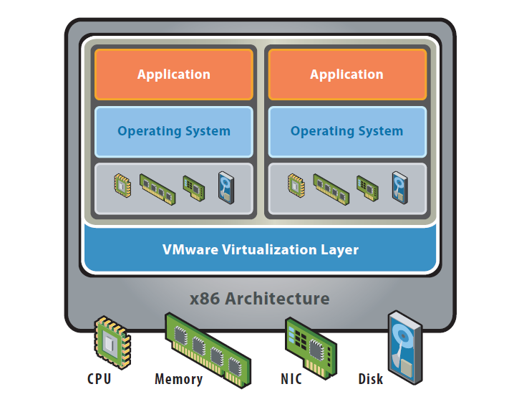
Concept of Virtualization
“Virtualization” refers to the creation of a virtual machine
  A virtual machine is a software implementation of a machine (i.e. a computer) that executes programs like a physical machine
Before Virtualization
After Virtualization
  * “Virtualization in education”, IBM, 2007
figures from: VMware white paper, virtualization overview
Notes:
Virtualization for complexity & Heterogeneity, sharing (making exclusive hardware sharable)
What is a difference between “platform virtualization” and others?
- it virtualizes ISA (CPU) such that OS can decouples from CPU.

Slide 77
Why Virtualization ?
  Decoupling the operating systems from physical hardware supports
  Maximum resource utilization
    Multiple OS environments can co-exist on the same computer, in strong isolation from each other
    Server consolidation
  Fault tolerance
    Fault and migrate
  Portability
    Can use any OS
  Manageability
    Easy to maintain
Notes:
Maximum resource utilization –
Server consolidation is an approach to the efficient usage of computer server resources in order to reduce the total number of servers or server locations that an organization requires. The practice developed in response to the problem of server sprawl, a situation in which multiple, under-utilized servers take up more space and consume more resources than can be justified by their workload
Multiple virtual machines
Portability
- the virtual machine can provide an instruction set architecture (ISA) that is somewhat different from that of the real machine

Slide 78


Why Virtualize?
Too many servers for too little work
High costs and infrastructure needs
  Maintenance
  Networking
  Floor space
  Cooling
  Power
  Disaster Recovery

Slide 79
Virtualization is Essentially Another Layer of OS
How does the process and OS use hardware resources?
 | process | OS
CPU | Non-privileged registers and instructions | +Privileged registers and instructions
memory | Virtual memory | +Physical memory
exceptions | Signals, errors | +Traps, interrupts
I/O | File system | Programmed I/O, DMA, interrupts

Slide 80
Outline
Why we study OS?
8 problems of OS
Course information

Slide 81
Faculty Information
Instructor
  CHEN Haibo 陈海波
  XIA Yubin 夏虞斌
  WANG Zhaoguo 王肇国
  Office: Room 3-401, Software Building
  Contact:
    haibochen@sjtu.edu.cn xiayubin@sjtu.edu.cn, wangzhaoguo@sjtu.edu.cn
TA
  LI Dingji dj_lee@foxmail.com 18037910004
  LI Haoyu haoyu.li@sjtu.edu.cn 17621808964
  LI Zinan rododo@sjtu.edu.cn 13162578896

Slide 82

Website

Slide 83
Reference Books
xv6: a simple, Unix-like teaching operating system. By Russ Cox, Frans Kaashoek, Robert Morris. Online
Understanding Linux Kernel.

Slide 84
Next Class
OS architecture

Slide 85
Recall
What is OS from a programmer’s perspective?
  A set of API, aka, system calls
  E.g., int 0x80
What are differences from other APIs?
  The system calls are usually hardware-related
  E.g., fork, FILE ops, socket, select/epoll
Who invokes the system calls?
  Application itself, libraries (e.g., glibc)
  Application through the libraries

Slide 86
Software Stack
Architecture
  Functionality and Appearance of a computer system but not implementation details
  Level of Abstraction = Implementation layer
    ISA, ABI, API
Application
Programs
Libraries
ABI
Operating System
Drivers
Memory
Manager
Scheduler
API
ISA
Execution Hardware
Memory
Translation
System Interconnect (Bus)
Controllers
Controllers
IO Devices,
Networking
Main Memory

Slide 87
Architecture, Implementation Layers
Implementation Layer : ISA
  Instruction Set Architecture
  Divides hardware and software
  Concept of ISA originates from IBM 360
    IBM System/360 Model (20, 40, 30, 50, 60, 62, 70, 92, 44, 57, 65, 67, 75, 91, 25, 85, 95, 195, 22) : 1964~1971
    Various prices, processing power, processing unit, devices
    But guarantee a software compatibility
  User ISA and System ISA

Slide 88
Implement the ISA
Machine from the perspective of a system
  ISA provides interface between system and machine
Application Software
Application
Programs
Libraries
Operating System
Operating System
Drivers
Memory
Manager
Scheduler
System ISA
User ISA
Execution Hardware
ISA
Memory
Translation
Machine
System Interconnect (Bus)
Controllers
Controllers
IO Devices,
Networking
Main Memory
Question: ISA Emulation?

Slide 89
Architecture, Implementation Layers
Implementation Layer : ABI
  Application Binary Interface
  Provides a program with access to the hardware resource and services available in a system
  Consists of User ISA and System Call Interfaces

Slide 90
Implement the ABI
Machine from the perspective of a process
  ABI provides interface between process and machine
    E.g., ELF in Linux, EXE in Windows
Application Software
Application
Programs
Libraries
System calls
Operating System
Drivers
Memory
Manager
Scheduler
User ISA
Execution Hardware
ABI
Memory
Translation
Machine
System Interconnect (Bus)
Controllers
Controllers
IO Devices,
Networking
Main Memory
Question: Which software
does ABI Emulation?

Slide 91
Architecture, Implementation Layers
Implementation Layer : API
  Application Programming Interface
  Key element is Standard Library ( or Libraries )
  Typically defined at the source code level of High Level Language
  Libc in Unix environment : supports the UNIX/C programming language

