Slide 1
FS: FAT32 & NTFS
Yubin Xia

Slide 2
FAT File System
FAT-16
FAT-32
exFAT

Slide 3
Clusters and Sectors
Sector: smallest storage unit on disk
  512 bytes
Cluster: smallest allocated disk space to hold file
  Data clusters are located after metadata of partition
  Different cluster sizes depending on volume size
Volume Size FAT32 Cluster Size
<32MB Not Supported
32MB ~ 64MB 512 bytes
65MB ~ 128MB 1KB
129MB ~ 256MB 2KB
257MB ~ 8GB 4KB
8GB ~ 16GB 8KB
16GB ~ 32GB 16KB
Default FAT Cluster Sizes
Notes:
3

Slide 4
Organization of an FAT Volume
Boot Sector
Reserved
Sectors
FAT 1
FAT 2 (Duplicate)
Root Folder
Other Folders and All Files
Boot Sector
- Layout of the volume
- File system structure
- Boot code
Root Folder
- Describes the files and folders
in the root of the partition
FAT 1
- Original FAT
Other Folder and All Files
- Contains the data for the files
and folders within the file
system.
FAT 2 (Duplicate)
- Backup copy of FAT
Notes:
4

Slide 5
Stores basic info about the file system
FAT version, location of boot files
Total number of blocks
Index of the root directory in the FAT
File allocation table (FAT)
Marks which blocks are free or in-use
Linked-list structure to manage large files
Store file and directory data
Each block is a fixed size (4KB – 64KB)
Files may span multiple blocks
Super Block
Disk

Slide 6
FAT Boot Sector
FAT Boot Sector
  Locate at the first logical sector of each partition
  Created when you format a volume
  End with a 2-byte sector marker (always 0x55AA)
Component
  An x86-based CPU jump instruction
  Original Equipment Manufacturer Identification (OEM ID)
  BIOS Parameter Block (BPB)
  Extended BPB
  Executable boot code
Notes:
6

Slide 7
FAT 1 and FAT 2
File Allocation Table (FAT)
  Identifies all clusters as
    unused, cluster in use by a file, bad cluster,
    last cluster in a file
  FAT 2 is used for consistency-checking program
Notes:
7

Slide 8
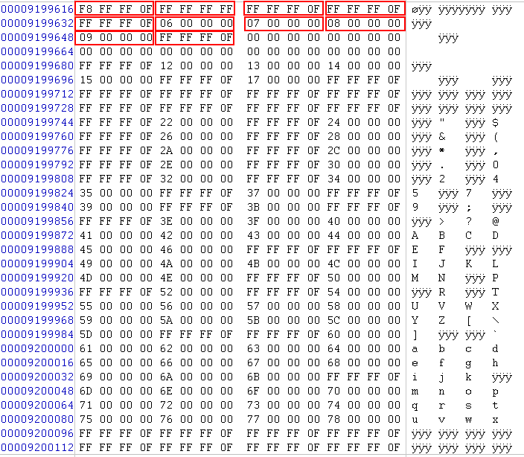
A Sample of FAT

Slide 9
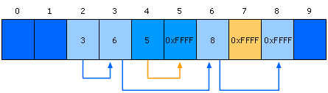
File Processing on FAT Clusters
Store file information in FAT
  Continues to store file info in the next available cluster
    when the file requires space greater than the cluster's size
  Three Files: 1 with (2-3-6-8), 2 with (4-5), 3 with (7)
Notes:
9

Slide 10
FAT Root Folder
FAT Root Folder Structure
Root Folder Entry
Size
Description
Name
11B
Name in 8.3 format
Attribute Byte
1B
Information about entry
(e.g. archive, system, hidden, and read-only)
Creation Time and Date
5B
Time and date file was create
Last Access Date
2B
Date file was last accessed
Last Modification Time and Date
4B
Time and data file was last modified
First Cluster
2B
Starting cluster number in the file allocation table
File Size
4B
Size of the file
Notes:
10

Slide 11
File Naming
File Names in Windows Server 2003
  Support long file name, up to 255 characters
  Generate a 8.3 short file name
Support Long File Name
  The main folder entry stores 8.3 short file name
  The secondary folder entries store long file name
    Each stores 13 characters in Unicode
Notes:
11

Slide 12
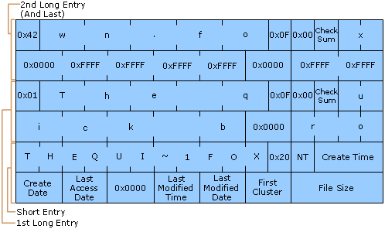
File Naming (cont.)
e.g. file with “The quick brown.fox” and “Thequi~1.fox”
long file name
short file name
Notes:
12

Slide 13
FAT32 Long File Name
Using 0xF in directory entry
  Means this entry is part of long file name
  0xF is not used in DOS/WIN32 (consider as invalid)
Using unicode for storage
  2 bytes (64 bits)
The short (8.3) file name is still there
  The system cannot work without short name

Slide 14
Short Name Generation
What if there is already a file with name THEQUI~1FOX?
  Then use THEQUI~2FOX
  If still conflict, using THEQUI~3FOX
  If still conflict, using …
  If still conflict, using T~999999FOX
  If still conflict, error

Slide 15
Question
What is the process of searching a file by its long name?
Notes:
Sequentially search!

Slide 16
File Name Search in ExFAT
Search name by hash value first
  Hash the upper case version of the file name
  Each record in the directory is searched by comparing the hash value
  When a match is found, the filenames are compared to ensure that the proper file was located in case of collisions
    Only two characters have to be compared, why?

Slide 17
FAT: The Good and the Bad
The Good – FAT supports:
  Hierarchical tree of directories and files
  Variable length files
  Basic file and directory meta-data
The Bad
  At most, FAT32 supports 2TB disks
  Locating free chunks requires scanning the entire FAT
  Prone to internal and external fragmentation
    Large blocks → internal fragmentation
  Reads require a lot of random seeking

Slide 18




Lots of Seeking
FAT may have very low spatial locality, thus a lot of random seeking
Consider the following code:
  int fd = open(“my_file.txt”, “r”);
  int r = read(fd, buffer, 1024 * 4 * 4); // 4x4KB blocks
56
57
58
59
60
61
62
63
64
65
67
68
FAT
67
0xFFFF
0
0xFFFF
63
0
56
57
0
0
59
60
56
57
58
59
60
61
62
63
64
65
67
68
Blocks

Slide 19
NTFS

Slide 20
NTFS Clusters
Cluster: smallest allocated disk space to hold file
  Sequentially logical cluster numbers from the beginning of the partition
  Clusters start at sector ZERO (different to FAT)
  Floppy disks do not use NTFS
  Different cluster sizes depending on volume size
Volume Size NTFS Cluster Size
7MB ~ 512MB 512 bytes
513MB ~ 1GB 1KB
1GB ~ 2GB 2KB
2GB ~ 2TB 4KB
Default NTFS Cluster Sizes
Notes:
20

Slide 21
Organization of an NTFS Volume
NTFS
Boot Sector
Master
File Table
File System
Data
Master File Table Copy
NTFS Boot Sector
- Layout of the volume
- File system structure
- Boot code
File System Data
- Data no contained within MFT
Master File Table
- Attributes of files
- Attributes of folders
(Most Important)
Master File Table Copy
- a copy of MFT
Notes:
21

Slide 22
Master File Table
Master File Table (MFT)
  A relational database
  Rows: file records
  Columns: file attributes
  Contains at least one entry for every file
Metadata files
  Describe the MFT
  The first 16 records of MFT for metadata files
  Begin with a dollar sign, e.g., $Mft, $MftMirr, $LogFile, …
Notes:
22

Slide 23
MFT
The MFT is an array of file records
Each record is 1024 bytes
The first record in the MFT is for the MFT itself
The name of the MFT is $MFT
The first 16 records in the MFT are reserved for metadata files
MFT Entry
Header
Attributes
Unused
Space
1024 Bytes

Slide 24
Metadata Files in MFT
System File
Name Rec
Purpose of File
Master File
Table
$Mft 0
Contains file record for each file and folder on a NTFS volume.
Master File
Table Mirror
$MftMirr 1
Duplicate image of the first four records of MFT
Log File
$LogFile 2
Restores metadata for fast recovery
Volume File
$Volume 3
Contains information about the volume
Attribute Definitions
$AttrDef 4
Lists attribute names, numbers, and descriptions
Root File Name Index
. 5
The root file
Cluster Bitmap
$Bitmap 6
Represents the volume by showing free and unused clusters.
Notes:
24

Slide 25
Metadata Files in MFT (cont.)
System File
Name Rec
Purpose of File
Boot Sector
$Boot 7
Includes the BPB and additional bootstrap loader code
Bad Cluster file
$BadClus 8
Contains bad clusters for a volume
Security File
$Secure 9
Contains unique security descriptors for all files
Upcase Table
$Upcase 10
Used to match Unicode uppercase characters
NTFS Extension File
$Extend 11
Optional extensions such as quotas, reparse point data ...
12-15
Reserved for future use
Notes:
25

Slide 26
MFT Zone
MFT contains a record for each file and folder on the volume
  File and folder records are 1KB each
MFT Zone
  Exclusive use of the MFT
  Prevent fragmentation
  Dedicate 12.5% of volume by default (!)
  On demand allocation for additional MFT zone
Notes:
26

Slide 27
NTFS File Record Attributes
File Attributes
  View each file and folder as a set of file attributes
  Resident Attributes vs. Nonresident Attributes
    Small files and folders are entirely contained within the file's MFT record (typically, less than 900 bytes)
  Types:
    Standard Info: access mode, timestamp, link count …
    Attribute List: locations of all nonresident attributes
    File Name: long and short file names
    Data / Index: data of file or index of folder
    Object ID: volume-unique file identifier
    …
Notes:
27

Slide 28
NTFS File Record Attributes
Index of Folder
  Folder records contain index information
  (directory entry)
  Organized B-tree structure for large folders
Last Access Time
  The most up-to-data LAT is always stored in memory
  Written to disk
    WHERE: file's attribute AND directory entry for the file
    WHEN: more than an hour OR update other file attributes
Notes:
28

Slide 29
File Naming
File Names in Windows Server 2003
  Support long file name, up to 255 characters
  NTFS generate a 8.3 short file name
HOW to generate short file name
  Deletes all of unsupported characters (e.g. space)
  Deletes all extra periods (abc.def.txt)
  Truncates the file name to six characters and appends a tilde(~) and a number
  Translates all characters in file name and extension to uppercase
  “This is test 1.txt” -> “THISIS~1.TXT”
Notes:
29

Slide 30
Compression of Files and Folders
NTFS Compression
  Implemented within NTFS
  Compression only in disk
  Uncompress before moving data to memory
Moving and Copying Files or Folders
  Change compression state
  Add overhead to the system
Notes:
30

Slide 31
Hard Links
Hard Links
  Add a directory entry for the hard link without duplicating the original file
  Application can modify a file by using any of its hard Links
  Cannot give a file different security descriptors on a per-hard-link basis
Notes:
31

Slide 32
Sparse Files
Sparse Files
  Focus on the file contain large sections of data composed of zeros
  Store
    Allocates disk clusters only for the data explicitly specified by the application
    Non-specified ranges of the file are represented by non-allocated space on the disk
  Read
    From allocated ranges, return the data stored
    From non-allocated ranges, return ZERO
Notes:
32

Slide 33
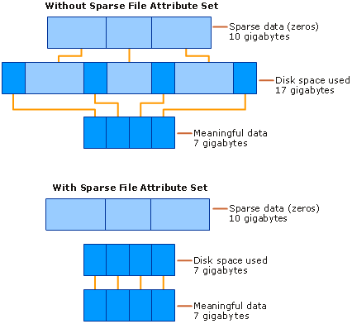
Sparse Files (cont.)
Notes:
33

Slide 34
MBR & Mount

Slide 35
The Master Boot Record
Address |  | Description | Size (Bytes)
Hex | Dec.
0x000 | 0 | Bootstrap code area | 446
0x1BE | 446 | Partition Entry #1 | 16
0x1CE | 462 | Partition Entry #2 | 16
0x1DE | 478 | Partition Entry #3 | 16
0x1EE | 494 | Partition Entry #4 | 16
0x1FE | 510 | Magic Number | 2
 |  | Total: | 512
Includes the starting LBA and length of the partition
MBR
Partition 1
(ext3)
Partition 2
(swap)
Partition 3
(NTFS)
Partition 4
(FAT32)
Disk 1
MBR
Partition 1
(NTFS)
Disk 2

Slide 36
Extended Partitions
In some cases, you may want >4 partitions
Modern OSes support extended partitions
MBR
Partition 1
(ext3)
Partition 2
(swap)
Partition 3
(Extended Partition)
Ext. Part.
Logical Partition 1
(NTFS)
Logical Partition 2
(NTFS)
Partition 4
(FAT32)
Disk 1
Extended partitions may use OS-specific partition table formats (meta-data)
  Thus, other OSes may not be able to read the logical partitions

Slide 37
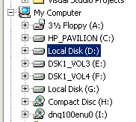
Types of Root File Systems
Windows exposes a multi-rooted system
  Each device and partition is assigned a letter
  Internally, a single root is maintained
Linux has a single root
  One partition is mounted as /
  All other partitions are mounted somewhere under /
Typically, the partition containing the kernel is mounted as / or C:

Slide 38
Mounting a File System
Read the super block for the target file system
  Contains meta-data about the file system
  Version, size, locations of key structures on disk, etc.
Determine the mount point
  On Windows: pick a drive letter
  On Linux: mount the new file system under a specific directory
Filesystem Size Used Avail Use% Mounted on
/dev/sda5 127G 86G 42G 68% /media/cbw/Data
/dev/sda4 61G 34G 27G 57% /media/cbw/Windows
/dev/sdb1 1.9G 352K 1.9G 1% /media/cbw/NDSS-2013

Slide 39
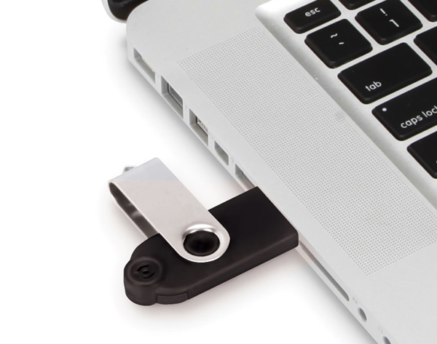
Mount isn't Just for Bootup
When you plug storage devices into your running system, mount is executed in the background
Example: plugging in a USB stick
Why “safely eject” a device?
  Flush cached writes to that device
  Cleanly unmount the file system on that device

Slide 40
Homework
Please learn about btrfs, use your own words to describe its system architecture, and states its pros and cons (you can compare it with ext4/fat/ntfs)
(optional) you can also check ReiserFS and ZFS, they also have very interesting features

