Slide 1
GFS and NFS
Yubin Xia

Slide 2
Intro to GFS

Slide 3
Background
In 2003
  50+ GFS clusters
  Each with thousands of storage nodes
  Managing petabytes of data
  GFS is under lots of applications and other systems in Google, such as bigtable, etc.
Built on top of commodity machine and disks
Tailored for Google workloads

Slide 4
Introduction to GFS
Shares the same goals as previous distributed file systems
  Performance, Scalability, Reliability, Availability
But with some differences:
  Component failures are considered the norm rather than the exception
  Files are huge by traditional standards.
  Most files are mutated by appending new data
  rather than overwriting existing data
  Co-designing the file system and applications increases flexibility in development

Slide 5
Design Assumptions
System is built from commodity hardware which fails as the norm
  The system must be able to detect and recover from such occurrences
The system must be optimized to deal with large files (multi-GB)
Two types of reading
  Large streaming reads
  Small random reads

Slide 6
Design Assumptions
Large sequential writes
  Appending data to files which are seldom altered again.
Atomicity in concurrent writes from multiple clients
High sustained bandwidth is more valuable
than low latency

Slide 7
Typical workloads on GFS
Two kinds of reads: large streaming reads & small random reads
  Large streaming reads usually read 1MB or more
  Oftentimes, applications read through contiguous regions in the file
  Small random reads are usually only a few KBs at some arbitrary offset
Also many large, sequential writes that append data to files
  Similar operation sizes to reads
  Once written, files are seldom modified again
  Small writes at arbitrary offsets do not have to be efficient
Multiple clients (e.g. ~100) concurrently appending to a single file
  e.g. producer-consumer queues, many-way merging

Slide 8
GFS Interface
Not POSIX-compliant, but supports typical file system operations: create, delete, open, close, read, and write
snapshot: creates a copy of a file or a directory tree at low cost
record append: allow multiple clients to append data to the same file concurrently
  At least the very first append is guaranteed to be atomic

Slide 9
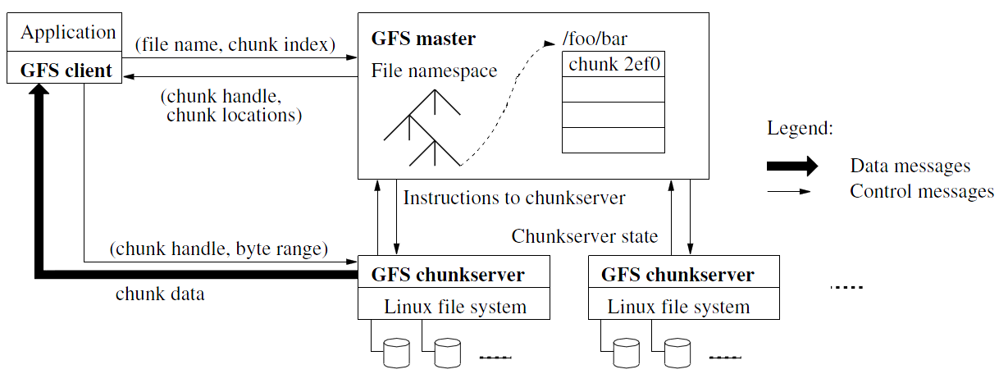
Architecture

Slide 10
Design Architecture
GFS Cluster (accessed by clients)
  Single Master + Multiple Chunkservers
Chunkserver
  Files of fixed sized chunks
  Each chunk has a globally unique 64-bit chunk handle.
Master
  Maintains file system metadata
    Namespace
    Access Control Information
    Mapping from files to chunks
    Current locations of chunks

Slide 11
Design Architecture
Principle: data flow is decoupled from control flow
  Clients interact with the master for metadata operations
  Clients interact directly with chunkservers for all files operations
  This means performance can be improved by scheduling expensive data flow based on the network topology
Neither the clients nor the chunkservers cache file data
  Working sets are usually too large to be cached, chunkservers can use Linux’s buffer cache

Slide 12
Single Master Node
Clients do not read or write through the master
The master relays relevant chunkserver location information to the client
The client temporarily caches the chunkserver data and directly accesses the chunkserver
Shadow Masters (fault tolerance)

Slide 13
Metadata on Master
Three major types:
  Chunk namespaces
  Mapping from files to chunks
  Location of chunk replicas
Chunk location is not stored persistently
and is instead read on each startup
Metadata is stored in memory
  Namespaces and file-to-chunk mappings are also stored persistently in operation log
Master monitors chunk location through heartbeat messages with each chunk.

Slide 14
Metadata on Master
For the namespace metadata
  Master does not use any per-directory data structures
  No inodes! No symlinks or hard links, either
  Every file and directory is represented as a node in a lookup table, mapping pathnames to metadata
  Stored efficiently using prefix compression
    < 64 bytes per namespace entry
Each node in the namespace tree has a corresponding read-write lock to manage concurrency
  Because all metadata are stored in memory, the master can efficiently scan the entire state of the system periodically in the background
  Master’s memory capacity does not limit the size of the system

Slide 15
The Operation Log
Only persistent record of metadata
Also serves as a logical timeline that defines the serialized order of concurrent operations
Master recovers its state by replaying the operation log
  To minimize startup time, the master checkpoints the log periodically
  The checkpoint is represented in a B-tree like form, can be directly mapped into memory, but stored on dis
  Checkpoints are created without delaying incoming requests to master, can be created in ~1 minute for a cluster with a few million files

Slide 16
Chunkserver
Contains chunks (blocks) of a fixed size
  64 MB
  Fewer chunk location, fewer metadata
Chunks are replicated regularly
  Default: 3-way mirror (across machines and racks)
Talks with master through heartbeat messages
  This let’s master determines chunk locations and assesses state of the overall system
  The chunkserver has the final word over what chunks it does or does not have on its own disks – not the master

Slide 17
Chunk Size
64 MB, a key design parameter (Much larger than most file systems)
Disadvantages:
  Wasted space due to internal fragmentation
  Small files consist of a few chunks, which then get lots of traffic from concurrent clients
  This can be mitigated by increasing the replication factor
Advantages:
  Reduces clients’ need to interact with master (reads/writes on the same chunk only require one request)
  Since client is likely to perform many operations on a given chunk, keeping a persistent TCP connection to the chunkserver reduces network overhead
  Reduces the size of the metadata stored in master → metadata can be entirely kept in memory

Slide 18
Why a Single Master?
The master now has global knowledge of the whole system, which drastically simplifies the design
But the master is (hopefully) never the bottleneck
  Clients never read and write file data through the master; client only requests from master which chunkservers to talk to
  Master can also provide additional information about subsequent chunks to further reduce latency
  Further reads of the same chunk don’t involve the master, either

Slide 19
Why a Single Master?
Master state is also replicated for reliability on multiple machines, using the operation log and checkpoints
  If master fails, GFS can start a new master process at any of these replicas and modify DNS alias accordingly
“Shadow” masters also provide read-only access to the file system, even when primary master is down
  They read a replica of the operation log and apply the same sequence of changes
  Not mirrors of master: they lag primary master by fractions of a second
  This means we can still read up-to-date file contents while master is in recovery!

Slide 20
System Interactions
Mutation
  Write
  Append
  Acts on all of the chunk’s replicas
Lease
  Initial timeout of 60 seconds, which can be renewed or revoked.
Data Flow
  Decoupled control flow from data flow
  Data pushed linearly to avoid bottlenecks and high latency links

Slide 21
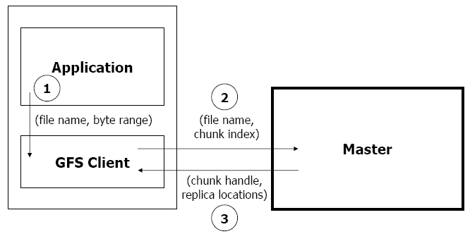
Read Algorithm

Slide 22
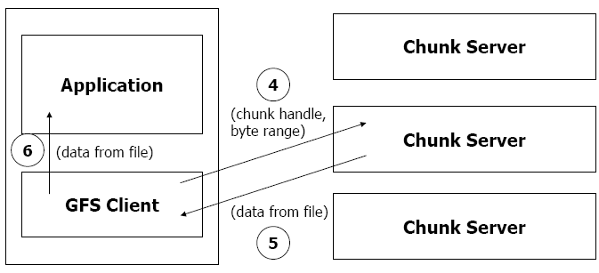
Read Algorithm

Slide 23
Read Algorithm
1. Application originates the read request.
2. GFS client translates the request from (filename, byte range) -> (filename, chunk index), and sends it to master.
3. Master responds with chunk handle and replica locations (i.e. chunk servers where the replicas are stored).
4. Client picks a location and sends the (chunk handle, byte range) request to that location.
5. Chunk server sends requested data to the client.
6. Client forwards the data to the application.

Slide 24
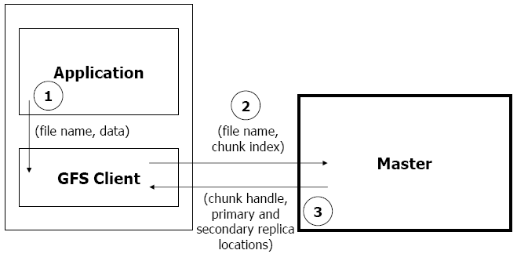
Write Algorithm

Slide 25
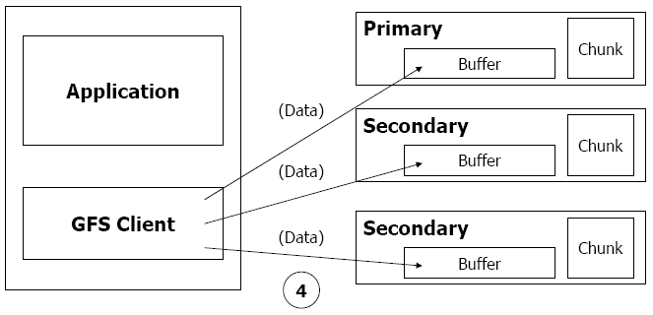
Write Algorithm

Slide 26
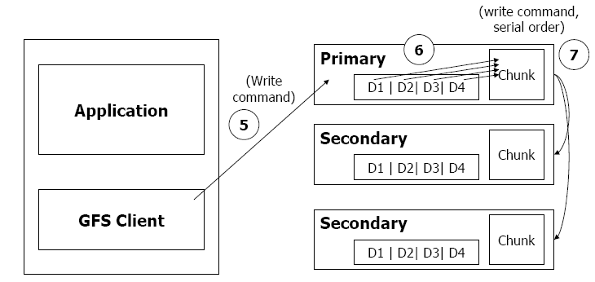
Write Algorithm

Slide 27
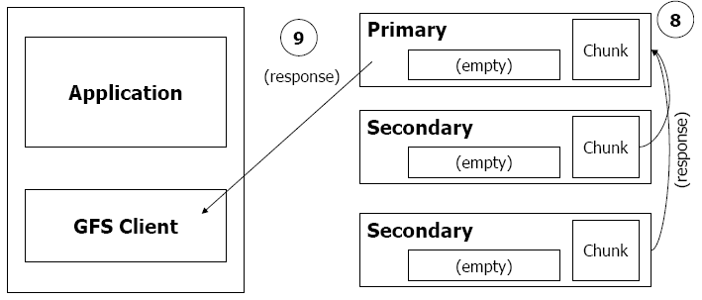
Write Algorithm

Slide 28
Write Algorithm
1. Application originates write request.
2. GFS client translates request from (filename, data) -> (filename, chunk index), and sends it to master.
3. Master responds with chunk handle and (primary + secondary) replica locations.
4. Client pushes write data to all locations. Data is stored in chunkservers’ internal buffers.
5. Client sends write command to primary.

Slide 29
Write Algorithm
6. Primary determines serial order for data instances stored in its buffer and writes the instances in that order to the chunk.
7. Primary sends serial order to the secondaries and tells them to perform the write.
8. Secondaries respond to the primary.
9. Primary responds back to client.
Note: If write fails at one of chunk servers, client is informed and retries the write.

Slide 30
Master Operation
Replica Placement
Creation, Re-replication, Rebalancing
Garbage Collection
Stale Replica Detection

Slide 31
Fault Tolerance and Diagnosis
Fast recovery
  Master and chunkserver are designed to restore their states and start in seconds
Chunk replication : 3-way mirrors
  Across multiple machines, across multiple racks

Slide 32
Fault Tolerance and Diagnosis
Master Mechanisms:
  Log of all changes made to metadata
  Periodic checkpoints of the log
  Log and checkpoints replicated on multiple machines
  Master state is replicated on multiple machines
  “Shadow” masters for reading data if “real” master is down

Slide 33
Fault Tolerance and Diagnosis
Data integrity
  A chunk is divided into 64-KB blocks
  Each with its 32-bit checksum
  Verified at read and write times
  Also background scans for rarely used data

Slide 34
Summary of GFS
Runs on commodity hardware and is scalable
Performs well for the specified tasks and assumptions previously mentioned
Innovation
  File system API tailored to stylized workload
  Single-master design to simplify coordination
  Metadata fit in memory

Slide 35
Summary of GFS
Flat namespace
Dedicated Care for Component Failure
  hard disk failure, data corruption, network disconnection, etc.
High-throughput
  Minimized the master involvement
    Chunk servers themselves send and receive the client data
    The master leases authority to mutate chunks

Slide 36
Intro to NFS

Slide 37
Accessing Remote Files
FTP, telnet, …
    Explicit access
    User-directed connection to access remote resource
  We want more transparency
    Allow user to access remote resource just as local ones
NAS: Network Attached Storage

Slide 38
File Service Types
Upload/Download model
    Read file: copy file from server to client
    Write file: copy file from client to server
  Advantage
    Simple
  Problem
    Wasteful “what if client needs small piece?”
    Problematic “what if client doesn’t have enough space?”
    Consistency “what if others modify the same file?”

Slide 39
File Service Types
Remote access model
    File service provides functional interface
    (create, delete, read, write, etc …)
  Advantage
    Client gets only what’s needed
    Server can manage coherent view of file system
  Problem
    Possible server and network congestion
      Servers are accessed for duration of file access
      Same data may be requested repeatedly

Slide 40
Remote File Service
  File Service
    Provides file access interface to clients
Directory Service
    Maps textual names for file to internal locations that can be used by file service
  Client module (driver)
    Client side interface for file & directory service
    If done right, helps provide access transparency
      e.g. implement the FS under the VFS layer

Slide 41
Semantics of File Sharing
  Sequential semantics
    Read returns result of last write
Easily achieved if
    Only one server
    Clients do not cache data
  BUT
    Performance problem if no cache
    We can write-through
      Must notify clients holding copies
      Requires extra state, generates extra traffic

Slide 42
Semantics of File Sharing
  Session semantics
Relax the rules
    Changes to an open file are initially visible
    only to the process that modified it
    Last process to modify the file wins

Slide 43
Accessing Remote Files
Implement the client module as an FS under VFS
System Call Interface
VFS
Sockets
ext4
procfs
RemoteFS
Network Protocols
Network
NIC
Kernel-level
sockets interface

Slide 44
Server: Stateful or Stateless
  Stateful →
Shorter requests
  Better performance in processing requests
  Cache coherence is possible
    Server can know who’s accessing what
  File locking is possible
Server maintains client-specific state
Notes:
State: e.g., offset, ..

Slide 45
Server: Stateful or Stateless
  Stateless →
Each request must identify file and offsets
  Server/Client can crash and recovery
    No state to lose
  No open/close needed
  No server space used for state (scalable)
  Problems if file is deleted on server
  File locking not possible
Server maintains no info for client

Slide 46
Caching
Hide latency to improve performance for repeated accesses by bringing the data closer to where it’s needed
Three places to replicate data
    Server’s buffer cache
    Client’s buffer cache
    Client’s disk
WARNING:
Potential cache consistency problem

Slide 47
Approaches to Caching
  Write-through
    Keep data cached at the client
    but send modifications to the server
    What if another client reads its own
    (out-of-data) cache copy?
    All accesses will require checking with server
    Or … server maintains state of clients and sends invalidations

Slide 48
Approaches to Caching
  Delayed writes (write-behind)
    Data is cached locally (watch out for consistency – others won’t see updates)
    Remote files updated (immediately) periodically
    One bulk write is more efficient than lots of little writes
    Problem: semantics become ambiguous

Slide 49
Approaches to Caching
  Read-ahead (prefetch)
    Request chunks of data before it is needed
    Minimize wait when it actually is needed
  Write on close
    Admit that we have session semantics
  Centralized control
    Keep track of who has what open and cached on each node
    Stateful file system with signaling traffic

Slide 50
NFS: Network File System
  Design Goals
    Any machine can be a client or server
    Must support diskless workstations
    Heterogeneous system must be supported
      Different HW, OS, underlying file system
    Access transparency
    Recovery from failure
      Stateless, UDP, client retries
    High performance
      Use caching and read-ahead

Slide 51
NFS Protocols: Mount
  Mounting Protocol:
  Request access to exported directory tree
    Client sends pathname to server
      Requests permission to access contents
    Server returns file handle
Client: parses pathname
contacts server for file handle
Client: create in-memory VFS inode at mount point
internally points to rnode for remote files
(client keeps state, not the server)

Slide 52
NFS Protocols: Mount
  Static mounting
    mount request contacts server
Server:
add list of shared directories to /etc/exports
Client:
mount r900:/users/paul /home/paul

Slide 53
NFS Protocols: Access
  Directory and File Access Protocol:
  Access files and directories (read, mkdir, …)
    First, perform a lookup RPC
      Returns file handle and attributes
    “lookup” is not like “open”
      Establish state on the client only
      (no information on server)
      Call the NFS lookup function
    The handle passed as a parameter for other file access function
      e.g., read(handle, offset, count)

Slide 54
NFS Performance
  Usually slower than local
  Improve by caching at client
    Goal: reduce number of remote ops
    Caching: read, readlink, getattr, lookup, readdir
      Cache file data at client (buffer cache)
      Cache file attribute information at client
      Cache pathname bindings for faster lookup
  Server side
    Caching is “automatic” via buffer cache
    All NFS writes are write-through to disk
Notes:
buffer cache has no relation with file states (e.g., open/close): they are at different layers.

Slide 55
Validation
Inconsistencies may arise in NFS
  Try to resolve inconsistency by validation
    Save timestamp of file
    When file opened or server contacted for new
      Compare last modification time
      If remote is more recent, invalidate cached data
  Always invalidate data after some time
    open files (3 sec), directories (30 sec)
  If data block is modified, it is:
    Marked dirty, then flushed on file close

Slide 56
Improving Read Performance
  Transfer data in large chunks
    8KB default
  Read-ahead
    Optimize for sequential file access
    Send requests to read disk blocks before they are requested by the applications

Slide 57
Problem with NFS
  File consistency
Assumes clocks are synchronized
  Open with append can’t be guaranteed to work
  Locking cannot work
    Separate lock manager added (stateful)
  No reference counting of open files
    You can delete a file opened by yourself/others
  Global UID space assumed
  …

