Slide 1
Scalable Locking
Yubin Xia
Some slides adjusted from. Elsa L Gunter (UIUC), Jonathan Walpole (PSU)
Paul McKenney (IBM) Tom Hart (University of Toronto), Frans Kaashoek (MIT)

Slide 2
Outline
Scalability Tutorial
Non-scalable locks
Scalable locks

Slide 3
Scalability Tutorials

Slide 4
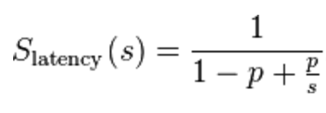
What is scalability?
Application does N times as much work on N cores as it could on 1 core
Scalability may be limited by Amdahl's Law:
  Locks, shared data structures, ... Shared hardware (DRAM, NIC, ...)

Slide 5
Locking
Why do kernels normally use locks?
Locks support a concurrent programming style based on mutual exclusion
  Acquire lock on entry to critical sections
  Release lock on exit
  Block or spin if lock is held
  Only one thread at a time executes the critical section
Locks prevent concurrent access and enable sequential reasoning about critical section code

Slide 6
Sample: SEND & RECEIVE
Bounded Buffer
  Shared between modules
  Producers and consumers
Race Condition
  If multiple writers
  Using lock to ensure single writer principle
Locking
  ACQUIRE & RELEASE
  Need atomicity
    RSM: read-set-memory

Slide 7

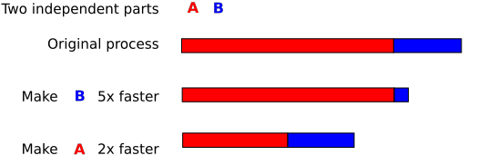
Amdahl's Law

Slide 8
Critical-section efficiency
Lock Acquisition (T_{a} )
Critical Section (T_{c} )
Lock Release (T_{r} )
T_{c}
Critical-section efficiency =
T_{c}+T_{a}+T_{r}
Ignoring lock contention and cache conflicts in the critical section

Slide 9
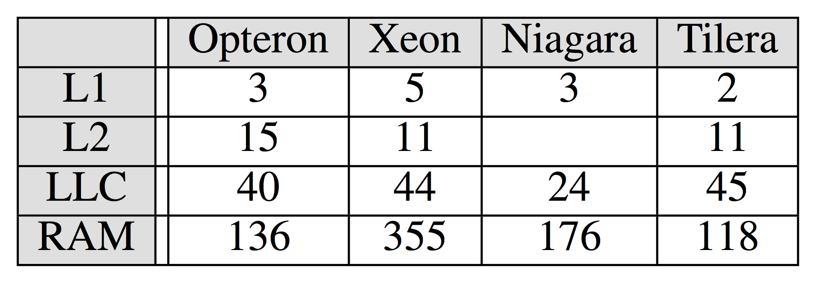
Some numbers you may want to know
Source: Everything you always wanted to know about synchronization, but were afraid to ask. [SOSP'13]

Slide 10
Shared Memory Multiprocessors
P
1
P
n
Scale
Switch
(Interleaved)
P
First-level $
P
1
n
(Interleaved)
$
$
Main memory
Inter
connection network
Shared Cache
Mem
Mem
Centralized Memory
Dance Hall, UMA
P
1
P
n
Mem
$
Mem
$
Inter
connection network
Distributed Memory (NUMA)

Slide 11
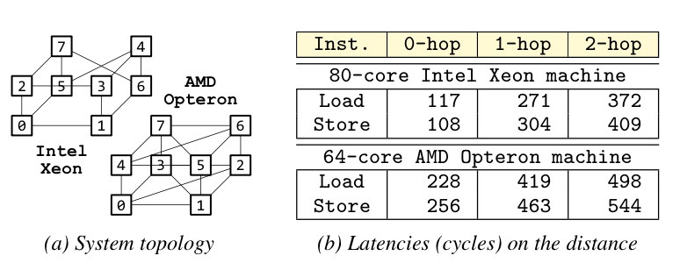
More numbers you may want to know

Slide 12
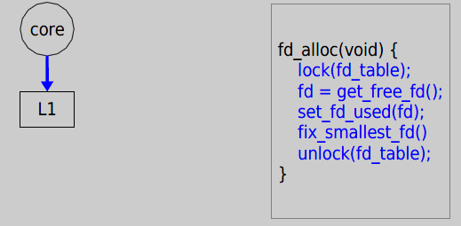
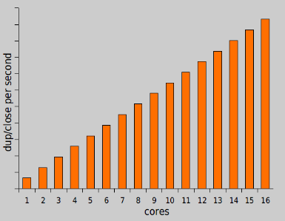
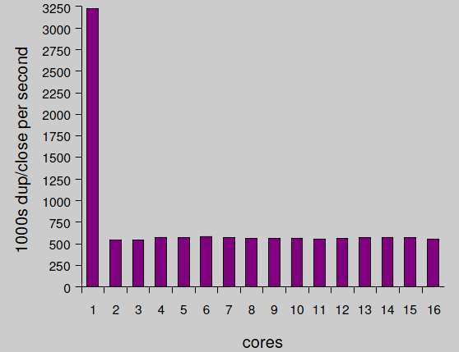
Motivating example: file descriptors
Ideal FD performance graph
Actual FD performance

Slide 13
Why throughput drops?
Load fd_table data from L1 in 3 cycles.

Slide 14
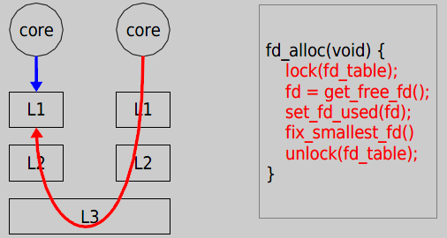
Why throughput drops?
Now it takes 121 cycles!

Slide 15
Non-scalable Locking are dangerous

Slide 16
Cause: Non-scalable locks
Non-scalable locks
Such as spin locks
Poor performance when highly contended
Many systems are using non-scalable locks
But they are dangerous

Slide 17
Why dangerous
Lead to performance collapse when adding a few more cores
Even tiny critical section will also lead to this performance collapse

Slide 18
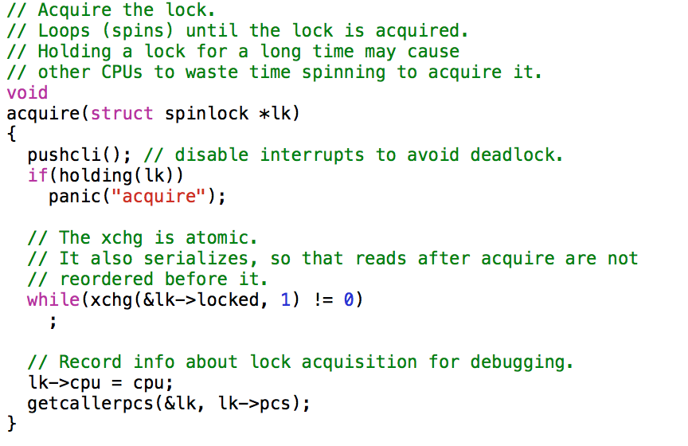
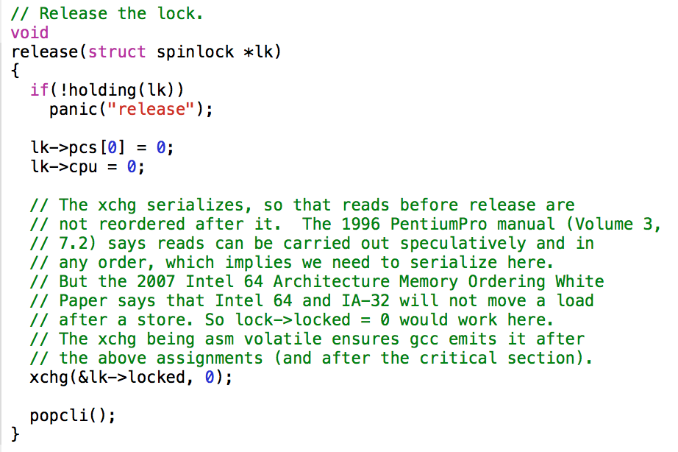
Xv6 locking

Slide 19
Case study: ticket spinlock
Normal spinlock has extremely noticeable unfairness
  Even on a 8-core CPU
Ticket spinlock guarantees lock are granted to acquirers in order
  Used in Linux kernel
But it’s non-scalable lock
Notes:
Reference http://lwn.net/Articles/267968/

Slide 20
Pseudo code for ticket lock
struct spinlock_t {
int current_ticket;
int next_ticket;
}
void spin_lock(spinlock_t *l) {
int t = atomic_xadd(&l->next_ticket);
while (t != l->current_ticket)
; // spin
}
void spin_unlock(spinlock_t *l) {
l->current_ticket++;
}

Slide 21
Pseudo code for ticket lock
struct spinlock_t {
int current_ticket;
int next_ticket;
}
Currently serving which one
Ticket for the next comer
void spin_lock(spinlock_t *l) {
int t = atomic_xadd(&l->next_ticket);
while (t != l->current_ticket)
; // spin
}
Add and get
original value
void spin_unlock(spinlock_t *l) {
l->current_ticket++;
}

Slide 22
Background on cache coherence
On multi-core processors, each core has its own private cache
Need to keep the cache content in sync when some CPU modifies some memory
Accomplished by cache coherence protocol

Slide 23
Example Cache Coherence Problem
P
1
P
2
P
3
u
= ?
u
= ?
3
$
4
$
5
$
u
:5
u
:5
u
= 7
1
I/O devices
u
:5
2
Memory
Notes:
Questions: how does P1/P2 know which processor or memory hold the most recent versions?

Slide 24
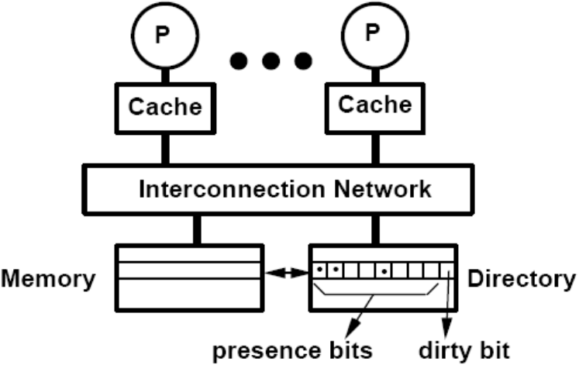
Directory-based cache coherence

Slide 25
Directory-based cache coherence
Store
Shared

Slide 26
Directory-based cache coherence
Store
Shared

Slide 27
Directory-based cache coherence
Store
Modified

Slide 28
Directory-based cache coherence
Load
Modified

Slide 29
Directory-based cache coherence
Load
Probe message
Modified

Slide 30
Directory-based cache coherence
Load
Read response
Modified

Slide 31
Directory-based cache coherence
Load
Read response
Shared

Slide 32
A few notes on cache coherence
There may be more than a single directory
  Especially for NUMA systems
Interconnect structure affects cache coherence performance
Directory is just one possible implementation
  Snooping is another commonly used approach

Slide 33
Intuition of the collapse
Key point: read with modified cache line have to get data back from the owner
  Coherence message are processed sequentially
Lock holder modifies cache holding the lock
Waiter is trying to read the lock
  They get value of the lock from the lock holder
  More readers means the next lock holder needs to wait more time to get the lock

Slide 34
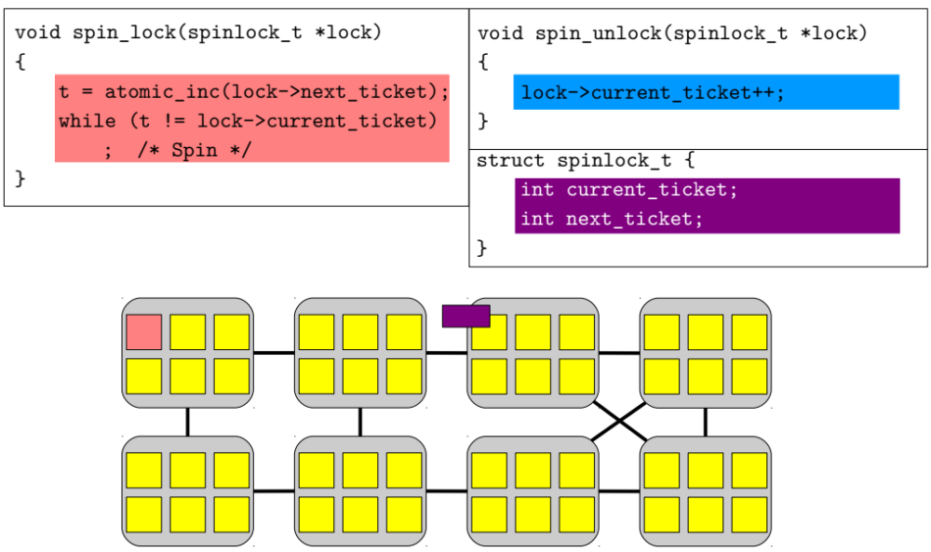
Allocate a ticket
read current ticket and spin

Slide 35
Allocate a ticket
read current ticket and spin
cache coherence message

Slide 36
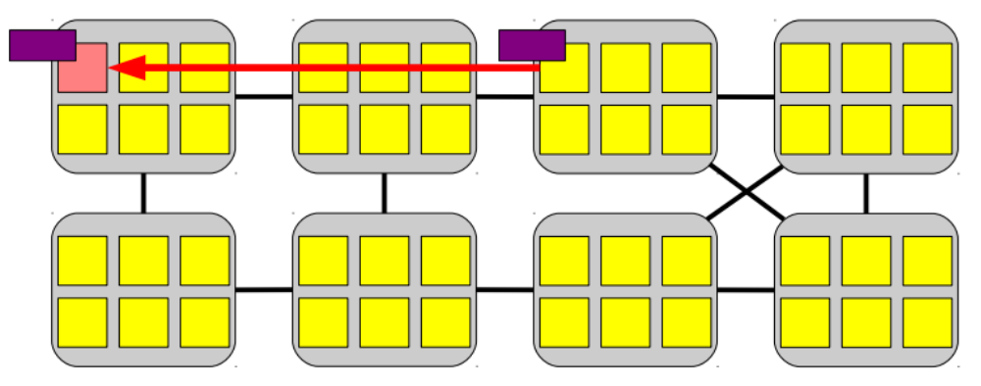
Allocate a ticket
read current ticket and spin
cache coherence message

Slide 37
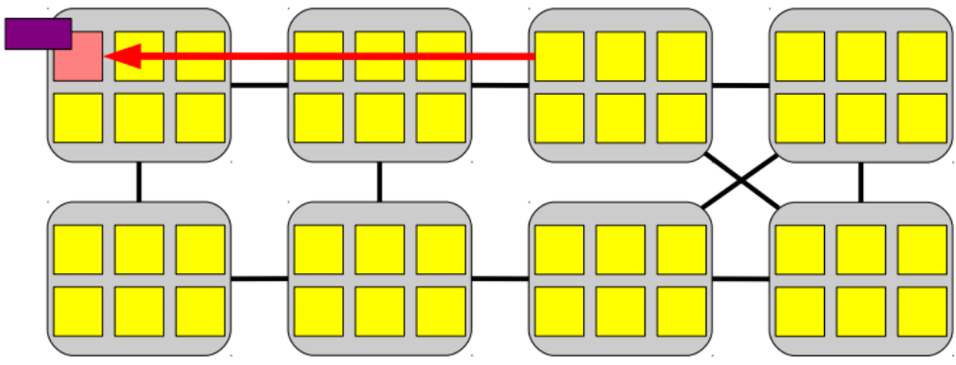
Allocate a ticket
read current ticket and spin
120 ~ 420 cycles

Slide 38
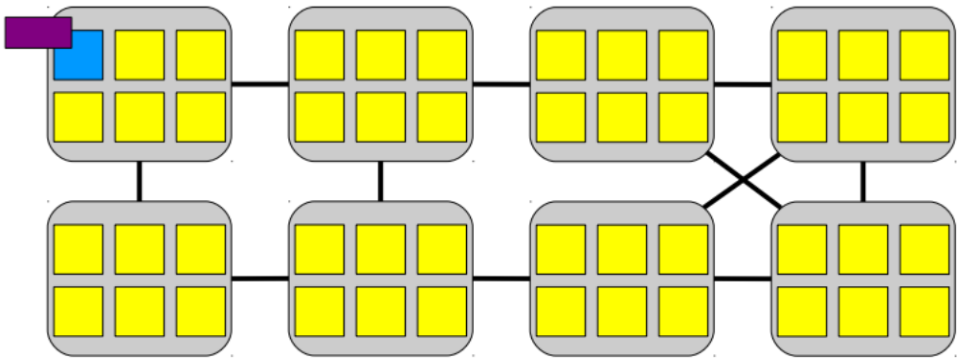
update the ticket value

Slide 39
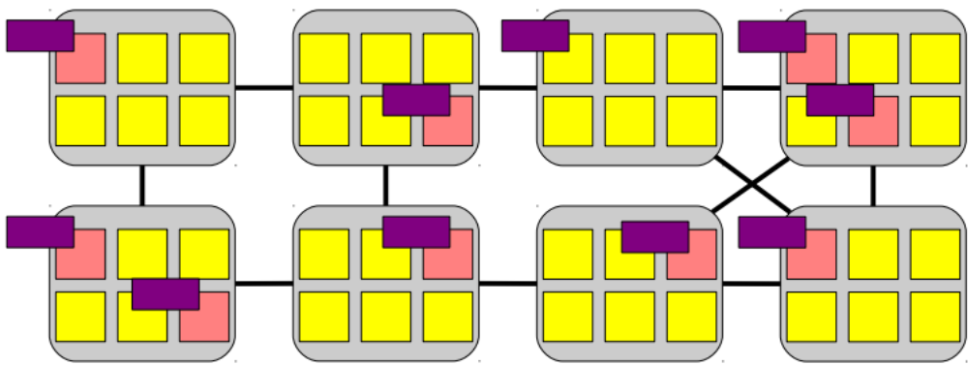
Lock shared by all core

Slide 40
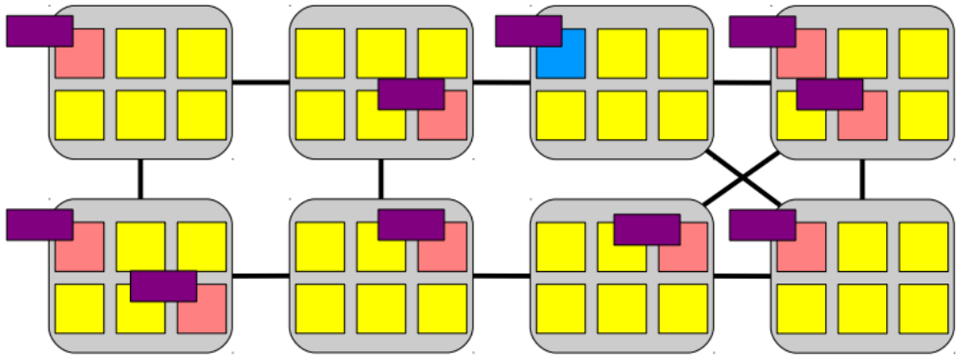
Lock holder update ticket

Slide 41
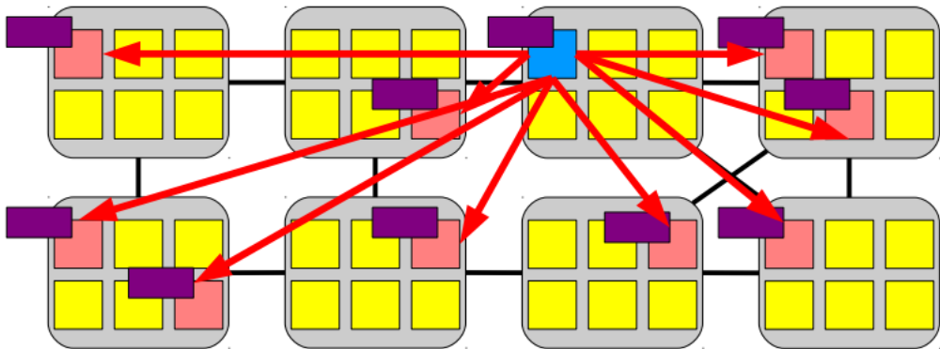
Invalidate message
Lock holder update ticket

Slide 42
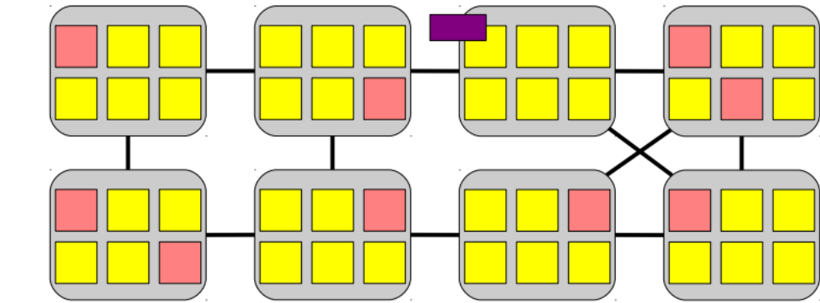
Only lock holder has lock in cache
Lock holder update ticket

Slide 43
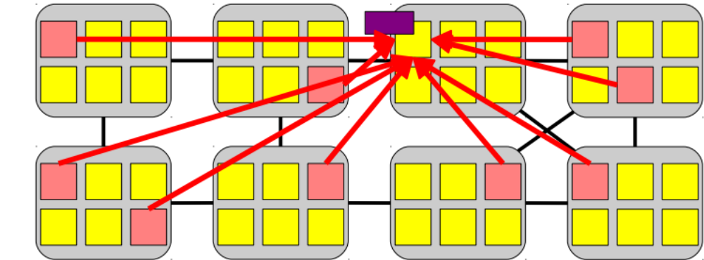
All waiters read the lock

Slide 44

500 ~ 4000 cycles!
All waiters read the lock

Slide 45

Reply read request one by one
All waiters read the lock

Slide 46
Reply read request one by one
All waiters read the lock

Slide 47
Previous lock holder notifies next
lock holder after sending out
N/2 replies
All waiters read the lock

Slide 48
Scalable Locking

Slide 49
Making ticket spinlock scalable
Common way: use proportional back-off
Why this would work?
Is this a good way?
void spin_lock(spinlock_t *l) {
int t = atomic_xadd(&l->next_ticket);
while (t != lock->current_ticket)
// wait more time with each failure
;
}

Slide 50
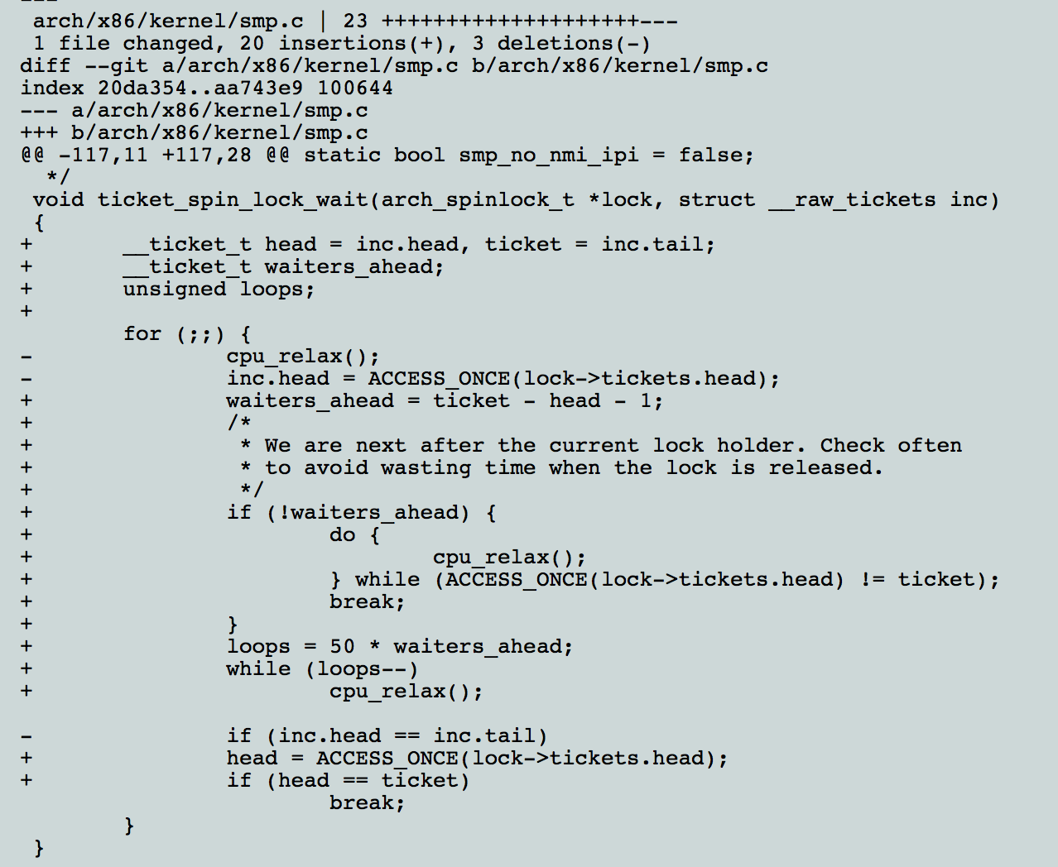
Example Fix

Slide 51
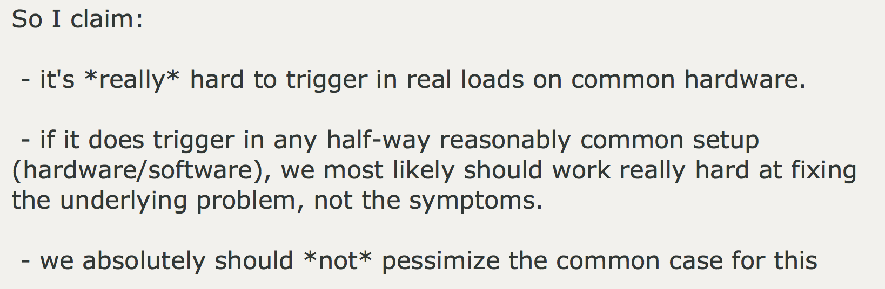
Linus’ Response
http://linux-kernel.2935.n7.nabble.com/PATCH-v5-0-5-x86-smp-make-ticket-spinlock-proportional-backoff-w-auto-tuning-td596698i20.html

Slide 52
Using scalable locks
Many existing scalable locks
Main idea is to avoid contending on a single cache line
Example
  MCS (John M. Mellor-Crummey and Michael L. Scott)
  K42

Slide 53
General idea of MCS lock
mcs_lock
NULL

Slide 54
General idea of MCS lock
Use compare and swap to change
mcs_lock point to self node
Check previous node
NULL in this case, no need to wait
mcs_lock
waiting: 0
next: NULL

Slide 55
General idea of MCS lock
mcs_lock
Previous node is not NULL
Current waiting is 1
Wait until lock holder
set waiting to 0
waiting: 0
next:
waiting: 1
next: NULL

Slide 56
General idea of MCS lock
mcs_lock
Previous node is not NULL
Current waiting is 1
Wait until lock holder
set waiting to 0
waiting: 0
next:
waiting: 0
next: NULL

Slide 57
General idea of MCS lock
mcs_lock
Previous node is not NULL
Current waiting is 1
Wait until lock holder
set waiting to 0
waiting: 0
next: NULL

Slide 58
Code
mcs_node{
mcs_node next;
int is_locked;
}
mcs_lock{
mcs_node queue;
}
function lock(mcs_lock lock, mcs_node my_node){
my_node.next = NULL;
mcs_node predecessor =
fetch_and_store(lock.queue, my_node);
if(predecessor != NULL){
my_node.is_locked = true;
predecessor.next = my_node;
while(my_node.is_locked){};
}
}

Slide 59
function unlock(mcs_lock lock, mcs_node my_node){
if(my_node.next == NULL){
if(compare_and_swap(lock.queue, my_node, NULL){
return;
}else{
while(my_node.next == NULL){};
}
}
my_node.next.is_locked = false;
}

Slide 60

MCS Locks
1-R
L
2-B
2-R
3-B
3-R
3-E
4-R
4-B
function unlock(mcs_lock lock, mcs_node my_node){
if(my_node.next == NULL){
if(compare_and_swap(lock.queue, my_node, NULL){
return;
}else{
while(my_node.next == NULL){};
}
}
my_node.next.is_locked = false;
}
5-B

Slide 61
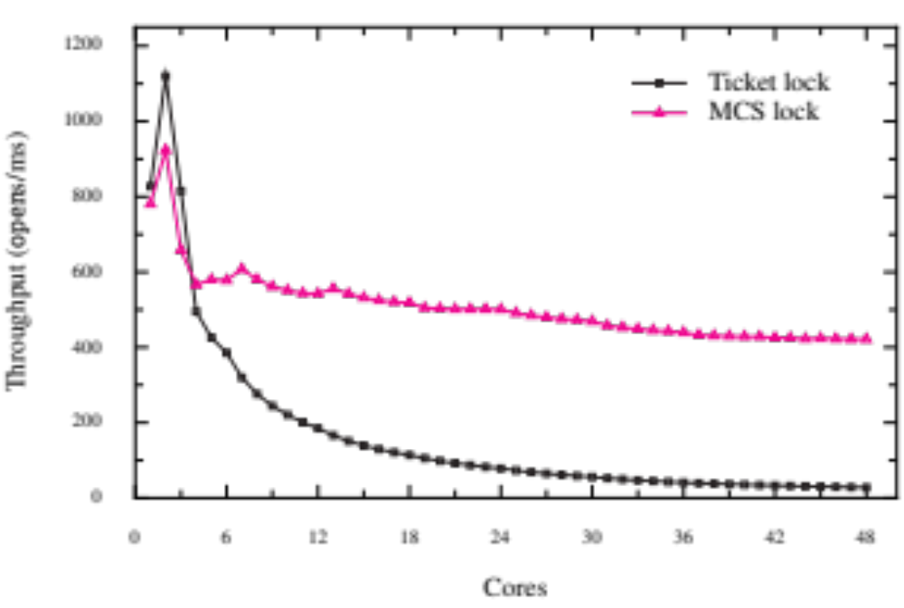
Using scalable locks: FOPS

