Slide 1
OS Structures
Haibo Chen

Slide 2
Review
Why OS is important?
8 important problems in OS

Slide 3
Operating System Design and Implementation
Design and Implementation of OS not “solvable”, but some approaches have proven successful
  Internal structure of different Operating Systems can vary widely
  Start by defining goals and specifications
  Affected by choice of hardware, type of system
Remember “Worse is better design”

Slide 4
Operating System Design and Implementation
User goals and System goals
  User goals
    operating system should be convenient to use, easy to learn, reliable, safe, and fast
  System goals
    operating system should be easy to design, implement, and maintain, as well as flexible, reliable, error-free, and efficient

Slide 5
Operating System Design and Implementation (Cont.)
Important principle to separate
Policy: What will be done?
Mechanism: How to do it?
Mechanisms determine how to do something
Policies decide what will be done
  The separation of policy from mechanism is a very important principle
  It allows maximum flexibility if policy decisions are to be changed later
Notes:
E.g., scheduling mechanism VS. scheduling policy; network package filter; cache policy

Slide 6
Kernels
Kernel classification (wikipedia)
Monolithic kernel
  A monolithic kernel is an operating system architecture where the entire operating system is working in kernel space and is alone in supervisor mode.
    Linux, BSD…
Kernel (architecture) | Monolithic | Microkernel | Exokernel | hybrid

Slide 7
Kernels
Microkernel
  is the near-minimum amount of software that can provide the mechanisms needed to implement an operating system (OS).
  low-level address space management, thread management, and inter-process communication (IPC) and so on …
  Mach, L4 kernel
Hybrid kernel
  is a kernel architecture based on combining aspects of microkernel and monolithic kernel architectures used in computer operating systems.
  Windows NT kernel

Slide 8
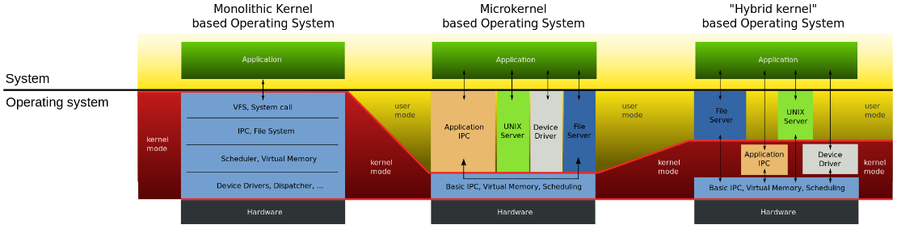

Slide 9


Simple Structure
MS-DOS – written to provide the most functionality in the least space (1981~1994)
  Not divided into modules
  Although MS-DOS has some structure, its interfaces and levels of functionality are not well separated

Slide 10
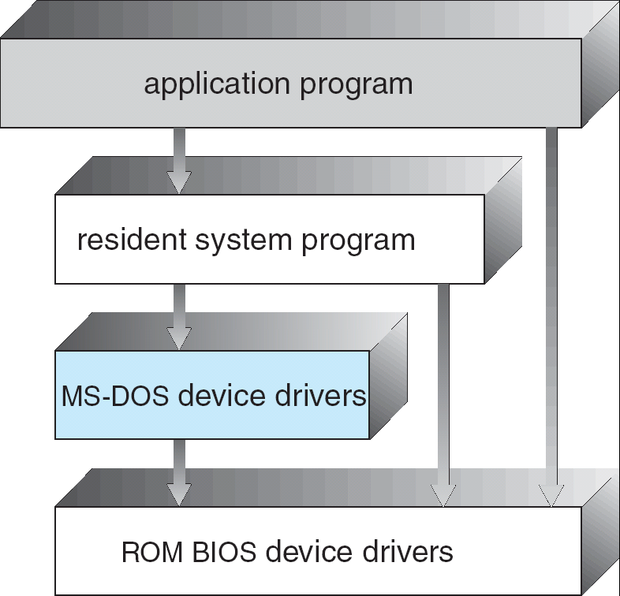
MS-DOS Layer Structure

Slide 11
Layered Approach
The operating system is divided into a number of layers (levels)
  Each built on top of lower layers
  The bottom layer (layer 0), is the hardware
  The highest (layer N) is the user interface
With modularity, layers are selected such that
  each uses functions (operations) and services of only lower-level layers

Slide 12
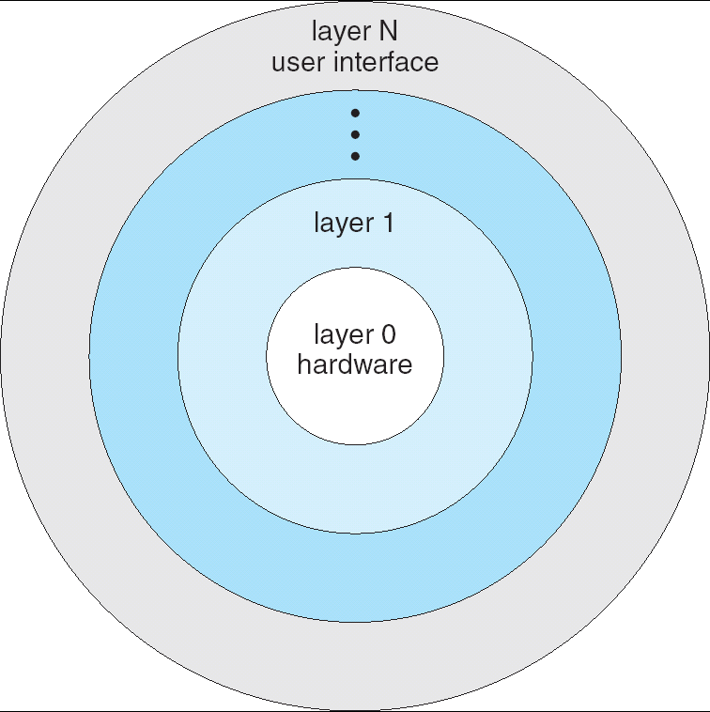
Layered Operating System

Slide 13
UNIX
UNIX – limited by hardware functionality
  the original UNIX operating system had limited structuring.
The UNIX OS consists of two separable parts
  Systems programs
  The kernel
    Consists of everything below the system-call interface and above the physical hardware
    Provides the file system, CPU scheduling, memory management, and other operating-system functions; a large number of functions for one level

Slide 14
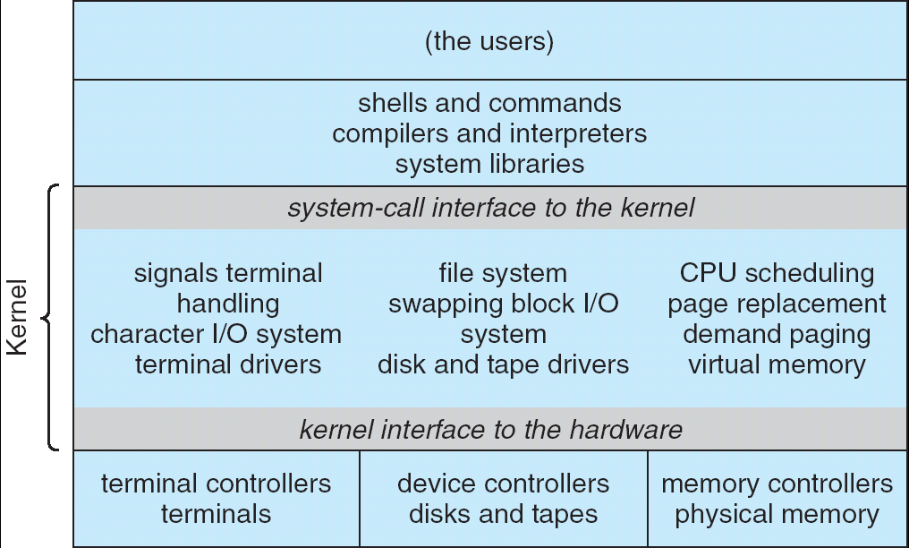
UNIX System Structure

Slide 15
Microkernel System Structure
Moves as much from the kernel into “user” space
Communication takes place between user modules using message passing
Benefits:
  Easier to extend a microkernel
  Easier to port the operating system to new architectures
  More reliable (less code is running in kernel mode)
  More secure
Detriments:
  Performance overhead of user space to kernel space communication

Slide 16
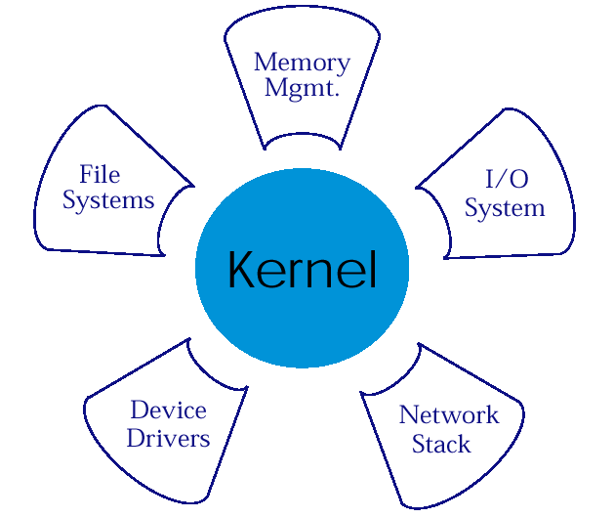
Microkernel Structure & Instances
APP1
APPn
LPC
APP2
APP4
HAL
APP3

Slide 17
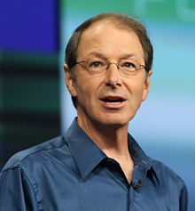
Mach
Developed at CMU
Led by Rick Rashid
  Now VP of research at Microsoft
Initial release: 1985
Big impact (as we will see)
Rick Rashid

Slide 18
What does a microkernel (Mach) do?
Task and thread management:
  Task (process) unit of allocation
  Thread, unit of execution
  Implements CPU scheduling: exposed to apps
    Applications/environments can implement their own scheduling policies
Interprocess communication (IPC)
  Between threads via ports
  Secured by capabilities

Slide 19
What does a microkernel (Mach) do?
Memory object management:
  Essentially virtual memory
  Persistent store accessed via IPC
System call redirection:
  Enable to trap system calls and transfer control to user mode
  Essentially enable applications to modify/extend the behavior and functionality of system calls, e.g.,
    Enable binary emulation of environments, tracing, debugging

Slide 20
What else does a microkernel (Mach) do?
Device support:
  Implemented using IPC (devices are contacted via ports)
  Support both synchronous and asynchronous devices
User multiprocessing:
  Essentially a user level thread package, with wait()/signal() primitives
  One or more user threads can map to same kernel thread
Multicomputer support:
  Can map transparently tasks/resources on different nodes in a cluster

Slide 21
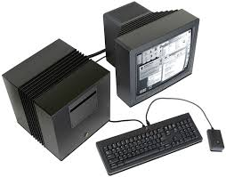
Mach 2.5
Contains BSD code compatibility code, e.g., one-to-one mapping between tasks and processes
Some commercial success:
  NeXT
    Steve Jobs’ company after he left Apple
    Used by Tim Berners-Lee to develop WWW
  Encore, OSF (Open Software Foundation), …

Slide 22
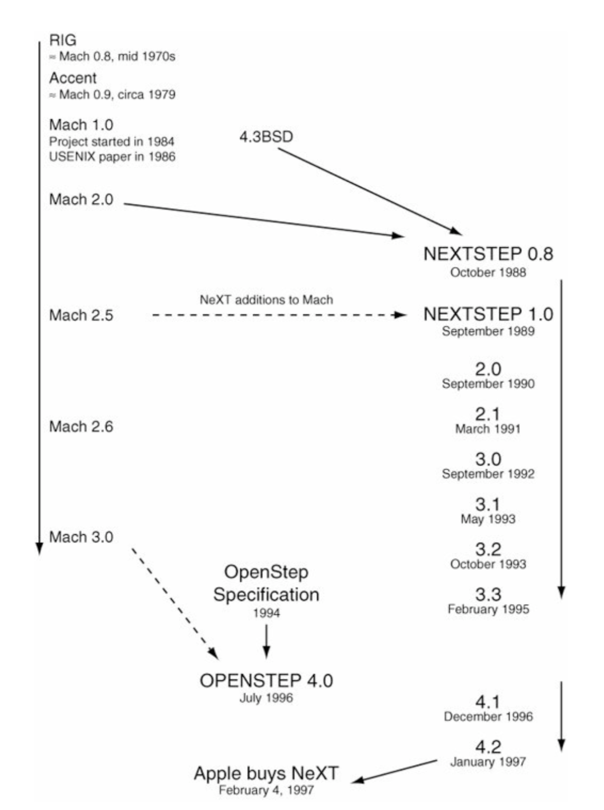
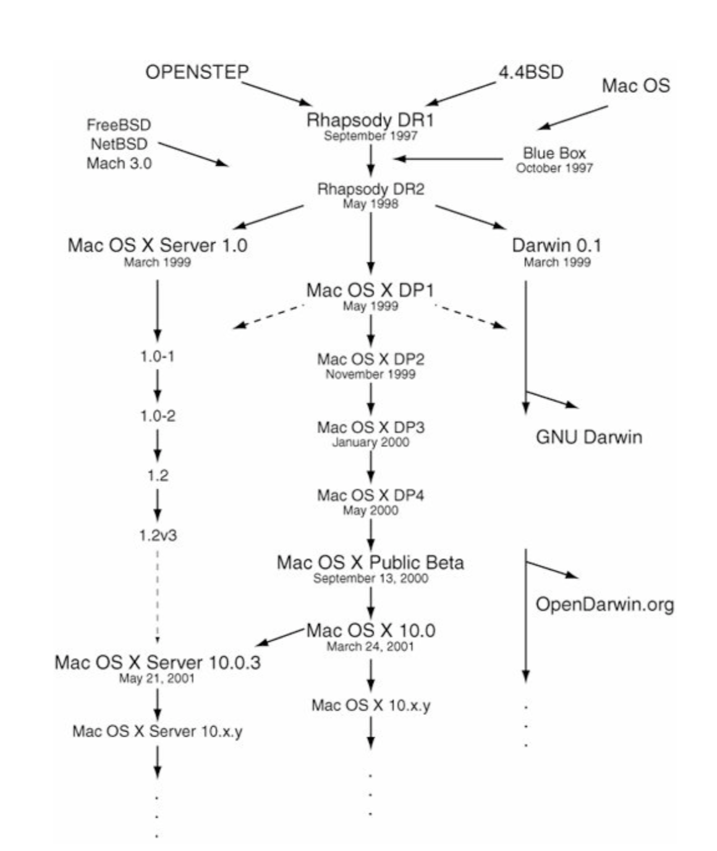
The Evolution of MacOS/iOS

Slide 23
Mach 3
Eliminate BSD code
Rewrite IPC to improve performance
  RPC on (then) contemporary workstations: 95 usec
Expose device interface
Provide more control to user applications via continuation:
  Address of an user function to be called when thread is rescheduled plus some data: essentially a callback
  Enable application to save restore state, so that the microkernel doesn’t need to do it, e.g., saving and restoring register state

Slide 24
OSes and Application Programs
Mach allows application to implement:
  Paging
  Control data cached by virtual memory
  …
Redirection allows call traps to link directly to executable binaries without modifying the kernel!
  Just need an emulation library

Slide 25
L3 -> L4

Slide 26
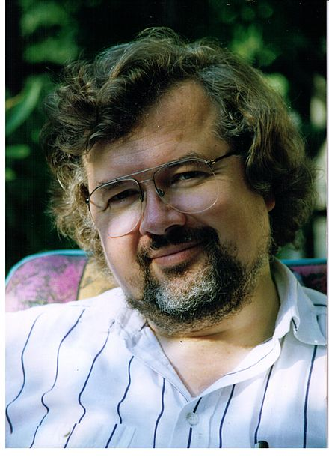
How it started? (1993)
Microkernels (e.g., Mach) still too slow
  Mostly because IPCs
Tide was turning towards monolithic kernels
Jochen Liedtke (GMD – Society for Mathematics and Information technology) aimed to show that IPC can be supper-fast
Jochen Liedtke

Slide 27
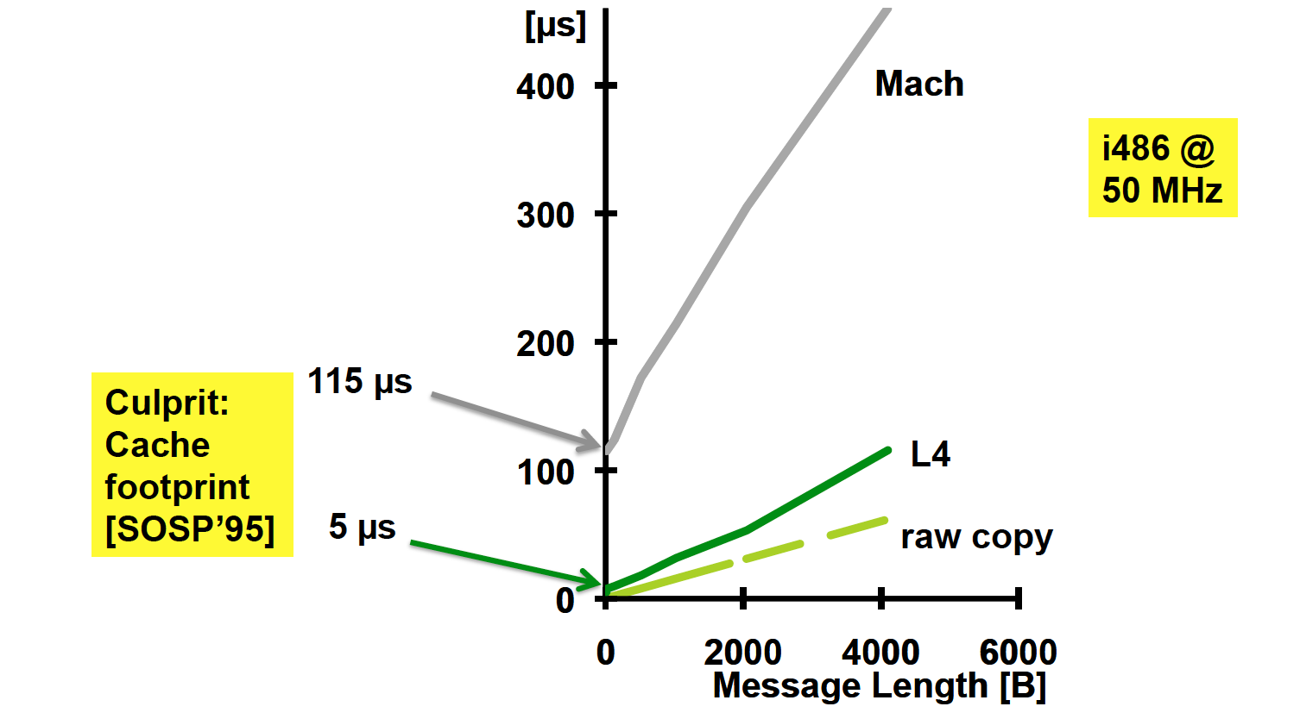

How fast?

Slide 28
How did he do it?
Synchronous IPC → Rendezvous model
Thread src
Thread dest
Running
Running
send(dest, msg)
Kernel copy
Wait
…
wait(src, msg)
Running
Running
Kernel executes in sender’s context
Copies memory data directly to receiver (single-copy)
Leaves message registers unchanged during context switch (zero copy)

Slide 29
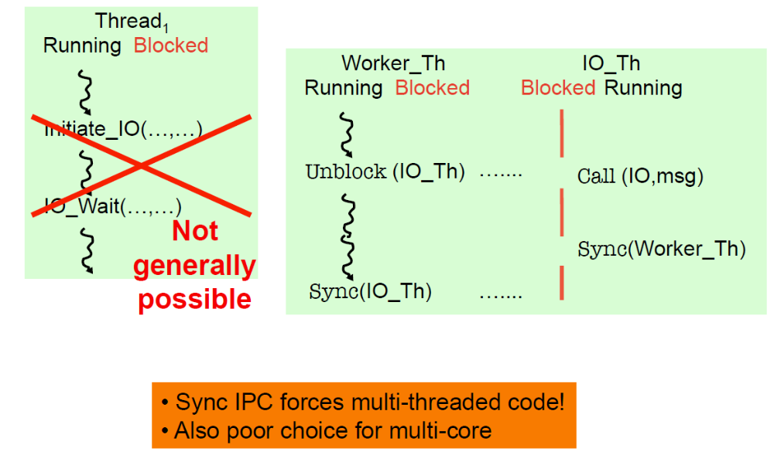
Synchronous IPC Issues
Sync IPC forces multi-threading model

Slide 30
Asynchronous IPCs
Disadvantages of synchronous IPCs
  Have to block on I/O operations
  Forces apps to use multithreading
  Poor choice for multicores (no need to block if IO executes on another core!)
Want async IPCs
  Want something like select()/poll()/epoll() in Unix
Thread
Running
initiate_IO(…)
wait_IO(…)
…
receive
msg

Slide 31
Async notifications
Thread
Sending is non-blocking and asynchronous
Receiver, who can block or poll for message
seL4: Asynchronous Endpoints (AEP)
  Single-word notification field
  Send sets a bit in notification field
  Bits in notification field are ORed → notification
  wait(), effectively select() across notification fields
Running
poll(…)
wait()
…
receive
msg
Added async notifications to complement syn IPCs

Slide 32
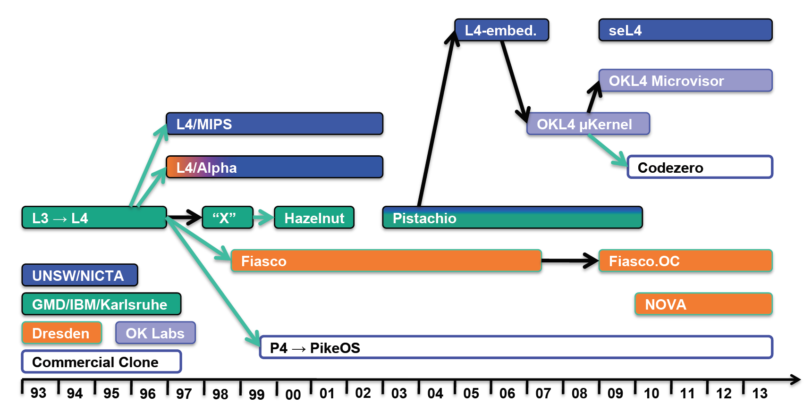
L4 family tree

Slide 33
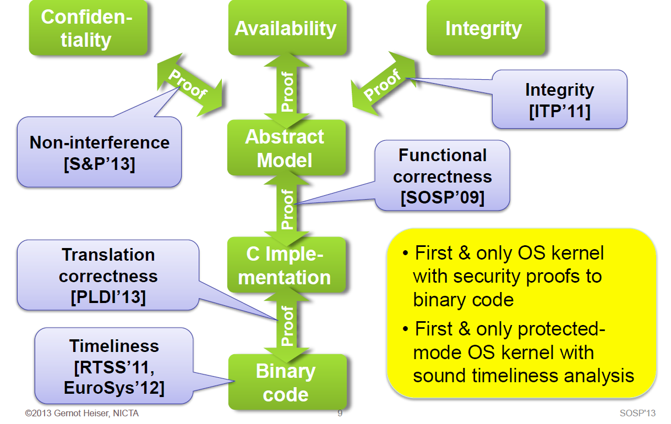
seL4: Unprecedented Dependability

Slide 34
So why didn’t take over entire world!
Hardware standardization:
  Intel and ARM dominating
  Less need for portability, one of main goals of Mach
Software standardization:
  Windows, MacOS/iOS, Linux/Android
  Less need to factor out common functionality
Maybe just a fluke?
  Linux could have been very well adopted the microkernel approach
  Philosophical debate between Linus and Andy Tanembaum
    One of Linus main arguments: there is only i386 I need to write code for!
(http://www.oreilly.com/openbook/opensources/book/appa.html)

Slide 35
Exokernel

Slide 36
Exokernel Structure
Overview
  let the kernel allocate the physical resources of the machine to multiple application programs, and
  let each program decide what to do with these resources.
  The program can link to an operating system library (libOS) that implements OS abstractions.
Exokernel: An operating system architecture for application-level resource management, SOSP’95
Notes:
Exokernel微内核的核心观点是：只要内核还提供对系统资源的抽象，就不能实现性能的最大优化 -- 内核应该支持一个最小的、高度优化的原语集，而不是提供对系统资源的抽象。从这个观点上来说，IPC也是一个太高级的抽象因而不能达到最高的性能。Exokernel微内核的核心是支持一个高度优化的原语名叫保护控制转移(protected control transfer, PCT)。PCT是一个不带参数的跨地址空间的过程调用，其功能类似于一个硬件中断。在PCT的基础上，可以实现高级的IPC抽象如RPC。在MIPS R3000处理器上，一个基于PCT的RPC实现了仅10µs的开销，而在同一硬件上运行的Mach RPC为95µs。

Slide 37
Exokernel & Corey
Exokernel [SOSP’95]
  Kernel classification
  Motivation
  Design and Implementation
  Evaluation
Corey [OSDI’08]
  Multi-core era and scalability problem
  Sharing and Address range
  Summery
Notes:
Papers about exokernel
exokernel

Slide 38
Motivation
Exokernel’s Motivation
  In traditional operating systems, only privileged servers and the kernel can manage system resources
  Un-trusted applications are required to interact with the hardware via some abstraction model
    File systems for disk storage, virtual address spaces for memory, etc.
  Application demands vary widely!!
    An interface designed to accommodate every application must anticipate all possible needs
Notes:
Traditional kernel은 application program이 abstraction model을 통해서만 hardware와 interact 할 수 있게 함
One option is to remove the kernel completely and program directly to the hardware, but then the entire machine would be dedicated to the application being written
Exokernel concept is a compromise

Slide 39
Exokernel’s Idea
Give un-trusted applications as much control over physical resources as possible
To force as few abstraction as possible on developers, enabling them to make as many decisions as possible about hardware abstractions.
  Let the kernel allocate the basic physical resources of the machine
  Let each program decide what to do with these resources
Exokernel separate protection from management
  They protect resources but delegate management to application
Notes:
Exokernel은 barebones system resources management라고도 불림(뼈대가 보이는 커널)
The program can than link to a support library that implements the abstractions it needs ( or it can implements its own).
protection and multiplexing of resources만 하면 되기때문에 필연적으로(side-effect로) tiny하다
Microkernels’ implementation of message passing
Monolithic kernels; implementation of abstractions
delegate : 위임하다

Slide 40
Library Operating System
Most programs to be linked with libraries instead of communicating with the exokernel directly
  The libraries hide low-level resources
An applications can choose the library which best suits its needs, or even build its own
The kernel only ensures that the requested resource is free, and the application is allowed to access it.
  Allow programmer to implement custom abstractions, omit unnecessary ones, most commonly to improve performance
Notes:
Wikipedia에 따르면 implemented application을 libOS라고 한다고 함.
The kernel only ensures that the requested resource is free, and the application is allowed to access it.
library는 그 자체로도 OS의 대부분의 기능을 수행하므로 libOS라고 불린다

Slide 41
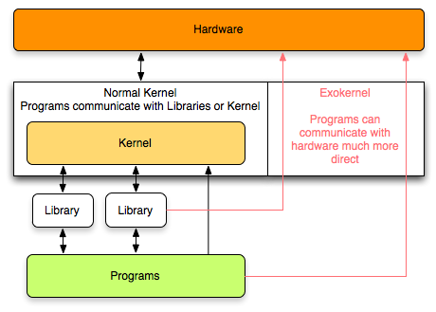
Exokernel Example 1
Exokernel give more direct access to the hardware, thus removing most abstractions
Notes:
Exokernel are much smaller than a normal kernel (monolithic kernel). They give more direct access to the hardware, thus removing most abstractions

Slide 42
Exokernel Example 2
Traditional OS
Apache
SQL Server
FIXED
Abstractions
Interface
Hardware

Slide 43
Exokernel Example 2
Exokernel + Library OS
Apache
SQL Server
Library OS
chosen from available
Library OS
customized for SQL Server
Abstractions
Interface
Abstractions
Interface
Exokernel
Hardware

Slide 44
Exokernel Design Challenge
Kernel’s new role
  Tracking ownership of resources
  Ensuring resource protection
  Revoking resource access
  Three techniques
    Secure binding
    Visible revocation
    Abort protocol
Notes:
An Exokernel employs three techniques to export resources securely. First, by using secure bindings, applications can securely bind to machine resources and handle events. Second, by using visible resource revocation, applications participate in a resource revocation protocol. Third, by using an abort protocol, and exokernel can break secure bindings of uncooperative applications by force.

Slide 45
Secure binding
It is a protection mechanism that decouples authorization from actual use of a resource
Can improve performance
  The protection checks involved in enforcing a secure binding are expressed in terms of simple operations that the kernel can implement quickly
  A secure binding performs authorization only at bind time, which allows management to be decoupled from protection
Three techniques
  Hardware mechanism, software caching, and downloading application code
Notes:
First, by using secure bindings, applications can securely bind to machine resources and handle events.

Slide 46
Visible resource revocation
A way to reclaim resources and break their(application & resources) secure binding
An exokernel uses visible revocation for most resources
  Traditionally, OS have performed revocation invisibly, de-allocating resources without application involvement
Dialogue between an exokernel and a library OS
  Library OS should organize resource lists
Notes:
Second, by using visible resource revocation, applications participate in a resource revocation protocol.

Slide 47
The abort protocol
An exokernel must also be able to take resources from library operating systems that fail to respond satisfactorily to revocation requests
If a library OS fails to respond quickly, the secure bindings need to be broken “by force”
An exokernel simply breaks all secure bindings to the resource and informs the library operating system
Notes:
Third, by using an abort protocol, and exokernel can break secure bindings of uncooperative applications by force.

Slide 48
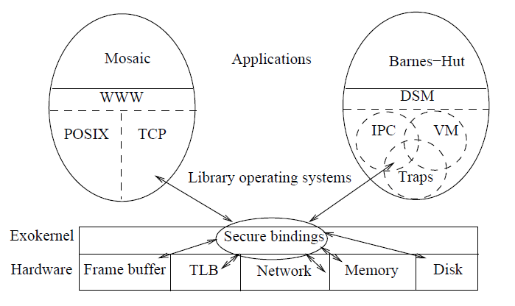
Exokernel Example 3
An example exokernel-based system consisting of a thin exokernel veneer that exports resources to library operating systems through secure bindings.
Notes:
Each library operating system implements its own system objects and policies. Applications link against standard libraries (e.g., WWW, POSIX, and TCP libraries for Web applications) or against specialized libraries (e.g., a distributed shared memory library for parallel applications).

Slide 49
Implementation
Prototype ( Xok / ExOS )
  Xok
    Exokernel
    Runs on x86 (Aegis runs on DEC)
    Safely multiplexes the physical resources
  ExOS
    Library OS
    Manages fundamental OS abstractions at application level
      completely within the address space of the application that is using it
Notes:
x86이랑 DEC이랑 다른 것은 page table이 하드웨어 적으로 접근이 되어서 page table에 접근 하는 건 어쩔 수 없이 system call을 해야한다는 것이라고.

Slide 50
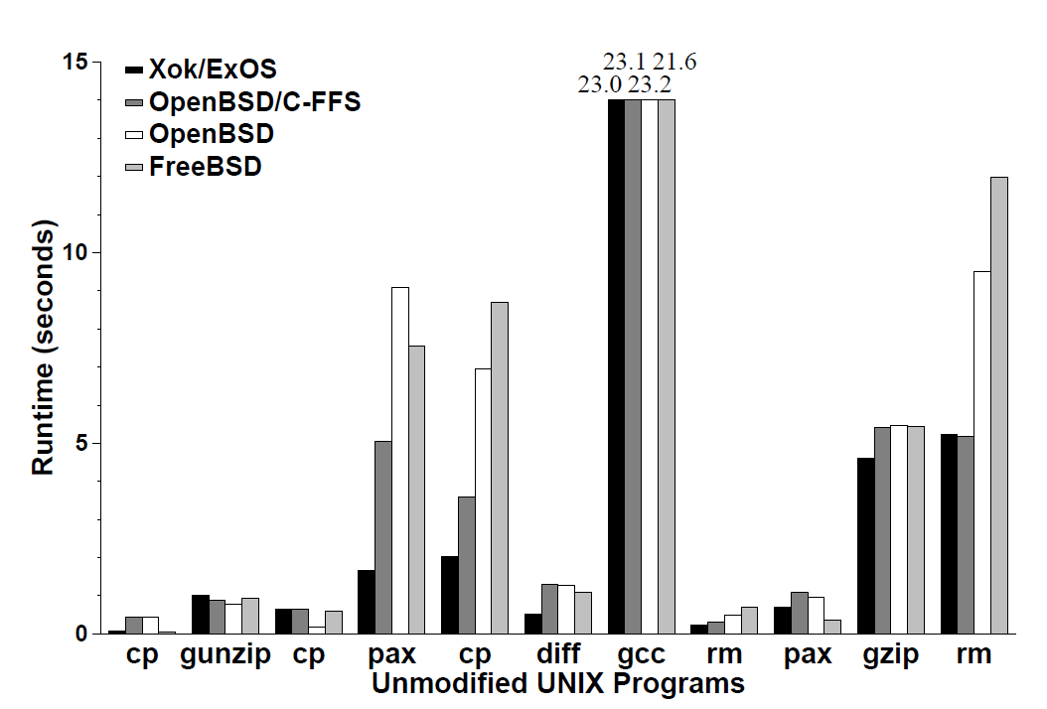
Evaluation
Application Performance and Flexibility on Exokernel Systems, SOSP’97

Slide 51
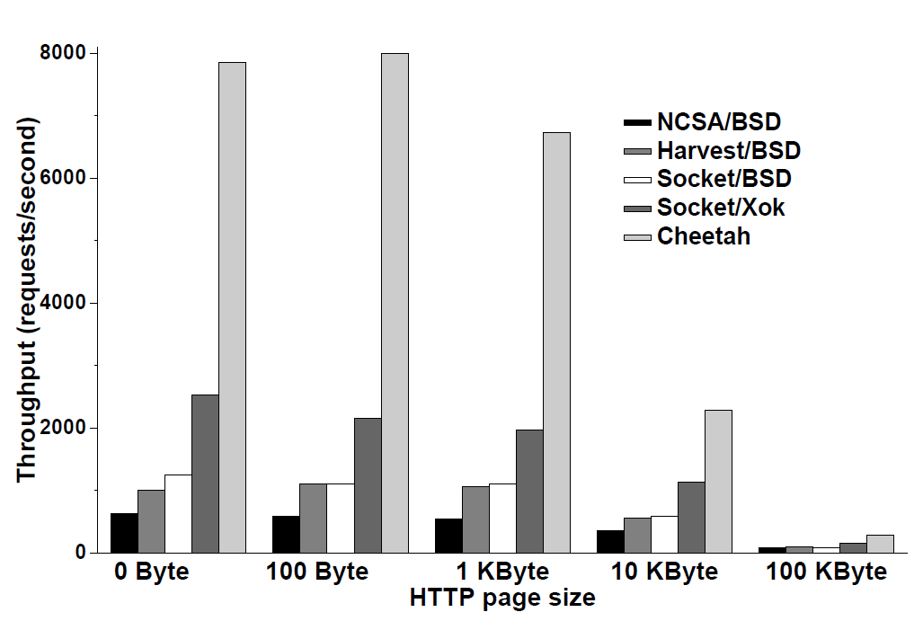
Evaluation
Application-level control can significantly improve the performance of applications

Slide 52
Criticisms of Exokernel
Customer-Support:
  “Extensibility has its problems. For example, it makes the customer-support issues a lot more complicated, because you no longer know which OS each of your customers is running” (Milojicic, 1999).

Slide 53
Comparison
OS
App
Logic
User-Mode
Kernel-Mode
DOS
UNIX
MicroKernel
ExoKernel
Notes:
Q1: what are difference? Consider file system, page fault handler, device driver, cpu scheduling
Q2: what is address space? Note that the kernel and apps share the same space
Q3: which one has the best performance
Q4: what is virtual machine’s architecture? Both Xen and KVM

Slide 54
Homework
Application can gain a better performance of memory and file system in exokernel compared with microkernel or monolithic kernel, why? And what's the price of performance profit?
Exokernel grants the applications more control over hardware resource. How does exokernel protect application against each other? And how to understand this goal of paper: to separate protection from management?
Open question - do you think why has not exokernel been as popular as monolithic kernel(Linux) and Hybrid kernel(Windows NT)?

Slide 55
References
Exokernel: an operating system architecture for application-speciﬁc resource management, SOSP’95
Application Performance and Flexibility on Exokernel Systems, SOSP’97
Corey: An Operating System for Many Cores, OSDI’05

Slide 56
Labs
Implement JOS: adopted from MIT 6.828 course
  Lab1: Booting a PC
  Lab2: Memory Management
  Lab3: User Environments
  Lab4: Preemptive Multitasking
  *Lab 5: XXX
  *Lab 6: XXX

Slide 57
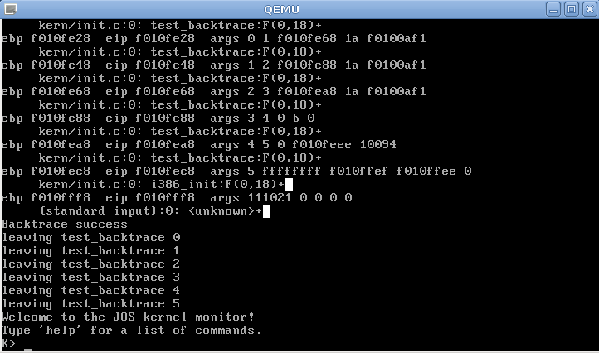
Lab 1 Boot a PC
Familiar with PC boot process

Slide 58
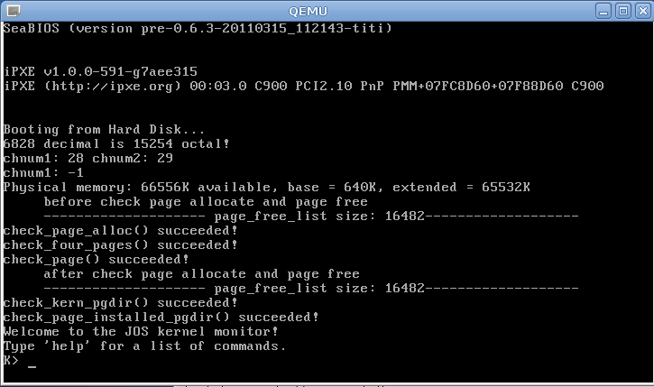
Lab2 Memory Management
Setup virtual memory map for JOS

Slide 59
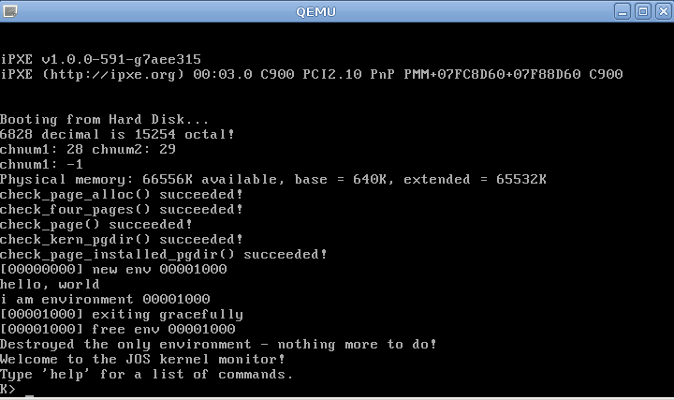
Lab3: User environment
Environment in JOS = Process in Linux
In this lab, only an environment on a single core

Slide 60
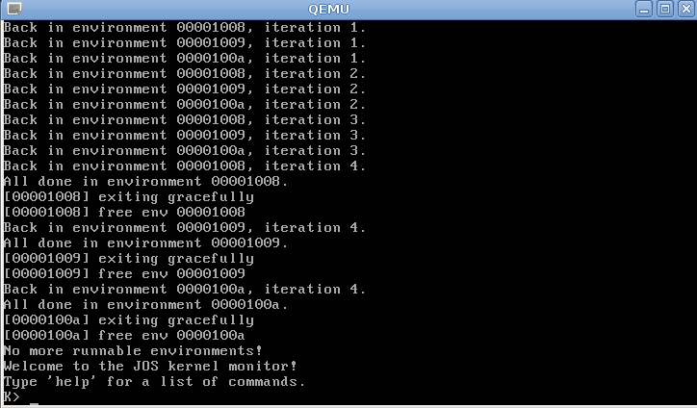
Lab4: Preemptive Multitasking
Multicore
Preemptive multitasking

Slide 61
Build your OS
Supporting code will be provided
Still a hard but interesting job
Hints: Start to work early and work hard

Slide 62
Lab Rules
Individual project
Don’t copy any code from others
Can read but don’t copy other OSes (Linux, Open/FreeBSD, etc.)
  Cite any code that inspired your code
Please don’t post any “攻略”or code

Slide 63

Grading
General (Tentative)
  Lab 1~4: 40%
  Final Exam：40%
    Labs will be reflected in exam
  Homework: 10%
    Help you to understand OS/Labs
  Course performance (5%)
    Q&A in classroom, Presentation
  Bonus (5%): Lab5 & Lab6
    Must finish both in order to get at least 80% scores
Notes:
63
28/02/2019

