Slide 1
Introduction to Virtualization
Yubin Xia
Software School
Shanghai Jiao Tong University
Some Slides adapted from VMWare’s academic course plan

Slide 2
The Reality (1)– Computer is powerful
Processor
  Core counts: about 20% per year
Memory
  DRAM capacity: about 60% per year (4x every 3 years)
  Memory speed: about 10% per year
  Cost per bit: improves about 25% per year
Disk
  capacity: about 60% per year
  Total use of data: 100% per 9 months!
Network Bandwidth
  Bandwidth increasing more than 50% per year! (Nielsen's Law)

Slide 3
The Reality (2) – Business Trend
Low utilization of Computers:
  Most are below 20%
  Think: why it’s Amazon, an e-commerce company, who develops cloud first?
Maintenance of machines is costly:
  ~5X to 10X cost of HW/SW
Service outages are frequent and expensive
  65% of IT managers report that their websites were unavailable to customers over a 6-month period
    25%: 3 or more outages
  social effects: negative press, loss of customers who “click over” to competitor

Slide 4




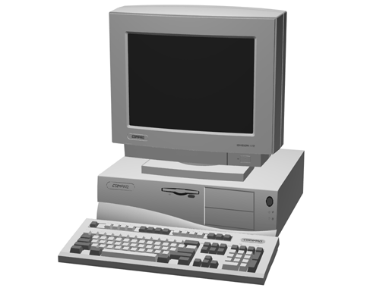
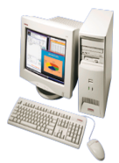

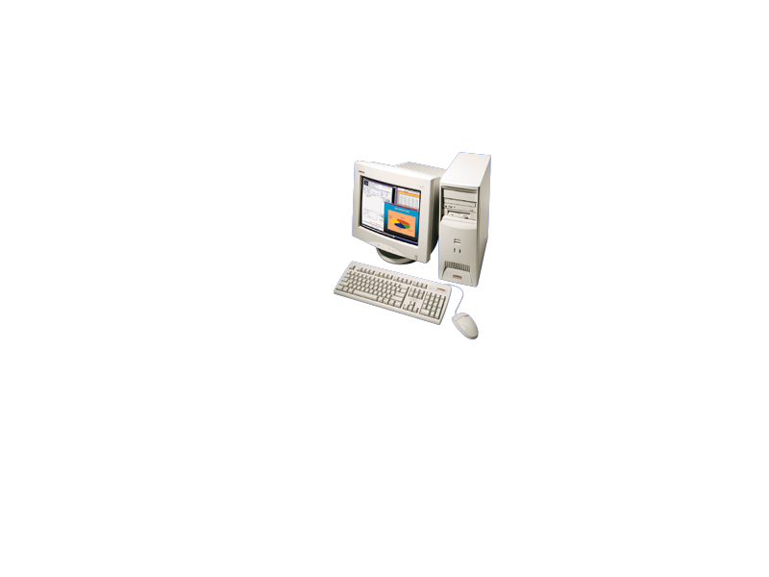
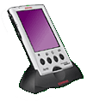

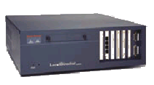




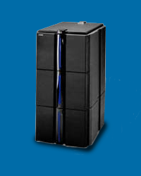
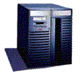
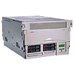

Why not virtualize?
Today’s
data center
Cloud
computing
Fault resist
Cost Effect
Easy to maintain
Virtual resource
pool

Slide 5
“Any problem in computer science can be solved with another level of indirection.”
  David Wheeler in Butler Lampson’s 1992 ACM Turing Award speech.

Slide 6
Outline
What is virtualization?
Virtualization classification
Monitor Architectures

Slide 7
What is Virtualization
Linux
Linux (devel)
XP
Vista
MacOS
Virtual Machine Monitor
Hardware
Notes:
Virtualization can be defined many ways. I will try to define it formally and also define it by giving a few examples. However loosely, virtualization is the addition of a software layer (the virtual machine monitor) between the hardware and the existing software that exports an interface at the same level as the underlying hardware.
In the strictest case the exported interface is the exact same as the underlying hardware and the virtual machine monitor provides no functionality except multiplexing the hardware among multiple VMs. This was largely the case in the old IBM VM/360 systems.
However the layer really can export a different hardware interface as the case in cross-ISA emulators. Also the layer can provide additional functionality not present in the operating system.
I think of virtualization as the addition of a layer of software that can run the original software with little or no changes.

Slide 8
Isomorphism
Guest
S_{i}
e(S_{i})
S_{j}
V(S_{i})
V(S_{j})
Host
S_{i}’
e’(S_{i}’)
S_{j}’
Formally, virtualization involves the construction of an isomorphism from guest state to host state.
Notes:
Virtualization software constructs an isomorphism from guest to host.
All guest state S is mapped onto host state S’ through some function V(S).
Additionally for every state changing operation e(S) in the guest there is a corresponding state changing operation e’(S’) in the host.
Virtualization software must implement V() and e().

Slide 9
Virtualization Properties
Isolation
Encapsulation
Interposition
Notes:
Virtualization has three main properties that give rise to all its applications.

Slide 10
Isolation
Fault Isolation
  Fundamental property of virtualization
Software Isolation
  Software versioning
  The DLL-Hell in Windows
Performance Isolation
  Accomplished through scheduling and resource allocation
Notes:
First, virtualization provides isolation. Isolation is key for many applications and comes in several flavors.
Fault Isolation. If one virtual machine contains a buggy operating system, that OS can start scribbling all over physical memory. These wild rights must be contained within the VM boundaries.
Performance Isolation. Ideally VMs performance would be independent of the activity going-on on the hardware. This must be accomplished by smart scheduling and resource allocation policies in the monitor.
Software Isolation. Most of the issues with computers today are complex software configurations. DLL hell on PCs, operating system and library versions, viruses, and other security threats. VMs are naturally isolated for each other by running in separate software environments.

Slide 11
Encapsulation
All VM state can be captured into a file
  Operate on VM by operating on file
  mv, cp, rm
Complexity
  Proportional to virtual HW model
  Independent of guest software configuration
Notes:
Encapsulation is the property that all VM state can be described and recorded simply. The VM state is basically the dynamic memory, static memory, and the register state of the CPU and devices. These items typically have a simple layout and are easy to describe. We can checkpoint a VM by writing out these items to a few files. The VM can be moved and copied by moving these files around. You can think about this as similar to doing a backup at the block level vs. doing a backup by recording all the packages, configuration and data files that encompass a file system.

Slide 12
Interposition
All guest actions go through monitor
Monitor can inspect, modify, deny operations
Enable
  Compression
  Encryption
  Profiling
  Translation
Notes:
At some level all access to the hardware passes through the monitor first. This gives the monitor and chance to operate on these accesses. The best example of this is encrypting all data written to a disk. The advantage of this is that it does it without the knowledge of the OS.

Slide 13
Why Not Using the OS?
It’s about interfaces
  VMMs operate at the hardware interface
  Hardware interface are typically smaller, better defined than software interfaces
Microkernel for commodity Operating Systems
Disadvantages of being in the monitor
  Semantic gap: VMM barely knows what guest is doing
  E.g., OS knows data and metadata, VMM not
Notes:
This brings up a good point. Why not do these things in the OS. By splitting up the system this way the OS functions more like a large application library. The VMM functions more like a smart set of device drivers. This is a nice split and can simplify overall system design. It also provides a natural administration boundary. However the monitor is often at a disadvantage because it does not have the same insight into what’s happening as the OS has. For example, the OS knows the distinction between data and metadata when implementing an encrypted file system. So there is a tradeoff there.

Slide 14
Virtualization benefits
Increased resource utilization:
  Server consolidation
Mobility
Enhanced Security
Trusted Computing
Test and Deployment
…

Slide 15
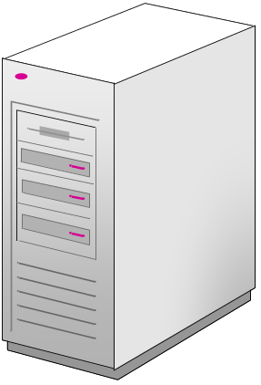
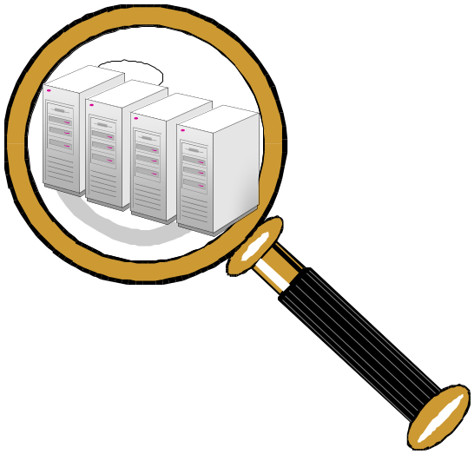
Virtualization: server consolidation
Physical Servers
Virtual Machines Guests
Virtual Server Host

Slide 16

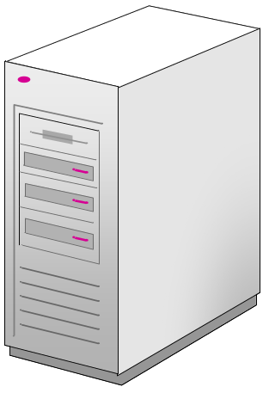



Mobility: load balance
Server 1
CPU Utilization =
Server 2
CPU Utilization =
90%
50%
70%
70%
VM Guest 1
VM Guest 2
None
VM Guest 3
VM Guest 4
VM Guest 5
None
VM Guest 2
VM Guest 6
VM Guest 7

Slide 17
Enhanced Security
Conventional
VM
Secure
VM
Firewall
VMM

Slide 18
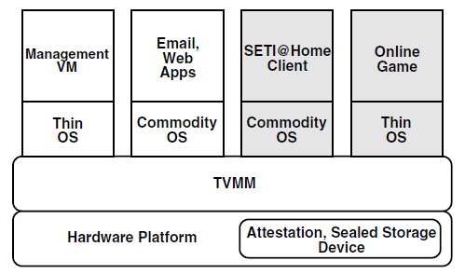
Trusted Computing

Slide 19
Testing and Deployment
Production
VM
Production
VM
Develop-
ment
VM
QA
VM
Production
VM
Production
VM
Develop
Test
Deploy

Slide 20
How to Virtualize

Slide 21
How to Virtualize?
Run an existing software component on another platform
  Component: applications, OS
  Platform: hardware, software
Keep isolation
  The component cannot access other’s data or environment
Keep transparency
  No modification to the software component

Slide 22
Architecture & Interfaces
API
Applications
Libraries
System Calls
ABI
Operating
System
ISA
System ISA
User ISA
Hardware
API – application programming interface
ABI – application binary interface
ISA – instruction set architecture

Slide 23
Architecture, Implementation Layers
Implementation Layer : ISA
  Instruction Set Architecture
  Divides hardware and software
  User ISA and System ISA
    User ISA example: mov $0, %eax
    System ISA examples: cli, sti, mov $0, %cr0

Slide 24
Architecture, Implementation Layers
Implementation Layer : ABI
  Application Binary Interface
  Provides a program with access to the hardware resource and services available in a system
  Consists of User ISA and System Call Interfaces
  Also contains calling convention

Slide 25
Architecture, Implementation Layers
Implementation Layer : API
  Application Programming Interface
  Key element is Standard Library ( or Libraries )
  Typically defined at the source code level of High Level Language
  clib in Unix environment : supports the UNIX/C programming language

Slide 26
Question: At Which Layer?
Hello world
Web game
Dota
Office 2013
Windows 8
Java applications
Python scripts
API
Applications
Libraries
System Calls
ABI
Operating
System
ISA
System ISA
User ISA
Hardware
Notes:
Web,python: API: underlying is library/runtime
Windows/Linux apps: ABI: underlying is OS
OS: ISA: underlying is hardware
Java: ABI/API underlying is JVM

Slide 27
What is a VM and Where is the VM?
What is “Machine”? 2 perspectives
From the perspective of a process:
  ABI provides interface between process and machine
From the perspective of a system:
  Underlying hardware itself is a machine
  ISA provides interface between system and machine

Slide 28
What is a VM and Where is the VM?
Machine from the perspective of a process
  ABI provides interface between process and machine
Application Software
Application
Programs
Libraries
System calls
Operating System
Drivers
Memory
Manager
Scheduler
User ISA
Execution Hardware
Machine
ABI
Memory
Translation
System Interconnect (Bus)
Controllers
Controllers
IO Devices,
Networking
Main Memory

Slide 29
What is a VM and Where is the VM?
Machine from the perspective of a system
  ISA provides interface between system and machine
Application Software
Application
Programs
Libraries
Operating System
Operating System
Drivers
Memory
Manager
Scheduler
System ISA
User ISA
ISA
Execution Hardware
Memory
Translation
Machine
System Interconnect (Bus)
Controllers
Controllers
IO Devices,
Networking
Main Memory

Slide 30
Types of Hypervisor

Slide 31
Types of Virtualization
Process Virtualization
  Language construction
    Java, .NET
  Cross-ISA emulation
    Apple’s 68000-PowerPC-Intel Transition
  Application virtualization
    Sandboxing, mobility
Device Virtualization
  RAID
System Virtualization
  VMware
  Xen
  Microsoft’s Hyper-V (aka. Viridian)
Notes:
In process virtualization, only a single process is run under the control of the virtualization software. Typically both the process and the virtualization software run at user level in the same context. The most common uses of process virtualization are language construction and cross-ISA emulation. Dynamic binary optimization has also become popular in the literature. Commercial another type of virtualization called Application Virtualization aims to offer the same benefits of system virtualization by does it at the application level.
Typically the operating system is responsible for creating levels of abstraction on top of the systems devices. However many of the techniques can be considered virtualization. For example when the exported interface is at the same level as the underlying interface, I would consider this device virtualization. Specifically, RAID is a type of disk virtualization. NAT is a type of network virtualization. These virtualizations can be components of a larger system virtualization or can be implemented at the lower level of the operating system.
System Virtualization aim to virtualize the entire system with enough accuracy to run largely unmodified operating systems on top.

Slide 32
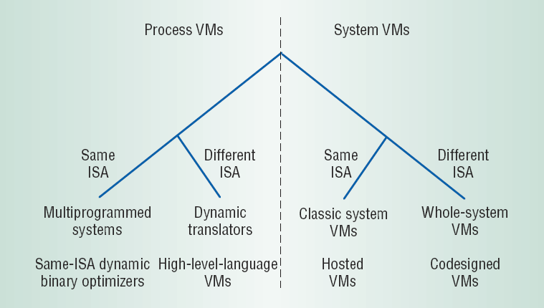
Design Space (Level vs. ISA)
API Interface
ABI Interface

Slide 33
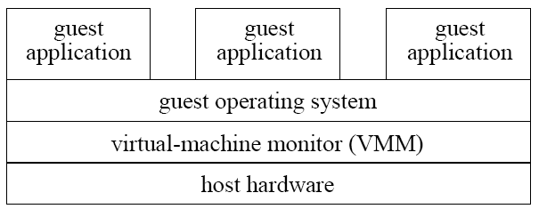
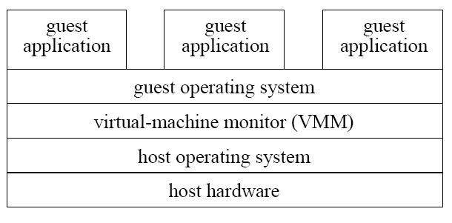
System VMMs
Type 1
Type 1: runs directly on hardware
  High performance
  e.g., Xen, VMware ESX Server
Type 2: runs on Host OS
  Ease of construction/installation
  e.g., VMware Workstation
Type 2

Slide 34
System Virtual Machine Monitor Architectures
Traditional
Hosted
  VMware Workstation
Hybrid
  VMware ESX
  Xen
Hypervisor

Slide 35
Different Architectures of VMM
VM-1
VM-2
VM-1
VM-2
VM-1
VM-2
VMM
VMM
VMM
Host OS
Host OS
VMM
Hardware
Hardware
Hardware
Xen
Linux KVM
Qemu

Slide 36
Type-1 Hypervisor (VMM)
Linux
Linux (devel)
XP
Vista
MacOS
Virtual Machine Monitor
Hardware
Notes:
Virtualization can be defined many ways. I will try to define it formally and also define it by giving a few examples. However loosely, virtualization is the addition of a software layer (the virtual machine monitor) between the hardware and the existing software that exports an interface at the same level as the underlying hardware.
In the strictest case the exported interface is the exact same as the underlying hardware and the virtual machine monitor provides no functionality except multiplexing the hardware among multiple VMs. This was largely the case in the old IBM VM/360 systems.
However the layer really can export a different hardware interface as the case in cross-ISA emulators. Also the layer can provide additional functionality not present in the operating system.
I think of virtualization as the addition of a layer of software that can run the original software with little or no changes.

Slide 37
Type-2: Hosted Virtual Machines
Goal:
  Run Virtual Machines as an application on an existing Operating System
Why
  Application continuity
  Reuse existing device drivers
  Leverage OS support
    File system
    CPU Scheduler
  VM management platform

Slide 38
Hosted Monitor Architecture
User App
Guest OS (Linux)
Host OS (Window XP)
Virtual Machine Monitor
Kernel Module
World Switch
Hardware
Notes:
The virtual machine monitor runs in its own address space at kernel level. The VMM time shares the hardware with the host. When the UserApp runs in the host, it switches to the VMM by way of a World Switch. The world switch save all the registers, page tables, etc of the host and then loads the state of the VMM. Initially the state of the VMM is setup up by the UserApp. This includes what the registers should be and the structure and contents of the page tables. When the VMM voluntarily gives up the CPU, it World Switches back to the host.

Slide 39
Hosted Monitor Architecture
User App
Guest OS (Linux)
Host OS (Window XP)
Virtual Machine Monitor
Kernel Module
CPU / Memory
Virtualization
Hardware
Notes:
All CPU and Memory virtualization is handled internally to the VMM for performance. This is the whole idea behind this architecture. The VMM has access to all the privileged state of the CPU to provide the fastest CPU/memory virtualization possible.

Slide 40
Hosted Monitor Architecture
User App
Guest OS (Linux)
Host OS (Window XP)
Virtual Machine Monitor
Kernel Module
Device I/O
Network, Disk,
Display, Keyboard, Timer, USB
Hardware
Notes:
To utilize OS abstractions and existing device drivers the VMM forwards all device requests to the UserApp. The UserApp then uses system call interfaces to access the devices.

Slide 41
Hosted Monitor Architecture
User App
Guest OS (Linux)
Host OS (Window XP)
Virtual Machine Monitor
Kernel Module
Interrupts
Hardware
Notes:
Because the VMM does not handle devices it simply forwards all interrupts on to the host.
Note the VMM must handle CPU generated exceptions like page faults and illegal instruction faults.

Slide 42
Hosted Monitor Scheduling
User App
User App
Guest OS (Linux)
Guest OS (Vista)
Host OS (Window XP)
Virtual Machine Monitor
Virtual Machine Monitor
Kernel Module
Hardware

Slide 43
Hosted Monitor Scheduling
3
User App
User App
Guest OS (Linux)
Guest OS (Vista)
Host OS (Window XP)
Virtual Machine Monitor
Virtual Machine Monitor
Kernel Module
1
CPU Scheduler
2
Hardware
Notes:
The CPU scheduler runs the blue UserApp .
The UserApp switches to its VMM.
The blue guest is run and gets CPU time.

Slide 44
Hosted Monitor Scheduling
User App
User App
Guest OS (Linux)
Guest OS (Vista)
Host OS (Window XP)
Virtual Machine Monitor
Virtual Machine Monitor
Kernel Module
5
CPU Scheduler
4
Hardware
Notes:
4. A time interrupt comes in.
5. The VMM forwards the timer interrupt to the host. The host scheduler runs.

Slide 45
Hosted Monitor Scheduling
8
User App
User App
Guest OS (Linux)
Guest OS (Vista)
Host OS (Window XP)
Virtual Machine Monitor
Virtual Machine Monitor
Kernel Module
6
7
CPU Scheduler
Hardware
Notes:
6. The host scheduler deschedules the blue UserApp and schedules the green UserApp.
7. The green UserApp switch to its VMM.
8. The green guest gets CPU Time
How is the time run in VM accounted for?

Slide 46
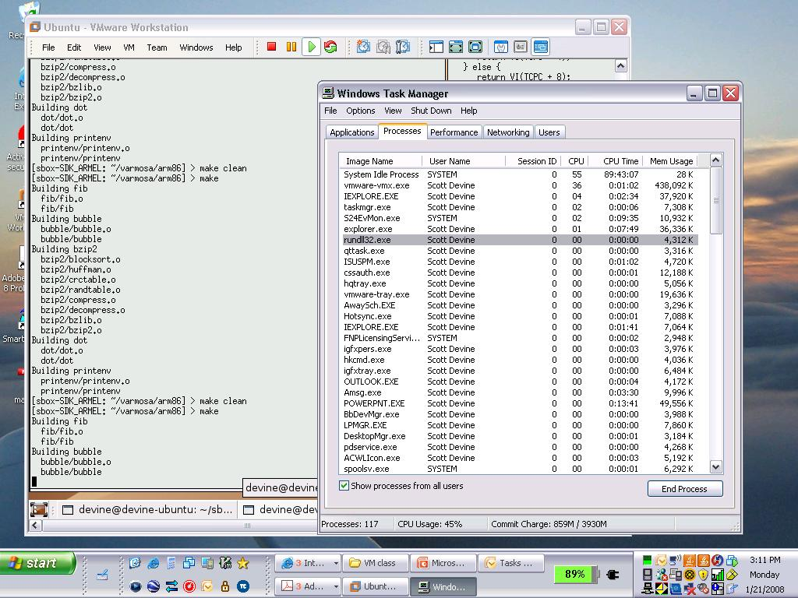
Notes:
The associated UserApp (VMX) gets it.

Slide 47
Hosted Architecture Tradeoffs
Positives
  Installs like an application
    No disk partitioning needed
    Virtual disk is a file on host file system
    No host-rebooting needed
  Runs like an application
    Uses host’s schedulers
Negatives
  I/O path is slow
    Requires many world switches
  Relies on host scheduling
    May not be suitable for intensive VM workloads

Slide 48
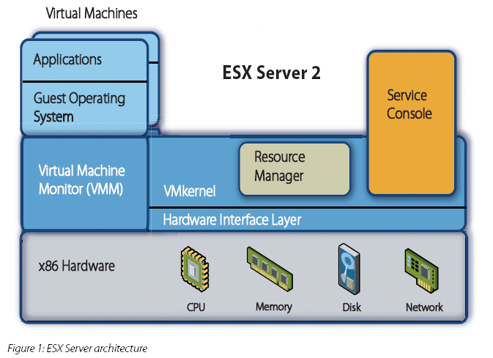
VMware ESX 2.0
Source: http://www.vmware.com/pdf/esx2_performance_implications.pdf
Notes:
Traditional arch for cpu scheduling, memory allocation, virtual disk, virtual network. Console OS is there for legacy devices, USB, and as a management platform, i.e. it has the network stack.

Slide 49
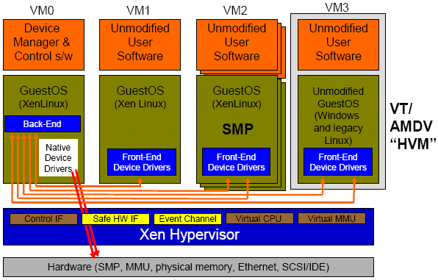
Hybrid Ex 2 - Xen 3.0
Para –virtualization
  Linux Guest
Hardware-supported virtualization
  Unmodified Windows
Isolated Device Drivers
Source: Ottawa Linux Symposium 2006 presentation.
http://www.cl.cam.ac.uk/netos/papers/

Slide 50
Hypervisor
Hardware-supported single-use monitor
Characteristics
  Small size
  Runs in a special hardware mode
  Guest OS runs in normal privileged level
Uses
  Security
  System management
  Fault tolerance
User
Mode
Operating System
Kernel
Mode
Hypervisor
Monitor
Mode
Hardware

