Slide 1
Virtualization: CPU and Memory
Yubin Xia
Software School
Shanghai Jiao Tong University
Some Slides adapted from VMWare’s academic course plan

Slide 2
Review: OS Structure
OS
App
Logic
User-Mode
Kernel-Mode
DOS
UNIX
MicroKernel
ExoKernel
Notes:
Q1: what are difference? Consider file system, page fault handler, device driver, cpu scheduling
Q2: what is address space? Note that the kernel and apps share the same space
Q3: which one has the best performance
Q4: what is virtual machine’s architecture? Both Xen and KVM

Slide 3
Virtualization Layers
At which layer?
  Hello world
  Web game
  Dota
  Office 2013
  Windows 8
  Java applications
  Python scripts
  High Sierra
Applications
API
Libraries
System Calls
ABI
Operating
System
ISA
System ISA
User ISA
Hardware
API – application programming interface
ABI – application binary interface
ISA – instruction set architecture

Slide 4
What is a VM and Where is the VM?
Machine from the perspective of a system
  ISA provides interface between system and machine
Application
Programs
Libraries
Application Software
Operating System
Drivers
Memory
Manager
Scheduler
Operating System
Execution Hardware
Memory
Translation
System ISA
User ISA
ISA
System Interconnect (Bus)
Machine
Controllers
Controllers
IO Devices,
Networking
Main Memory

Slide 5
Different Architectures of VMM
VM-1
VM-2
VM-1
VM-2
VM-1
VM-2
VMM
VMM
VMM
Host OS
Host OS
VMM
Hardware
Hardware
Hardware
Xen
Linux KVM
Qemu

Slide 6
CPU Virtualization

Slide 7
Formal Requirement of Virtualization
Popek & Goldberg, 1974 “Formal Requirements for Virtualizable Third Generation Architectures”
Provide by “virtual machine monitor” with three essential characteristics:
  Essentially identical execution environment (as real machine)
  Minor performance penalty for programs in VM
  VMM has complete control over system resources

Slide 8
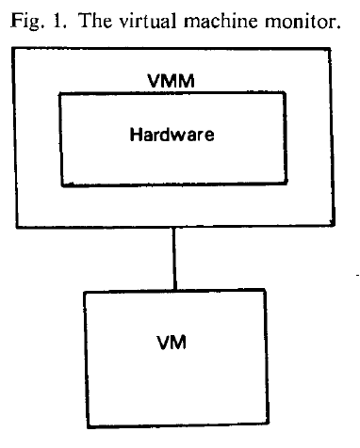
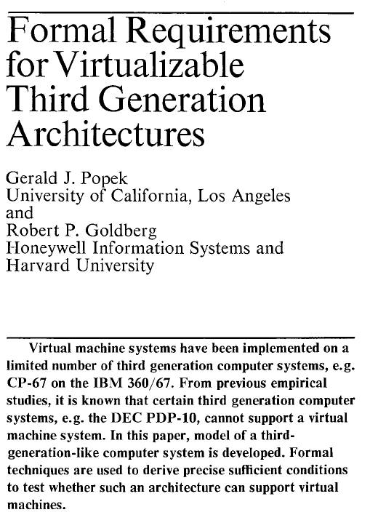
Principles in 1974
“an efficient, isolated duplicate of the real machine”
Efficiency
  Innocuous instructions should execute directly on hardware
Resource control
  Executed programs may not affect the system resources
Equivalence
  The behavior of a program executing under the VMM should be the same as if the program were executed directly on the hardware (except possibly for timing and resource availability)
Communications of the ACM, vol 17, no 7, 1974, pp.412-421

Slide 9
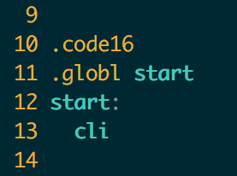
Recap: Run OS as an Application
Stuck at the very first instruction
  cli : disable interrupt
  It’s a privilege instruction
  Cannot run in user mode!
Similar instructions
  E.g., change CR3, set IDT, etc.
  These instructions will change machine states
  Aka., System ISA
xv6: bootasm.S

Slide 10
Solution: Trap & Emulate
Trap: running privilege instructions in user-mode will trap to the VMM
Emulate: those instructions are implemented as functions in the VMM
  System states are kept in VMM’s memory, and are changed according
Guest OS-1
Guest OS-2
Guest OS-3
Trap
Mov $100, CR3
Host OS
Emulate
Emulate
Mov $20, CR3
CPU
Mem
Device

Slide 11
X86 is not Strictly Virtualizable
Example: the popf instruction
  popf takes a word off the stack and puts in into the flags register
    One flag in that register is the interrupt enable flag (IF)
  At system level the IF flag is updated by popf
  At user level the IF flag is not updated, and CPU silently drops updates to the IF
There 17 such instructions in X86
  SGDT, SIDT, SLDT, SMSW, PUSHF, POPF, LAR, LSL, VERR, VERW, POP, PUSH, CALL, JMP, INT n, RET, STR, MOV

Slide 12
How to Deal with the 17 Instructions?
Instruction Interpretation: emulate them by software
Binary translation: translate them to other instructions
Para-virtualization: replace them in the source code
New hardware: change the CPU

Slide 13
Sol-1: Instruction Interpretation
Emulate Fetch/Decode/Execute pipeline in software
  Emulate all the system status using memory
    E.g., using an array GPR[8] for general purpose registers
  None guest instruction executes directly on hardware
E.g., Bochs
Positives
  Easy to implement & minimal complexity
Negatives
  Very slow!

Slide 14
Sol-2: Binary Translator
Translate before execution
  Translation unit is basic block (why?)
  Each basic block -> code cache
  Translate the 17 instructions to function calls
    Implemented by the VMM
E.g., VMware, Qemu

Slide 15
Issues with Binary Translation
PC synchronization on interrupts
  Now interrupt will only happen at basic block boundary
  But on real machine, interrupt may happen at any instruction
Carefully handle self-modifying code (SMC)
  Notified on writes to translated guest code

Slide 16
Sol-3: Para-virtualization
Modify OS and let it cooperate with the VMM
  Change sensitive instructions to calls to the VMM
    Also known as hypercall
  Hypercall can be seen as trap
E.g., Xen
  Widely used by industry like Amazon’s EC2

Slide 17
Sol-4: Hardware Supported CPU Virtualization
VMX root operation:
  Full privileged, intended for Virtual Machine Monitor
VMX non-root operation:
  Not fully privileged, intended for guest software
Both forms of operation support all four privilege levels from 0 to 3

Slide 18
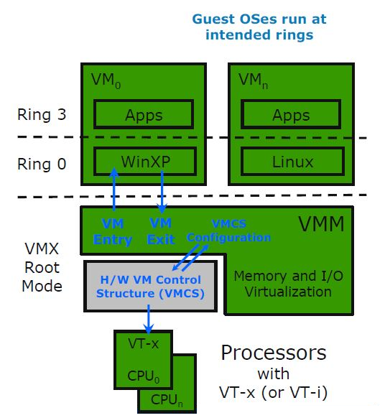
CPU Virtualization with VT-x
Two new mode:
  Root and non-root
VMX root operation:
  Fully privileged, intended for VM monitor
VMX non-root operation:
  Not fully privileged, intended for guest software
  Reduces Guest SW privilege w/o relying on rings
  Solution to Ring Aliasing and Ring Compression

Slide 19
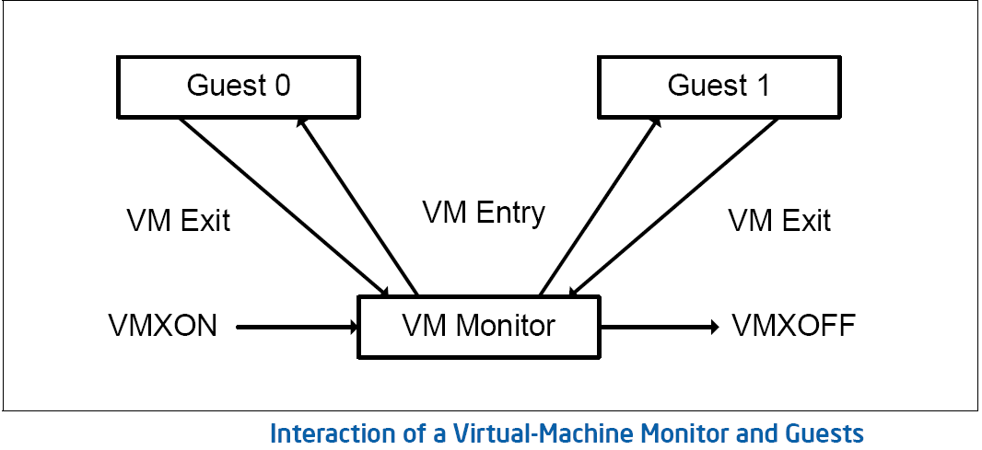
VM Entry and VM Exit
VM₀
VM₁
App
App
...
App
...
App
App
...
App
Guest OS₀
Guest OS₁
VM Entry
  Transition from VMM to Guest
  Enters VMX non-root operation
  Loads Guest state from VMCS
  VMLAUNCH used on initial entry
  VMRESUME used on subsequent entries
VM Exit
  VMEXIT instruction used on transition
  from Guest to VMM
  Enters VMX root operation
  Saves Guest state in VMCS
  Loads VMM state from VMCS
VM Monitor
VM Exit
VM Entry
Physical Host Hardware

Slide 20
Virtual Machine Control Structure (VMCS)
Data structure that manages VM entries and VM exits.
VM entries load processor state from the guest-state area.
VM exits save processor state to the guest-state area and the exit reason, and then load processor state from the host-state area.
Notes:
VM entries and VM exits are managed by a new data structure called the virtual-machine control structure.
Processor operation is changed substantially in VMX non-root operation. The most important change is that many instructions and events cause VM exits. Some instructions (e.g. INVD) cause VM exits unconditionally and thus can never be executed in VMX non-root operation. Other instructions (e.g. INVLPG) and all events can be configured to do so conditionally using VM-execution control fields in the VMCS.
Guest-state area. Processor state is saved into the guest-state area on VM exits and loaded from there on VM entries.
Host-state area. Processor state is loaded from the host-state area on VM exits.
VM-execution control fields. These fields control processor behavior in VMX non-root operation. They determine in part the causes of VM exits.
VM-exit control fields. These fields control VM exits.
VM-entry control fields. These fields control VM entries.
VM-exit information fields. These fields receive information on VM exits and describe the cause and the nature of VM exits. They are read-only.

Slide 21
VMCS: VM Control Structure
The VMCS consists of six logical groups:
Guest-state area: Processor state saved into the guest-state area on VM exits and loaded on VM entries.
Host-state area: Processor state loaded from the host-state area on VM exits.
VM-execution control fields: Fields controlling processor operation in VMX non-root operation.
VM-exit control fields: Fields that control VM exits.
VM-entry control fields: Fields that control VM entries.
VM-exit information fields: Read-only fields to receive information on VM exits describing the cause and the nature of the VM exit.

Slide 22
VT-x Operations
VM 1
VM 2
VM n
VMX
Non-root
Operation
Ring 3
Ring 3
Ring 3
. . .
Ring 0
Ring 0
Ring 0
VM Exit
VMCS
1
VMCS
2
VMCS
n
VMX Root
Operation
Ring 3
IA-32
Operation
Ring 0
VMLAUNCH
VMRESUME
VMXON

Slide 23
VT-x New instructions
VMXON and VMXOFF
  To enter and exit VMX-root mode.
VMLAUNCH: Used on initial transition from VMM to Guest
  Enters VMX non-root operation mode
VMRESUME: Used on subsequent entries
  Enters VMX non-root operation mode
  Loads Guest state and Exit criteria from VMCS
VMEXIT
  Used on transition from Guest to VMM
  Enters VMX root operation mode
  Saves Guest state in VMCS
  Loads VMM state from VMCS
VMPTRST and VMPTRLD
  To Read and Write the VMCS pointer.
VMREAD, VMWRITE, VMCLEAR
  Read from, Write to and clear a VMCS.
Notes:
The VT-x instructions are available on VMX root mode only.

Slide 24
Memory Virtualization

Slide 25
Virtualizing Memory
VMM constructs a page table that maps guest address to host physical address
  E.g., if guest VM has 1GB of memory, it can access memory address 0~1GB
  Each guest VM has its own mapping for memory address 0, etc.
  Different host physical address used to store data for those memory locations

Slide 26
Virtualizing the Page Tables
Terminology: 3 types of address now
  GVA->GPA->HPA (Guest virtual. Guest physical. Host physical)
  Guest VM's page table contains GPA
Setting CR3 to point to guest page table would not work
  E.g., a processes in VM might access host physical address 0~1GB, which might not belong to that guest VM
  Solution-1: shadow paging
  Solution-2: direct paging
  Solution-3: new hardware

Slide 27
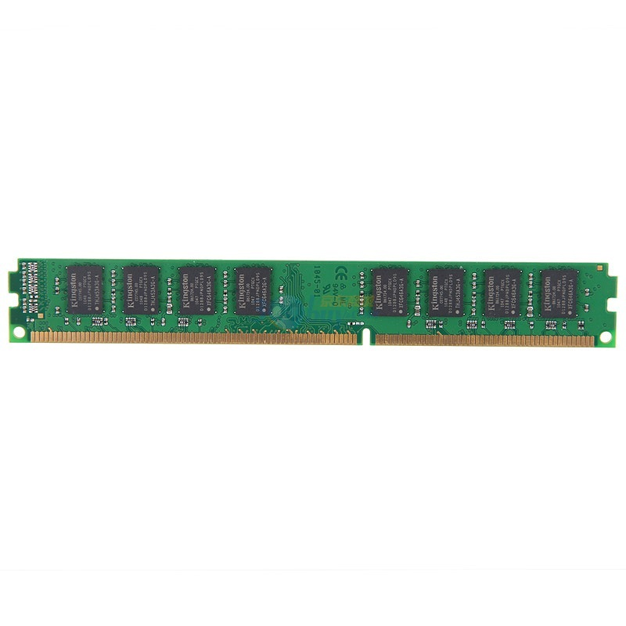
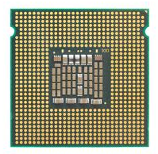
Solution-1: Shadow Pages
Guest VM
GVA
GVA
GPT
GPA
GPA
HPT
SPT
HPA
HPA
CR3

Slide 28
Two Page Tables Become One
VMM intercepts guest OS setting the virtual CR3
VMM iterates over the guest page table, constructs a corresponding shadow page table
In shadow PT, every guest physical address is translated into host physical address
Finally, VMM loads the host physical address of the shadow page table

Slide 29
Setup Shadow Page Table
set_cr3 (guest_page_table):
for GVA in 0 to 2²⁰
if guest_page_table[GVA] & PTE_P:
GPA = guest_page_table[GVA] >> 12
HPA = host_page_table[GPA] >> 12
shadow_page_table[GVA] = (HPA<<12)|PTE_P
else
shadow_page_table[GVA] = 0
CR3 = PHYSICAL_ADDR(shadow_page_table)

Slide 30
What if Guest OS Modifies Its Page Table?
Real hardware would start using the new page table's mappings
  Virtual machine monitor has a separate shadow page table
Goal:
  VMM needs to intercept when guest OS modifies page table, update shadow page table accordingly
Technique:
  Use the read/write bit in the PTE to mark those pages read-only
  If guest OS tries to modify them, hardware triggers page fault
  Page fault handled by VMM: update shadow page table & restart guest

Slide 31
Protect Kernel-only Pages
How do we selectively allow / deny access to kernel-only pages in guest PT?
  Hardware doesn't know about our virtual U/K bit
Idea:
  Generate two shadow page tables, one for U, one for K
  When guest OS switches to U mode, VMM must invoke set_ptp(current, 0)

Slide 32
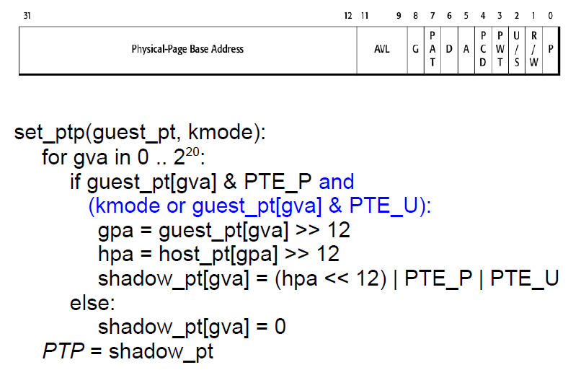
Protect Kernel-only Pages

Slide 33
Two Memory Views of Guest VM
When guest OS
is running
When application
is running
Kernel space
No user access
User space
User access

Slide 34
Sol-2: Direct Paging (Para-virtualization)
Modify the guest OS
  No GPA is needed, just GVA and HPA
  Guest OS directly manages its HPA space
  Use hypercall to let the VMM update the page table
  The hardware CR3 will point to guest page table
VMM will check all the page table operations
  The guest page tables are read-only to the guest

Slide 35
Sol-2: Direct Paging (Para-virtualization)
Positive
  Easy to implement and more clear architecture
  Better performance: guest can batch to reduce trap
Negatives
  Not transparent to the guest OS
  The guest now knows much info, e.g., HPA
    May use such info to trigger rowhammer attacks

Slide 36
Sol-3: Hardware Supported Memory Virtualization
Hardware implementation
  Intel’s EPT (Extended Page Table)
  AMD’s NPT (Nested Page Table)
Another table
  EPT for translation from GPA to HPA
  EPT is controlled by the hypervisor
  EPT is per-VM

Slide 37
Guest VM
VMM
GVA
PT
GPA
VA
EPT
PT
HPA
PA
Non-root mode
Root mode

Slide 38
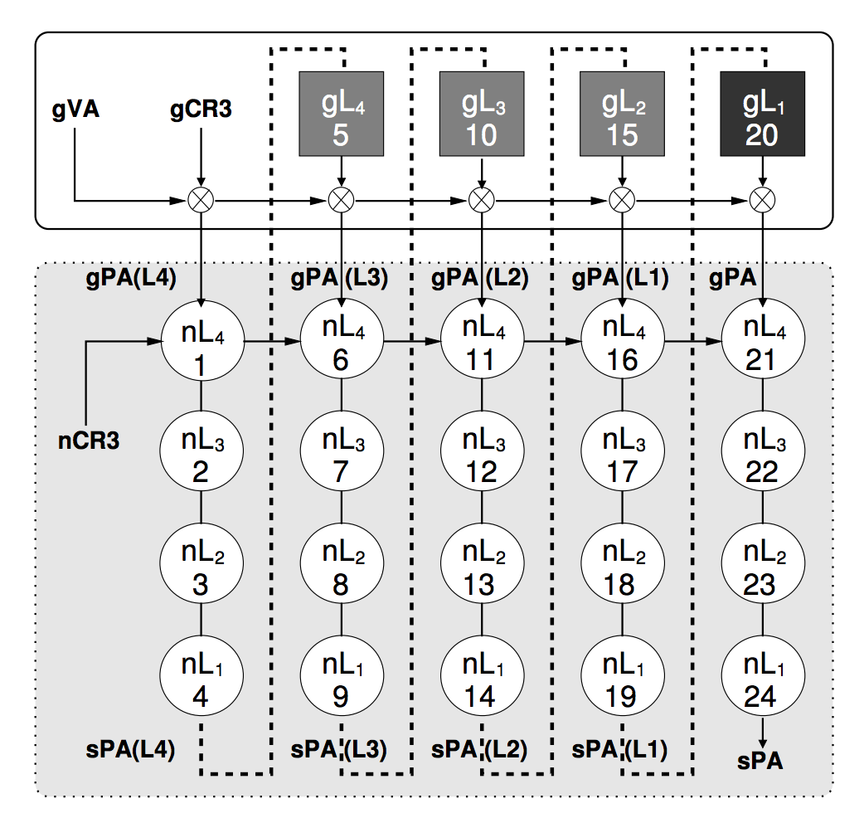
EPT Increases Memory Access
sPA == HPA
nCR3 == hCR3
nL₁ == hL₁
One memory access from the guest VM may lead up to 20 memory accesses!

Slide 39
Case Study: VMware

Slide 40
Managing Memory in VMM
Configure VMs to use more memory than actually available
What happens when running out of memory?
Strawman: use LRU paging at VMM
  OS already uses LRU → doubling paging
  OS will recycle whatever page VMM just paged out
  Better to do random eviction

Slide 41
Vmware ESX: Reclaiming Pages
Idea: trick OS to return memory to VMM
OS is better at deciding what to swap
  Normally OS uses all available memory
  E.g. buffer cache contains old pages, OS won‘t discard if it does not need memory
ESX trick: balloon driver

Slide 42
Memory Balooning
Baloon inflates by requesting
lots of “pinned” memory pages
Baloon is a special
pseudo-device loaded into OS
VMM instructs baloon to
inflate or deflate depending
on memory pressure
OS1
OS2
Baloon tells VMM to recycle
its “private” pinned pages
VMM
To accommodate inflated baloon,
OS releases/swaps out
some of its memory pages

Slide 43
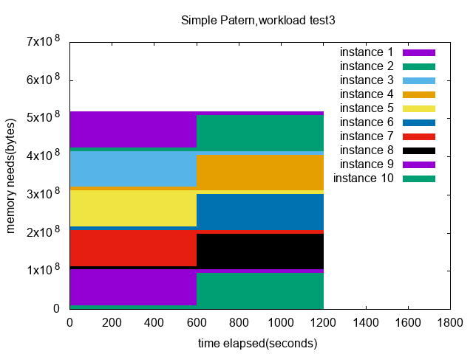
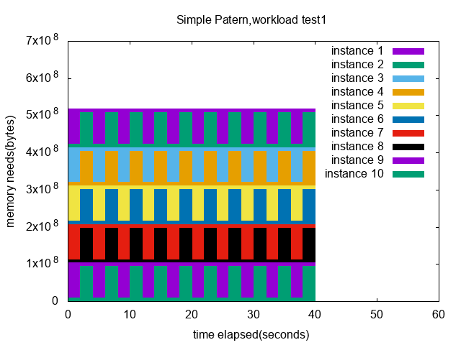

A simple pattern evaluation
10 small VMs configured with initial memory 90MB, maxmem 256MB.
Three tests with three pattern change intervals.
Notes:
So me and DD conducted some performance evaluation based on a simple pattern workload.
We run 10 TinyD VMs configured with initial memory of 90 MB, and maximum memory of 256 MB.
We divide the VMs into 5 groups. For each pair of VMs in a group, one of them runs a high-memory-demand workload, while the other runs a low-memory-demand workload.
We have three tests with three pattern change intervals, that is 2 seconds, 20 seconds, and 600 seconds.

Slide 44
Ballooning policy analysis
Notes:
Here are examples of test results on KVM.
We can see that different policies have magnitudes of difference in performance.
The performance of some policies might reach somewhere close to the performance of running as process in this workload,
While some other policies might behave as if there’s no ballooning taking place at all.
结论：policy related to workload pattern

Slide 45
ESX: Sharing Pages across VMs
Many VMs run same OS and programs
  Many Linux boxes with Apache server
Idea: use 1 machine page for identical physical pages
Periodically scan to find identical machine pages
  Do copy-on-write to eliminate redundancy
Optimization: use a hash table keyed by hash(content)
  Allows quick lookup based on page content

Slide 46
Page Table Isolation

Slide 47

Meltdown
Key:
0x0000 0001
….
attack:
LD RAX, Key
LD RBX, S[RAX]
…
probe:
Kernel
User
CPU
Permission Check Error !
Key → RAX_0
S[RAX_0] → RBX_0
…
EXCEPTION!!!
ROLLBACK
Probe()
S
Cache
*Key = 1

Slide 48


Meltdown
key = 0x01
Mapped with kernel privilege in page table
Kernel
User
Access key
Permission Error!

Slide 49

Meltdown
key = 0x01
Mapped with kernel privilege in page table
Kernel
User
Meltdown
Can access key!

Slide 50



Meltdown
CPU
Instruction
Effect
Cache
Memory
key = 0x01
Kernel
User
Meltdown

Slide 51
Meltdown
CPU
Instruction
Effect
Permission Error!
1
Load key, %rax
%rax = 1
Reorder
Execution
Load buf[%rax], %rbx
Access buf[1]
2
Cache
Memory
key = 0x01
Kernel
Key = 1
… | buf[0] | buf[1] | buf[2] | … | buf[n] | …
User
Meltdown
buf
(Attack buffer)

Slide 52
Meltdown
CPU
Instruction
Effect
Permission Error!
1
Load key, %rax
%rax = 1
Reorder
Execution
Load buf[%rax], %rbx
Access buf[1]
2
Rollback status
w/o cache status!
Exception
3
Cache
Memory
key = 0x01
Kernel
2
Key = 1
buf[1]
2
… | buf[0] | buf[1] | buf[2] | … | buf[n] | …
User
Access
buf[1]
Fill buf[1]
to cache
Meltdown
buf
(Attack buffer)

Slide 53
Meltdown
CPU
Instruction
Effect
Permission Error!
1
Load key, %rax
%rax = 1
Attacker finds that buf[1] is in the cache, so that key equals to 1!
Reorder
Execution
Load buf[%rax], %rbx
Access buf[1]
2
Rollback status
w/o cache status!
Exception
3
Cache
Memory
key = 0x01
Kernel
2
Key = 1
buf[1]
2
… | buf[0] | buf[1] | buf[2] | … | buf[n] | …
User
Access
buf[1]
Fill buf[1]
to cache
Meltdown
buf
(Attack buffer)

Slide 54
Existing Solution
    KPTI (Kernel Page Table Isolation)
Two page tables for user and kernel space
  User page table only maps user space
  Kernel page table maps both user and kernel space
Switch the page table during user/kernel switching
  Add latency to syscalls, signal handler,…
Up to 30% overhead on server application
Not suitable for the cloud environment

Slide 55
Goals
Defend against Meltdown attack in cloud environment
Applicability
  No kernel source code modification
  No need to reboot a guest
Performance
  Faster than KPTI

Slide 56
EPT-based Kernel Space Isolation
First try: directly remove kernel mapping in EPT-u

Slide 57
EPT-based Kernel Space Isolation
    Naïve method
Remove GPA-to-HPA mapping for kernel in EPT-u
Cannot distinguish kernel-used and user-used GPA
    kernel
    user
    Guest virtual address
    (GVA)
    guest physical address
    (GPA)
    host physical address
    (HPA)
    gPT
    (guest page table)
    EPT
    Extended page table

Slide 58
EPT-based Kernel Space Isolation
    Naïve method
Remove GPA-to-HPA mapping for kernel in EPT-u
Cannot distinguish kernel-used and user-used GPA
Direct map
    kernel
Remove all GPAs, not work
    Direct map region in kernel maps all GPAs
    user
    Guest virtual address
    (GVA)
    guest physical address
    (GPA)
    host physical address
    (HPA)
    gPT
    (guest page table)
    EPT
    Extended page table

Slide 59
EPT-based Kernel Space Isolation
Second try: zero the guest page table for kernel space in EPT-u

Slide 60
EPT-based Kernel Space Isolation
    EPTI method
Zero GVA-to-GPA mapping for kernel
gPT page
    kernel
    user
    Guest virtual address
    (GVA)
    guest physical address
    (GPA)
    host physical address
    (HPA)
    gPT
    (guest page table)
    EPT
    Extended page table

Slide 61
EPT-based Kernel Space Isolation
    EPTI method
Zero GVA-to-GPA mapping for kernel
Remap gPT page which controls kernel mapping to a zeroed page in EPT-u
    In EPT-k
gPT page
mapping
    kernel
    In EPT-u
00000000
    user
    Guest virtual address
    (GVA)
    guest physical address
    (GPA)
    host physical address
    (HPA)
    gPT
    (guest page table)
    EPT
    Extended page table

Slide 62
EPT-based Kernel Space Isolation
    4-level guest page table (gPT)
    Remap guest level-3 page table page (gL3)
All processes share the same level-3 page table page for kernel mapping (kernel gL3)
    Level-4
    Level-3
    Level-2
    Level-1
    kernel
    user
    kernel
    user
    .
    .
    .

Slide 63
EPT-based Kernel Space Isolation
    4-level guest page table (gPT)
    Remap guest level-3 page table page (gL3)
All processes share the same level-3 page table page for kernel mapping (kernel gL3)
Remap kernel gL3 to a zeroed host physical page in EPT-u
    Level-4
    Level-3
    Level-2
    Level-1
    kernel
    user
    In EPT-k
    In EPT-u
    kernel
    user
00000000
    .
    .
    .
00000000
    Host physical page

Slide 64
EPT-based Kernel Space Isolation
    4-level guest page table (gPT)
    Remap guest level-3 page table (gL3)
All processes share the same level-3 page table for kernel mapping (kernel gL3)
Remap kernel gL3 to a zeroed host physical page in EPT-u
    Level-4
    Level-3
    Level-2
    Level-1
    kernel
Need to trace all enabled kernel level-3 page table pages (kernel gL3)
    user
    In EPT-k
    In EPT-u
    kernel
    user
00000000
    .
    .
    .
00000000
    Host physical page

Slide 65
Tracing Kernel gL3
    Use trap to get kernel gL3 in hypervisor
Trap guest load-CR3 operation
  To get all guest level-4 page table pages
Trap write operation of guest level-4 page table page
  To get all enabled kernel guest level-3 page table pages (kernel gL3)
Too many traps will hurt the performance

Slide 66
Tracing Kernel gL3
    Three optimizations to reducing traps
Write protection method for access/dirty bit updating
Selectively trap load-CR3 operation
Trap modification on gL3 only

Slide 67
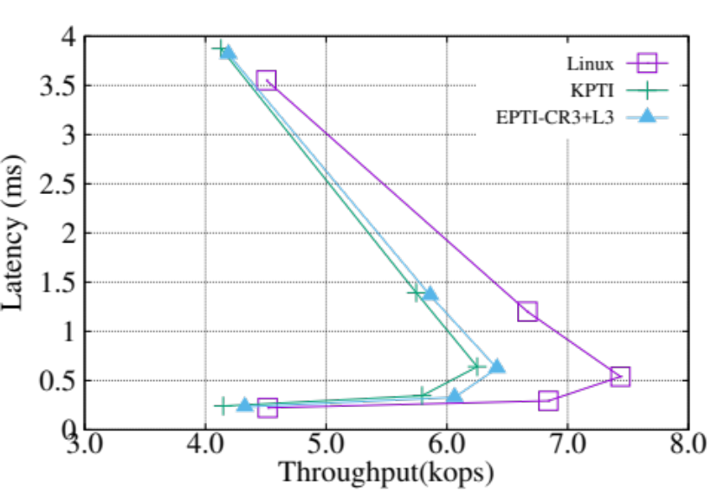
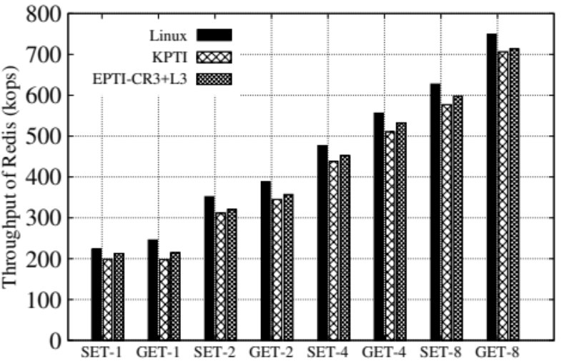
Performance
Redis
Apache

Slide 68
KPTI vs. EPTI (Our Solution)
 | KPTI | EPTI
Defend against Meltdown | Yes | Yes
Patch without manual effort | No | Yes
Independent on kernel version | No | Yes
Without rebooting | No | Yes
Performance overhead | Moderate | Low

Slide 69
Further Reading
www.govirtual.com
系统虚拟化--原理与实现
  http://www.china-pub.com/45151&ref=xiangguan

