Slide 1
8 Important Problems
(Not a Rank)
Scale Up
Security & Privacy
Energy Efficiency
Mobility
Write Correct (Parallel) Code
Scale Out
Non-Volatile Storage
Virtualization

Slide 2
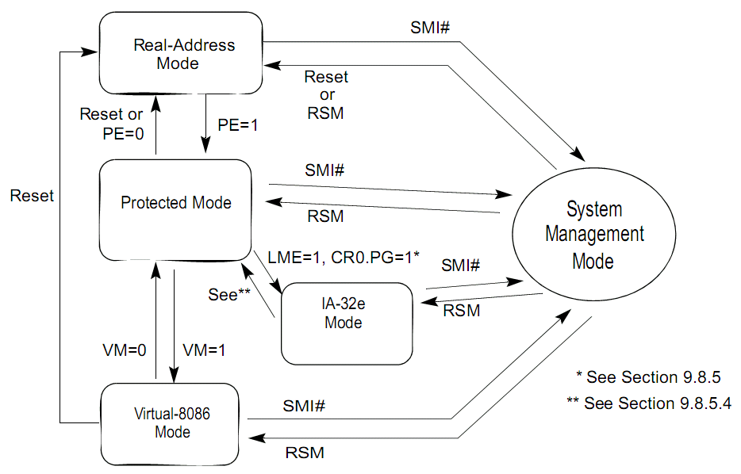
System Architecture Overview
  Volume 3A: System Programming Guide, Part 1
    2.1~2.5
Modes
Real Mode
Protected Mode
SMM

Slide 3
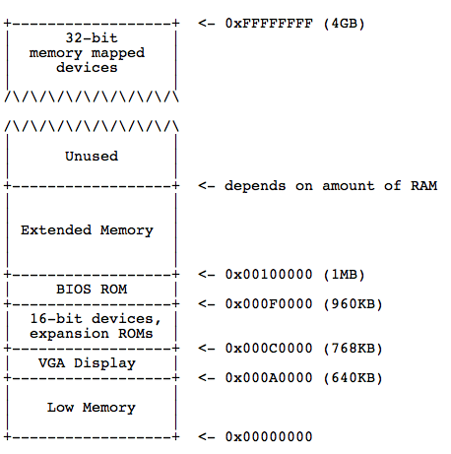
Memory Layout

Slide 4
Kernel Structure

Slide 5
Kernels
Kernel classification (wikipedia)
Monolithic kernel
  A monolithic kernel is an operating system architecture where the entire operating system is working in kernel space and is alone in supervisor mode.
    Linux, BSD…
Kernel (architecture) | Monolithic | Microkernel | Exokernel | hybrid
Notes:
Monolithic : 또한 하드웨어나 운영체제에 종속적인 부분을 분리한 계층구조를 가지고 있어, 다른 형태의 플랫폼 이식에 유연성을 제공하지만 새로운 입출력장치의 추가시, 인터럽트 처리기가 커널 내부에 추가되어야 하므로 커널은 대부분 다시 컴파일되고 부팅되어야 한다.

Slide 6
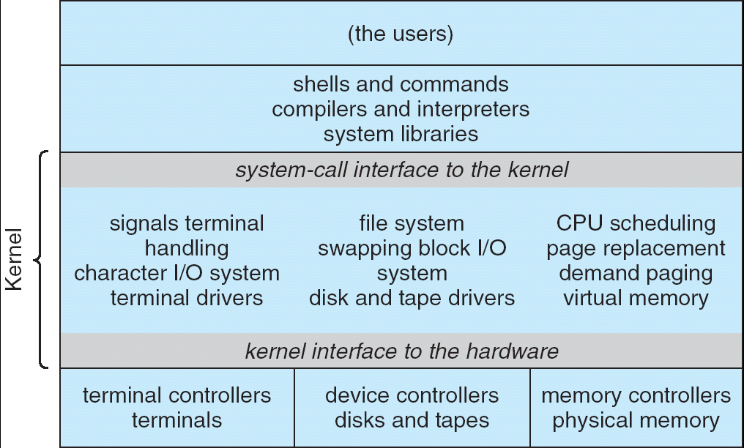
UNIX System Structure

Slide 7
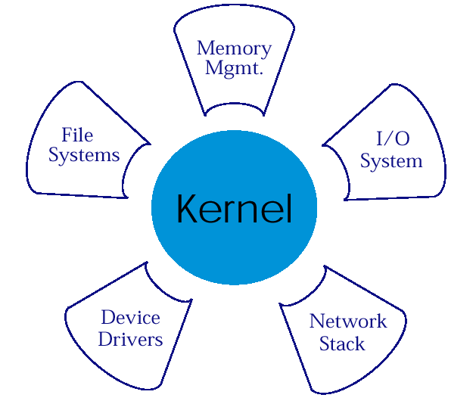
Microkernel Structure & Instances
APP1
APPn
LPC
APP2
APP4
HAL
APP3

Slide 8
Exokernel Structure
Overview
  let the kernel allocate the physical resources of the machine to multiple application programs, and
  let each program decide what to do with these resources.
  The program can link to an operating system library (libOS) that implements OS abstractions.
Exokernel: An operating system architecture for application-level resource management, SOSP’95
Notes:
Exokernel微内核的核心观点是：只要内核还提供对系统资源的抽象，就不能实现性能的最大优化 -- 内核应该支持一个最小的、高度优化的原语集，而不是提供对系统资源的抽象。从这个观点上来说，IPC也是一个太高级的抽象因而不能达到最高的性能。Exokernel微内核的核心是支持一个高度优化的原语名叫保护控制转移(protected control transfer, PCT)。PCT是一个不带参数的跨地址空间的过程调用，其功能类似于一个硬件中断。在PCT的基础上，可以实现高级的IPC抽象如RPC。在MIPS R3000处理器上，一个基于PCT的RPC实现了仅10µs的开销，而在同一硬件上运行的Mach RPC为95µs。

Slide 9
IPC – Message Passing
Mechanism for processes to communicate and to synchronize their actions
Message system
  processes communicate with each other without resorting to shared variables
IPC facility provides two operations:
  send(message) – message size fixed or variable
  receive(message)

Slide 10
Synchronous IPC & Asynchronous IPC
Message passing may be either blocking or non-blocking
Blocking is considered synchronous
  Blocking send has the sender block until the message is received
  Blocking receive has the receiver block until a message is available
Non-blocking is considered asynchronous
  Non-blocking send has the sender send the message and continue
  Non-blocking receive has the receiver receive a valid message or null

Slide 11
Lightweight RPC (LRPC)
Simple control transfer: client’s thread executes in server’s domain
Simple data transfer: shared argument stack, plus registers
Simple stubs: i.e. highly optimized marshalling
Design for concurrency: Avoids shared data structures

Slide 12
Virtual Memory

Slide 13
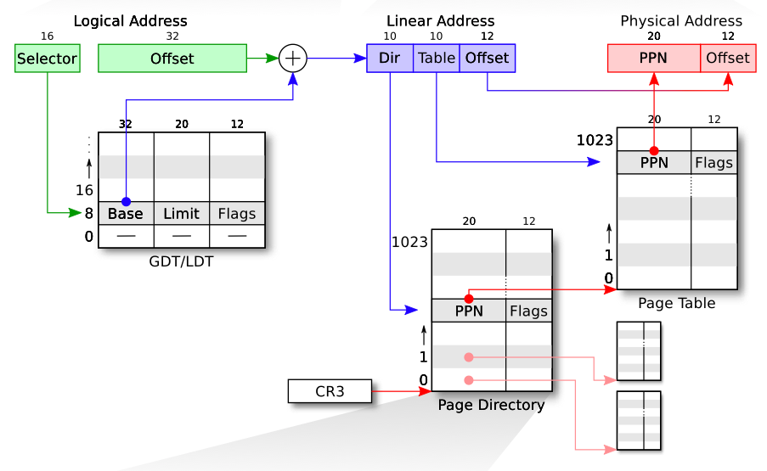
Protected Mode Address Translation

Slide 14
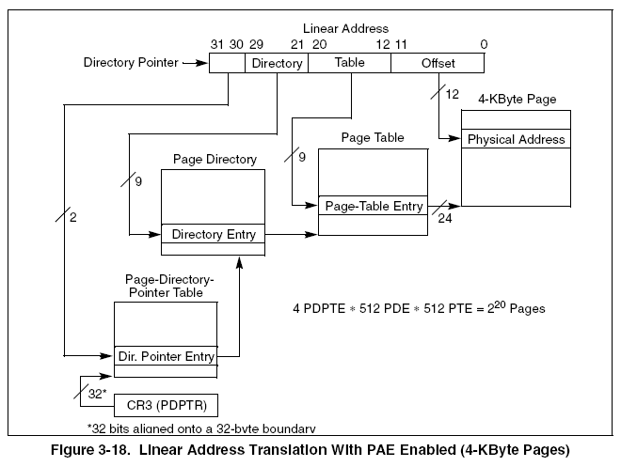
Address translation: PAE-4k

Slide 15
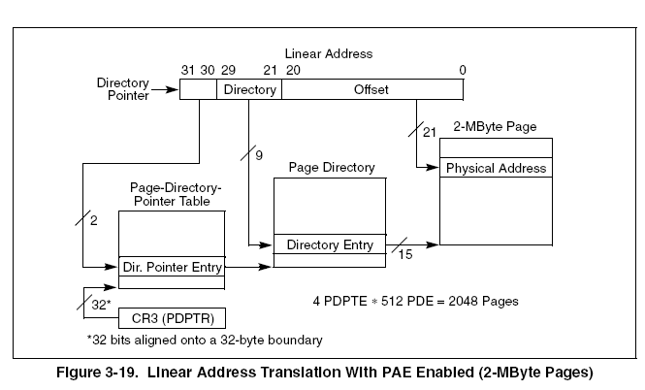
Address translation: PAE-2M

Slide 16
what's going to happen when the kernel enables segment?
virtual address translation comes into effect?
  presumably the enabling instruction has address segment-base + 0xffffc
  The address may not contain any valid instruction!
  Solution
    Ensure that the addresses are the same before and after

Slide 17
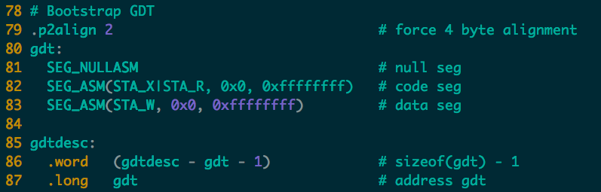
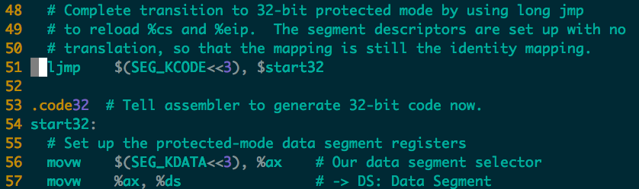
Enable Segment

Slide 18
what's going to happen when the kernel enables paging?
virtual address translation comes into effect?
  presumably the enabling instruction has address 0x100xxx
  0x100xxx maps to user memory, not kernel instructions!
  solution
    temporary page table with kernel mapped at both 0x80100000 and 0x100000
    that's what the first few kernel instructions set up

Slide 19
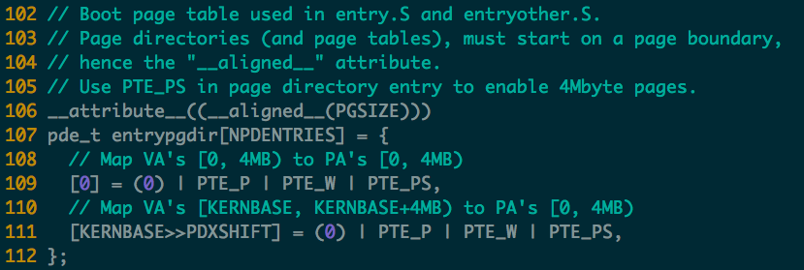
entrypgdir

Slide 20
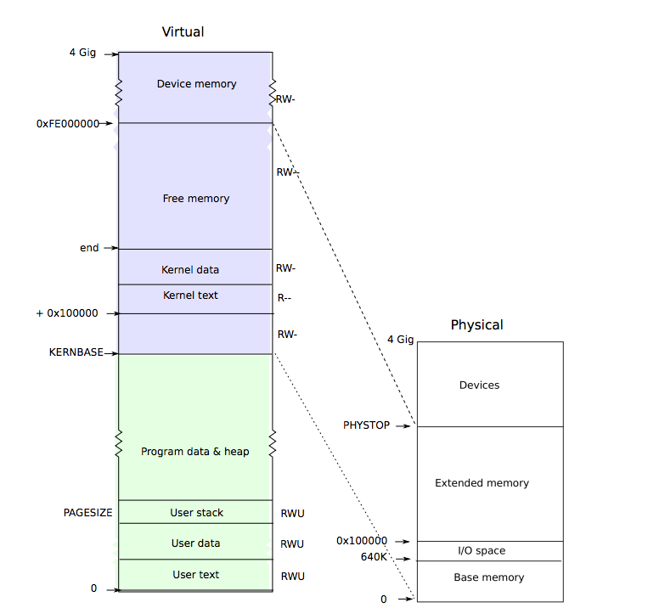

Slide 21
Virtualize CPU: Process

Slide 22
Process: Big Picture
More programs than processors.
  How to share the limited number of processors among the programs?
Observation: most programs don't need the processor continuously
  because they frequently have to wait for input (from user, disk, network, etc.)
Idea: when one program must wait, it releases the processor, and gives it to another program.

Slide 23
Concepts
System call
  a user program can ask for an operating system service
Exception
  refers to an illegal program action
Interrupt
  refers to a signal generated by a hardware device

Slide 24
When a trap occurs
If the processor was executing in user mode
  it loads %esp and %ss from the task segment descriptor
  pushes the old user %ss and %esp onto the new stack.
If the processor was executing in kernel mode,
  none of the above happens.
The processor then pushes the %eflags, %cs, and %eip registers.
  For some traps, the processor also pushes an error word.
The processor then loads %eip and %cs from the relevant IDT entry.

Slide 25
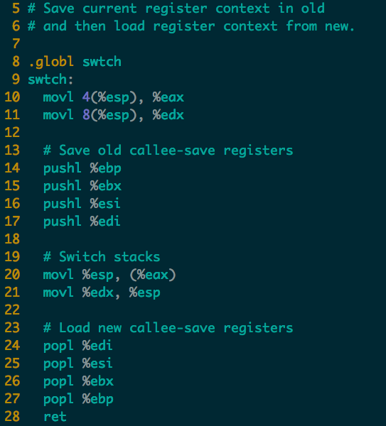

Context Switch in xv6 (swtch.S)
new
new
old
old
ret addr
ret addr
ebp
ebp
ebx
ebx
esi
esi
edi
edi
esp
esp
Notes:
Note that the 4 pushl will generate a struct context. One missing field is eip, where is it?
Where is the old context saved?

Slide 26
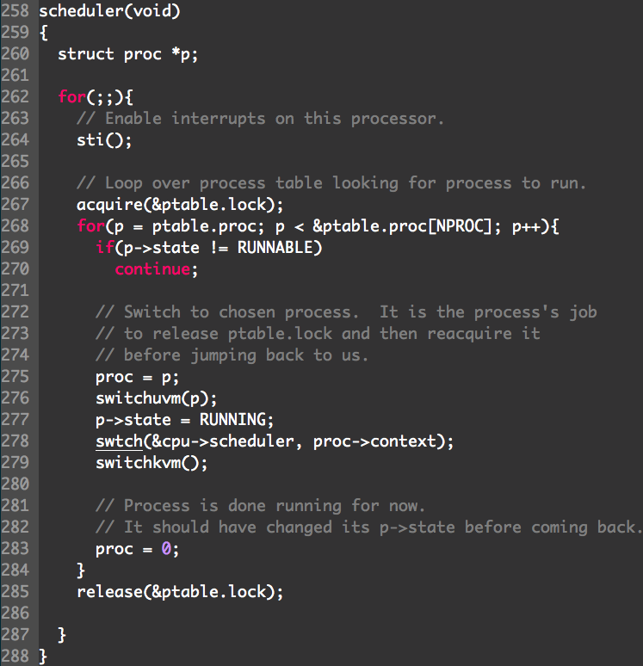
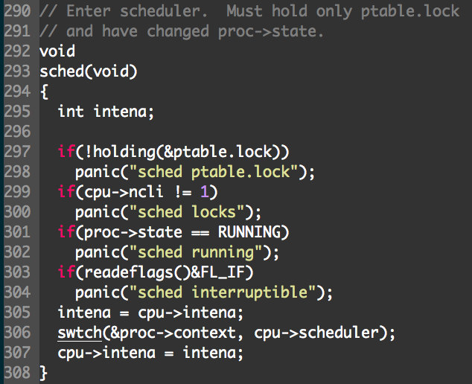

Slide 27
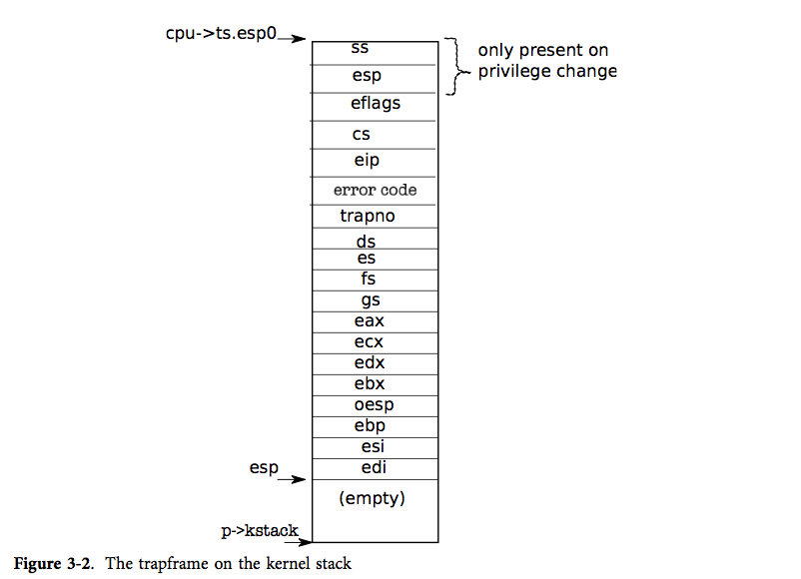
TrapFrame

Slide 28
Top and Bottom Halves
Top-half: do minimum work and return
  ISR (Interrupt Service Routine)
Bottom-half: deferred processing
  softirqs, tasklets, workqueues, kernel threads
Top half
Bottom half
tasklet
softirq
workqueue
kernel thread

Slide 29
File System

Slide 30
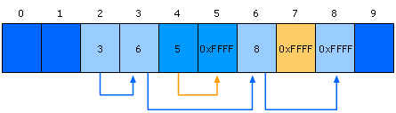
File Processing on FAT Clusters
Store file information in FAT
  Continues to store file info in the next available cluster
    when the file requires space greater than the cluster's size
  Three Files: 1 with (2-3-6-8), 2 with (4-5), 3 with (7)
Notes:
30

Slide 31
Crash Consistency
Synchronous meta-data update + fsck
  Used in xv6-rev0
  During check, synchronize meta-data, such as file size
Logging (ext 3/4), xv6-rev6 and following versions
  Before doing actual meta-data update, log the event
  After crash, recover from log
Soft update (FreeBSD fs modified on FFS)
  Soft update, not covered in this course

Slide 32
Xv6's simple logging
FS has a log on disk syscall:
  begin_trans()
  bp = bread()
  bp->data[] = ...
  log_write(bp)
  more writes ...
  commit_trans()
inodes
in-use bitmap
data block
Log block
unused
superblock

Slide 33
How does ext3 get good perf.?
batches many syscalls per commit
defers copying cache block to log until it commits log to disk
hopes multiple sycalls modified same block
  thus many syscalls but only one copy of block in log
  "write absorbtion"

Slide 34
Issues with ext3
disks usually have write caches and re-order writes, for performance
  sometimes hard to turn off (the disk lies)
  often with re-ordering enabled for speed, out of ignorance
bad news if disk writes commit block before preceding stuff
  then recovery replays "descriptors" with random block #s!
  and writes them with random content!
how to solve this problem?
  using checksum
Notes:
no checksum in ext3 commit record

Slide 35
Ordered vs Journaled
Ext-3 has three modes of journaling: journaled mode (full mode), ordered mode, and writeback mode
journaling file content is slow, every data block written twice
perhaps not needed to keep FS internally consistent
can we just lazily write file content blocks?
no:
  if metadata updated first, crash may leave file pointing to blocks with someone else's data
ext3 ordered mode:
  write content block to disk before committing inode w/ new block #
  thus won't see stale data if there's a crash
most people use ext3 ordered mode

Slide 36
Log-structured File System
Key idea: buffer all writes (including meta-data) in memory
  Write these long segments to disk sequentially
  Treat the disk as a circular buffer, i.e. don’t overwrite
Advantages:
  All writes are large and sequential
Big question:
  How do you manage meta-data and maintain structure in this kind of design?

Slide 37
Treating the Disk as a Log
Same concept as data journaling
  Data and meta-data get appended to a log
  Stale data isn’t overwritten, its replaced
Data Block 1
Data Block 2
inode
1
Data Block 5
inode
2
Data Block 1
inode
1
Disk

Slide 38
Synchronization

Slide 39
What is scalability?
Application does N times as much work on N cores as it could on 1 core
Scalability may be limited by Amdahl's Law:
  Locks, shared data structures, ... Shared hardware (DRAM, NIC, ...)

Slide 40

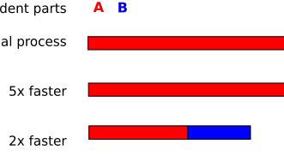
Amdahl's Law

Slide 41
Locking
Why do kernels normally use locks?
Locks support a concurrent programming style based on mutual exclusion
  Acquire lock on entry to critical sections
  Release lock on exit
  Block or spin if lock is held
  Only one thread at a time executes the critical section
Locks prevent concurrent access and enable sequential reasoning about critical section code

Slide 42
Critical-section efficiency
Lock Acquisition (T_{a} )
Critical Section (T_{c} )
Lock Release (T_{r} )
T_{c}
Critical-section efficiency =
T_{c}+T_{a}+T_{r}
Ignoring lock contention and cache conflicts in the critical section

Slide 43
Making ticket spinlock scalable
Common way: use proportional back-off
void spin_lock(spinlock_t *l) {
int t = atomic_xadd(&l->next_ticket);
while (t != lock->current_ticket)
// wait more time with each failure
;
}

Slide 44
General idea of MCS lock
mcs_lock
Previous node is not NULL
Current waiting is 1
Wait until lock holder
set waiting to 0
waiting: 0
next:
waiting: 0
next: NULL

Slide 45
Virtualization

Slide 46
Taxonomy
Process VMs
System VMs
Same
ISA
Different
ISA
Same
ISA
Different
ISA
Multiprogrammed
Systems
Dynamic
Translators
Classic-System
VMs
Whole-System
VMs
Dynamic
Binary
Optimizers
HLL VMs
Hosted
VMs
Co-designed
VMs

Slide 47
x86 virtualization challenge
The IA-32 instruction set contains 17 sensitive, unprivileged instructions:
  Sensitive register instructions: read or change sensitive registers and/or memory locations such as a clock register or interrupt registers:
    SGDT, SIDT, SLDT, SMSW, PUSHF, POPF
  Protection system instructions: reference the storage protection system, memory or address relocation system:
    LAR, LSL, VERR, VERW, POP, PUSH, CALL, JMP, INT n, RET, STR, MOV
Notes:
IA-32 (x86)
(Main article:X86 virtualization)
The IA-32 instruction set contains 17 sensitive, unprivileged instructions[3]. They can be categorized in two groups:
Sensitive register instructions: read or change sensitive registers and/or memory locations such as a clock register or interrupt registers:
PUSHF: Push EFLAGS onto stack
POPF: Pop EFLAGS from stack
SGDT: Store global descriptor table (GDT) register
SIDT: Store interrupt descriptor table (IDT) register
SLDT: Store local descriptor table (LDT) register
SMSW: Store machine status word
Protection system instructions: reference the storage protection system, memory or address relocation system:
CALL: Call procedure
JMP: Jump
INT n: Software Interrupt
LAR: Load access rights
LSL: Load segment limit
MOV: Move data between general-purpose registers; move data between memory and general-purpose or segment registers; move immediates to general-purpose registers
POP: Pop off of stack
PUSH: Push onto stack
RET: Return
STR: Store task register
VERR: Verify segment for reading
VERW: Verify segment for writing

Slide 48
Types of Virtualization
Types
  Trap-and-emulate
  Instruction interpretation
  Binary translation
  Para-virtualization
Examples
  Bochs
  Xen-PV, Xen-HVM
  VMware ESX, VMware Workstation
  Qemu

Slide 49
Virtualized Address Spaces
0
4GB
Current Guest Process
Guest OS
Virtual
Address Spaces
0
4GB
Virtual RAM
Virtual
Frame
Buffer
Virtual
Devices
Virtual
ROM
Physical
Address Spaces
0
4GB
RAM
Devices
Frame
Buffer
ROM
Machine
Address Space
Notes:
In a traditional system there are typically 2 address spaces – the virtual address space (VAS) and the physical address space (PAS). The OS and user processes run in the VAS. The OS manages the mapping from VAS to PAS through the use of the Memory Management Unit (MMU) provided in the processor. The OS maintains a page table that maps each page in the current VAS to a page in the PAS. Typically the OS will maintain one page table per user level process.

Slide 50
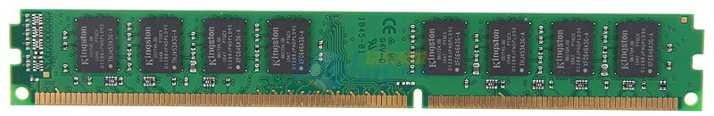
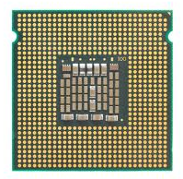
Guest VM
GVA
GPT
GPA
HPT
SPT
HPA
Shadow Paging

Slide 51
Issues with Shadow Page Tables
Positives
  Handle page faults in same way as Emulated TLBs
  Fast guest context switching
Page Table Consistency
  Guest may not need invalidate TLB on writes to off-line page tables
  Need to trace writes to shadow page tables to invalidate entries
Memory Bloat
  Caching guest page tables takes memory
  Need to determine when guest has reused page tables

Slide 52
What Is EPT?
CR3
EPT Base Pointer (EPTP)
Guest IA-32
Page
Tables
Guest Physical Address
Extended
Page
Tables
Host Physical Address
Guest Linear Address
Extended Page Table
A new page-table structure, under the control of the VMM
  Defines mapping between guest- and host-physical addresses
  EPT base pointer (new VMCS field) points to the EPT page tables
  EPT (optionally) activated on VM entry, deactivated on VM exit
Guest has full control over its own IA-32 page tables
  No VM exits due to guest page faults, INVLPG, or CR3 changes

Slide 53
Guest VM
VMM
GVA
PT
GPA
VA
EPT
PT
HPA
PA
Non-root mode
Root mode
Nested Paging

Slide 54
VT-d: Intel® Virtualization Technology for Directed I/O
Provides the capability to ensure improved isolation of I/O resources for greater reliability, security, and availability.
Supports the remapping of I/O DMA transfers and device-generated interrupts.
Provides flexibility to support multiple usage models that may run un-modified, special-purpose, or "virtualization aware" guest OSs.

Slide 55
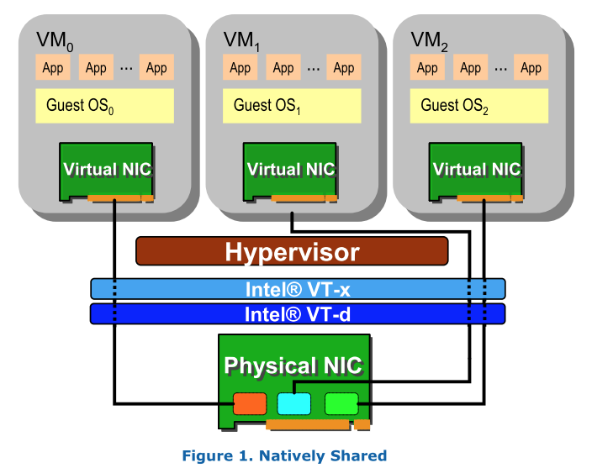
Single Root I/O Virtualization

Slide 56
Intel Virtualization Technology Evolution
Standards for IO-device sharing:
Multi-Context I/O Devices
Endpoint Address Translation Caching
Under definition in the PCI-SIG* IOVWG
Vector 3:
I/O Focus
PCI-SIG
Vector 2:
Platform Focus
Hardware support for IO-device virtualization
Device DMA remapping
Direct assignment of I/O devices to VMs
Interrupt Routing and Remapping
VT-d
VT-x
Establish foundation
for virtualization in the
IA-32 and
Itanium architectures…
… followed by on-going evolution of support:
Micro-architectural (e.g., lower VM switch times)
Architectural (e.g., Extended Page Tables)
Vector 1:
Processor Focus
VT-i
VMM
Software
Evolution
Software-only VMMs
Binary translation
Paravirtualization
Simpler
and more Secure
VMM through
foundation
of virtualizable ISAs
Increasingly better CPU and I/O virtualization
performance and functionality as I/O devices
and VMMs exploit infrastructure provided
by VT-x, VT-i, VT-d
Past
No Hardware
Support
Today
VMM software evolution over time with hardware support
*Other names and brands may be claimed as the property of others

Slide 57
Intel’s VT-x
Introduce new modes
  Root mode and non-root mode
  VMEXIT: from non-root mode to root mode
  VMENTER: from root mode to non-root mode
VMEXIT
  Hypervisor can config which situation will trigger
  Several privileged instruction, e.g., the 17 ones, CPUID, etc.
EPT
  Now guest OS can switch context without VMEXIT

Slide 58
Virtualization Techs
Virtualization | Software Solution | Hardware Solution
CPU | Trap & Emulate Instruction interpretation Binary translation Para-virtualization: no 17 insns | VT-x Root / non-root mode VMCS
Memory | Shadow page table Separating page tables for U/K Para-virtualization: Direct paging | EPT
I/O | Direct I/O Device emulation Para-virtualization: Front-end & back-end driver (e.g., virtio) | IOMMU SR-IOV

Slide 59
Key Points
File systems: flash, naming, consistency, logging
Process: states switching, fork
Interrupts, System calls
Virtual memory: performance factors, paging structures, address translation
Synchronization: scalability, atomicity
Data race / bugs: happen-before, lockset, bugs
Virtualization: CPU, memory, I/O
Labs

Slide 60
Why Study OS?
Operating system is a maturing field
  Hard to get people to switch operating systems
  Then why?
Many things are OS issues
  High-performance
  Resource consumption
  Battery life, radio spectrum
  Security needs a solid foundation
  New “smart” devices need new OSes
Q: What applications are highly OS-related, which are not?

Slide 61
Why Study OS?
OS is the core of the broad “systems area”
Lots of systems companies
  Microsoft, Google, IBM, EMC, CISCO, VMware
  What’s Google’s core?
    Google Cluster, GFS, MapReduce, BigTable
  Good OS knowledge is a necessity to get you good offers/promotions
    at such companies and top universities

Slide 62
Thanks
Thank you all for spending this semester with us
Good luck on the final exam!

