Slide 1
Serverless Computing
2019-6-11

Slide 2










Serverless Computing
– Function as a Service (FaaS)
Define
Upload
Events
Function code
Platform
ref: Istemi Ekin Akkus - “SAND: Towards High-Performance Serverless Computing” on ATC'18
Notes:
程序员：上传代码，定义触发事件（HTTP请求等）
trigger event-> platform gateway -> instantiate according to function codes -> compute -> result return to user/other functions (chained functions)
if multiple requests arrive concurrently, platform automatically scales up function instances to handle them, and deallocate these instances when computing is done.

Slide 3
Advantages
event-driven
  stateless

Slide 4
Advantages
event-driven
auto-scale
  instantiate new runtimes for new requests
  destroy runtime when request finished
  isolation between instances

Slide 5
Advantages
event-driven
auto-scale
easier dev-ops
  applications developers focus on application logic
  no server management

Slide 6
Advantages
event-driven
auto-scale
easier dev-ops
fine-grained billing
  cost-efficient for short-lasting applications
  limited fine-grained (e.g. AWS Lambda: 100ms)

Slide 7
Serverless Computing
- c.f. Microservices
Serverless
Microservice
simple function
auto-scale
short running
no server management
simple function
scale, not automatic
long running
service manage required
Notes:
Microservice is an architecture style that split a complex application into a suite of micro-services.

Slide 8
Service Providers
 | AWS Lambda | Azure Functions | Google Cloud Functions
Supported Languages | Node.js, Python, Java, C# and Go | C#, F#, Python, Java, Node.js, PHP | Node.js, Python
Persistent Storage | Completely stateless | Environment variables can be set, and can be stored into blob storage | Persistent storage available.
Max Code Size | 50 MB compressed 250 MB uncompressed | None, you pay storage cost | 100 MB compressed 500 MB uncompressed
Max Execution Time | 900 secs. | 600 secs. | 540 secs.
Concurrent Functions | 1K | depend on Triggers | 1K
Event Triggers | AWS Services + API Gateway | Microsoft service requests + HTTP webhooks, APIM, Function proxy and bindings | HTTP + Cloud Pub/Sub + Cloud Storage + Direct Triggers
Source: RightScale
Notes:
AWS – Amazon; Azure – Microsoft

Slide 9

A Real-life Example – Dragon Quest
hundreds of thousands of people play in the same world
in-game screenshot function:
  image processing (in server) includes: thumbnail creation, addition of a copyright watermark, etc.
  resource intensive
  200 – 300 images per minute at usual, but as high as 6000 images per minute on events such as New Year's Eve
in-game screenshots taken by customers
ref: https://aws.amazon.com/cn/solutions/case-studies/square-enix/
Notes:
dragon quest：勇者斗恶龙（大型多人在线角色扮演游戏）
motivation of AWS: "The screenshots are processed sequentially server side. During the spikes that occur a few times each year, it would sometimes take three or four hours before image processing finished and customers could view their screenshots," Agata says. "Accelerating this process and boosting customer satisfaction was one of the challenges Square Enix faced in growing its customer base."

Slide 10
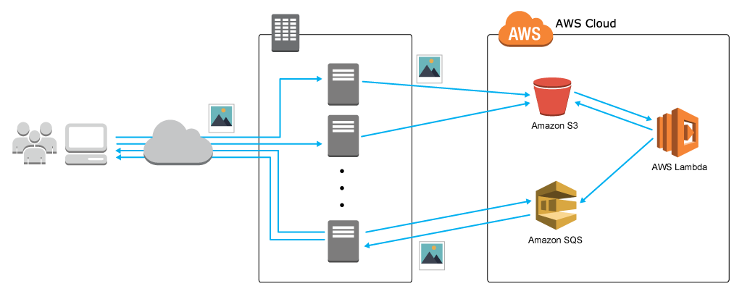
A Real-life Example – Dragon Quest
image data uploaded to Amazon Simple Storage Server (S3)
S3 event triggers AWS Lambda for image processing
outputs from Amazon Simple Queue Service (SQS) are imported into the on-premises servers to save the processed data

Slide 11
A Real-life Example – Dragon Quest
Benefits:
  reduced processing time
    several hours -> 10 seconds
  reduced processing cost
    one twentieth of on premises
  reduced infrastructure and labor cost
    eliminating the labor associated with operations, maintenance, and server replacement

Slide 12
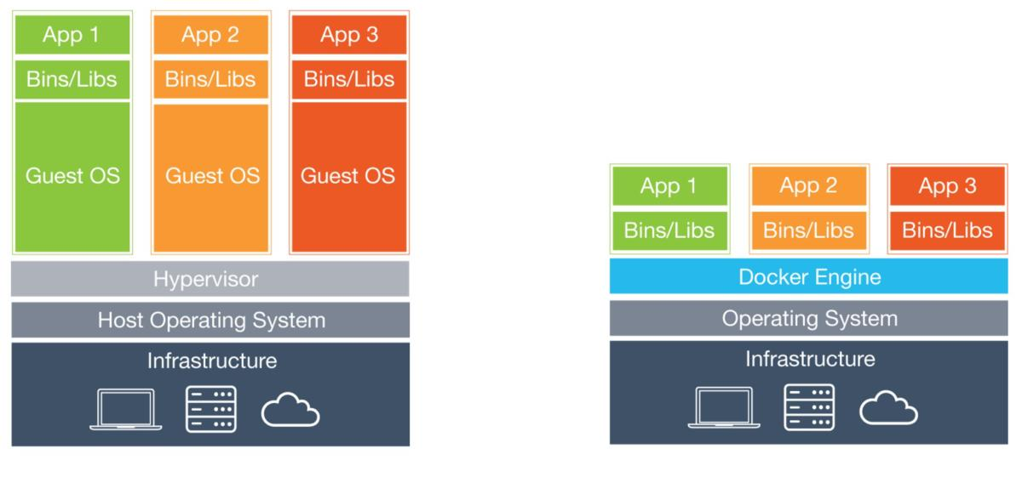
Sandbox Technologies – Virtual Machine
each virtual machine with its own OS
strong isolation
heavy weight
extremely slow startup
VM
hardware abstraction

Slide 13
Sandbox Technologies – Container
all containers share OS
weak isolation
light weight
faster startup
  hundreds of milliseconds
Container
OS-level abstraction

Slide 14
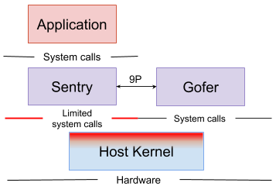
Sandbox Technologies – gVisor
user-space kernel for containers, with stronger isolation
Sentry handles most system calls from application
Gofer handles I/O operations
Sentry and Gofer communicate via 9P protocol
gVisor

Slide 15
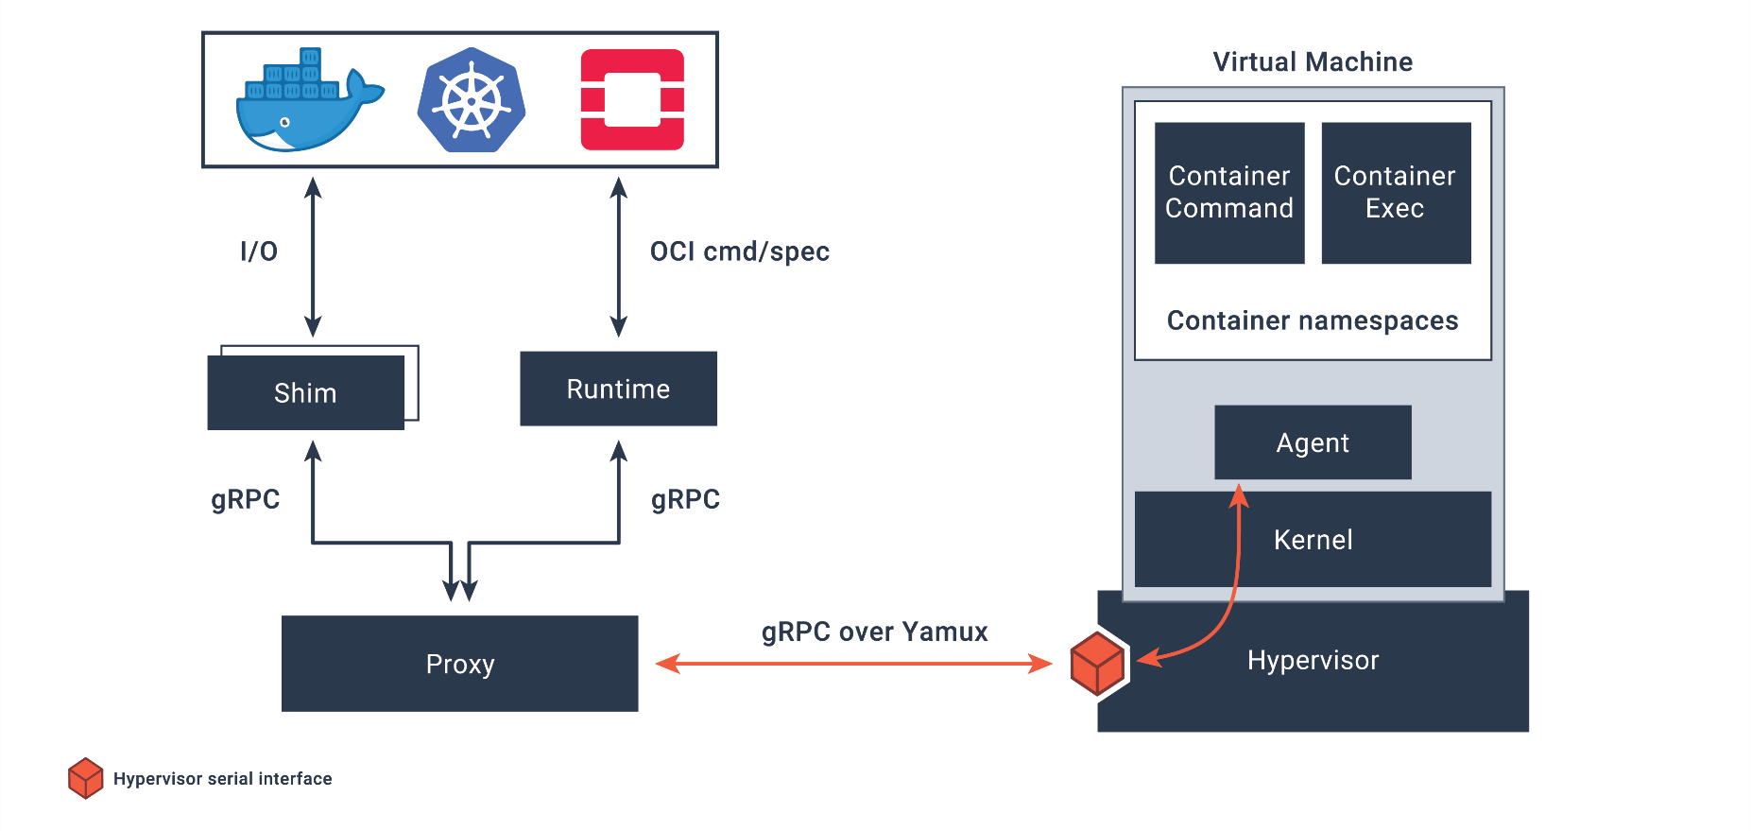
Sandbox Technologies – Kata Container
secure container runtime with light-weight VM

Slide 16
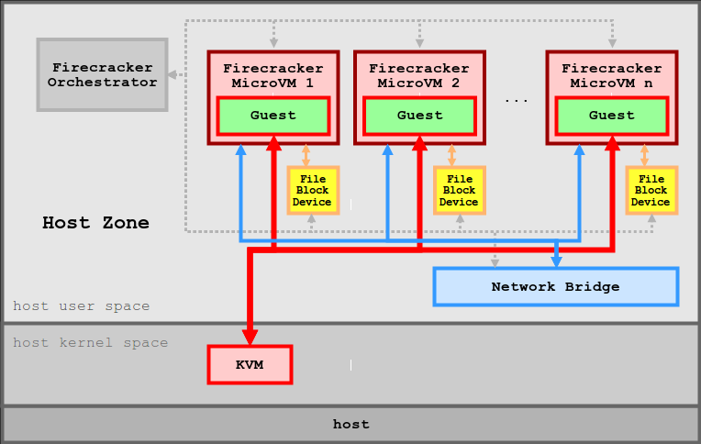
Sandbox Technologies – Firecracker
microVM using KVM
steady and fast startup (125ms)
employed by AWS Lambda

Slide 17

Orchestration - Kubernetes
a system for running and coordinating containers across a cluster of machines
provides predictability, scalability, and high availability
a natural fit for serverless platform implementation

Slide 18
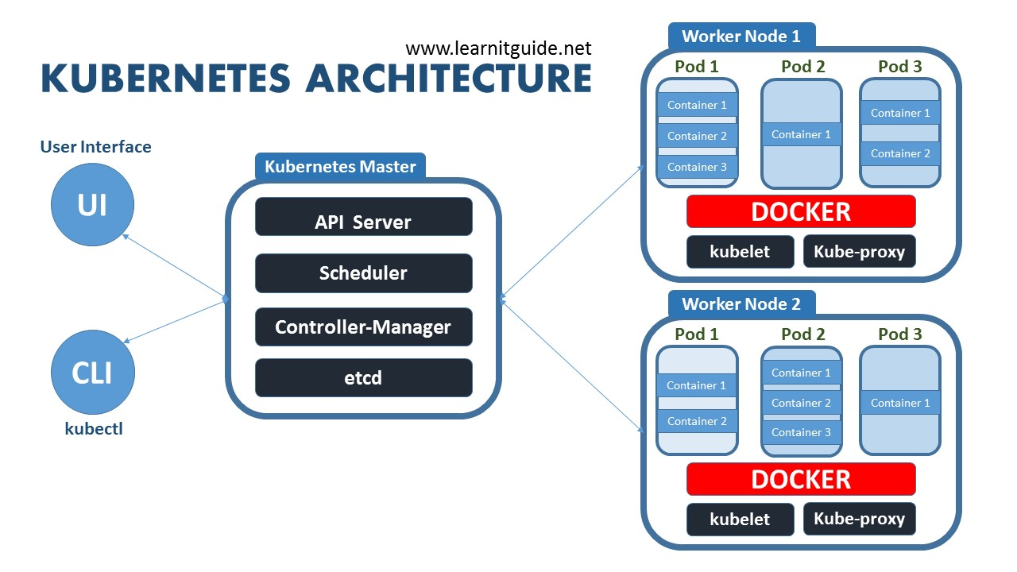
Orchestration - Kubernetes

Slide 19
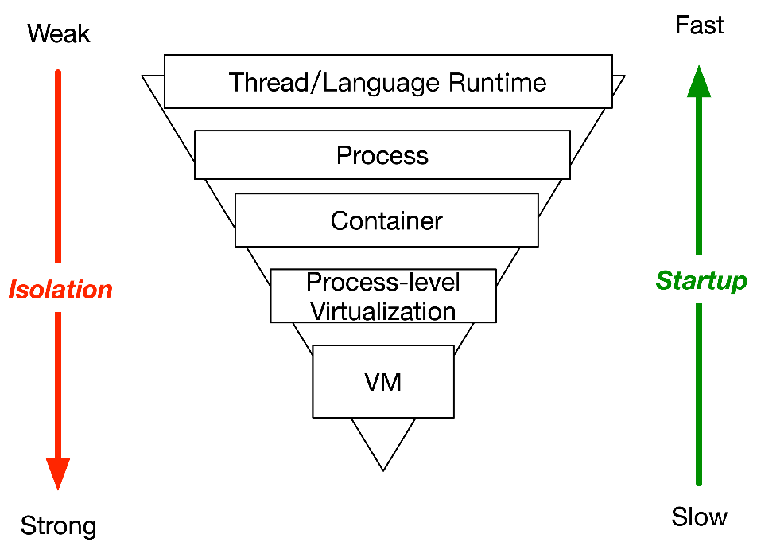
Challenges – Latency
fast start-up and shut-down
fast communication
tail latency
tradeoff with isolation level
Notes:
fast start-up and shut-down
serverless functions are shot-lived. AWS Lambda默认最长执行时间15min （半年前还是5Min），总的来说function的执行时间一般在秒级、毫秒级，甚至更少。
对于传统Long-lived web server（动辄几个月的执行时间）可以忽略的启动和结束时间，在serverless场景中可能是不可接受的。
启动时间直接影响到用户体验，结束时间影响平台灵活性。
fast communication
request -> platform gateway
platform gateway -> function instance
gate way 和instance并不一定在一台机器/一个datacenter，尤其在burst的情况下，通信压力还是很大的
function results -> result receiver
function -> function (chained function)
因为function一般只做一些简单的工作，很多application是由一些function相互串联而成的，类似microservice架构。
tail latency
serverless应用中由于细粒度架构，使得各个环节的tail latency可能极大影响用户体验。
tail latency可能使burst场景下满足SLA更困难。

Slide 20
Challenges – Resource
resource footprint
resource allocation/assignment speed
resource utilization
Notes:
footprint
影响同样host上能hold的instance数量
影响启动时间等
allocation/assignment speed
影响启动时间，同理deallocation速度影响结束时间
为了做到快速，资源可能事先分配好，在idle的时候是其他应用在使用，那么当event trigger时需要很快速地把这部分资源使用权从别的应用程序那里拿过来。
utilization
如果为了速度，过于激进地给Instance分配资源，不给别人用，在idle的时候utilization会非常低，不能接受

Slide 21
Challenges – State handling
real-life applications are often stateful
intermediate states passed between chained functions
via external storage (e.g. Amazon S3)
  storage also needs to be fast, auto-scale, fine-grained
Notes:
although serverless as stateless nature…
Amazon S3: Simple Storage Service

Slide 22
Init-less Loading
Latency introduced by initialization

Slide 23
Startup Latency Breakdown
gVisor+SPECJbb as a case study
  Runtime sandbox initialization：22.33 ms
  Application initialization：1850 ms
2.44 ms
19.88 ms
1850 ms
Configuration Parse
Sandbox
initialization
JVM initialization
Execute handler
gVisor logic
Gateway
Process
The major of startup latency comes from application initialization!

Slide 24
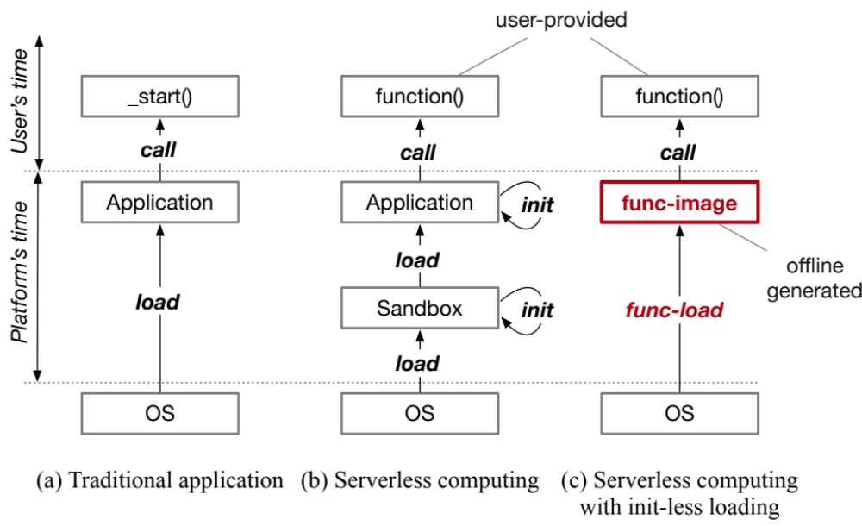
Startup Latency Breakdown
Initializations cause high startup latency for serverless applications
Can we eliminate the initialization phase?

Slide 25
Overview
func-image compilation and func-load
Wrapper program
run
Runtime Initialization
call
Function invocation
Memory
load
save
Func-load
Persistent storage
Function's
entry point
Wrapper program
Func-image
Function
Function
Runtime
Runtime
Notes:
Overview，主要是包含两个部分，func-image compilation和func-load。

Slide 26
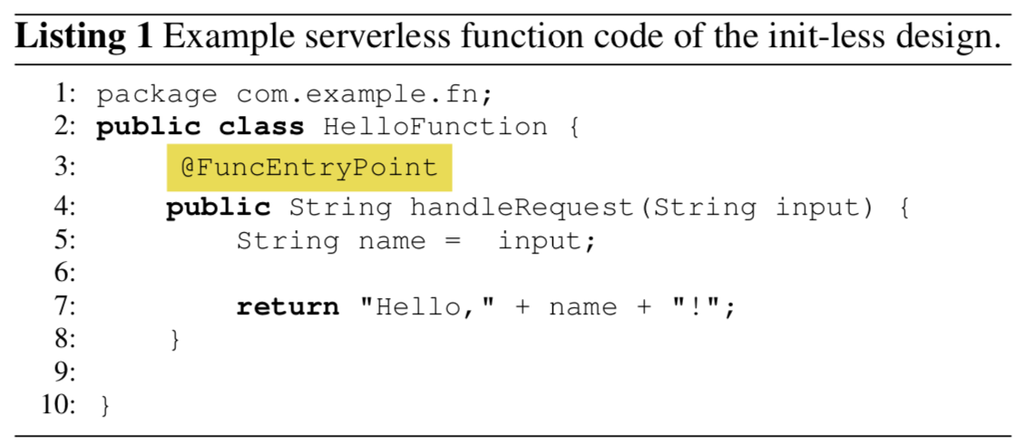
Strawman Implementation
strawman:
  Save (compilation): checkpoint
  Func-load: restore
func-entry point
Which point to checkpoint?
Serverless computing platforms | Default func-entry point
AWS Lambda | before the invocation of handler
Oracle FN Project | before the invocation of cmd
Google Cloud Functions | index.js/function.js/main in package.json
IBM Cloud Function | before main() function
Microsoft Azure Functions | before invocation of entryPoint
Notes:
指定entry-point在serverless 平台是很常见的，我们的调研显示主流的大部分平台都会有要求在配置文件指定handler函数或者是实现一个特定的接口函数。

Slide 27
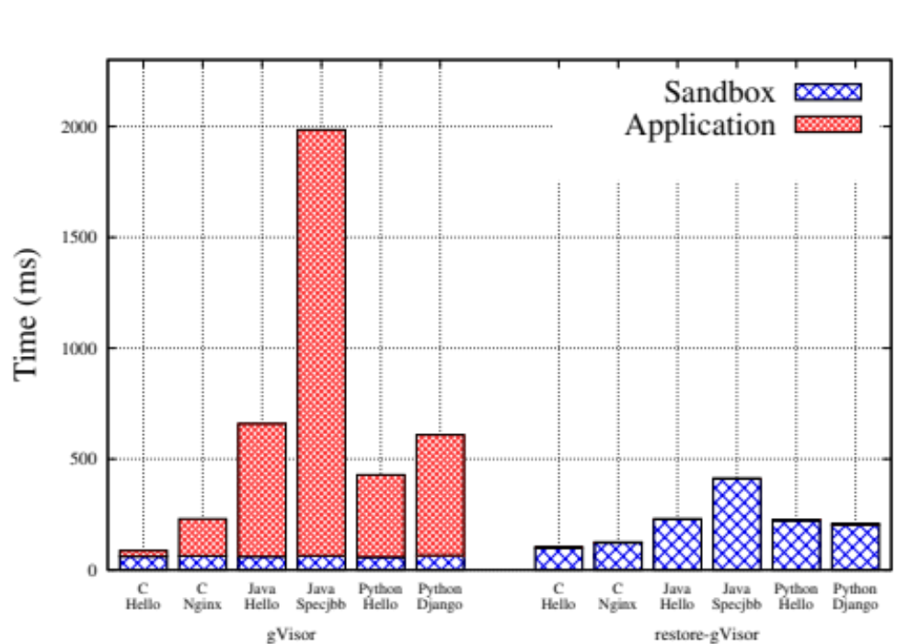
Evaluation of Strawman Implementation
Strawman: gVisor checkpoint/restore + func-entry point
2x-5x improvement than gVisor
Notes:
已经有了很大的提升，application initialization time已经没有了。
但是时间依然很长，并且sandbox initialization的时间变长了。

Slide 28
Evaluation of Strawman Implementation
Strawman: gVisor checkpoint/restore + func-entry point
I/O connection
Metadata load
Memory load
Sandox init
Still can be improved!
Notes:
原因：除了sandbox init之外，还增加了func-load引入三部分restore的开销。
I/O，回复和I/O子系统的连接，如open一个checkpoint状态时open的文件。
Metadata，主要是guest kernel的部分，包含tasklist，fdtable等信息。
Memory，主要是应用和language runtime执行初始化后的内存状态。

