Slide 1
Inter Process Communication
Yubin Xia
IPADS, SJTU
Credit to Timothy Roscoe, ETH

Slide 2
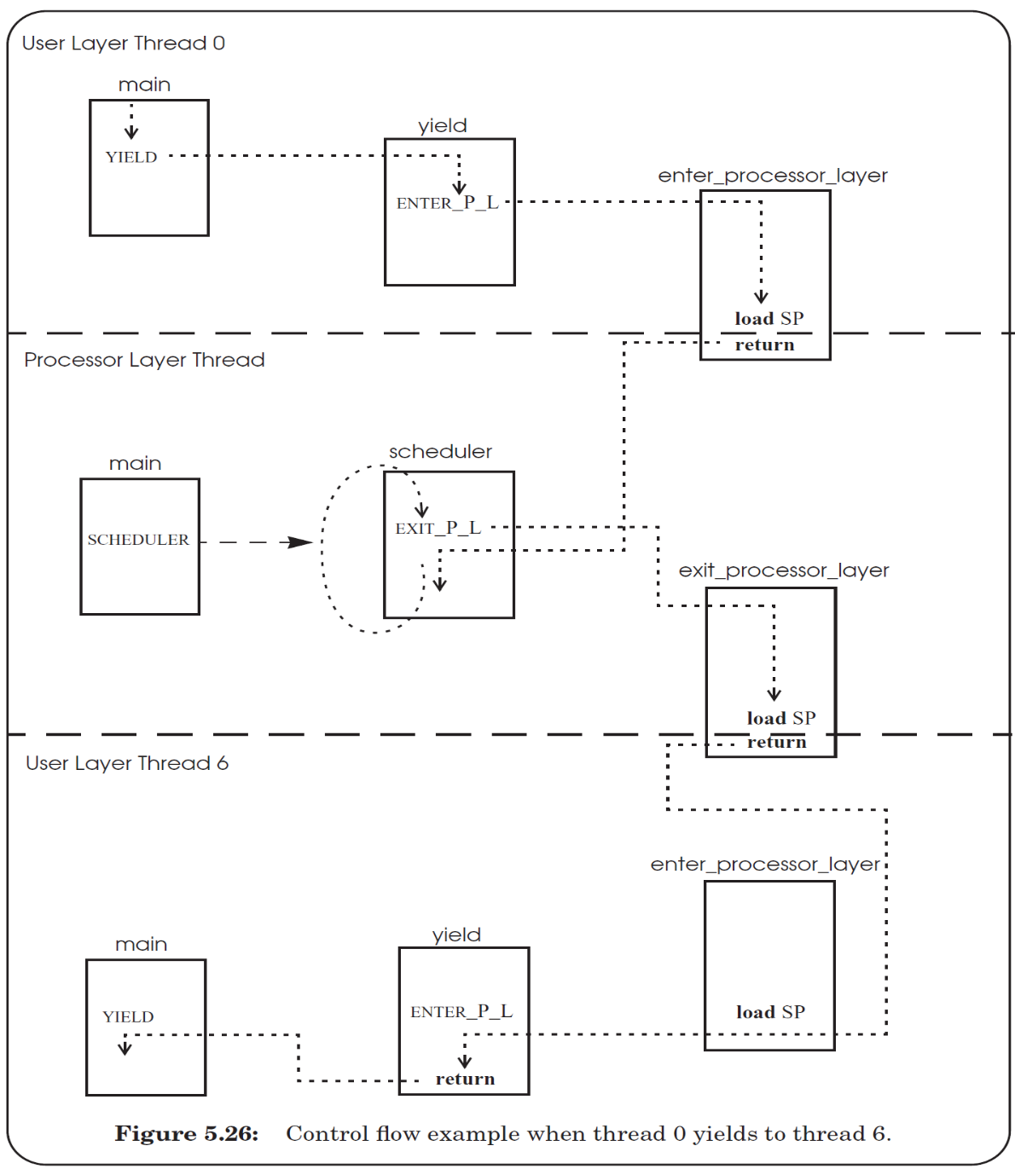
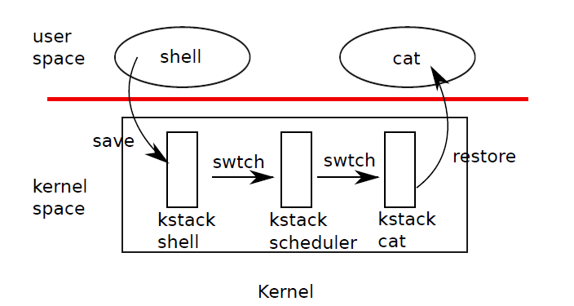
Review: Thread

Slide 3
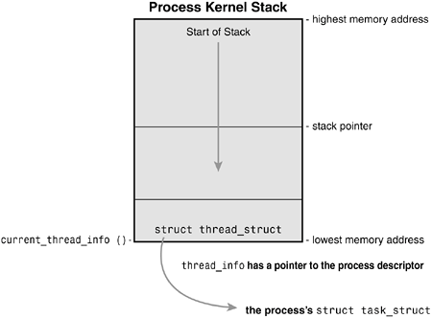
Kernel Stack and thread_struct
In Linux:
struct thread_info {
struct task_struct *task;
struct exec_domain *exec_domain;
unsigned long flags;
unsigned long status;
__u32 cpu;
__s32 preempt_count;
mm_segment_t addr_limit;
struct restart_block restart_block;
unsigned long previous_esp;
__u8 supervisor_stack[0];
};

Slide 4
Review Questions
Q: What is the difference between context and thread?
Q: What is the difference between a kernel thread and a user thread?
Q: Does every user-level thread has a kernel-level thread?
Q: Which one is selected by a scheduler? Context, thread or process?
Q: The number of kernel stack equals to the number of which: context, thread or process?
Q: Can a kernel thread has multiple contexts?
Q: When all CPU cores are running in user-level, all the kernel stacks are empty?
Context is a concept in kernel, because user cannot switch stack
Q: To fully utilize a multi-core CPU, which threading model should be used: user-level thread or kernel thread?
Q: What is the difference between user-level threading and co-routine?

Slide 5
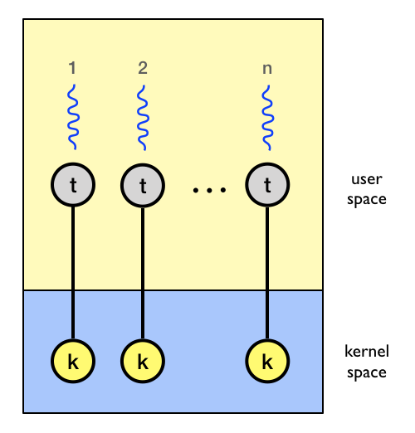
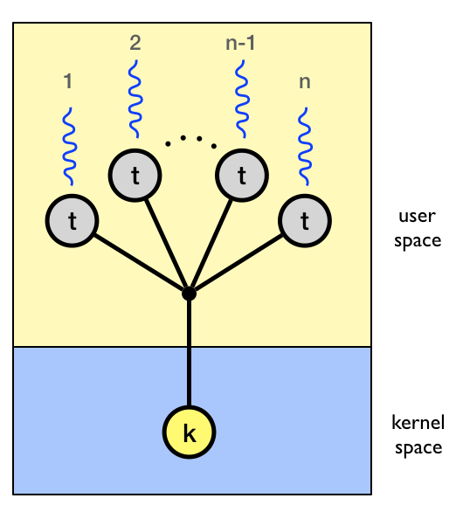
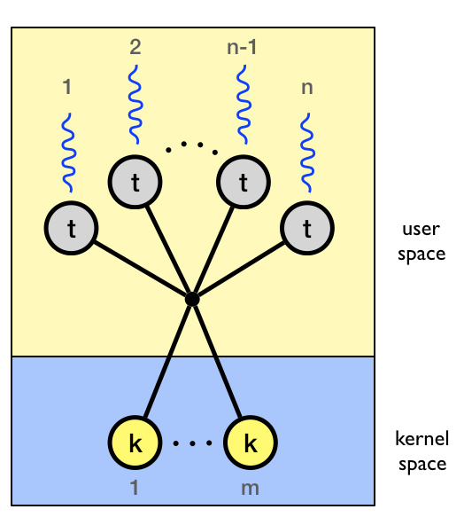
Threading Model
1:1
1:N
M:N

Slide 6
IPC

Slide 7
Cooperating Processes
Independent process cannot affect or be affected by the execution of another process
Cooperating process can affect or be affected by the execution of another process
Advantages of process cooperation
  Information sharing
  Computation speed-up
  Modularity
  Convenience

Slide 8
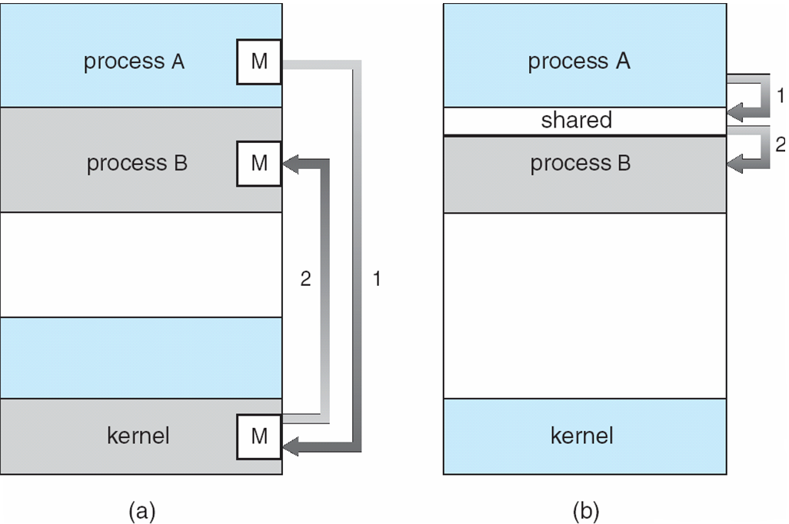
Communications Models

Slide 9
IPC
Cooperating processes need interprocess communication (IPC)
Two models of IPC
  Shared memory
  Message passing

Slide 10
Producer-Consumer Problem
Producer process produces information that is consumed by a consumer process
  unbounded-buffer places no practical limit on the size of the buffer
  bounded-buffer assumes that there is a fixed buffer size

Slide 11
Bounded-Buffer – Shared-Memory Solution
Shared data
      #define BUFFER_SIZE 10
      typedef struct {
      . . .
      } item;
      item buffer[BUFFER_SIZE];
      int in = 0;
      int out = 0;
Solution is correct, but can only use BUFFER_SIZE-1 elements

Slide 12
Bounded-Buffer – Producer
while (true) {
/* Produce an item */
while (((in = (in + 1) % BUFFER SIZE count)
== out)
; /* do nothing -- no free buffers */
buffer[in] = item;
in = (in + 1) % BUFFER SIZE;
}

Slide 13
Bounded Buffer – Consumer
while (true) {
while (in == out)
; // do nothing -- nothing to consume
// remove an item from the buffer
item = buffer[out];
out = (out + 1) % BUFFER SIZE;
return item;
}

Slide 14
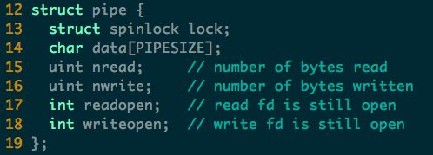
Example of IPC in xv6: Pipe (pipe.c)

Slide 15
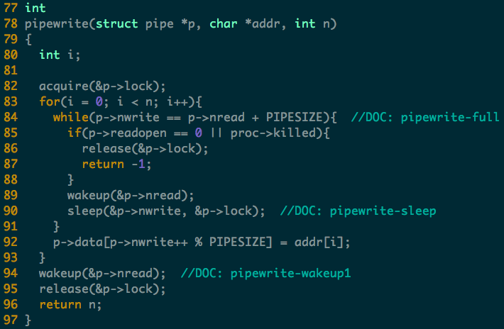
Notes:
Two wakeup here
The first wakeup is since the buffer is full and thus need to be read (previous write).
The second wakeup is similar, ask to read the (current write).
Note: sleep with lock

Slide 16
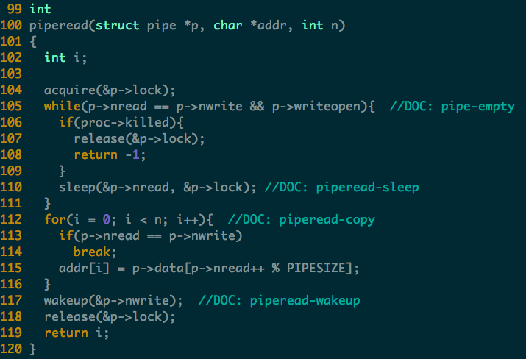
Notes:
Why only one wakeup(writer) here?
In the while loop, no need to wakeup writer since the buffer is empty and no write will sleep
After the for loop, some writer may be waiting (e.g., the buffer was full before read), so wake them up.

Slide 17
IPC – Message Passing
Mechanism for processes to communicate and to synchronize their actions
Message system
  processes communicate with each other without resorting to shared variables
IPC facility provides two operations:
  send(message) – message size fixed or variable
  receive(message)

Slide 18
Message Passing (Cont.)
If P and Q wish to communicate, they need to:
  establish a communication link between them
  exchange messages via send/receive
Implementation of communication link
  physical (e.g., shared memory, hardware bus)
  logical (e.g., logical properties)

Slide 19
Implementation Questions
How are links established?
Can a link be associated with more than two processes?
How many links can be between every pair of communicating processes?
What is the capacity of a link?
Is the size of a message that the link can accommodate fixed or variable?
Is a link unidirectional or bi-directional?

Slide 20
Direct Communication
Processes must name each other explicitly:
  send (P, message) – send a message to process P
  receive(Q, message) – receive a message from process Q
Properties of communication link
  Links are established automatically
  A link is associated with exactly one pair of communicating processes
  Between each pair there exists exactly one link
  The link may be unidirectional, but is usually bi-directional

Slide 21
Indirect Communication
Messages are directed and received from mailboxes (also referred to as ports)
  Each mailbox has a unique id
  Processes can communicate only if they share a mailbox

Slide 22
Indirect Communication
Properties of communication link
  Link established only if processes share a common mailbox
  A link may be associated with many processes
  Each pair of processes may share several communication links
  Link may be unidirectional or bi-directional

Slide 23
Indirect Communication
Operations
  create a new mailbox
  send and receive messages through mailbox
  destroy a mailbox
Primitives are defined as:
send(A, message) – send a message to mailbox A
receive(A, message) – receive a message from mailbox A

Slide 24
Indirect Communication
Mailbox sharing
  P₁, P₂, and P₃ share mailbox A
  P₁, sends; P₂ and P₃ receive
  Who gets the message?
Solutions
  Allow a link to be associated with at most two processes
  Allow only one process at a time to execute a receive operation
  Allow the system to select arbitrarily the receiver. Sender is notified who the receiver was.

Slide 25
Synchronization & Asynchronous
Message passing may be either blocking or non-blocking
Blocking is considered synchronous
  Blocking send has the sender block until the message is received
  Blocking receive has the receiver block until a message is available
Non-blocking is considered asynchronous
  Non-blocking send has the sender send the message and continue
  Non-blocking receive has the receiver receive a valid message or null

Slide 26
Buffering
Queue of messages attached to the link; implemented in one of three ways
  1. Zero capacity – 0 messages
  Sender must wait for receiver (rendezvous)
  2. Bounded capacity – finite length of n messages
  Sender must wait if link full
  3. Unbounded capacity – infinite length
  Sender never waits

Slide 27
Examples of IPC Systems - POSIX
POSIX Shared Memory
  Process first creates shared memory segment
  segment id = shmget(IPC PRIVATE, size, S IRUSR | S IWUSR);
  Process wanting access to that shared memory must attach to it
  shared memory = (char *) shmat(id, NULL, 0);
  Now the process could write to the shared memory
  sprintf(shared memory, "Writing to shared memory");
  When done a process can detach the shared memory from its address space
  shmdt(shared memory);

Slide 28
Communications in Client-Server Systems
Sockets
Remote Procedure Calls
Remote Method Invocation (Java)

Slide 29
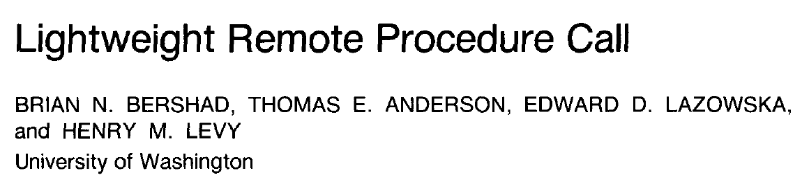
LRPC

Slide 30
Lots of Unix IPC mechanisms
Pipes
Signals
Unix‐domain sockets
POSIX semaphores
FIFOs (named pipes)
Shared memory segments
System V semaphore sets
POSIX message queues
System V message queues
etc.

Slide 31
IPC is usually heavyweight
IPC mechanisms in conventional systems tend to combine:
  Notification: (telling the destination process that something has happened)
  Scheduling: (changing the current runnable status of the destination, or source)
  Data transfer: (actually conveying a message payload)
Unix doesn’t have a lightweight IPC mechanism

Slide 32
IPC in Unix is usually polled
Blocking read()/recv() or select()/poll()
Signals are the nearest thing to upcalls, but...
  Dedicated (small) stack
  Limited number of syscalls available (e.g. semaphores)
  Calling out with longjmp() problematic, to say the least
Unix lacks a good upcall / event delivery mechanism

Slide 33
The Problem
How to perform has cross‐domain invocations?
Does the calling domain/process block?
Is the scheduler involved?
Is more than one thread involved?
What happens across physical processors?

Slide 34
Lightweight RPC (LRPC):
Basic concepts
Simple control transfer: client’s thread executes in server’s domain
Simple data transfer: shared argument stack, plus registers
Simple stubs: i.e. highly optimized marshalling
Design for concurrency: Avoids shared data structures

Slide 35
High overhead of previous efforts
Stubs copy lots of data (not an issue for the network)
Message buffers usually copied through the kernel (4 copies!)
Access validation
Message transfer (queueing/dequeuing of messages)
Scheduling: programmer sees thread crossing domains, system actually rendezvous’s two threads in different domains
Context switch (x 2)
Dispatch: find a receiver thread to interpret message, and either dispatch another thread, or leave another one waiting for more messages

Slide 36
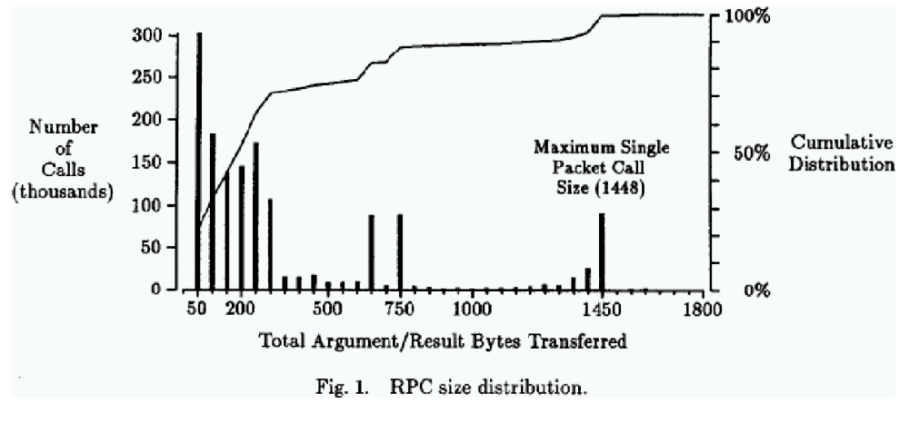
Most messages are short

Slide 37
LRPC Binding: connection setup phase
Procedure Descriptors (PDs) registered with kernel for each procedure in the called interface
For each PD, argument stacks (A‐stacks) are preallocated and mapped read/write in both domains
Kernel preallocates linkage records for return from A‐stacks
Returns A‐stack list to client as (unforgeable) Binding Object

Slide 38
Calling sequence (all on client thread)
Verify Binding Object, find correct PD
Verify A‐Stack, find corresponding linkage
Ensure no other thread using that A‐stack/linkage pair
Put caller’s return addr and stack pointer in linkage
Push linkage on to thread control block’s stack (for nested calls)
Find an execution stack (E‐stack) in server’s domain
Update thread’s SP to run off E‐stack
Perform address space switch to server domain
Upcall server’s stub at address given in PD

Slide 39
LRPC discussion
Main kernel housekeeping task is allocating A‐stacks and E‐stacks
Shared A‐stacks reduce copying of data while still safe
Stubs incorporated other optimizations (see paper)
Address space switch is most of the overhead (no TLB tags)
For multiprocessors:
  Check for processor idling on server domain
  If so, swap calling and idling threads
    (note: thread migration was very cheap on the Firefly!)
  Same trick applies on return path

