Slide 1
Interrupt
Yubin Xia
IPADS, SJTU
ACKs: Some slides are adapted from the textbook’s original slides and Frans’s os course notes

Slide 2
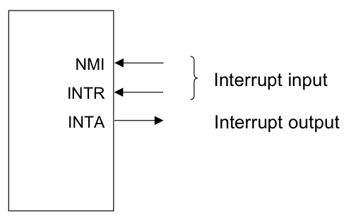
Review: Events causing User->Kernel
Device interrupt: external
  Nonmaskable interrupt (NMI)
  input pin
  Interrupt (INTR) input pin
Software interrupt: execution of the Interrupt instruction
  e.g., INT
Program faults: If some error condition occur by the execution of an instruction. E.g.,
  divide-by-zero interrupt

Slide 3
Review: OS as Services
Exception
Application (CPU)
Exception
Table
OS
Services
I/O Device
Interrupt
Notes:
Question: what if

Slide 4
Review: Terminology for Intel
Interrupts (asynchronous, device generated)
  Maskable: device-generated, associated with IRQs (interrupt request lines); may be temporarily disabled (still pending)
  Nonmaskable: some critical hardware failures
Exceptions (synchronous, from software)
  Processor-detected
    Faults – correctable (restartable); e.g. page fault
    Traps – no reexecution needed; e.g. breakpoint
    Aborts – severe error; process usually terminated (by signal)
  Programmed exceptions (software interrupts)
    int (system call), int3 (breakpoint)
    into (overflow), bounds (address check)

Slide 5
Putting It All Together
Memory Bus
IRQs
0
PIC
(8259A)
CPU
IDTR
INTR
255
IDT
vector
N
handler
Mask points
0

Slide 6
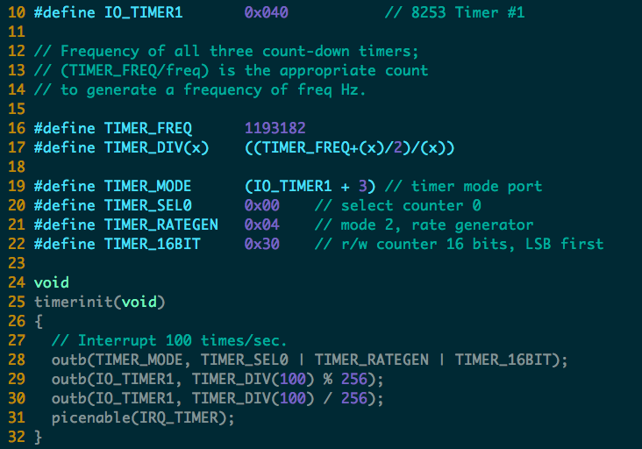

Slide 7
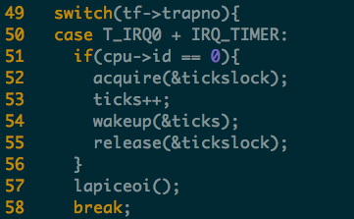
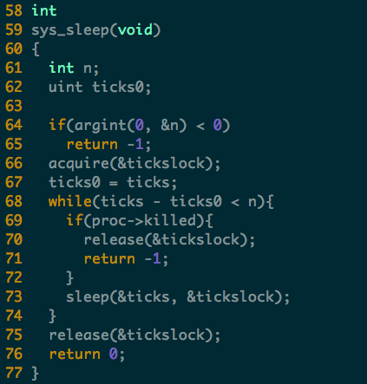
Timer Interrupt

Slide 8
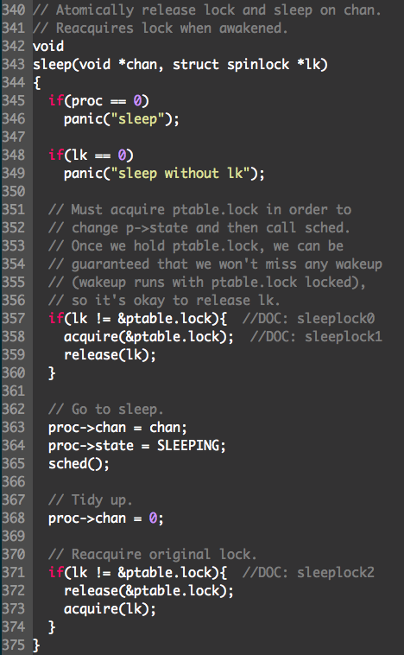
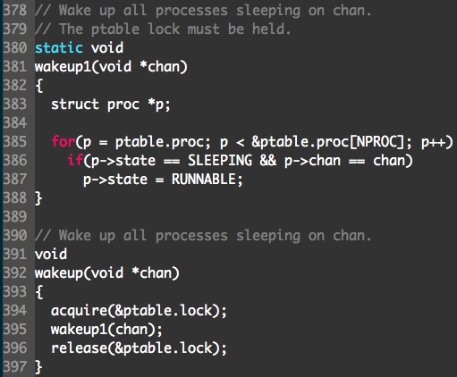
Sleep & Wakeup

Slide 9
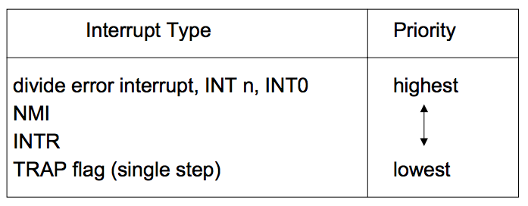
Interrupt Priority
When different types of interrupt (i.e., software, NMI, INTR or exceptions) occur at the same time, the one with the highest priority is handled first
Intel microprocessors use the following order of priority:

Slide 10
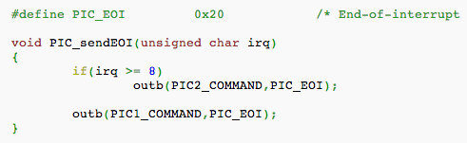
EOI: End of Interrupt
Issued to the PIC chips at the end of an IRQ-based interrupt routine
  If the IRQ came from the Master PIC, it is sufficient to issue this command only to the Master PIC;
  If the IRQ came from the Slave PIC, it is necessary to issue the command to both PIC chips

Slide 11
Nested Interrupts
What if a second interrupt occurs while an interrupt routine is excuting?
Generally a good thing to permit that — is it possible?
And why is it a good thing?

Slide 12
Maximizing Parallelism
Keep all I/O devices as busy as possible
In general, an I/O interrupt represents the end of an operation
  Another request should be issued ASAP
Most devices do not interfere with each others' data structures
  No reason to block out other devices

Slide 13
Handling Nested Interrupts
As soon as possible, unmask the global interrupt
As soon as reasonable, re-enable interrupts from that IRQ
But that is not always a great idea, since it could cause re-entry to the same handler
IRQ-specific mask is not enabled during interrupt-handling

Slide 14
Nested Execution
Interrupts can be interrupted
  By different interrupts; handlers need not be reentrant
  Small portions execute with interrupts disabled
  Interrupts remain pending until acked by CPU
Exceptions can be interrupted
  By interrupts (devices needing service)
Exceptions can nest two levels deep
  Exceptions indicate coding error
  Exception code (kernel code) should not have bugs
  Page fault is possible (trying to touch user data)

Slide 15
Interrupt Masking
Two different types: global and selective
  Global — delays all interrupts
  Selective — mask individual IRQs selectively
    This is usually what's needed — interference most common from two interrupts of the same type
NMI (Non-Maskable Interrupt)

Slide 16
Triple Fault
Things never to do in an OS #1: Swap out the page swapping code (triple-fault here we come) —Kemp
When a fault occurs, the CPU invokes an exception handler.
If a fault occurs while trying to invoke the exception handler, that's called a double fault, which the CPU tries to handle with yet another exception handler.
If that invocation results in a fault too, the system reboots with a triple fault.
Notes:
A triple fault is usually a sign that the exception handler called is faulty, or worse, that the whole exception handling in your system is screwed up. (LDT or GDT issues, bogus pointers or faulty memory mappings are frequent offenders.)
Another frequent cause of triple faults is a kernel stack overflow. If the stack reaches an invalid page (one with its present bit clear), a page fault is generated. However, the CPU faults while trying to push the exception information on to the stack, so a double fault is generated. The same problem still exists so a triple fault is generated.

Slide 17
/proc/interrupts
$ cat /proc/interrupts
CPU0
0: 865119901 IO-APIC-edge timer
1: 4 IO-APIC-edge keyboard
2: 0 XT-PIC cascade
8: 1 IO-APIC-edge rtc
12: 20 IO-APIC-edge PS/2 Mouse
14: 6532494 IO-APIC-edge ide0
15: 34 IO-APIC-edge ide1
16: 0 IO-APIC-level usb-uhci
19: 0 IO-APIC-level usb-uhci
23: 0 IO-APIC-level ehci-hcd
32: 40 IO-APIC-level ioc0
33: 40 IO-APIC-level ioc1
48: 273306628 IO-APIC-level eth0
NMI: 0
ERR: 0
Columns: IRQ, count, interrupt controller, devices

Slide 18
More in /proc/pci:
$ cat /proc/pci
PCI devices found:
Bus 0, device 0, function 0:
Host bridge: PCI device 8086:2550 (Intel Corp.) (rev 3).
Prefetchable 32 bit memory at 0xe8000000 [0xebffffff].
Bus 0, device 29, function 1:
USB Controller: Intel Corp. 82801DB USB (Hub #2) (rev 2).
IRQ 19.
I/O at 0xd400 [0xd41f].
Bus 0, device 31, function 1:
IDE interface: Intel Corp. 82801DB ICH4 IDE (rev 2).
IRQ 16.
I/O at 0xf000 [0xf00f].
Non-prefetchable 32 bit memory at 0x80000000 [0x800003ff].
Bus 3, device 1, function 0:
Ethernet controller: Broadcom NetXtreme BCM5703X Gigabit Eth (rev 2).
IRQ 48.
Master Capable. Latency=64. Min Gnt=64.
Non-prefetchable 64 bit memory at 0xf7000000 [0xf700ffff].

Slide 19
Bottom half (in Linux)

Slide 20
Interrupt Handling Philosophy
To preserve IRQ order on the same line, must disable incoming interrupts on same line
  New interrupts can get lost if controller buffer overflow
Interrupt preempts what CPU was doing, which may be important
Even not important, undesirable to block user program for long
So, handler must run for a very short time!
  Do as little as possible in the interrupt handler
    Often just: queue a work item and set a flag
  Defer non-critical actions till later
Notes:
What disable mean: cpu or PIC not accepting, but device controller can still accept (limited by buffer size)

Slide 21
Intr Handlers Have No Process Context
Interrupts (as opposed to exceptions) are not associated with particular instructions
They are also not associated with a given process (user program)
The currently-running process, at the time of the interrupt, has no relationship whatsoever to that interrupt
Interrupt handlers cannot sleep!

Slide 22
Why No Sleep?
The interrupt handler has no way of knowing what the interrupted process was doing. An example:
  Process1 enters kernel mode.
  Process1 acquires LockA.
  Interrupt occurs.
  ISR tries to acquire LockA.
  ISR calls sleep to wait for LockA to be released.
At this point, you have a deadlock:
  Process1 can't resume execution until the ISR is done with its stack, but the ISR is blocked waiting for Process1 to release LockA
https://stackoverflow.com/questions/1053572/why-kernel-code-thread-executing-in-interrupt-context-cannot-sleep

Slide 23
What Can’t You (ISR) Do?
You cannot sleep
  or call something that might sleep
You cannot refer to current
You cannot allocate memory with GPF_KERNEL (which can sleep), you must use GPF_ATOMIC (which can fail)
You cannot call schedule()
You cannot do a down() semaphore call
  However, you can do an up()
You cannot transfer data to/from user space
  E.g., copy_to_user(), copy_from_user()

Slide 24
Interrupt Stack
When an interrupt occurs, what stack is used?
  Exceptions: The kernel stack of the current process, whatever it is, is used (There’s always some process running — the "idle" process, if nothing else)
  Interrupts: hard IRQ stack (1 per processor)
  SoftIRQs: soft IRQ stack (1 per processor)
These stacks are configured in the IDT and TSS at boot time by the kernel

Slide 25
Top and Bottom Halves
Top-half: do minimum work and return
  ISR (Interrupt Service Routine)
Bottom-half: deferred processing
  softirqs, tasklets, workqueues, kernel threads
Top half
Bottom half
tasklet
softirq
workqueue
kernel thread

Slide 26
Top Half: Do it Now!
Perform minimal, common functions: saving registers, unmasking other interrupts. Eventually, undoes that: restores registers, returns to previous context.
Most important: call proper interrupt handler provided in device drivers (C program)
Typically queue the request and set a flag for deferred processing
Top half
softirq
Softirq flag = 0
Softirq flag = 1

Slide 27
Bottom Half: Do it Later!
Mechanisms to defer work to later:
  softirqs
  tasklets (built on top of softirqs)
  work queues
  kernel threads
All can be interrupted

Slide 28
Softirqs
Statically allocated: specified at kernel compile time
Limited number:
Priority Type
0 High-priority tasklets
1 Timer interrupts
2 Network transmission
3 Network reception
4 Block devices
5 Regular tasklets

Slide 29
When Do Softirqs Run?
Run at various points by the kernel:
  After system calls
  After exceptions
  After interrupts (top halves/IRQs, including the timer intr)
  When the scheduler runs ksoftirqd
Softirq routines can be executed simultaneously on multiple CPUs:
  Code must be re-entrant
  Code must do its own locking as needed
Hardware interrupts are enabled when softirqs run

Slide 30
Rescheduling Softirqs
A softirq routine can reschedule itself
  i.e., raise one softirq when handling a softirq
Problem: while processing one softirq, another is raised. Process it?
  No -> long delay for new irq
  Always -> starve user program when long softirq burst
  Livelock!
Solution: Quota + dedicated context ksoftirqd
  Softirq scheduler only runs a limited number of requests at a time
  The rest are executed by a kernel thread, ksoftirqd, which competes with user processes for CPU time
  Ksoftirqd subject to scheduling, as user process
ksoftirqd

Slide 31
Tasklets
Problem: softirq is static
  To add a new type of Softirq, need to convince Linus!
Solution: tasklets
  Built on top of softirq
  New types are created and destroyed dynamically
  Simplified for multi-core processing: at any time, only one tasklet among all of the same type can run
Problem with softirq and tasklets
  They have no process contexts, thus cannot sleep

Slide 32
Tasklets
Can be created and destroyed dynamically
Run on the CPU that scheduled it (cache affinity)
Individual tasklets are locked during execution
  no problem about re-entrancy
  no need for locking by the code
Tasklets can run in parallel on multiple CPUs
  Same tasklet can only run on one CPU
Were once the preferred mechanism for most deferred activity, now changing

Slide 33
The Trouble with Tasklets
Hard to get right
One has to be careful about sleeping
Run at higher priority than other tasks
Can produce uncontrolled latency if coded badly
Ongoing discussion about eliminating tasklets
  Will likely slowly fade over time

Slide 34
Work Queues
Softirqs and tasklets run in an interrupt context; work queues have a process context
The idea:
  You throw work (fn, args) to a workqueue
  Workqueue add to an internal FIFO queue
  A dedicated workqueue process loops forever, dequeuing (fn, args), and running fn(args)
Since they have a process context, they can sleep
  They are kernel-only; no user mode associated with it
  Do not try copying data into/out of user space
Notes:
To create a workqueue, call creat_workqueue("name")
The add a deferred task, call queue_work(), which will add a work item (fn, args) to a queue
Kernel will create a thread, looping forever (until workqueue destroyed). Each iteration will dequeue (fn, args), and run fn on args.

Slide 35
Kernel Threads
Always operate in kernel mode
  Again, no user context
2.6.30 introduced the notion of threaded interrupt handlers
  Imported from the realtime tree
  request_threaded_irq()
  Now each bottom half has its own context, unlike work queues
  Idea is to eventually replace tasklets and work queues

Slide 36
Comparing Approaches
 | ISR | SoftIRQ | Tasklet | WorkQueue | KThread
Will disable all interrupts? | Briefly | No | No | No | No
Will disable other instances of self? | Yes | Yes | No | No | No
Higher priority than regular scheduled tasks? | Yes | Yes* | Yes* | No | No
Will be run on same processor as ISR? | N/A | Yes | Yes | Yes | Maybe
More than one run can on same CPU? | No | No | No | Yes | Yes
Same one can run on multiple CPUs? | Yes | Yes | No | Yes | Yes
Full context switch? | No | No | No | Yes | Yes
Can sleep? (Has own kernel stack) | No | No | No | Yes | Yes
Can access user space? | No | No | No | No | No
*Within limits, can be run by ksoftirqd

Slide 37
System Calls

Slide 38
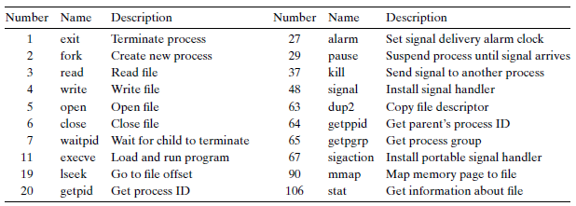
System Calls in Previous Classes (Partial)

Slide 39
Tracing System Calls
Linux has a powerful mechanism for tracing system call execution for a compiled application
Output is printed for each system call as it is executed, including parameters and return codes
The ptrace() system call is used
  Also used by debuggers (breakpoint, singlestep, etc)
Use the "strace" command (man strace for info)
You can trace library calls using the "ltrace" command

Slide 40
Using strace
int main() {
write(1, "Hello world!\n", 13);
}
$ strace -o hello.out ./hello
execve("./hello2", ["./hello2"], [/* 59 vars */]) = 0
uname({sys="Linux", node="kiwi", ...}) = 0
brk(0) = 0xca9000
brk(0xcaa1c0) = 0xcaa1c0
arch_prctl(ARCH_SET_FS, 0xca9880) = 0
brk(0xccb1c0) = 0xccb1c0
brk(0xccc000) = 0xccc000
write(1, "Hello world!\n", 13) = 13
exit_group(13) = ?
Notes:
arch_prctl: set architecture-specific thread state. ARCH_SET_FS Set the 64-bit base for the FS register to addr.

Slide 41
2 Ways to Do System Calls: From Coder’s View
Using C (glibc)
E.g., open()
Application
1
Using assembly
E.g., "int 0x80"
Library
2
Kernel

Slide 42
3 Ways to Do System Calls: From Machine’s View
int 0x80
SYSENTER
SYSCALL
Application
Library
Kernel

Slide 43
Example of Calling exit()
int main(int argc, char *argv[]) {
unsigned int syscall_nr = 60; // 60 is for exit()
int exit_status = 42; // 42 is the return value
asm ("movl %0, %%eax\n"
"movl %1, %%ebx\n"
"int $0x80"
:
: "m" (syscall_nr), "m" (exit_status)
: "eax", "ebx");
}

Slide 44
Lib call/Syscall Return Codes
Library calls return -1 on error and place a specific error code in the global variable errno
System calls return specific negative values to indicate an error in %eax
  Most system calls return -errno
The library wrapper code is responsible for conforming the return values to the errno convention

Slide 45
Passing System Call Parameters
The first parameter is always the syscall #
  eax on Intel
Linux allows up to six additional parameters
  ebx, ecx, edx, esi, edi, ebp on Intel
System calls that require more parameters package the remaining params in a struct and pass a pointer to that struct as the sixth parameter
Problem: must validate pointers
  Could be invalid, e.g. NULL ➔ crash OS
  Or worse, could point to OS, device memory ➔ security hole

Slide 46
How to validate user pointers?
Too expensive to do a thorough check
  Need to check that the pointer is within all valid memory regions of the calling process
Solution: No comprehensive check
  Linux does a simple check for address pointers and only determines if pointer variables are within the largest possible range of user memory (more details when talking about process)
  Even if a pointer value passes this check, it is still quite possible that the specific value is invalid
  Dereferencing an invalid pointer in kernel code would normally be interpreted as a kernel bug and generate an Oops message on the console and kill the offending process
  Linux does something very sophisticated to avoid this situation

Slide 47
Handling faults due to user-pointers
Kernel code must access user-pointers using a small set of "paranoid" routines (e.g. copy_from_user)
  Thus, kernel knows what addresses in its code can throw invalid memory access exceptions (page fault)
When a page fault occurs, the kernel’s page fault handler checks the faulting EIP (recall: saved by hw)
If EIP matches one of the paranoid routines, kernel will not oops; instead, will call "fixup" code
Many violations of this rule in Linux. Tons of security holes are found

Slide 48
Paranoid functions to access user pointers
Function | Action
get_user(), __get_user() | reads integer (1,2,4 bytes)
put_user(), __put_user() | writes integer (1,2,4 bytes)
copy_from_user(), __copy_from_user | copy a block from user space
copy_to_user(), __copy_to_user() | copy a block to user space
strncpy_from_user(), __strncpy_from_user() | copies null-terminated string from user space
strnlen_user(), __strnlen_user() | returns length of null-terminated string in user space
clear_user(), __clear_user() | fills memory area with zeros

Slide 49
New Instruction:
SYSENTER/SYSEXIT & SYSCALL/SYSRET
"int 0x80" is Obsolete
  Windows XP does not use it any more
  That’s why it requires at least Pentium II
New Instructions
  SYSENTER/SYSEXIT: Intel, and then AMD
  SYSCALL/SYSRET: AMD, and then Intel

Slide 50
Simplify System Call by SYSCALL/SYSRET
SYSCALL/SYSRET has lower latency
  Less than 25% of the cycles of previous solution
Why faster?
  Assume OS implements a flat-memory model
  Simplifies calls to and returns from the OS
  Eliminating unneeded checks, and by loading pre-determined values into the CS and SS segment registers
More details: http://wiki.osdev.org/SYSENTER

Slide 51
Compatibility across Intel and AMD
For a 32-bit Kernel
  SYSENTER/SYSEXIT are the only compatible pair
For a 64-bit Kernel
  SYSCALL/SYSRET are the only compatible pair
  In Long mode only (not Long Compat mode)

Slide 52
Using SYSCALL to Invoke the exit() System Call
#include <unistd.h>
int main(int argc, char *argv[]) {
unsigned long syscall_nr = 60;
long exit_status = 42;
syscall(syscall_nr, exit_status);
}
int main(int argc, char *argv[]) {
unsigned long syscall_nr = 60;
long exit_nr = 42;
asm ("movq %0, %%rax\n"
"movq %1, %%rdi\n"
"syscall"
: :
"m" (syscall_nr), "m" (exit_nr) :
"rax", "rdi"); }

Slide 53
System Call
Fetch the n’th descriptor from the IDT, where n is the argument of int.
Check that CPL in %cs is <= DPL, where DPL is the privilege level in the descriptor.
Save %esp and %ss in a CPU-internal registers, but only if the target segment selector’s PL < CPL.
Load %ss and %esp from a task segment descriptor.
Push %ss, %esp, %eflags, %cs, %eip,
Clear some bits of %eflags
Set %cs and %eip to the values in the descriptor

Slide 54
System Call: INT Instruction
decide the vector number, in this case it's the 0x80 in ``int 0x80’’
fetch the interrupt descriptor for vector 0x80 from the IDT.
  (the CPU finds it by taking the 0x40'th 8-byte entry starting at the physical address that the IDTR CPU register points to)
check that CPL <= DPL in the descriptor (but only if INT instruction).
save ESP and SS in a CPU-internal register (but only if target segment selector's PL < CPL) (*)
load SS and ESP from TSS
push user SS (*)
push user ESP (*)
push EFLAGS
push CS
push EIP
clear some EFLAGS bits (on interrupts, see below)
set CS and EIP from IDT descriptor's segment selector and offset
4, 6 and 7 are not needed if trap happens in kernel space

Slide 55
vDSO
Virtual Dynamic Shared Object

Slide 56
The Motivation of vDSO
The latency of syscall is not negligible
  Especially for those called frequently
    E.g., gettimeofday()
How to reduce the latency of syscall?
  Most of the time is for state saving/restoring
  If no mode switching, then no state saving/restoring

Slide 57
The Code of gettimeofday()
Defined by the kernel
  As a part of kernel code during compiling
Run in user space
  The code is loaded into a page shared with user
  The page is as known as vDSO
    Virtual Dynamic Shared Object
  Time value is also mapped to user space (read-only)
    Can only be changed in kernel mode
The source can be found in arch/x86/vdso/vclock_gettime.c

Slide 58
Where is the Shared Page for vDSO?
$ ldd `which bash`
linux-vdso.so.1 => (0x00007fff667ff000)
libtinfo.so.5 => /lib/x86_64-linux-gnu/libtinfo.so.5 (0x00007f623df7d000)
libdl.so.2 => /lib/x86_64-linux-gnu/libdl.so.2 (0x00007f623dd79000)
libc.so.6 => /lib/x86_64-linux-gnu/libc.so.6 (0x00007f623d9ba000)
/lib64/ld-linux-x86-64.so.2 (0x00007f623e1ae000)

Slide 59
Flex-SC
  Flexible System Call Scheduling with Exception-Less System Calls, OSDI’10

Slide 60
The Motivation
How to further reduce the latency of syscall?
  Not only for gettimeofday()
Where does the latency come from?
  Mostly for the state switch
    Save and restore states
    Privilege checking
  Cache pollution
Could we do syscall without state switching?

Slide 61
Flexible System Call
New syscall mechanism – Flexible System Call
  Introduce system call page that is shared by user & kernel
  User threads can push the system call requests into the system call page
  kernel threads will poll the system call requests out the system call page
Exception-less syscall
  Remove synchronicity by decoupling invocation from execution

Slide 62
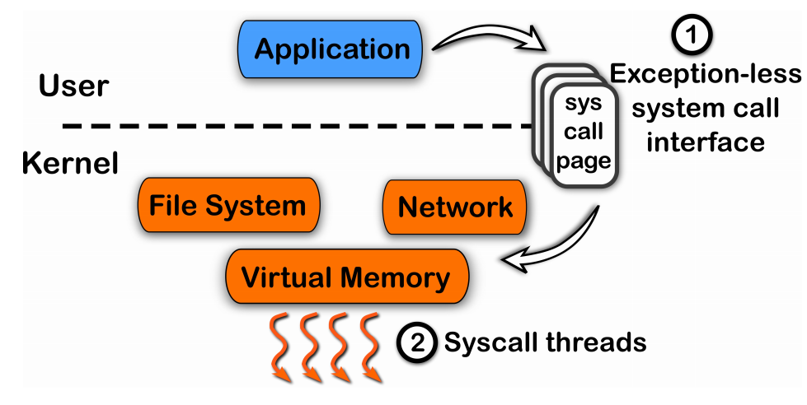
FlexSC: Another Way to System Call

Slide 63
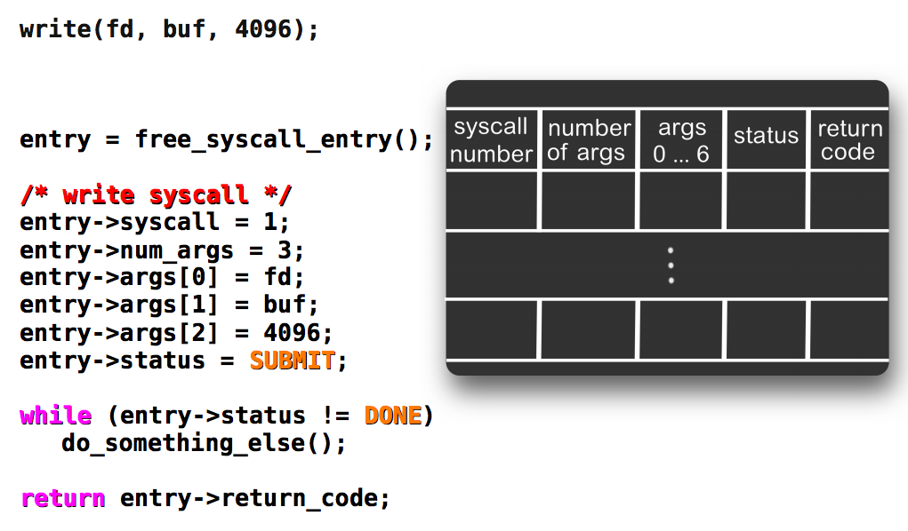
Exception-less System Call

Slide 64
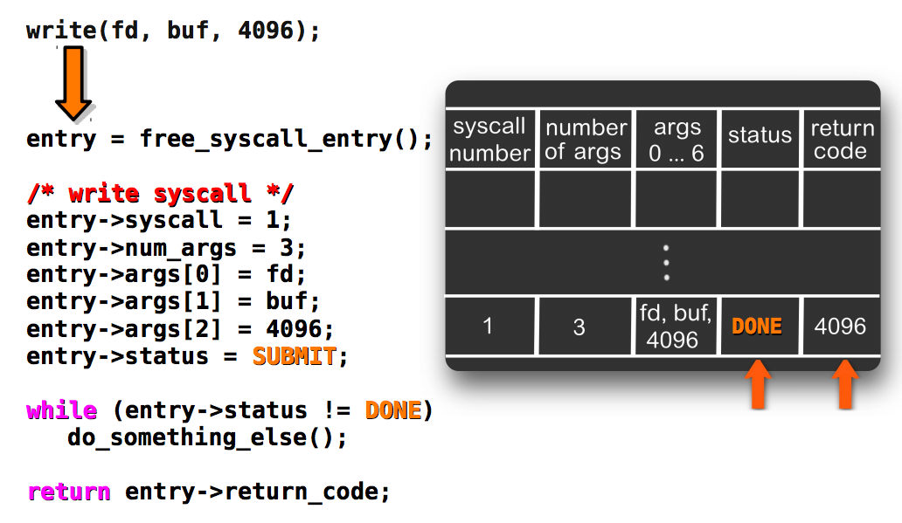
Kernel Fill the Results

Slide 65
Running on a Single Core: Single Threads
Application
Push system call
User
Kernel
Sys call page
Sys call page
Switch to user
Sys call page
Switch to kernel
a
b
c
d
Kernel threads
pull system call

Slide 66
Running on a Single Core: Multiple Threads
switch
switch
switch
user thread
user thread
user thread
user thread
user thread
user thread
user thread
user thread
Push system call
Sys call page
Push system call
Sys call page
Push system call
Push system call
Sys call page
a
b
User mode
Kernel mode
Switch to kernel
Switch to user
c
d
kernel thread
pull system call
FlexSC: Flexible System Call Scheduling with Exception-Less System Calls

Slide 67
Conclusion
System call VS. function call
  Trap! Switching the mode
  State saving/restoring, changing stack, checking…
‘Int 0x80’ is not enough
  New instructions for lower latency
  vDSO for reducing trapping
  FlexSC for further reducing trapping by multi-core

Slide 68
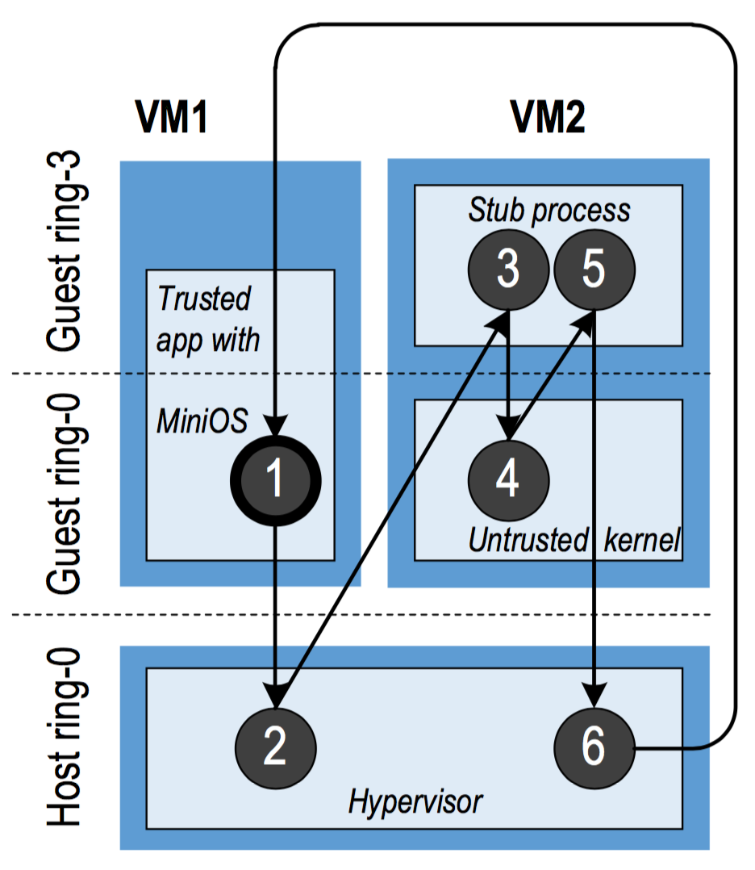
Cross-Mode Calls
ProxOS
  Two virtual machines, one is trusted and the other is untrusted
  Redirect untrusted system calls to the untrusted VMs
  Overhead of mode switching could be high!
More
  Nested Virtualization

Slide 69
Optimization for Cross-Mode Calls
Using shared memory (like FlexSC)
  Make synchronous calls to asynchronous ones
  Require app logic to be changed
How about a new instruction for world-call?
  A world is just a mode (including VM, kernel/user, etc.)
  Separating protection from managing
    Configure by software (managing)
    Check by hardware (protection)

