Slide 1
SYNC or ASYNC ?
Time to Fuse for Distributed
Graph-Parallel Computation
Chenning Xie⁺, Rong Chen⁺, Haibing Guan*,
Binyu Zang⁺ and Haibo Chen⁺
Institute of Parallel and Distributed Systems ⁺
Department of Computer Science *
Shanghai Jiao Tong University

Slide 2






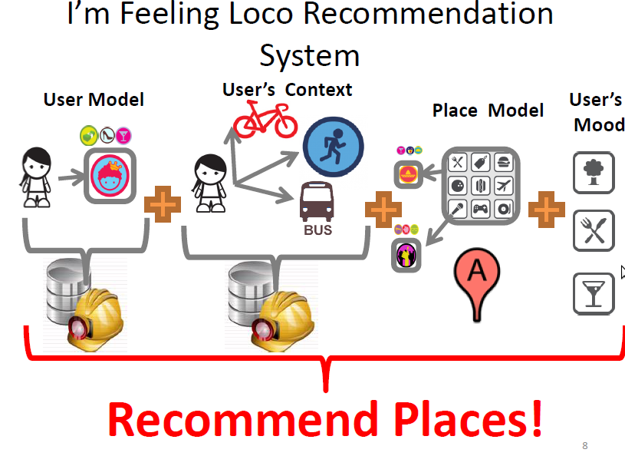

Big Data → Graph Computation
1.11 Billion Users
100 Hrs of Video
every minute
6 Billion Photos
400 Million
Tweets/day
Graph-structured computation
has adopted in a wide range of areas
NLP

Slide 3


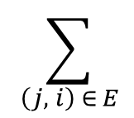
Graph-parallel Computation
∑
  “Think as Vertex”, e.g. PageRank :
R_{i} = W_{i,j} R_{j}
4
5
  Characteristics
    Linked set → data dependence
    Rank of who links it → predictable accesses
    Convergence → iterative computation
3
1
2

Slide 4
Distributed Graph Computation
  Larger Graph
  Complicated Computation
  Storage support

Slide 5


Distributed Graph Computation
User define the logic (e.g. Pagerank) :
Input: R_{j} (Data of neighbor j )
Compute():
∑
Vertex_Data = W_{j}R_{j}
Framework:
Load & partition over cluster
Schedule compute() Repeatedly until get convergence
4
5
4
5
3
1
3
1
2
Machine A
Machine B

Slide 6
Existing Scheduling Modes - Synchronous
( Sync Mode )
Scheduling:
Machine A
while (iteration ≤ max) do
if V_{a}== ∅ then break
V’_{a}← ∅
foreach v ∈ V_{a}do
A ← compute(v)
V’_{a} ← V’_{a}∪ A
barrier to update
V_{a}← V’_{a}
iteration ++
Pseudocode
1
3
4
1
3
4
2
5
2
5
Iteration
Internal state (e.g. Machine A):
Active
Vertices
Memory
4
1
3
4
2
5
1
3
Flip
Global Barrier
Previous State
4
5
1
3
4
2
1
3

Slide 7
Existing Scheduling Modes - Asynchronous
( Async Mode )
Scheduling:
while (V_{a} != ∅) do
v = dequeue( V_{a} )
A ← compute(v)
V’_{a} ← V’_{a}∪ A
signal across machines
Pseudocode
4
4
5
3
3
1
2
1
2
Machine A
Machine B
Internal State (e.g. Machine A):
Active
Queue
3
4
Propagate ASAP,
to converge faster
Machine B
Piped Proceeding Queue
1

Slide 8
Existing Scheduling Modes
Synchronous
Machine A
1
3
4
1
3
4
2
5
2
5
Which could get a better performance?
Iteration
4
4
5
3
3
1
2
1
2
Machine A
Machine B
Asynchronous

Slide 9
Algorithms: Sync vs. Async
Same Configuration + Different Algorithms ?
Different algorithms prefer different modes
Large active vertex set with
collecting all data from neighbors
Belief Propagation Algorithm
Require fast broadcast of shortest path value

Slide 10
Configuration: Sync vs. Async
Same Configuration + Different Algorithms: Uncertain
Different Configuration + Same Algorithms (LBP) ?
Better choice changes with configuration
Different. Partitions
Scale on #Machines
Partition methods affect
load balance & communication
Sync mode batches heavy load ,
Async mode scales better.

Slide 11
Stages: Sync vs. Async
Same Configuration + Different Algorithms: Uncertain
Different Configuration + Same Algorithms: Uncertain
Same Configuration + Same Algorithm ?
No one stays ahead for all the execution
SSSP
Graph Coloring
Execution Time (s)
Execution Time (s)
Async mode starts faster,
Sync mode grows with a peak.
Sync faster but not converge,
Async slower but converged.

Slide 12
Summery: Sync vs. Async
  Properties
  Communication
  Convergence
  SYNC
  Regular
  Slow
  vs.
  ASYNC
  Irregular
  Fast
Better choice is Unintuitive
Single mode alone may be still Suboptimal
  Favorites
  Algorithm
  Workload
  Scalability
  SYNC
  I/O Bound
  Heavyweight
  | Graph |
  vs.
  ASYNC
  CPU bound
  Lightweight
  | Machines |

Slide 13
Contributions
First comprehensive study on Sync & Async modes
PowerSwitch – adaptive, fast & seamless switches
Hybrid Execution Mode ( Hsync Mode ):
  Dynamically and transparently support the correct mode switches
Switch Timing Model:
  Determine the more efficient mode combined with online sampling, offline profiling and heuristics

Slide 14
Agenda
How to Switch - the Hsync mode
  Internal state conversion
  Consistency & correctness
When to Switch – the timing model
  Performance Metrics
  Current mode prediction
  The other mode estimation
Implementation
Evaluation

Slide 15
Challenges of switches
  Convert state at Consistent switch points
  Sync mode
    Vertex update: unordered
    Flip in global barrier
  Async mode
    Priority/FIFO queue
    Dequeue and enqueue
Internal state of one machine
Active Queue
Memory
Active
Vertices
3
4
1
3
4
Flip
Global Barrier
Previous State
Piped Proceeding Queue
1
Machine B

Slide 16
Challenges of switches Hsync mode
  Consistent switch points :
    Sync -> Async: global barrier
    Async -> Sync: suspend & wait
  State transfer: active vertex set
Internal state of one machine
Active Queue
Memory
Active
Vertices
3
4
1
3
4
Switch point
Switch point
Flip
Global Barrier
Previous State
Piped Proceeding Queue
1
Machine B

Slide 17
Agenda
How to Switch - the Hsync mode
  Internal state conversion
  Consistency & correctness
When to Switch – the timing model
  Performance Metrics
  Current mode prediction
  The other mode estimation
Implementation
Evaluation

Slide 18
Switch timing - affected by lots of factors
Challenges:
How to quantify the real-time performance?
How to obtain the metrics？
Performance Metrics
Throughput = --------------------
|V_{compute}|
* µ
T_{interval}
|NumTask_{async}|
Convergence ratio µ =
by sampling specific input pattern,
e.g. power-law, large diameter, high density…
|NumTask_{sync}|

Slide 19
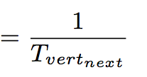
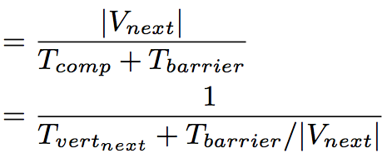
Predict Throughput for Current mode
Sync
Iteration as interval
Async
Constant interval
Throughput
Throughput
Calculate the next interval based on:
Current + History accumulation

Slide 20
Predict for Other offline mode
No more execution information
Predict Async when in sync mode:
Solution
Online sampling : on subset of input in Async before start
Offline profiling : build Neural Network model, refer to paper

Slide 21
Predict for Other offline mode
Predict Sync when in async mode:
Hard to predict exactly
Heuristic: Sync makes high utilization of resource.
Thro_{Sync} > Thro_{Async} , if workload is enough
Condition:
  Number of active vertices increases
  Workload : --------------- > Thro_{Async}
|V_{new}|
T
Async -> Sync

Slide 22
Prediction Accuracy
PageRank: Predicted throughput vs. Real sampled
Sync mode
Async mode

Slide 23
Prediction Accuracy
Pagerank:
PageRank: Predicted switch timing vs. Optimal
Predict 15.2s
Optimal 14.5s

Slide 24
Implementation
PowerSwitch:
  Based on latest GraphLab (PowerGraph) v2.2
  with both Sync & Async modes.
  Provide the same graph abstraction
  transparent & compatible to all apps of GraphLab
Open Source
http://ipads.se.sjtu.edu.cn/projects/powerswitch.html

Slide 25
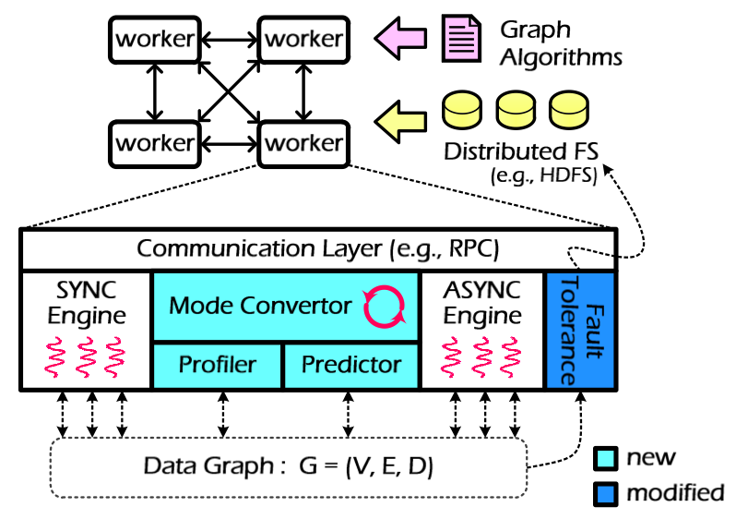
Implementation - Architecture
  New
  Mode switcher
  Sampler
  Predictor
  Extension
  Fault tolerance
Sampler
Predictor

Slide 26
Evaluation
Baseline: original SYNC & ASYNC mode
Configuration
  48-node EC2-like cluster (VM based).
  Each node has 4 AMD Opteron cores, 12GB of RAM, connected with 1 GigE network.
Algorithms and Data Set
Algorithm | Graph | |V| | |E|
PageRank | LJournal | 5.4M | 79M
 | Wiki | 5.7M | 130M
 | Twitter | 42M | 1.47B
LBP | SYN-ImageData | 1-12M | 2-24M
SSSP | RoadCA | 1.9M | 5.5M
Coloring | Twitter | 42M | 1.47B

Slide 27
Performance Overview
PageRank SSSP LBP Coloring
Outperform the baseline with best mode
from 9% to 73% for all algorithms and dataset

Slide 28
Switch Overhead
Sync->Async : 0.1s
Async->Sync : 0.6s
Overhead grows slightly
with active vertex number increasing.

Slide 29
Case: Single Source Shortest Path (SSSP)
Speedup
Switch Point:
Async to Sync
Switch Point:
Sync to Async
Execution Time (s)
Execution Mode: Async -> Sync-> Async

Slide 30
Conclusion
  PowerSwitch
    A comprehensive analysis to the performance of Sync and Async modes for different algorithms, configuration and stages
    A Hsync mode that dynamically switch modes
    between Sync & Async to pursue optimal performance
    An effective switch timing model to predict suitable mode with sampling & profiling
    Outperforms GraphLab with best mode from 9% to 73% for various algorithms and dataset

Slide 31







Thanks
Questions
http://ipads.se.sjtu.edu.cn/projects/powerswitch.html
Institute of Parallel and Distributed Systems

