Slide 1

Transparent and Efficient
CFI Enforcement with Intel Processor Trace (IPT)
Institute of Parallel and Distributed Systems
Control Flow Integrity
IPADS
Yutao Liu, Peitao Shi, Xinran Wang, Haibo Chen, Binyu Zang, Haibing Guan
Institute of Parallel and Distributed System (IPADS)
Shanghai Jiao Tong University
http://ipads.se.sjtu.edu.cn

Slide 2





Control Flow Hijacking Attacks
Shellcode execution
Memory corruption bugs
BAD
THING
Overwrite
Code reuse
Attackers
Victim memory

Slide 3




Attacks & Defenses
Defenses
Control flow hijacking attacks
Randomization
Enforcement

Slide 4
Program’s Control Flow
BB-1
Program consists of basic block (BB)
Control flow from one BB to other BB
Each BB has limited valid targets
CFG can be pre-generated
BB-2
BB-3
BB-4
BB-5
BB-6
INVALID
Attack: issues an invalid control flow transfer
BB-7
BB-8
BB-9
BB-10
BB-11
Control Flow Graph (CFG)
Control Flow Integrity (CFI):
Enforce control flow as CFG during runtime

Slide 5



Runtime CFI Enforcement
Method #1: instrumented checking
check(%ecx)
jmp *%ecx
…
check(%ebx)
call *%ebx
…
check(stack)
ret
Check all branches
jmp *%ecx
…
call *%ebx
…
ret
Compiler
based
Break code integrity
Binary
rewriting
COTS unfriendly
Share library unfriendly
Method #2: transparent monitoring
RUNTIME
Binary
Analysis
Compare
Transparent to applications
Binary

Slide 6
Transparent Monitoring
How to TRACE?
When to TRIGGER?
What to CHECK?

Slide 7
How to Trace
Trace by hardware (performance counter)
  Two choices before: BTS & LBR
Branch trace store (BTS)
  Trace every branch in memory: source,destination, type
  Sufficient information, but extraordinarily slow
Last branch record (LBR)
  Only trace most recent (16 or 32) branches in register
  Very fast, but with insufficient information
  History flush attacks

Slide 8
When to trigger
When the trace buffer is full
  Buffer size matters
  Trade-off between performance and security
When specific events happen
  Whenever attack may happen
  Cross-boundary points
Security sensitive system call

Slide 9
What to check
Heuristic checking
  Ensure that control flow obeys some simple rules:
    Call to a function entry
    Return to instruction right after call
    Etc.
Strict CFG enforcement
  Pre-generate CFG,and enforce it at runtime
  Fine- or coarse-grained CFG
    Shadow stack?
Fine-grained CFG enforcement

Slide 10

In a Summary…
Efficient trace with sufficient runtime information
  BTS and LBR cannot survive
Appropriate triggering point
  Prevent attacks without sacrificing too much performance
Fine-grained CFG enforcement
  Heuristic check is not enough

Slide 11
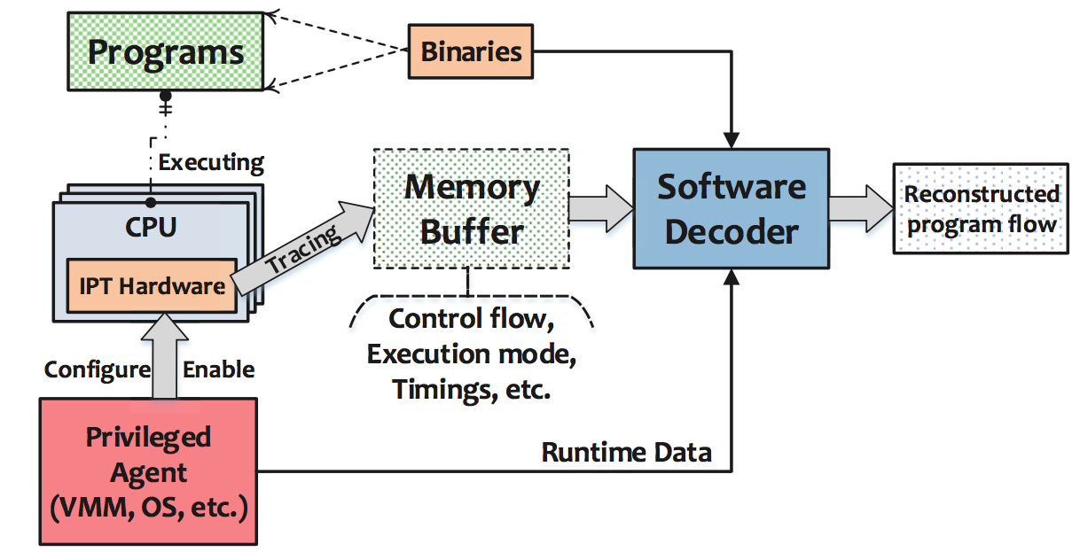
IPT to the Rescue
Intel Processor Trace (IPT)
  Introduced in Intel Broadwell
  Fast tracing
  Can trace sufficient information in memory
BUT WHY>>>

Slide 12
Background: Demystify IPT Fast Trace
IPT uses aggressive compression
  Unconditional direct branches are not logged at all
  Conditional branches are compressed to a single bit
  Each indirect branch is traced as one target address
  Result in average <1 bit per retired instruction

Slide 13
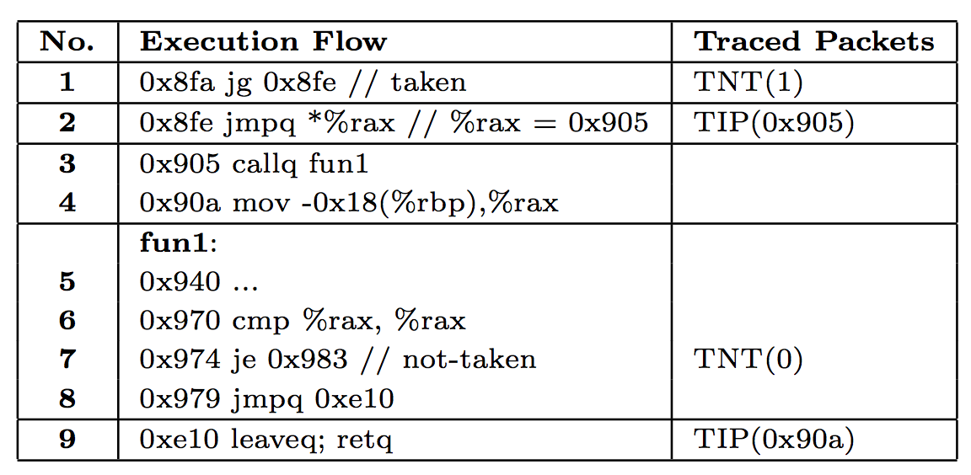
Background: IPT Trace Example
TIP packet: target address of indirect branch
TNT packet: indication of taken or non-taken conditional branch

Slide 14
Challenges: Fast Trace vs. Slow Decode
The performance overhead is shifted from tracing to decoding
  Decoding is several orders of magnitude slower than tracing.
 | Precise | Tracing | Decoding | Filtering
BTS | Full | Slow (50X) | Fast | None
LBR | Low | Very Fast (< 1%) | Fast | CPL, CoFI
IPT | Full | Fast (3%) | Slow (200X) | CPL, CR3, IP

Slide 15
Contribution
FlowGuard: practical CFI with IPT
  Transparent monitor without instrumentation
  Efficient trace and check by separating fast and slow paths
  Precise CFI enforcement with fine-grained CFG and runtime information
Evaluation results
  Apply FlowGuard to server applications
  Prevent a various of code reuse attacks
  Less than 4% performance overhead for normal use cases

Slide 16
Outline
  Efficient trace and check
  Precise CFI enforcement
Implementation and evaluation

Slide 17
Why Slow Decode is Required?
Main problem: inconsistency between static generated CFG and IPT traced data
BB-1
Indirect edge
Direct edge
BB-2
BB-3
Conditional branch information
BB-2
BB-3
T
BB-4
BB-5
BB-6
N
BB-5
T
N
BB-7
BB-8
BB-9
BB-10
BB-7
BB-9
BB-10
Traditional static generated CFG
IPT traced data

Slide 18
Solution: IPT Compatible CFG Construction
Indirect targets connected CFG (ITC-CFG)
  Nodes left: BB with incoming indirect edges (IT-BB)
  Edges reconnection: two IT-BBs are connected if and only if:
    There is only one indirect edge in the path from BB-x to BB-y
    This indirect edge is targeted at BB-y
BB-1
BB-2
BB-3
BB-5
BB-2
BB-3
Static
analysis
T
BB-4
BB-5
BB-6
N
BB-7
BB-9
BB-10
BB-7
BB-8
BB-9
BB-10

Slide 19
Fast Path Check in Runtime
IPT traced data can be directly matched on the ITC-CFG
BB-2
BB-3
BB-5
TIP
BB-2
TIP
BB-3
?
……
BB-7
BB-9
BB-10
TIP
BB-7
TIP
BB-9
ITC-CFG
IPT traced data

Slide 20
Outline
  Efficient trace and check
  Precise CFI enforcement
Implementation and evaluation

Slide 21
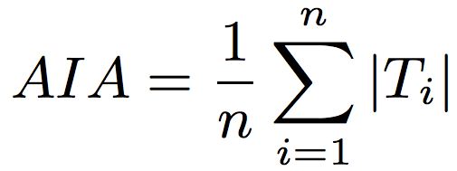
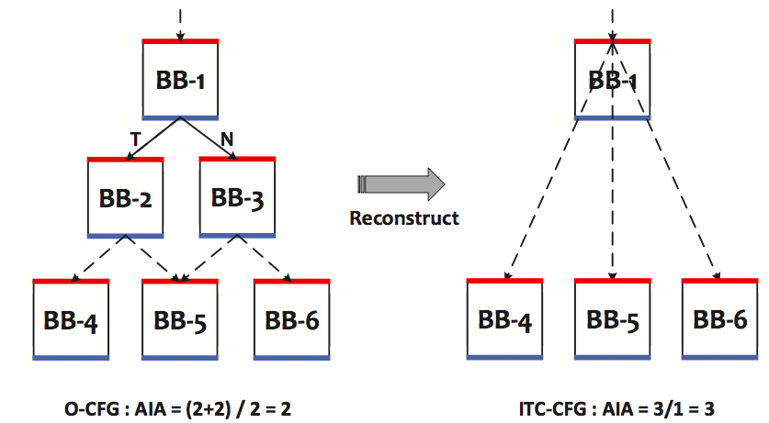
This can be solved by slow decode!
Fast Path (ITC-CFG) Problem
Coarse-grained CFI
  Over-approximated CFG generation
  Result in large false negative
  Not benefit from the whole dynamic information
Precision loss
  Average indirect targets allowed (AIA)
Main reason:
lack of TNT information

Slide 22
Solution: Separate Fast and Slow Path
IPT traced data
ITC-CFG
Edges
matched?
Y
No attack
N
Fast path
Attack detected
Credible
edges
matched?
IPT traced data
Credit
labeled
ITC-CFG
Y
Edges
matched?
Y
No attack
N
N
How?
Attack detected
Slow path
Slow path
Pre-generated
Binary

Slide 23
Dynamic Fuzzing Training
Dynamic training to label ITC-CFG edges with credits
  The credit of each edge depends on its occurrence during the training phase
  Each edge is also associated with the TNT information
BB-2
BB-3
BB-5
BB-2
BB-3
BB-5
NULL
T
NULL
BB-7
BB-9
BB-10
BB-7
BB-9
BB-10
ITC-CFG
Credit Labeled ITC-CFG

Slide 24
Dynamic Fuzzing Training (cont’)
Dynamic training to label ITC-CFG edges with credits
  The credit of each edge depends on its occurrence during the training phase
  Each edge is also associated with the TNT information
We use a fuzzing based approach
  AFL: a coverage-oriented fuzzer
Note: the security of FlowGuard does not rely on the coverage

Slide 25
System Call Interception
We have a default setting with 7 security-sensitive system calls
  read, write, execve, mmap, mprotect, sigaction, sigreturn
Provide users with interface to specify their own endpoints

Slide 26
Outline
  Efficient trace and check
  Precise CFI enforcement
Implementation and evaluation

Slide 27
FlowGuard Architecture
1
Static
Binary
Analysis
Process
Executable
Credit
Labeled
ITC-CFG
Libraries
Dynamic
Fuzzing
Training
2
User
4
Kernel
Kernel
Module
Syscall Interceptor
Flow
Checker
Cores
3
5
Fast
Path
Slow
Path
Memory

Slide 28
Experimental Setup
Intel Skylake machine with IPT support
  8 cores & 16GB RAM
  Debian 8.0, Linux kernel 4.3.0
Dyninst plugin for static binary analysis
AFL for fuzzing the software and collecting training inputs
  desock to channel socket communication to the console

Slide 29
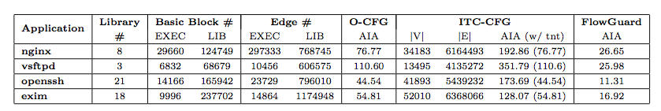
Security Analysis
Attack detected
  ROP: during write() syscall
  SROP: during sigreturn() syscall
Average Indirect-targets Allowed (AIA) summary

Slide 30
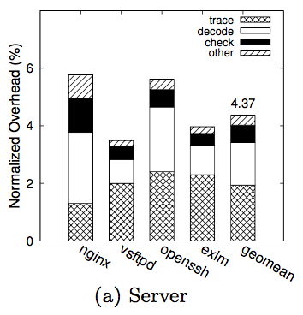
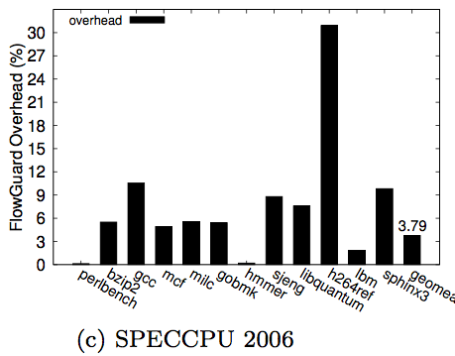
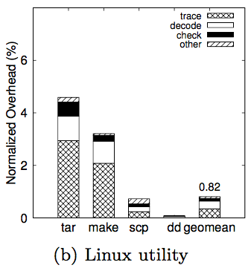
Performance Evaluation
Macro Benchmarks

Slide 31
Summary
Institute of Parallel and Distributed Systems
IPADS
FlowGuard: leverage IPT for practical CFI
  Transparent monitor without instrumentation
  Efficient trace and check by separating fast and slow paths
  Precise CFI enforcement with fine-grained CFG and runtime information
A working prototype on Intel Skylake with promising result
  Successfully detect ROP like attacks and optimize AIA
  Small Performance impact

Slide 32

Institute of Parallel and Distributed Systems
Thanks
IPADS
Questions
Institute of Parallel And Distributed Systems
http://ipads.se.sjtu.edu.cn

