Slide 1

Thwarting Memory Disclosure with Efficient Hypervisor-enforced
Intra-domain Isolation
Institute of Parallel and Distributed Systems
CCS
2015
IPADS
Yutao Liu, Tianyu Zhou, Kexin Chen, Haibo Chen, Yubin Xia
Institute of Parallel and Distributed System (IPADS)
Shanghai Jiao Tong University
http://ipads.se.sjtu.edu.cn

Slide 2



HeartBleed Attack
Intra-app memory disclosure attack
  One over-read bug discloses the whole memory data
Affect over 60% of websites
  Attackers can steal private keys and user accounts
010000100001110100001001001001010privatekeys101100111100010password001011110010000111110
Heartbeat msg
Memory
Attackers
Arbitrary memory data
Over-read bug

Slide 3
Memory Disclosure Vuls are Prevalent
CVEs summary (2000 ~ 2015)
It is hard to prevent all of these bugs
388

Slide 4

Large Attack Surface for Secret Disclosure
Process Isolation
Web Server
Process
Web
Other
Processes
✗
Private Keys
Intra-application attack
Libraries
Operating System
Cross-ring attack
Kernel-level attack
Vulnerabilities
Rootkit
Secret
Attack

Slide 5
Compartmentalization to the Rescue
  Main problem: All data reside in the same region
  Attackers can read memory of the compromised process
  Rootkit can read memory of the whole system
  One potential solution: compartmentalization
  Create specific compartment for the critical data
  Isolate it from other compartments
Issues with prior efforts
  Cannot protect from malicious kernel
  Too coarse to prevent intra-app attacks
  Hard to protect large-scale software

Slide 6
Contribution
SeCage: hypervisor-enforced intra-app compartment
  Strong isolation: prevent from large attack surfaces
  Practical: hybrid approach to decomposing large-scale software
  Efficient: leverage commodity hardware features (VMFUNC) to separate policy from invocation to minimize VM traps
Evaluation results
  Apply SeCage to OpenSSL and CryptoLoop
  Prevent secret disclosure attacks, e.g., heartbleed, rootkit
  Less than 8% performance overhead for normal use cases

Slide 7
Outline
  Approach overview
  Runtime isolation enforcement
Application decomposition
Implementation and evaluation

Slide 8
Approach Overview
Goal: protect secrets from large attack surfaces, yet in a practical and efficient way
Compartmentalize critical data and code
  Use hybrid analysis to extract secret closure
  Isolate the secret closure from other context
Leverage hypervisor to enforce memory isolation
  Secret compartments reside in different memory regions
  Illegal secret memory access triggers violation to VMExit

Slide 9
SeCage Architecture
Application decomposition
APP
Decomposition
APP
Main Compartment
CODE
Secret Compartment
S Func
APP
Trampoline
Life-cycle Management
DATA
DATA
Operating System
Runtime Protection
Hypervisor
Memory Isolation
Initialization
Hardware
Threat model & assumption
  Trust the hypervisor, not trust OS or other compartments in app
  Do not consider about DoS and side-channel attacks

Slide 10
Challenges
Frequent hypervisor-intervention for VM-based approach
  Introduce large performance overhead
Heavy manual effort for compartmentalization
  Secrets are used and propagated throughout the lifecycle
  Require precise and complete closure of secrets

Slide 11
Outline
  Approach overview
  Runtime isolation enforcement
Application decomposition
Implementation and evaluation

Slide 12
Runtime Isolation Enforcement
Hypervisor-enforced memory isolation
  Shadow the secret memory using EPT memory protection
  Leverage VMFUNC to separate control plane and data plane
Securing execution flow with trampoline mechanism
  Sensitive functions are not self-contained
  Communication between secret and main compartment should be protected
Lifecycle protection of secret compartment

Slide 13
Extended Page Table (EPT) 101
Translate guest physical addr to host physical addr
  The two-level translation are all done by hardware
EPT is manipulated and maintained by hypervisor
  Hypervisor controls how guest accesses physical address
  Any EPT violation triggers VMExit to hypervisor
Guest Virtual Address (GVA)
Guest
Page table
Guest Physical Address (GPA)
EPT
Host Physical Address (HPA)

Slide 14
Memory Isolation using EPT Mechanism
Leverage EPT mechanism to shadow secret memory
  Data segment: secret memory is removed from main EPT
  Code segment: sensitive functions only exist in secret EPT
Main EPT
Secret EPT
Other Data
Data Segment
Secrets
Other
Logics
Code Segment
Sensitive Functions
Springboard
Trampoline

Slide 15
Problem of EPT protection
Context switch introduces large overhead
  Every EPT switch is intervened by hypervisor
  VMExit takes much more time than function call

Slide 16
VM Function (VMFUNC) 101
VM Functions: Intel virtualization extension
  Non-root guest VMs can directly invoke some functions without VMExit
VM Function 0: EPTP Switching
  Software in guest VM can directly load a new EPT pointer
VMFUNC can provide the hypervisor-level function at the cost of system calls

Slide 17
Using VMFUNC for Efficiency
Separate control plane from data plane
  Control plane (policy): hypervisor pre-configure the EPT used by different compartments
  Data plane (invocation): application can directly switch EPT without hypervisor intervention
0: Alternate-EPTP
1: Alternate-EPTP
Set VMCS control bits
Configure EPTP_LIST_ADDR
511: Alternate-EPTP
EPTP Switching invocation: VMFUNC opcode (EAX = 0, ECX = EPTP_index)

Slide 18
Security Problem of VMFUNC
What if attackers directly switch EPT?
  Since EPT switching is not checked by hypervisor
Recall: the code segment of the secret compartment
  It only contains trusted sensitive functions
  The legal entrances to the secret compartment are fixed
  Invalid VMFUNC invocation causes EPT violation
Other
Logics
Code Segment
Sensitive Functions
Springboard
Trampoline

Slide 19
Runtime Isolation Enforcement
Hypervisor-enforced memory isolation
  Shadow the secret memory using EPT memory protection
  Leverage VMFUNC to separate control plane and data plane
Securing execution flow with trampoline mechanism
  Sensitive functions are not self-contained
  Communication between secret and main compartment should be protected
Lifecycle protection of secret compartment

Slide 20
Secret Compartment is Not Self-contained
Main compartment may invoke sensitive functions
Secret compartment may invoke normal functions
  E.g., system call,library call, etc.
Different compartments have different context
  We use trampoline and springboard to switch the context
main compartment
secret compartment
Trampoline
secret compartment
main compartment
Springboard

Slide 21
Use VMFUNC to Secure Execution Flow
Trampoline control flow
Springboard control flow
Trampoline
Trampoline
s_func()
real_s_func()
s_func()
main compartment
secret compartment
main compartment
Context
Switch
Context
Switch
Springboard
Springboard
lib_call()
real_lib_call()
lib_call()
secret compartment
main compartment
secret compartment
Context
Switch
Context
Switch
Context switch is done using VMFUNC

Slide 22
Runtime Isolation Enforcement
Hypervisor-enforced memory isolation
  Shadow the secret memory using EPT memory protection
  Leverage VMFUNC to separate control plane and data plane
Securing execution flow with trampoline mechanism
  Sensitive functions are not self-contained
  Communication between secret and main compartment should be protected
Lifecycle protection of secret compartment

Slide 23
Example: Lifecycle of Web Server App
Private key is involved in the lifecycle of web server
  Creation: private key is stored in the configuration file
  Deployment: private key is loaded into memory
  Execution: private key is propagated and used during runtime
  Termination: private key is required to be cleared
SeCage divides the lifecycle into 5 stages
Pre-LOAD
App-LOAD
SeCage-INIT
RUNTIME
SeCage-RESTORE
Time
Creation
Deployment
Execution
Termination

Slide 24
Lifecycle Protection
3 new hypercalls to manipulate secret compartment
  Initialize and terminate secret compartment
  Load secrets to memory
Ensure secrets never flow to other compartments
Guest VM in Main EPT
Guest VM in Secret EPT
No Secret
No Secret
Pre-LOAD
App-LOAD
SeCage-INIT
RUNTIME
SeCage-RESTORE
Time
Creation
Deployment
Execution
Termination
SECAGE_INIT
SECRET_LOAD
SECAGE_RESTORE

Slide 25
Outline
  Approach overview
  Runtime isolation enforcement
Application decomposition
Implementation and evaluation

Slide 26
Challenge: Decompose Large-scale Software
Static approach: precision issues like pointer aliasing
  Lead to significantly larger closure than necessary
  May introduce larger TCB and worse performance
Dynamic approach: completeness issue
  May introduce large false positive
Previous efforts to secure OpenSSL application
  Either resort to much more simplified version like PolarSSL
    E.g., TrustVisor ^{[S&P’10]}, Mimosa ^{[S&P’15]}
  Or use more coarse-grained application decomposition
    E.g., PrivTrans^{[security’04]}, which decouple the whole enc/dec modules

Slide 27
Application Decomposition in SeCage
A hybrid approach to decomposing application
  Dynamic approach to extracting the secret closure
  Automatic decomposition during compilation time
  Static approach to getting the complete potential sensitive functions, used to avoid corner case during runtime
Application
Dynamic Closure Extraction
Static Taint Analysis
Potential Sensitive Functions
Main
Logic
Secret Closure
Compilation
Main
Compartment
Secret Compartment
Runtime Check

Slide 28
Dynamic Closure Extraction
Observation: the execution flow of secrets is relatively fixed
Goal: get most common but possibly incomplete secret closure
Approach: combine mprotect and debug exception
  More details can be found in the paper

Slide 29
Static Taint Analysis
Taint analysis on secret data flow
  Leverage CIL* to analyse on the intermediate representation of the application
  Following data flow should be tracked
    Propagation of secrets through assignment
    Propagation of secrets through function parameters
    Propagation of secrets through return values
    Dereference of secrets
* CIL (C Intermediate Language). http://kerneis.github.io/cil/.

Slide 30
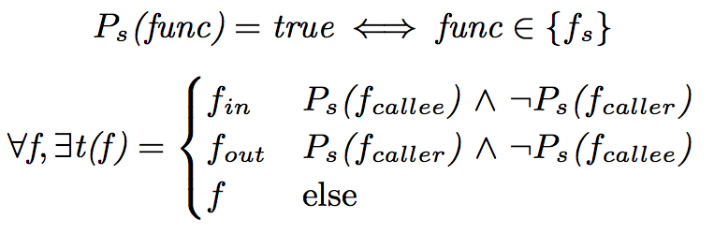
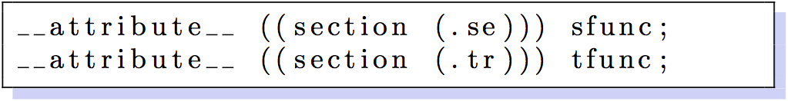
Automatic Application Decomposition
Leverage CIL to replace {f_{s}} calls with {f_{t}} calls
Leverage GCC section attribute to create memory regions
Modify linker to separate secrets from the main region

Slide 31
Outline
  Approach overview
  Runtime isolation enforcement
Application decomposition
Implementation and evaluation

Slide 32
Implementation
Implemented on Intel Haswell machine
  Haswell processor with VMFUNC supported
  4 cores (8 hardware threads using hyper-threading),
  32 GB memory
Software environment
  KVM with Linux 3.13.7
  Guest VM with Linux 3.16.1
    2 virtual cores and 4 GB memory
Application analysis and decomposition
  CIL framework, OCaml extension, bash script

Slide 33
Usage Scenarios
Protecting Nginx from HeartBleed
  Protect prime numbers (p and q) and private key exponent (d)
Protecting OpenSSH from Rootkit
  Protect private keys of OpenSSH (same as Nginx)
Protecting CryptoLoop* from Kernel Memory Disclosure
  Protect AES cryptographic keys as secrets
* CryptoLoop: file system encryption using kernel Crypto API

Slide 34
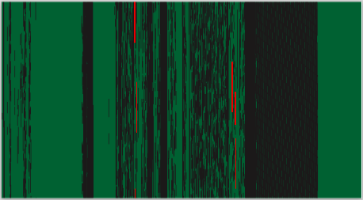
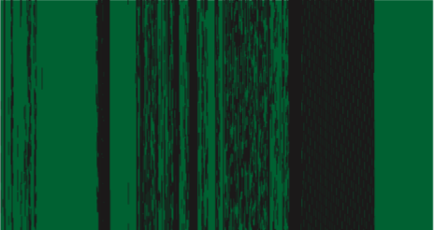


Security Analysis
Secrets exposure elimination
Reduced attack surfaces
  Small code base in secret compartment
    1350 LoCs for OpenSSL and 430 LoCs for CryptoLoop
  Restrictions in sensitive functions
    E.g., no I/O operation, etc.
Normal Nginx
SeCage Nginx
Normal
OpenSSH
SeCage
OpenSSH

Slide 35
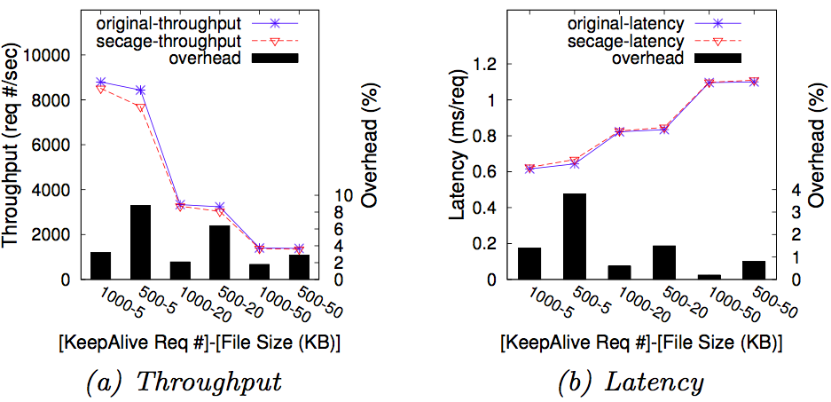
Performance Evaluation
Nginx throughput and latency
  Use ab benchmark
  Simulate 20 clients
  N KeepAlive requests
  X bytes per request
OpenSSH latency
  SSH to the server and execute common Linux commands
  Average latency overhead: 6 ms (3%)
CryptoLoop I/O bandwidth
  Use fio benchmark with sequential read/write configurations
  Average slowdown: 4%

Slide 36
Related Efforts
  Application-level secret isolation
  E.g., DieHarder ^{[CCS’10]}, CRYPTON ^{[CCS’13]} , Copker ^{[NDSS’14]}
  Vulnerable to the attack surfaces of kernel, e.g., rootkit
  Hypervisor-based application protection
  E.g., OverShadow ^{[ASPLOS’08]}, InkTag ^{[ASPLOS’13]} , Terra ^{[SOSP’03]}
  Vulnerable to the intra-process attack, e.g., heartbleed
  Hardware-based secret protection
  E.g., TrustVisor ^{[S&P’10]}, Haven ^{[OSDI’14]}, Mimosa ^{[S&P’15]}
  Not suitable for existing hardware and large-scale software
SeCage can solve all of these problems

Slide 37
Summary
Memory disclosure attacks are hard to defend
  Broad attack surfaces in user level and kernel level (388 CVEs)
SeCage: a practical and efficient hypervisor-enforced approach for secret protection
  Memory compartmentalization with small TCB
  Efficient mechanism to separate policy from invocation
  Practical application decomposition for large-scale software
A working prototype on KVM with promising result
  Successfully eliminate secret exposure
  Small Performance impact

Slide 38


Institute of Parallel and Distributed Systems
Thanks
IPADS
Questions
Institute of Parallel And Distributed Systems
http://ipads.se.sjtu.edu.cn

