Slide 1

A Case for Virtualizing Persistent Memory
Liang Liang, Rong Chen, Haibo Chen, Yubin Xia,
KwanJong Park, Binyu Zang, Haibing Guan
Institute of Parallel and Distributed Systems
Shanghai Jiao Tong University, China
Samsung Electronics Co., Ltd.
Notes:
Good Afternoon everyone,
it is an honor to present our work titled “A Case for Virtualizing Persistent Memory”, which make a case study on how to efficiently virtualize PM to improve cost-effectiveness and performance.
I’m Rong, Other authors of this paper are:

Slide 2



Performance and Persistence
Tension between Performance and Persistence
  Volatile storage
    Performance ✔ vs. Persistence ✘
  Non-volatile storage
    Performance ✘ vs. Persistence ✔
Persistent memory
  Performance ✔ vs. Persistence ✔
Features
Low
latency
Non-
Volatile
Notes:
Computer systems have long faced a tension between performance and persistence, which poses a challenge to place data in volatile and non-volatile storage to ensure crash recovery under power failures.
PM embraces the features of …. is promising to relax this tension by providing high-performance and persistence for recoverable systems.
//Persistent memory, either in the form of battery-backed memory cards like NVDIMM or emerging non-volatile memory like PCM, Memristor, is promising to relax this tension by providing high-performance and persistence for recoverable systems.

Slide 3






Proliferation of PM
Hardware vendor
Software developer
  Prediction：
  PM will soon be adopted
Data Centers
Cloud Providers
Notes:
Because of its promise, PM has gained significant interests from both hardware and software sides.
Major memory vendors like Micron, Viking have provided commercial NVRAM to the mass market.
In response of this, researchers have investigated a number of ways of utilizing PM. Linux and Windows developers have started to provide support for PM-aware file systems.
we envision that PM will soon be an part of cloud computing systems.

Slide 4





Need of PM Virtualization
Cost Effectiveness
≈
….
Performance
Load/Store
slow
fast
Notes:
In this paper, we make a case study on how to efficiently virtualize PM to improve cost-effectiveness and performance,
as new technologies, PM is still with a relatively high price. For example, currently NV-DIMM’s price is at least 8-10X higher than DRAM according to the price quote from NV- DIMM providers;
Besides,
some emerging memory technologies like PCM or Memristor still have inferior write performance than DRAM, virtualizing them may lead to performance improvement.

Slide 5
Outline
Outline
The Need of PM Virtualization
Design of VPM.
Implementation
Evaluation
Conclusion
Notes:
Here is the Outline of this talk

Slide 6





VPM: Overview
PM
Virtualized PM
Hardware
VM apps
PM
DRAM
SSD
Notes:
So I’m going to present our system VPM.

Slide 7
VPM: Overview
Emulate Persistent Memory(PM) with mix of PM, DRAM and hard disk(SSD)
VPM
Challenge
Virtualized PM
Hardware
VM apps
How to emulate persistency of PM
with other storage medium?
PM
Guest VM
DRAM
SSD
Hypervisor

Slide 8
Design: Two Approaches
Full Virtualization
Retain Transparency to guest VMs.
Para-Virtualization
Enable guest VMs to provide hints to hypervisor
to improve performance.
Notes:
Similar as the traditional server virtualization, there are two typical ways to virtualize PM:
Full-virtualization
2) Para-virtualization
The two ways share similar characteristics with server virtualization: the former provides transparency, but the latter may provide better performance.

Slide 9

Full Virtualization: VPM-HV
Read request is issued over PM.
Read request is handled.
EPT
Mapping for
virtualized PM
PM
RAM
SSD
Notes:
It is the EPT from Intel, this snapshot illustrates the working process of VPM,
Part of EPT contains the mapping between virtualized PM and physical resources.
Red… Blue…. Black……

Slide 10
Full Virtualization: VPM-HV
Read request is issued over DRAM.
Read request is handled.
EPT
Mapping for
virtualized PM
PM
RAM
SSD

Slide 11

Full Virtualization: VPM-HV
Write request is issued over PM.
Write request is handled.
EPT
Mapping for
virtualized PM
PM
RAM
SSD
Notes:
If the guest tries to write some page mapped to PM, since PM is natrually persistent, so the write request can be handle directly

Slide 12
Full Virtualization: VPM-HV
Write request is issued over DRAM.
Trap and remap DRAM with PM.
Write request is handled.
EPT
Mapping for
virtualized PM
PM
RAM
SSD
Notes:
But if the guest tries to write some page mapped to DRAM, which is a volatile storage. VPM will write protect this page and make the write request trap to hypervisor, and remap this page from DRAM to NVRAM. After that write request can be applied.

Slide 13
Full Virtualization: VPM-HV
Write over non-PM mapped memory will always trap to hypervisor.
EPT
Mapping for
virtualized PM
PM
RAM
SSD
Notes:
Only by this means we can guarantee that every write will be persisted in full virtualization

Slide 14
VPM-HV: Architecture
VM0
PMEM
Write Protected (DRAM)
VPM
Mapped to EPT
Not mapped
Writable (NVRAM)
VM0
VPM DS
VM1
VPM DS
On Disk
VM0
PMEM-PT
VM0
Disk
VM0
VP-meta
NVRAM
DRAM
Backing Block n
backed
Backing
Block m
NVRAM
DRAM
…
NVM Pool
Reserved
for
metadata
Shared across all VM
Notes:
VPM can run multiple virtual machines, each VM is connected with a data store inside VPM.
Pmem page table illustrate the mapping of virtualized PM that we have already talked about. We can see that each DRAM page will be backed by secondary storage.
The NVRAM page is assigned from global NVM Pool, which is shared across all VM
The metadata block contains some information that used for crash recovery

Slide 15
Design: Two Approaches
Full Virtualization
Retain Transparency to guest VMs.
Para-Virtualization
Enable guest VMs to provide hints to hypervisor
to improve performance.
Notes:
So it is full virtualization approach..
Next is PV.
In PV we enable….

Slide 16
VPM-PV: Four Interfaces
vpm_protect(page)
Claim that a page is
being modified by guest.
vpm_unprotect(page)
Claim that some pages should be persisted.
vpm_persist(range)
vpm_pcommit(void)
Wait until all persist requests have been done.

Slide 17

Para-Virtualization: VPM-PV
Write request is wanted.
Lock page
Write request is issued over DRAM.
Write request is handled.
Unlock page
EPT
PM
RAM
SSD

Slide 18
Para-Virtualization: VPM-PV
Issue a persist request
Return immediately
vpm_persist
Persist Q
EPT
PM
RAM
SSD
Notes:
In order to guarantee persistence…

Slide 19

Para-Virtualization: VPM-PV
Persist thread will consume these requests in the background
Do nothing to a PM mapped page
Persist Q
EPT
Persist Thread
PM
RAM
SSD

Slide 20
Para-Virtualization: VPM-PV
Persist thread will consume these requests in the background
Do nothing to a PM mapped page
Apply HOT DRAM mapped page to PM
Persist Q
EPT
Persist Thread
PM
RAM
SSD

Slide 21
Para-Virtualization: VPM-PV
Persist thread will consume these requests in the background
Do nothing to a PM mapped page
Apply HOT DRAM mapped page to PM
Persist COLD DRAM mapped page to SSD
Persist Q
EPT
Persist Thread
PM
RAM
SSD

Slide 22
Para-Virtualization: VPM-PV
Persist thread will consume these requests in the background
Do nothing to a PM mapped page
Apply HOT DRAM mapped page to PM
Persist COLD DRAM mapped page to SSD
Persist Q
EPT
Persist Thread
PM
RAM
SSD

Slide 23
Para-Virtualization: VPM-PV
Issue pcommit
Block until all requests are handled
Pcommit is handled
Persist Q
VPM
Persist Thread

Slide 24
VPM-PV: Architecture
VM0
Shared M
Hypercall
PMEM
Writable (DRAM)
Not mapped
VPM
Writable (NVRAM)
On Disk
VM0
VPM DS
VM1
VPM DS
VM0
PMEM-PT
Shared M
VM0
VP-meta
NVRAM
DRAM
Backing Block n
Backing
Block m
NVRAM
DRAM
…
NVM Pool
Reserved
for
metadata
Shared across all VM

Slide 25
Outline
Outline
The Need of PM Virtualization
Design of VPM.
Implementation
Evaluation
Conclusion

Slide 26
VPM Implementation
Guest OS
  Kernel module for managing and allocating PM
  Uses reserved consecutive physical memory region, backed by VPM
VPM Hypervisor
  Tracking of PM
    VM exit event for VPM-HV
    Use vpm_persist interface for VPM-PV
  Managing of PM
    Remaps the guest PM page to a DRAM page if the updating frequency is not high enough.

Slide 27
Optimization Decomposition
Batching of flushing to disk
  Swap Out → Disk Flush
  Flush is not emergent if swapped page is not taken promptly
  Dirtied data reaches a certain threshold or on applications’ request
Reducing writing cost with lazy reallocation
  Does not immediately clear if swapped page is not taken promptly
  Its content and mapping info still retain until it is reused by others

Slide 28
Outline
Outline
The Need of PM Virtualization
Design of VPM.
Implementation
Evaluation
Conclusion

Slide 29
Evaluation
PM Types
  NV-DIMM
  PCM
Virtualization Types
  VPM-HV
  VPM-PV
PMBD throughput slowdown
Notes:
We evaluate VPM by considering the 2 dimensions:
NV-DIMM has similar performance with DRAM and has no endurance problem, while PCM has a limitation on write and is slow on write.

Slide 30
Fileserver over NVDIMM/PCM
a. Achieve over 80% of the performance with only 20% of the PM
b. PV Outperforms than base line in PCM.
Notes:
achieve over 80% of the performance with only 20% of the PM
Frequent flush, introduces many VMExits, which impairs the chance to hide the flush latency in the background.
achieve over 80% of the performance with only 20% PM provided

Slide 31
Varmail over NVDIMM/PCM
Frequent flush, introduces many VMExits, which impairs the chance to hide the flush latency in the background.
Notes:
achieve over 80% of the performance with only 20% of the PM
Frequent flush, introduces many VMExits, which impairs the chance to hide the flush latency in the background.
achieve over 80% of the performance with only 20% PM provided
PV Outperforms than HV in PCM.
directly write on DRAM, which absorbs multiple modifications over PM pages and avoids writing to PCM

Slide 32
Crash Recovery (Emulate)
Inject Crash
  Drop EPT entries
start
crash
crash

Slide 33
Conclusion
A study on interfaces and hypervisor to virtualize PM
A prototype: VPM
  Full-virtualization of PM
  Para-virtualization of PM
Efficiently manage and multiplex PM, leading to small performance degradation
Thanks
http://ipads.se.sjtu.edu.cn/

Slide 34
Tracking of PM
    Hardware virtualization of PM
  Leverages the Access/Dirty Bit on EPT entries, tracks PM pages every 5ms in VM-Exit event
  Checking ALL PM pages will hurt performance
    Two-level scanning, pages will be exchanged between 2 level
    Hot pages for each round
    Cold pages will be scanned in a clock manner
Para-virtualization of PM
  Obtained directly when processing vpm_persist APIs.

Slide 35
Managing of PM
Hardware virtualization of PM
  Handling PM access EPT-violation
    Allocate native PM
    In the worst situation, it revokes an already allocated PM page
  Guest PM Page remapping
    Remaps the guest PM page to a DRAM page if the updating frequency is not high enough.
    Happens at the same frequency as the PM access tracking.
Para-virtualization of PM
  Handling PM access EPT-violation
    Try to allocate native PM, but it is not compulsory
  Persist Thread in Hypervisor
    Share memory with each guest VM: protect/unprotect, persist request
    When vpm_pcommit comes, persist thread flushes whole queue

Slide 36
Challenge of PM Virtualization
Abstraction of PM
  Block device and memory
  PV
Consolidate PM to maximize cost-efficiency, performance
  Put read-most data in DRAM
  TDP
Crash recovery in hybrid memory architecture
  Reserve key data structures in PM
Notes:
There are several technical challenges in providing effi- cient virtualization for PM
First, current virtualization lacks support for an appropriate abstraction for PM
Specifically, VPM virtualizes PM as a block device and a special piece of memory and provides a few para- virtualization interfaces to bridge the semantic gap of per- sistency between guest VMs and the hypervisor.
Second, it is critical to consoli- date PM to maximize cost-efficiency, performance
VPM leverages DRAM to place read-mostly data in a transparent way by leverag- ing the two-dimensional paging (e.g., extended page table (EPT)) to dynamically migrating data between DRAM and PM.
Finally, crash recovery is a challenge for VPM under a hybrid memory architecture.
VPM address this challenge by making the part of hypervisors leverage PM to store its key data structures for crash recovery and using a portion of PM to bookkeep guest VM’s PM structures.

Slide 37
Crash Recovery

Slide 38


Using PM
PM has growing into a trend.
Features
Low
latency
Non-
Volatile
Industry ‘s Reaction
Cloud Providers
Data Centers
Notes:
PM has growing into a trend recently,
we envision that PM will soon be an part of cloud computing systems.
However, commodity hypervisors still lack support to efficiently virtualize and manage PM in a cloud environment.

Slide 39
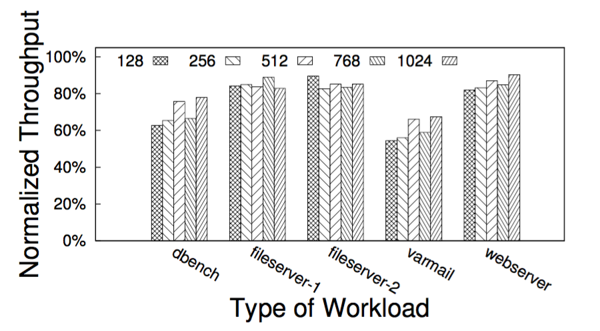
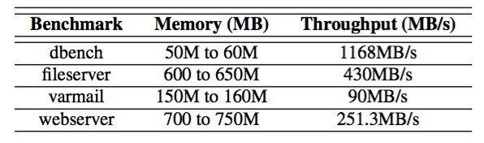
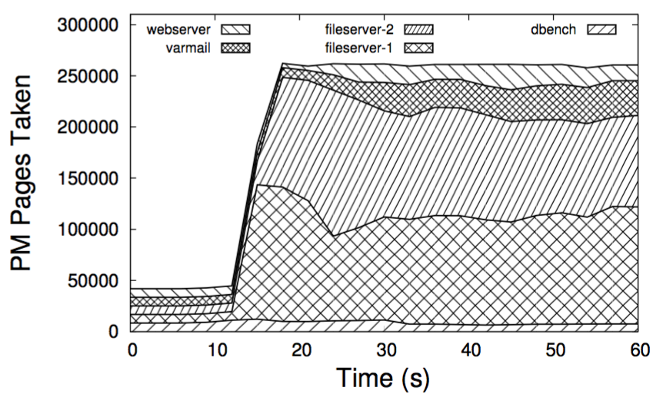
Application Benchmark
Performance for different workloads under consolidation
Fileserver and webserver are hardly effected

